Slide 1




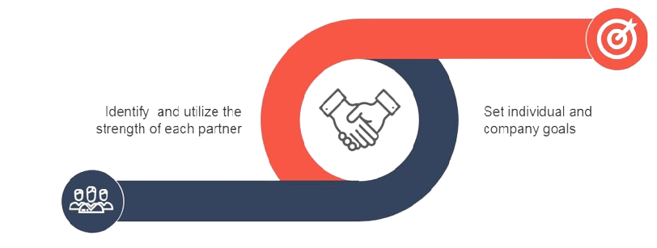



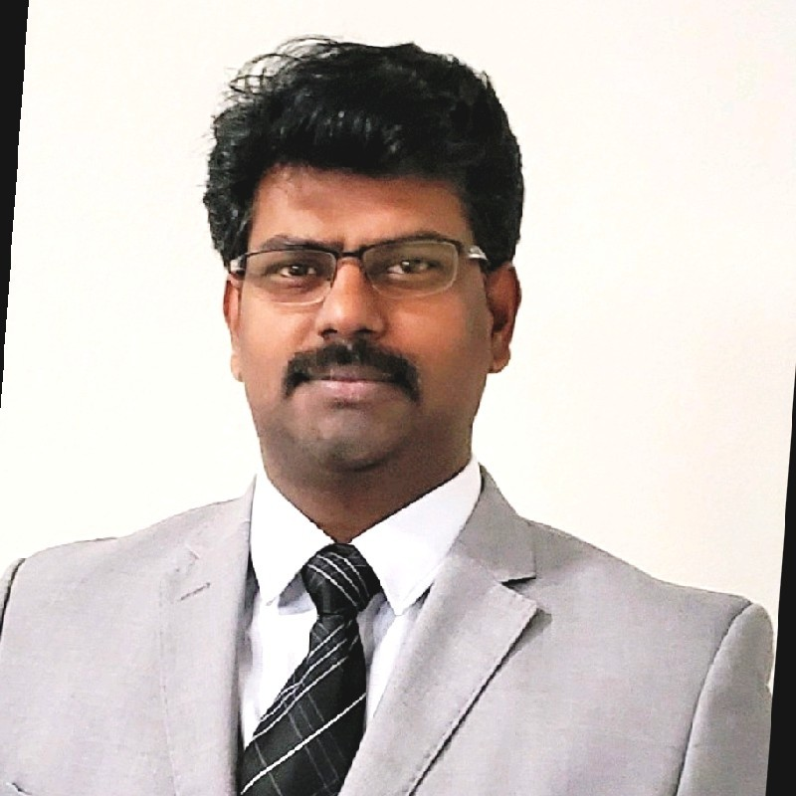






Baskaran K |  |  |  | kbaskaranpmp |  | +1 469 514 9942 |  | kbaski22@gmail.com
Transforming Businesses
Key Skills
Startup
Founder of Software Development Company – Established multi million-dollar business from scratch in less than two years
Strategized and delivered back to market in record 4 quarters for a bankrupt Startup
Established Strategic Delivery organization from scratch for multiple Product/Services Organizations
Management Lead
Product Strategist, Product Management, Program Management, Services Delivery Management, Business Development
Software SDLC, Release/Feature management, Resource Capacity optimization, Working Level Agreement, Cost center management, Budget & Cost Reduction, Profit & Loss
Presales, Due Diligence, Risks Assessment, Solution Assumptions & Dimensioning, SOW Statement of work
11+ Years
Add-on Sales
Grew Managed Services portfolio ADM accounts worth 300M+ by 5% add on sales in addition to year-on-year savings of more than 8% on existing accounts
Established and grew ADM Consulting business from $2+ M to $7+ M in a year
Converted Scope creep incidents into Add On sales creating Win-Win for Customer & organization
Created new multi million-dollar Initiatives through Innovation and modernization
Customer/Vendor Management
Client Relationships, Outsourcing and Vendor/Partner management, Manufacturing partner engagements, Negotiation, Tradeoffs
9+ Years
Team Management
People Management, Global Cross functional team management, Team building and Mentoring, Influencing, Persuading, Influencing, Delegating, Conflict resolving
11+ Years
Game Changer
Turned around several underperforming Delivery Organizations to Top performing entities for top tier telecom providers
Global Delivery
Spearhead designing Delivery Framework to meet SLAs for a versatile Objects of Service
Established seamless Delivery invariable of the resource location through Tools and Innovation
18+ Years
Technology Leadership
Architected and developed several telecom OSS applications for top tier telecom companies across a breath of domain from Radio Frequency optimization, Network Performance Management, Engineering Drafting, Robotic process automation
Extensive technology breadth from monolith applications to distributed Cloud Solutions
including RPA, AI , ML, Blockchain, Cyber Security
Process
Agile Scrum, Kanban, Incremental, Waterfall model, CMM & CMMi, Six-sigma, ITIL v3 Service Delivery, Scope Management, Requirements Analysis, Delivery scheduling across releases/deployments, Retrospective and continuous process improvements, Project closing and Knowledge base development
18+ Years
SCOPE
COST
QUALITY
Technology Leadership
Azure ADO, Jira, MS Project, VersionOne, Visio, MS Office, Workzone, ServiceNow, Remedy, HP Service Manager
C#, ASP.net, MS SQL Server, C, Ubuntu, Yocto Linux, Tableau, Splunk, Elasticsearch, Rabbit MQ, Logstash, Oracle , My SQL, ClearCase, Linux, Hyperledger Fabric Server, Golang, ReactJS, CouchDB, S3, Kubernetes, Kafka, Jenkins, AssistEdge RPA
Experience
Software Engineer
Senior Software
Engineer
Senior Service Delivery Manager
Senior Project Manager
Director of Product Engineering
Baskaran K
Director of Product Engineering
2006
2010
2017
2020
Education
Certifications
International Publications
Awards
Master of Technology (Information Technology) - Jan ‘02
Bachelor of Technology
(Electrical & Electronics) - May ‘99
Project Management Professional (PMP) - PMI
Microsoft Certified: Azure Fundamentals - Microsoft
ITIL® Foundation Certificate in IT Service - AXELOS
etom - Business Process Framework - TM FORUM
Six Sigma Yellow Badge - Motorola
“State Based IoT Security for Tamper Prevention” at ICIIA 2021
Risk Assessment Framework for Global Software Development” Springer 2018
A design to measure risk of global practitioners at CAST 2016
Excellence Award – BlueArmor – Dec 2021
Employee of the Quarter – Ericsson Inc – Mar 2017
eStar Leadership – Ericsson Inc – Sep 2015
Employee of Quarter – Ericsson Inc – Feb 2014
Power Award – Ericsson India – Sep 2011
Bravo Award – Motorola India Pvt Ltd – Apr 2008
Bravo Award – Motorola India Pvt Ltd – Jan 2007

