Slide 1




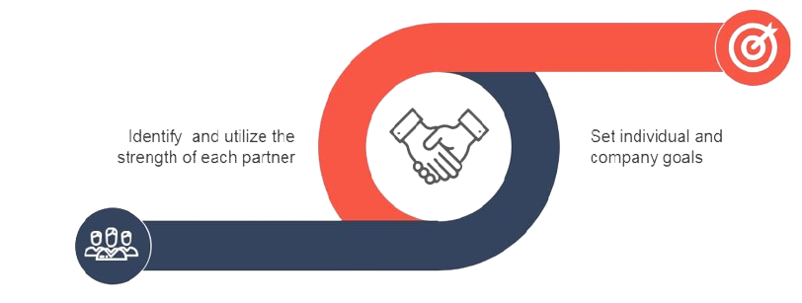



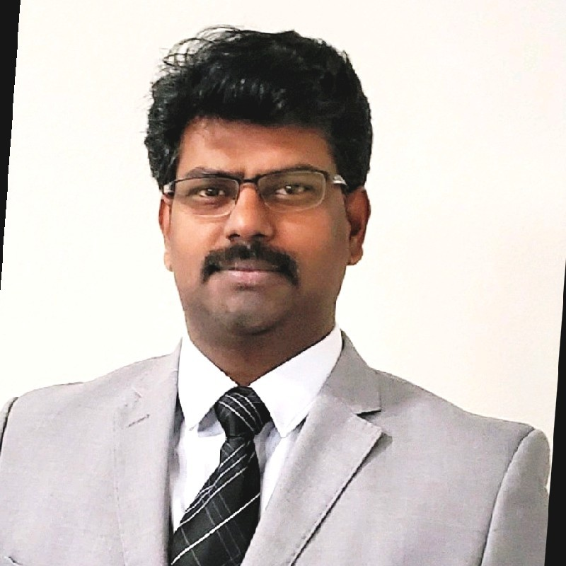






Baskaran K |  |  |  | kbaskaranpmp |  | +1 469 514 9942 |  | kbaski22@gmail.com
Transforming Businesses
Key Skills
Startup
Founder of Software Development Company – Established multi million-dollar business from scratch in less than two years
Strategized and delivered back to market in record 4 quarters for a bankrupt Startup
Established Strategic Delivery organization from scratch for multiple Product/Services Organizations
Management Lead
Product Strategist, Product Management, Program Management, Services Delivery Management, Business Development
Software SDLC, Release/Feature management, Resource Capacity optimization, Working Level Agreement, Cost center management, Budget & Cost Reduction, Profit & Loss
Presales, Due Diligence, Risks Assessment, Solution Assumptions & Dimensioning, SOW Statement of work
11+ Years
Add-on Sales
Grew Managed Services portfolio ADM accounts worth 300M+ by 5% add on sales in addition to year-on-year savings of more than 8% on existing accounts
Established and grew ADM Consulting business from $2+ M to $7+ M in a year
Converted Scope creep incidents into Add On sales creating Win-Win for Customer & organization
Created new multi million-dollar Initiatives through Innovation and modernization
Customer/Vendor Management
Client Relationships, Outsourcing and Vendor/Partner management, Manufacturing partner engagements, Negotiation, Tradeoffs
9+ Years
Game Changer
Turned around several underperforming Delivery Organizations to Top performing entities for top tier telecom providers
Team Management
People Management, Global Cross functional team management, Team building and Mentoring, Influencing, Persuading, Influencing, Delegating, Conflict resolving
11+ Years
Technology Leadership
Architected and developed several telecom OSS applications for top tier telecom companies across a breath of domain from Radio Frequency optimization, Network Performance Management, Engineering Drafting, Robotic process automation
Extensive technology breadth from monolith applications to distributed Cloud Solutions
including RPA, AI , ML, Blockchain, Cyber Security
Global Delivery
Spearhead designing Delivery Framework to meet SLAs for a versatile Objects of Service
Established seamless Delivery invariable of the resource location through Tools and Innovation
18+ Years
Process
Agile Scrum, Kanban, Incremental, Waterfall model, CMM & CMMi, Six-sigma, ITIL v3 Service Delivery, Scope Management, Requirements Analysis, Delivery scheduling across releases/deployments, Retrospective and continuous process improvements, Project closing and Knowledge base development
18+ Years
SCOPE
COST
QUALITY
Technology Leadership
Azure ADO, Jira, MS Project, VersionOne, Visio, MS Office, Workzone, ServiceNow, Remedy, HP Service Manager
C#, ASP.net, MS SQL Server, C, Ubuntu, Yocto Linux, Tableau, Splunk, Elasticsearch, Rabbit MQ, Logstash, Oracle , My SQL, ClearCase, Linux, Hyperledger Fabric Server, Golang, ReactJS, CouchDB, S3, Kubernetes, Kafka, Jenkins, AssistEdge RPA
Experience
Software Engineer
Senior Software
Engineer
Senior Service Delivery Manager
Senior Project Manager
Director of Product Engineering
Baskaran K
Director of Product Engineering
2006
2010
2017
2020
Education
Certifications
International Publications
Awards
Master of Technology (Information Technology) - Jan ‘02
Bachelor of Technology
(Electrical & Electronics) - May ‘99
Project Management Professional (PMP) - PMI
Microsoft Certified: Azure Fundamentals - Microsoft
ITIL® Foundation Certificate in IT Service - AXELOS
etom - Business Process Framework - TM FORUM
Six Sigma Yellow Badge - Motorola
“State Based IoT Security for Tamper Prevention” at ICIIA 2021
Risk Assessment Framework for Global Software Development” Springer 2018
A design to measure risk of global practitioners at CAST 2016
Excellence Award – BlueArmor – Dec 2021
Employee of the Quarter – Ericsson Inc – Mar 2017
eStar Leadership – Ericsson Inc – Sep 2015
Employee of Quarter – Ericsson Inc – Feb 2014
Power Award – Ericsson India – Sep 2011
Bravo Award – Motorola India Pvt Ltd – Apr 2008
Bravo Award – Motorola India Pvt Ltd – Jan 2007

