Slide 1
Implement VTP
LAN Switching and Wireless – Chapter 4

Slide 2
Objectives
Explain the role of VTP in a converged switched network
Describe the operation of VTP: VTP domains, VTP Modes, VTP Advertisements, and VTP Pruning.
Configure VTP on the switches in a converged network.

Slide 3
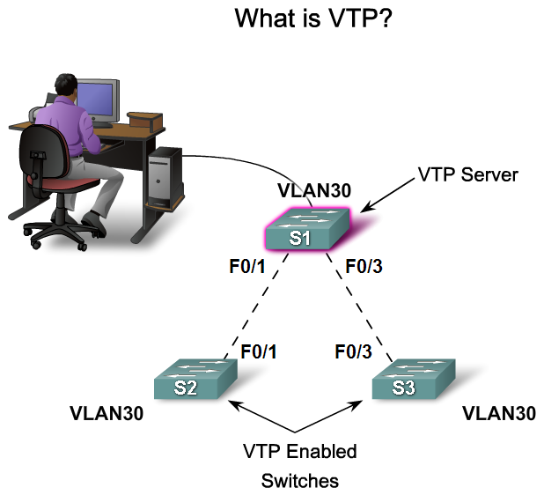
Explain the Role of VTP in a Converged Switched Network
Explain the role of VTP in a multi-switch network

Slide 4
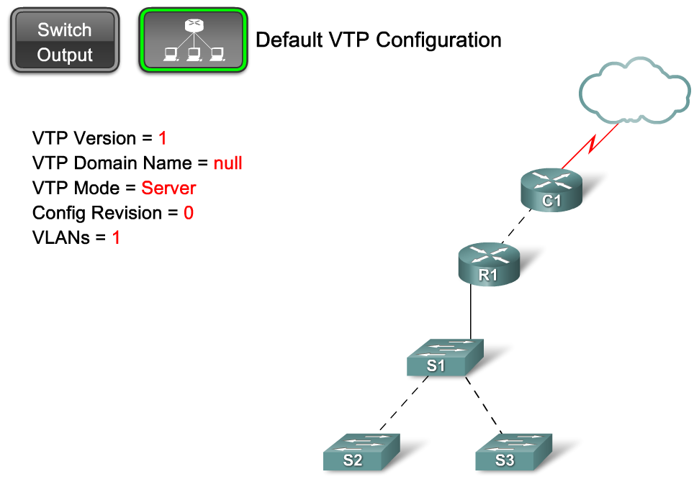
Describe the Operation of VTP
Describe the importance of the default VTP configuration

Slide 5
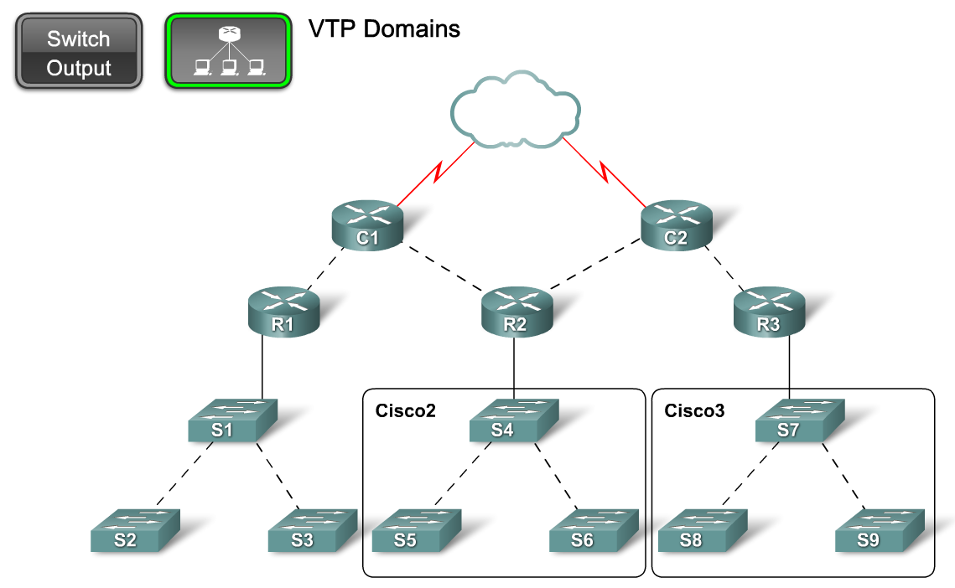
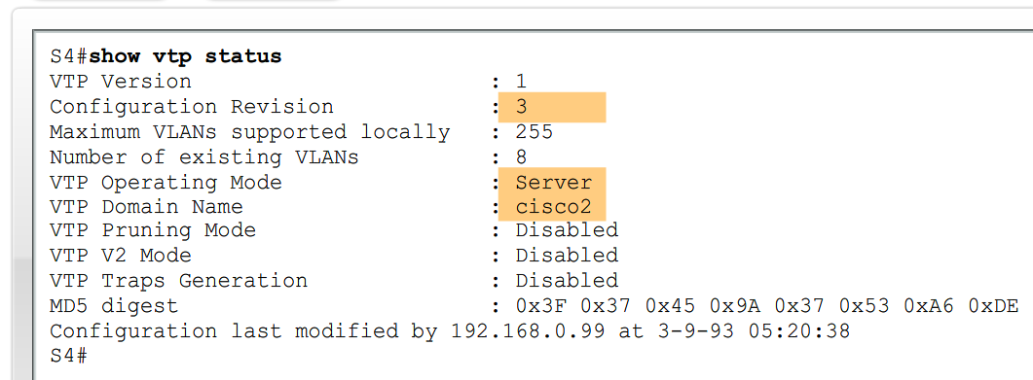
Describe the Operation of VTP
Explain the role of domains in VTP

Slide 6
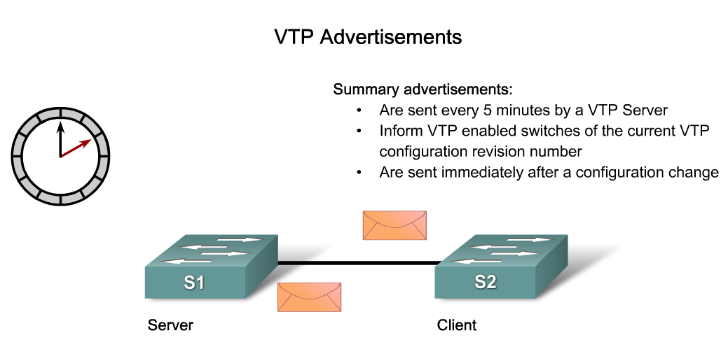
Describe the Operation of VTP
Describe how VTP exchanges domain and VLAN information between switches in the same VTP domain

Slide 7
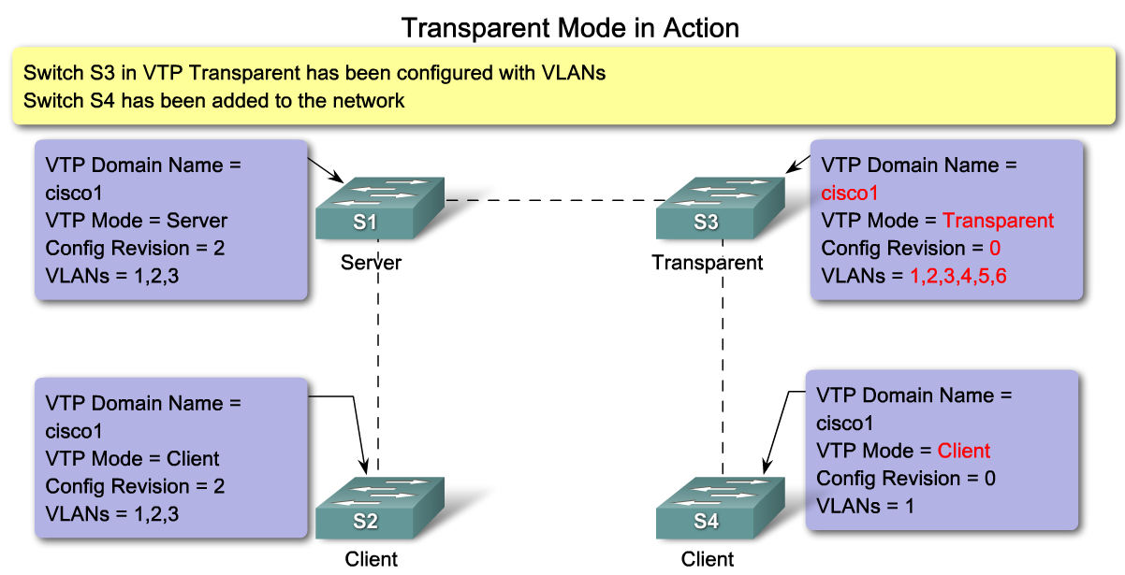
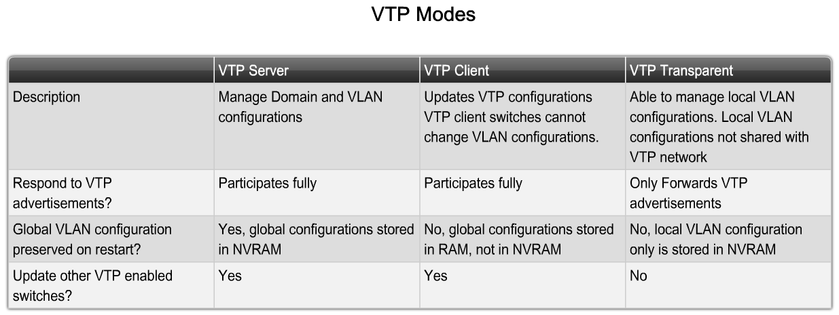
Describe the Operation of VTP
Describe the role VTP modes play in enabling VTP to distribute and synchronize domain and VLAN configuration information in a network

Slide 8
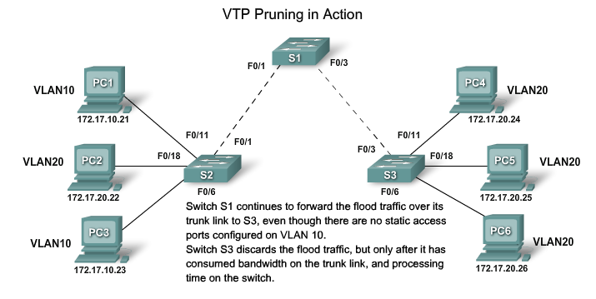
Describe the Operation of VTP
Explain how VTP pruning functions

Slide 9
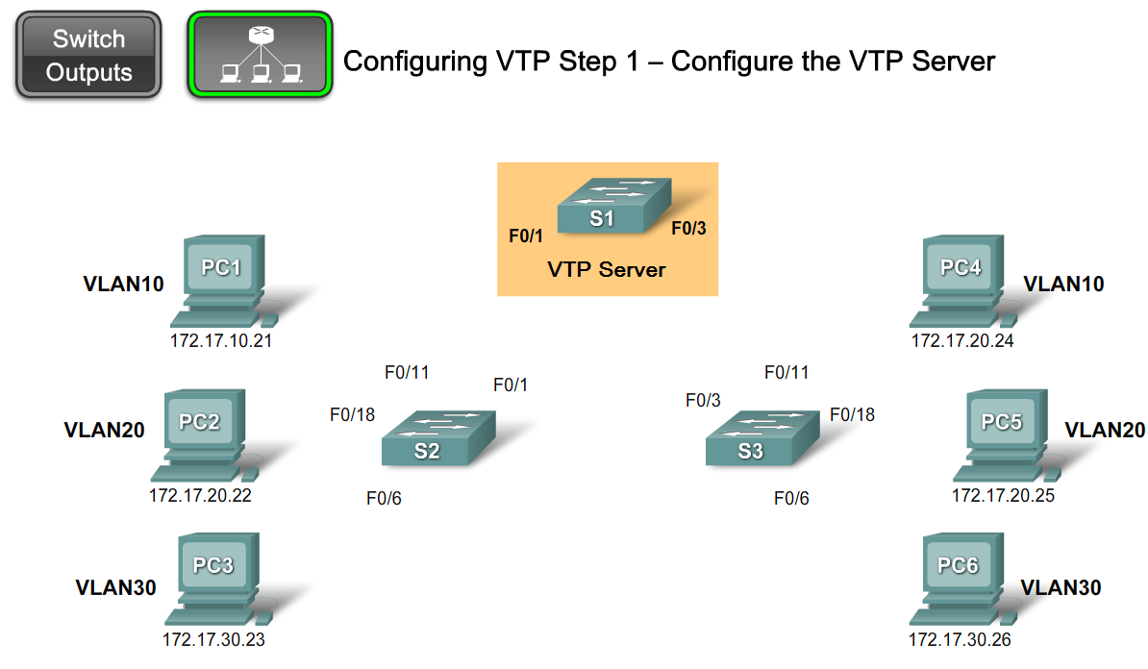
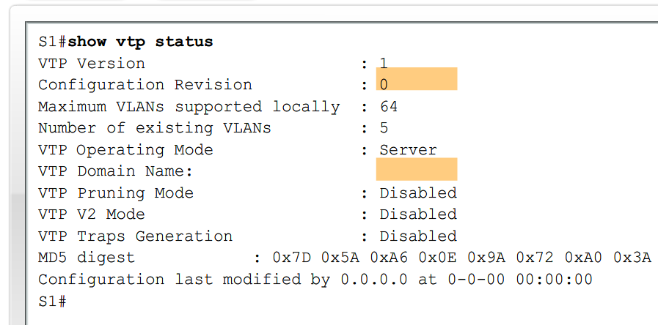
Configure VTP on the Switches in a Converged Network
Configure VTP on a Cisco Catalyst Switch

Slide 10
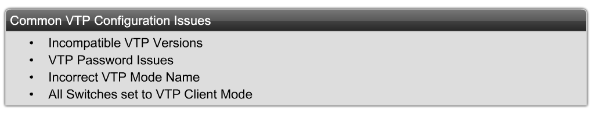
Configure VTP on the Switches in a Converged Network
Identify and troubleshoot common VTP configuration problems

Slide 11
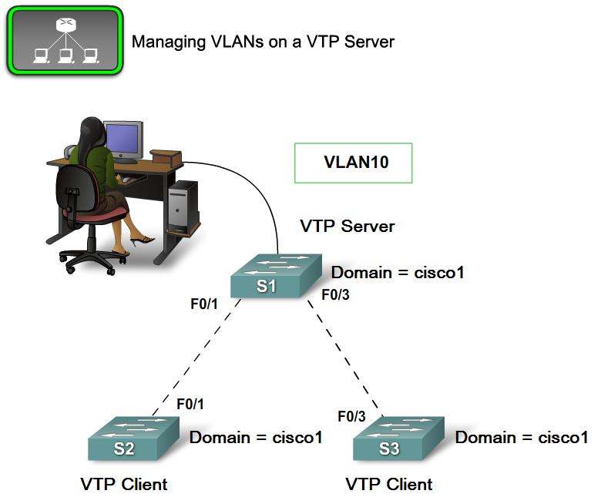
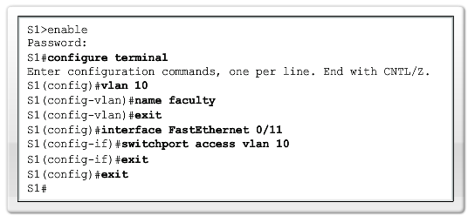
Configure VTP on the Switches in a Converged Network
Manage VLANs on a VTP enabled network

Slide 12
Summary
VTP is a Cisco proprietary protocol used to exchange VLAN information across trunk links.
A switch can be in one of 3 VTP operating modes
  Client
    Cannot create, modify or delete VLAN
  Server
    Can create, modify & delete VLAN
  Transparent
  Can create, modify, & delete LOCAL VLAN
  Forwards VTP advertisements.

Slide 13
Summary
VTP pruning
  Limits unnecessary dissemination of VLAN information.
Verify VTP configuration
  Show VTP status
  Show interfaces trunk

