Slide 1
Implement Inter-VLAN Routing
LAN Switching and Wireless – Chapter 6

Slide 2
Objectives
Explain to the satisfaction of a qualified instructor how network traffic is routed between VLANs in a converged network.
Configure inter-VLAN routing on a router to enable communications between end-user devices on separate VLANs
Troubleshoot common inter-VLAN connectivity issues.

Slide 3
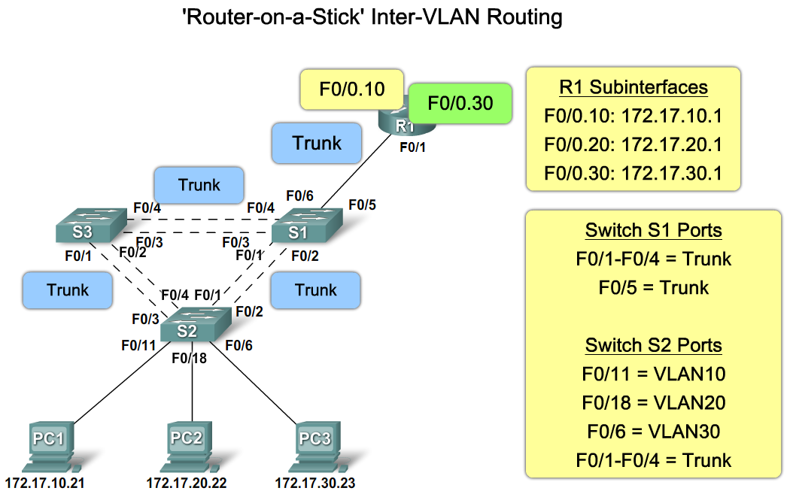
Explain How Network Traffic is Routed Between VLANs in a Converged Network
Describe the role of interfaces and subinterfaces in supporting inter-VLAN routing

Slide 4
We define inter-VLAN routing as a process of forwarding network traffic from one VLAN to another VLAN using a router.
VLANs are associated with unique IP subnets on the network. This subnet configuration facilitates the routing process in a multi-VLAN environment.
When using a router to facilitate inter-VLAN routing, the router interfaces can be connected to separate VLANs. Devices on those VLANs send traffic through the router to reach other VLANs.

Slide 5
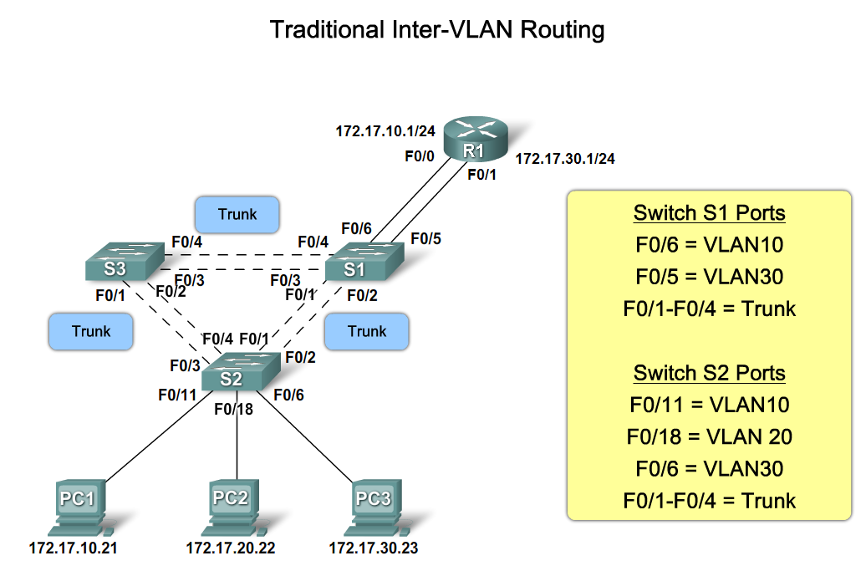
Explain How Network Traffic is Routed Between VLANs in a Converged Network
Describe the routing options between VLANs

Slide 6
Network Traffic is Routed Between VLANs in a Converged Network
"Router-on-a-stick" is a type of router configuration in which a single physical interface routes traffic between multiple VLANs on a network.
The router interface is configured to operate as a trunk link and is connected to a switch port configured in trunk mode.
The router performs the inter-VLAN routing by accepting VLAN tagged traffic on the trunk interface coming from the adjacent switch and internally routing between the VLANs using subinterfaces.
The router then forwards the routed traffic-VLAN tagged for the destination VLAN-out the same physical interface.

Slide 7
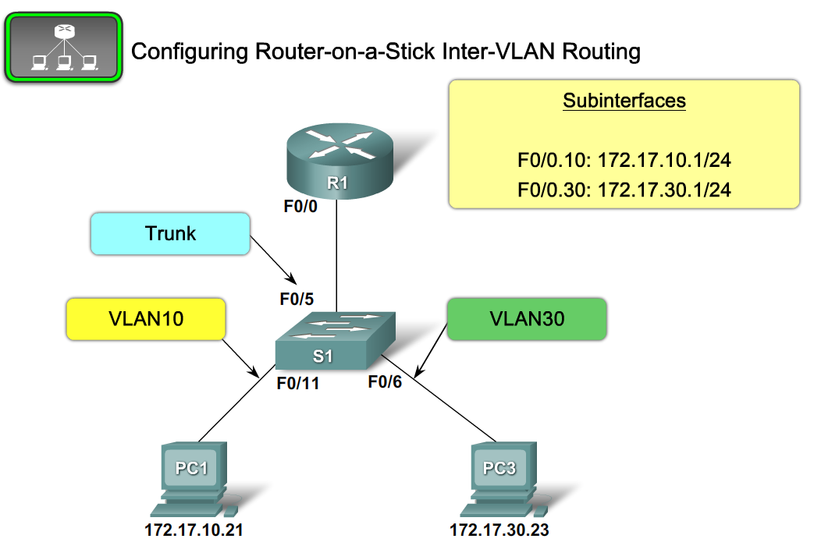
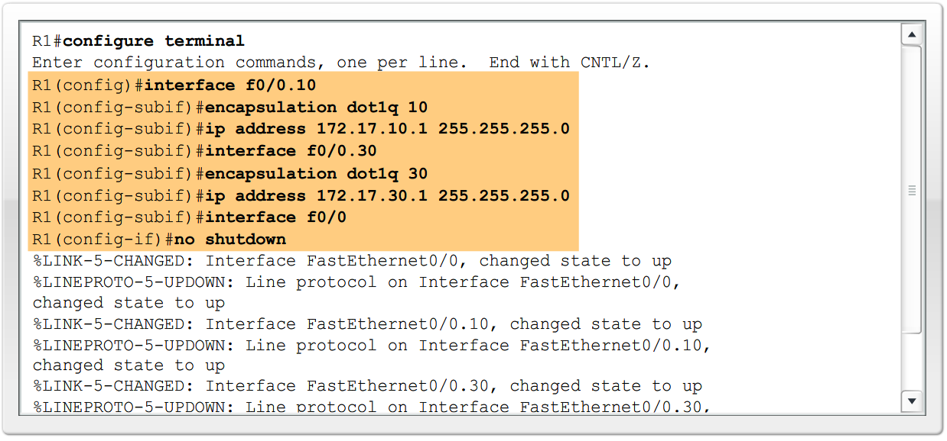
Configure Inter-VLAN Routing
Describe the steps to configure inter-VLAN routing

Slide 8
Using the Router as a Gateway
The router accomplishes the routing by having each of its physical interfaces connected to a unique VLAN.
Each interface is also configured with an IP address for the subnet associated with the particular VLAN that it is connected to.
By configuring the IP addresses on the physical interfaces, network devices connected to each of the VLANs can communicate with the router using the physical interface connected to the same VLAN.
In this configuration, network devices can use the router as a gateway to access the devices connected to the other VLANs.

Slide 9
Using the Router as a Gateway
Once the source device has determined that the packet must travel through the local router interface on the connected VLAN, the source device sends out an ARP request to determine the MAC address of the local router interface.
Once the router sends its ARP reply back to the source device, the source device can use the MAC address to finish framing the packet before it sends it out on the network as unicast traffic.
Since the Ethernet frame has the destination MAC address of the router interface, the switch knows exactly which switch port to forward the unicast traffic out of to reach the router interface on that VLAN.

Slide 10
Using the Router as a Gateway
When the frame arrives at the router, the router removes the source and destination MAC address information to examine the destination IP address of the packet.
The router compares the destination address to entries in its routing table to determine where it needs to forward the data to reach its final destination.
If the router determines that the destination network is a locally connected network, as would be the case in inter-VLAN routing, the router sends an ARP request out the interface physically connected to the destination VLAN.

Slide 11
Using the Router as a Gateway
The destination device responds back to the router with its MAC address, which the router then uses to frame the packet. The router then sends the unicast traffic to the switch, which forwards it out the port where the destination device is connected.

Slide 12
Router Subinterface and Inter-VLAN Routing
Subinterfaces are software-based virtual interfaces that are assigned to physical interfaces.
Each subinterface is configured with its own IP address, subnet mask, and unique VLAN assignment, allowing a single physical interface to simultaneously be part of multiple logical networks.
This is useful when performing inter-VLAN routing on networks with multiple VLANs and few router physical interfaces.

Slide 13
Router Subinterface and Inter-VLAN Routing
When configuring inter-VLAN routing using the router-on-a-stick model, the physical interface of the router must be connected to a trunk link on the adjacent switch. Subinterfaces are created for each unique VLAN/subnet on the network.
Each subinterface is assigned an IP address specific to the subnet that it will be part of and configured to VLAN tag frames for the VLAN that the interface is to interact with.
That way, the router can keep the traffic from each subinterface separated as it traverses the trunk link back to the switch.

Slide 14
Router Subinterface and Inter-VLAN Routing
Functionally, the router-on-a-stick model for inter-VLAN routing is the same as using the traditional routing model, but instead of using the physical interfaces to perform the routing, subinterfaces of a single interface are used.

Slide 15
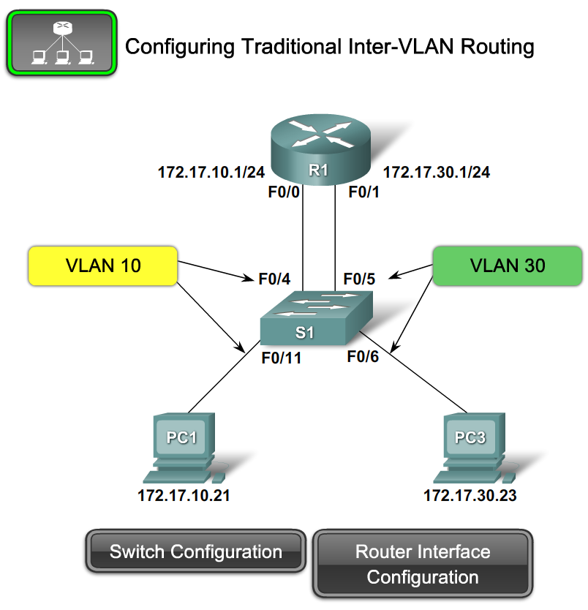
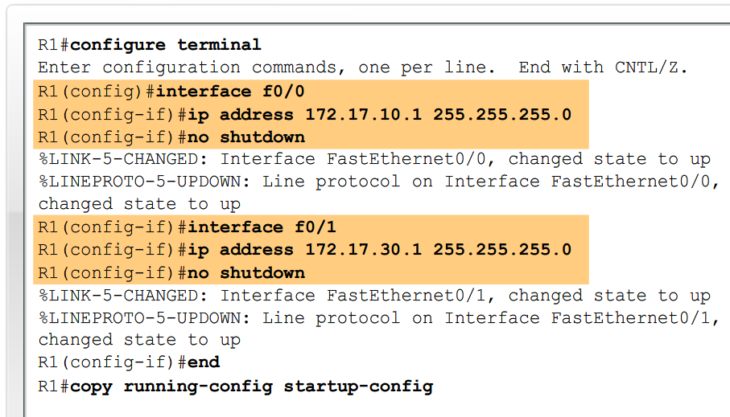
Configure Inter-VLAN Routing
Describe the steps to configure inter-VLAN routing

Slide 16
Port Limits
Physical interfaces are configured to have one interface per VLAN on the network. On networks with many VLANs, using a single router to perform inter-VLAN routing is not possible. Routers have physical limitations that prevent them from containing large numbers of physical interfaces. Instead, you could use multiple routers to perform inter-VLAN routing for all VLANs if avoiding the use of subinterfaces is a priority.

Slide 17
Port Limits
Subinterfaces allow a router to scale to accommodate more VLANs than the physical interfaces permit. Inter-VLAN routing in large environments with many VLANs can usually be better accommodated by using a single physical interface with many subinterfaces.

Slide 18
Performance
Because there is no contention for bandwidth on separate physical interfaces, physical interfaces have better performance when compared to using subinterfaces.
Traffic from each connected VLAN has access to the full bandwidth of the physical router interface connected to that VLAN for inter-VLAN routing.

Slide 19
Performance
When subinterfaces are used for inter-VLAN routing, the traffic being routed competes for bandwidth on the single physical interface.
On a busy network, this could cause a bottleneck for communication.
To balance the traffic load on a physical interface, subinterfaces are configured on multiple physical interfaces resulting in less contention between VLAN traffic.

Slide 20
Access Ports and Trunk Ports
Connecting physical interfaces for inter-VLAN routing requires that the switch ports be configured as access ports.
Subinterfaces require the switch port to be configured as a trunk port so that it can accept VLAN tagged traffic on the trunk link.
Using subinterfaces, many VLANs can be routed over a single trunk link rather than a single physical interface for each VLAN.

Slide 21
Cost
Financially, it is more cost-effective to use subinterfaces over separate physical interfaces.
Routers that have many physical interfaces cost more than routers with a single interface.
Additionally, if you have a router with many physical interfaces, each interface is connected to a separate switch port, consuming extra switch ports on the network.
Switch ports are an expensive resource on high performance switches.
By consuming additional ports for inter-VLAN routing functions, both the switch and the router drive up the overall cost of the inter-VLAN routing solution.

Slide 22
Complexity
Using subinterfaces for inter-VLAN routing results in a less complex physical configuration than using separate physical interfaces, because there are fewer physical network cables interconnecting the router to the switch.
With fewer cables, there is less confusion about where the cable is connected on the switch. Because the VLANs are being trunked over a single link, it is easier to troubleshoot the physical connections.

Slide 23
ROUTER INTERFACE and SUBINTERFACE COMPARISON
Physical Interface | Subinterface
One physical interface per VLAN | One physical interface for many VLANs
No bandwidth contention | Bandwidth contention
Connected to access mode switch port | Connected to trunk mode switch port
More expensive | Less expensive
Less complex connection configuration | More complex connection configuration

Slide 24
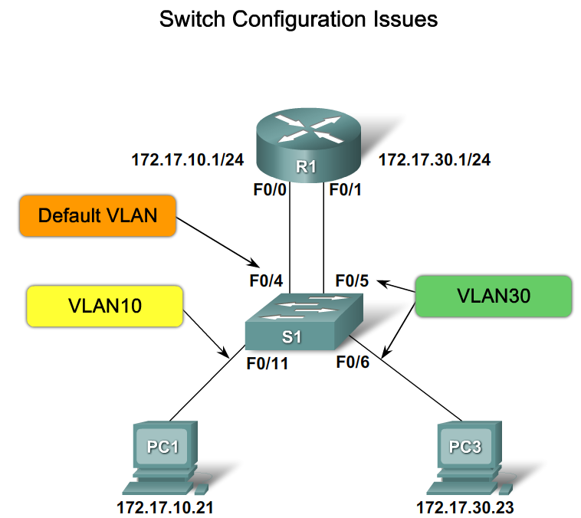
Troubleshoot Common Inter-VLAN Connectivity Issues
Incorrect VLAN Assignment

Slide 25
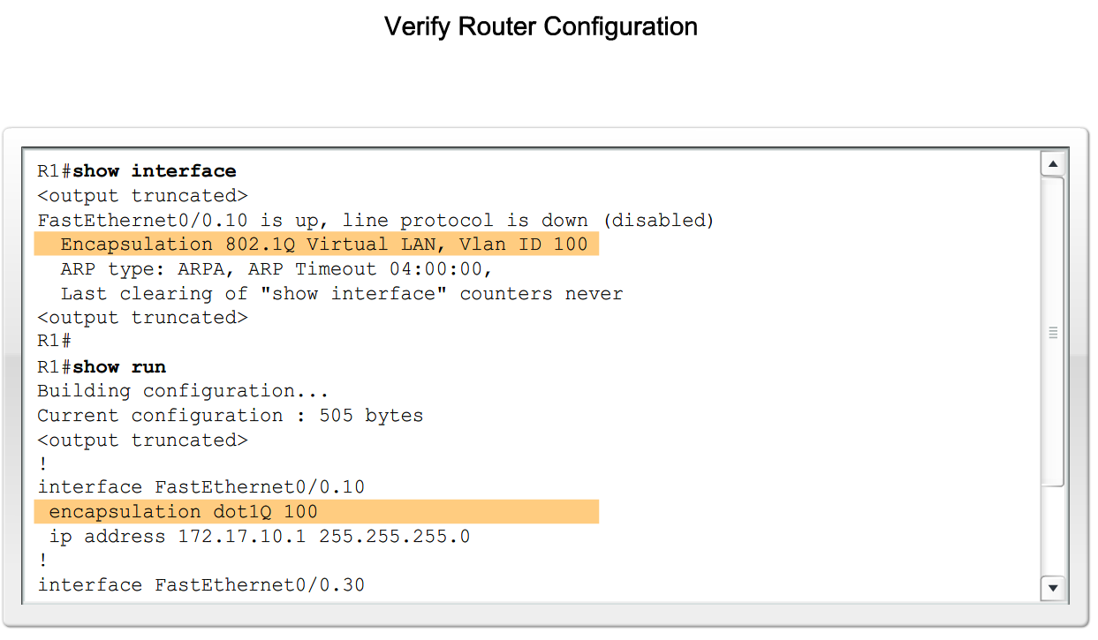
Troubleshoot Common Inter-VLAN Connectivity Issues
Incorrect Access Mode

Slide 26
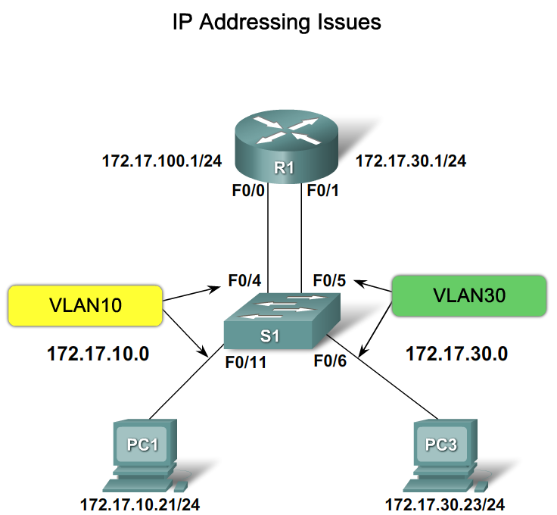
Troubleshoot Common Inter-VLAN Connectivity Issues
IP Addressing Issues

Slide 27
Summary
Inter-VLAN routing is the process of routing information between VLANs
Inter-VLAN routing requires the use of a router or a layer 3 switch
Traditional inter-VLAN routing
  Requires multiple router interfaces that are each connected to separate VLANs

Slide 28
Summary
Router on a stick
  this is an inter-VLAN routing topology that uses router sub interfaces connected to a layer 2 switch.
  Each Subinterface must be configured with:
  An IP address
  Associated VLAN number
Configuration of inter VLAN routing
  Configure switch ports connected to router with correct VLAN
  Configure each router subinterface with the correct IP address & VLAN ID
Verify configuration on switch and router

