Slide 1
LAN Design
LAN Switching and Wireless – Chapter 1

Slide 2
Objectives
Describe how a hierarchical network supports the voice, video and data needs of a small and medium-sized business.
Match the appropriate Cisco switch to each layer in the hierarchical network design model.

Slide 3
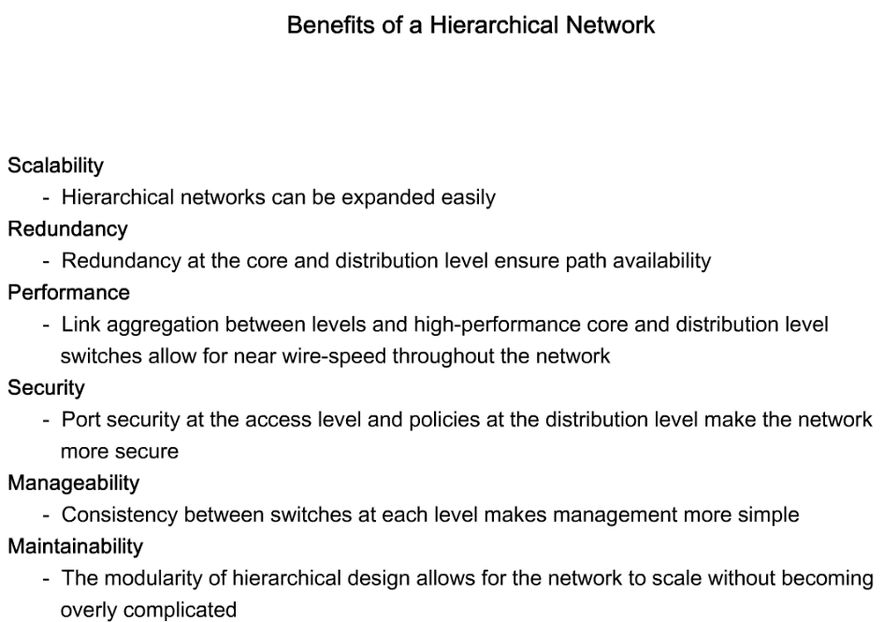
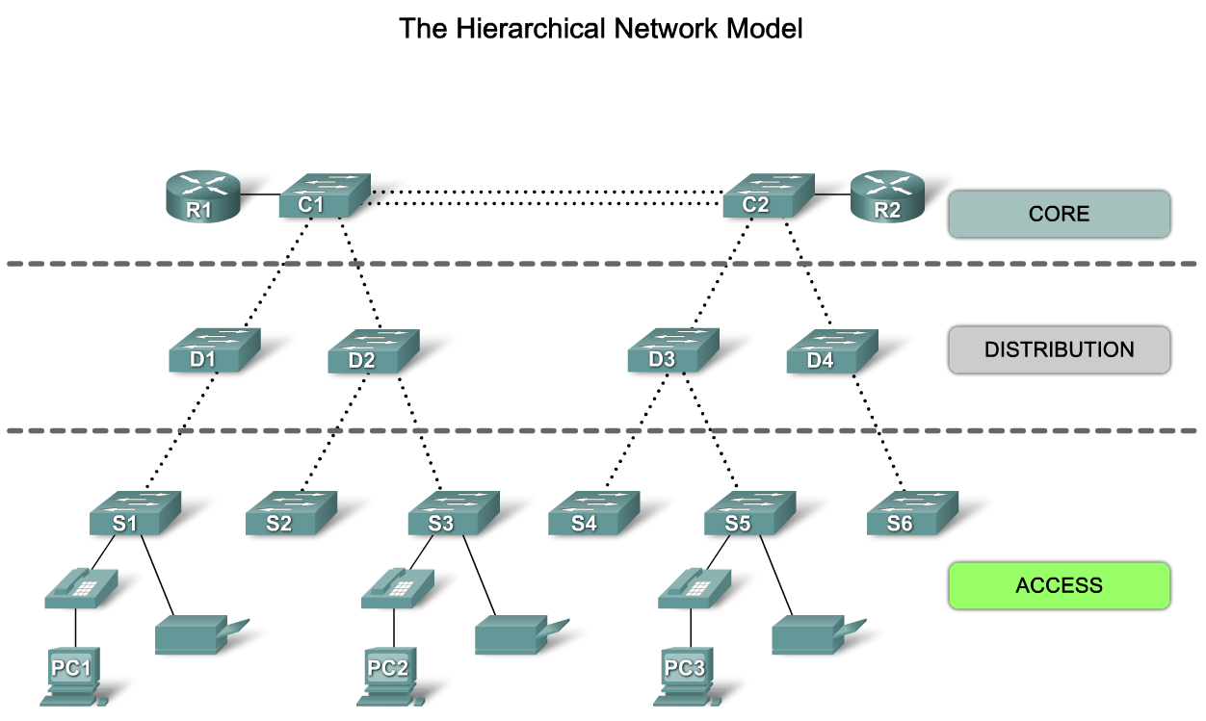
Describe how a Hierarchical Network Supports the Needs of a Small & Medium-Sized Business
Explain the benefits of the hierarchical network model

Slide 4
Access Layer
The access layer interfaces with end devices, such as PCs, printers, and IP phones, to provide access to the rest of the network. The access layer can include routers, switches, bridges, hubs, and wireless access points (AP).
The main purpose of the access layer is to provide a means of connecting devices to the network and controlling which devices are allowed to communicate on the network.

Slide 5
Distribution Layer
The distribution layer aggregates the data received from the access layer switches before it is transmitted to the core layer for routing to its final destination.
The distribution layer controls the flow of network traffic using policies and delineates broadcast domains by performing routing functions between virtual LANs (VLANs) defined at the access layer. VLANs allow you to segment the traffic on a switch into separate subnetworks.

Slide 6
Core Layer
The core layer of the hierarchical design is the high-speed backbone of the internetwork.
It is critical for interconnectivity between distribution layer devices, so it is important for the core to be highly available and redundant. The core area can also connect to Internet resources.
The core aggregates the traffic from all the distribution layer devices, so it must be capable of forwarding large amounts of data quickly.

Slide 7
Describe how a Hierarchical Network Supports the Needs of a Small & Medium-Sized Business

Slide 8
Hierarchical Network Design Principles
Network diameter
  the number of devices that a packet has to cross before it reaches its destination. Keeping the network diameter low ensures low and predictable latency between devices.
Bandwidth aggregation
  is the practice of considering the specific bandwidth requirements of each part of the hierarchy.
Redundancy
  is one part of creating a highly available network. Redundancy can be provided in a number of ways.

Slide 9
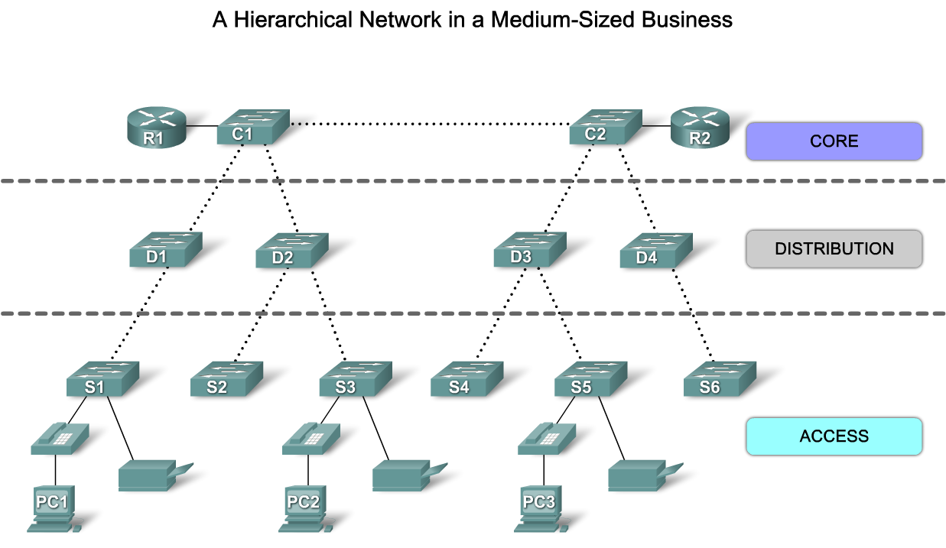
Describe how a Hierarchical Network Supports the Needs of a Small & Medium-Sized Business
Describe the key principles of hierarchical network design

Slide 10
Convergence
Convergence is the process of combining voice and video communications on a data network.
Converged networks also required extensive management in relation to Quality of Service (QoS), because voice and video data traffic needed to be classified and prioritized on the network.
One benefit of a converged network is that there is just one network to manage.
Another benefit is lower implementation and management costs.

Slide 11
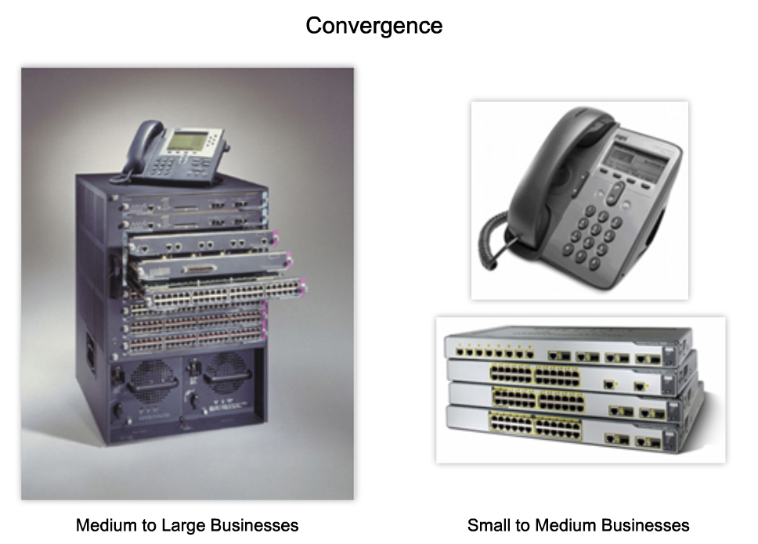
Describe how a Hierarchical Network Supports the Needs of a Small & Medium-Sized Business
Describe the role of a converged network in supporting small and medium-sized (SMB) business voice, video, and data needs

Slide 12
Traffic flow analysis
Network traffic
  is the amount of data sent through a network for a given period of time.
Traffic flow analysis
  is the process of measuring the bandwidth usage on a network and analyzing the data for the purpose of performance tuning, capacity planning, and making hardware improvement decisions
Analyzing the various traffic sources and their impact on the network, allows you to more accurately tune and upgrade the network to achieve the best possible performance.

Slide 13
User Communities Analysis
User community analysis is the process of identifying various groupings of users and their impact on network performance.
The way users are grouped affects issues related to port density and traffic flow, which, in turn, influences the selection of network switches

Slide 14
Data Stores and Data Servers Analysis
Data stores can be servers, storage area networks (SANs), network-attached storage (NAS), tape backup units, or any other device or component where large quantities of data are stored.
Client-server traffic typically traverses multiple switches to reach its destination.
Server-server traffic is the traffic generated between data storage devices on the network. Some server applications generate very high volumes of traffic between data stores and other servers.

Slide 15
Topology Diagrams
A topology diagram is a graphical representation of a network infrastructure.
A topology diagram shows how all switches are interconnected, detailed down to which switch port interconnects the devices.
A topology diagram graphically displays any redundant paths or aggregated ports between switches that provide for resiliency and performance.
It shows where and how many switches are in use on your network, as well as identifies their configuration.

Slide 16
Topology Diagrams
Topology diagrams can also contain information about device densities and user communities.
Having a topology diagram allows you to visually identify potential bottlenecks in network traffic so that you can focus your traffic analysis data collection on areas where improvements can have the most significant impact on performance.

Slide 17
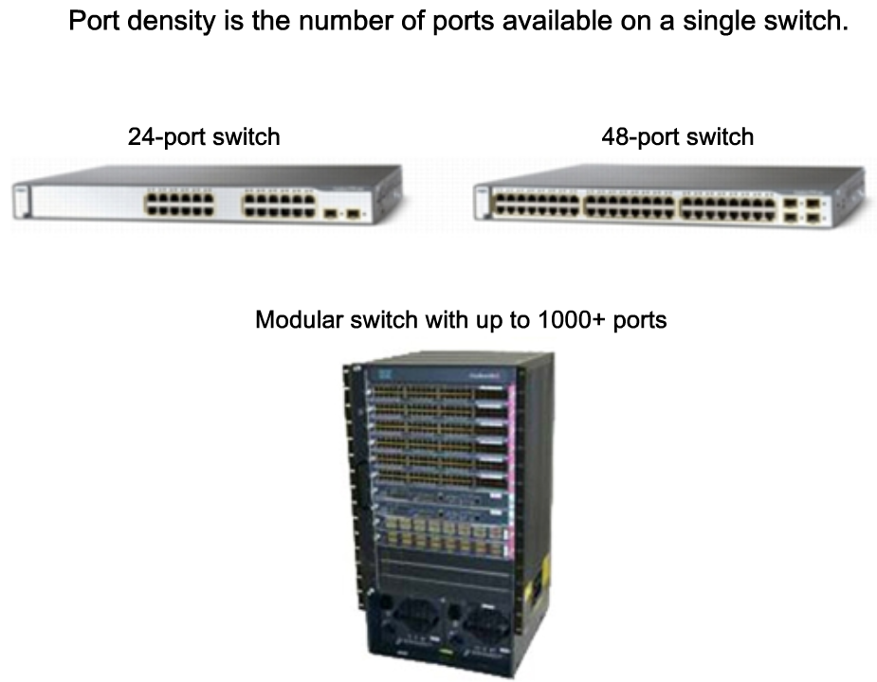
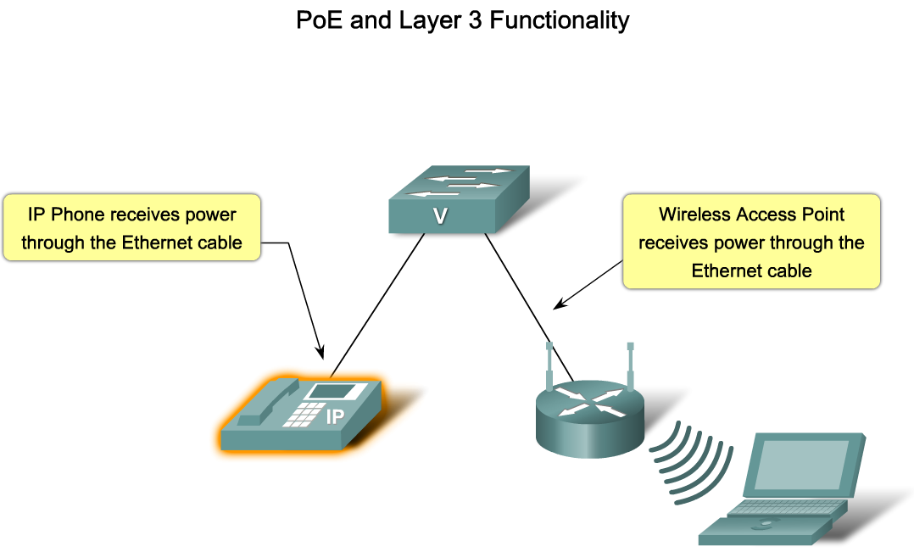
Match the Appropriate Cisco Switch to each Layer in the Hierarchical Network Design Model
Identify the considerations used to select a switch for a hierarchical network

Slide 18
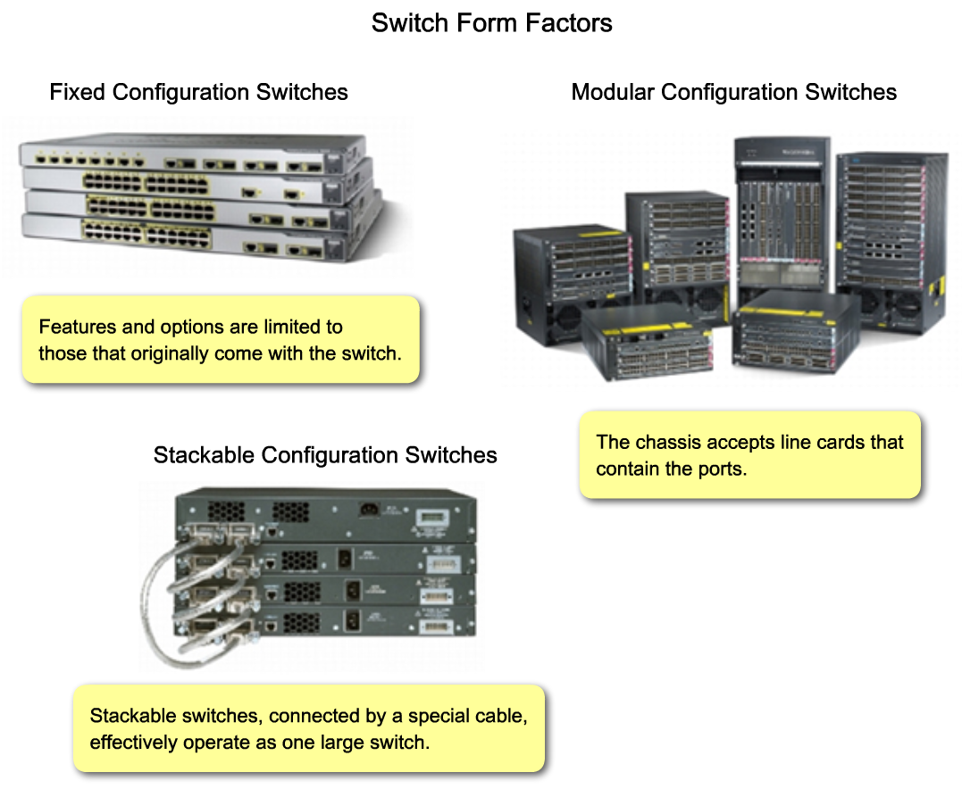
Match the Appropriate Cisco Switch to each Layer in the Hierarchical Network Design Model
Identify the key features of switches that are used in hierarchical networks

Slide 19
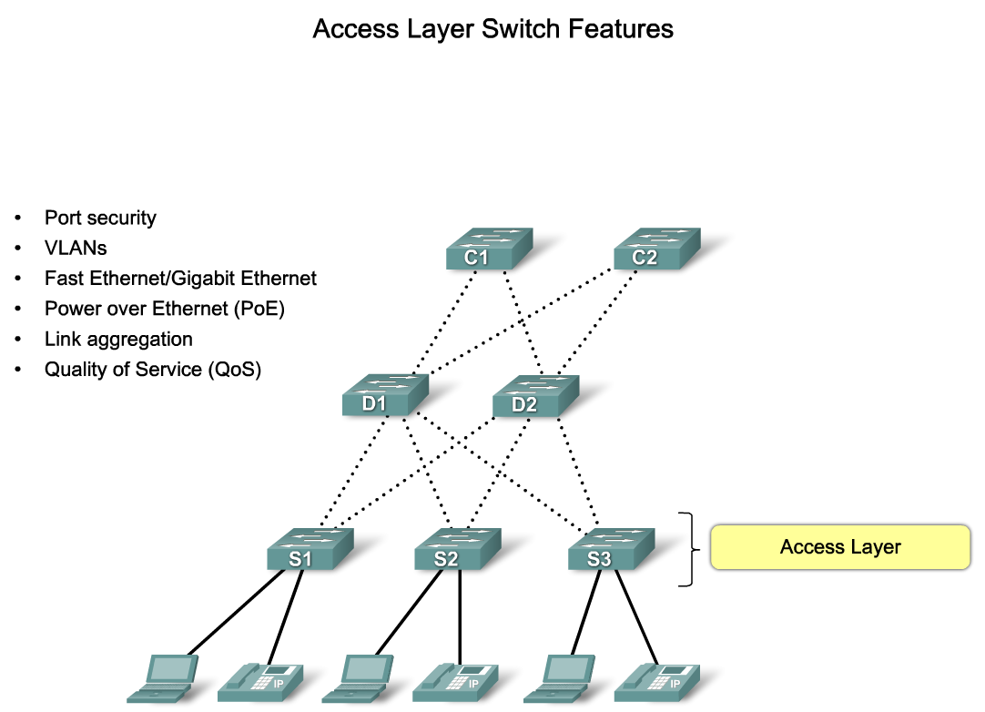
Match the Appropriate Cisco Switch to each Layer in the Hierarchical Network Design Model

Slide 20
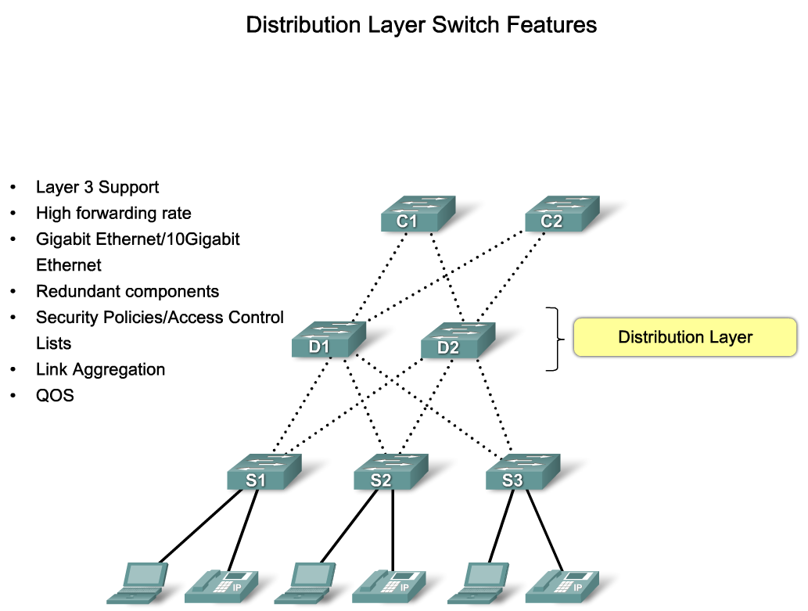
Match the Appropriate Cisco Switch to each Layer in the Hierarchical Network Design Model

Slide 21
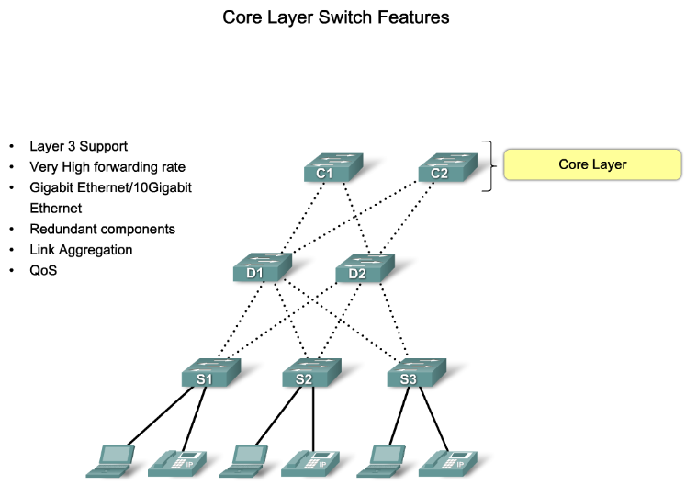
Match the Appropriate Cisco Switch to each Layer in the Hierarchical Network Design Model

Slide 22
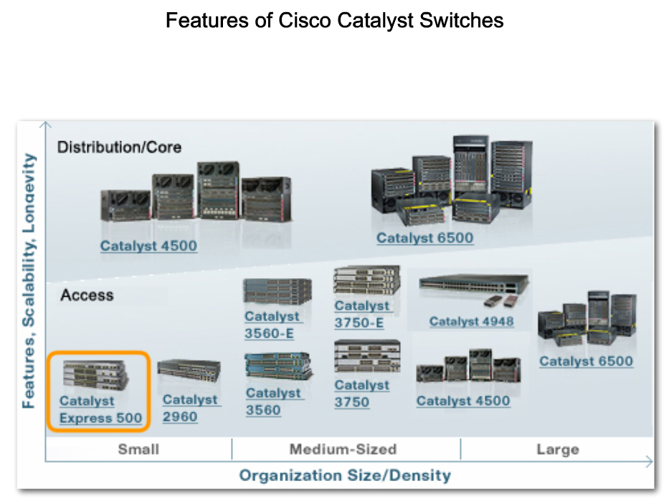
Match the Appropriate Cisco Switch to each Layer in the Hierarchical Network Design Model
Identify the Cisco switches used in SMB applications

Slide 23
Summary
Hierarchical Design model addresses performance, scalability, maintainability & manageability issues.
Traffic Analysis is used to monitor network performance.
Hierarchical Design Model is composed of 3 layers:
  Access
  Distribution
  Core
Switches selected for each layer must meet the needs of each hierarchical layer as well as the needs of the business.

