Slide 1

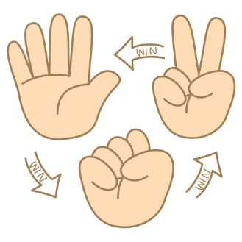

ROCK-PAPER-SCISSORS
VS A.I.
VS ONLINE
FINDING A MATCH…
PLAY!
OPPONENT FOUND!
VS OFFLINE
SETTINGS

Slide 2


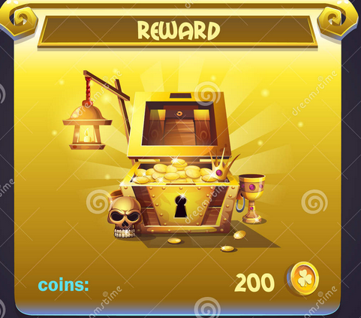
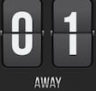




Juan Deag
Match Results
You win!
Bobby

