Slide 1
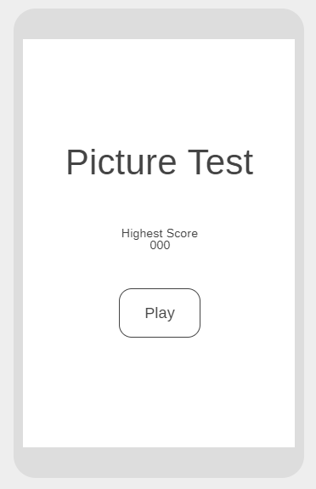
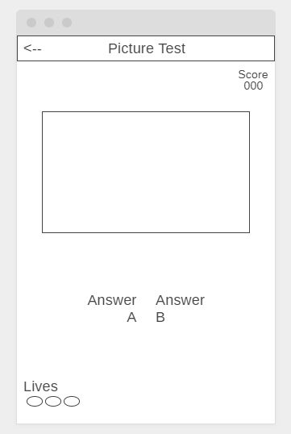
Guess this object

Slide 2



Picture Test
Score
000
Picture Test
Guess this object
Highest Score
000
PLAY
Answer
A
Answer
B
Lives

Slide 3
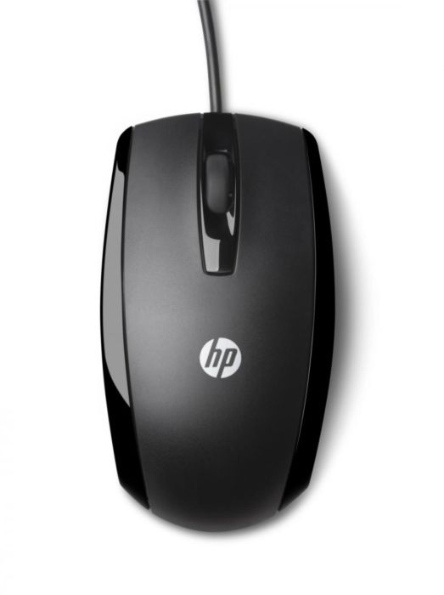
Picture Test
Score
010
Picture Test
Guess this object
Highest Score
000
PLAY
Mouse
Car
Lives

