Slide 1
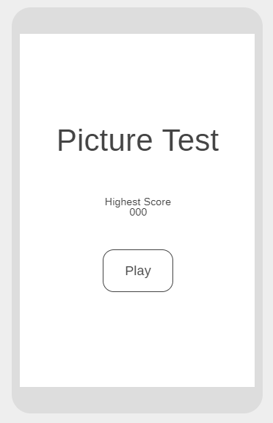
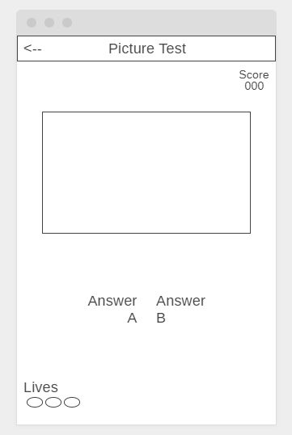

Press this button to go back to the home screen
This is the help button
Guess this object
Pictures of different items will appear here
Press this button to start the game
Choice B
Choice A

Slide 2



Picture Test
Score
000
Picture Test
Guess this object
Highest Score
000
PLAY
Answer
A
Answer
B
Lives

Slide 3
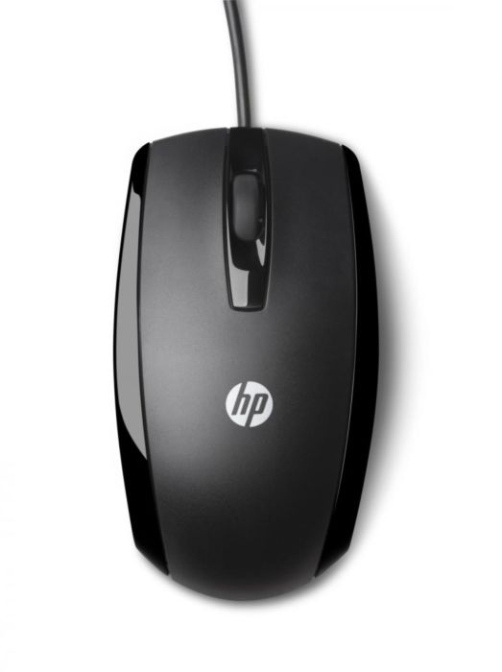
Picture Test
Score
010
Picture Test
Guess this object
Highest Score
000
PLAY
Mouse
Car
Lives

