Slide 1
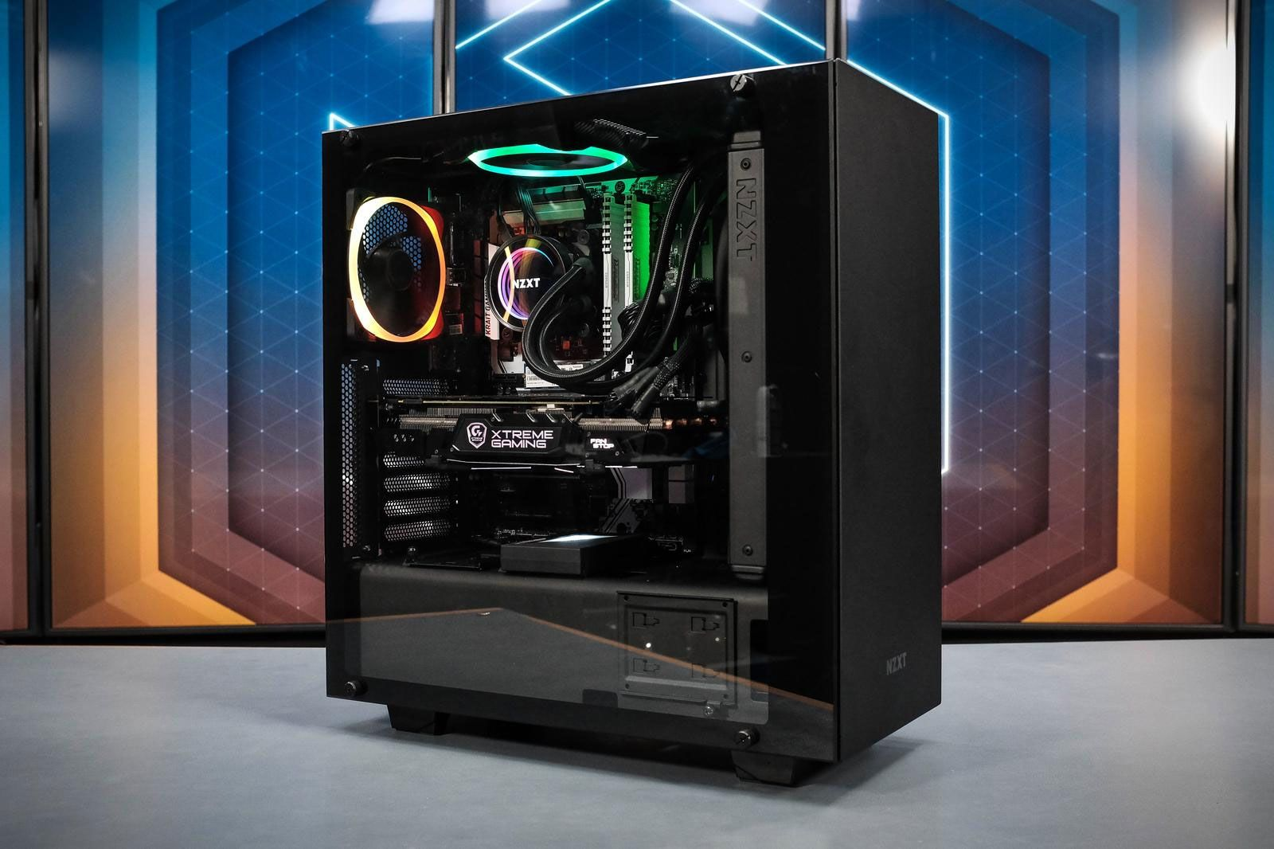
Build your own PC

Slide 2


Why? Can save money! Fun!

Slide 3

No need to worry. It’s almost like a Lego!

Slide 4
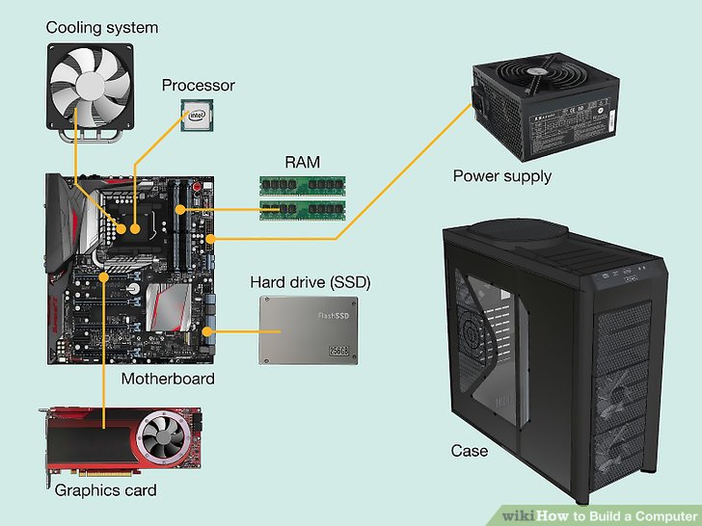
Moreover.. It hasn’t changed over 30 years!

Slide 5
You need to know something… Only 6 5 things
CPU
Mainboard
Graphic card
Memory
Hdd
Power Supply

Slide 6


What to choose?!!

Slide 7
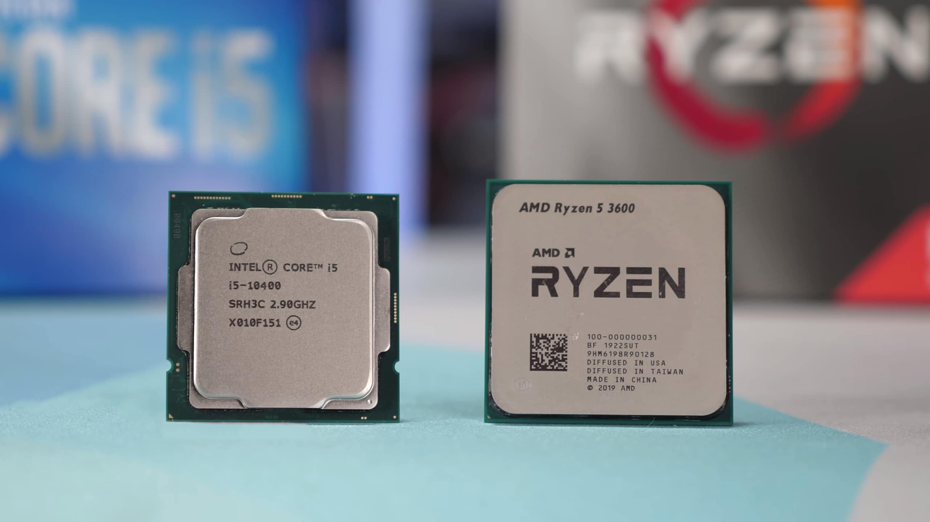
Step 1 - Choose CPU. Mainboard follows the CPU
Step 2
CPU
Mainboard
CPU,Memory
Hdd
Power

Slide 8
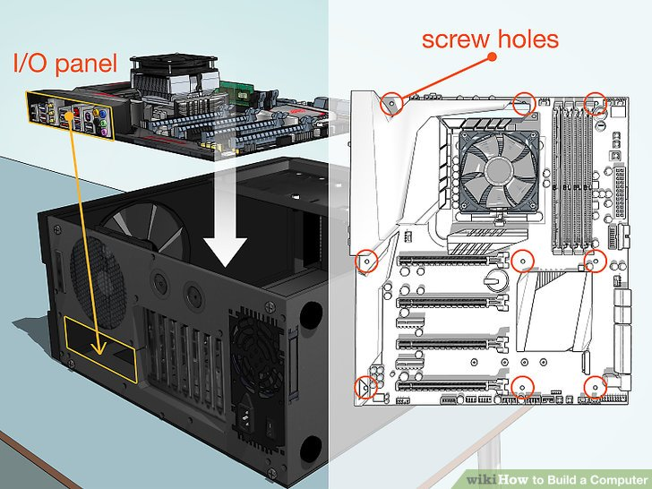
Step 1 - Put main board into the case
Step 2
CPU
Mainboard
CPU,Memory
Hdd
Power

Slide 9
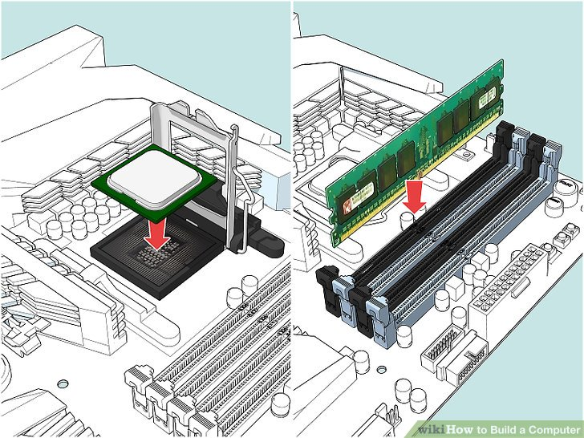
Step 1 - Put CPU, Memory into the board
Step 3
CPU
Mainboard
CPU,Memory
Hdd
Power

Slide 10
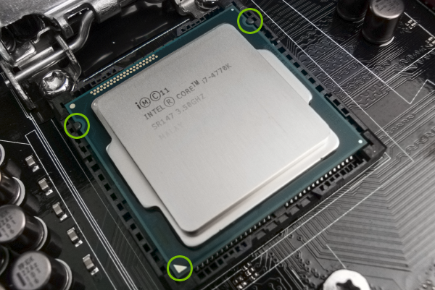
Step 1 - No need to worry
Step 3
CPU
Mainboard
CPU,Memory
Hdd
Power

Slide 11
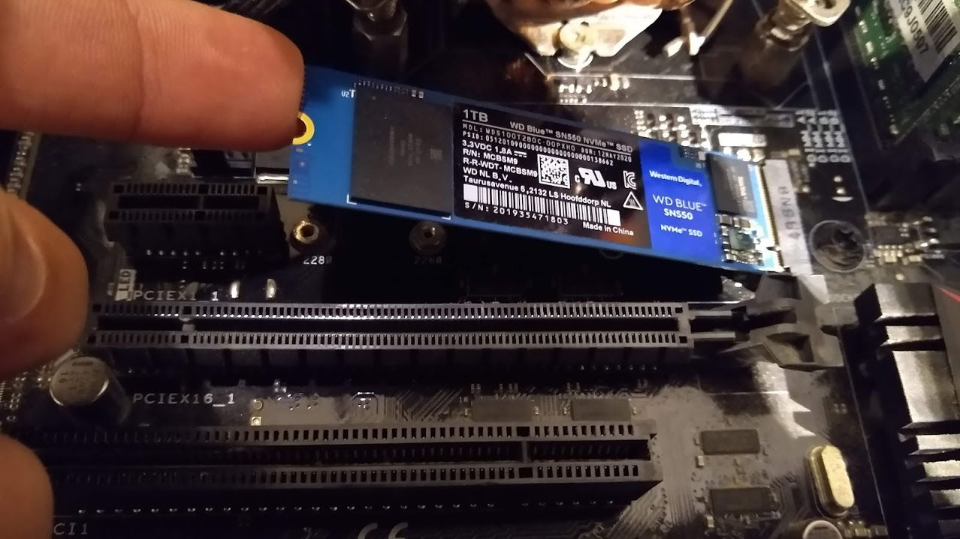
Step 1 - Put HDD into the board
Step 4
CPU
Mainboard
CPU,Memory
Hdd
Power

Slide 12
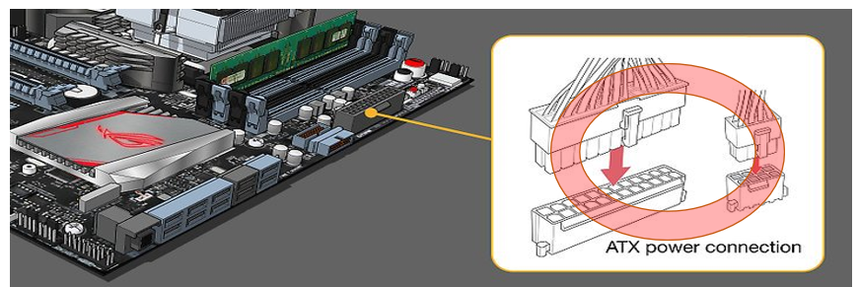
Step 1 - Connect power into the board
Step 5
CPU
Mainboard
CPU,Memory
Hdd
Power

Slide 13
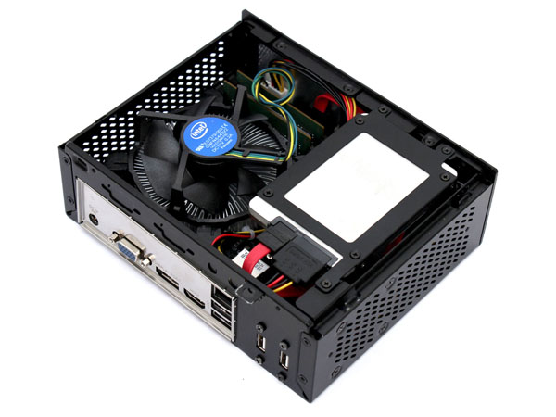
Wrap up – Can save money! It’s Fun!
1. Which CPU
2.Mainboard
3.CPU,Memory
4.Hdd
5.Power Supply

