Slide 1
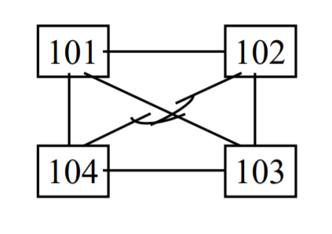
Spanning tree
Byeongchan Gwak, Student ID 501026
ROOT
The lowest bridge ID will be a root bridge.
In spanning tree, there should not be a looping.
Path to the root should have the lowest cost.

