Slide 1
JAXB
TAG v5 – Apr 2014

Slide 2
Table of Contents
Introduction
Why JAXB?
Annotations
Features
© ValueLabs | www.valuelabs.com | Confidential

Slide 3
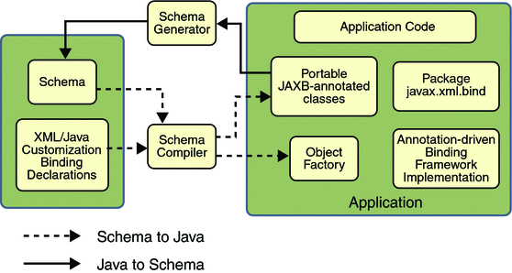
Introduction
What is JAXB?
© ValueLabs | www.valuelabs.com | Confidential

Slide 4
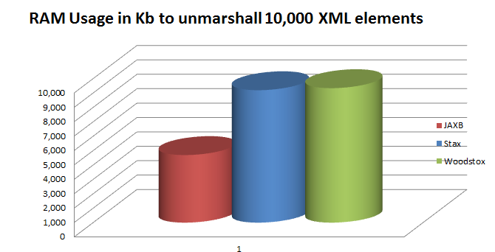
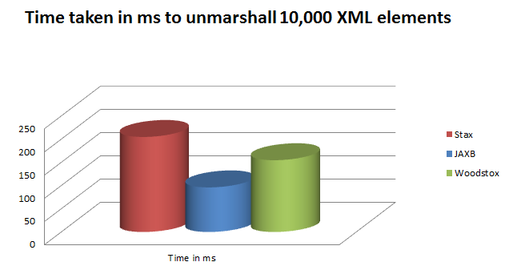
Why JAXB?
Performance
Support
Enhancements
Easy to use API
Well documented
© ValueLabs | www.valuelabs.com | Confidential

Slide 5
Annotations
XmlType
XmlTransient
XmlValue
XmlAttribute
XmlJavaTypeAdapter
XmlList
XmlElementsWrapper
XmlElements
XmlIDREF
XmlJavaTypeAdapter
© ValueLabs | www.valuelabs.com | Confidential

Slide 6
Features
Custom Character Handler
Class Resolver
Cycle Detection
XJC
© ValueLabs | www.valuelabs.com | Confidential

Slide 7

Thank you!
Sai Krishna Kishore B

