Slide 1
Ado
(framework for web-projects on Mojolicious)

Slide 2
Table of Contents
What is it?
What it provides?
Minimal Core
Plugins
Commands
Applications
Demo
Credits
Contributors? Investors? Sponsors?

Slide 3
What is it?
Ado is:
  busy or delaying activity; bustle; fuss - суматоха, бъркотия, суетня. http://www.thefreedictionary.com/ado
  Yet another Perl module on CPAN: https://metacpan.org/pod/Ado
  A set of mojo commands: ~/$ ado adduser
  A (Mojolicious) application:
  require Mojolicious::Commands;
  Mojolicious::Commands->start_app('Ado');
  A CMS!, A CRM!, An ERP!..

Slide 4
What is it?
Ado's purpose is to quickly put together a web application based on Mojolicious with scalability, performance and growth in mind.

Slide 5
What is it?
An Ado system starts as a lightweight but well structured application that can turn into an ERP, a CMS, a CRM or all in one by just adding plugins along the way, as the organization, which is using it grows.

Slide 6
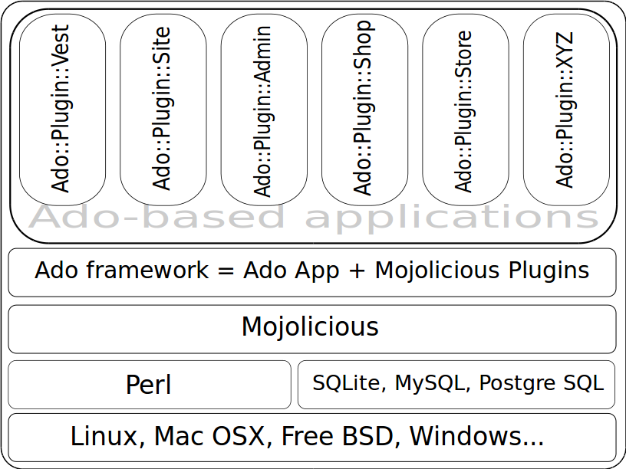
What is it?
Layers / Blocks

Slide 7
What it provides?
Glue code, that you otherwise write every time you start a new Mojolicious project.
Default configuration in etc/ado.conf.
Database in etc/ado.sqlite. MySQL or PostgreSQL can be used.

Slide 8
What it provides?
Default name-space for controllers: Ado::Control::*. You can use your own.
Model: Ado::Model::* based on DBIx::Simple::Class. You can generate your classes on the fly.
Additional Commands: Ado::Command::*.

Slide 9
What it provides?
Examples – Ado is a Mojolicious application, aiming to be a good example.
Semantic-UI CSS/JS framework in public/vendor/Semantic-UI.
Always up to date with latest Mojolicious!

Slide 10
Minimal Core
Ado strives to provide just the code that you otherwise have to write with every next Mojolicious project.
Bundled Semantic-UI for UI.

Slide 11
Minimal Core
Additional assets (CSS, JS, templates) are optional.
Mojolicious::Plugin::AssetPack can be used to manage them.
All plugins are (should be) optional. Use them if you wish!
Enough to start a personal site in minutes.

Slide 12
Plugins
Any Mojolicious::Plugin::* can be used.
Ado::Plugin is the base class for Ado plugins.
It allows you to use plugin-specific and
mode-specific configuration files:
  Ado/etc/plugins/routes.conf
  Ado/etc/plugins/routes.development.conf

Slide 13
Plugins
JSON and Perl configuration file formats are supported.
Any configuration format is supported as long as Mojolicious::Plugin::XYZConfig follows the Mojo API.
Every Ado plugin ISA Mojolicious::Plugin!

Slide 14
Plugins
Ado::Plugin::I18n localizes your application and site.
  automatically detects the current UserAgent language preferences
  Options can be set in etc/ado.conf or in etc/plugins/i18n.conf:
  language_from_route => 1, # eg. /bg/news/list
  language_from_host => 1, # eg. fr.example.com
  language_from_param => 1, # eg. ?language=de
  language_from_cookie => 1, # eg. Cookie: language=bg;
  language_from_headers => 1, # eg. Accept-Language: bg,fr;q=0.8,en-us;q=0.5,en;q=0.3
  Helpers:
  l() - <%= l('hello', user->name) %>
  language() - Allows you to (re)set the current language. No need to use this helper!
  It is called automatically in Mojolicious/around_action hook.
  Storage of translation entries in the database is planned.

Slide 15
Plugins
Ado::Plugin::Routes allows you to define your routes in a separate file $MOJO_HOME/etc/plugins/routes.conf.
In the configuration file you can also use the app keyword and add complex routes as you would do directly in the code.
Options:
  routes => [
  {route => '/ado-users', via => ['GET'],
  to => 'ado-users#list',},
  ...
  ],
  base_url_path =>'/'

Slide 16
Plugins
Ado::Plugin::MarkdownRenderer is a markdown renderer.
Text::MultiMarkdown is the default renderer. Support for other is planned.
Create a controller and use the md_to_html helper.
See Ado::Control::Doc for an example.
Many options. See the docs.

Slide 17
Plugins
Ado::Plugin::MarkdownRenderer Helpers:
  markdown - Accepts markdown text and options. Returns HTML.
  #in a template
  %==markdown($text)
  md_to_html
  <%= md_to_html($file_path) %>
  % #<article>$html</article>
  %# using $c->stash('md_file')
  <%= md_to_html() %>
  % #<article>$html</article>

Slide 18
Plugins
Ado::Plugin::Auth authenticates users to an Ado system.
Users can be authenticated locally or (TODO!) using Facebook, Google, Twitter and other authentication service-providers.
Mojolicious::Plugin::OAuth2 is planned as dependency.

Slide 19
Plugins
Ado::Plugin::AdoHelpers will be a collection of helpers for Ado if we need even more.
Mojolicious::Plugin::DefaultHelpers, Mojolicious::Plugin::TagHelpers

Slide 20
Commands
Ado::Command::version shows version information for installed core and optional modules.
  $ ado version
  ADO:
  0.55 - U+2C04 GLAGOLITIC CAPITAL LETTER DOBRO (Ⰴ)
  Thanks for testing a development release, you are awesome!
  CORE
  Perl (v5.18.2, linux)
  Mojolicious (5.18, Tiger Face)
  OPTIONAL
  EV 4.0+ (4.17)
  IO::Socket::IP 0.20+ (0.29)
  IO::Socket::SSL 1.84+ (1.962)
  This version is up to date, have fun!

Slide 21
Commands
Ado::Command::adduser adds a user to an Ado application. It is a facade for Ado::Model::Users.
$ ado adduser
USAGE:
# Minimal required options to add a user
bin/ado adduser --login_name USERNAME --email user@example.com
--first_name John --last_name Smith
# Add a user to an additional group
bin/ado adduser --login_name USERNAME --ingroup GROUPNAME
# Change password / disable a user
bin/ado adduser --login_name USERNAME --ingroup GROUPNAME --disabled
--login_password !@#$%^&
See perldoc Ado::Command::adduser for full set of options.

Slide 22
Commands
Ado::Command::generate::apache2vhost generates a minimal Apache2 Virtual Host configuration file for your Ado application.
On the command-line:
$ bin/ado generate apache2vhost --ServerName example.com -s \
> etc/001-example.com.vhost.conf
In your code:
use Ado::Command::generate::apache2vhost;
my $vhost = Ado::Command::generate::apache2vhost->new;
$vhost->run('--ServerName' => 'example.com', '-p' => 8080);

Slide 23
Commands
Ado::Command::generate::apache2htaccessgenerates an Apache2 .htaccess configuration file. Use this command on a shared hosting too.
  ado generate apache2htaccess --module cgi,fcgid \
  > .htaccess

Slide 24
Commands
Ado::Command::generate::adoplugin generates an Ado::Plugin.
  $ ado generate adoplugin --name MyBlog
  $ ado generate adoplugin --name MyBlog –crud \
  -t 'articles,news'
Ado::Command::generate::crud generates MVC set of files.
  $ ado generate crud --tables='news,articles'

Slide 25
Commands
dsc_dump_schema.pl is a script to dump a schema from a database. Comes with DBIx::Simple::Class.
#dump all tables
dsc_dump_schema.pl --dsn DBI:mysql:database=mydb;host=127.0.0.1;mysql_enable_utf8=1 \
-u me -p mypassword --overwrite 1 --lib_root ./lib
#or dump only the "users" table - using short options and choosing a namespace
dsc_dump_schema.pl -dsn dbi:SQLite:database=etc/ado.sqlite \
-n Ado::Model -l lib -t users

Slide 26
Applications
Entire custom applications can be created by just using your own plugins.
You can directly inherit Ado. Ado ISA Mojolicious.
Use Mojolicious Plugins
  Preferably written by someone of the Mojolicious core development-team.
  Look in the code and decide if it is well written.
  Make sure it is often updated and works with latest Mojo.

Slide 27
Contributors? Investors? Sponsors?
See Ado::Manual::Contributing.
Hire me to implement your Ideas.
Use Ado and report issues.
Convince your boss Ado worths it.

Slide 28
Credits
Вълчо Неделчев (Valcho Nedelchev)
  Helped by writing code, moral support and feedback.
Станислав Лечев (Stanislav Lechev)
  Helped by providing free hosting for the Ado demo site
  http://ado.0xaf.org/, moral support and feedback.
You?
  Ideas, feature requests, code, design, Mojo mastery...

Slide 29
Demo
Create one or more tables to be used by your plugin.
CREATE TABLE blog (
id INTEGER PRIMARY KEY,
title VARCHAR NOT NULL UNIQUE,
body TEXT NOT NULL,
published BOOL DEFAULT '0',
deleted BOOL NOT NULL DEFAULT '0',
user_id INTEGER REFERENCES users(id),
group_id INTEGER REFERENCES groups(id),
permissions VARCHAR(10) DEFAULT '-rwxr-xr-xr'
);
CREATE INDEX blog_published ON blog(published);
CREATE INDEX blog_deleted ON blog(deleted);

Slide 30
Demo
Add some dummy records.
INSERT INTO blog(title,body,user_id,group_id)
VALUES('Hey','Hello world',3,3);
INSERT INTO blog(title,body,user_id,group_id)
VALUES('Hey You','Hello Universe',3,3);

Slide 31
Demo
Generate your plugin:
$ ado generate adoplugin -n Blog --crud -t blog
[mkdir] /home/berov/opt/public_dev/Ado-Plugin-Blog/lib/Ado/Plugin
[write] /home/berov/opt/public_dev/Ado-Plugin-Blog/lib/Ado/Plugin/Blog.pm
[write] /home/berov/opt/public_dev/Ado-Plugin-Blog/lib/Ado/Control/Blog.pm
[write] /home/berov/opt/public_dev/Ado-Plugin-Blog/site_templates/blog/list.html.ep
[write] /home/berov/opt/public_dev/Ado-Plugin-Blog/site_templates/blog/create.html.ep
…
[write] /home/berov/opt/public_dev/Ado-Plugin-Blog/t/plugin/blog-00.t
[write] /home/berov/opt/public_dev/Ado-Plugin-Blog/Build.PL
[mkdir] /home/berov/opt/public_dev/Ado-Plugin-Blog/etc/plugins
[write] /home/berov/opt/public_dev/Ado-Plugin-Blog/etc/plugins/blog.conf

Slide 32
Demo
Add some dummy records.
INSERT INTO blog(title,body,user_id,group_id)
VALUES('Hey','Hello world',3,3);
INSERT INTO blog(title,body,user_id,group_id)
VALUES('Hey You','Hello Universe',3,3);

Slide 33
Demo
Copy blog.conf to blog.development.conf and edit blog.development.conf
$ ado generate adoplugin -n Blog --crud -t blog
cd /home/berov/opt/public_dev/Ado-Plugin-Blog/etc/plugins/
cp blog.conf blog.development.conf
Edit etc/ado.development.conf to make Ado know about it:
plugins => [
…
'blog',
]

Slide 34
Demo
Run Ado with your new plugin to see if it works.
$ export PERL5LIB=$HOME/opt/public_dev/Ado-Plugin-Blog/lib:$PERL5LIB
$ ado daemon

Slide 35
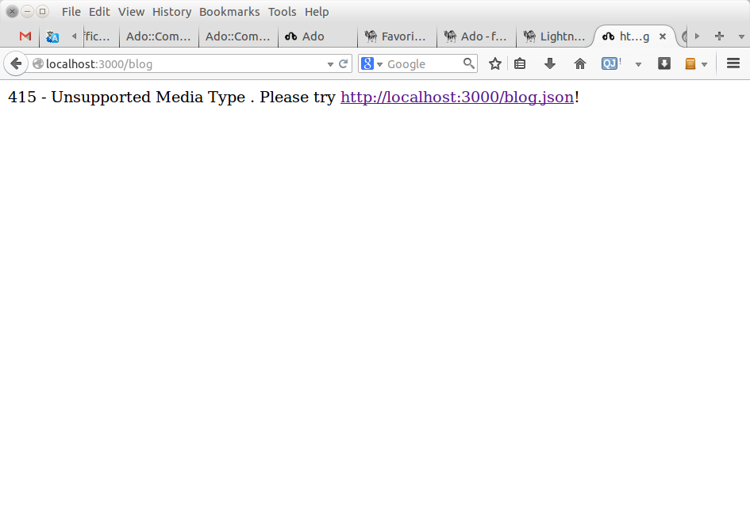
Demo
It works:

Slide 36
Благодаря!
Thanks!
Merci!
Díky!!
Multumesc!
Спасибо!

