Slide 1
Perl Programming Course
Working with databases
Krassimir Berov
I-can.eu

Slide 2
Contents
DBI
DBD
Connect
Select
Insert
Update
Delete
Example Application (CGI::Ex::Recipes)

Slide 3
DBI
DBI - Database independent interface for Perl
  Provides a consistent database interface, independent of the actual database being used
  DBI is a layer of "glue" between an application and one or more database driver modules
  DBI provides a standard interface and framework for the drivers to operate within
  Most of the work is done by the drivers

Slide 4
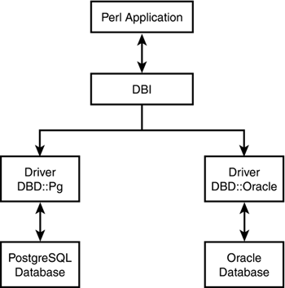
DBI
DBI Architecture

Slide 5
DBD::*
Drivers provide implementations of the DBI methods using the private interface functions of the corresponding database engine
  DBD::mysql – MySQL driver
  DBD::SQLite – Self Contained RDBMS
  DBD::Oracle - Oracle database driver
  DBD::Pg - PostgreSQL database driver
perl -MDBI -e'print join $/,DBI->available_drivers, $/'
#many available on cpan...
cpan[4]> i /^DBD::*/

Slide 6
Connect
Establishes a database connection, or session, to the requested $data_source/$dsn.
Returns a database handle object if the connection succeeds.
Use $dbh->disconnect to terminate the connection.
If the connect fails, it returns undef and sets both $DBI::err and $DBI::errstr.
use DBI; use strict; use warnings;
my $dsn = 'dbi:SQLite:dbname=$file';
#or
my $dsn = 'DBI:mysql:database=bgcc;host=localhost;';
my $dbh = DBI->connect(
$dsn, $username, $password
) or die $DBI::errstr;

Slide 7
Select
Use Database Handle Methods and
Statement Handle Methods
to retrieve data in various forms
use DBI; use strict; use warnings;
#...
my $sql = "SELECT * FROM recipes WHERE id = ?"
my $sth = $dbh->prepare($sql);
$sth->execute($id);
my $hashref = $sth->fetchrow_hashref;
my $arrayref = $sth->fetchrow_arrayref;
my $arrayref = $sth->fetch; # alias
#or just
my $arrayref = $dbh->selectrow_arrayref(
$sql, \%attr, @bind_values);
my $hashref = $dbh->selectrow_hashref(
$sql, \%attr, @bind_values);

Slide 8
Insert
Use prepare() and execute() to insert a row in a table
use DBI; use strict; use warnings;
#...
my $sql = "INSERT INTO recipes
(title, problem, analysis) VALUES (?, ?, ?)";
$dbh->prepare($sql)->execute($title,$problem,$analysis);

Slide 9
Update
Use prepare() and execute() or do() to update a row in a table
The do() method can be used for non repeated non-SELECT statement (or with drivers that don't support placeholders)
use DBI; use strict; use warnings;
#...
my $sql = "UPDATE recipes SET title=?, problem=?, analysis=? WHERE id=?";
$true_or_undef = $dbh->prepare($sql)->execute(
$title, $problem, $analysis, $id);
$rows_affected = $dbh->do($sql_with_hardcoded_values);

Slide 10
Delete
Use prepare() and execute() or do() to delete a row from a table
use DBI; use strict; use warnings;
#...
my $sql = "DELETE FROM recipes WHERE id = ?";
$dbh->prepare($sql)->execute($id);
#or just
$dbh->do($sql,undef,$id);

Slide 11
Example Application
#1.download and install Apache
#2.install CGI::Ex::Recipes within htdocs/
#with config option 'AllowOverride All'
cpan[1]> install CGI::Ex::Recipes

Slide 12
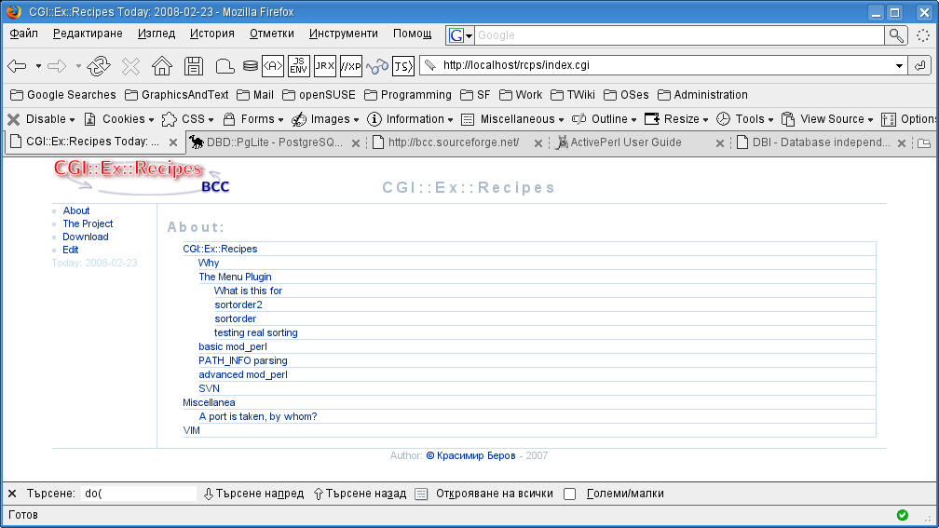
Example Application

Slide 13
DBI
Ressources
  Beginning Perl
  (Chapter 13 – Perl and databases
  (Introducing Relational Databases))
  perldoc DBI
  perldoc DBD::SQLite
  perldoc DBD::mysql
  etc...

Slide 14
Working with databases
Questions?

