Slide 1
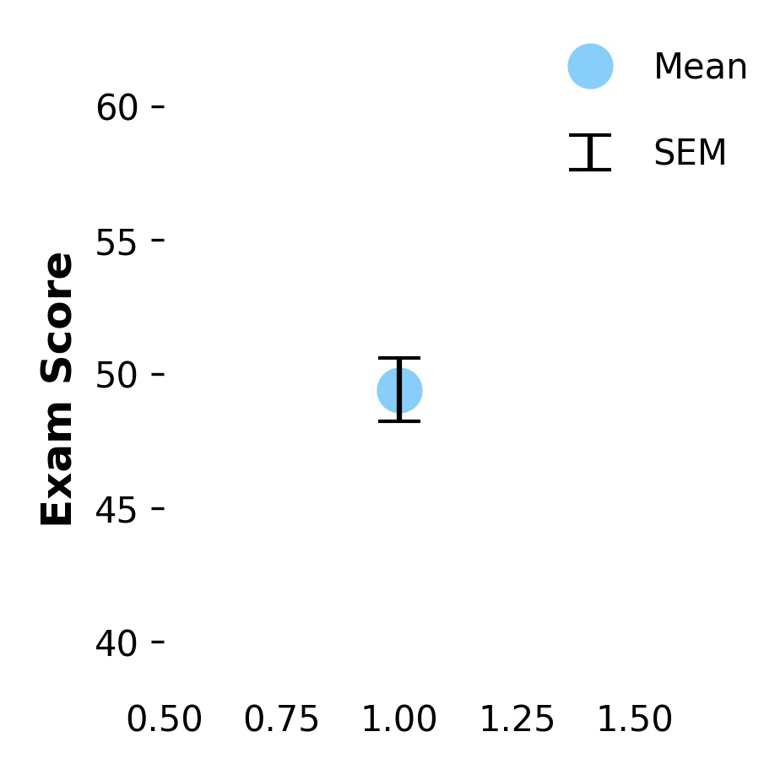
Data
Stats
Graph
Exam Scores:
57.4
54.3
53.7
49.7
39.1
…
48.8
59.1
Mean: 49.4
Standard Deviation (SD): 10.6
Standard Error of the Mean (SEM): 1.18
The dot indicates the mean
The error bars span +/- 1 SEM

Slide 2
Data
Stats
Graph
Error bars indicate +/- 1 SEM
Exam Scores:
57.4
54.3
53.7
49.7
39.1
…
48.8
59.1
Dot indicates mean of group
Mean: 49.4
Standard Deviation (SD): 10.6
Standard Error of the Mean (SEM): 1.18

