Slide 1
Detecting phishing urlS
Kendra Frederick
CenturyLink Data Scientist Take-Home

Slide 2
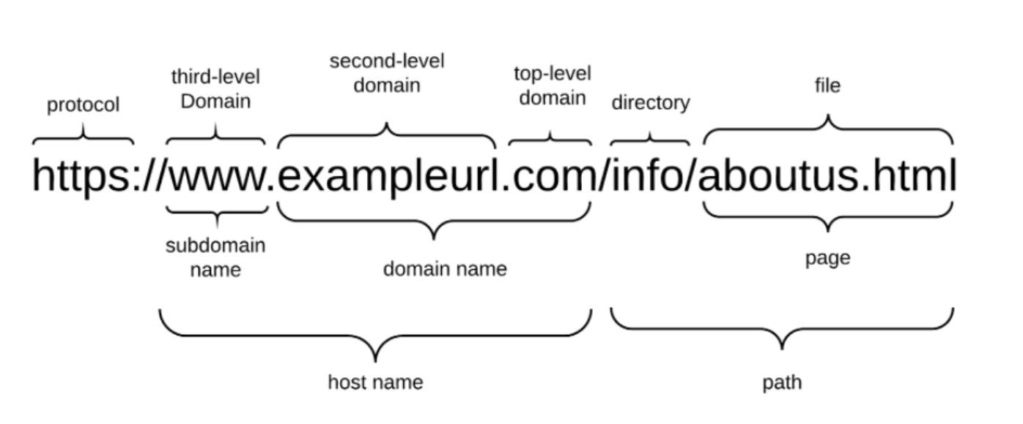
background
Phishing URLs

Slide 3
Data collection strategy
Phishing URLs:
Supplied site (https://openphish.com/feed.txt )
Additional source (https://www.phishtank.com/)
Total: 11,339 URLs
“Benign” URLs:
Chose one cc_index file at random from Nov 2019 index (>300 total in month)
This was still not randomized enough! (more later)

Slide 4
features
Given time constraints, decided to restrict features to those contained within URL string
Length of URL
Number of “special” characters (/ . ), digits
Unicode characters (HEX encoding)
HTTP or HTTPS
Top-level-domain*
Subdomain = www or is null
“Supicious” words in URL (php, abuse, verification)
Notes:
Refs:

Slide 5
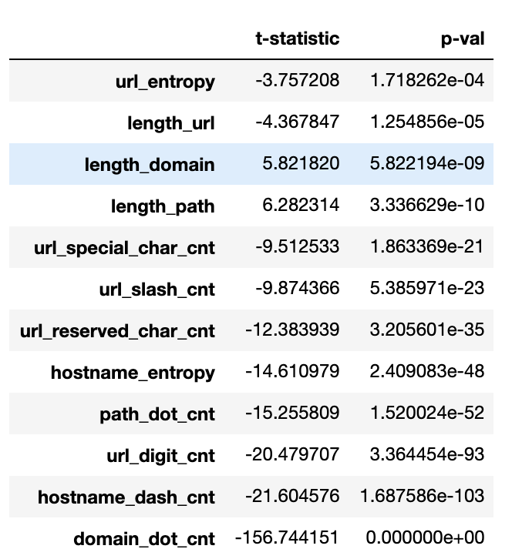
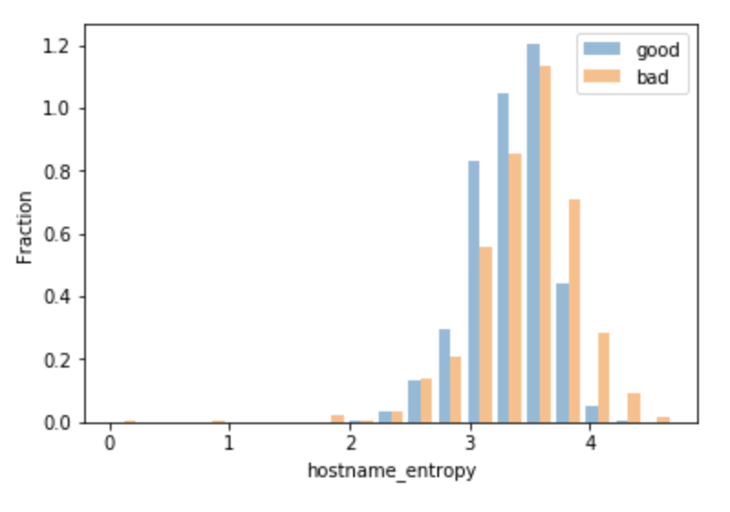
Feature selection
All continuous numerical features showed a statistically significant difference in mean between Benign & Phishing URLs

Slide 6
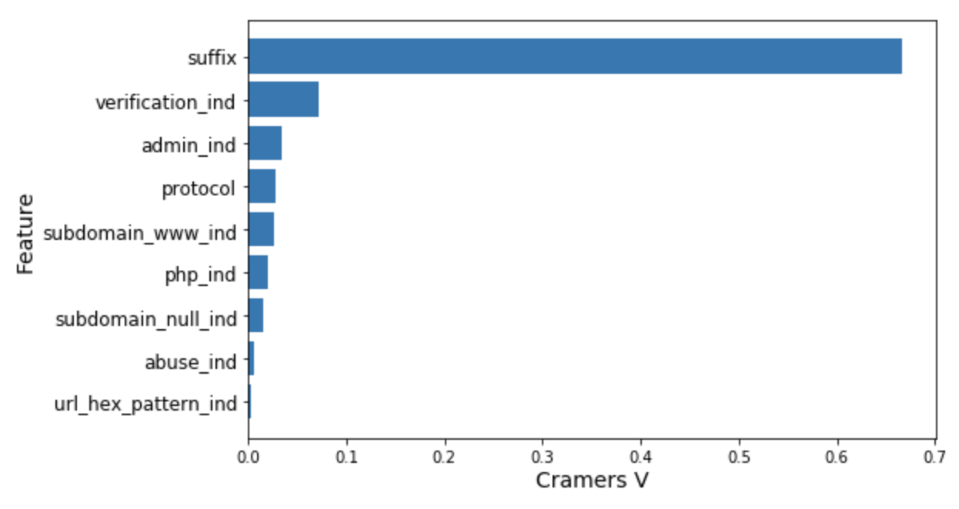
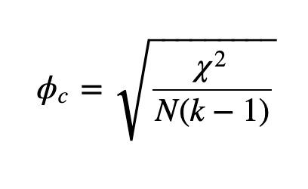
FEATURE SELECTION
Chi2 statistic can be used to evaluate significance of categorical features.
However, with large data sets, it’s “easy” to obtain a significant result
Cramer’s V measures the strength of the association. [0, 1]
Notes:
ϕc denotes Cramér’s V;*
χ2 is the Pearson chi-square statistic from the aforementioned test;
N is the sample size involved in the test and
k is the lesser number of categories of either variable.

Slide 7
suffix: not randomly sampled!
Suffix | Benign | Phishing
.com | 100% | 55%
Not .com | 0% | 45%
CommonCrawl Index files appear to be alphabetically ordered by top-level domain (suffix), then domain name.
I chose 144 (out of 302), which is .com & domain names starting with ‘c’.

Slide 8
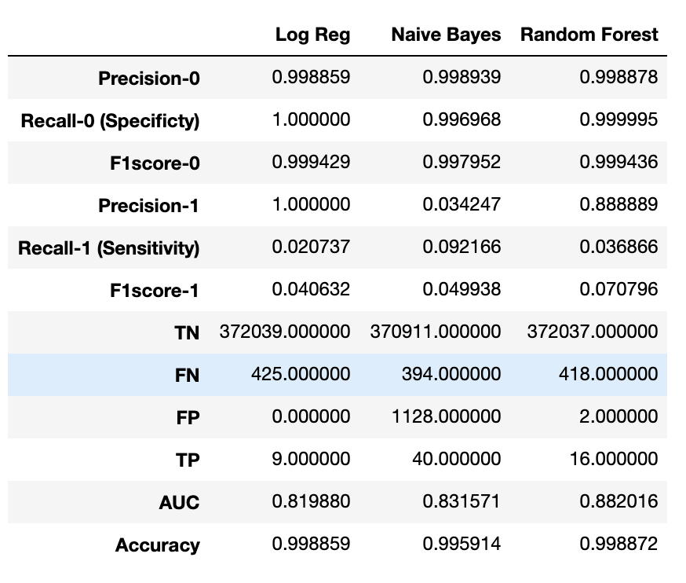
modeling

Slide 9
FEATURES – potential additional
Additional URL-based features
Levenstein distance from English (other language?) word
Expand shortened URLs
Own ‘suspicious’ list
Web page
Title (NLP)
Size / length
# of redirects to load
DOM properties
Page Rank / keyword analysis
Domain
Length of time registered
Registrant name hidden
Graph/linkage analysis
Linkage to / from
# search results for domain
RESOURCES:
ICANN (https://lookup.icann.org/lookup)
WHOIS (https://www.whois.net/)
Notes:
Page Rank: / # search results for domain / Alexa Rank

Slide 10
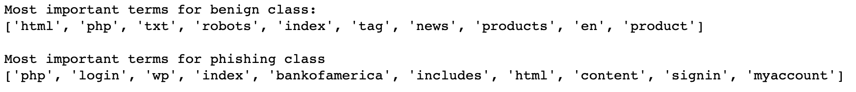
“suspicious” words

Slide 11
REFERENCES
Jeeva, S.C., Rajsingh, E.B. Intelligent phishing url detection using association rule mining. Hum. Cent. Comput. Inf. Sci. 6, 10 (2016) doi:10.1186/s13673-016-0064-3
Web Phishing Detection Using a Deep Learning Framework. Wireless Communications and Mobile Computing. (2018). Article ID 4678746.
Patil, Dharmaraj & Patil, Jayantrao. (2018). Malicious URLs Detection Using Decision Tree Classifiers and Majority Voting Technique. Cybernetics and Information Technologies. 18. 11-29. 10.2478/cait-2018-0002.

