Slide 1
Detecting phishing urlS
Kendra Frederick
CenturyLink Data Scientist Take-Home

Slide 2
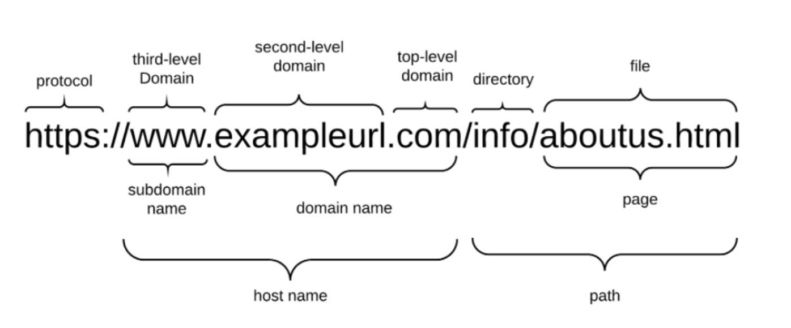
background
Phishing: a fraudulent attempt to elicit sensitive information
Malicious URLs often have different patterns & characteristics than benign ones
Phishing URLs

Slide 3
Data collection strategy
Phishing URLs:
Supplied site (https://openphish.com/feed.txt )
Additional source (https://www.phishtank.com/)
Total: 11,339 URLs
“Benign” URLs:
Chose one cc_index file at random from the Nov 2019 CommonCrawl index
>300 total in month
Each file contains 7-10 million URLs
This was still not randomized enough! (more later)
Rate of Phishing URLs:
Literature: ~0.4%
My dataset: ~0.1%

Slide 4
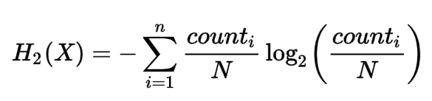
features
Given time constraints, decided to restrict features to those contained within URL string
Length of URL
Number of “special” characters ($ - _ . + ! * ’( ) , )
Number of digits, dots, slashes
HEX encoding (%XX) present
HTTP or HTTPS
“Suspicious” words in URL (php, abuse, admin, verification)
Top-level-domain
Subdomain = www or is null
Entropy of hostname, url
Notes:
Refs:

Slide 5
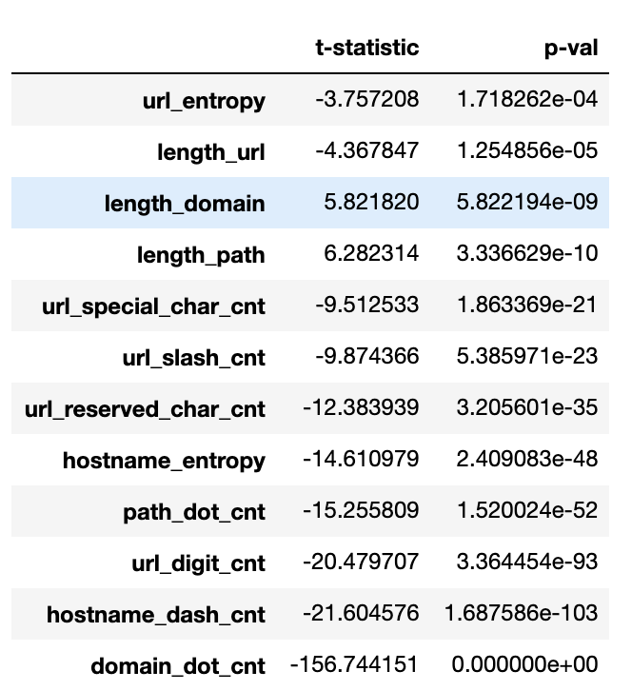
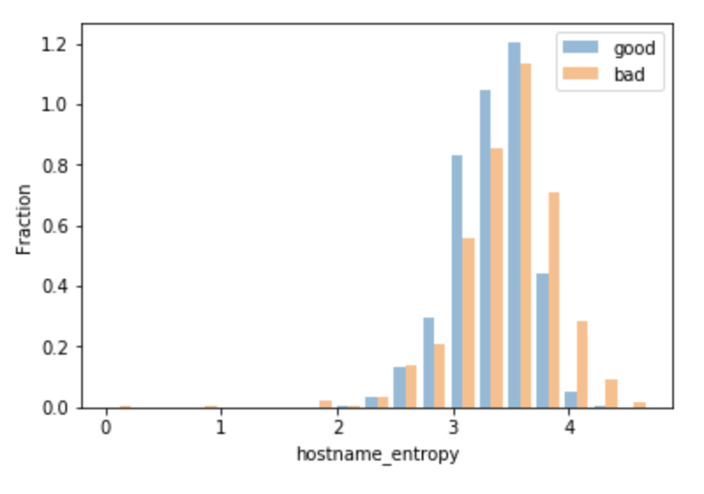
Feature selection
All continuous numerical features showed a statistically significant difference in mean between Benign & Phishing URLs

Slide 6
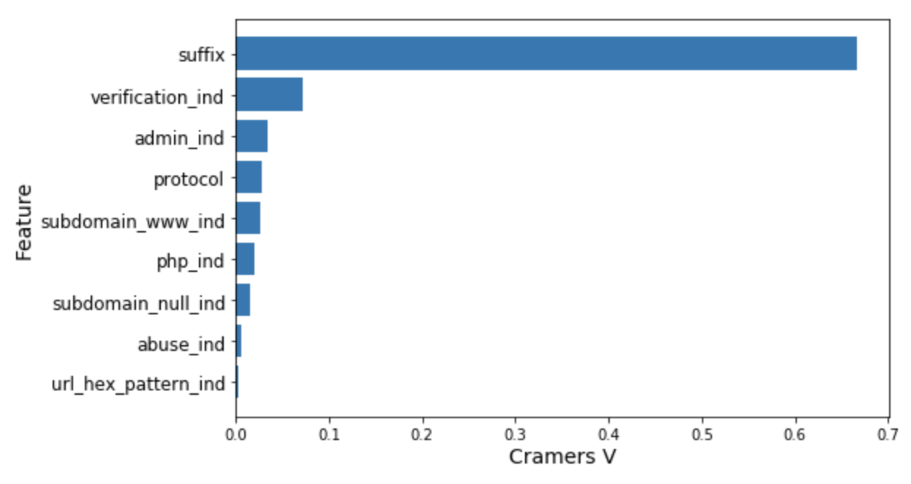
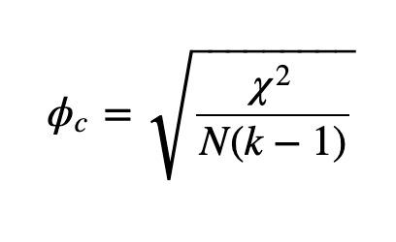
FEATURE SELECTION
Chi2 statistic can be used to evaluate significance of categorical features.
However, with large data sets, it’s “easy” to obtain a significant result
Cramer’s V measures the strength of the association. [0, 1]
Notes:
ϕc denotes Cramér’s V;*
χ2 is the Pearson chi-square statistic from the aforementioned test;
N is the sample size involved in the test and
k is the lesser number of categories of either variable.

Slide 7
suffix: not randomly sampled!
Suffix | Benign | Phishing
.com | 100% | 55%
not .com | 0% | 45%
CommonCrawl Index files appear to be alphabetically ordered by top-level domain (suffix), then domain name.
I chose file # 144 (out of 302), which is .com TLDs & domain names starting with ‘c’.

Slide 8
modeling
Metrix | Logistic Regression (1, 2) | Naïve Bayes (1) | Random Forest (3, 4)
F1-score | 0.0379 | 0.0437 | 0.2844
Precision | 0.8878 | 0.0288 | 0.9167
Recall | 0.0193 | 0.0908 | 0.1684
FPR | 3.36e-6 | 3.40e-3 | 1.61e-5
Average of test results on 5-fold cross-validation on subset (20%) of training data
Did not converge
Result of one test set taken from same subset of training data
n_estimators = 100, no limit on max depth, criterion = gini

Slide 9
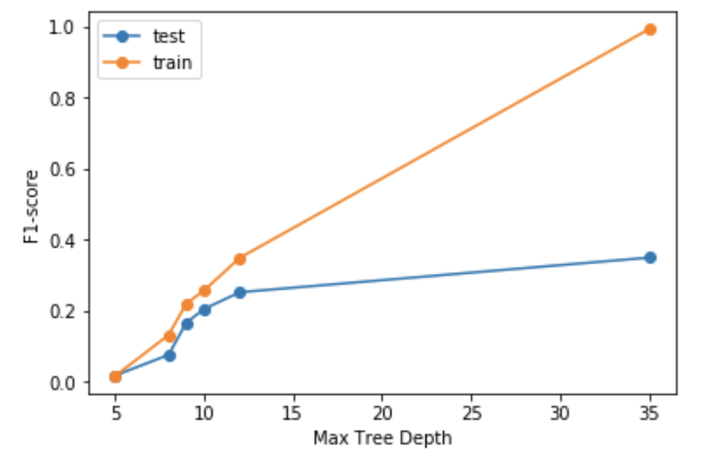
Model tuning
Tuning max tree depth of Random Forest
Overfitting!
Optimal Depth
Final model: max depth = 10, n_estimators = 100, criteria = entropy

Slide 10
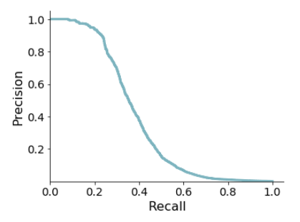
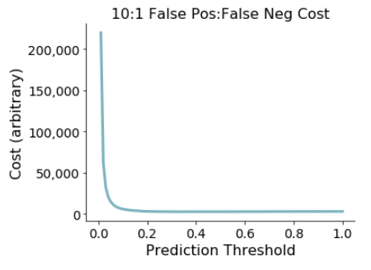
Final Model evaluation
Precision-Recall Curve
Cost Function (example)
Optimal threshold = 0.20

Slide 11
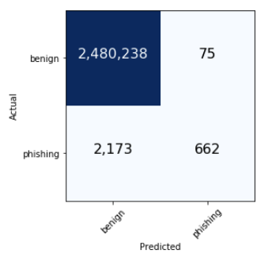
FINAL MODEL evaluation
False Positive
Metric | Value
F1 – train | 0.3598
F1 – test | 0.3707
Precision | 0.8982
Recall | 0.2335
False Pos Rate | 3.023-5
False Negative
True Pos
Threshold = 0.20

Slide 12
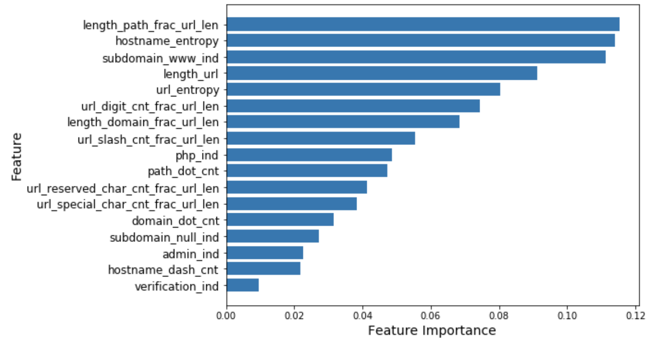
FEATURE IMPORTANCE
Notes:
As none are categorical, we can trust these FI’s.

Slide 13
Future work
Better randomization of Benign URLs
Stack with Multinomial Naïve Bayes model fit on NLP features (Count of path “tokens”)
Additional Features

Slide 14
POTENTIAL ADDITIONAL FEATURES
Additional URL-based features
Levenshtein distance from English (other language?) word
Expand shortened URLs
Own ‘suspicious’ list
Web page
Title (NLP)
Size / length
# of redirects to load
DOM properties
Page Rank / keyword analysis
Domain
Length of time registered
Registrant name hidden
Graph/linkage analysis
Linkage to / from
# search results for domain
RESOURCES:
ICANN (https://lookup.icann.org/lookup)
WHOIS (https://www.whois.net/)
Notes:
Page Rank: / # search results for domain / Alexa Rank

Slide 15
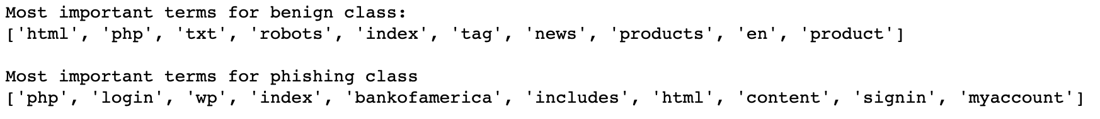
Custom “suspicious” words
From TF-IDF vectorization of URL

Slide 16
REFERENCES
Jeeva, S.C., Rajsingh, E.B. Intelligent phishing url detection using association rule mining. Hum. Cent. Comput. Inf. Sci. 6, 10 (2016) doi:10.1186/s13673-016-0064-3
Web Phishing Detection Using a Deep Learning Framework. Wireless Communications and Mobile Computing. (2018). Article ID 4678746.
Patil, Dharmaraj & Patil, Jayantrao. (2018). Malicious URLs Detection Using Decision Tree Classifiers and Majority Voting Technique. Cybernetics and Information Technologies. 18. 11-29. 10.2478/cait-2018-0002.

Slide 17
Thank you

Slide 18
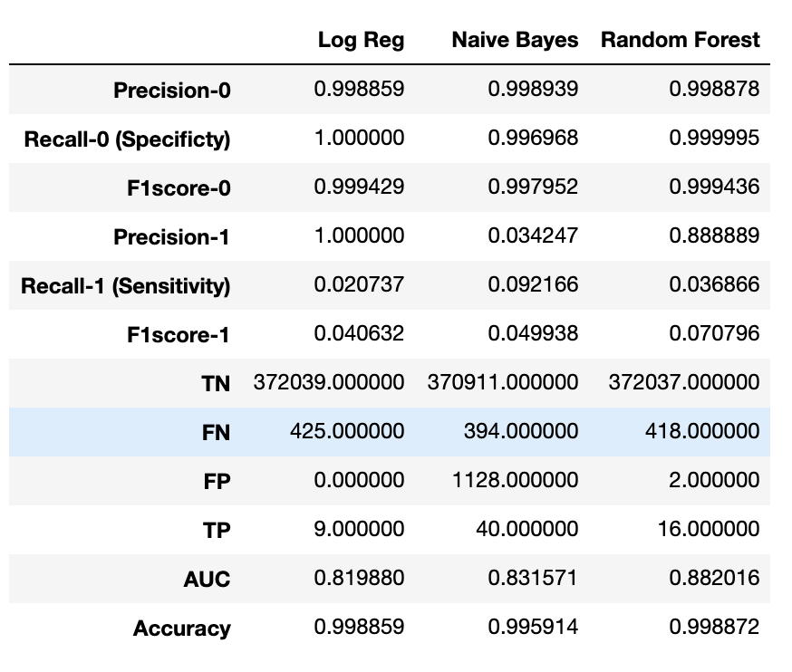
Full evaluation metrics of models

Slide 19
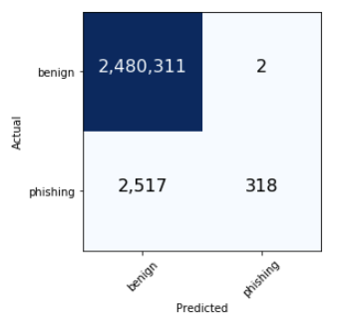
FINAL MODEL evaluation
At threshold of 0.50
Random Forest
n_estimators: 100
max_depth: 10
criterion: entropy
False Positive
Metric | Value
F1 – train | 0.2196
F1 – test | 0.2016
Precision | 0.9938
Recall | 0.1121
False Pos Rate | 8.06e-7
False Negative
True Pos

