Slide 1

Visual localization with RLOCS and Sequential Localizer
ICCV 2021 Workshop on
Map-Based Localization for Autonomous Driving
Yuchen Yang, Jiafei Xu, Xudong Zhang, Shuang Gao, Kun Jiang, Jijunnan Li, Yandong Guo
OPPO Research Institute
All authors are with OPPO Research Institute, Shanghai, China

Slide 2
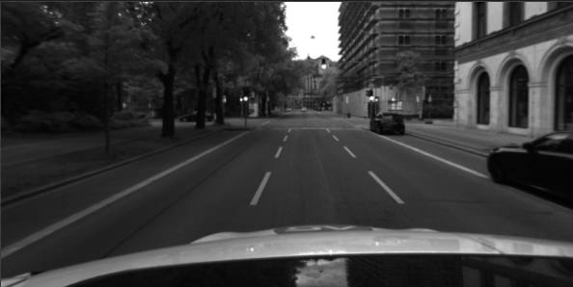

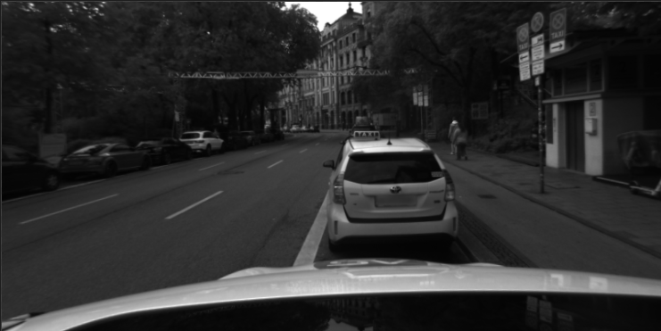
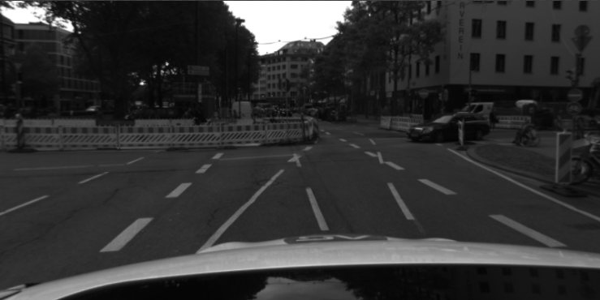
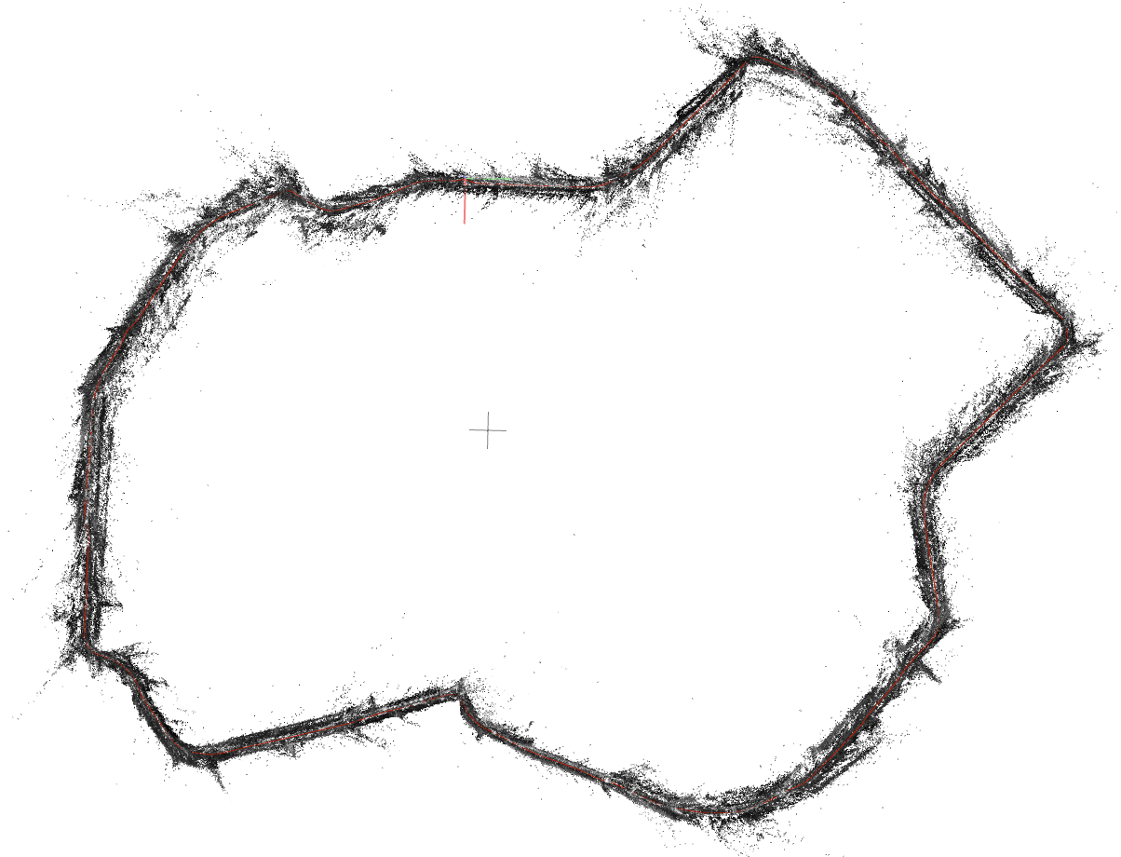
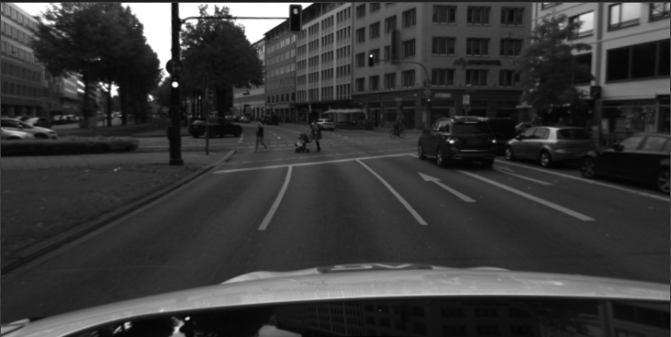
Overall pipeline
RLOCS^{[1]}
Sequential
localizer
SLAM
Localization
Global feature extraction
Image retrieval
Image retrieval filter
Relative camera pose
Query image
Local feature extraction
Feature matching &
Semantic label check
PNP RANSAC
Camera pose
Semantic
Mapping
Global feature extraction
Database extension
Local feature extraction
Re-localize failed cases
Loose coupling
Database images
Semantic segmentation
SfM
reconstruction
Final pose
[1] Zhou Y, Fan H, Gao S, et al. Retrieval and Localization with Observation Constraints[J]. arXiv preprint arXiv:2108.08516, 2021.

Slide 3

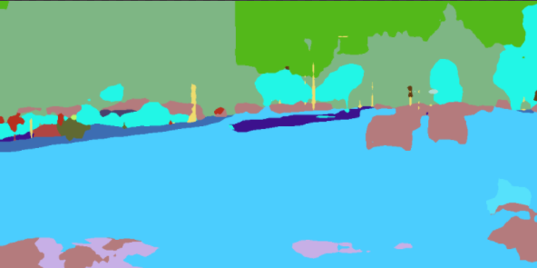

RLOCS-Mapping
Input②
Camera Intrinsic &
Image Extrinsic
Semantic point cloud
NN
matching
Input①
Colmap SfM
reconstruction
Superpoint^{[2]}
Geometric Constraint
Feature matching
Database images
NetVLAD^{[3]}
Image pairs
BiSeNet-v2^{[4]}
(pre-trained on cityscape)
[2] DeTone D, Malisiewicz T, Rabinovich A. Superpoint: Self-supervised interest point detection and description[C]//Proceedings of the IEEE conference on computer vision and pattern recognition workshops. 2018: 224-236.
[3] Arandjelovic R, Gronat P, Torii A, et al. NetVLAD: CNN architecture for weakly supervised place recognition[C]//Proceedings of the IEEE conference on computer vision and pattern recognition. 2016: 5297-5307.
[4] Yu C, Wang J, Peng C, et al. Bisenet: Bilateral segmentation network for real-time semantic segmentation[C]//Proceedings of the European conference on computer vision (ECCV). 2018: 325-341.

Slide 4

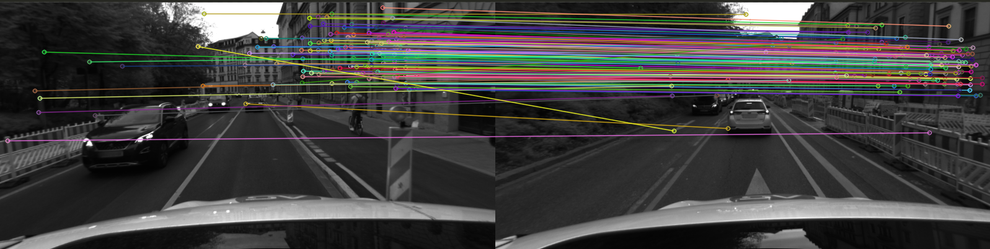
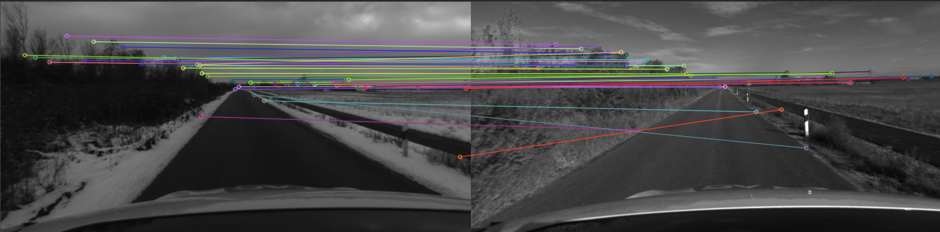
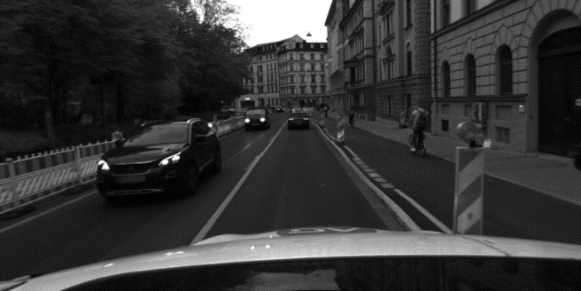
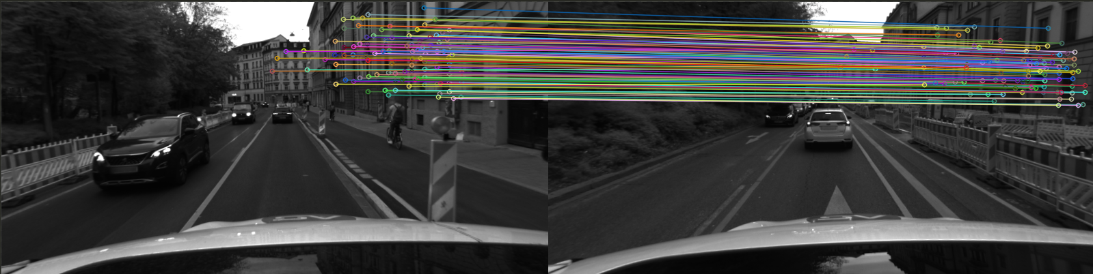
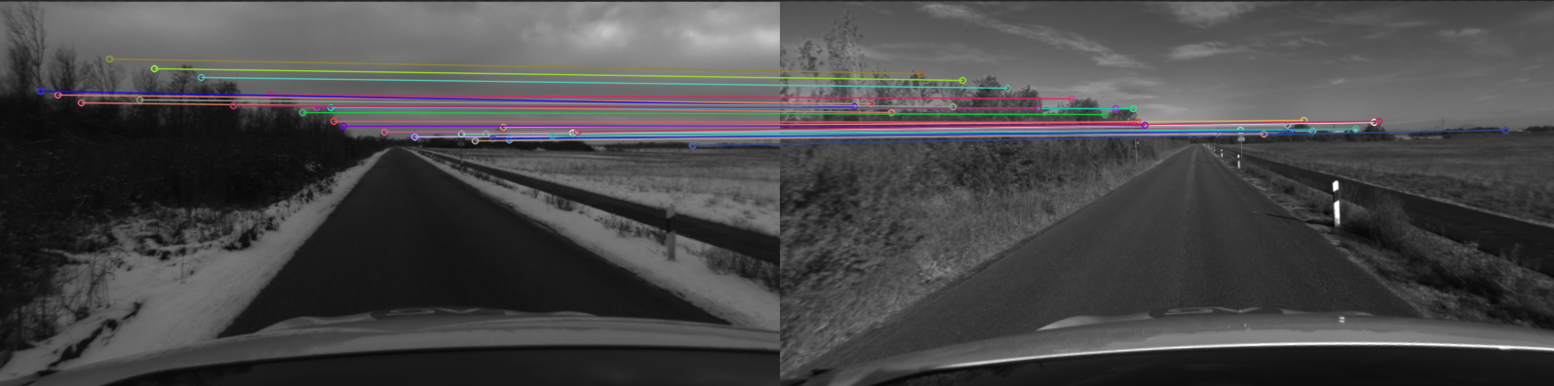
RLOCS-Localization
HOW^{[5]} image retrieval
K Similar database images
PNP RANSAC
K PNP candidates
Superpoint
NN Feature matching
Semantic label check
DBSCAN &
Merge matches
Camera pose
PNP RANSAC
BiSeNet-v2
Before
Before
Query image
After
After
[5] Tolias G, Jenicek T, Chum O. Learning and aggregating deep local descriptors for instance-level recognition[C]//European Conference on Computer Vision. Springer, Cham, 2020: 460-477.

Slide 5
Sequential localizer
Image retrieval filter
SLAM relative pose
Last localization result
Database camera
Image retrieval
SLAM relative pose
Predict Pose
Filtering
Filtered retrieval results
Last localization result
Use SLAM to filter out wrong retrieval results

Slide 6
Sequential localizer
Database extension
One frame localization
Camera pose
distance < TH
Mapping
2D-3D Matches
Compare distance
distance > TH
Re-localize
Monte Carlo sampling^{[6]}
50% matches
PNP RANSAC
Sub-pose
Camera pose
Use well localized cameras to help localizing other cameras
[6] I. M. Sobol, A primer for the Monte Carlo method. CRC press, 1994.

Slide 7
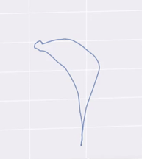
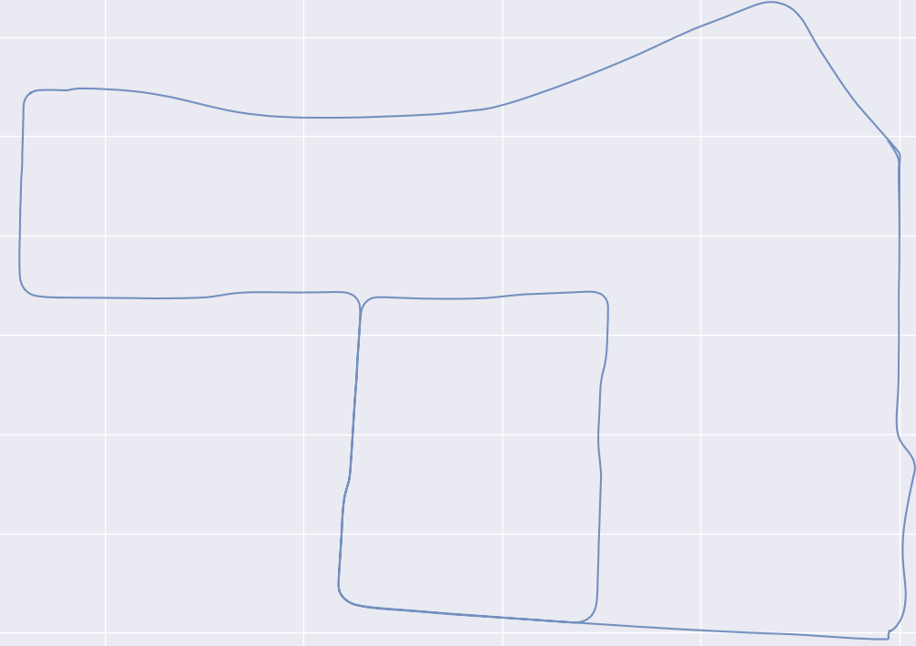
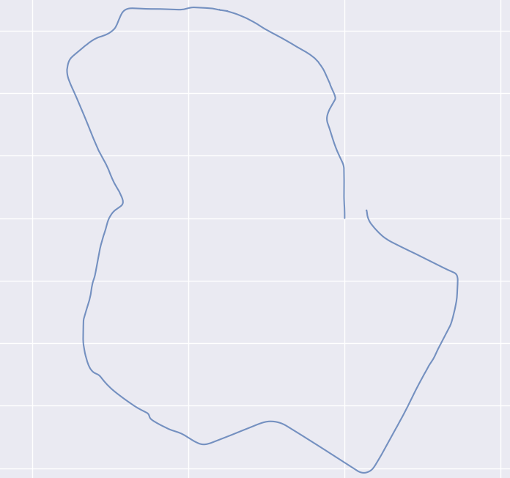
Sequential localizer
Results of ORB-SLAM2^{[7]}
SLAM & Loose coupling
Countryside
Neighborhood
Visual localization results
Failed cases
Closest successful frame
SLAM tracking
SLAM result
Oldtown
Final pose
Combine SLAM and visual localization
[7] Raúl Mur-Artal and Juan D. Tardós. ORB-SLAM2: an Open-Source SLAM System for Monocular, Stereo and RGB-D Cameras. IEEE Transactions on Robotics, vol. 33, no. 5, pp. 1255-1262, 2017.

Slide 8
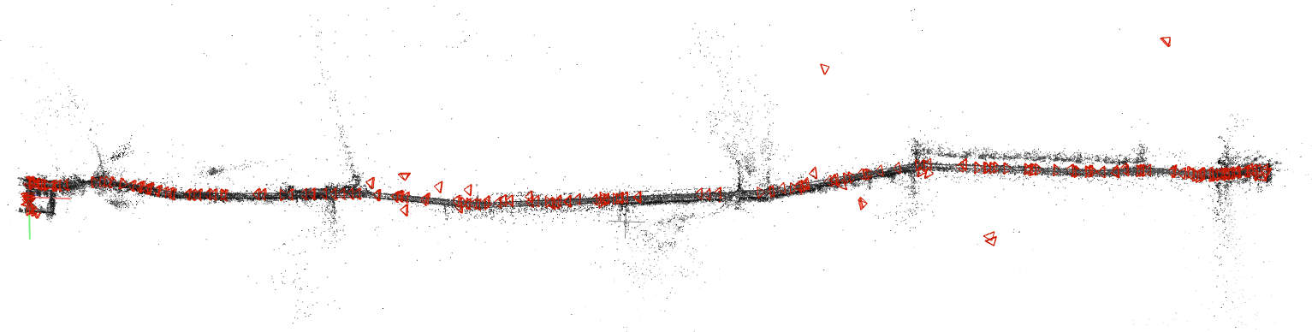
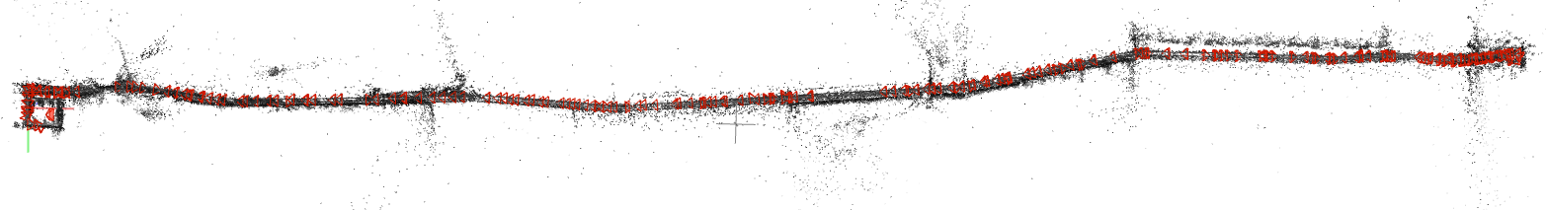
Results
Countryside – RLOCS
After adding sequential localizer

Slide 9
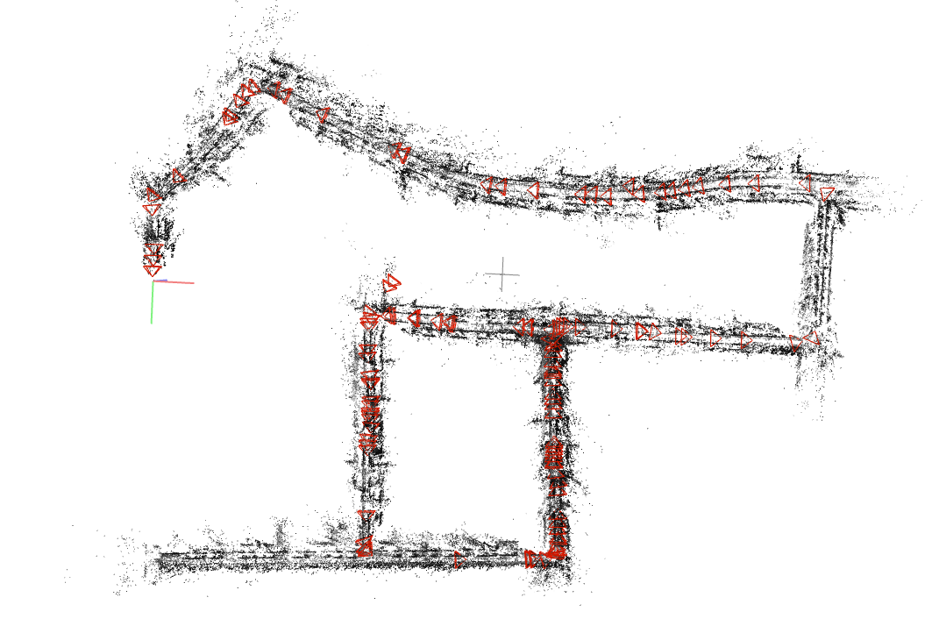
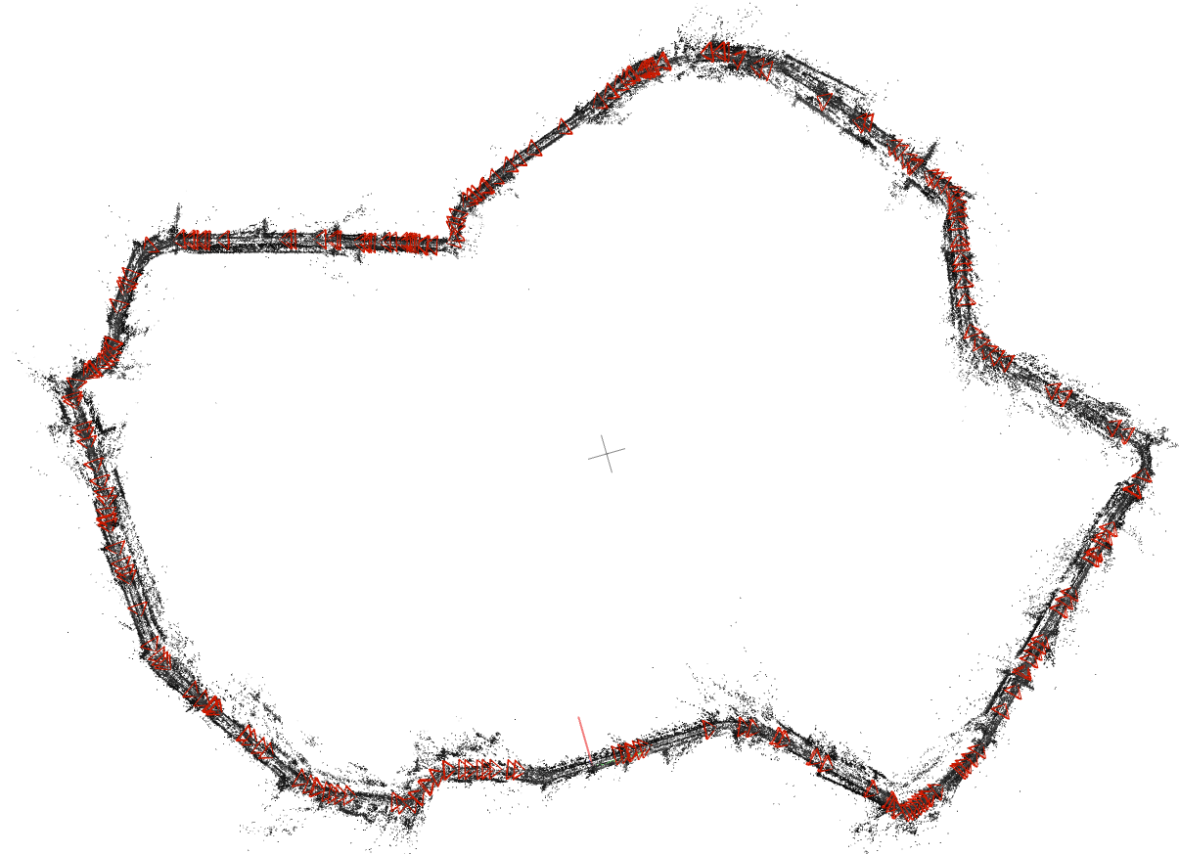
Results
Neighborhood
Oldtown

Slide 10
Summary and outlook
Advantages:
Use simple localization pipeline and SLAM
Use SLAM to improve image retrieval and sequential localization
Limitations:
Low efficiency of the localization algorithm
Localization cannot run online
Future work:
Solve limitations
Tightly couple SLAM and visual localization
Integrate more sensors

Slide 11
Thank you
yangyuchen@oppo.com

