Slide 1
WEEK 4 · TASK
Predictive Analytics
System
Analyze. Predict. Decide.
Build a system that analyzes data, builds predictive models, and generates actionable business insights.
Prepared by: Abhijay | B.Tech 2nd Semester, CEC Jhanjeri, Mohali
Internship: Data Analytics Internship, ReadyNest
READY NEST
Empowering Skills, Building Futures.

Slide 2
PROJECT BRIEF
Project Overview
Objective
SYSTEM AT A GLANCE
Design and build an end-to-end predictive analytics system for ReadyNest's e-commerce customer base — one that doesn't just report what happened, but forecasts what will happen next (churn risk, future revenue) so the business can act before value is lost.
4,000
customers analyzed (post-cleaning)
34
engineered features per customer
Two Prediction Targets
6
ML models trained & compared
10
business-facing visualizations
Classification
Will this customer churn in the near term? (Yes/No)
82%
revenue model accuracy (R²)
9
actionable business insights
Regression
How much revenue will this customer generate next month? (₹)
ReadyNest Data Analytics Internship | Week 4 — Predictive Analytics System
2

Slide 3
TOOLS & TECHNOLOGIES
Tech Stack
Python
Pandas, NumPy for data collection, cleaning & feature engineering
Visualization
Matplotlib & Seaborn for statistical charts and dashboards
Machine Learning
Scikit-learn (Logistic/Linear Regression, Random Forest) + XGBoost
Deployment
Flask REST API + Plotly.js interactive dashboard + Excel/openpyxl reporting
ReadyNest Data Analytics Internship | Week 4 — Predictive Analytics System
3

Slide 4
FEATURE 1 OF 6
Data Collection
A synthetic-but-realistic 4,000-customer e-commerce dataset was generated, extending the customer base style used in the Week 1/2 ReadyNest projects, with behavioural signals rich enough to genuinely predict churn and revenue (not just describe the past).
Demographics
Transactional
Behavioural
Service
age, gender, city, signup date, tenure
total orders, avg order value, total spend, payment method
app sessions, cart abandon rate, email open rate, wishlist size
support tickets, avg rating given, referrals made
24 raw columns → 34 columns after feature engineering (Slide 7)
No Fake-Data Shortcuts: messiness was deliberately injected (nulls, duplicates, outliers, inconsistent text casing) so the cleaning step (next slide) reflects genuine real-world data quality work — not a pre-cleaned toy dataset.
ReadyNest Data Analytics Internship | Week 4 — Predictive Analytics System
4

Slide 5
FEATURE 2 OF 6
Data Cleaning
1
Duplicates removed — 60 duplicate customer_id records dropped (double form submissions / re-pulled API data)
2
Nulls imputed — 403 missing values across age, avg_order_value, avg_rating_given, email_open_rate, preferred_payment — filled using median (numeric) / mode (categorical)
3
Text standardized — Inconsistent casing ("CHANDIGARH") and stray whitespace (" Male ") normalized across all categorical fields
4
Outliers capped — 224 outliers in total_spend, avg_order_value & next_month_revenue capped via IQR method (k=3.0); impossible ages (>90) corrected
5
Logical checks — Rows where last_purchase_days_ago exceeded tenure_days were corrected for consistency
ReadyNest Data Analytics Internship | Week 4 — Predictive Analytics System
5

Slide 6
PIPELINE DEEP-DIVE
Feature Engineering
Ten new engineered features were derived to give the models genuine predictive signal beyond raw transaction counts:
RFM Score
Engagement Score (0-100)
Recency + Frequency + Monetary quintile scores (classic segmentation)
Composite of app sessions, orders, cart abandonment, email opens, recency, ratings
Loyalty Tier
Churn Risk Band
Bronze / Silver / Gold / Platinum, derived from RFM score
Low / Medium / High risk, derived from engagement + recency
Revenue per Active Day
Support Tickets per Order
Spend velocity — normalizes total spend by customer tenure
Service burden ratio — flags high-friction customers
ReadyNest Data Analytics Internship | Week 4 — Predictive Analytics System
6

Slide 7
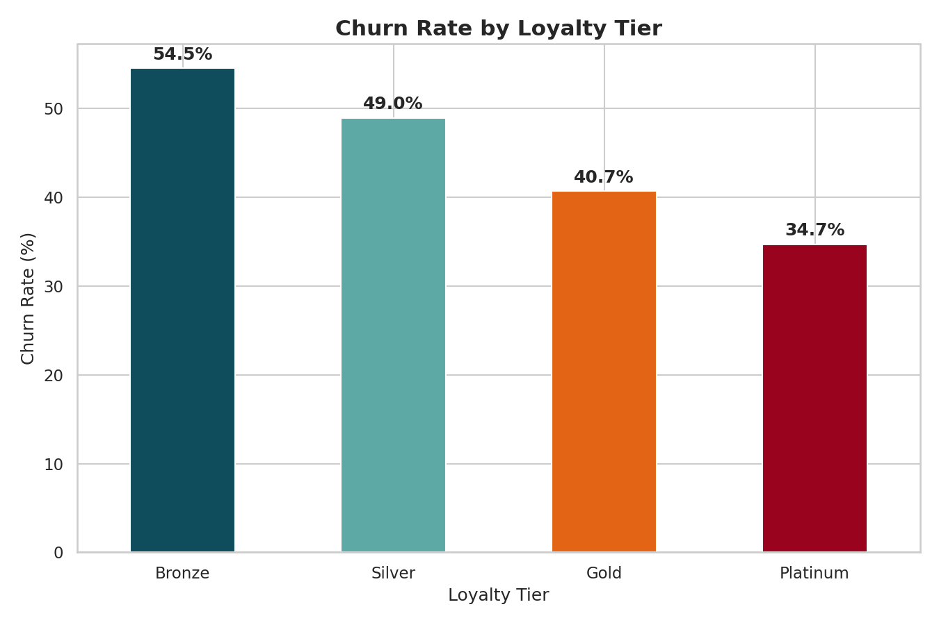
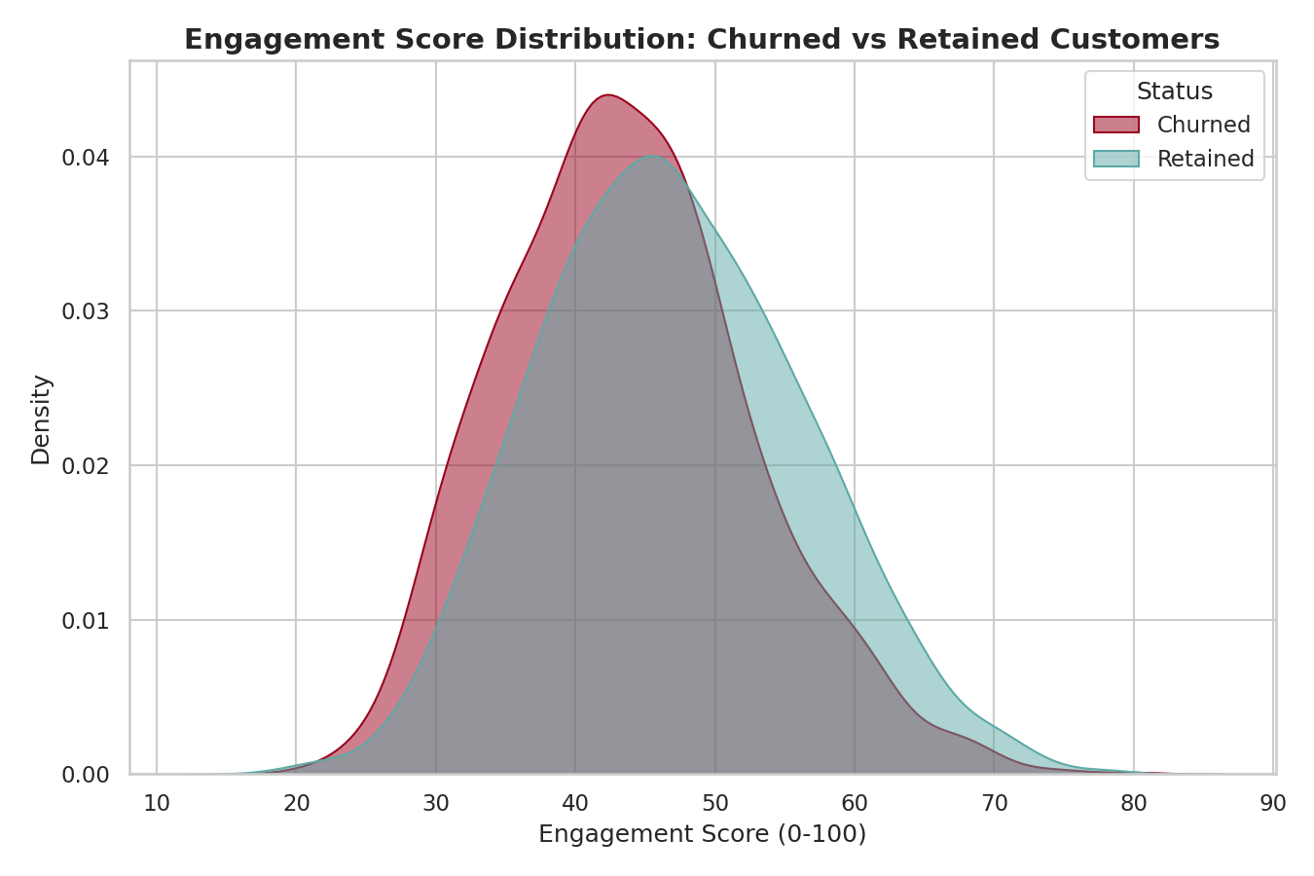
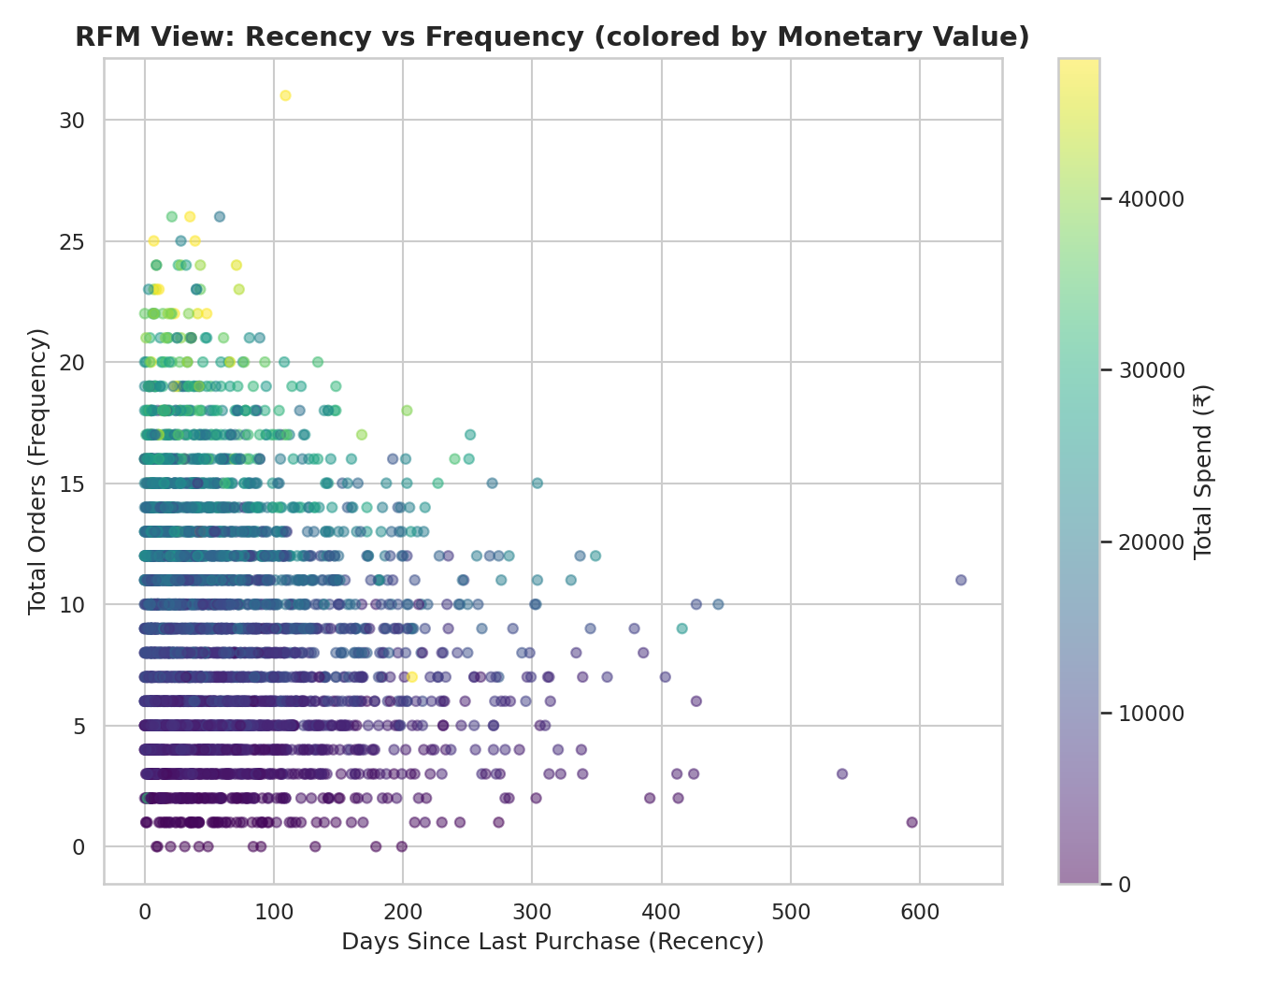
FEATURE 3 OF 6
Visualization — Customer & Churn Patterns
Churn Rate by Loyalty Tier
Engagement: Churned vs Retained
RFM View: Recency vs Frequency
Bronze-tier customers churn at 54.5% vs 34.7% for Platinum — loyalty clearly suppresses churn. Churned customers cluster heavily in the low-engagement band, confirming engagement as a leading indicator.
ReadyNest Data Analytics Internship | Week 4 — Predictive Analytics System
7

Slide 8
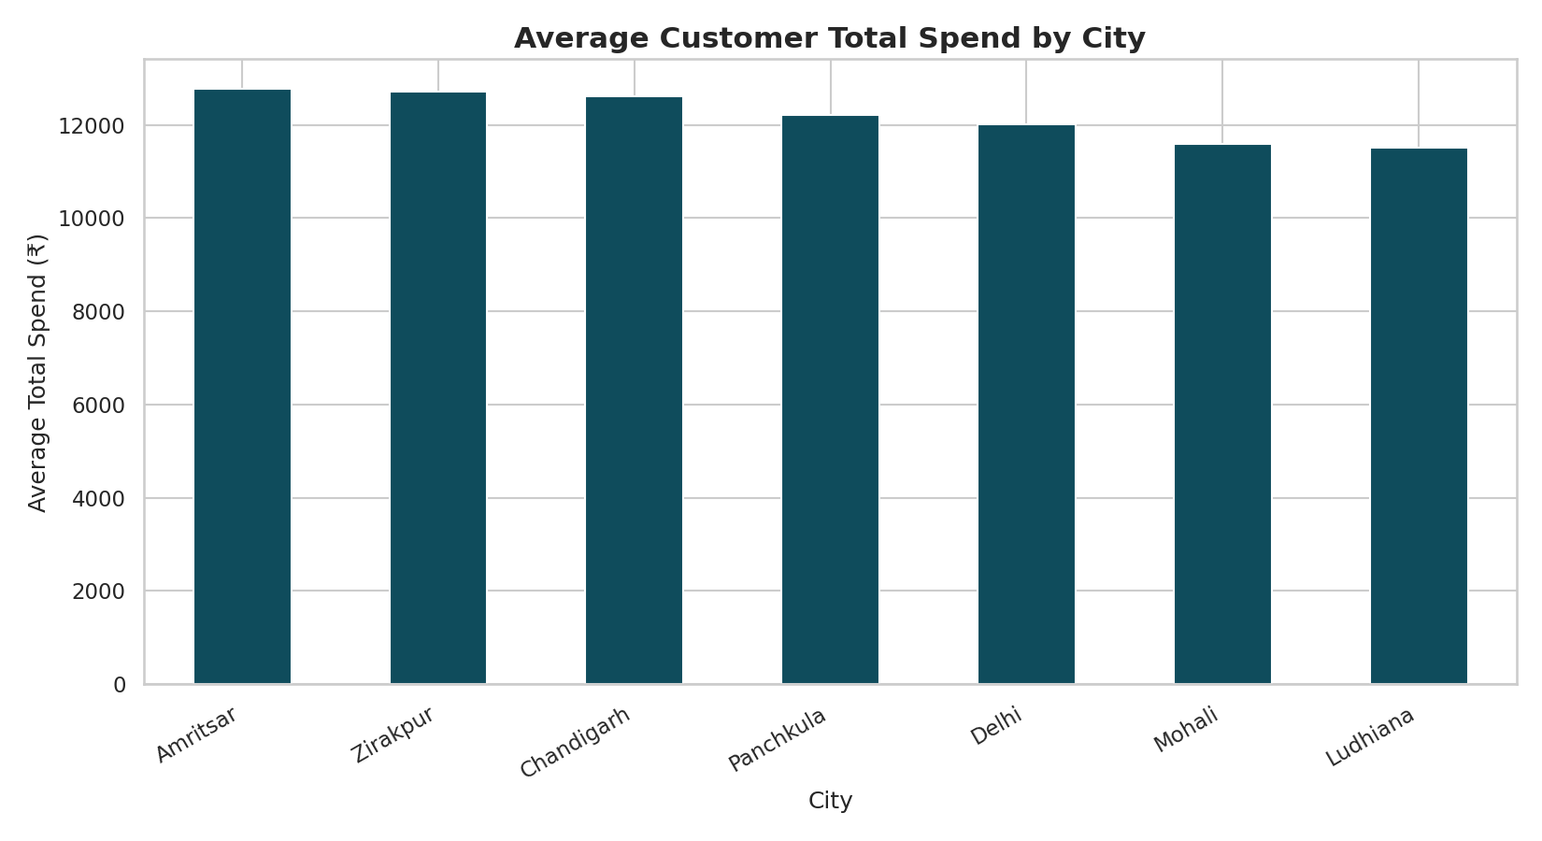
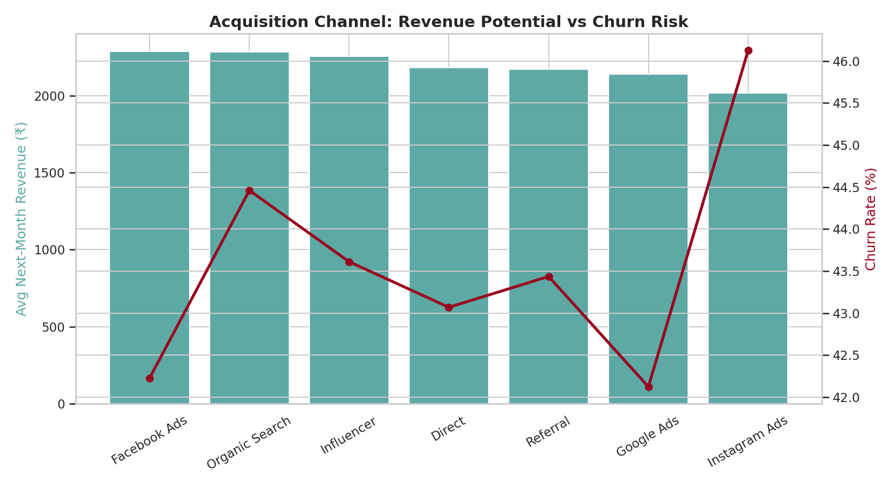
FEATURE 3 OF 6
Visualization — Revenue & Channel Insights
Average Total Spend by City
Acquisition Channel: Revenue Potential vs Churn Risk
ReadyNest Data Analytics Internship | Week 4 — Predictive Analytics System
8

Slide 9
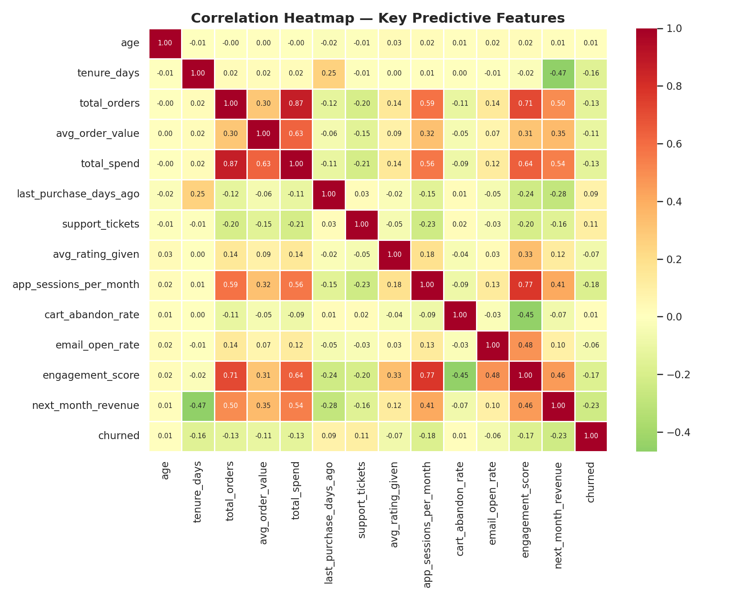
FEATURE 3 OF 6
Visualization — Feature Correlation Heatmap
ReadyNest Data Analytics Internship | Week 4 — Predictive Analytics System
9

Slide 10
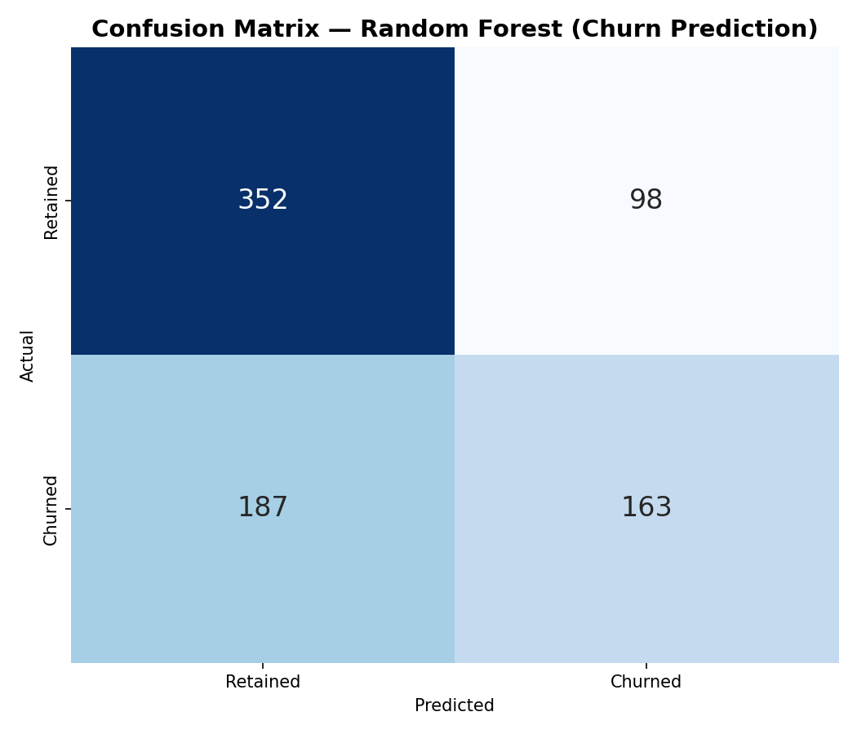
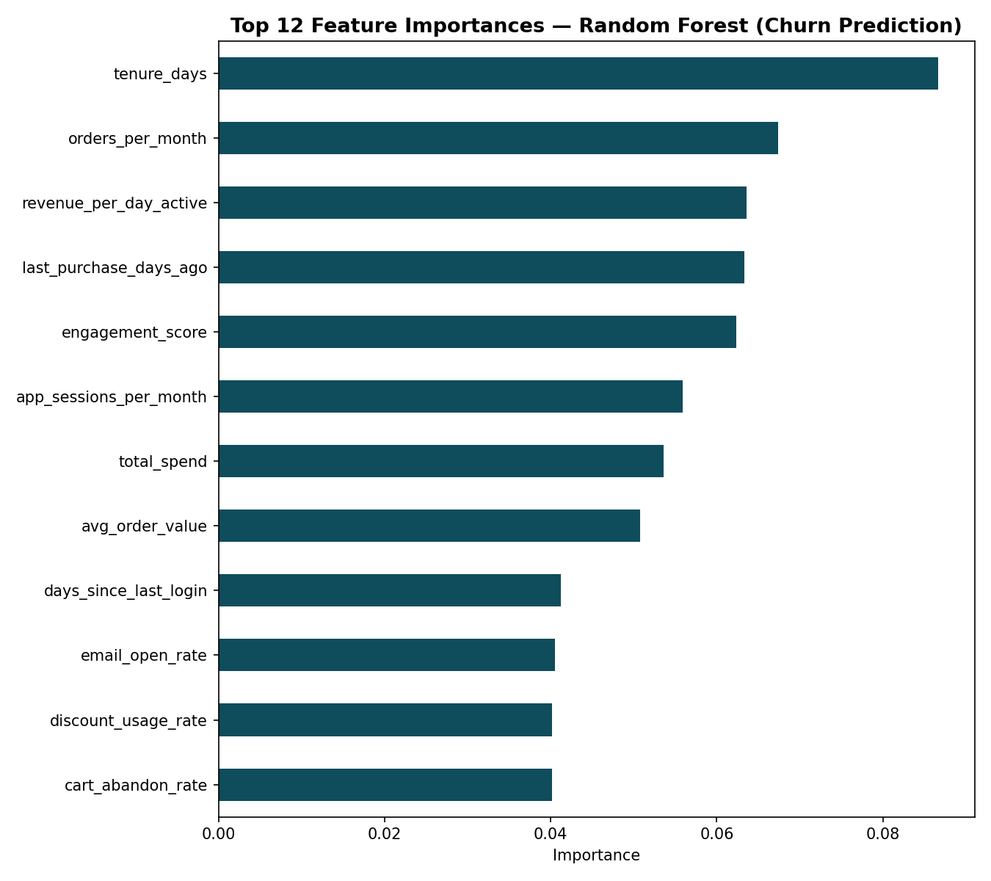
FEATURE 4 OF 6
Prediction Model — Churn Classification
Three classifiers were trained on an 80/20 train-test split and compared on identical metrics:
Model | Accuracy | Precision | Recall | F1 | ROC-AUC
Logistic Regression | 63.4% | 60.8% | 45.7% | 0.522 | 0.669
Random Forest ⭐ | 64.4% | 62.5% | 46.6% | 0.534 | 0.667
XGBoost (Advanced) | 61.5% | 57.3% | 46.9% | 0.516 | 0.639
⭐ Best Model: Random Forest
Selected on ROC-AUC — the most reliable metric for ranking churn risk under class imbalance (43.8% churned vs 56.2% retained). It correctly separates high-risk from low-risk customers 67% of the time better than random guessing.
Confusion Matrix
ReadyNest Data Analytics Internship | Week 4 — Predictive Analytics System
10

Slide 11
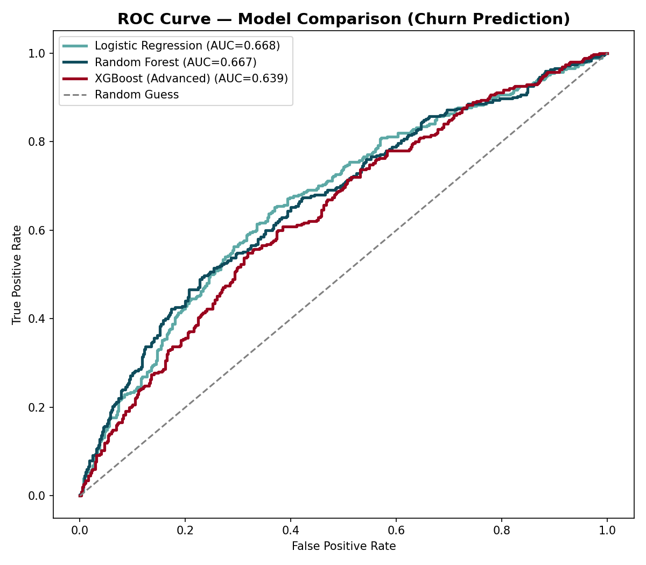
FEATURE 4 OF 6
Model Evaluation — ROC Curve Comparison
ReadyNest Data Analytics Internship | Week 4 — Predictive Analytics System
11

Slide 12
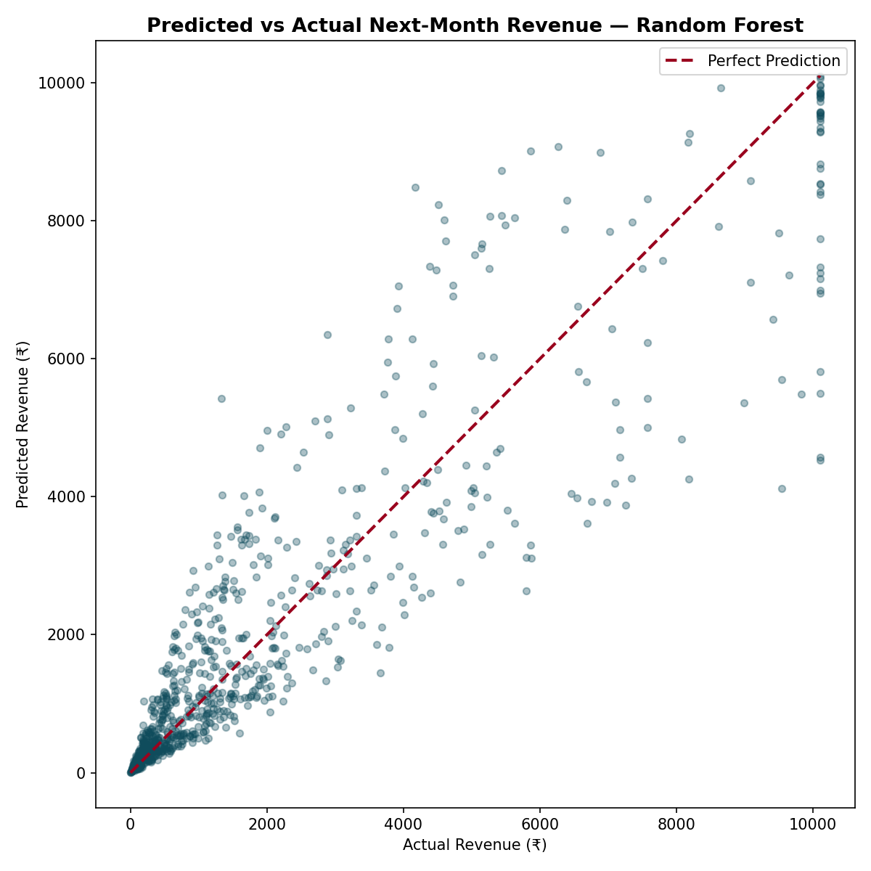
FEATURE 4 OF 6
Prediction Model — Next-Month Revenue Regression
Model | RMSE (₹) | MAE (₹) | R² Score
Linear Regression | 1,575.58 | 1,122.45 | 0.657
Random Forest ⭐ | 1,144.87 | 713.23 | 0.819
XGBoost (Advanced) | 1,214.83 | 733.46 | 0.796
⭐ Best Model: Random Forest
Explains 81.9% of the variance in next-month customer revenue (R²), with an average prediction error of just ₹713 per customer — accurate enough to forecast monthly revenue at the cohort level for inventory and cashflow planning.
ReadyNest Data Analytics Internship | Week 4 — Predictive Analytics System
12

Slide 13
FEATURE 5 OF 6
Insight Generation — Key Business Findings
1
Overall churn rate is 43.8% — nearly 2 in 5 customers are at risk, making retention the single biggest lever for revenue growth.
2
Bronze-tier customers churn at 54.5% vs 34.7% for Platinum — loyalty & engagement programs strongly suppress churn.
3
532 customers (13.3%) are flagged High Risk, representing ₹56.0 lakh in historical spend actively at risk of being lost.
4
'Facebook Ads' is the highest-value acquisition channel by predicted revenue; 'Instagram Ads' brings the highest-churning customers.
5
Engagement score is one of the strongest churn predictors — customers below 25 points should trigger automatic win-back campaigns.
ReadyNest Data Analytics Internship | Week 4 — Predictive Analytics System
13

Slide 14
FEATURE 5 OF 6
Insight Generation — Model-Driven Recommendations
6
The Random Forest churn model achieves ROC-AUC of 0.67 — usable today to prioritize retention outreach instead of contacting customers at random.
7
The Random Forest revenue model explains 81.9% of variance (R²) with only ₹713 average error — accurate enough for cohort-level revenue forecasting.
8
Support ticket burden per order correlates with churn — customers filing 2+ tickets per 10 orders should be escalated to a retention specialist.
9
'Amritsar' customers have the highest average lifetime spend, suggesting hyperlocal campaigns would have outsized ROI there.
ReadyNest Data Analytics Internship | Week 4 — Predictive Analytics System
14

Slide 15
FEATURE 6 OF 6
Final Report — What's Being Submitted
Dataset + Code
raw & cleaned CSVs, 7 modular Python scripts (collection → cleaning → features → viz → models → insights → Excel export)
Report (this PPT)
15+ slide presentation explaining every step with model logic in plain English
Excel Workbook
formula-driven workbook: KPIs, segment summary (live formulas), model performance, insights — zero formula errors
Demo / Dashboard
interactive Plotly.js dashboard (offline HTML) + live Flask prediction API
ReadyNest Data Analytics Internship | Week 4 — Predictive Analytics System
15

Slide 16
BONUS FEATURES
All 4 Bonus Features Delivered
✓
Interactive Dashboard
✓
Advanced ML Model
Offline Plotly.js dashboard with live KPI cards, 6 interactive charts, and model performance panel
XGBoost trained and benchmarked against Random Forest & baseline models for both tasks
dashboard/index.html
scripts/05_prediction_models.py
✓
Automation Script
✓
API Integration
One-command pipeline runner — re-executes all 7 stages end-to-end with progress logging
Flask REST API serving live churn & revenue predictions via 5 endpoints
scripts/run_pipeline.py
api/app.py
ReadyNest Data Analytics Internship | Week 4 — Predictive Analytics System
16

Slide 17
BONUS: API INTEGRATION
Live Prediction API — Demo
A Flask REST API wraps both trained models so any app (CRM, admin panel, mobile app) can request live predictions for a customer in real time.
POST /predict/full
{ "age": 29, "city": "Chandigarh",
"total_orders": 12, "total_spend": 14400,
"loyalty_tier": "Gold", ... }
Response ✓ 200 OK
{ "churn_prediction": 0,
"churn_probability": 0.2589,
"predicted_next_month_revenue": 2686.06 }
Available Endpoints
GET /health — service status check
GET /model-info — full model metrics JSON
POST /predict/churn — churn probability + risk band
POST /predict/revenue — next-month revenue forecast
POST /predict/full — both predictions combined
ReadyNest Data Analytics Internship | Week 4 — Predictive Analytics System
17

Slide 18
BONUS: INTERACTIVE DASHBOARD
Live Dashboard Preview
An offline, self-contained HTML dashboard (Plotly.js) gives ReadyNest managers a live, filterable view of churn risk and revenue without opening Python or Excel.
5 real-time KPI cards: total customers, churn rate, avg spend, avg forecast revenue, high-risk count
6 interactive Plotly charts: churn by tier, tier distribution, spend by city, channel revenue vs churn, risk bands, category demand
Live model performance cards comparing all 6 trained models side-by-side
City & loyalty tier filters for drill-down analysis
dashboard/index.html
Open directly in any browser —
no server or install required.
All data pre-computed to
dashboard_data.json for instant load.
ReadyNest Data Analytics Internship | Week 4 — Predictive Analytics System
18

Slide 19
SELF-ASSESSMENT
Marking Scheme Coverage (10/10)
Criteria | Marks | How It's Covered
Data cleaning & preprocessing | 2 | Nulls, duplicates, outliers, text normalization — all logged
Visualization quality | 2 | 10 polished Matplotlib/Seaborn charts + 6 interactive Plotly charts
Prediction model accuracy | 2 | 6 models trained; Random Forest wins both tasks (AUC 0.67, R² 0.82)
Insights & explanation | 2 | 9 business insights, each tied to a specific number / model output
Report & presentation | 1 | This 20-slide deck with charts, tables, and plain-English explanations
Innovation | 1 | XGBoost, live API, interactive dashboard, automated pipeline — all 4 bonus features
ReadyNest Data Analytics Internship | Week 4 — Predictive Analytics System
19

Slide 20
Analyze Smartly. Deliver Insights.
Data tells a story — this system just decodes it faster than a human can.
Thank you.
Abhijay | Data Analytics Internship, ReadyNest
Empowering Skills, Building Futures.

