Slide 1
Match Ticketing Analysis Tool

Slide 2

Kishkinda University
Department of Computer Science and Engineering.
Guided By: Sukumar T
Project team members:
Jason Kenneth N | KUB23CSE045
Bharath Kumar J M | KUB23CSE025
K Bharath Kumar | KUB23CSE054
Shanawaz I H | BTech-CSE073
S Noor Basha | BTech-CSE080

Slide 3
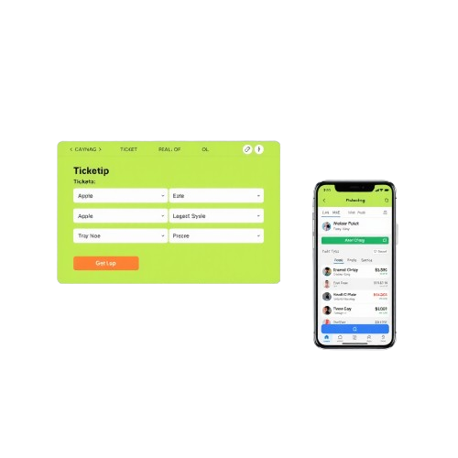
Introduction
Match Ticketing Analysis Tool POC provides a solid foundation for building a more comprehensive ticketing system, enabling event organizers to make data-driven decisions and optimize their ticket sales strategies

Slide 4

Objective
Create a tool to handle CRUD operations for ticket sales.
Analyze ticket sales data to optimize pricing and promotions.
Predict future ticket sales trends.
It provides functions for analyzing and predicting ticket sales trends.
The tool uses Object-Oriented Programming (OOP) and Data Structures and Algorithms (DSA) principles.

Slide 5



Requirements
Software Requirements:
Python 3.8
Visual Studio code, pycharm, etc
Unittest library for unit testing
Database Management System
Hardware Requirements:
Processor: Intel i5
Ram: 8 Gb
Harddisk: 500Gb

Slide 6
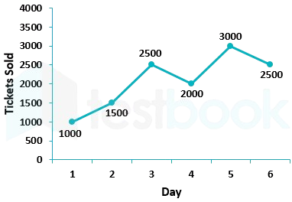
Ticket Sales missions and goals
The Ticket Sales represents a collection of tickets
Efficient Ticket Management: The Ticket Sales class allows for efficient management of ticket sales data, including adding, selling, and deleting tickets.
Improve Ticket Validation: Enhance the class to include ticket validation to prevent duplicate or invalid tickets from being added or sold.
Easy Data Retrieval: The class provides methods to retrieve ticket data, making it easy to access and analyze sales information.

Slide 7
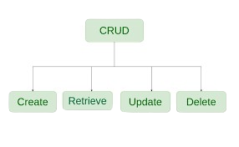
CRUD Operations missions and goals
CRUD: Create, Read, Update, Delete
Helps us to modify the code
In the project we can create a new ticket, Read the ticket, Update the price of the ticket and to delete the ticket when it is required
It helps to keep the data in dynamic manner

Slide 8
Modules:
Ticket Module:
Purpose: Encapsulate the details and behaviors of a ticket.
TicketSales Module:
Purpose: Manage the collection of tickets and provide functionalities to add, sell, delete, and analyze tickets.
TicketSalesTest Module:
Purpose: Provide unit tests for the TicketSales class to ensure its methods work correctly.
Main Module:
Purpose: Serve as the entry point for running the ticket sales system and tests.

Slide 9

Analyzing and predicting Ticket Sales Data
Data-Driven Insights: The analysis function provides valuable insights into ticket sales data, enabling informed decisions on pricing and promotions.
Predictive Capabilities: The prediction function offers a basic trend analysis, which can be improved with machine learning algorithms to forecast future sales.
Enhance Prediction Model: Develop a more sophisticated prediction model using machine learning algorithms to improve the accuracy of sales forecasts.

Slide 10



Realtime Applications
Sports Teams and Leagues
Concert and Festival Promoters
Theater and Performing Arts
Travel and Tourism

Slide 11

Conclusion and future enhancements
The Match Ticketing Analysis Tool POC is a functional prototype
Future work includes integrating a machine learning algorithm for prediction
Real-time Data Updates
User Authentication and Authorization

Slide 12
References
Python Documentation: The official Python documentation is a great resource for learning Python and its various libraries. https://docs.python.org/3/
Real Python: A community-driven website that provides tutorials, articles, and resources for learning Python. https://realpython.com/
"Python Crash Course" by Eric Matthes: A comprehensive book that covers the basics of Python programming, including data structures, file input/output, and web development.
"Automate the Boring Stuff with Python" by Al Sweigart: A practical book that focuses on using Python for automating tasks, including data analysis and visualization.
"Python for Data Analysis" by Wes McKinney: A book that focuses on using Python for data analysis, including data cleaning, visualization, and machine learning.

