Slide 1
Cloud Computing
By
K. Bhaskara Rao
Asst. Prof.
IT Dept.
BEC

Slide 2
AWS RDS (Relational database service)

Slide 3
AWS RDS
Amazon RDS is a fully managed relational database service.
Amazon Relational Database Service (Amazon RDS) is a web service that makes it easier to set up, operate, and scale a relational database in the cloud.
It provides cost-efficient and resizable capacity while automating time-consuming administration tasks such as hardware provisioning, database setup, patching and backups.
It frees you to focus on your applications so you can give them the fast performance, high availability, security and compatibility they need.
Amazon RDS is available on several database instance types - optimized for memory, performance or I/O - and provides you with six familiar database engines to choose from, including
Amazon Aurora,
PostgreSQL,
MySQL,
MariaDB,
Oracle Database, and
SQL Server.
You can use the AWS Database Migration Service to easily migrate or replicate your existing databases to Amazon RDS.

Slide 4
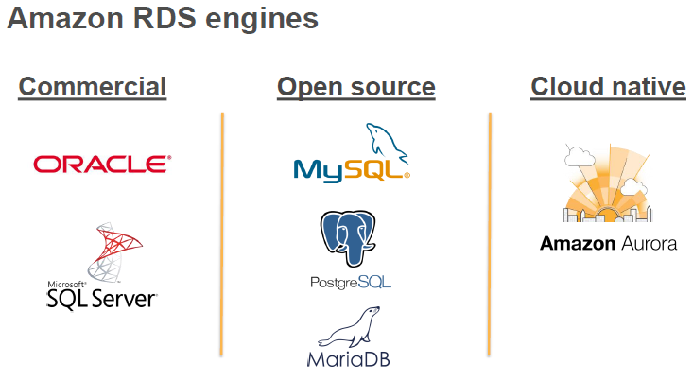
Amazon RDS

Slide 5
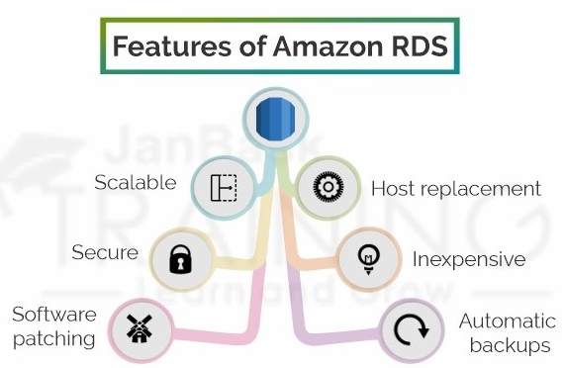
AWS RDS

Slide 6
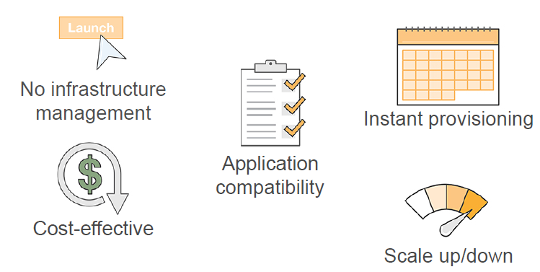
Amazon RDS

Slide 7
AWS RDS features
Scalable− Amazon RDS permits to scale the social database by utilizing the AWS Management Console or RDS-explicit API. We can either increase or decrease your RDS prerequisites within minutes.
Inexpensive− Using Amazon RDS, we pay just for the features that we actually use. There is no forthcoming and long-term payment.
Secure− Amazon RDS gives unlimited authority over the system to get to their database and their related services.
Automatic backups− Amazon RDS backs up everything in the database including exchange logs up to most recent five minutes and furthermore oversees programmed backup timings.
Software patching− Automatically gets all the most recent patches for the database programming. We can likewise indicate when the product ought to be fixed utilizing DB Engine Version Management.

Slide 8
AWS RDS benefits
https://console.aws.amazon.com/rds/ -→ AWS CONSOLE
Benefits:
Easy to administer
Highly scalable
Available and durable
Fast
Secure
Inexpensive
reliable
Easy to administer:
Amazon RDS makes it easy to go from project conception to deployment. Use the Amazon RDS Management Console, the AWS RDS Command-Line Interface, or simple API calls to access the capabilities of a production-ready relational database in minutes.
No need for infrastructure provisioning, and no need for installing and maintaining database software.
Highly scalable
You can scale your database's compute and storage resources with only a few mouse clicks or an API call, often with no downtime.
Many Amazon RDS engine types allow you to launch one or more Read Replicas to offload read traffic from your primary database instance.

Slide 9
AWS RDS benefits
Available and durable:
Amazon RDS runs on the same highly reliable infrastructure used by other Amazon Web Services.
When you provision a Multi-AZ DB Instance, Amazon RDS synchronously replicates the data to a standby instance in a different Availability Zone (AZ). Amazon RDS has many other features that enhance reliability for critical production databases, including automated backups, database snapshots, and automatic host replacement.
Fast
Amazon RDS supports the most demanding database applications. You can choose between two SSD-backed storage options: one optimized for high-performance OLTP applications, and the other for cost-effective general-purpose use.
In addition, Amazon Aurora provides performance on par with commercial databases at 1/10th the cost.

Slide 10
AWS RDS benefits
Secure
Amazon RDS makes it easy to control network access to your database. Amazon RDS also lets you run your database instances in Amazon Virtual Private Cloud (Amazon VPC), which enables you to isolate your database instances and to connect to your existing IT infrastructure through an industry-standard encrypted IPsec VPN.
Many Amazon RDS engine types offer encryption at rest and encryption in transit.
Inexpensive
You pay very low rates and only for the resources you actually consume.
In addition, you benefit from the option of On-Demand pricing with no up-front or long-term commitments, or even lower hourly rates via our Reserved Instance pricing.

Slide 11
Deploying with Amazon RDS
The normal process for deploying a DBMS is:
• Choose the system
• Obtain the software:
− If commercial software, purchase license for estimated usage
− If open source software, choose the version and download the software
• Specify, purchase, install, and configure the platform (hardware and disk storage)
• Install the DBMS
• Configure the administrative user and the initial database
• Secure the system

Slide 12
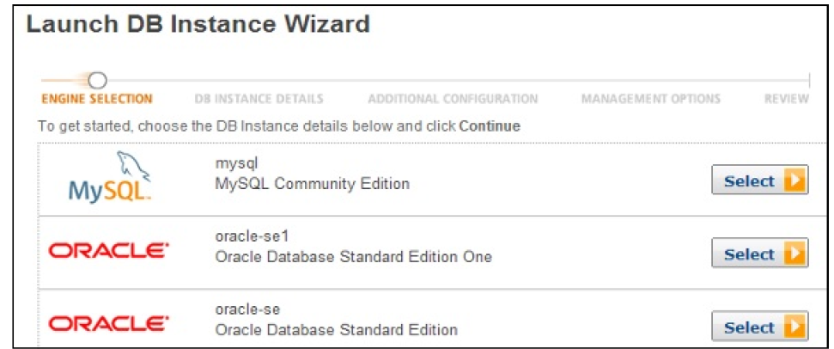
Setup Amazon RDS
Steps:
1. Login to AWS Mgt. Console. Using the link: https://console.aws.amazon.com/rds/
2. Select the region where the db instance is to be created, at top right corner of the rds console.
3. Select instances in navigation pane. Then click ‘Launch DB instance’ button. The Launch DB instance wizard opens.
4. Select the type of instance and click Select button.

Slide 13
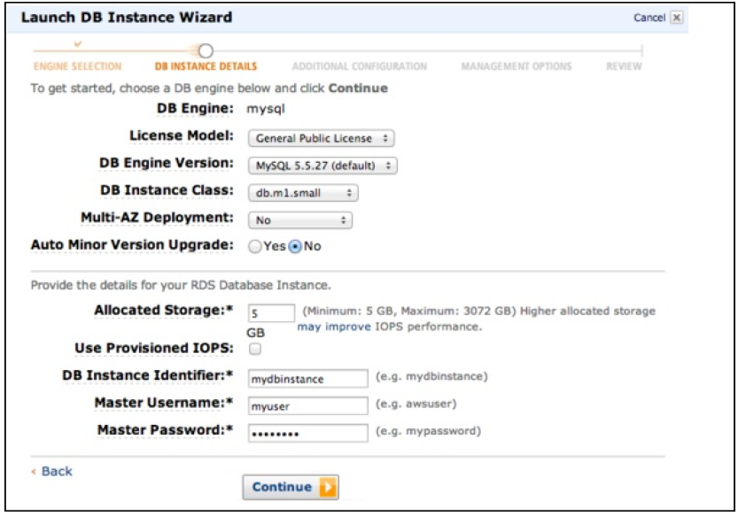
Setup Amazon RDS
5. Give the details in ‘Launch DB instance Wizard’ dialog:

Slide 14
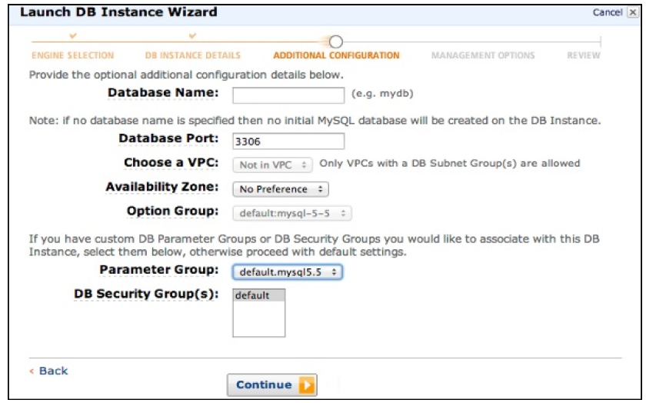
Setup Amazon RDS
Step 6: On the ‘Additional Configuration’ page, provide additional information required to launch MySql db instance.

Slide 15
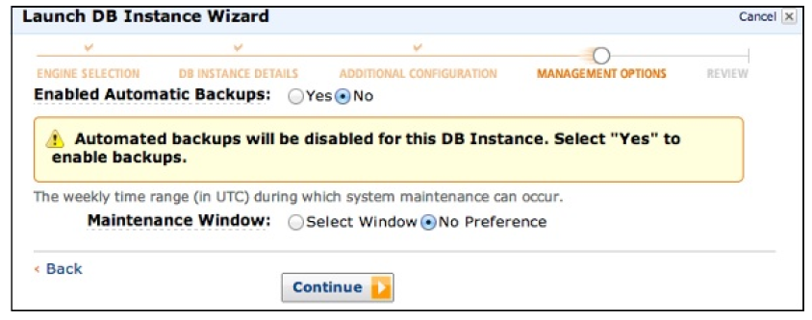
Setup Amazon RDS
Step 7: On ‘Management Options’ page,select options and click ‘Continue’.

Slide 16
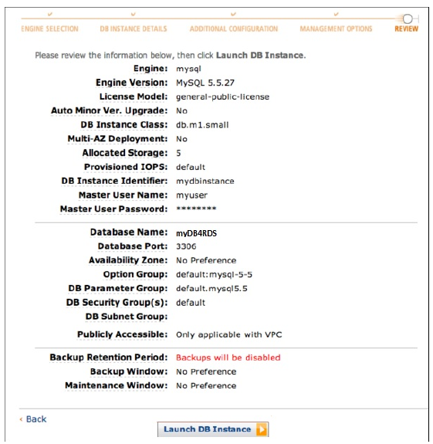
Setup Amazon RDS
Step 8: Review and click ‘Launch DB instance’ button to Finish.

Slide 17
Cost of Amazon RDS
Parameters:
Instance Class
Running Time
Storage
I/O requests per month
Backup storage

Slide 18
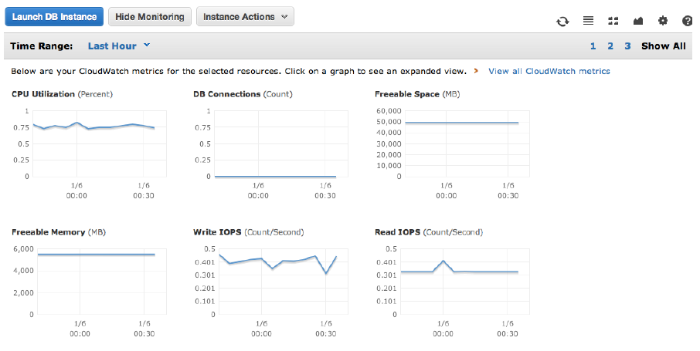
Amazon RDS

Slide 19
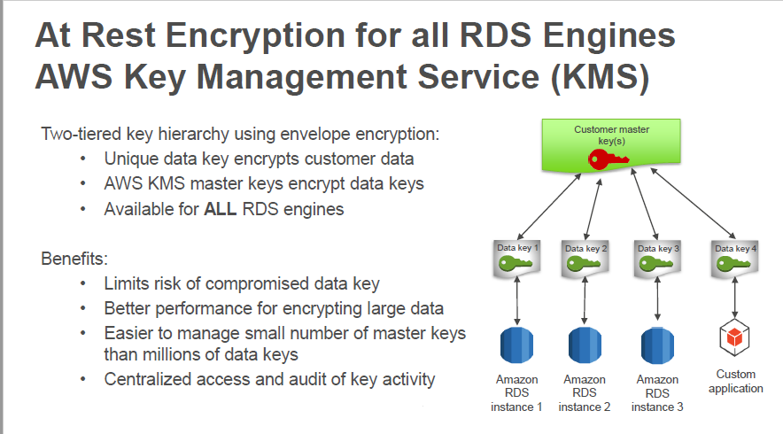
Amazon RDS

Slide 20
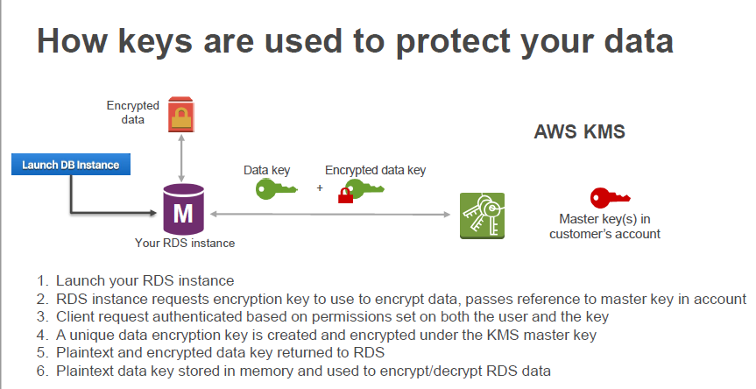
Amazon RDS

Slide 21
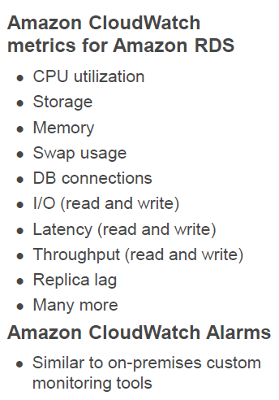
Amazon RDS

Slide 22
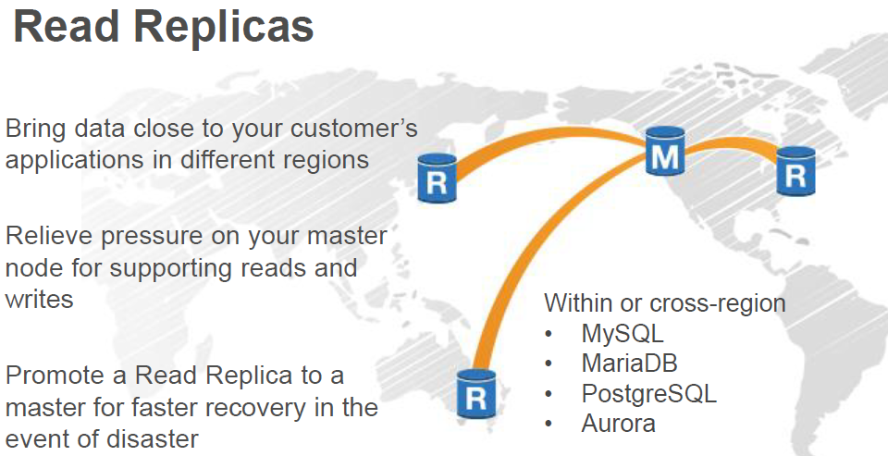
Amazon RDS

Slide 23
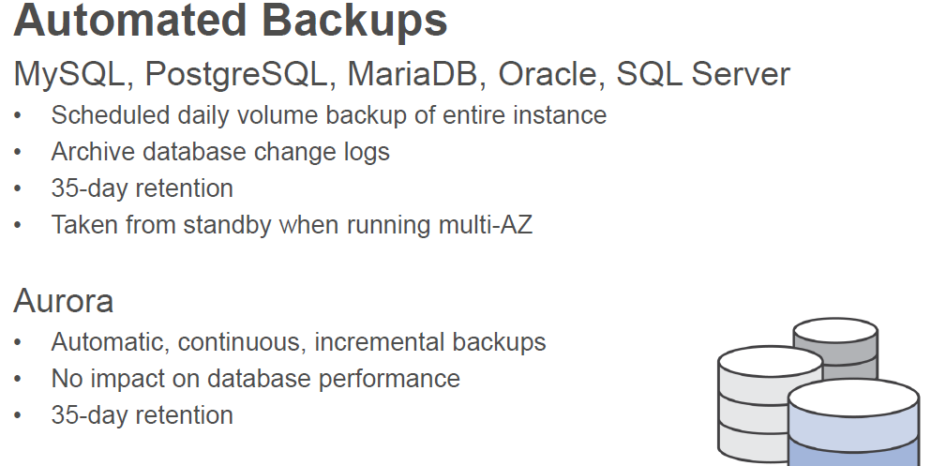
Amazon RDS

Slide 24
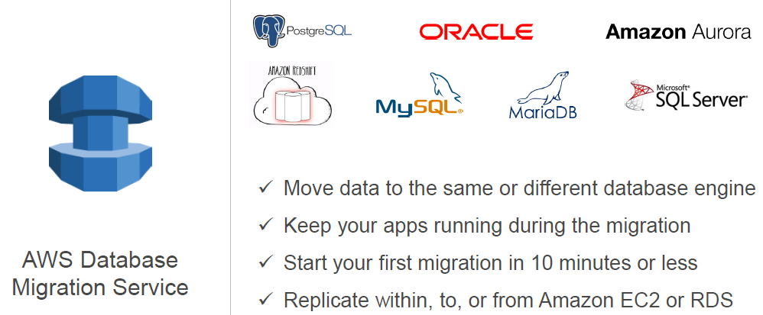
Amazon RDS

Slide 25
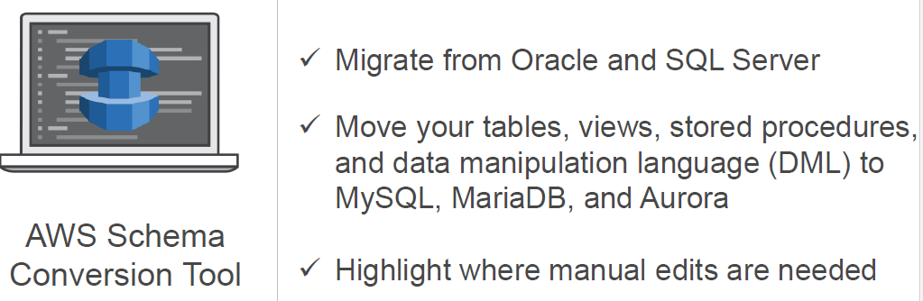
Amazon RDS

Slide 26
AWS RDS:

Slide 27
AWS RDS
Why do you want a managed relational database service? Because Amazon RDS takes over many of the difficult and tedious management tasks of a relational database:
When you buy a server, you get CPU, memory, storage, and IOPS, all bundled together. With Amazon RDS, these are split apart so that you can scale them independently. If you need more CPU, less IOPS, or more storage, you can easily allocate them.
Amazon RDS manages backups, software patching, automatic failure detection, and recovery.
To deliver a managed service experience, Amazon RDS doesn't provide shell access to DB instances. It also restricts access to certain system procedures and tables that require advanced privileges.
You can have automated backups performed when you need them, or manually create your own backup snapshot. You can use these backups to restore a database. The Amazon RDS restore process works reliably and efficiently.
You can use the database products you are already familiar with: MySQL, MariaDB, PostgreSQL, Oracle, Microsoft SQL Server.
You can get high availability with a primary instance and a synchronous secondary instance that you can fail over to when problems occur. You can also use MariaDB, Microsoft SQL Server, MySQL, Oracle, and PostgreSQL read replicas to increase read scaling.
In addition to the security in your database package, you can help control who can access your RDS databases by using AWS Identity and Access Management (IAM) to define users and permissions. You can also help protect your databases by putting them in a virtual private cloud.

Slide 28
AWS RDS:

Slide 29
AWS RDS - MySQL DB
1. Crating an Amazon RDS DB instance (CreateDBInstance)
using Console
using AWS CLI
using RDS API
2. Connecting to an Amazon RDS DB instance
Finding the connection information for a MySQL DB instance
Connecting from the MySQL client
using MySQL client (Mysql workbench)
using RDS API
MySQL commandline tool (mysql shell)/ AWS CLI
3. Getting DescribeDBInstances information
using Console
using AWS CLI
using RDS API
4. Importing and Exporting data
5. Managing and RDS DB Instance
Starting, Stopping, Rebooting, Modifying, Renaming, Deleting DB instances
6. Working with RDS events

Slide 30
AWS RDS - Connecting to Db
Reasons for connection to db failure:
The RDS DB instance is in a state other than available, so it can't accept connections.
The source you use to connect to the DB instance is missing from the sources authorized to access the DB instance in your security group, network access control lists (ACLs), or local firewalls.
The wrong DNS name or endpoint was used to connect to the DB instance.
The Multi-AZ DB instance failed over, and the secondary DB instance uses a subnet or route table that doesn't allow inbound connections.
The user authentication is incorrect.
Sdk urls:
https://docs.aws.amazon.com/code-samples/latest/catalog/javav2-rds-src-main-java-com-example-rds-CreateDBInstance.java.html
https://docs.aws.amazon.com/AWSJavaSDK/latest/javadoc/com/amazonaws/services/rds/AmazonRDSClient.html
https://docs.aws.amazon.com/code-samples/latest/catalog/javav2-rds-src-main-java-com-example-rds-DescribeDBInstances.java.html

Slide 31
AWS RDS - Connecting to MySql Db instance
The connection information for a DB instance includes its endpoint, port, and a valid database user, such as the master user.
For example, suppose that an endpoint value is mydb.123456789012.us-east-1.rds.amazonaws.com. In this case, the port value is 3306, and the database user is admin.
Given this information, you specify the following values in a connection string:
• For host or host name or DNS name, specify mydb.123456789012.useast1.rds.amazonaws.com.
• For port, specify 3306.
• For user, specify admin.
To connect to a DB instance, use any client for a DB engine. For example, you might use the mysql utility to connect to a MariaDB or MySQL DB instance.

Slide 32
AWS RDS - Connecting to MySql Db instance
Getting Connection Information:
Console
To find the connection information for a DB instance in the AWS Management Console
1. Sign in to the AWS Management Console and open the Amazon RDS console at https://
console.aws.amazon.com/rds/.
2. In the navigation pane, choose Databases to display a list of your DB instances.
3. Choose the name of the MySQL DB instance to display its details.
4. On the Connectivity & security tab, copy the endpoint. Also, note the port number. You need both the endpoint and the port number to connect to the DB instance.
Ex: From Windows command prompt, give command to get connection information:
aws rds describe-db-instances --filters "Name=engine,Values=mysql" --query "*[].[DBInstanceIdentifier,Endpoint.Address,Endpoint.Port,MasterUsername]"

Slide 33
AWS RDS - Connecting to MySql Db instance
To connect to a DB instance using the MySQL client, enter the following command at a Windows command prompt to connect to a DB instance using the MySQL client.
For the -h parameter, substitute the DNS name (endpoint) for your DB instance.
For the -P parameter, substitute the port for your DB instance.
For the -u parameter, substitute the user name of a valid database user, such as the master user. Enter the master user password when prompted.
Ex: To connect with mydb1id mysql database
C:\Users\bh>mysql -h mydb1id.c90djrnrrzvh.us-east-1.rds.amazonaws.com -P 3306 -u admin -p
Output:
Enter password: **********
Welcome to the MariaDB monitor. Commands end with ; or \g.
Your MySQL connection id is 193
Server version: 8.0.20 Source distribution
Copyright (c) 2000, 2018, Oracle, MariaDB Corporation Ab and others.
Type 'help;' or '\h' for help. Type '\c' to clear the current input statement.
MySQL [(none)]>

Slide 34
AWS RDS - Connecting to MySql Db instance
using AWS JAVA API:

Slide 35
AWS RDS - Connecting to MySql Db instance FROM MYSQL WORKBENCH
using AWS JAVA API:
To connect from MySQL Workbench
Download and install MySQL Workbench at Download MySQL Workbench
Open MySQL Workbench.
From Database, choose Manage Connections.
In the Manage Server Connections window, choose New.
In the Connect to Database window, enter the following information:
• Stored Connection – Enter a name for the connection, such as MyDB.
• Hostname – Enter the DB instance endpoint.
• Port – Enter the port used by the DB instance.
• Username – Enter the user name of a valid database user, such as the master user.
• Password – Optionally, choose Store in Vault and then enter and save the password for the user.
6. Optionally, choose Test Connection to confirm that the connection to the DB instance is successful.
7. Choose Close.
8. From Database, choose Connect to Database.
9. From Stored Connection, choose your connection.
10. Choose OK.

Slide 36
AWS RDS - Data import
https://docs.aws.amazon.com/AmazonRDS/latest/UserGuide/MySQL.Procedural.Importing.Other.html
You can use several different techniques to import data into an Amazon RDS for MySQL DB instance. The best approach depends on the source of the data, the amount of data, and whether the import is done one time or is ongoing.
If you are migrating an application along with the data, also consider the amount of downtime that you are willing to experience.
mysqldump:
For Windows, the following command needs to be run in a command prompt that has been opened by right-clicking Command Prompt on the Windows programs menu and choosing Run as administrator:
mysqldump -u localuser
--databases world
--single-transaction
--compress
--order-by-primary
-plocalpassword | mysql -u rdsuser
--port=3306
--host=myinstance.123456789012.us-east-1.rds.amazonaws.com
-prdspassword

Slide 37
AWS RDS - Data import
mysqldump -u local_user \
--databases database_name \
--single-transaction \
--compress \
--order-by-primary \
-plocal_password | mysql -u RDS_user \
--port=port_number \
--host=host_name \
-pRDS_password

Slide 38
AWS RDS
The parameters used are as follows:
-u local_user – Use to specify a user name. In the first usage of this parameter, you specify the name of a user account on the local MySQL or MariaDB database identified by the --databases parameter.
--databases database_name – Use to specify the name of the database on the local MySQL or MariaDB instance that you want to import into Amazon RDS.
--single-transaction – Use to ensure that all of the data loaded from the local database is consistent with a single point in time. If there are other processes changing the data while mysqldump is reading it, using this option helps maintain data integrity.
--compress – Use to reduce network bandwidth consumption by compressing the data from the local database before sending it to Amazon RDS.
--order-by-primary – Use to reduce load time by sorting each table's data by its primary key.
-plocal_password – Use to specify a password. In the first usage of this parameter, you specify the password for the user account identified by the first -u parameter.
-u RDS_user – Use to specify a user name. In the second usage of this parameter, you specify the name of a user account on the default database for the MySQL or MariaDB DB instance identified by the --host parameter.

Slide 39
AWS RDS
--port port_number – Use to specify the port for your MySQL or MariaDB DB instance. By default, this is 3306 unless you changed the value when creating the instance.
--host host_name – Use to specify the DNS name from the Amazon RDS DB instance endpoint, for example, myinstance.123456789012.us-east-1.rds.amazonaws.com. You can find the endpoint value in the instance details in the Amazon RDS Management Console.
-pRDS_password – Use to specify a password. In the second usage of this parameter, you specify the password for the user account identified by the second -u parameter.

Slide 40
AWS CLI for RDS
To find the connection information for a DB instance by using the AWS CLI, call the describe-dbinstances command. In the call, query for the DB instance ID, endpoint, port, and master user name.
aws rds describe-db-instances --query "*[].[DBInstanceIdentifier,Endpoint.Address,Endpoint.Port,MasterUsername]"

Slide 41
Managing RDS DB Instance:
Starting, Stopping, Rebooting, Modifying, Renaming, Deleting DB instances

Slide 42
AWS RDS – Stopping DB Instance
Managing an RDS DB Instance:
Starting, Stopping, Rebooting, Modifying, Renaming, Deleting DB instances
Stopping an RDS DB Instance:
If you use a DB instance intermittently, for temporary testing, or for a daily development activity, you can stop your Amazon RDS DB instance temporarily to save money.
While your DB instance is stopped, you are charged for provisioned storage (including Provisioned IOPS) and backup storage (including manual snapshots and automated backups within your specified retention window), but not for DB instance hours.
You can stop a DB using the AWS Management Console, the AWS CLI, or the RDS API.
Limitations:
You can't stop a DB instance that has a read replica, or that is a read replica.
You can't stop an Amazon RDS for SQL Server DB instance in a Multi-AZ configuration.
You can't modify a stopped DB instance.
You can't delete an option group that is associated with a stopped DB instance.
You can't delete a DB parameter group that is associated with a stopped DB instance.

Slide 43
AWS RDS – Stopping DB Instance
Using AWS Console:
To stop a DB instance
1. Sign in to the AWS Management Console and open the Amazon RDS console at https://
console.aws.amazon.com/rds/.
2. In the navigation pane, choose Databases, and then choose the DB instance that you want to stop.
3. For Actions, choose Stop.
4. (Optional) In the Stop DB Instance window, choose Yes for Create Snapshot? and enter the
snapshot name for Snapshot name. Choose Yes if you want to create a snapshot of the DB instance before stopping it.
5. Choose Yes, Stop Now to stop the DB instance, or choose Cancel to cancel the operation.
using RDS API:
To stop a DB instance by using the Amazon RDS API, call the StopDBInstance operation with the following parameter:
• DBInstanceIdentifier – the name of the DB instance.
Using AWS CLI:
aws rds stop-db-instance --db-instance-identifier mydbinstance.
Where:
DBInstanceIdentifier → the name of the DB instance.

Slide 44
AWS RDS – Starting DB Instance
Starting an Amazon RDS DB instance that was previously stopped:
After you stop your DB instance, you can restart it to begin using it again.
When you start a DB instance that you previously stopped, the DB instance retains the ID, Domain Name Server (DNS) endpoint, parameter group, security group, and option group. When you start a stopped instance, you are charged a full instance hour.
To start a DB instance using Console:
1. Sign in to the AWS Management Console and open the Amazon RDS console at https://
console.aws.amazon.com/rds/.
2. In the navigation pane, choose Databases, and then choose the DB instance that you want to start.
3. For Actions, choose Start.
Using AWS CLI:
aws rds start-db-instance --db-instance-identifier mydbinstance
Using RDS API:
To start a DB instance by using the Amazon RDS API, call the StartDBInstance operation with the
following parameter:
• DBInstanceIdentifier – The name of the DB instance.

Slide 45
AWS RDS – Modifying DB Instance
Using AWS Console:
To modify a DB instance
1. Sign in to the AWS Management Console and open the Amazon RDS console at https://
console.aws.amazon.com/rds/.
2. In the navigation pane, choose Databases, and then choose the DB instance that you want to modify.
3. Choose Modify. The Modify DB Instance page appears.
4. Change any of the settings that you want.
5. When all the changes are as you want them, choose Continue and check the summary of
modifications.
6. (Optional) Choose Apply immediately to apply the changes immediately. Choosing this option can cause downtime in some cases.
7. On the confirmation page, review your changes. If they are correct, choose Modify DB Instance to save your changes.
Or choose Back to edit your changes or Cancel to cancel your changes.

Slide 46
AWS RDS – Modifying DB Instance
Using AWS CLI:
To modify a DB instance by using the AWS CLI, call the modify-db-instance command. Specify the DB instance identifier and the values for the options that you want to modify.
Modifying an Amazon RDS DB instance:
aws rds modify-db-instance ^
--db-instance-identifier mydbinstance ^
--backup-retention-period 7 ^
--deletion-protection ^
--no-apply-immediately
Using RDS API:
To modify a DB instance by using the Amazon RDS API, call the ModifyDBInstance operation. Specify the DB instance identifier, and the parameters for the settings that you want to modify

Slide 47
AWS RDS - Renaming DB Instance
Renaming DB Instance using Console:
1. Sign in to the AWS Management Console and open the Amazon RDS console at https://
console.aws.amazon.com/rds/.
2. In the navigation pane, choose Databases.
3. Choose the DB instance that you want to rename.
4. Choose Modify.
5. In Settings, enter a new name for DB instance identifier.
6. Choose Continue.
7. To apply the changes immediately, choose Apply immediately. Choosing this option can cause an outage in some cases.
8. On the confirmation page, review your changes. If they are correct, choose Modify DB Instance to save your changes.

Slide 48
AWS RDS - Renaming DB Instance
Renaming DB instance Using using CLI:
aws rds modify-db-instance ^
--db-instance-identifier DBInstanceIdentifier ^
--new-db-instance-identifier NewDBInstanceIdentifier
Using RDS API:
To rename a DB instance, call Amazon RDS API operation ModifyDBInstance with the following parameters:
• DBInstanceIdentifier — existing name for the instance
• NewDBInstanceIdentifier — new name for the instance

Slide 49
AWS RDS - Rebooting DB Instance
using Console:
To reboot a DB instance
1. Sign in to the AWS Management Console and open the Amazon RDS console at https://
console.aws.amazon.com/rds/.
2. In the navigation pane, choose Databases, and then choose the DB instance that you want to reboot.
3. For Actions, choose Reboot.
The Reboot DB Instance page appears.
4. (Optional) Choose Reboot with failover? to force a failover from one AZ to another.
5. Choose Reboot to reboot your DB instance. Alternatively, choose Cancel.
using CLI:
To reboot a DB instance by using the AWS CLI, call the reboot-db-instance command.
aws rds reboot-db-instance ^
--db-instance-identifier mydbinstance
Using RDS API:
To reboot a DB instance by using the Amazon RDS API, call the RebootDBInstance operation

Slide 50
AWS RDS

Slide 51
AWS RDS

Slide 52
AWS RDS

