Slide 1
Cloud Computing
By
K. Bhaskara Rao
Asst. Prof.
IT Dept.
BEC

Slide 2
S3 (Simple Storage service)

Slide 3
AWS S3
AWS Simple Storage Service (S3) is a web service exposed over the Internet to store
and retrieve data.
It provides infrastructure that is reliable, scalable, and cost-efficient.
Amazon uses AWS S3 to serve its global network of web sites. You can even host static web
sites over AWS S3.
AWS S3 stores data objects in buckets. A bucket is simply a logical container that is used to identify the namespace of data objects.
Each AWS user account can create up to 100 buckets.
You can also create folders under the bucket, and inside folders you can store
data objects. Consequently, it becomes easier to separate the logical storage of data objects.
Each data object has a unique key within a bucket. You can access the data objects using the following URL: http://BUCKET_NAME.s3.amazonaws.com/DATA_OBJECT_KEY.
Here BUCKET_NAME will be the actual bucket name in which DATA_OBJECT_KEY resides.

Slide 4
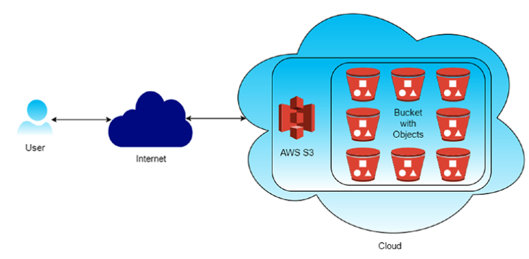
AWS S3

Slide 5
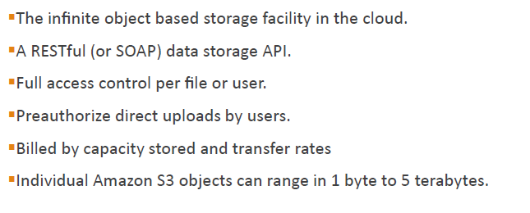
AWS S3

Slide 6
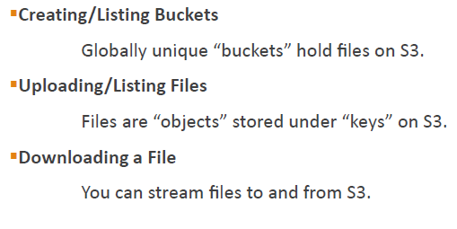
AWS S3

Slide 7
AWS S3 features
Scalability
AWS S3 provides infrastructure to store and retrieve data objects based on configuration.
It scales automatically when we store a large number of data objects. There won’t be any
configuration changes from the user’s end.
Availability
AWS S3 ensures that data objects are available at all times. You don’t need to manage
anything if you have heavy traffic overnight.
Cost Efficiency
AWS S3 follows the pay-as-you-go strategy, meaning you only have to pay for the
data objects you have stored and retrieved on AWS S3. For startups and small-scale
companies, it becomes inexpensive to use data storage infrastructure.
Static Web Hosting
AWS S3 provides static web site hosting that can be mapped. When you have static HTML
web sites, you can opt for hosting on S3 rather than purchasing the hosting space.

Slide 8
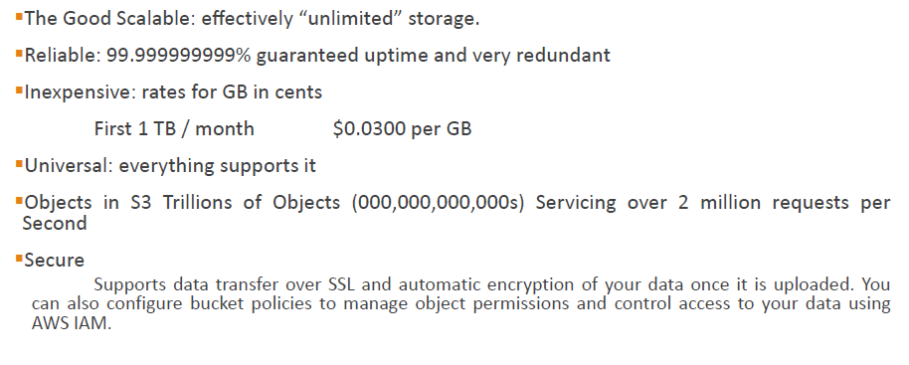
AWS S3 features

Slide 9
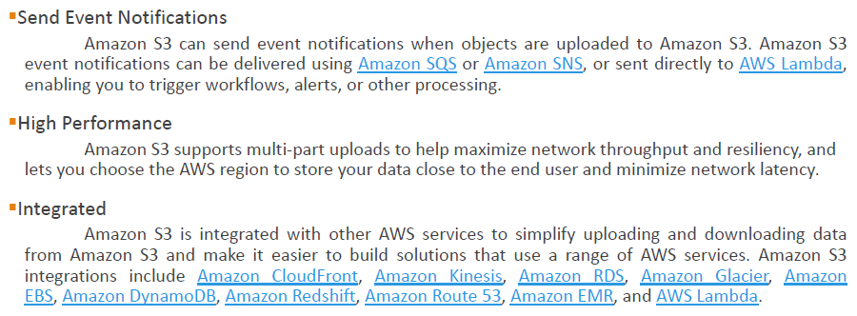
AWS S3 features

Slide 10
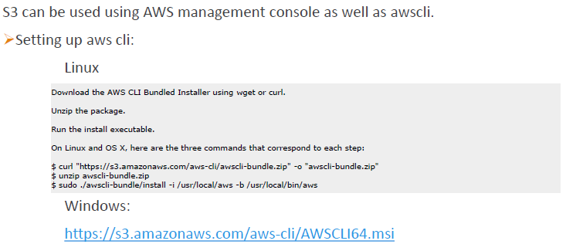
AWS S3 Configuring

Slide 11
S3 Buckets

Slide 12
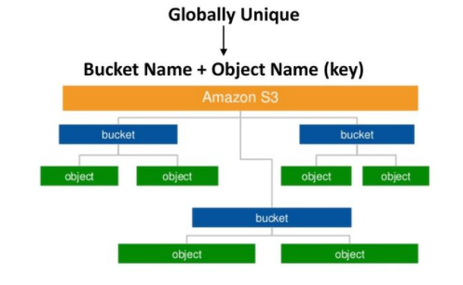
S3 Namespace

Slide 13
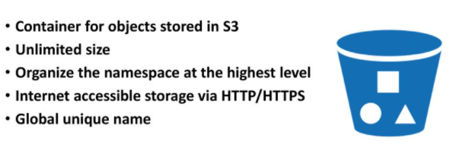
AWS S3
Bucket

Slide 14
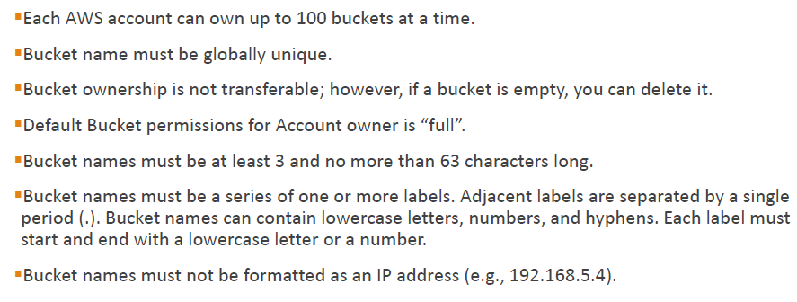
AWS S3 Bucket

Slide 15
AWS S3 Bucket
Creating a Bucket
Emptying a bucket
You can use the Amazon S3 console to empty a bucket, which deletes all of the objects in the bucket without deleting the bucket.
When you empty a bucket that has S3 Bucket Versioning enabled, all versions of all the objects in the bucket are deleted.
Deleting a Bucket
You can delete an empty Amazon S3 bucket
Viewing Bucket properties:

Slide 16
AWS S3 Bucket Properties
Bucket Versioning – Keep multiple versions of an object in one bucket by using versioning. By default, versioning is disabled for a new bucket.
Tags – With AWS cost allocation, you can use bucket tags to give billing for your use of a bucket. A tag is a key-value pair that represents a label that you assign to a bucket. To add tags, choose Tags, and then choose Add tag.
Default encryption – Enabling default encryption provides you with automatic server-side encryption. Amazon S3 encrypts an object before saving it to a disk and decrypts the object when you download it.
Server access logging – Get detailed records for the requests that are made to your bucket with server access logging. By default, Amazon S3 doesn't collect server access logs.
AWS CloudTrail data events – Use CloudTrail to log data events. By default, trails don't log data events. Additional charges apply for data events.
Event notifications – Enable certain Amazon S3 bucket events to send notification messages to a destination whenever the events occur. To enable events, choose Create event notification, and then specify the settings you want to use.
Transfer acceleration – Enable fast, easy, and secure transfers of files over long distances between your client and an S3 bucket.
Object Lock – Use S3 Object Lock to prevent an object from being deleted or overwritten for a fixed amount of time or indefinitely.
Requester Pays – Enable Requester Pays if you want the requester (instead of the bucket owner) to pay for requests and data transfers.
Static website hosting – You can host a static website on Amazon S3. To enable static website hosting, choose Static website hosting, and then specify the settings you want to use.

Slide 17
S3 Objects

Slide 18
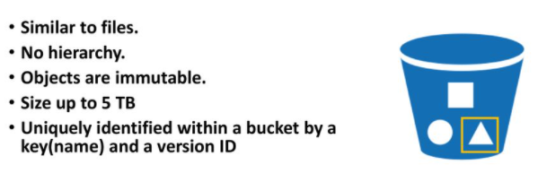
AWS S3
Object

Slide 19
AWS S3 Objects
Amazon S3 is an object store that uses unique key-values to store as many objects as you want.
You store these objects in one or more buckets, and each object can be up to 5 TB in size.
An object consists of the following:
Key
Version ID
Value
Metadata
Subresources
ACL (Access Control Information)
Key → The name that you assign to an object. You use the object key to retrieve the object.
Version ID → Within a bucket, a key and version ID uniquely identify an object. The version ID is a string that Amazon S3 generates when you add an object to a bucket.
Value → The content that you are storing.
An object value can be any sequence of bytes. Objects can range in size from zero to 5 TB.
Metadata → A set of name-value pairs with which you can store information regarding the object. You can assign metadata, referred to as user-defined metadata, to your objects in Amazon S3. (Ex: object creation date, Is server-side-encryption enabled?, content MD5).

Slide 20
AWS S3 Objects
Sub resources → used to store object specific additional information.
Access Control Information → You can control access to the objects you store in Amazon S3. Amazon S3 supports both the resource-based access control, such as an access control list (ACL) and bucket policies, and user-based access control.

Slide 21
S3 Object keys
The object key (or key name) uniquely identifies the object in an Amazon S3 bucket.
When you create an object, you specify the key name, which uniquely identifies the object in the bucket.
The Amazon S3 data model is a flat structure: You create a bucket, and the bucket store objects. There is no hierarchy of subbuckets or subfolders. However, you can infer logical hierarchy using key name prefixes and delimiters as the Amazon S3 console does.
Amazon S3 supports buckets and objects, and there is no hierarchy. However, by using prefixes and delimiters in an object key name, the Amazon S3 console and the AWS SDKs can infer hierarchy and introduce the concept of folders.
object key names can have alpha numeric, - _ . ‘ etc

Slide 22
AWS S3 Logging
Logging:
You can record the actions that are taken by users, roles, or AWS services on Amazon S3 resources and maintain log records for auditing and compliance purposes. To do this, you can use server access logging, AWS CloudTrail logging, or a combination of both. We recommend that you use AWS CloudTrail for logging bucket and object-level actions for your Amazon S3 resources.

Slide 23
AWS S3 Events
Events:
You can configure the events on the bucket activities. When a new object is added to the
bucket, notification should be sent to SNS or SQS or trigger the lambda function to carry
out some processing.
For example, logs are being added to the bucket. You want to filter out logs so you can configure an event that will trigger whenever a log file is added to the bucket.

Slide 24
AWS S3 Versioning
Versioning:
Versioning helps to store every version of objects. Versioned objects can be used to
recover the accidental override or expiration of an object. If bucket versioning is enabled,
then it can’t be disabled. It can only be suspended.

Slide 25
AWS S3 Versioning
Life Cycle:
The life cycle of objects can be managed by creating life-cycle rules. You can create rules
to move objects to other storage locations where objects are not accessed frequently, or
you can move objects to Glacier storage or even set an expiry date for the object.

Slide 26
AWS S3 – Cross Region Replication
Cross-Region Replication
Cross-region replication will replicate the bucket with objects to another region. To
enable cross-region replication, you need to enable versioning.

Slide 27
S3 using AWS CLI

Slide 28
S3 using AWS CLI
Create Bucket
Bucket Permissions
Tags
Create, Empty and Delete Buckets
Upload, Downloading & Deleting objects
Creating Folders
Logging
Events
Versioning
Life Cycle
Cross Region Replication
Transferring Acceleration

Slide 29
S3 using AWS CLI
Create Bucket
C:\> aws s3api create-bucket --bucket "bucket1withcli"
Ex:
1. aws s3api create-bucket --bucket "bucket2withcli"
2. aws s3api create-bucket --bucket “bucket2withcli” --region ap-south-1 --create-bucket-configuration LocationConstraint=ap-south-1
3. aws s3api create-bucket --bucket "bucket3withcli" --acl "public-read" --region ap-south-1 --create-bucket-configuration LocationConstraint=ap-south-1
4.
Upload, Downloading & Deleting objects
Ex: Uploading Object
aws s3api put-object --bucket "bucket3withcli" --key "arrow.gif" --body D:/arrow.gif
aws s3api delete-object --bucket "bucket3withcli" --key "elecbike.jpg“
aws s3api put-object --bucket "bucket3withcli" --key "elecbike.jpg" --body D:/elecbike.jpg --server-side-encryption AES256
Deletion of Object:
Ex:
aws s3api delete-object --bucket "bucket3withcli" --key "elecbike.jpg"
Create, Empty and Delete Buckets

Slide 30
S3 using AWS CLI
Deletion of Bucket:
aws s3api delete-bucket --bucket "bucket3withcli“
Emptying Bucket:
aws s3 rm s3://bucket3withcli –recursive
aws s3 rm s3://bucket-name/doc –recursive
→ removes objects that have the key name prefix doc, for example, doc/doc1 and doc/doc2.

Slide 31
S3 using AWS CLI
Creating Folders
Bucket Permissions
Tags

Slide 32
S3 using AWS CLI
Creating Folders
Bucket Permissions
Tags

Slide 33
Hosting Static WS in S3

Slide 34
S3 using AWS CLI – Hosting ws
Hosting a Static Website on Amazon S3:
Steps:
Create a Bucket
select ‘Enable Website Hosting’ option in properties window of Bucket.
Create Index.html file (or all files of website) and upload it to bucket
Make index.html ( or all files) status as ‘Make public’ from the actions menu of the index.html (or all files of the website).
Identify the URL of the website and test it from the browser.

Slide 35
Working with S3 using Java API

Slide 36
S3 using AWS SDK - Objects
Working with Objects:
Upload an Object
List Objects
Download an Object
Copy, Move or Rename an Object
Delete an Object
Delete Multiple Objects at Once
Working with ACLs and Access Policies
Bucket ACLs and Access Policies
Object ACLs and Access Policies

Slide 37
Working with AWS RDS (Relational Database Service)

Slide 38
using AWS RDS
AWS RDS: Relational Database Service

