Slide 1
THE BATTLE OF NEIGHBORHOODS FROM COURSERA CAPSTONE(Johannesburg)
IBM/Coursera Applied Data Science Capstone Project
Submitted by: Koduru Bhasker

Slide 2
Introduction
This project is related to understanding the appropriate location for having a gas station in South Africa.
The city of choice is Johannesburg. Johannesburg is the largest city of South Africa and is also one of the 50 largest urban areas of the world. Apart from being the largest city, Johannesburg is also most populous city with a population density of >2000 /sq km. The urban population is also very high. The passenger car sales for the past two months(Dec-19 and Jan-20) was averaging at ~40000 cars in the country with a major contribution from Johannesburg.
The purpose of this work is to locate an appropriate place for Gas station in Johannesburg. The existing Gas Stations locations and their proximity to each other will be analyzed as part of this work.

Slide 3
Data and Data Sources
Data¶
Based on definition of our problem, factors that will influence our decission are:
List of location and neighborhoods of Johannesburg
Number of and distance other Gas stations in the neighborhood, if any
Data Sources
Municipalities and neighborhoods of Johannesburg from Wikipedia (https://en.wikipedia.org/wiki/City_of_Johannesburg_Metropolitan_Municipality);
Geocode information from Geopy;
Gas stations in Johannesburg from Foursquare

Slide 4
Methodology
Data collection from wikipedia
Data insertion into my Jupyter notebook
Data preprocessing done in Notebook, leveraging Numpy and Pandas
Venue data was obtained via calls to the Foursquare API
Data visualization was achieved with a combination of Geopy and Folium to render maps of the clustered zip codes
Direct (manual/human) observation and analysis of the data frames used to arrive at the final recommendation

Slide 5
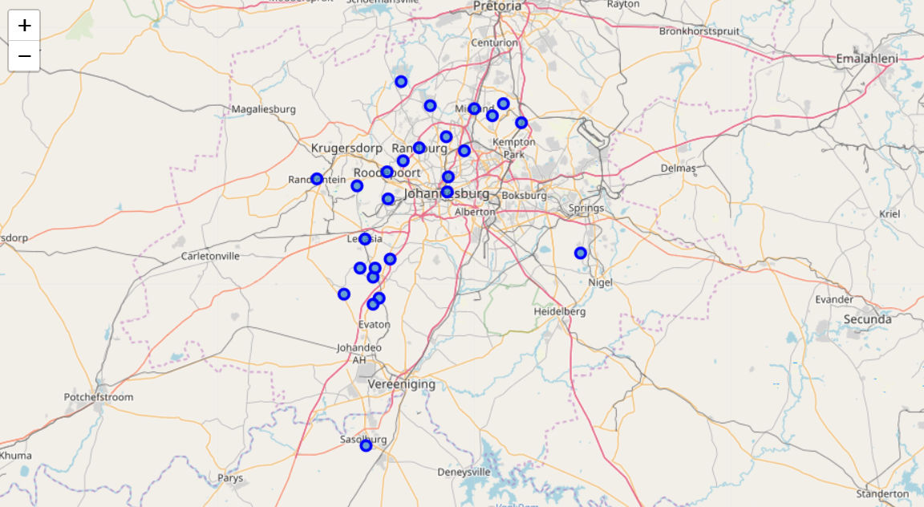
Results
Various Municipalities in Johannesburg

Slide 6
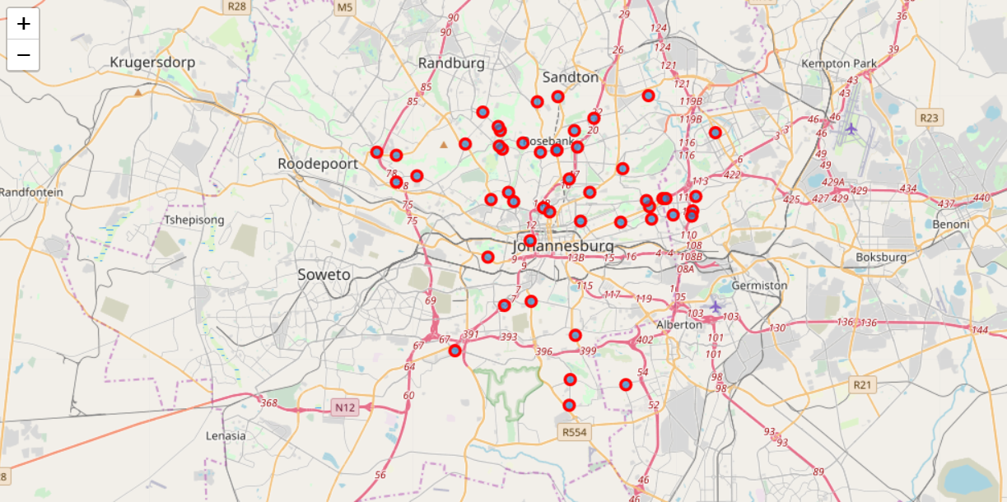
Results
Location of Gas Stations within Johannesburg

Slide 7
Results and Discussion
The results have provided the names of the Gas stations from the Foursquare API.
80% of the Gas stations in the city are either owned or a franchise of BP, Shell, ENGEN, the rest 20 owned by TOTAL, Sasol and others.
The closer look on the map, shows that the Gas stations are mostly placed on the city main roads.
The total number of population and proximity to the capital city and to the gold mine industry makes Johannesburg a city with more population and city with moving traffic.
For a city of million people and a city where car sales of 40000 was noticed(in the entire country), more number of gas stations are needed.

Slide 8
Conclusion
As the city is getting denser and wider roads are being constructed, the need for gas stations that can host convenience stores and rest area, plays a major role. With the boom of electric vehicles spreading across the world, the gas stations need to be planned well and needs further study with population density and active vehicle movement across different areas.

