Slide 1
INTERNATIONAL CONFERENCE ON INTELLIGENT, SECURED AND HUMAN-CENTERED TECHNOLOGIES (ICISHCT 2026)
PAPER ID: T2_PM_009
NAC-ViT: Neuronal Attention Circuit Vision Transformer for Brain Tumor Classification and Detection in MRI
Dr. Bhavesh C Kataria
Associate Professor, School of Computing and Technology
Institute of Advanced Research, Gandhinagar, Gujarat, India
bhavesh.iisc@gmail.com
SCT, IAR University • 29–30 October, 2026
Notes:
Title, author, affiliation and email: camera-ready paper src/ICISHCT_T2_PM_009_CameraReady.docx (title block). Paper ID T2_PM_009; single author.

Slide 2
Background & Motivation
MRI is the principal noninvasive examination for characterizing brain tumors.
The four classes differ in location, contrast enhancement and margin, yet overlap on single-sequence images.
Reported accuracies are not directly comparable: the backbone may be frozen or fine-tuned, and test images may come from the training collection.
Standard ViT attention is formed in one step (softmax of query–key products); NAC-ViT instead advances an attention state with a short logistic ODE: dA/dt = φA(1 − A) − ωA (saturating gate φ, linear leak ω).
Four-class task · 3,264 public brain MR images
Glioma
Meningioma
Pituitary tumor
No tumor
Notes:
Sources: paper §1 Introduction (MRI principal noninvasive exam [1],[2]; four classes overlap on single-sequence images; accuracies not directly comparable - backbone fixed vs fine-tuned, same-collection test) and Abstract (3,264 public four-class MR images; attention advanced by a short logistic ODE rather than a single softmax). phi and omega parametrize the attention update; they are not membrane-potential or EEG estimates (paper §1).

Slide 3
Research Gap & Objectives
Research gap
Four-class MRI accuracies across studies are not directly comparable.
Protocols differ: backbone frozen vs fine-tuned; test set drawn from the same collection or not.
NAC blocks were earlier trained only on a frozen ViT backbone (69.05%, not reproduced here).
Gate drift (φ, ω) under full fine-tuning had not been measured.
Objectives — three questions
Q1 Accuracy on a stratified 80/10/10 split of all 3,264 images (seed 42)?
Q2 Accuracy when the archive’s Testing folder is held out as an external test set?
Q3 Do the learned gates drift from their initial values, and do residual errors show a class-specific pattern?
This work: ViT-B/16 backbone and four NAC blocks fine-tuned jointly; both evaluation protocols fixed before test labels were inspected.
Notes:
Sources: paper §1 Introduction, final paragraph (earlier frozen-backbone experiment 69.05%, not reproduced; the three questions) and first paragraph (accuracies not directly comparable). 'Gates untested' is the paper's third question restated as a gap.

Slide 4
Contributions
Implemented & measured in this paper | Future work (not measured)
NAC-ViT: fine-tuned ViT-B/16 + four logistic-ODE attention blocks (88.10 M parameters) | Controlled ablation: fine-tuned ViT-B/16 without NAC blocks, same splits and seeds
Two protocols fixed before test labels were seen: pooled 80/10/10 split and archive Testing folder | Domain-shift mitigation (domain adaptation, multi-source training)
Learned gate φ, leak ω and τ = 1/ω read from the checkpoint | Multi-institutional, patient-level validation and clinical reader studies
All 12 pooled-test errors reported in full | —
YOLO11m detector trained separately on a separate collection | End-to-end detect → classify pipeline (design only, not measured)
Detection and classification were trained on different collections and are reported as separate measurements.
Notes:
Sources: paper Materials and Methods (NAC-ViT, 88.10M params; protocols fixed before test labels; detection model trained separately, no detector outputs passed to NAC-ViT), Results (learned φ, ω, τ; 12 errors, Table 5), Discussion (future controlled ablation without NAC; domain adaptation / multi-source training; multi-institutional patient-level validation and reader studies; two-stage pipeline is a design, not measured).

Slide 5
Methodology Workflow
Classification branch — NAC-ViT (both protocols)
Dataset
Preprocessing
Training
Evaluation
Results
3,264 public MR images
4 classes (Bhuvaji et al.)
Training / Testing folders
Resize 224 × 224
ImageNet normalisation
Aug: h-flip, ±15° rotation, brightness/contrast 0.1
A: pooled 80/10/10, seed 42 (2,609 / 325 / 330)
B: Testing folder held out (394); 10% val
AdamW · label smoothing 0.1
Accuracy, 95% Wilson CI
Macro F1, macro AUC
Per-class P / R / F1
A: pooled test 96.36%
B: Testing folder 78.43%
Reported separately
Separate detection branch — not coupled to NAC-ViT
Ultralytics brain-tumor
detection collection
YOLO11m · 640 × 640 · 300 epochs
AdamW + cosine LR
Best epoch 27: mAP@0.50 0.477
P 0.417 · R 0.795
Notes:
Sources: paper Materials and Methods (Table 1 counts; pooled 80/10/10 seed 42 = 2,609/325/330; Testing folder 394 as external test, stratified 10% of Training folder for validation; resize 224x224 + ImageNet normalisation; augmentation h-flip, ±15° rotation, brightness/contrast 0.1; Table 2 AdamW, label smoothing 0.1; Statistical reporting: Wilson CI, macro F1, macro AUC), Table 3 (96.36%, 78.43%), Detection model + Table 7 (YOLO11m, 640, 300 epochs, AdamW + cosine, epoch 27 P 0.417 R 0.795 mAP50 0.477). No detector output was passed to NAC-ViT.

Slide 6
NAC-ViT Architecture
MRI input
224 × 224, ImageNet-normalised
Patch embedding
196 patches (16×16) → 768-d + CLS token
ViT-B/16 encoder
ImageNet-1K init, all layers fine-tuned
4 × NAC block
4 heads, width 160
Classifier head
CLS token → LayerNorm → Dropout 0.1 → Linear
4 logits
glioma · meningioma · no tumor · pituitary
Inside one NAC block (applied 4 times)
Project
LayerNorm → Linear 768→160
Q, K, V: 4 heads, d_{h} = 40
Initial attention
A₀ = sigmoid(QK^{T} / √d_{h})
entries in (0, 1)
ODE update
dA/dt = φA(1 − A) − ωA
4 Euler steps, Δt = 0.1
A ← A + Δt·dA/dt, clipped to [0, 1]
Aggregate
Row-normalise A, multiply V
Linear 160→768 + residual
Bottleneck MLP
LayerNorm → 768→160→768
GELU, + residual
φ (gate) and ω (leak): softplus-constrained, one value per head, initialised ≈ 0.693; τ = 1/ω in Euler-step units. Whole network: 88.10 M trainable parameters.
Notes:
Sources: paper Materials and Methods, NAC-ViT paragraph and Table 2 (ViT-B/16 IMAGENET1K_V1; 224x224 -> 196 16x16 patches -> 768-d + class token; original 1000-way head dropped; 4 blocks, 4 heads, width 160; A0 = sigmoid(QK^T/sqrt(dh)); 4 Euler steps dt = 0.1 with clip [0,1]; row-normalised, aggregates values; residual + bottleneck MLP; softplus per-head phi, omega; head LayerNorm, dropout 0.1, linear to 4 logits; 88.10M params). Verified in src/train_nac_vit.py: NACBlock (LayerNorm -> in_proj 768->160 -> qkv; head_dim 160/4 = 40; out_proj 160->768 + residual; MLP 768->160->768 GELU + residual), NACViT.forward applies NAC blocks after the full ViT encoder and classifies the CLS token; phi_raw/omega_raw zeros -> softplus(0) ≈ 0.693. τ is in Euler-step units, not a membrane time constant.

Slide 7
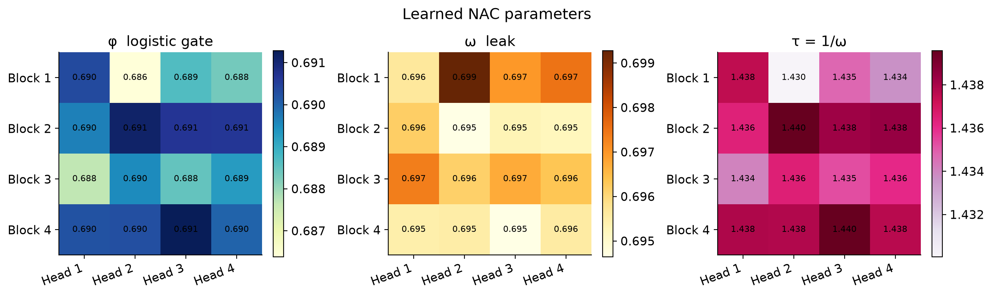
NAC Attention Dynamics
dA/dt = φ · A(t) · (1 − A(t)) − ω · A(t)
Illustrative: A(t) computed from the equation, φ = ω = 0.693 (init) — not model output
1.0
φ gate: saturating logistic term φA(1 − A); softplus, one per head
ω leak: linear decay −ωA; softplus, one per head
τ = 1/ω: in Euler-step units, not a membrane time in ms
Update: 4 Euler steps, Δt = 0.1, clipped to [0, 1]
A(t)
A₀ = 0.9
0.5
A₀ = 0.6
A₀ = 0.3
0
0
0.1
0.2
0.3
0.4
t (4 Euler steps of Δt = 0.1)
Learned after fine-tuning
φ 0.686–0.691
ω 0.695–0.699
τ 1.430–1.440
Gates stayed close to the initial ≈ 0.693 (τ ≈ 1.44)
Real run: learned φ, ω, τ per block (rows) and head (columns), pooled checkpoint
Notes:
Sources: paper §1 (equation; saturating gate, linear leak; φ, ω positive; τ = 1/ω; not membrane potential / EEG), Methods NAC-ViT (softplus per head; 4 Euler steps Δt = 0.1, clip [0,1]), Results 'Learned neuronal parameters' + Figure 8 (init ≈ 0.693, τ ≈ 1.44 in Euler-step units; φ 0.686–0.691, ω 0.695–0.699, τ 1.430–1.440). Code: src/train_nac_vit.py NACBlock. Figure: runs/classify/nac_vit_pooled/figures/nac_dynamics.png. The A(t) curve is ILLUSTRATIVE: 4 Euler steps of the equation computed for A0 = 0.9/0.6/0.3 with φ = ω = 0.693 (initialisation values); it is not model output. Note: the paper text says τ 'summarizes their ratio' but τ = 1/ω only (code).

Slide 8
Dataset & Experimental Setup
Classification archive — class counts (Table 1)
Model & optimisation (Table 2, both protocols)
Class | Training folder | Testing folder | Total
Glioma | 826 | 100 | 926
Meningioma | 822 | 115 | 937
No tumor | 395 | 105 | 500
Pituitary | 827 | 74 | 901
Total | 2,870 | 394 | 3,264
Component | Setting
Backbone | ViT-B/16, ImageNet-1K, all parameters trained
Attention blocks | 4 blocks, 4 heads, width 160
Integration | 4 Euler steps, Δt = 0.1
Loss | Cross-entropy, label smoothing 0.1
Optimizer | AdamW, weight decay 0.05
Learning rates | 1 × 10⁻⁵ backbone · 1 × 10⁻⁴ blocks + head
Schedule | 2-epoch warmup → cosine; stop after 8 epochs w/o val gain
Batch / hardware | 16 · NVIDIA RTX A5000, 22 GB · PyTorch 2.5.1
Parameters | 88.10 M, all trainable
Protocol A: pooled, stratified 80/10/10, seed 42
2,609
train
325
validation
330
test
Protocol B: archive Testing folder (394) kept intact as external test; stratified 10% of Training folder for validation
Notes:
Sources: paper Materials and Methods — Table 1 (class counts), pooled protocol (stratified 80/10/10, seed 42 → 2,609 / 325 / 330), external protocol (Testing folder 394 intact; stratified 10% of Training folder for validation), Table 2 (settings), NAC-ViT paragraph (88.10 M parameters). Cross-checked: runs/classify/nac_vit_pooled/splits.json (2609/325/330), results.json (88,098,212 params).

Slide 9
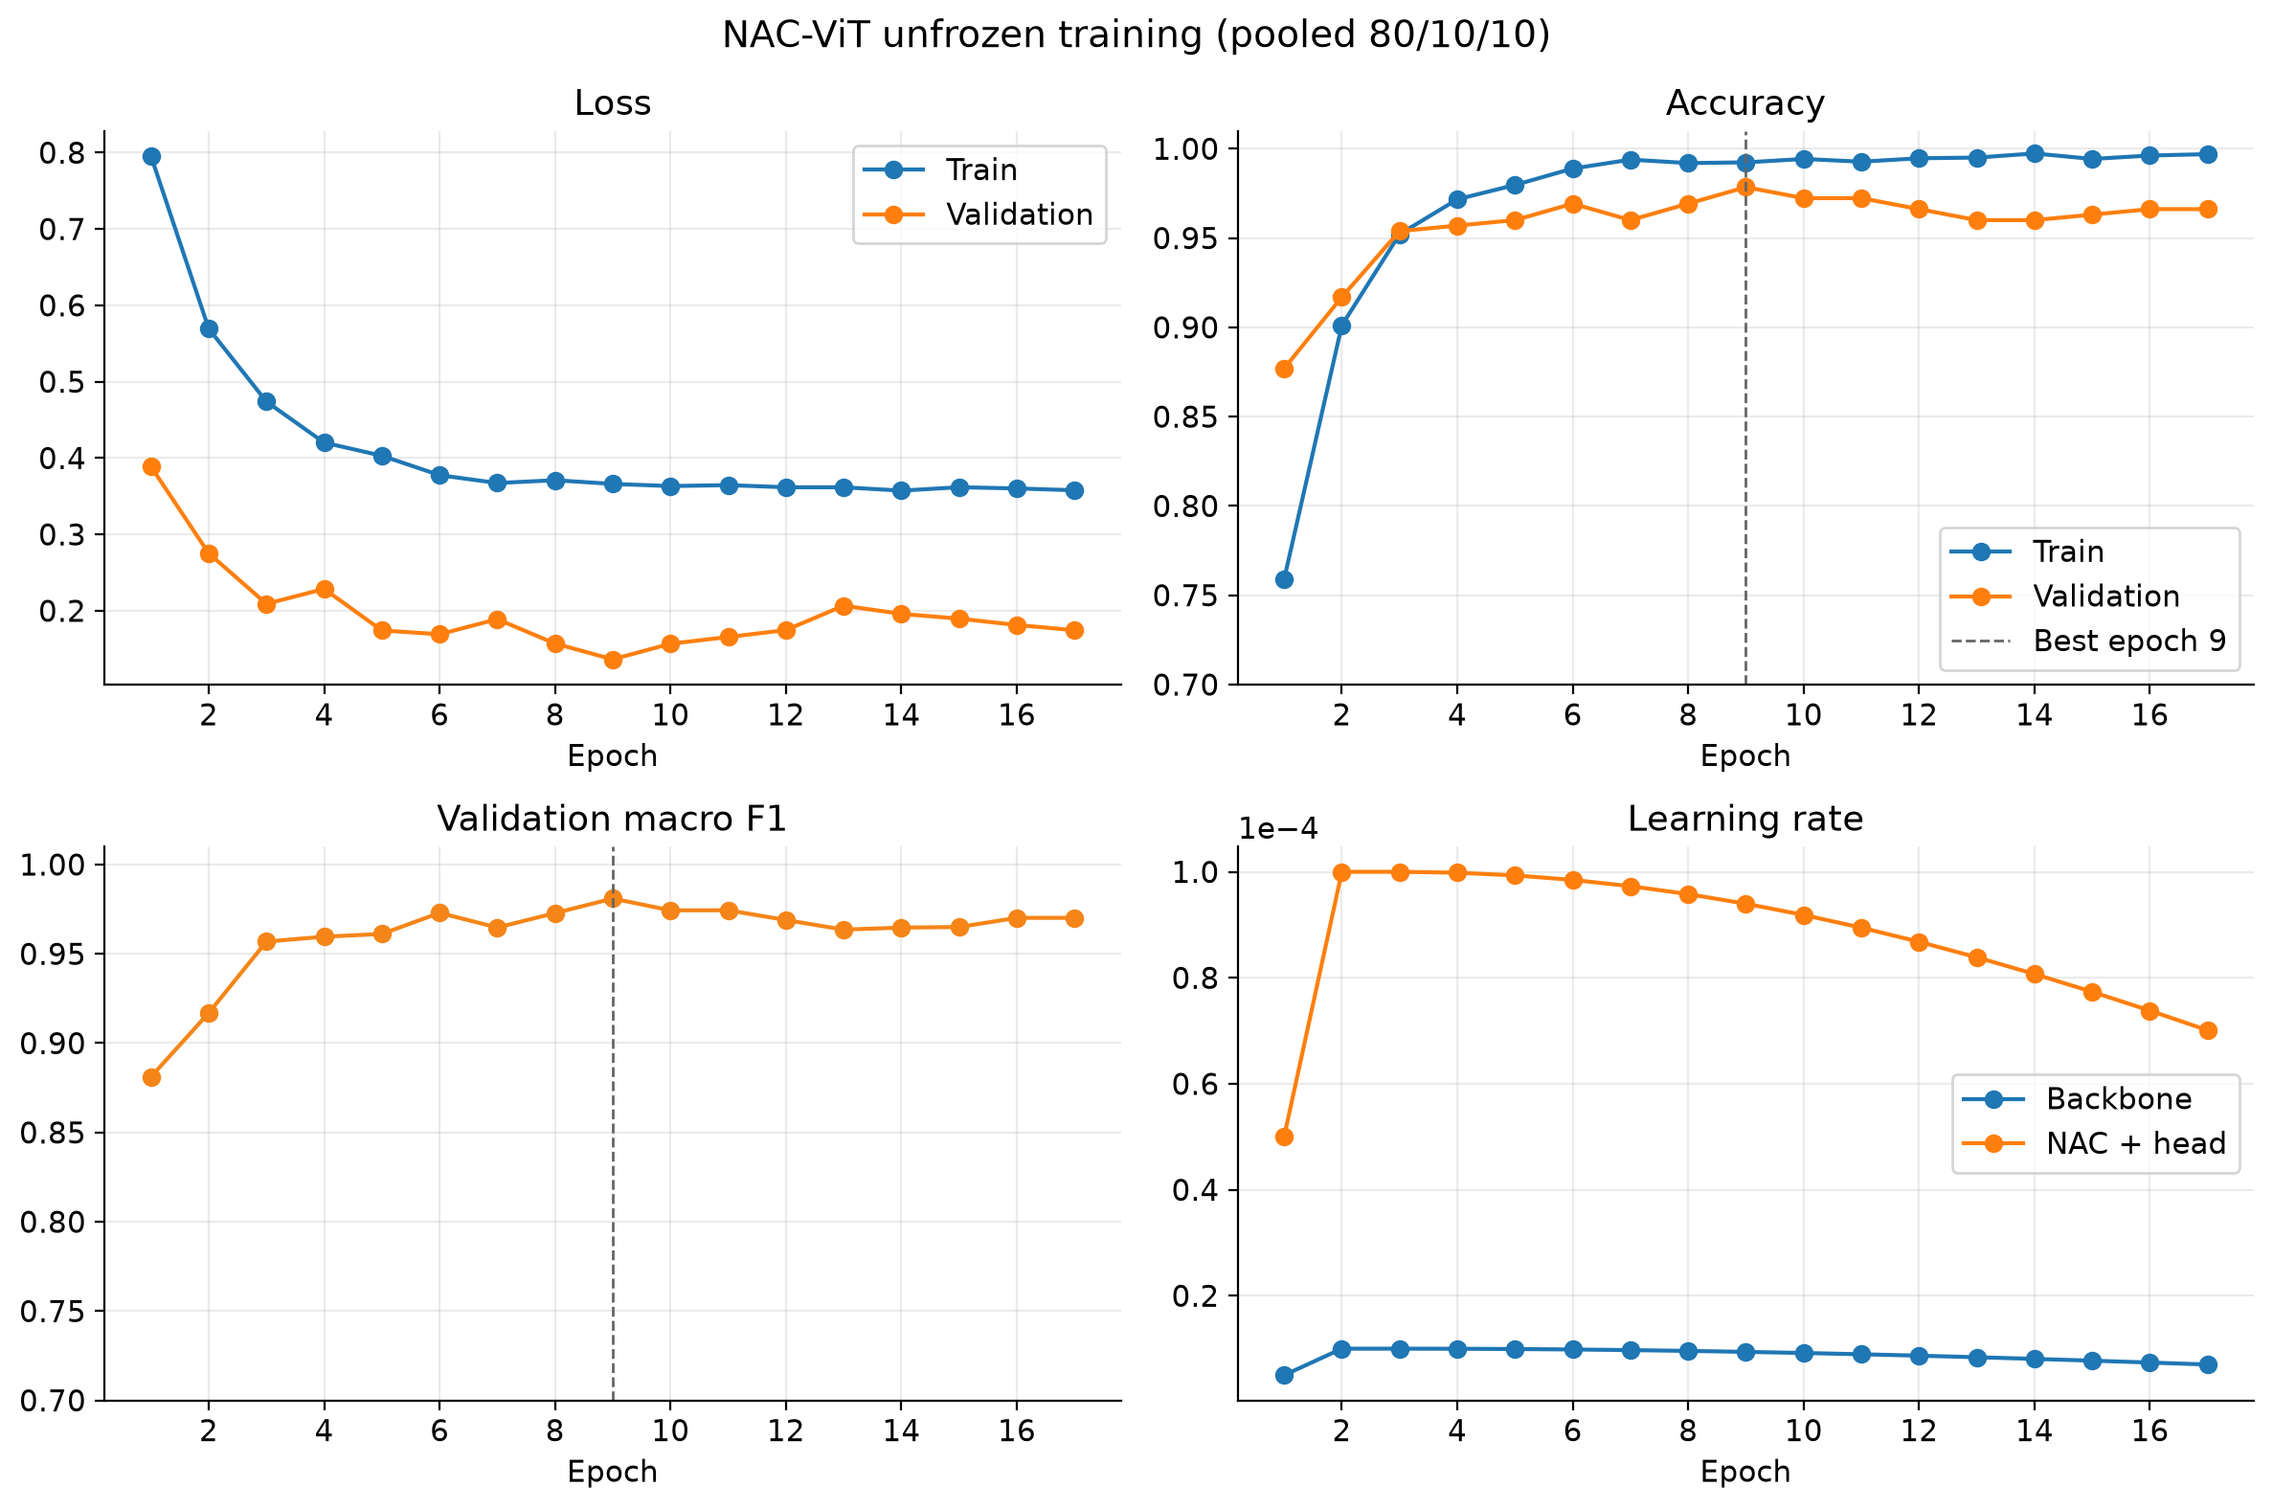
Results — Pooled Test Set
PROTOCOL A · pooled stratified 80/10/10 split (seed 42) · held-out test n = 330
96.36%
Test accuracy: 318 / 330 correct
95% Wilson score CI 93.8–97.9%
0.964
0.998
Macro F1
Macro one-vs-rest AUC
Validation set (n = 325) — not test
Best validation accuracy 97.85% at epoch 9 (checkpoint retained); training stopped at epoch 17 of 40
Real run (pooled): dashed line = epoch 9, checkpoint selected by validation accuracy
Notes:
Sources: paper Results 'Pooled test set' + Table 3 (318/330, 96.36%, Wilson 93.8–97.9%, macro F1 0.964, macro AUC 0.998; validation 97.85% at epoch 9, stopped at epoch 17 of max 40) and Figure 1. Cross-checked: runs/classify/nac_vit_pooled/results.json (test acc 0.96364, macro F1 0.96354, AUC 0.99831; val 0.97846) and history.csv (best val epoch 9). Figure: runs/classify/nac_vit_pooled/figures/training_curves.png. The validation number is a validation-set figure, not a test result.

Slide 10
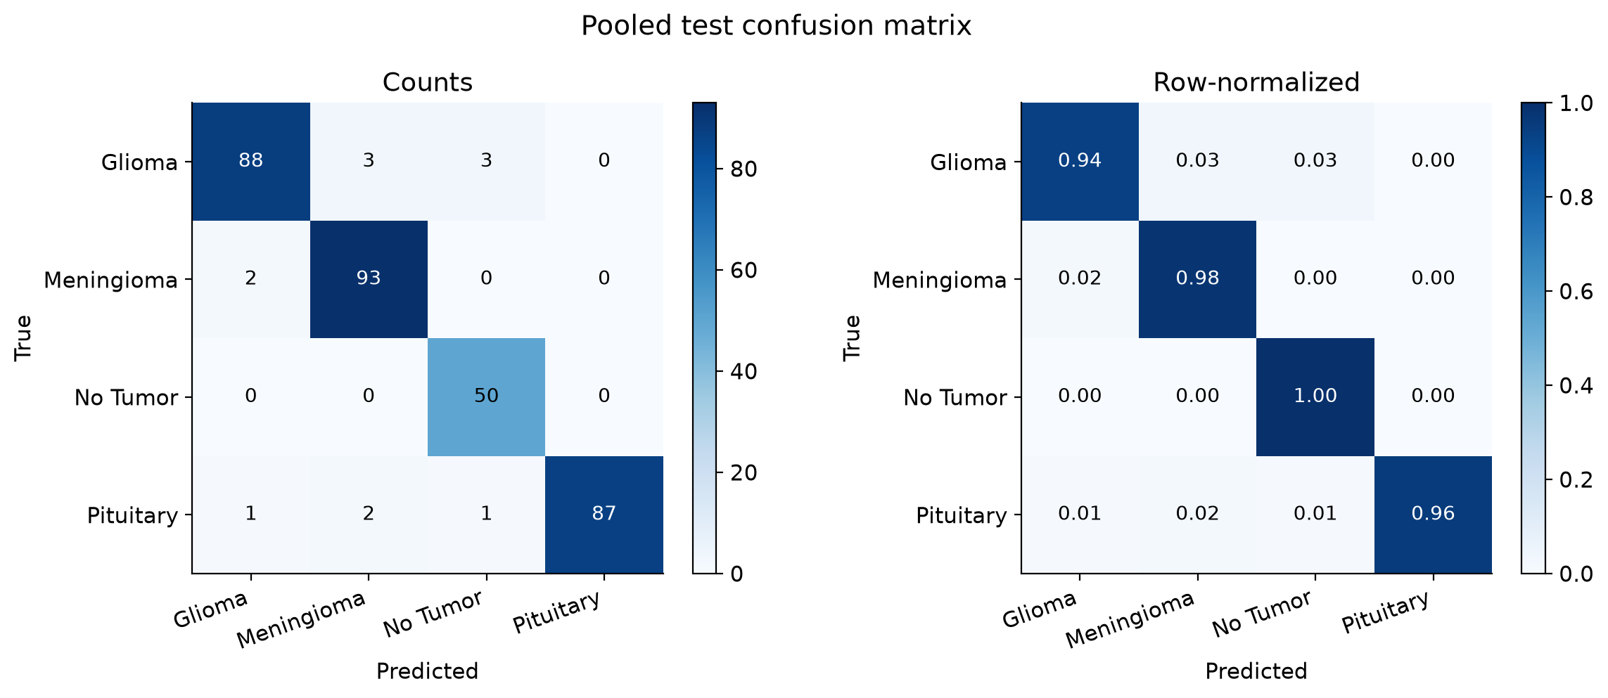
Per-Class Results — Pooled Test
PROTOCOL A · pooled stratified 80/10/10 split (seed 42) · test n = 330
Class | Precision | Recall | F1 | AUC | Support
Glioma | 0.967 | 0.936 | 0.951 | 0.995 | 94
Meningioma | 0.949 | 0.979 | 0.964 | 0.999 | 95
No tumor | 0.926 | 1.000 | 0.962 | 1.000 | 50
Pituitary | 1.000 | 0.956 | 0.978 | 1.000 | 91
Paper Table 4 (verified against results.json)
Real run: pooled test confusion matrix, counts and row-normalised (Figure 3)
12 errors of 330
6 of 12 at predicted-class probability ≥ 0.90
Glioma ↔ meningioma
the main boundary: 3 glioma → meningioma, 2 meningioma → glioma
No tumor
contributed no errors (recall 1.000)
Notes:
Sources: paper Table 4 (per-class metrics, pooled test n = 330), Figure 3 (confusion matrix), Table 5 and Discussion (12 errors; no-tumor class contributed no errors; six of 12 errors at predicted-class probability ≥ 0.90). Verified: runs/classify/nac_vit_pooled/results.json per_class (glioma P 0.967 R 0.936 F1 0.951 AUC 0.995; meningioma 0.949/0.979/0.964/0.999; no tumor 0.926/1.000/0.962/1.000; pituitary 1.000/0.956/0.978/1.000). Error counts read from figures/confusion_matrix.png (counts panel). Figure: runs/classify/nac_vit_pooled/figures/confusion_matrix.png.

Slide 11
Two Protocols, Two Measurements
Measure | Protocol A — pooled test | Protocol B — archive Testing folder
Test images | 330 (10% stratified, seed 42) | 394 (folder kept intact)
Correct | 318 | 309
Accuracy (95% Wilson CI) | 96.36% (93.8–97.9%) | 78.43% (74.1–82.2%)
Macro F1 · macro AUC | 0.964 · 0.998 | 0.750 · 0.924
Glioma recall · precision | 0.936 · 0.967 | 0.240 · 1.000
Meningioma recall · precision | 0.979 · 0.949 | 1.000 · 0.669
Validation accuracy (model selection) | 97.85% | 99.30%
What the two numbers show
Same recipe, different test sets: separate estimates, not one averaged result; the CIs do not overlap.
The drop is concentrated in glioma: 76 of 100 Testing-folder gliomas were assigned to other classes.
Implications for generalization
A: a within-collection estimate; it may overestimate performance on unseen patients.
B: a partial cross-collection check; the cause of the glioma drop is not isolated here.
Notes:
Sources: paper Table 3 (both protocols), Table 4 and Table 6 (per-class), Results 'Archive Testing folder as an external test' (309/394, 78.43%, Wilson 74.1–82.2%, macro F1 0.750, AUC 0.924; validation 99.30%; 24 of 100 gliomas correct, 76 assigned to other classes; meningioma recall 1.000 at precision 0.669), Materials and Methods (pooled split may overestimate generalization to unseen patients; Testing folder is a partial cross-collection check, not patient-level). Verified: runs/classify/nac_vit/results.json (acc 0.78426, macro F1 0.75008, AUC 0.92428, glioma P 1.0 R 0.24, best val 0.99298) and nac_vit_pooled/results.json. protocol_comparison.png deliberately NOT used (it includes the frozen-backbone 69.05% bar, not remeasured). The paper's Discussion attributes the drop to a shift between the two folders; the slide does not assert a cause.

Slide 12
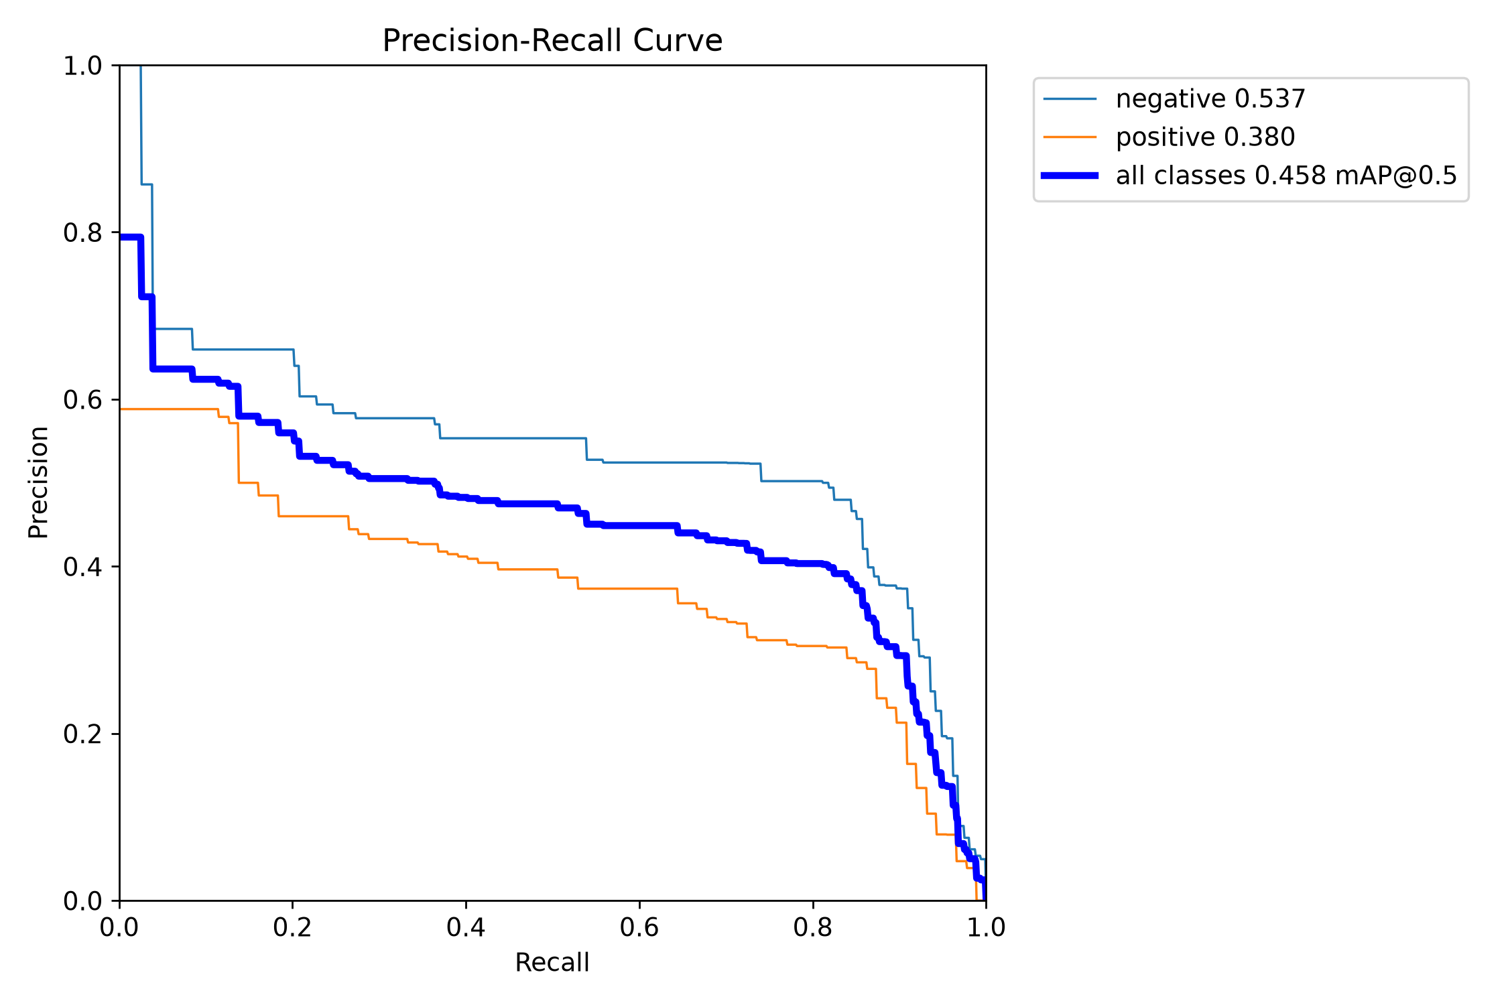
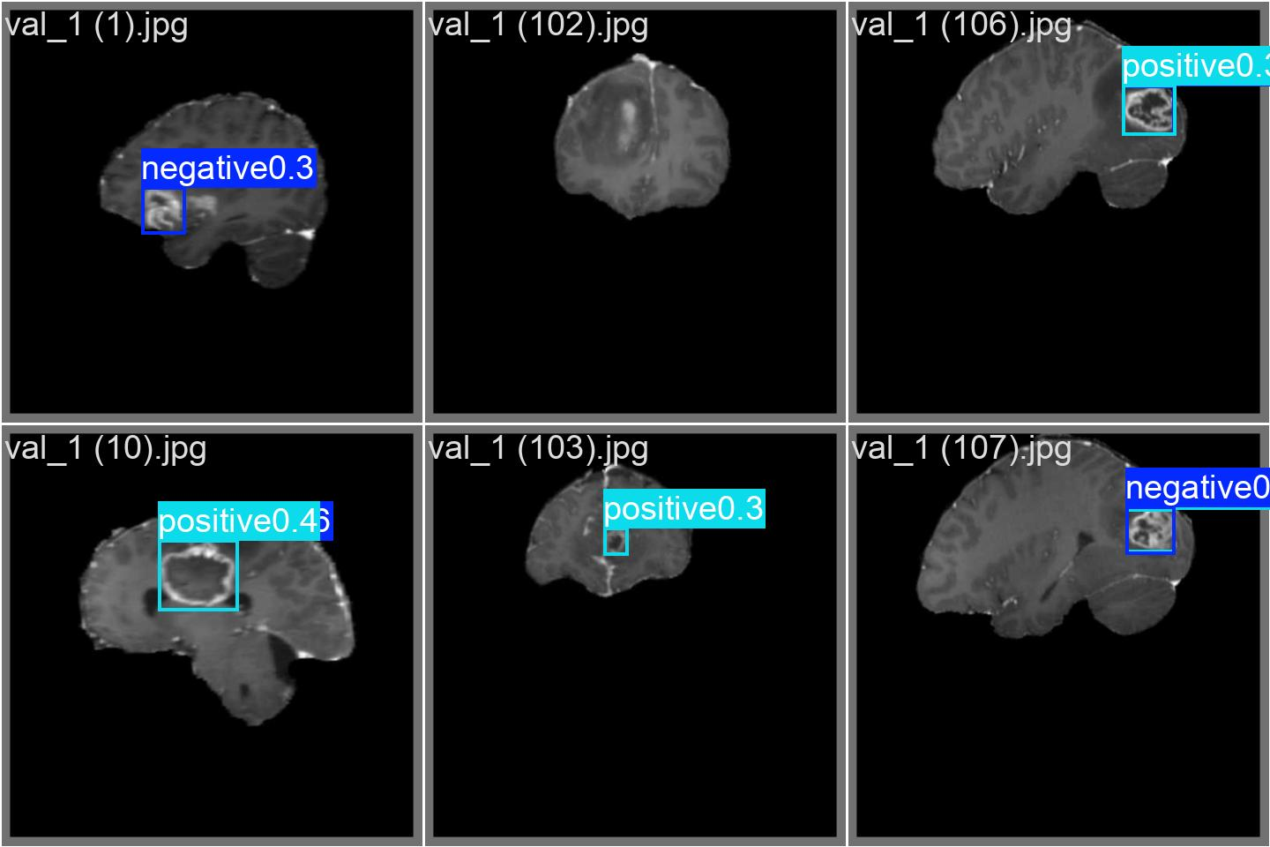
YOLO11m Detection — Separate Study
SEPARATE MEASUREMENT · different dataset (Ultralytics brain-tumor detection) · not coupled to NAC-ViT
Metric | Epoch 27 of 300
Precision | 0.417
Recall | 0.795
mAP@0.50 | 0.477
mAP@0.50:0.95 | 0.274
Real run: example validation predictions (val_batch0_pred, cropped); labels and confidences as output by the detector
YOLO11m · 640 × 640 · AdamW + cosine LR · 300 epochs, no early stopping; epoch of highest mAP@0.50
Real run: PR curve from the Ultralytics validation of the saved weights (legend 0.458); table = epoch-27 training-log peak
Reported at the peak
Later epochs did not improve on epoch 27; final-epoch metrics are not reported as results.
Evaluated independently
No detector output was passed to NAC-ViT.
A detect → classify pipeline is a design, not a measured result; no clinical claim.
Notes:
Sources: paper Detection model (YOLO11m, 640x640, 300 epochs, AdamW + cosine, no early stopping; metrics at epoch of highest mAP@0.50; no detector outputs passed to NAC-ViT; separate collections) and Table 7 (epoch 27 of 300: P 0.417, R 0.795, mAP@0.50 0.477, mAP@0.50:0.95 0.274; later epochs did not improve). Verified: runs/detect/brain_tumor_yolo/results.csv row epoch 27 (0.41652, 0.79542, 0.47664, 0.27443); args.yaml. Figures: runs/detect/brain_tumor_yolo/BoxPR_curve.png and val_batch0_pred.jpg (top 3x2 tiles cropped). DISCREPANCY: BoxPR_curve legend shows all-classes mAP@0.5 = 0.458 (Ultralytics final validation of saved weights), not 0.477 (epoch-27 training-log value). Final epoch 300 in results.csv: mAP50 0.003 (run degraded after the peak). Paper Discussion: two-stage pipeline is a design, not a measured end-to-end accuracy.

Slide 13
Discussion & Limitations
Discussion
Two protocols: 96.36% pooled vs 78.43% Testing folder — different test sets, CIs do not overlap; neither estimates the other.
Class-specific: Testing-folder drop concentrated in glioma (recall 0.240, precision 1.000); pooled errors cluster at glioma–meningioma, 6 of 12 at p ≥ 0.90.
Gates near init: φ, ω stayed ≈ 0.693, so the gain over the frozen run (69.05%, not remeasured) is attributed mainly to backbone adaptation.
Detection: recall 0.795 > precision 0.417 — relevant if a localizer precedes a classifier.
Limitations
Single public collection; no patient identifiers, so no patient-level split — the pooled estimate may overestimate.
No second institution, additional MR sequence, or clinical reader study.
No end-to-end evaluation: detector boxes were never passed to NAC-ViT; separate collections.
Detection peak only: epoch 27 reported; later epochs did not improve (log: mAP@0.50 0.003 at epoch 300).
Not reproduced: frozen-backbone 69.05%; no cross-validation or bootstrap.
Before any clinical use: multi-institutional, patient-level external validation and reader studies are required.
Notes:
Sources: paper Discussion (protocols and non-overlapping Wilson CIs; glioma recall 0.240 / precision 1.000; 12 pooled errors class-structured, 6 at p ≥ 0.90; frozen-backbone 69.05% partial ablation, gates near initialisation → backbone adaptation; detection recall > precision relevant before a classifier) and limitations paragraph (single collection, no patient-level split, no second institution / MR sequence / reader study, 69.05% not repeated, two-stage pipeline is a design, multi-institutional patient-level datasets needed for clinical readiness); Statistical reporting (no cross-validation or bootstrap). Epoch-300 mAP50 0.003 from runs/detect/brain_tumor_yolo/results.csv (not stated in the paper; paper says later epochs did not improve on the peak).

Slide 14
Conclusion & Future Work
Completed — measured in this study
96.36%
Protocol A pooled test: 318/330 correct
78.43%
Protocol B Testing folder: 309/394; deficit in glioma recall
φ, ω ≈ init
gate and leak stayed near 0.693; readable from the checkpoint
0.477
YOLO11m mAP@0.50 at epoch 27 — separate measurement
Proposed — not yet measured
Controlled ablation without NAC (same backbone, splits and seeds)
Domain-shift mitigation: domain adaptation, multi-source training
Multi-institutional, patient-level validation
1
2
3
Integrated crop-then-classify evaluation (detector → classifier)
Clinical reader studies
When do φ and ω diverge from init? (larger, more heterogeneous data)
4
5
6
Notes:
Sources: paper Conclusions (96.36% 318/330; 78.43% 309/394, deficit in glioma recall; gate and leak near initialisation, readable from the checkpoint; generalization needs multi-institutional validation and clinical reader studies), Table 7 (0.477 at epoch 27), Discussion (future controlled ablation without NAC; domain adaptation / multi-source training; conditions under which φ and ω diverge; end-to-end crop-then-classify not available) and limitations (multi-institutional patient-level datasets). Not included because the paper does not propose them: 'better detection' and 'prospective clinical evaluation' (paper says clinical reader studies).

Slide 15
THANK YOU
Questions & Discussion
Dr. Bhavesh C Kataria · bhavesh.iisc@gmail.com
Code: https://github.com/kbhavesh-emory/NAC-ViT-Brain-Tumor-Classification
Acknowledgment: Training was performed on PARAM Shavak at IAR University. The author thanks the maintainers of the public MRI archives used here.
ICISHCT 2026 • International Conference on Intelligent, Secure and Human-Centered Technologies
Notes:
Sources: paper title block (email), Data and code availability (code URL), Acknowledgment (PARAM Shavak at IAR University; maintainers of public MRI archives).

