Slide 1
IMDB Movie Ratings
Neha Gandhi; Faariya F Sheikh; Akhila Puthengot; Kristen Biskobing; Andrew Yang

Slide 2

Data from kaggle.
IMDB information for 5043 movies.
27 included features – numerical 15 and categorical 12

Slide 3
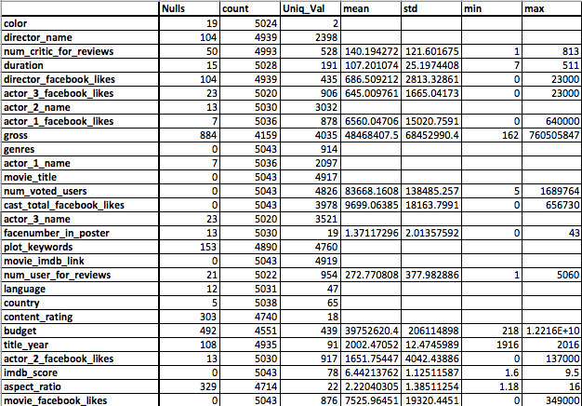
Data Summary

Slide 4
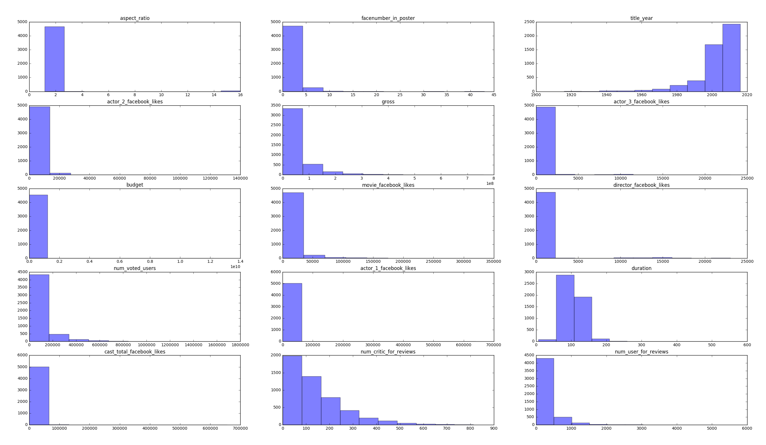
Numeric Features

