Slide 1



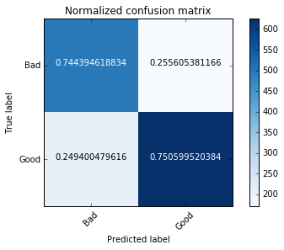
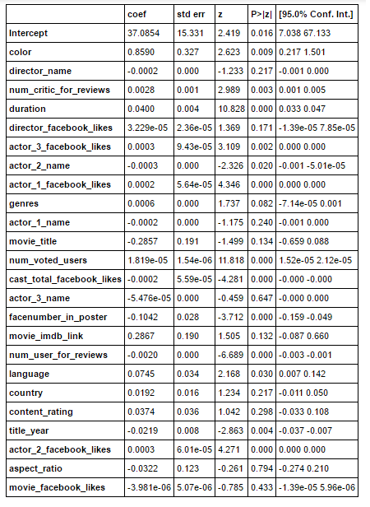


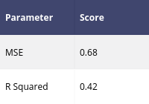
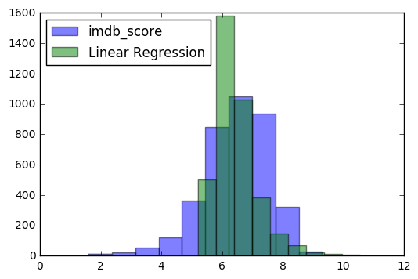

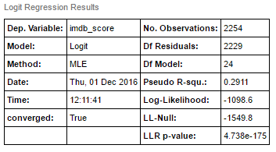
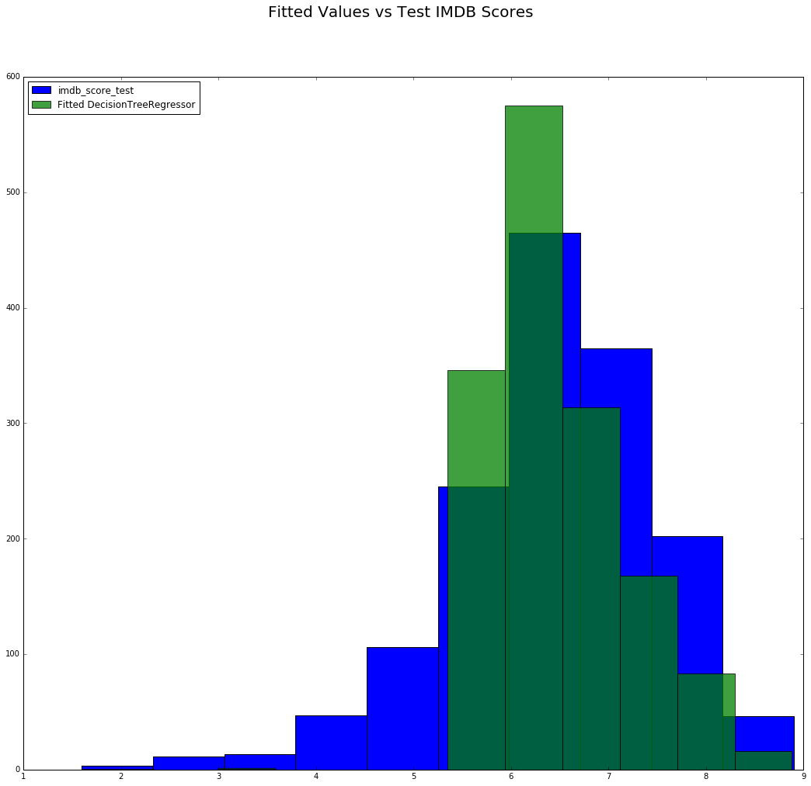
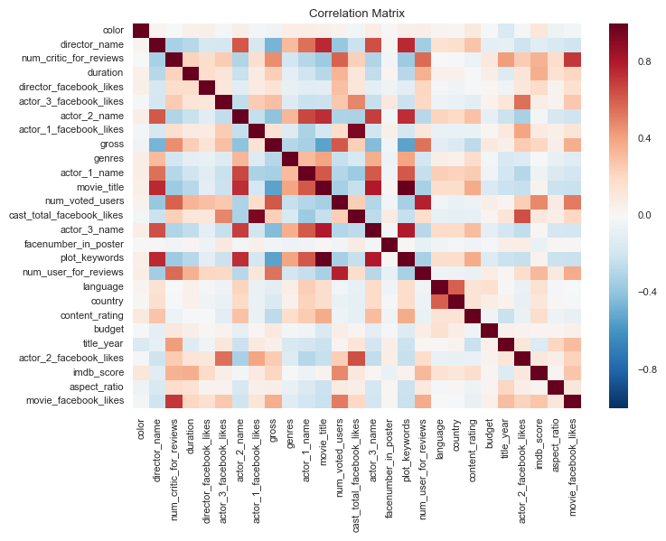
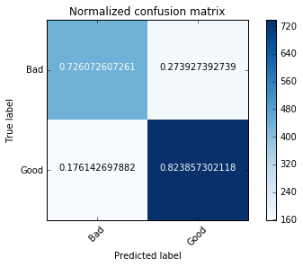
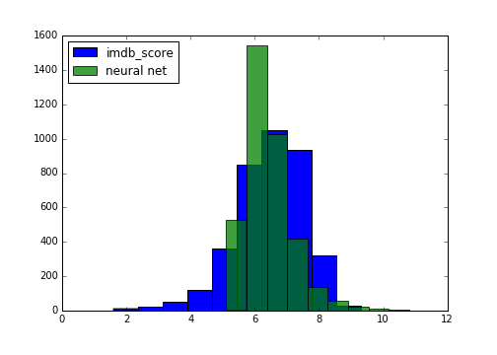
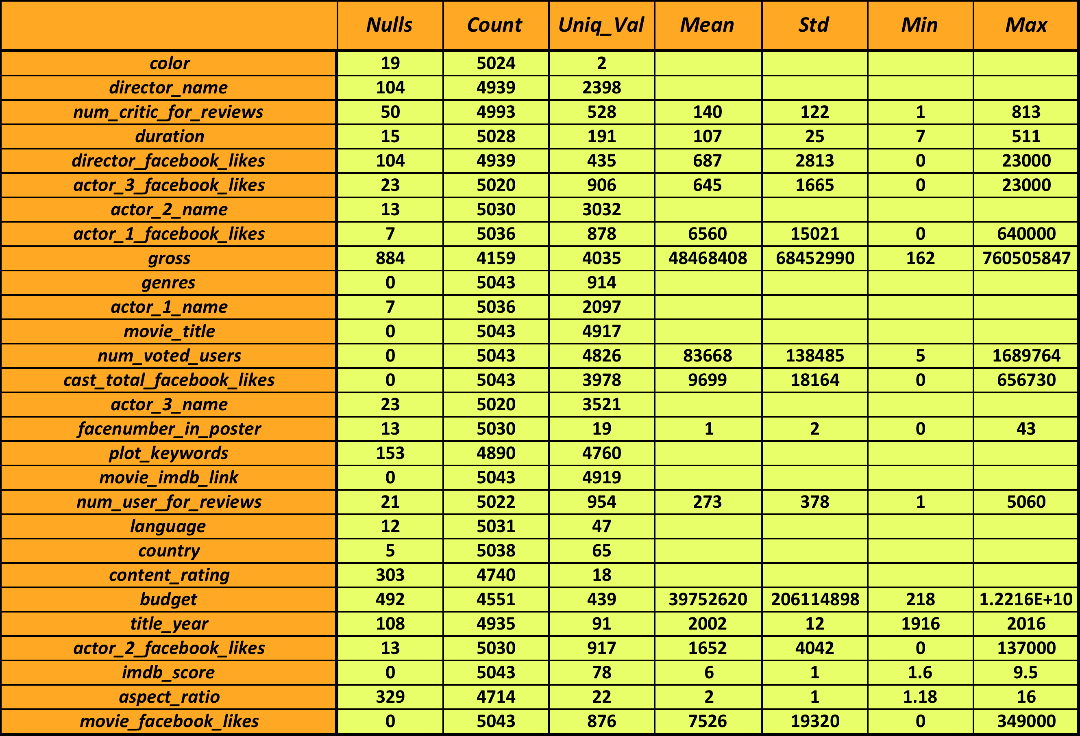
Predicting Movie Ratings
The Data
Regression
Classification
Comparison
The imdb dataset was used. To start the data encompassed 28 variables for 5043 movies spanning 100 years from 66 different countries. It contains 2399 unique directors and actors/actresses. The 28 variables can be found below:
Linear Regression
Logistic Regression
The R squared value is showing a definitive amount of variance between the predicted and test data.
A single layer in a neural net using regression is basically linear regression so the results were almost the same between these two models.
Data Statistic/Summary
Of the regression models the tree performed best. Both the linear regression and neural net were skewed towards better scores and even predicted higher than 10 for a few movies while the tree predicted more conservatively and stayed within the score bounds.
 | precision | recall | f1-score | support
0 | 0.7 | 0.75 | 0.72 | 669
1 | 0.79 | 0.75 | 0.77 | 834
avg/total | 0.75 | 0.75 | 0.75 | 1503
For the classification models the random forest seemed to perform slightly better than the logistic.
Regression Tree
After, review budget and gross were removed because they were found to be in the country’s currency where the movie was made. Converting to a single currency would not work since the survey covers many years, so we would have to account for inflation, fluctuation in exchange rates, and countries changing their currency.
Conclusions
Correlation Matrix
Random Forest
Used 2 categories for y and the model does not perform well for Bad and Good categories though it gives good precision for the Average category.
Using the regression models a production company could get a good idea of how well a movie will be received before the movie is released. Since all of the models have similar mse, depending on if a production company wanted to be conservative or aggressive, they could use the linear regression model or the regression tree.
The classification models could be used for a general idea about the movie, similar to rotten tomatoes fresh rating, with around a 75% accuracy rate.
 | Precision | Recall | F1-score | Support
A | 0.77 | 0.92 | 0.84 | 935
B | 0 | 0 | 0 | 46
G | 0.8 | 0.6 | 0.69 | 522
Avg/Total | 0.76 | 0.78 | 0.76 | 1503
Neural Net
Since there were so many directors and actors we decided to try a neural net. Multiple hidden layers were tried but a single layer was found to be the most accurate.
Used 2 categories for y, and this model gives better results as compared to the one with 3 categories for y(IMDB_score)
 | Precision | Recall | F1-score | Support
B | 0.73 | 0.73 | 0.73 | 606
G | 0.82 | 0.82 | 0.82 | 897
Avg/Total | 0.78 | 0.78 | 0.78 | 1503
Plot keywords and imdb_link were both removed as they were found to be highly correlated to movie title. The cleaned data set consists of 3,756 movies and 23 different variables. The output we are trying to predict is the imdb_score.
References:
https://www.kaggle.com/deepmatrix/imdb-5000-movie-dataset

