Slide 1


Slide 2



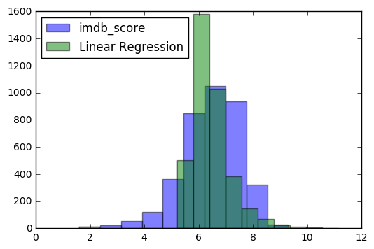


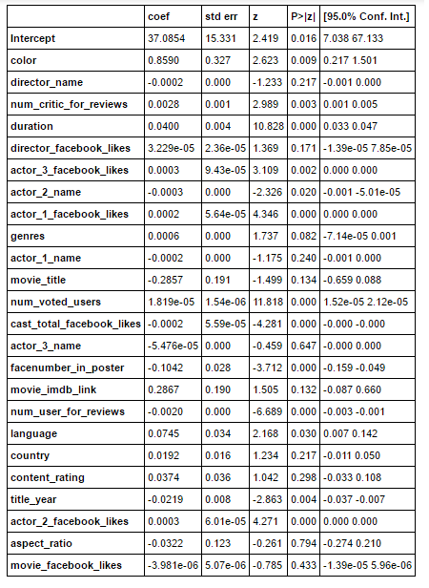


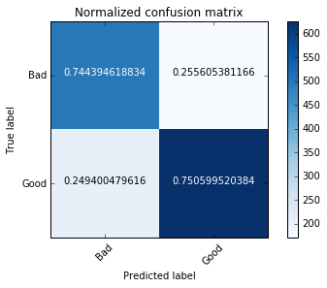

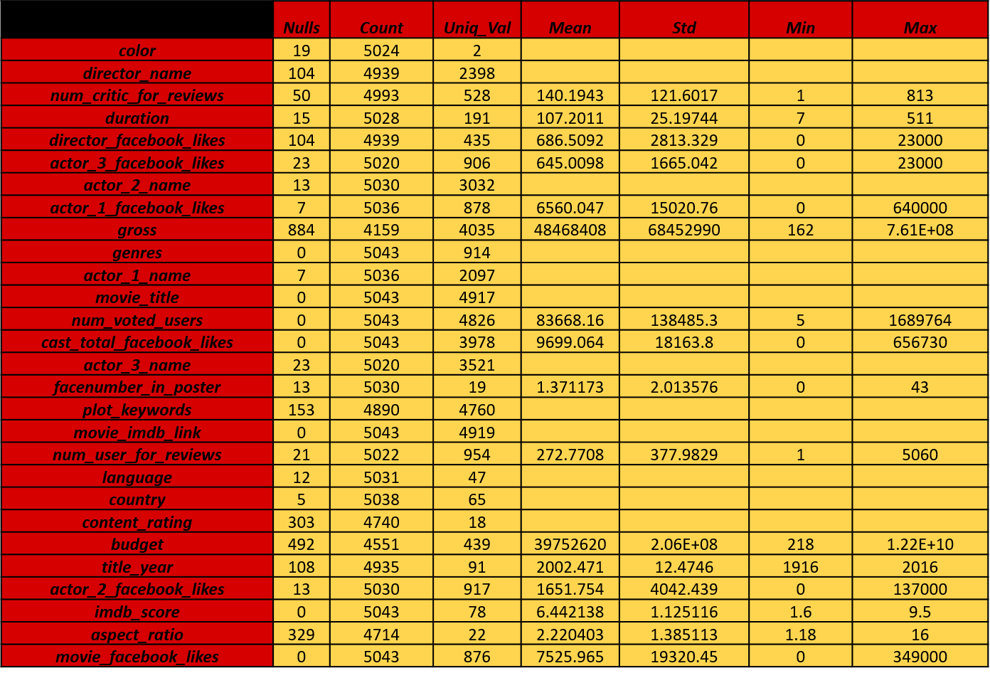
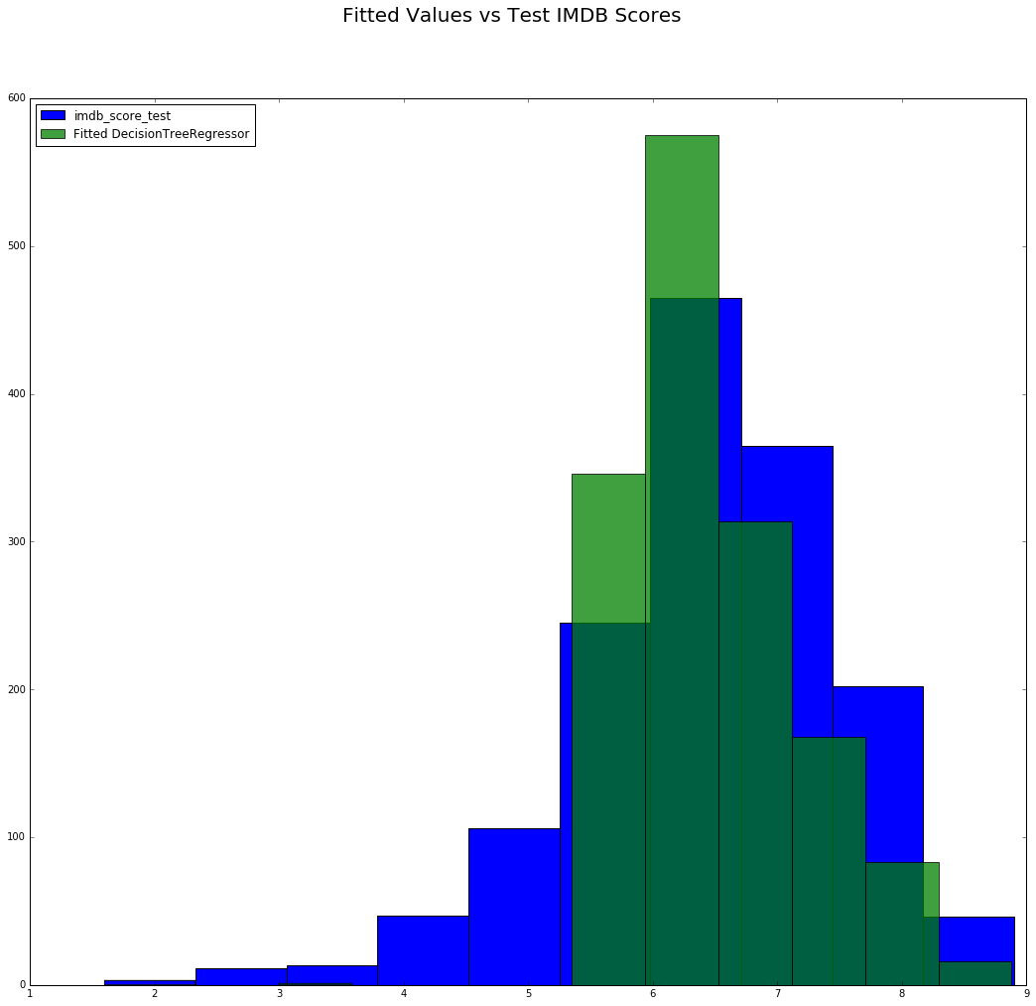
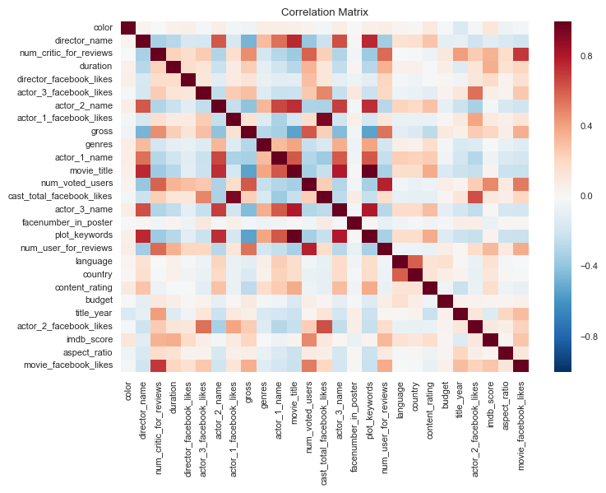
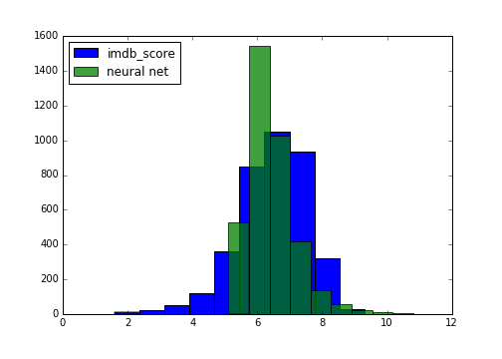
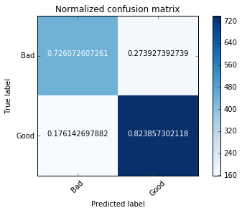
PREDICTING MOVIE RATINGS
Objective
Regression
Classification
Results
Use regression models to predict the IMDb number score of a particular movie based on several features related to the movie, as well as classification models to predict whether the movie will be scored good or bad; compare the accuracy/error of the various models to determine which one would potentially give the best prediction.
A single layer in a neural net using regression is basically linear regression so the results were almost the same between these two models.
Linear Regression
Logistic Regression
The summary output from the logistic regression provides the coefficients of the variables, their standard errors, the z-statistics, and their associated p-values. The p-values give the best indication of which x-variable feature(s) are the most significant in relation to IMDb score. For example, the number of Facebook likes that cast members for a movie accumulated, as well as the number of critics that reviewed the movie both have p-values below 0.05, indicating their significance. In addition, the output gives the 95% confidence interval.
The classification models gave the best results when using just two categories for the y-variable: Good or Bad. While two versions of the Random Forest model were tested (with two categories vs. with three categories), just two proved to have better precision and more valid confusion matrix.
All of the regression models were accurate to around half a point of the actual IMDb score.
The R squared value is showing a definitive amount of variance between the predicted and test data. Only 42 % of the error can be explained by the linear regression model.
Summary from Logit Regression output
The Data
The IMDb dataset was used. To start, the data encompassed 28 variables for 5043 movies spanning 100 years from 66 different countries. Movies, tv shows, and miniseries were all included. It contained 2400 unique directors and 3600 different actors and actresses in three separate fields. The plots and genres were grouped into single fields as a pipe delimited list.
Of the regression models the tree performed best. Both the linear regression and neural net were skewed towards better scores and even predicted higher than 10 for a few movies while the tree predicted more conservatively and stayed within the score bounds.
The Linear Regression gives a distributed performance, predicting well for some range but adding false predictions along some. The most important predictor was found to be the cast Facebook likes, showing that the popularity of the cast is a determining factor in IMDb ratings.
There are two possible predicted classes: “Good” IMDb rating or “Bad” IMDb rating. The confusion matrix gives an indication of how well the regression model performs, and an accuracy rate can be calculated from it.
Data Statistic/Summary
For the classification models, the random forest seemed to perform slightly better than the logistic according to the accuracy rate.
After review, the budget and gross monetary fields were removed because they were in the country’s currency where the movie was made. Converting to a single currency would not work since the survey covers many years. We would have to account for inflation, fluctuation in exchange rates, and countries changing their currency.
Regression Tree
Accuracy: 0.7458
 | precision | recall | f1-score | support
Bad | 0.7 | 0.75 | 0.72 | 669
Good | 0.79 | 0.75 | 0.77 | 834
avg/total | 0.75 | 0.75 | 0.75 | 1503
The Regression Tree predicts IMDB scores 5.5 to 7.5 more accurate then scores lower than 5 and higher than 8.5.
Generally, more voted users result in higher scores
From the regression tree (not shown here), more facebook likes (for actor 1, actor 2, director, movie, …etc) result in higher IMDB scores, while more number of critic reviews result in lower IMDB scores
The MSE value 0.589 is manually calculated from the Cumulative sum of [Sample(i)*MSE(i)] / # number of samples, where Sample(i) and MSE(i) is shown in each box at the end of the regression tree
Conclusions
Importance
A good score is defined as having a value greater than or equal to the mean of the values from the data. A bad score would be less than the mean. When “Good” is predicted, it is correct 79% of the time, according to the precision table.
Production budgets can range from the a few thousand to hundreds of millions of dollars. If a company has an easy way to quickly judge the consumers interest this can help them decide whether a movie is worth making and/or if the expenditure should be decreased, potentially saving the firm millions of dollars.
Using the regression models, a production company could get a good idea of how well a movie will be received before the movie is released. This could give them a notion about budget. Since all of the models have similar MSE, depending on if a production company wanted to be conservative or aggressive, they could use the linear regression model (aggressive) or the regression tree (conservative).
The classification models could be used for a general idea about the movie, similar to rotten tomato’s fresh rating, with around a 75% accuracy rate. This could be used to immediately identify if the movie should be considered for production.
Overall the classification models perform slightly better (the highest accuracy being 78%) and we might be able to enhance the accuracy further by pruning the models.
Correlation Matrix
Even though plot keywords and imdb_link had the highest symmetrical uncertainty, both were removed from the data set as they were found to be highly correlated to movie title, which is basically the id for the rating.
Random Forest
Accuracy: 0.7804
Neural Net
Since there were so many directors and actors we decided to try a neural net. Models with 1, 2, and 3 hidden layers and multiple different nodes were tried but the single layer with 5 nodes was found to be the most accurate.
We used all features in the set for our random forest model. In the first model, we divided the y feature i.e. IMDb score in 3 categories: Bad, Average & Good. Since our dataset is small, we did not have many movies that fell into Bad category, and as a result, the confusion matrix for this model did not work well for this category. But in the second model, when we split our y in 2 categories (basis the mean rating/score: Good & Bad) the model performed well, and it gave us a total accuracy of about 78%
The MSE went down as more layers and nodes were added. The number of layers seemed to effect the model more than the number of nodes.
 | Precision | Recall | F1-score | Support
A | 0.77 | 0.92 | 0.84 | 935
B | 0 | 0 | 0 | 46
G | 0.8 | 0.6 | 0.69 | 522
Avg/Total | 0.76 | 0.78 | 0.76 | 1503
References:
https://www.kaggle.com/deepmatrix/imdb-5000-movie-dataset
The most effective model contained the following: All 3 actor names, the director, genre, number of voted users, number of critics and user reviews, duration, facebook likes of the cast, director and movie, language, country, content rating, and aspect ratio.
 | Precision | Recall | F1-score | Support
B | 0.73 | 0.73 | 0.73 | 606
G | 0.82 | 0.82 | 0.82 | 897
Avg/Total | 0.78 | 0.78 | 0.78 | 1503
After eliminating the fields that were not going to be used, we then removed all of the rows which were missing values in any of the fields. The cleaned data set consisted of 3,756 movies and 23 different variables.
Kristen Biskobing | Neha Gandhi | Akhila Puthengot | Faariya Sheikh | Andrew Yang

