Slide 1
Customer Trends & Growth Opportunities
Konstantinos Bitos, Bsc Mechanical Engineer & Data Analyst 1/1/22

Slide 2
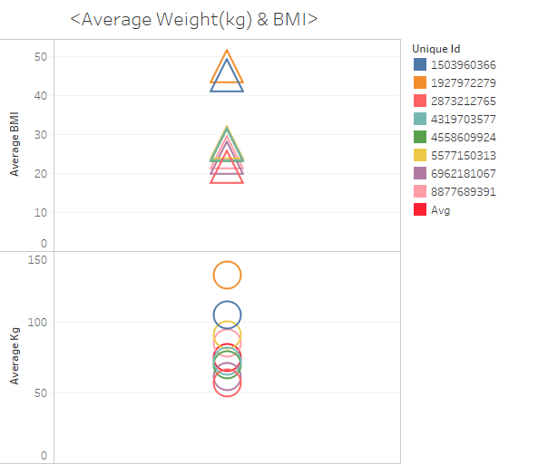
Key Takeaway(s):
Customer average is 65 kg in weight and have a 24 BMI.
Target audience should be adjusted accordingly.

Slide 3
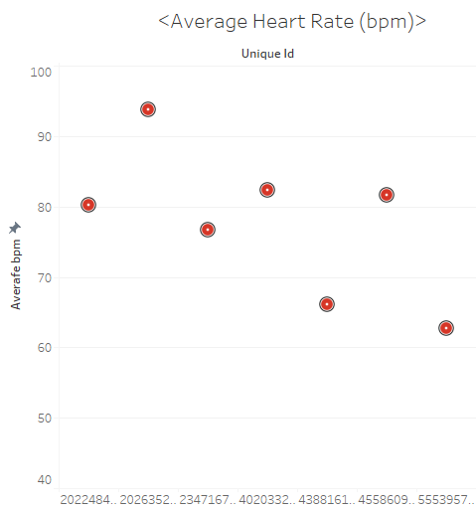
Heart Rate Sensory System
Key Takeaway:
Customer average heart rate is 78 bpm.

Slide 4
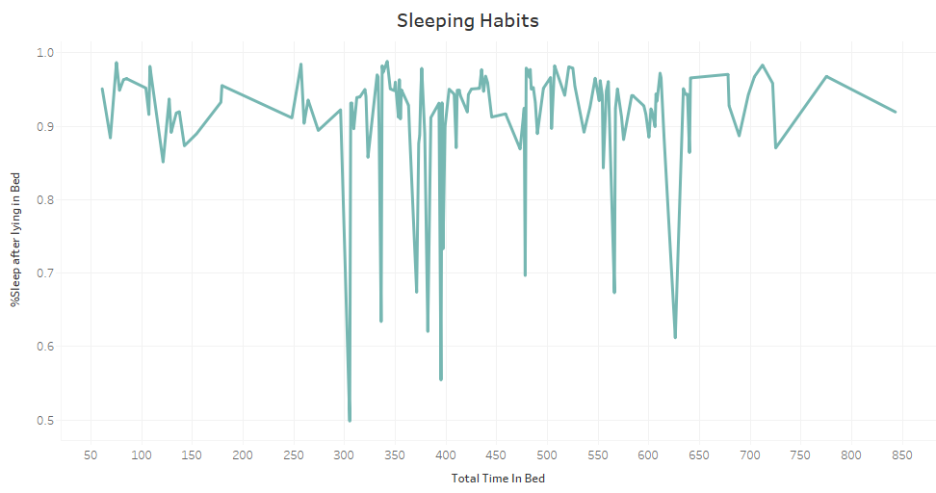

Slide 5
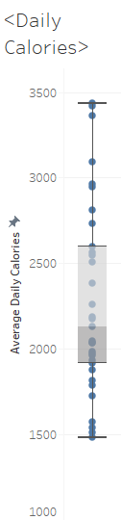
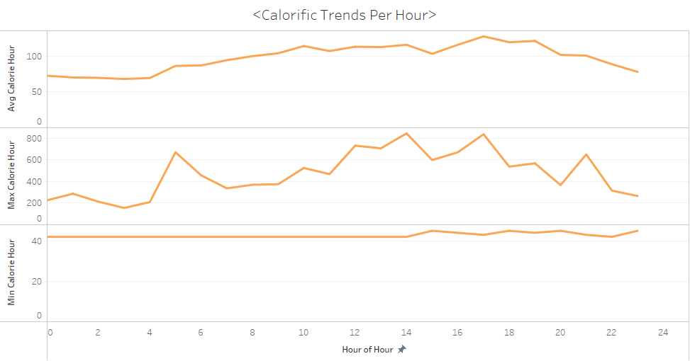

Slide 6
Key Takeaway(s)
Average User Daily Calories are 2661
User burn 660-860 calories more than the sedentary standard calorie burning natural process throughout the day.
Peaks in hourly burning occur during 5 to 7 AM, 12 to 5 PM & 9PM.
Higher average calorie burning occurs between 8 AM till 8 PM.

Slide 7
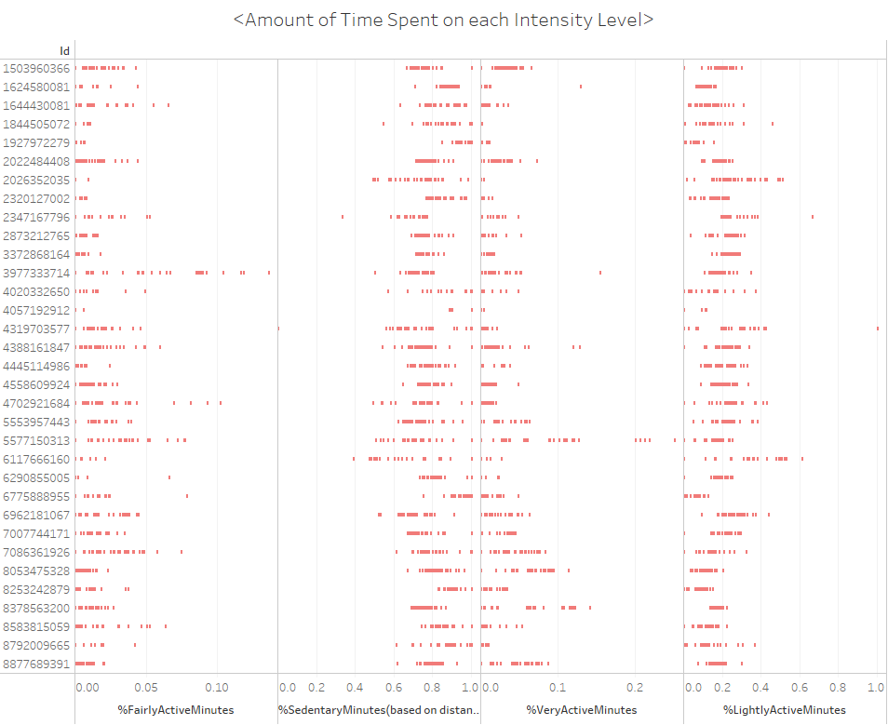
Key Takeaway(s):
Customers mostly exercise on a light intensity.
Fairly Active is less prevalent than Very Active
Target audience has a very active thus more athletic trend.

Slide 8
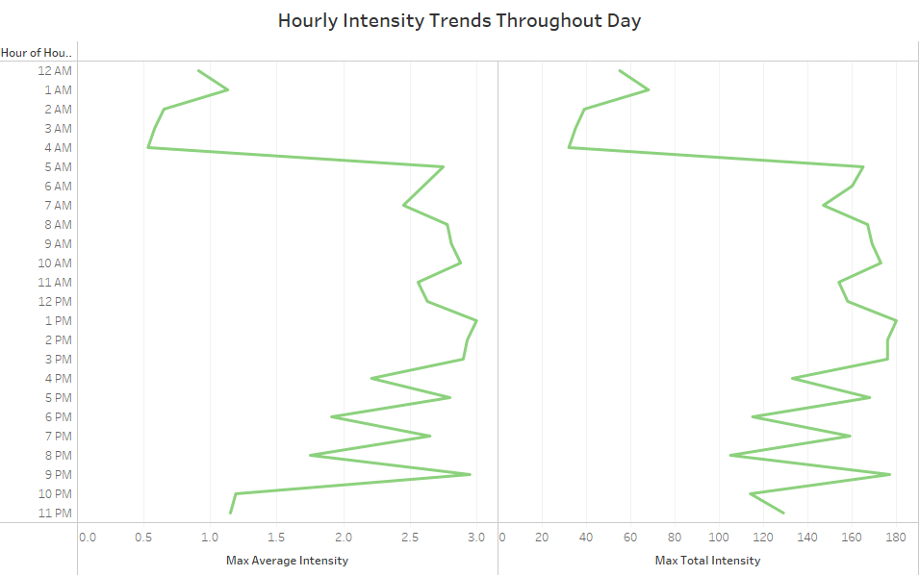
Key Takeaway(s):
Aforementioned hourly calorie burning peaks are validated from the intensity of exercise trends.

Slide 9
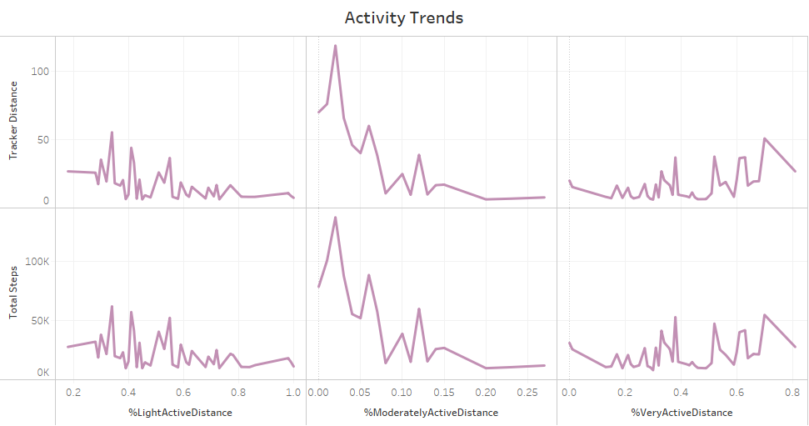

Slide 10
Average | Total Steps | Total Distance | Tracker Distance | Very Active Distance | Moderately Active Distance
 | 14309.18033 | 10.6836065 | 10.6836065 | 4.825737717 | 0.575245897
 | Light Active Distance | Sedentary Active Distance | Very Active Minutes | Fairly Active Minutes | Lightly Active Minutes
 | 5.255573777 | 0.002622951 | 53.24590164 | 14.78688525 | 231.0491803
 | Sedentary Minutes | Calories | %Very Active Distance | %Moderately Active Distance | %Light Active Distance
 | 972.9836066 | 2661.262295 | 0.38 | 0.06 | 0.55

Slide 11
Overall trends
We notice a target audience of highly athletic women , with a rising interest in blood oxygen saturation (SpO2) tracking and menstrual reminders[3].
Sleek Athletic-friendly yet her-oriented design
Eye gratifying design

Slide 12
Change the design/features
Introduce more high-value items
Pros:
Fully water resistant
SpO2 sensor focuses on menstrual cycle needs
Cons:
May alienate consumer base
Pros:
Expands overall inventory
Leans into luxury branding
Cons:
High production costs

Slide 13
Next steps:
Survey to determine customer tolerance for price increase.
Analyze production costs.
Compare with new desing initiative estimated revenue.

Slide 14
Bibliography/Source(s):
https://www.cdc.gov/physicalactivity/basics/measuring/heartrate.htm
https://www.goodto.com/wellbeing/diets-exercise/what-is-calorie-how-many-lose-weigt-425557
https://www.hsph.harvard.edu/news/multimedia-article/gaining-insight-into-womens-health/
https://www.gov.uk/government/news/say-thank-you-to-someone-at-companies-house

Slide 15

[4]

