Slide 1
Intrinsic dimension and Low-Rank adaptation (of LLMs)
Kebei Jiang
05/04/2023

Slide 2
Disclaimer
Old papers
Intrinsic Dimension is introduced in 2018
Self serving bias
Will digress
Will talk about stuff I don’t really understand!
Notation
Gray: my question/comment
Bold: trainable parameters

Slide 3
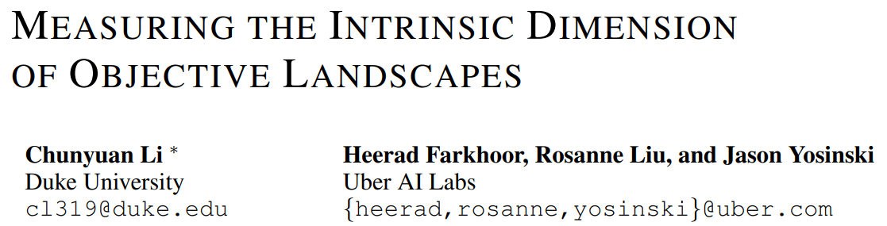
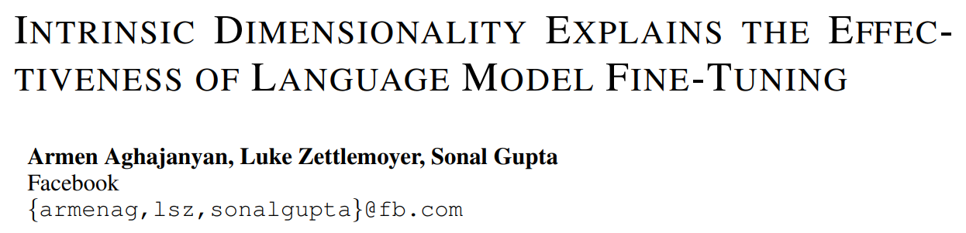
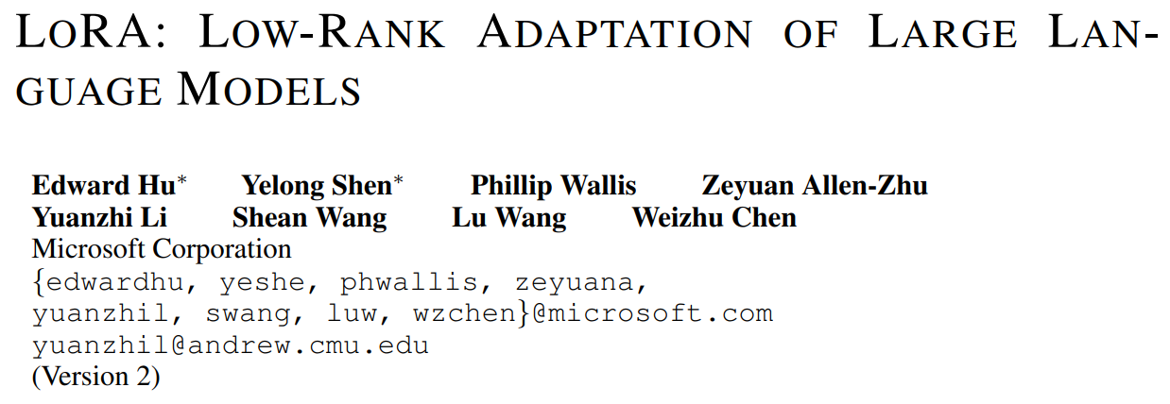
Big picture
ID
A tool to understand objective landscape (measure how well a model fits a task)
Accidentally, a parameter efficient model training (subspace training)
ID
IDFT
IDFT
Why pretraining + finetuning so efficient
Try to answer with ID
LoRA
LoRA
One instance of subspace training

Slide 4
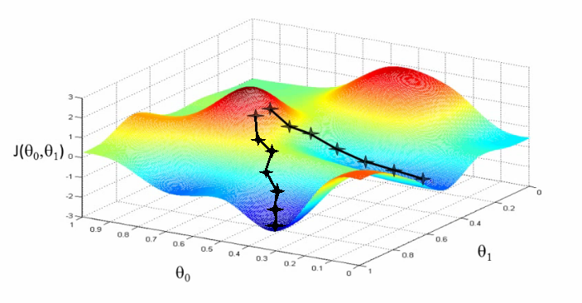
ID: Objective Landscapes
Fully determined by dataset and network architecture (with objective function)
Normally, training can make change in any direction to follow any path
Redundant dimensions/parameters
Easier training (larger solution set; more training directions?)
How to quantify which models are more efficient for given dataset (need better metric than # of params.)
Image source: https://www.holehouse.org/mlclass/01_02_Introduction_regression_analysis_and_gr.html

Slide 5
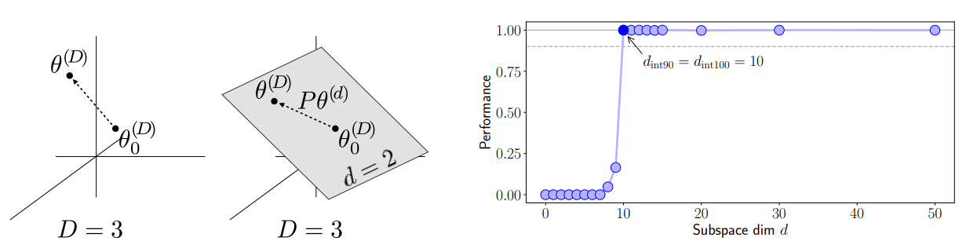
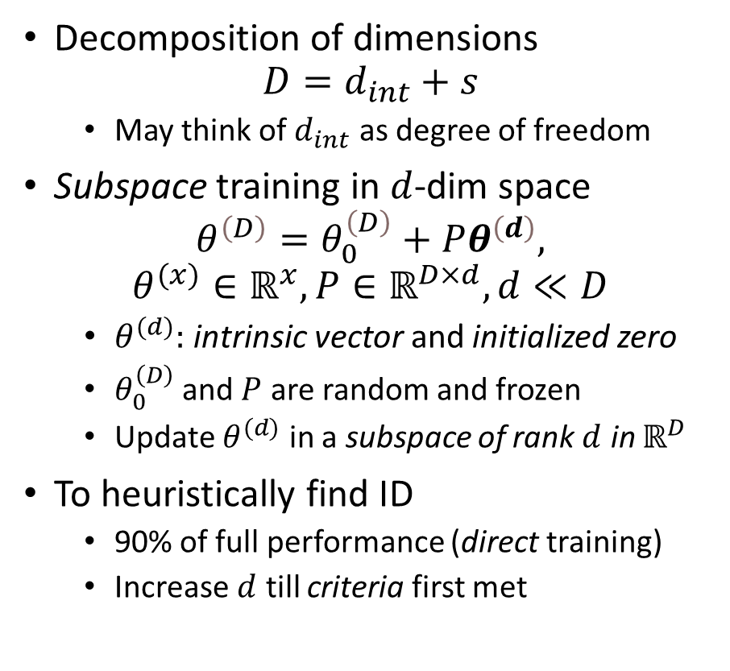

ID: Intrinsic Dimension
Decomposition of dimensions
$$D=d_{int}+s$$
May think of $d_{int}$ as degree of freedom
Subspace training in $d$-dim space
$$θ^{\left(D\right)}=θ_{0}^{\left(D\right)}+Pθ^{\left(d\right)},$$
$$θ^{(x)}∈ℝ^{x}, P∈ℝ^{D×d}, d≪D$$
$θ^{(d)}:$intrinsic vector and initialized zero
$θ_{0}^{\left(D\right)}$and $P$ are random and frozen
Update $θ^{(d)}$ in a subspace of rank $d$ in $ℝ^{D}$
To heuristically find ID
90% of full performance (direct training)
Increase $d$ till criteria first met
Perf = 1 is direct training in $ℝ^{D}$
Fig 1 of paper

Slide 6
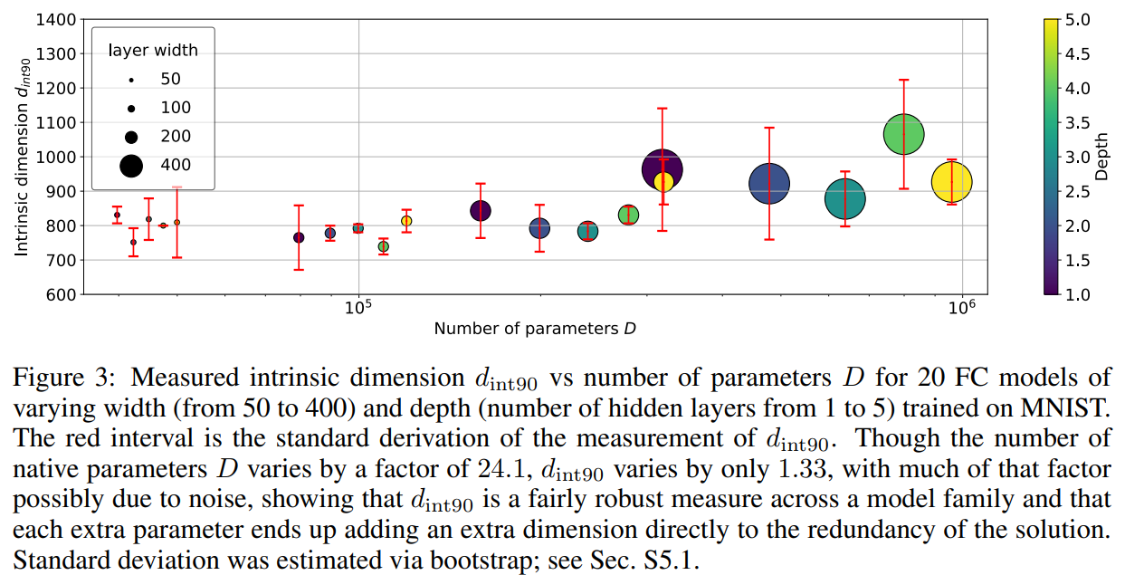
ID: Use case 1 (MNIST, FC of different sizes)
FCs of different width/depth share similar ID
ID is tighter than num of parameters
Added dimensions go directly into solution set
Possibly explains why larger NNs are easier to train
Subspace training is parameter efficient for compression/training
1 seed + 1 seed + 750 params < 784 pixels!
Fig 3 of paper

Slide 7
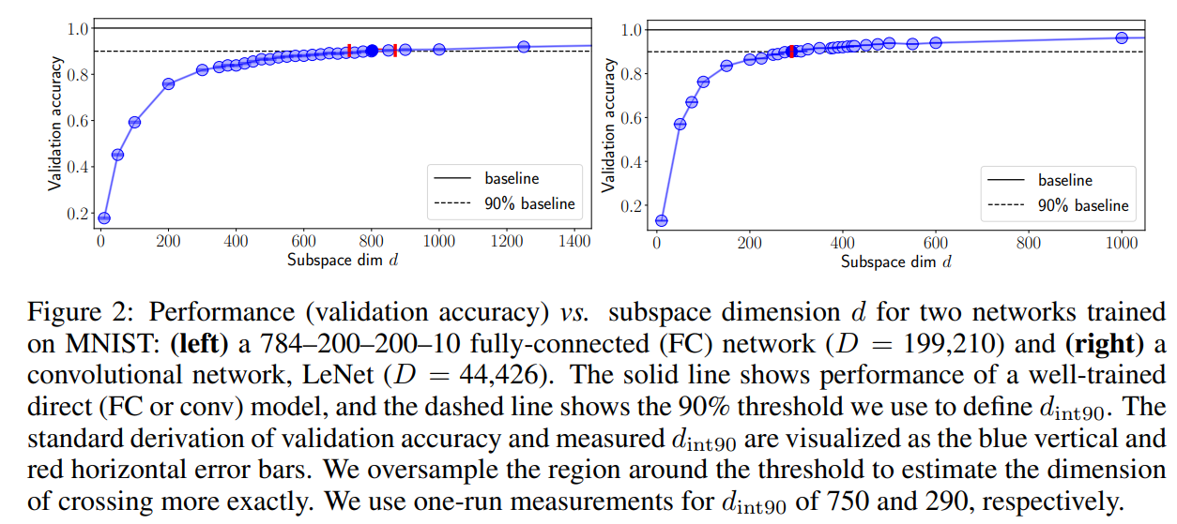
ID: Use case 2 (MINST, FC vs LeNet)
FC
LeNet
LeNet with a lower ID than FC (290 vs 750) being the better network for the task
ID is positively correlated with our experience
When image pixels are scrambled:
ID of FC stays the same because FC is invariant to the permutation
ID of LeNet jumped from 290 to 1400 (inductive bias)
Fig 2 of paper

Slide 8
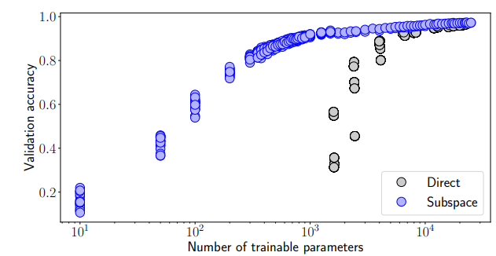
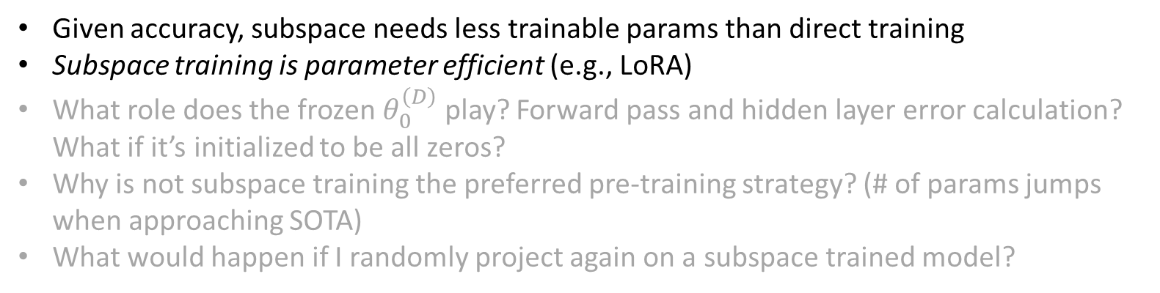
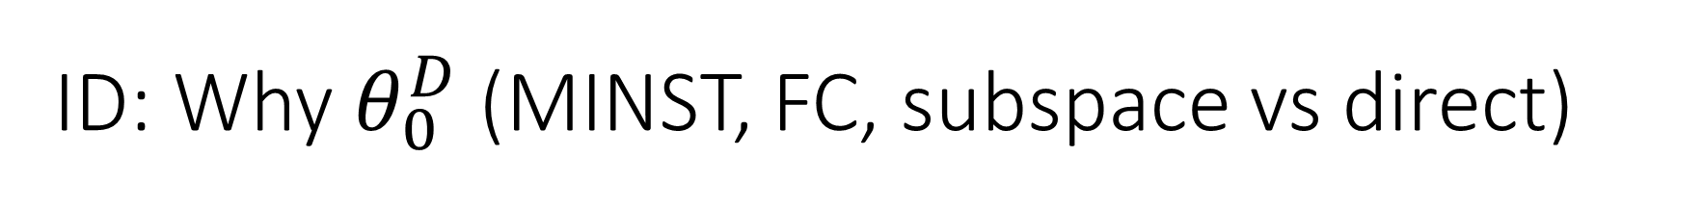
ID: Why $θ_{0}^{D}$(MINST, FC, subspace vs direct)
Given accuracy, subspace needs less trainable params than direct training
Subspace training is parameter efficient (e.g., LoRA)
What role does the frozen $θ_{0}^{\left(D\right)}$ play? Forward pass and hidden layer error calculation? What if it’s initialized to be all zeros?
Why is not subspace training the preferred pre-training strategy? (# of params jumps when approaching SOTA)
What would happen if I randomly project again on a subspace trained model?
Fig 4 of paper

Slide 9
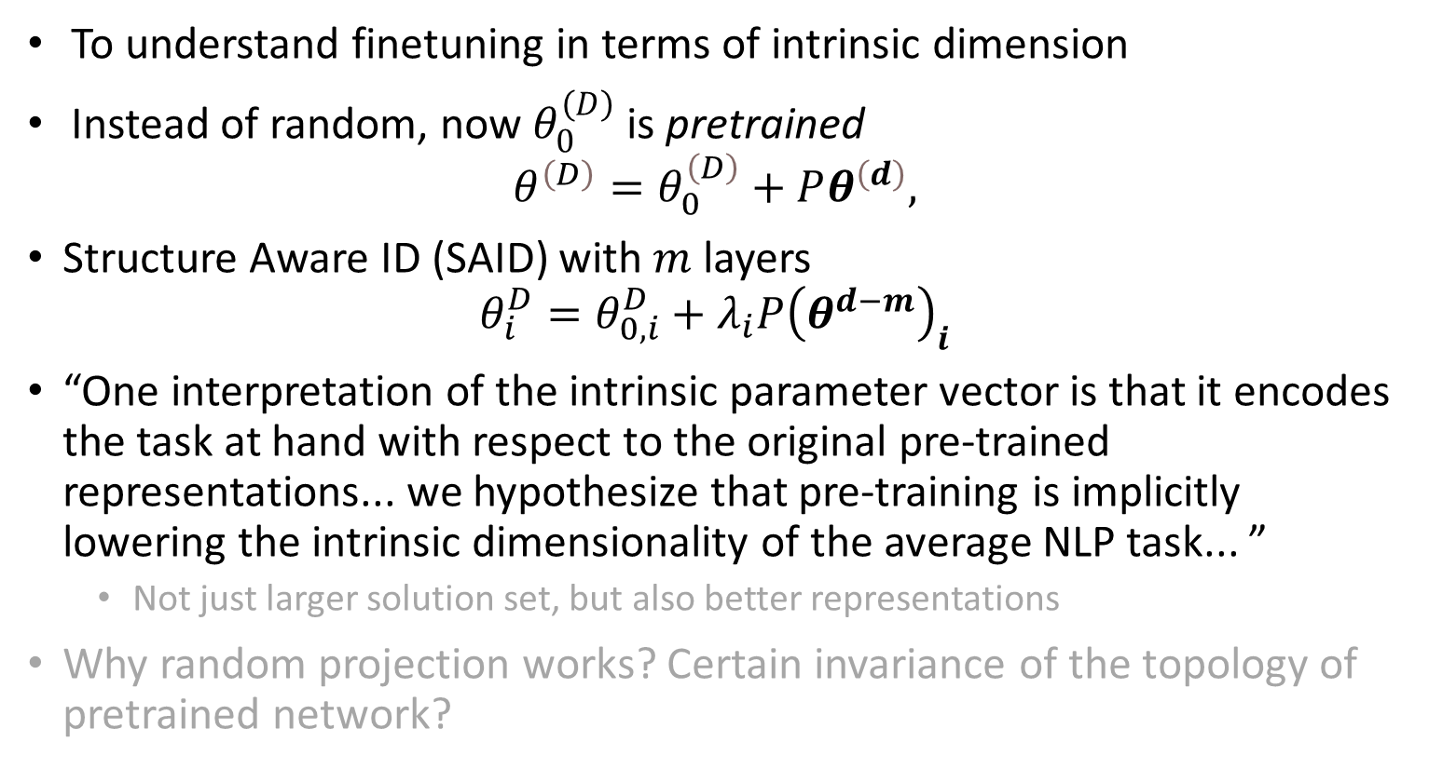
IDFT
To understand finetuning in terms of intrinsic dimension
Instead of random, now $θ_{0}^{\left(D\right)}$ is pretrained
$$θ^{\left(D\right)}=θ_{0}^{\left(D\right)}+Pθ^{\left(d\right)},$$
Structure Aware ID (SAID) with $m$ layers
$$θ_{i}^{D}=θ_{0,i}^{D}+λ_{i}P{\left(θ^{d−m}\right)}_{i}$$
“One interpretation of the intrinsic parameter vector is that it encodes the task at hand with respect to the original pre-trained representations... we hypothesize that pre-training is implicitly lowering the intrinsic dimensionality of the average NLP task... ”
Not just larger solution set, but also better representations
Why random projection works? Certain invariance of the topology of pretrained network?

Slide 10
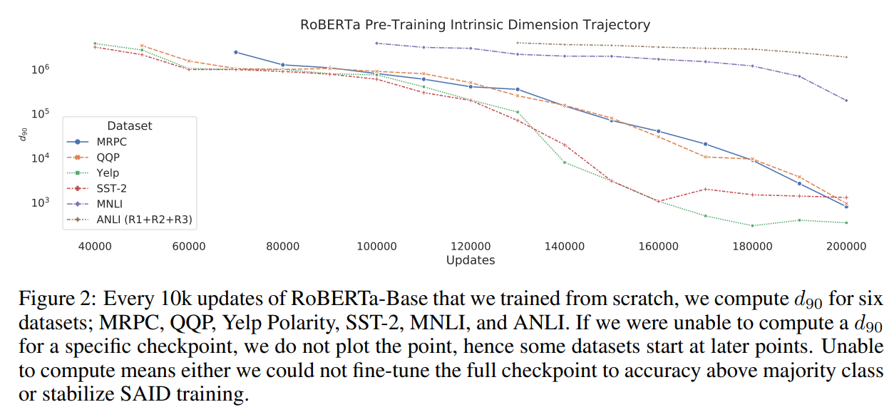
IDFT: ID trajectory during pre-training
In light of the result, can I view pre-training + fine-tuning as a generalization of direct training? The latter is a special case where both pt and ft have same data/obj. func. The former pays a transitional cost.

Slide 11
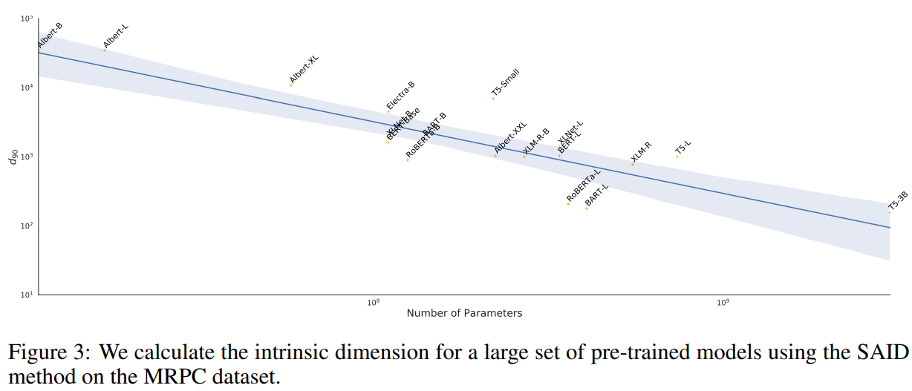
IDFT: parameter count vs ID
Not just larger solution set, but also better representations

Slide 12
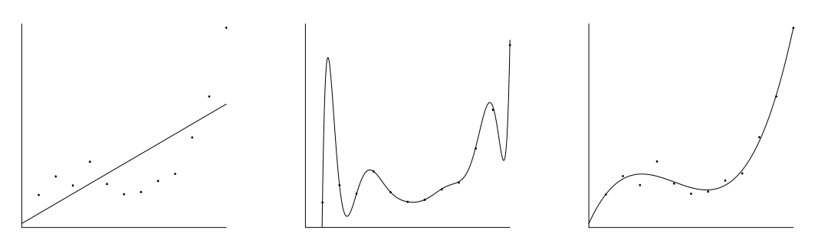
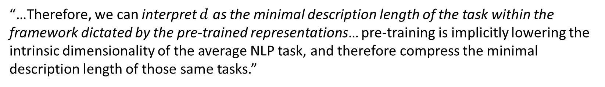
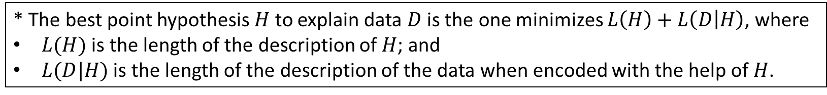
IDFT: Minimal description length (MDL)
* The best point hypothesis $H$ to explain data $D$ is the one minimizes $L\left(H\right)+L\left(D | H\right)$, where
$L(H)$ is the length of the description of $H$; and
$L(D|H)$ is the length of the description of the data when encoded with the help of $H$.
*three polynomials with different DL
“…Therefore, we can interpret $d$ as the minimal description length of the task within the framework dictated by the pre-trained representations… pre-training is implicitly lowering the intrinsic dimensionality of the average NLP task, and therefore compress the minimal description length of those same tasks.”
* Paraphrased https://arxiv.org/pdf/math/0406077.pdf

Slide 13
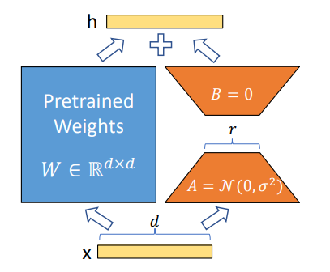
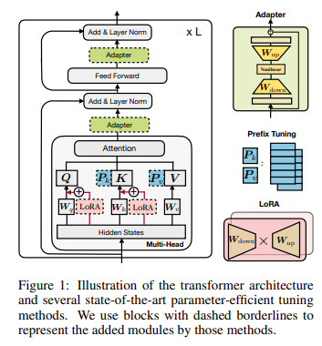
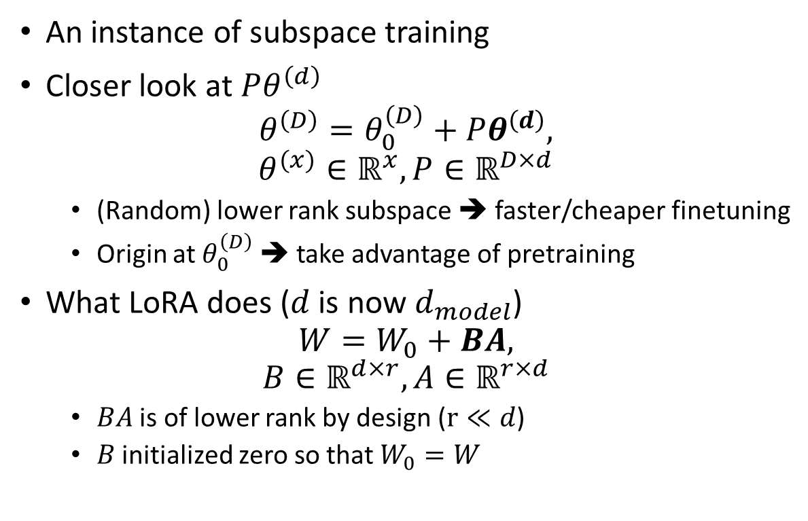
LoRA
An instance of subspace training
Closer look at $Pθ^{\left(d\right)}$
$$θ^{\left(D\right)}=θ_{0}^{\left(D\right)}+Pθ^{\left(d\right)},$$
$$θ^{(x)}∈ℝ^{x}, P∈ℝ^{D×d}$$
(Random) lower rank subspace ➔ faster/cheaper finetuning
Origin at $θ_{0}^{\left(D\right)}$ ➔ take advantage of pretraining
What LoRA does ($d$ is now $d_{model}$)
$$W=W_{0}+BA,$$
$$B∈ℝ^{d×r},A∈ℝ^{r×d}$$
$BA$ is of lower rank by design ($r≪d$)
$B$ initialized zero so that $W_{0}=W$
LoRA
Attention block: Fig 1 of https://arxiv.org/pdf/1804.08838.pdf

Slide 14
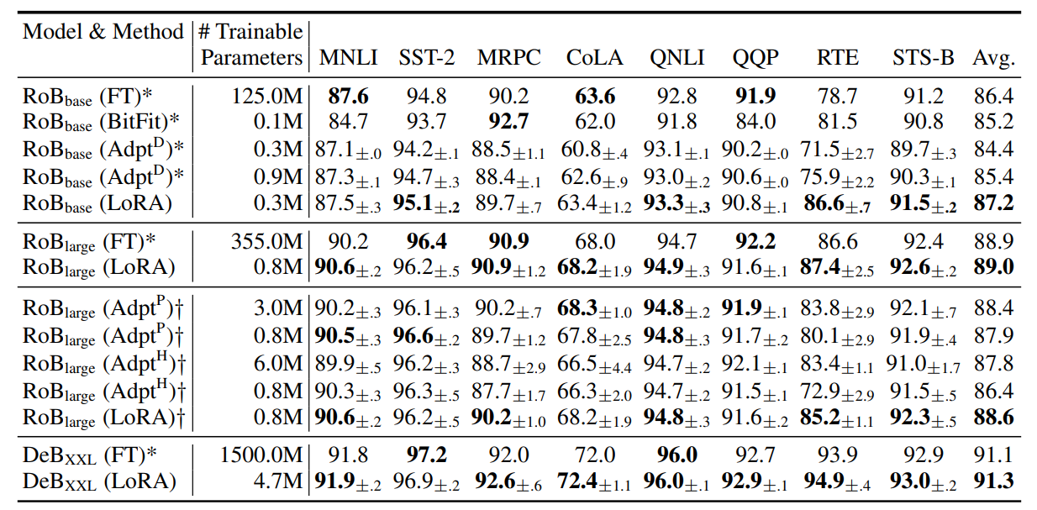
LoRA: results
Demo: Tesla V100, MRPC, 10 Eps, RoBERTa-L, AdamW
 | VRam | Duration | FT model size
LoRA | ~8 GB | ~6 mins | 7.0MB
Direct | ~14 GB | ~9 mins | 1.3GB
Table 2
of paper

Slide 15
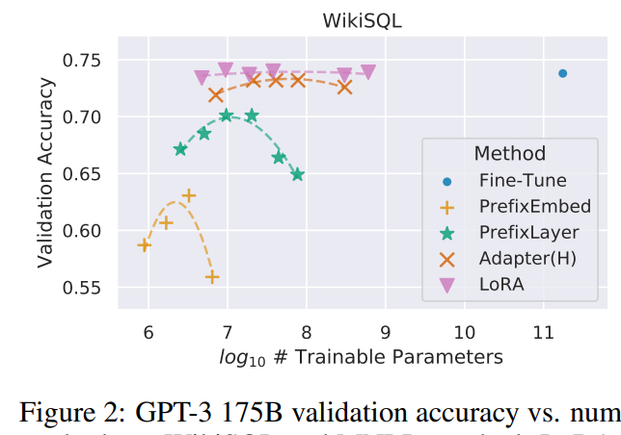
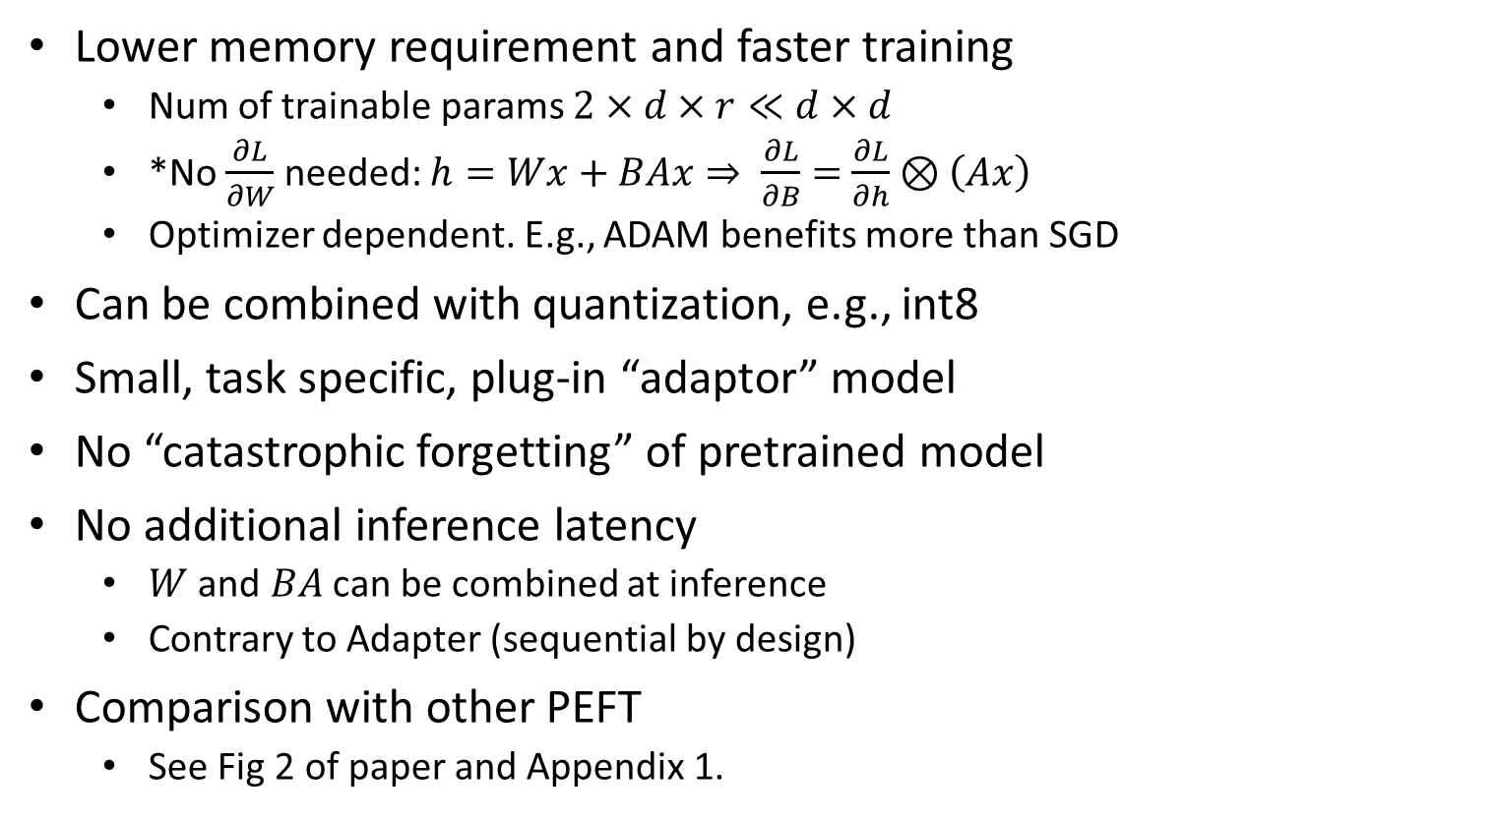
LoRA: analysis
Lower memory requirement and faster training
Num of trainable params $2×d×r≪d×d$
*No $\frac{∂L}{∂W}$ needed: $h=Wx+BAx⇒ \frac{∂L}{∂B}=$ $\frac{∂L}{∂h}⊗\left(Ax\right)$
Optimizer dependent. E.g., ADAM benefits more than SGD
Can be combined with quantization, e.g., int8
Small, task specific, plug-in “adaptor” model
No “catastrophic forgetting” of pretrained model
No additional inference latency
$W$ and $BA$ can be combined at inference
Contrary to Adapter (sequential by design)
Comparison with other PEFT
See Fig 2 of paper and Appendix 1.
* https://openreview.net/forum?id=nZeVKeeFYf9

Slide 16
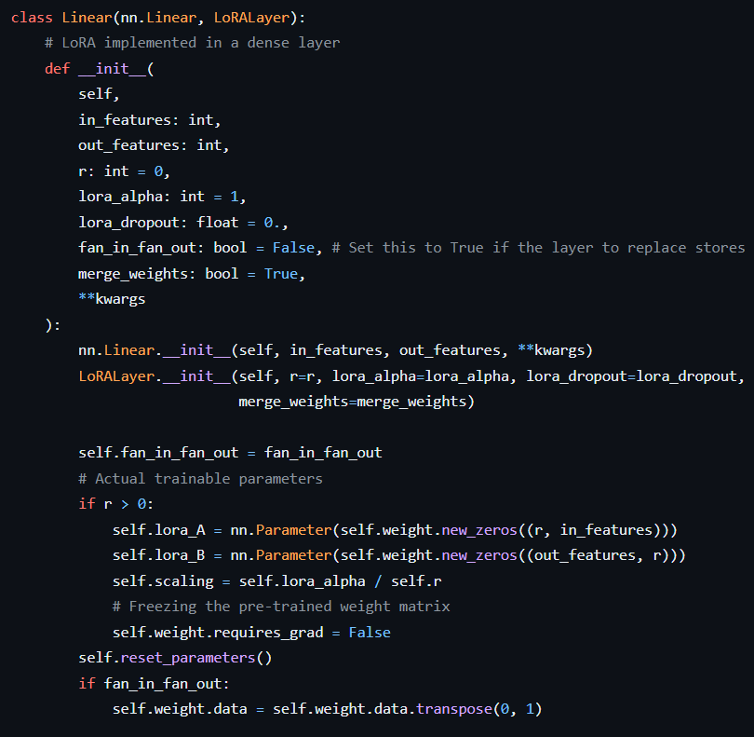
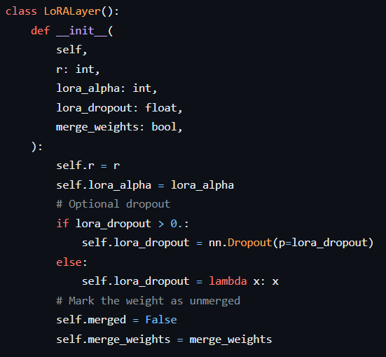
LoRA: implementation
https://github.com/microsoft/LoRA/blob/main/loralib/layers.py

Slide 17
The End
To demo…

Slide 18
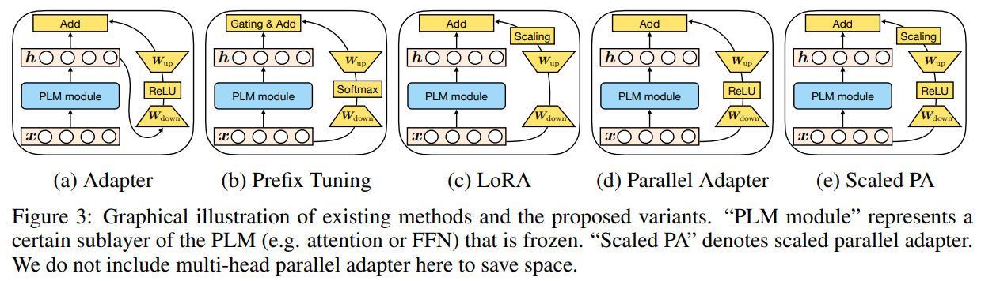
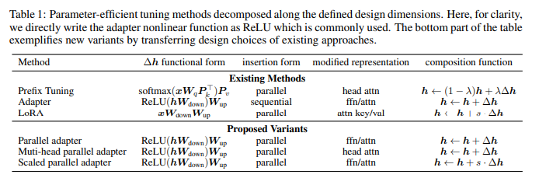
Appx 1: Unified view of PEFT
https://arxiv.org/pdf/1804.08838.pdf

Slide 19
References
Intrinsic Dimension
https://www.uber.com/blog/intrinsic-dimension/
https://github.com/uber-research/intrinsic-dimension/blob/master/intrinsic_dim/
LoRA
https://github.com/microsoft/LoRA/
MDL
Autoencoders, Minimum Description Length and Helmholtz Free Energy
DL representation
https://colah.github.io/posts/2014-03-NN-Manifolds-Topology/
NN visualization
Deep Learning
Principles of Riemannian Geometry in Neural Networks

Slide 20
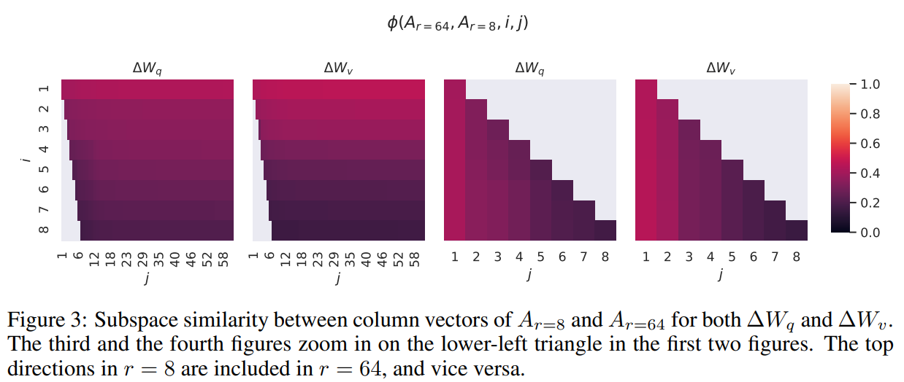
LoRA: Understanding The Low-Rank Updates
Poorly written; not included in ICLR submission
Zoom in seems flipped

Slide 21
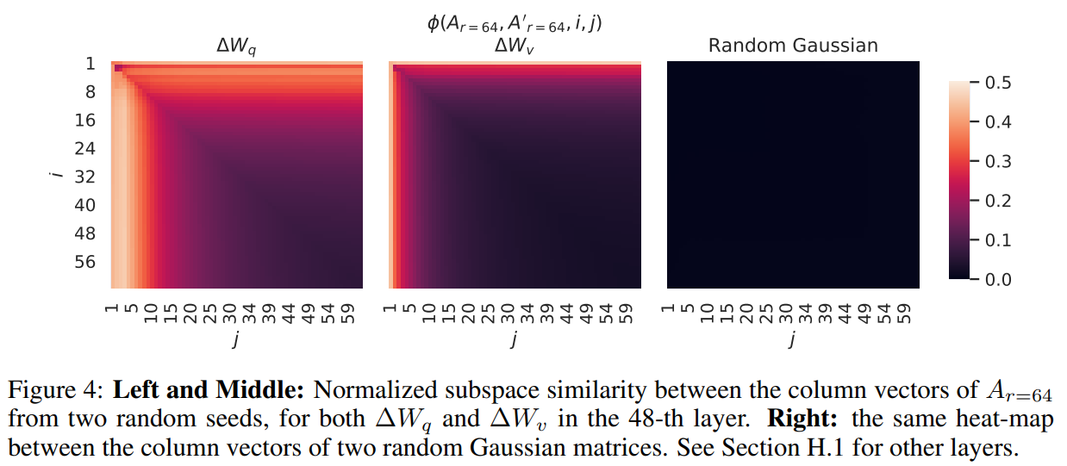
LoRA: Understanding The Low-Rank Updates
Poorly written; not included in ICLR submission

