Slide 1
Vision transformers

Slide 2
Background and related work
Why Transformers for Vision?
Previous work:
Local attention, scalable approximation…
Attention combined with CNN
Small patch size VIT
Papers:
TRANSFORMERS FOR IMAGE RECOGNITION AT SCALE (VIT paper)
Do Vision Transformers See Like Convolutional Neural Networks?
HOW DO VISION TRANSFORMERS WORK?

Slide 3
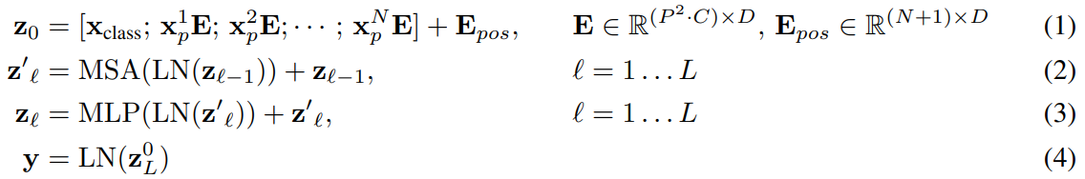
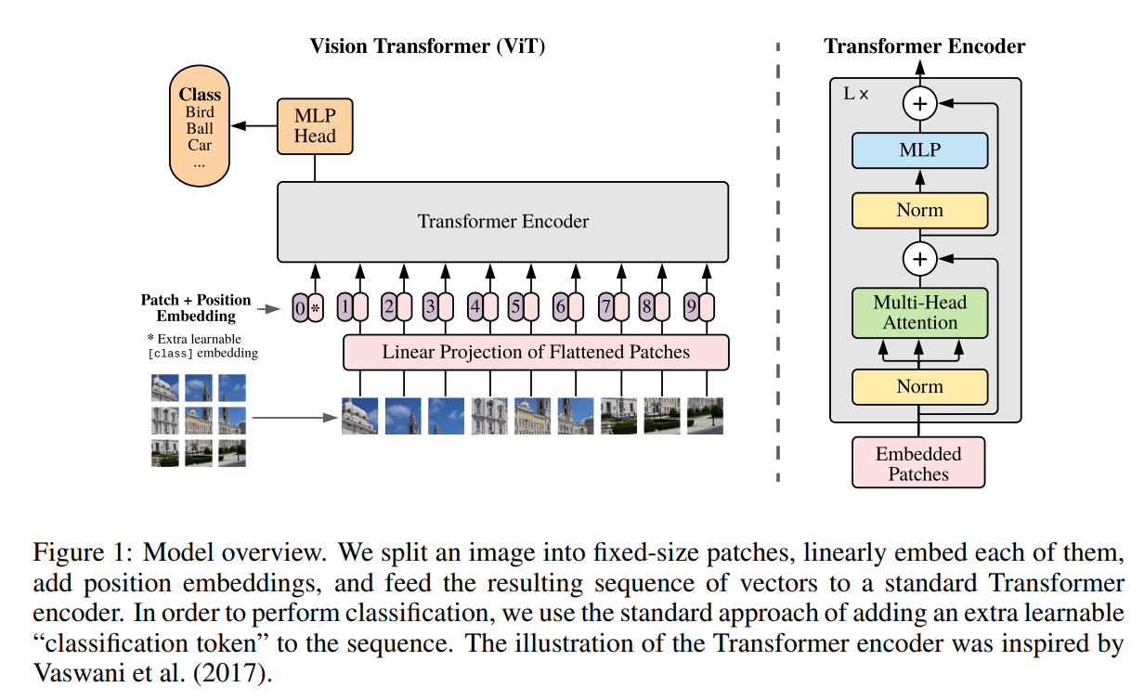
Method

Slide 4
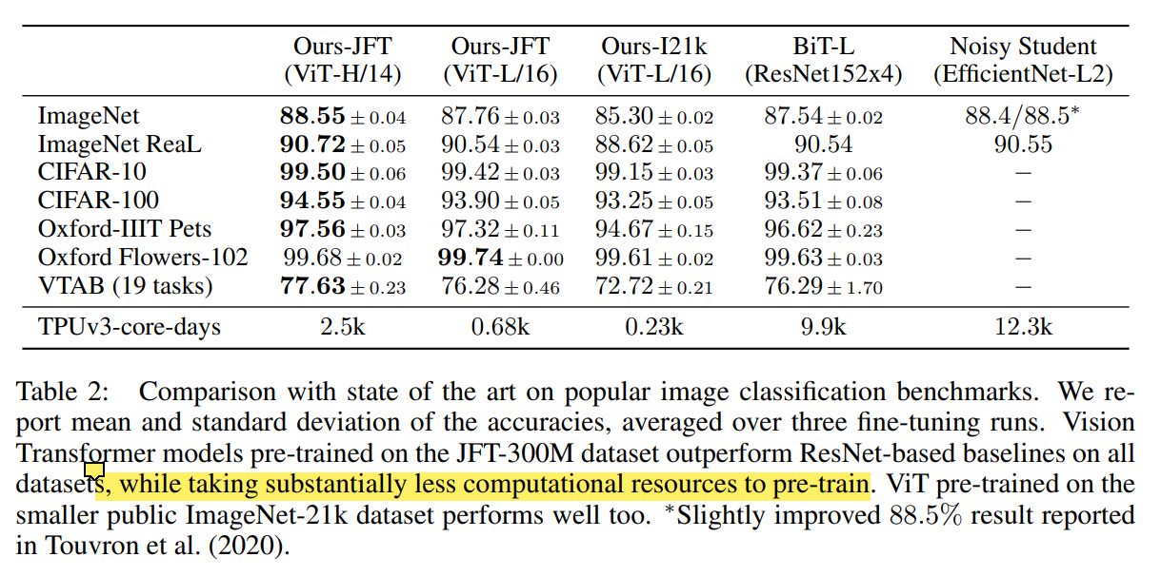
Experiments

Slide 5
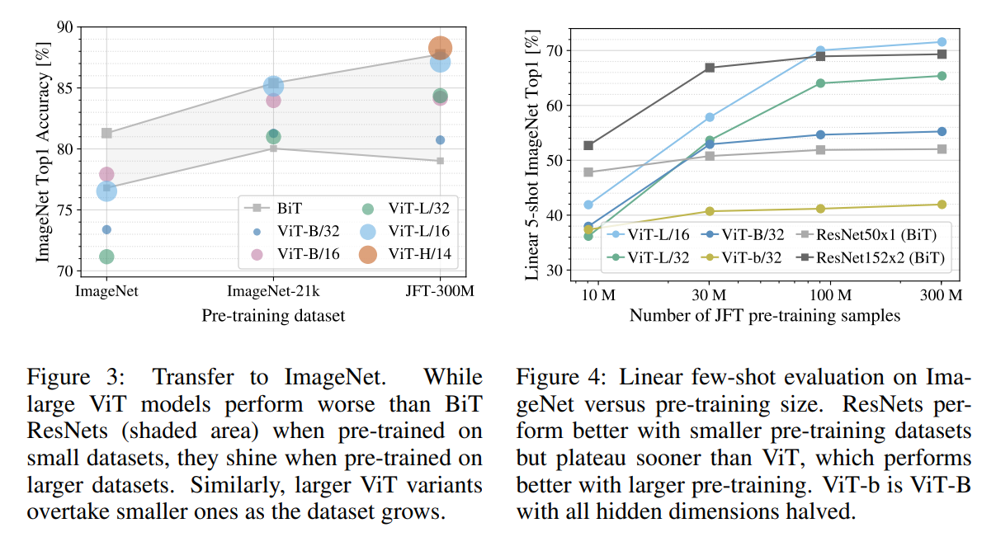
Experiments, cont.

Slide 6
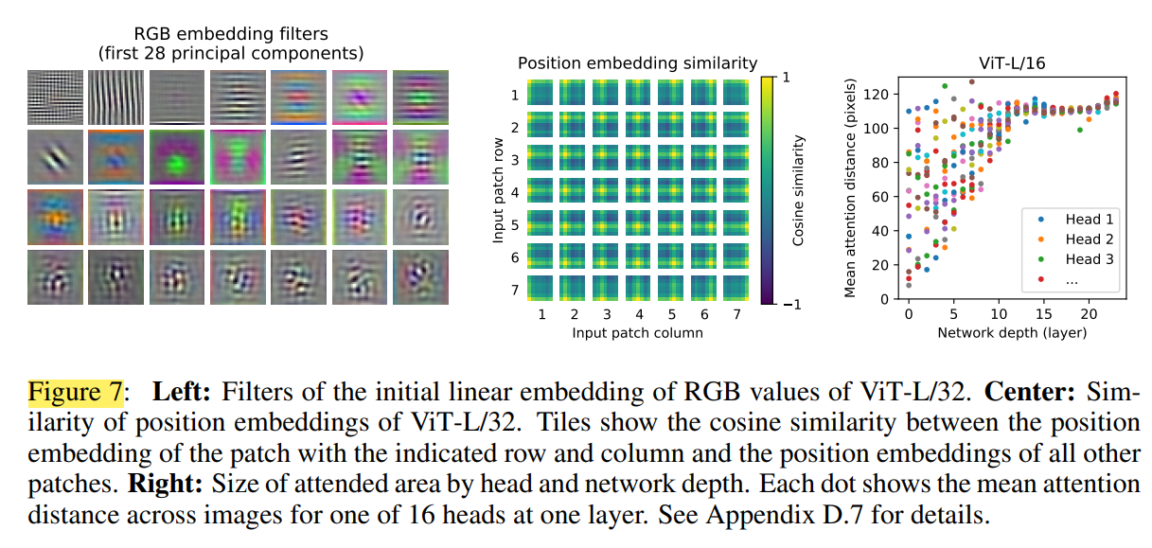
Visualization

Slide 7
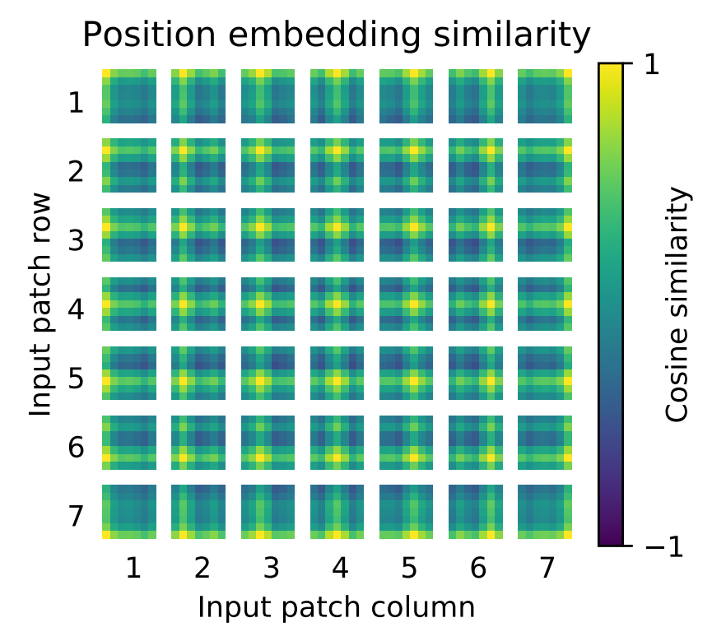
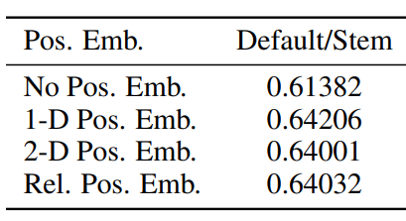
Positional embedding (trained)
ViT-B/16 evaluated on ImageNet 5-shot linear
Similarity bears positional information

Slide 8
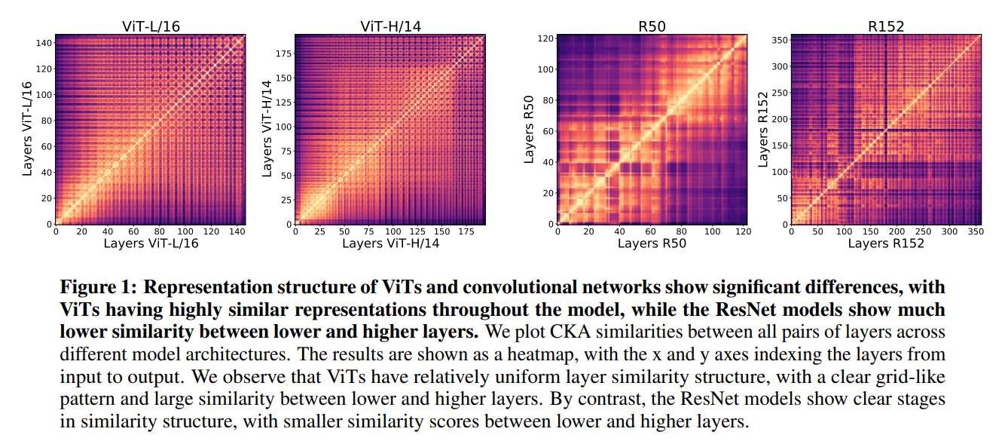
Strong propagation of representations
Strong propagation of representations between lower and higher layers.

Slide 9
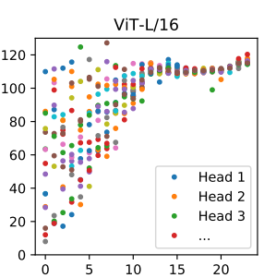
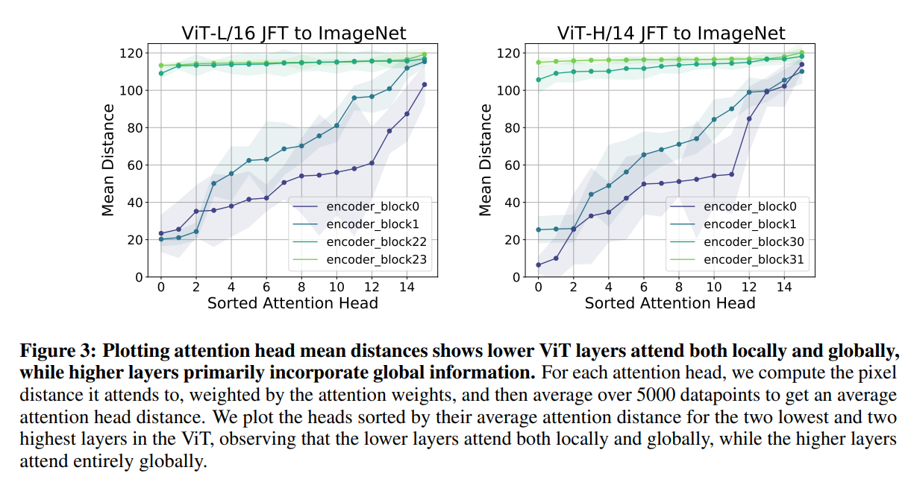
Local and global information

Slide 10
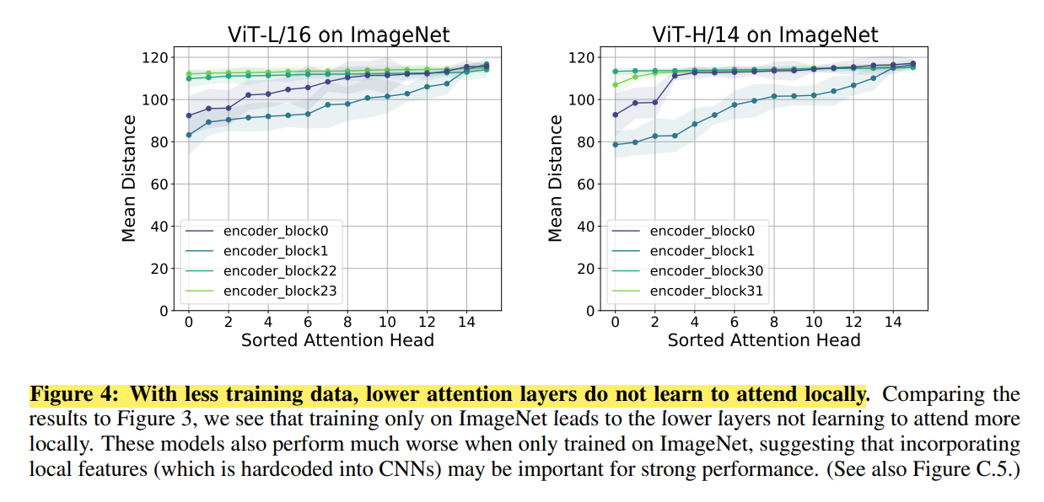
Local and global information, cont.

Slide 11
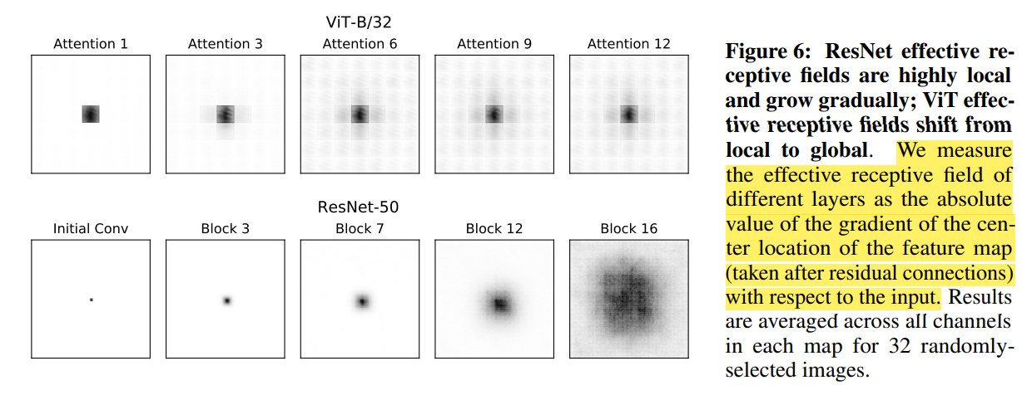
Receptive field

Slide 12
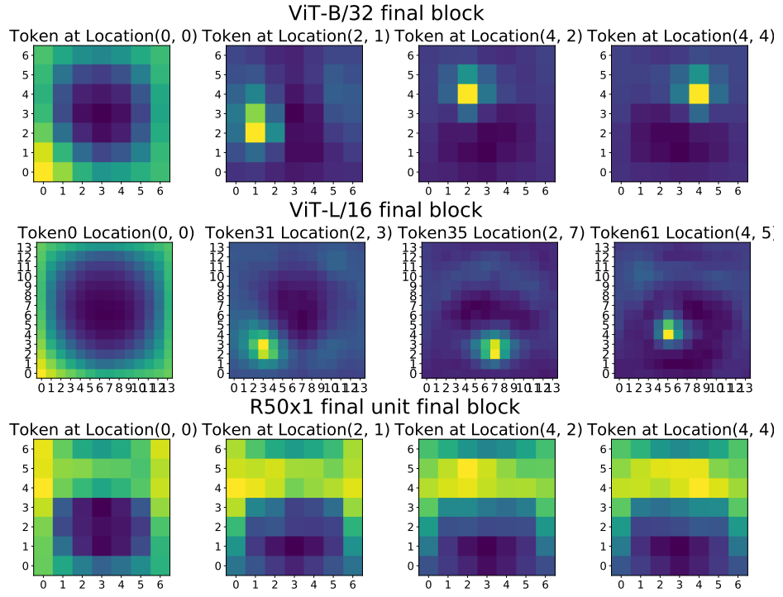
Spatial information and localization
Figure 9: Higher layers of ViT maintain spatial location information more faithfully than ResNets. Each heatmap plot shows the CKA similarity between a single token representation in final block of the model and the input images, which are divided into non-overlapping patches. We observe that ViT tokens have strongest similarity to their corresponding spatial location in the image, but tokens corresponding to spatial locations at the edge of the image (e.g. token 0) additionally show similarity to other edge positions. This demonstrates that spatial information from the input is preserved even at the final layer of ViT. By contrast, ResNet “tokens” (features at a specific spatial location) are much less spatially discriminative, showing comparable similarity across a broad set of input spatial locations. See Appendix for additional layers and results.
Potential for dense tasks like object detection

Slide 13
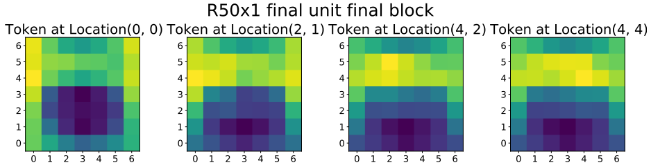
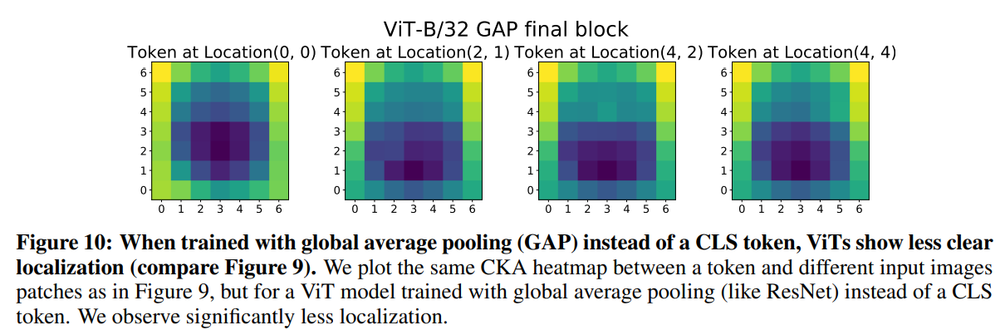
Spatial information and localization

Slide 14
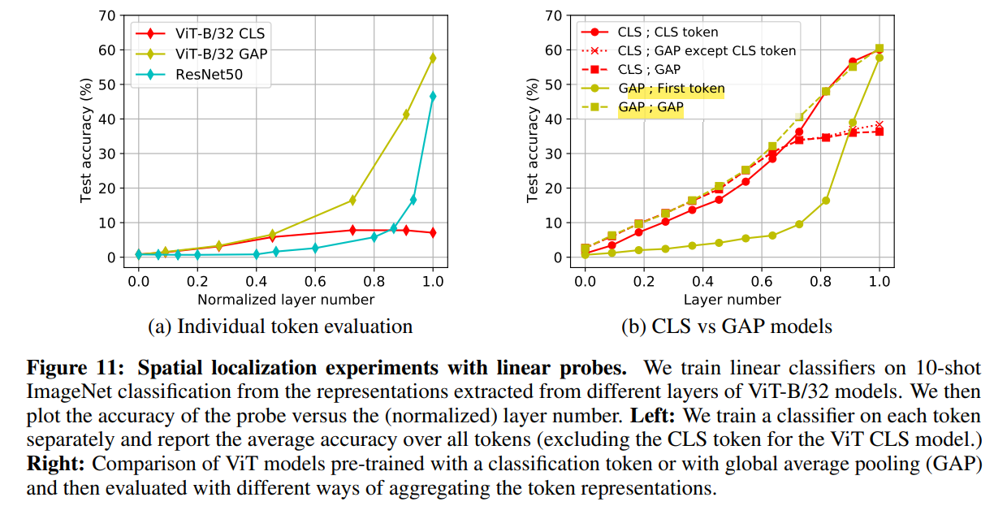
Spatial information and localization

Slide 15
Take aways
“From the perspective of convolutional neural networks (CNNs), MSAs are a transformation of all feature map points with large-sized and data-specific kernels.”
Inductive biases/small dataset vs general assumptions/large dataset

Slide 16
Next readings
Swin-transformers (CNN alike)
Different patch sizes
Hierarchical receptive field
Backbone to many vision tasks
Unsupervised pre-training
MOCO, MAE…

Slide 17
CKA: https://www.youtube.com/watch?v=TBjdvjdS2KM

