Slide 1

Data-X : A Course and Lab for
Data, Signals, and Systems
Data ^{X}
About Me:
Ikhlaq Sidhu
Chief Scientist & Founding Director,
Sutardja Center for Entrepreneurship & Technology
IEOR Emerging Area Professor Award, UC Berkeley

Slide 2
What is Computer Vision?
CS
Tools
Math Models
A Course and Lab
Customer Driven
Applied Project
Industry Perspective
Real Life
Problems

Slide 3
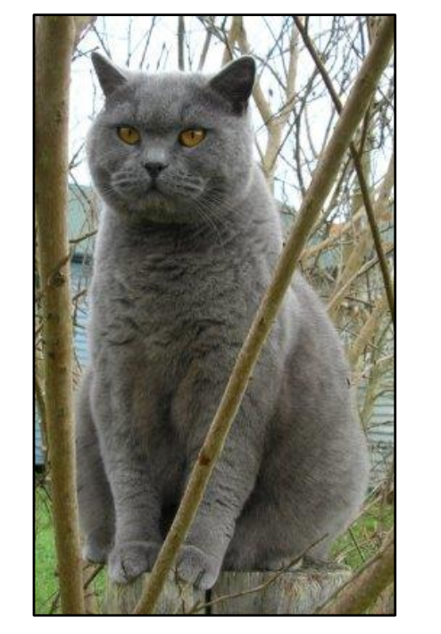
Image Classification: Feature Engineering
Assume that we are given a set of discrete labels:
  Cats, Dogs, Elephants, Ships
  Question: What should we use as predictors?
Cats

Slide 4
Image Classification: Feature Engineering II
Images are represented as 3D arrays of numbers, with integers between [0, 255]
3 for 3 color channels encoding RGB

Slide 5
How Data-X Challenge Lab works:
Insightful Story
Solution
Brainstorm Challenge
and Validate (4)
Propose Low Tech Solution (1)
Execute * Iterate
BMoE Reflections
Agile Spring (8)
Demo
or Die (1)
Quant Model Lectures + CS Code Examples
Live
CS Tool Industry Lectures – Video Flip
Team: Tech Lead, Product Lead + 2-4 Experts
Notes:
And, did you know what you wanted?

Slide 6
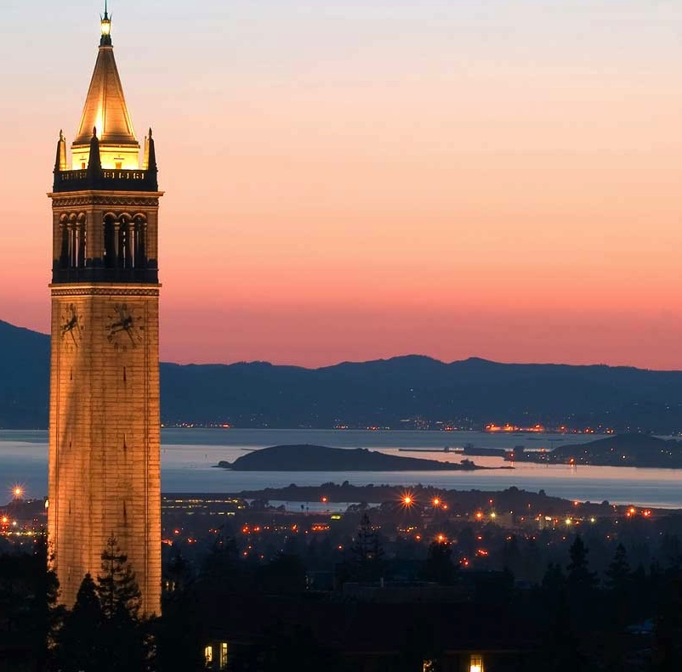
Berkeley Method of Entrepreneurship
Inductive Learning
Journey Based
Mindset and Behaviors
Frameworks and Cases
Networks and Connections
Co-developed by Ikhlaq Sidhu and Ken Singer

Slide 7
End of Section

