Slide 1
COMP 306: API Engineering & Cloud Computing
Class Activity 06 – ASP.NET Core Authentication Workshop
Created By: Kevin Ma (#300867968)
Fall 2018

Slide 2
Identity on ASP.NET Core
ASP.NET Core Identity is a membership to allow login functionality to be addd to an application
Users can create an acc and login w/an username and password
Users can login by using an external login provider such as Facebook, Google, Microsoft account, Twitter or others

Slide 3
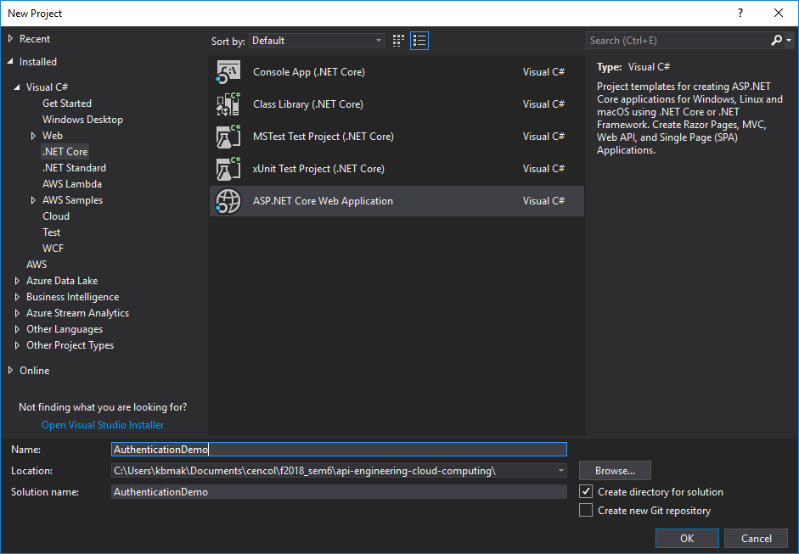
Implementation of ASP.NET Core Web App

Slide 4
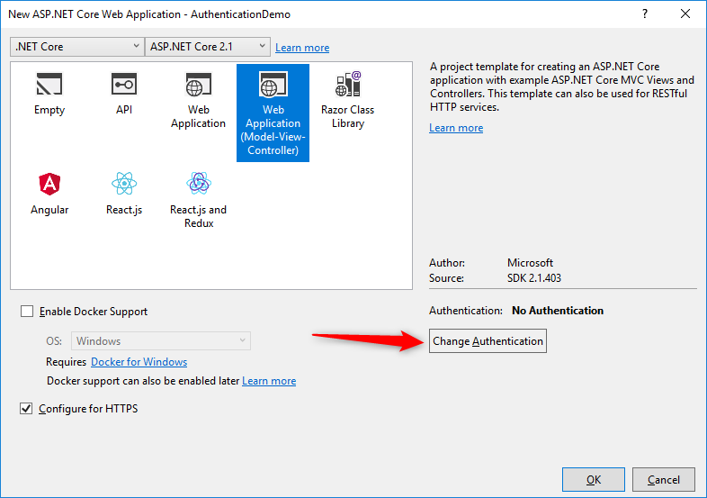
Implementation of ASP.NET Core Web App

Slide 5
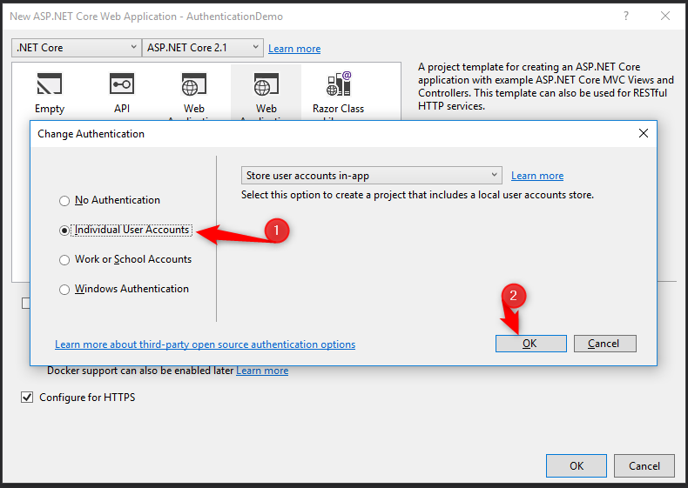
Implementation of ASP.NET Core Web App

Slide 6
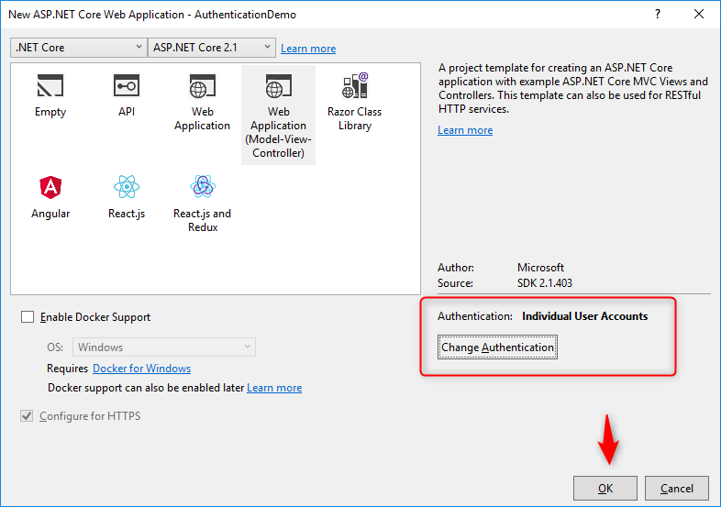
Implementation of ASP.NET Core Web App

Slide 7
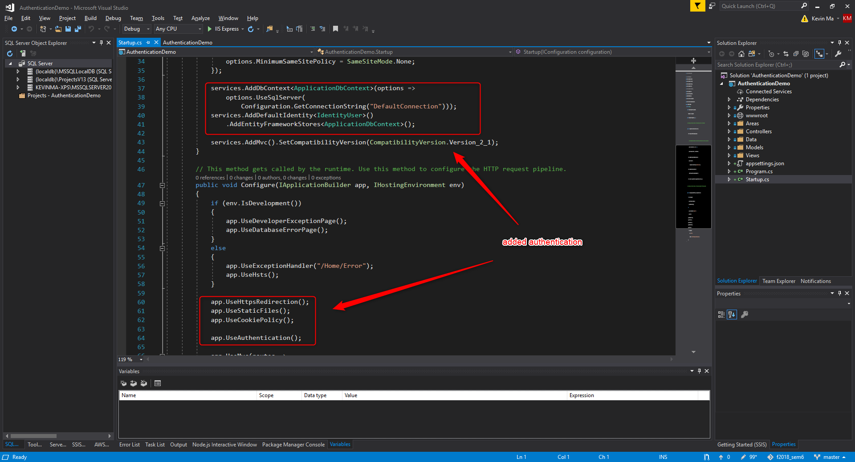
Implementation of ASP.NET Core Web App

Slide 8
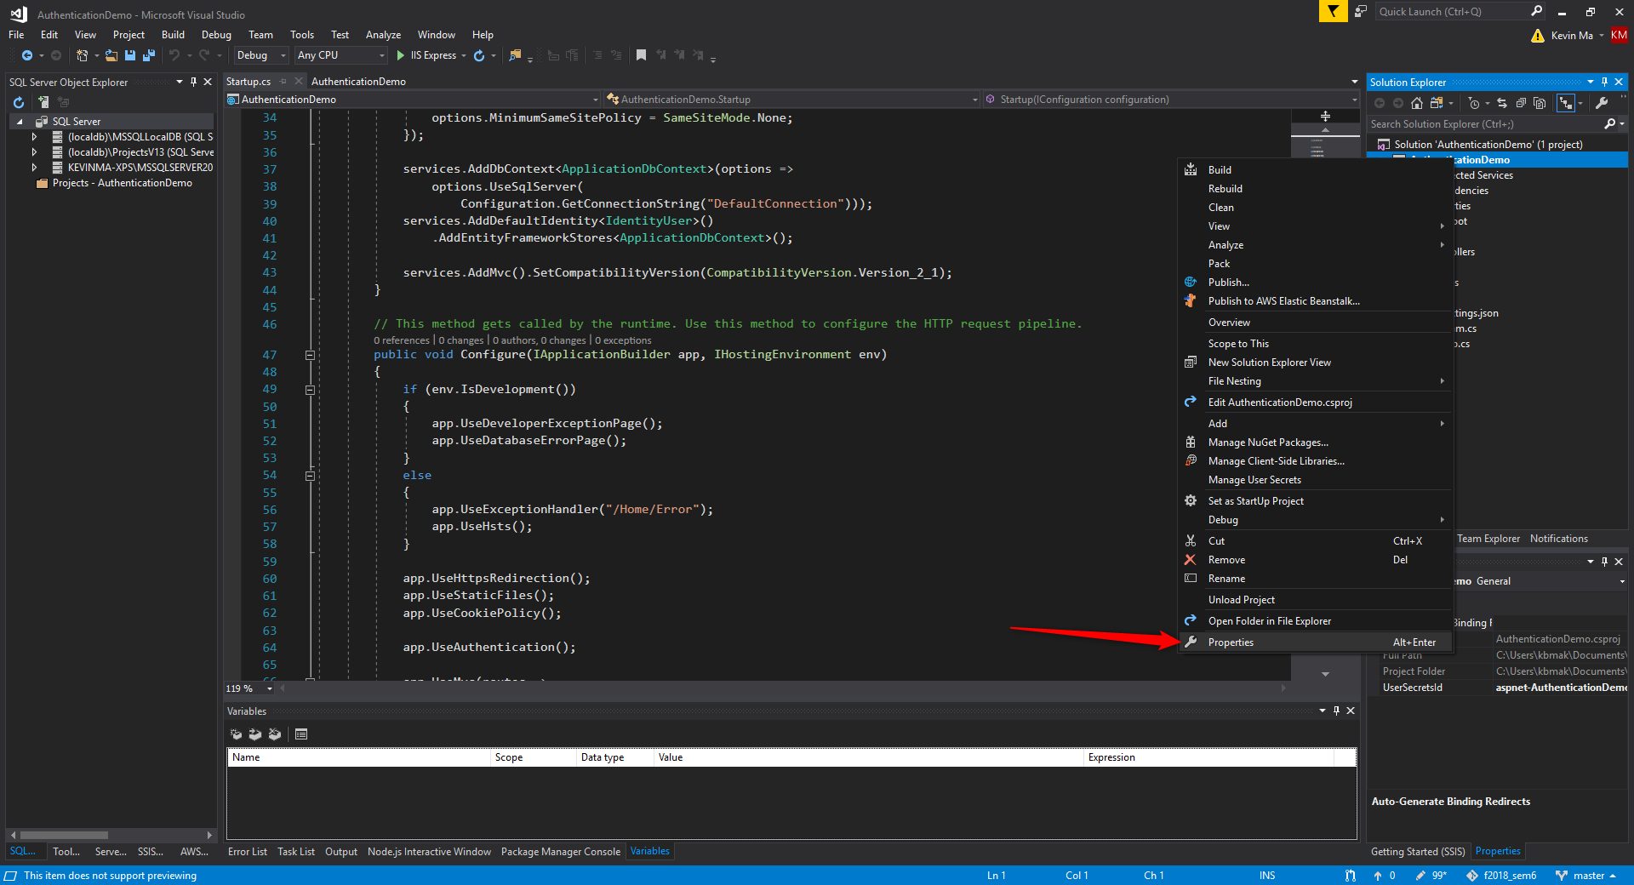
Enabling SSL

Slide 9
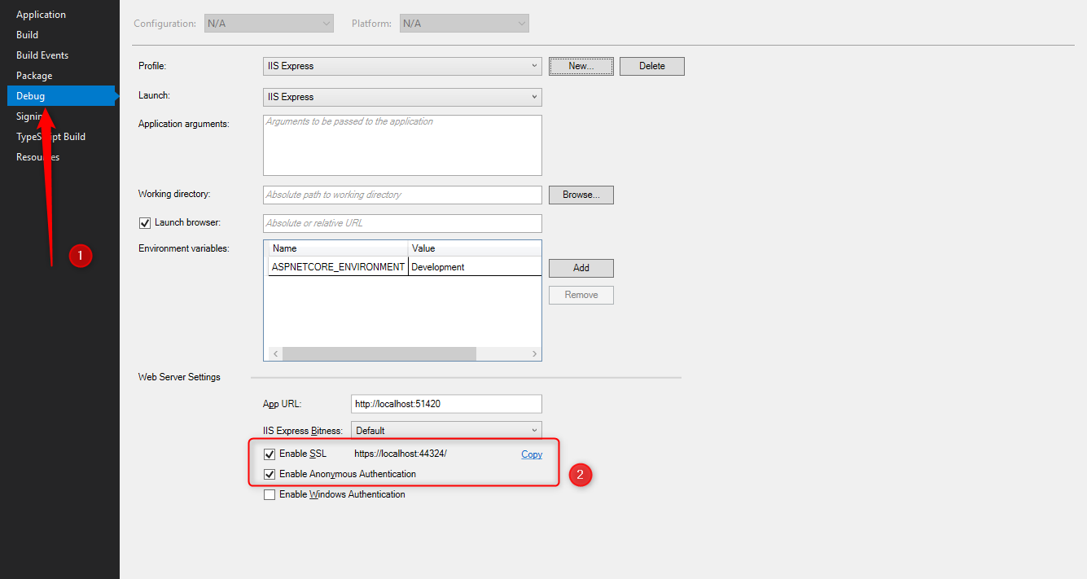
Enabling SSL

Slide 10
Entity Framework Core Migrations
A data model changes during development and gets out of sync with the database.
The migrations feature in EF Core provides a way to incrementally update the database schema to keep it in sync with the application’s data model while preserving existing data in the database

Slide 11
Entity Framework Core Migrations
Migrations includes CLI tools and APIs to do the following tasks:
Create migration
Update the database
Customize migration code
Remove a migration
Revert a migration
Generate SQL scripts

Slide 12
Entity Framework Core Migrations
Create migration
Add-Migration InitialCreate (PMC)
Dotnet ef migrations add InitialCreate (Console)
Update the database
Update-database (PMC)
Dotnet ef database update (Console)
Customize migration code
Add-Migration AddProductReview (PMC)
Dotnet ef migration add AddProductReview (Console)
Remove a migration
Remove-migration (PMC)
Dotnet ef migration remove (console)
Revert a migration
Update-database lastgoodmigration (PMC)
Dotnet ef database update lastgoodmigration (console)
Generate SQL scripts
Script-migration (PMC)
Dotnet ef migrations script (console)

Slide 13
Creating Database
Before running the application, apply migrations to the application
At the beginning, update the database using the Entity Framework Core Migration by using Update-Database command

Slide 14
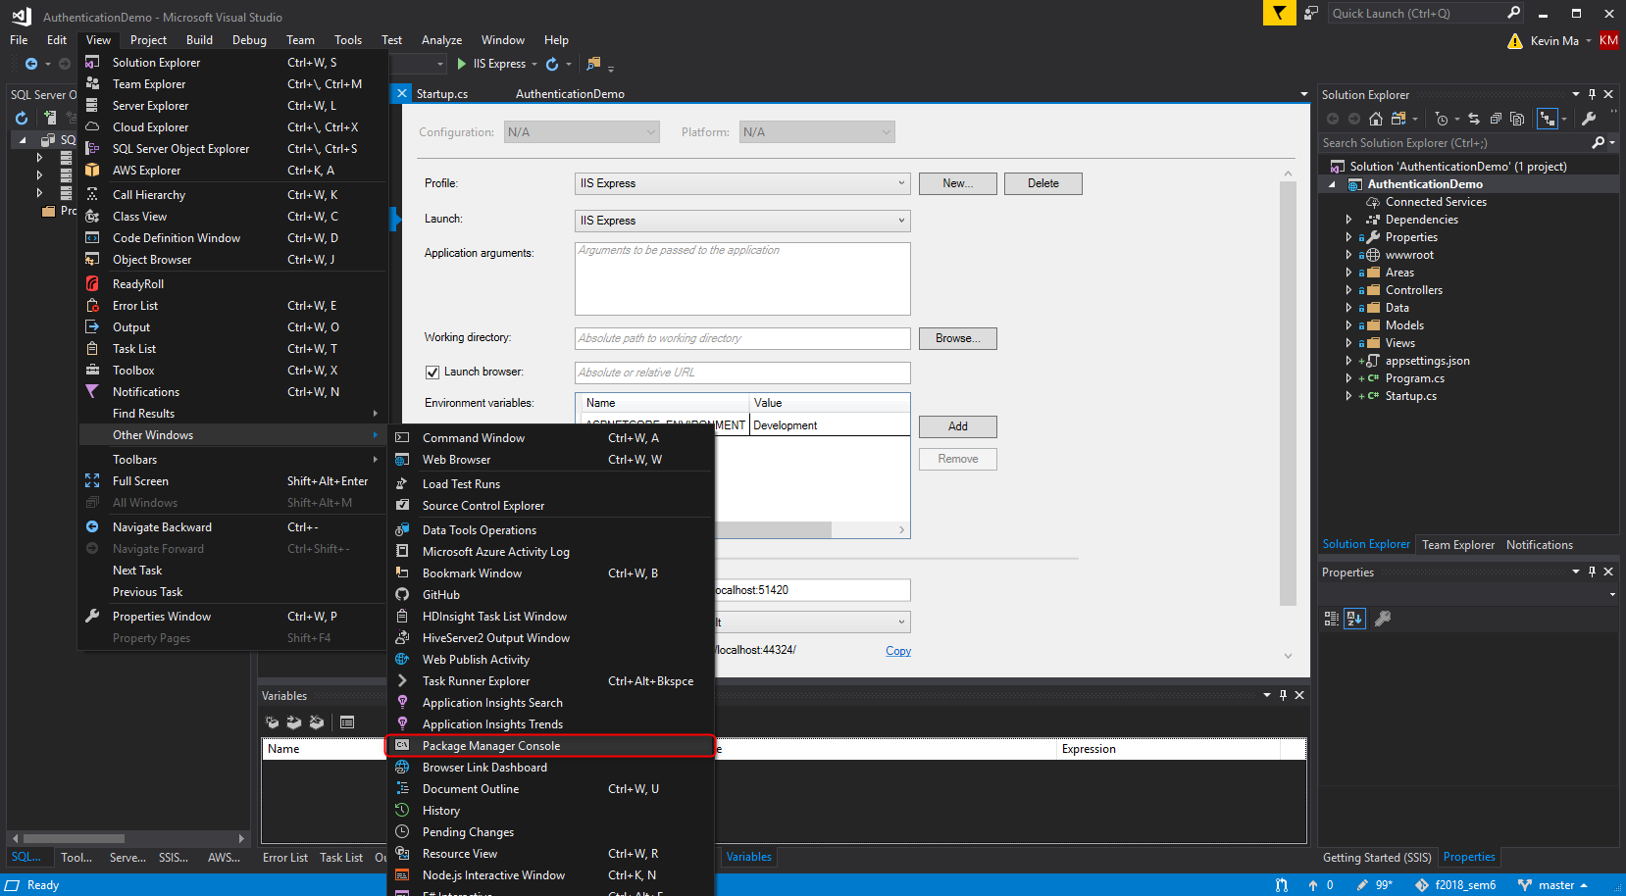
Creating Database – Opening PMC

Slide 15
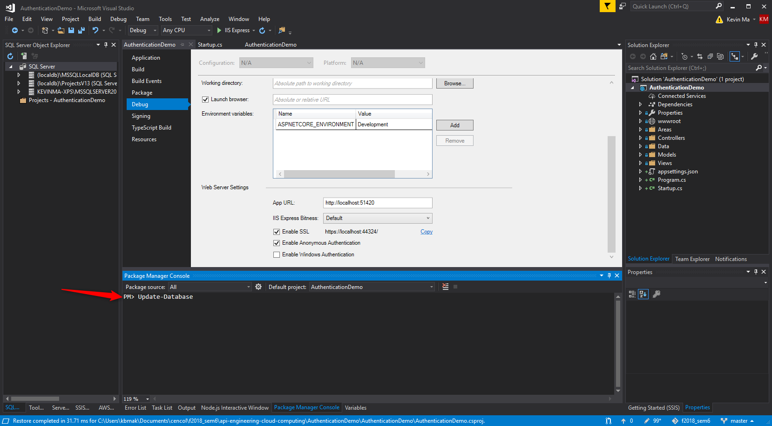
Creating Database – Updating Database

Slide 16
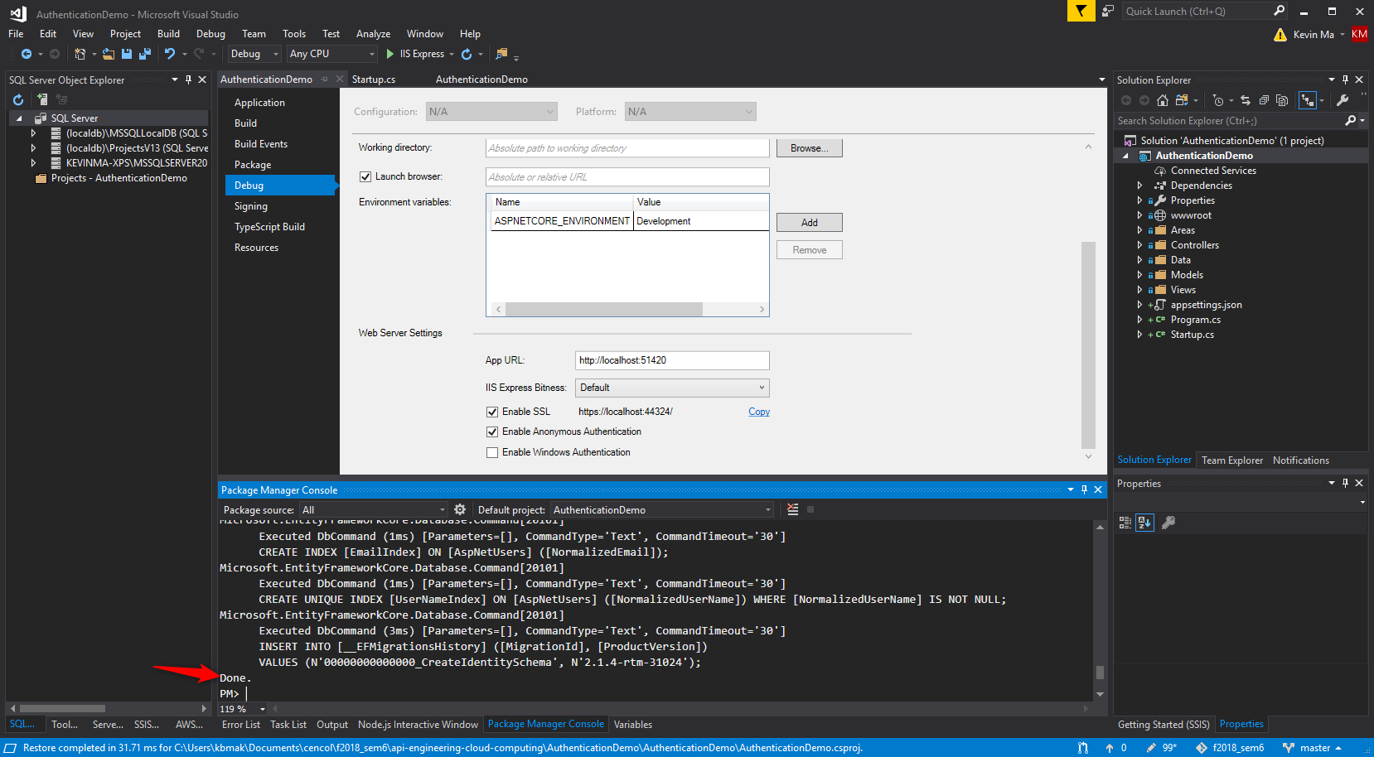
Creating Database – Updating Database

Slide 17
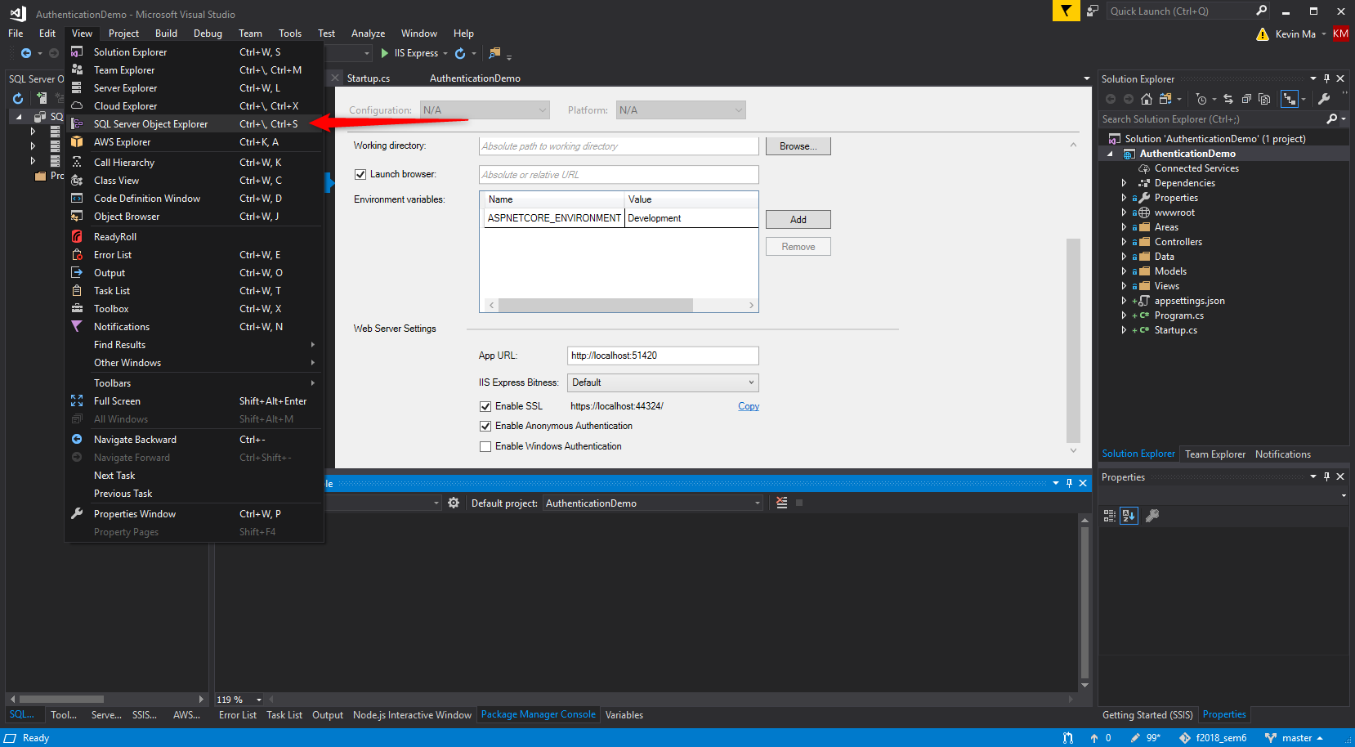
Creating Database – SQL Server Object Explorer

Slide 18
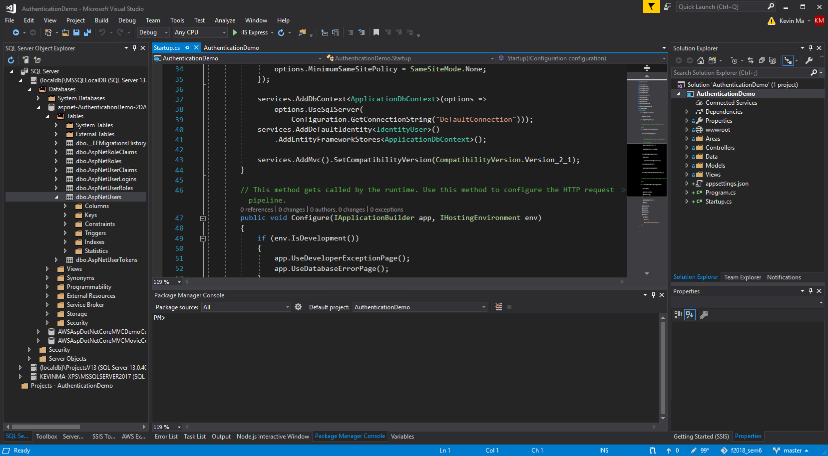
Creating Database – SQL Server Object Explorer

Slide 19
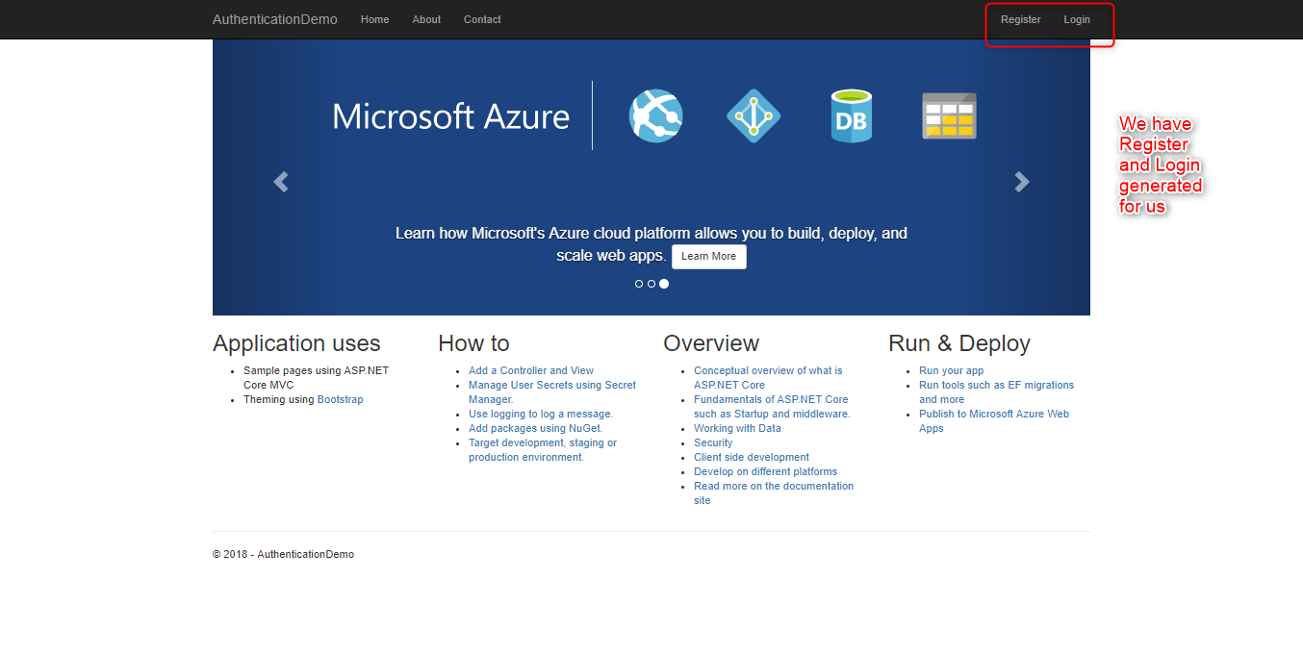
Running the Application

Slide 20
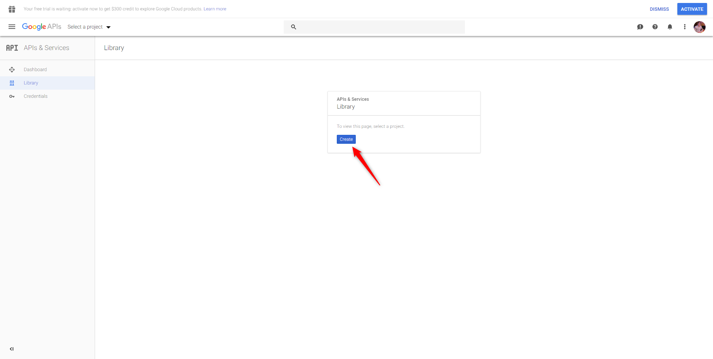
Creating a Google Application
Visit https://console.developers.google.com/projectselector/apis/library

Slide 21
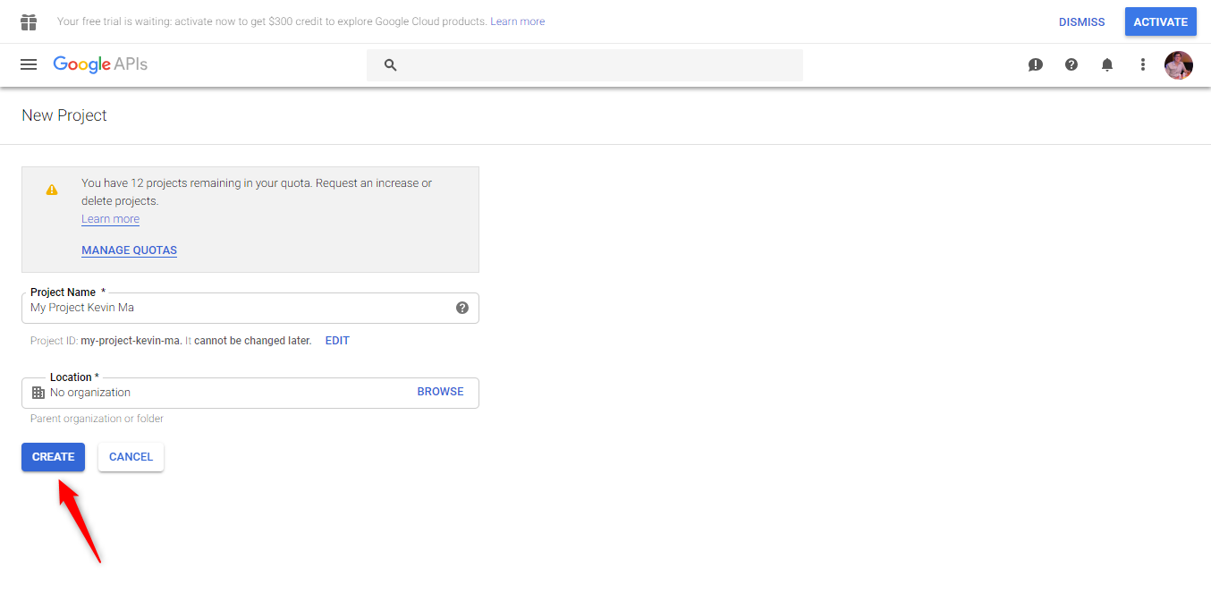
Creating a Google Application
Visit https://console.developers.google.com/projectselector/apis/library

Slide 22
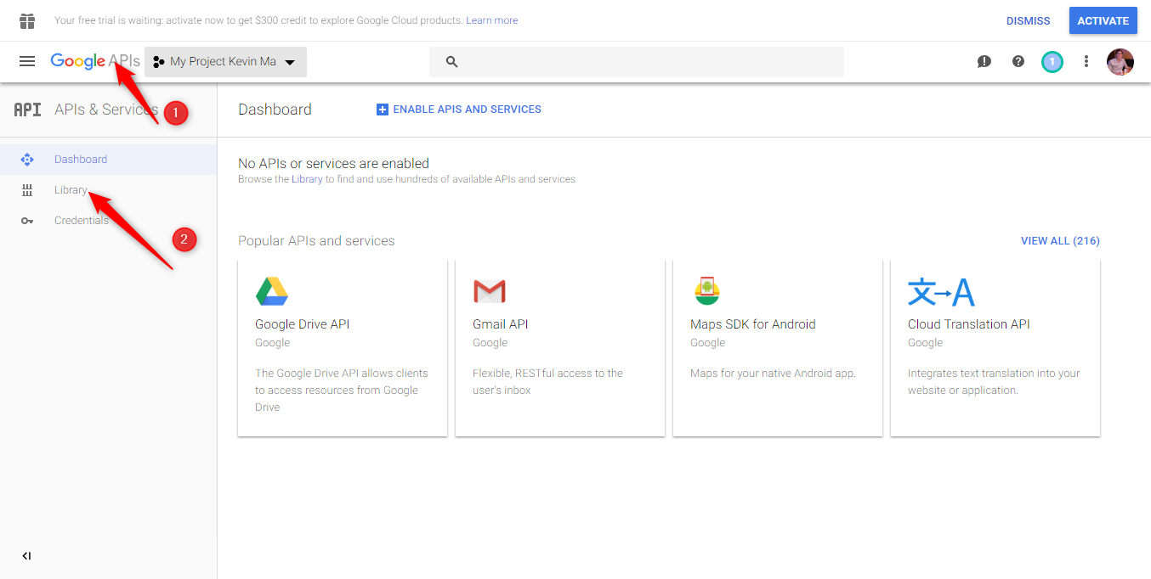
Creating a Google Application
Visit https://console.developers.google.com/projectselector/apis/library

Slide 23
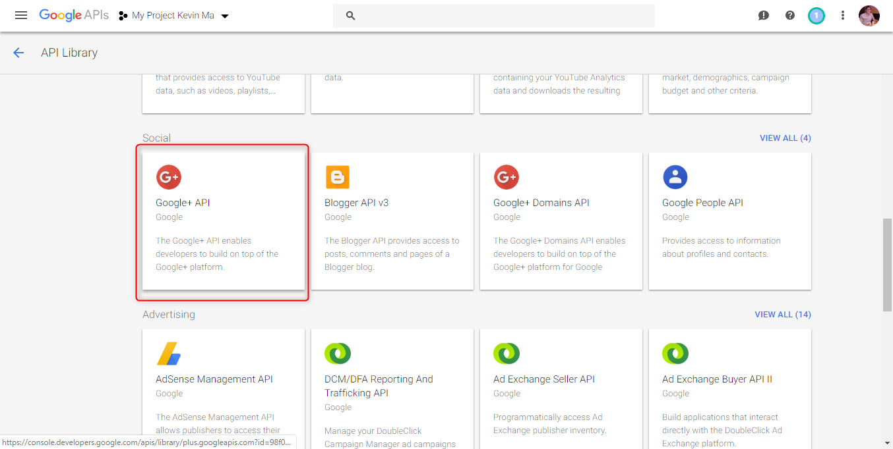
Creating a Google Application
Visit https://console.developers.google.com/projectselector/apis/library

Slide 24
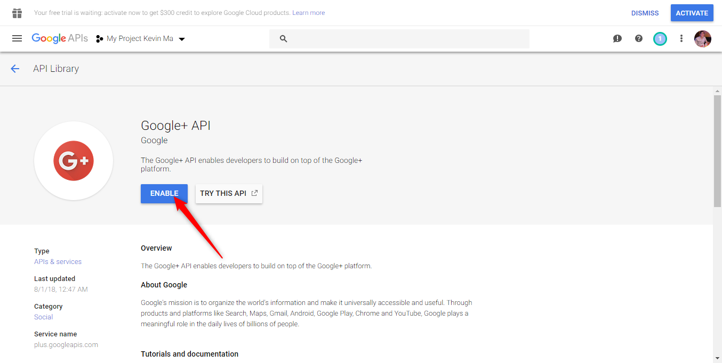
Creating a Google Application
Visit https://console.developers.google.com/projectselector/apis/library

Slide 25
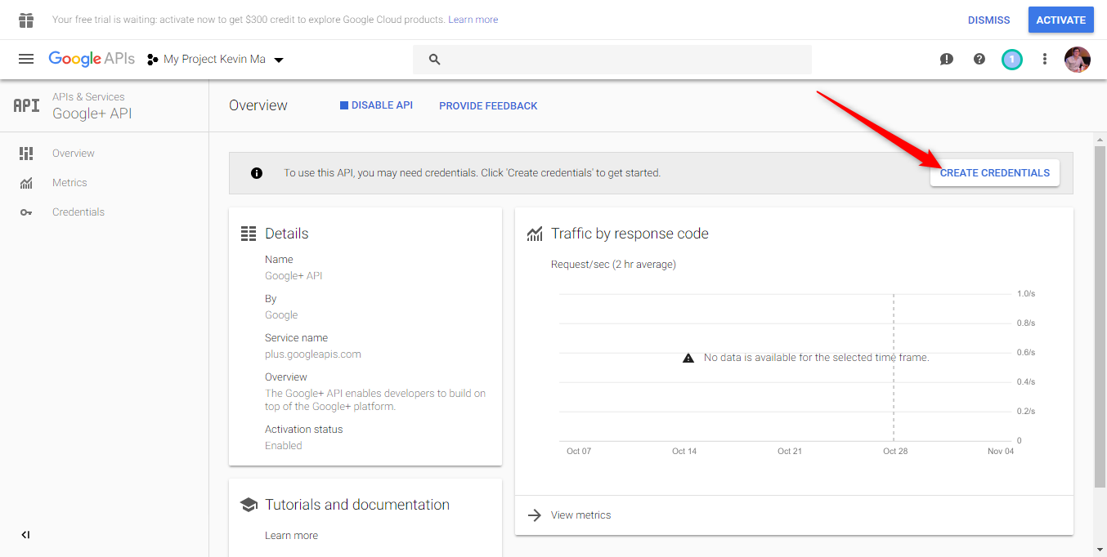
Creating a Google Application
Visit https://console.developers.google.com/projectselector/apis/library

Slide 26
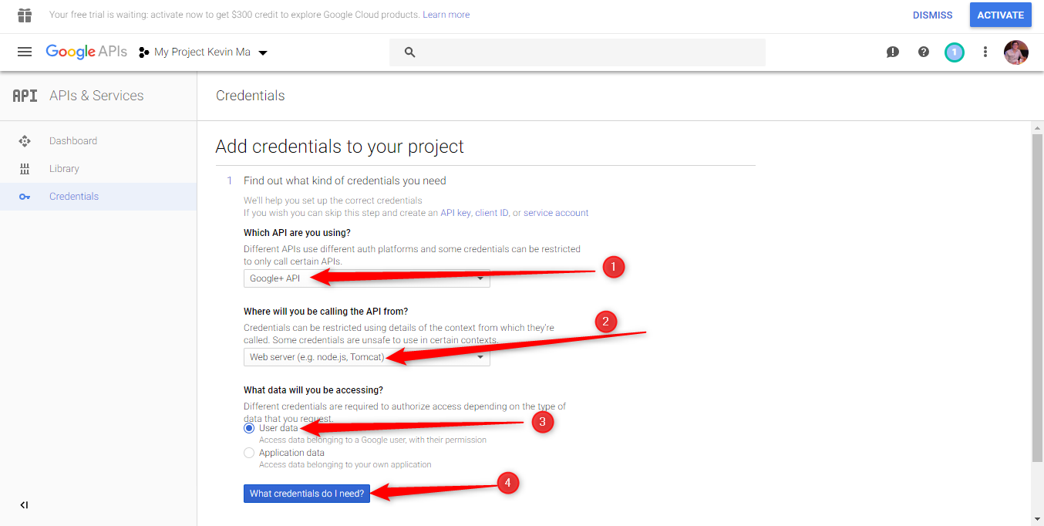
Creating a Google Application
Visit https://console.developers.google.com/projectselector/apis/library

Slide 27
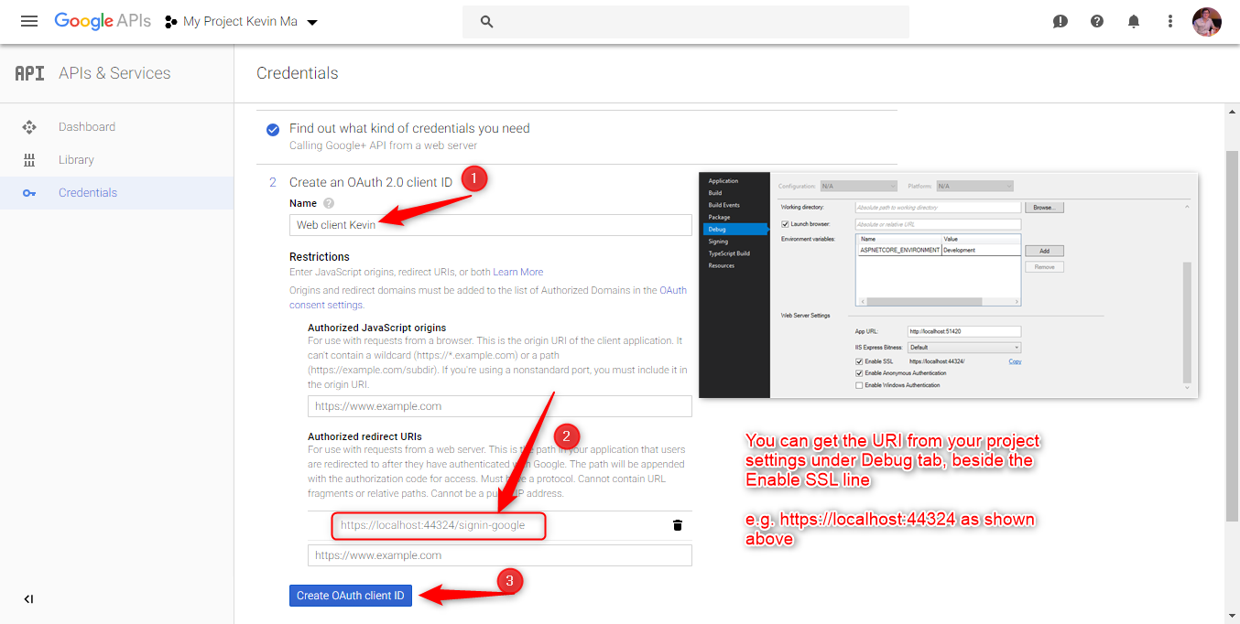
Creating a Google Application
Visit https://console.developers.google.com/projectselector/apis/library

Slide 28
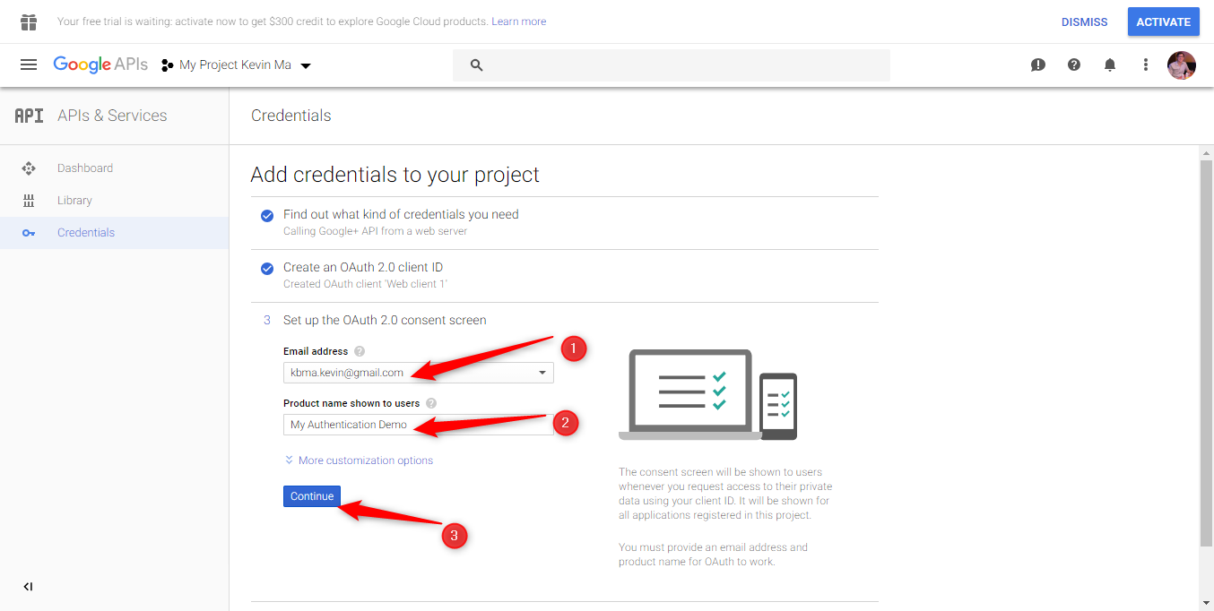
Creating a Google Application
Visit https://console.developers.google.com/projectselector/apis/library

Slide 29
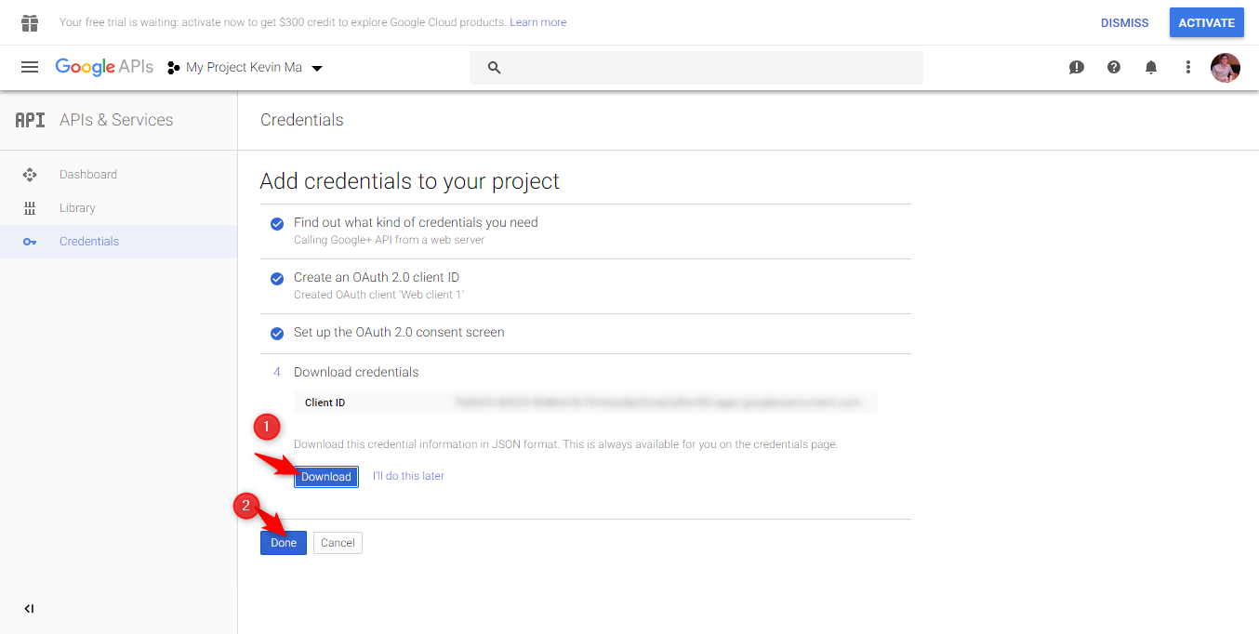
Creating a Google Application
Visit https://console.developers.google.com/projectselector/apis/library

Slide 30
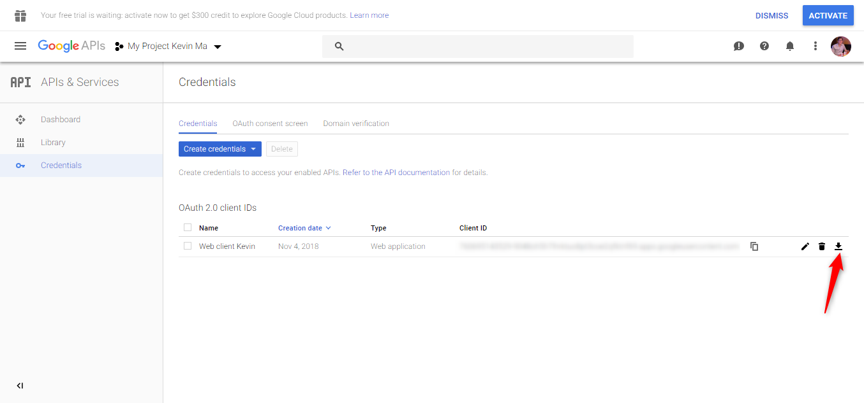
Creating a Google Application
Visit https://console.developers.google.com/projectselector/apis/library

Slide 31
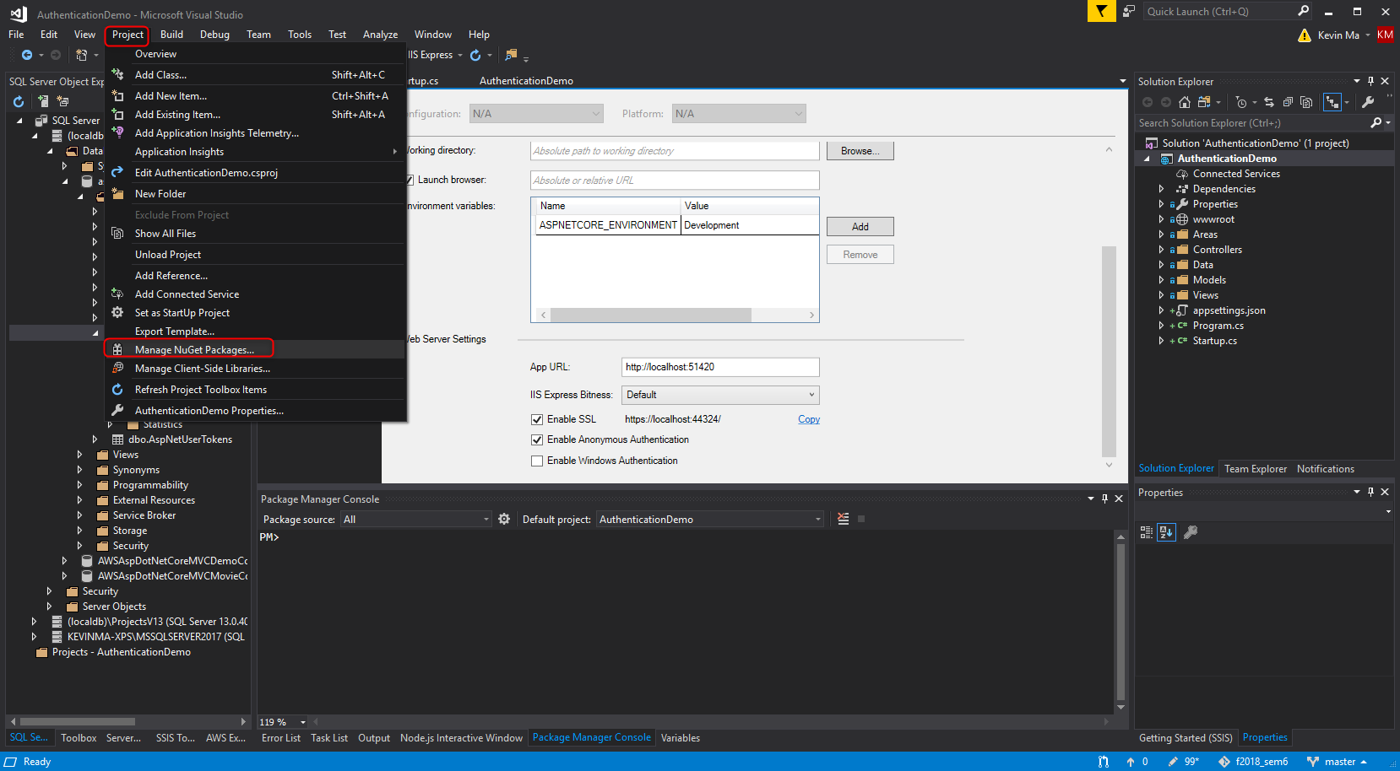
Configure Web App to use Google Auth

Slide 32
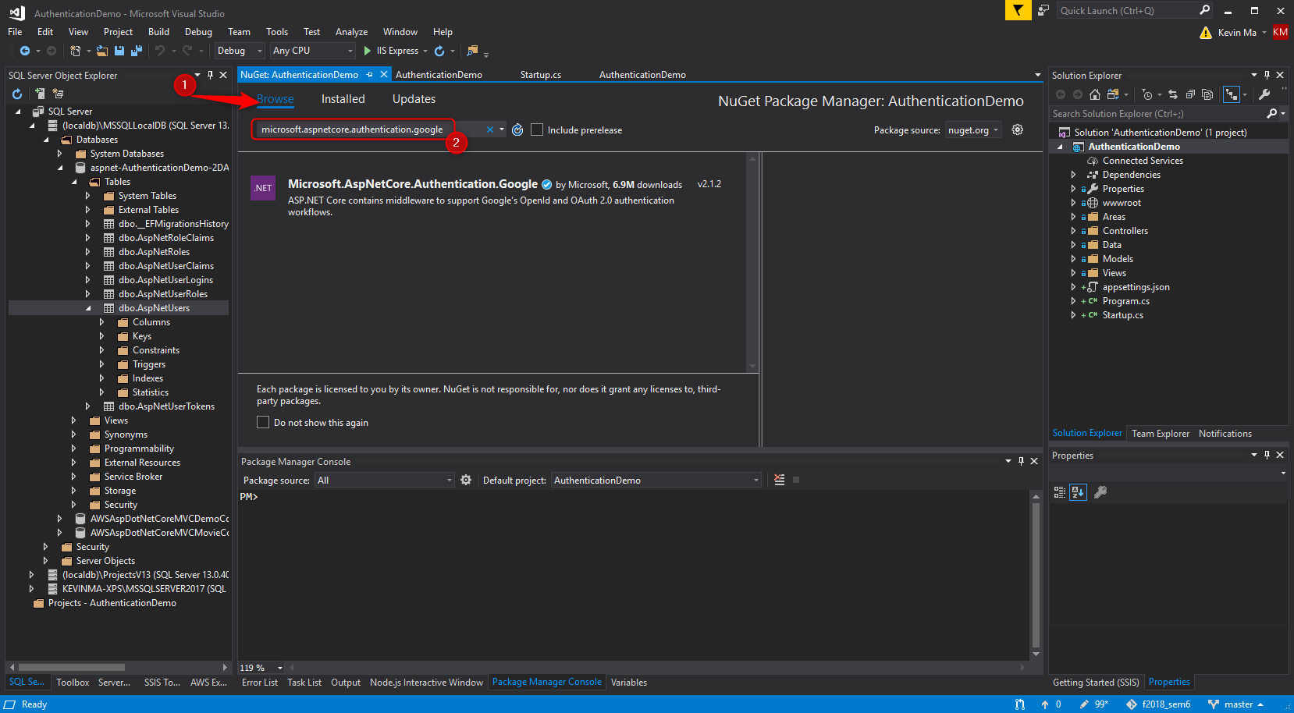
Configure Web App to use Google Auth

Slide 33
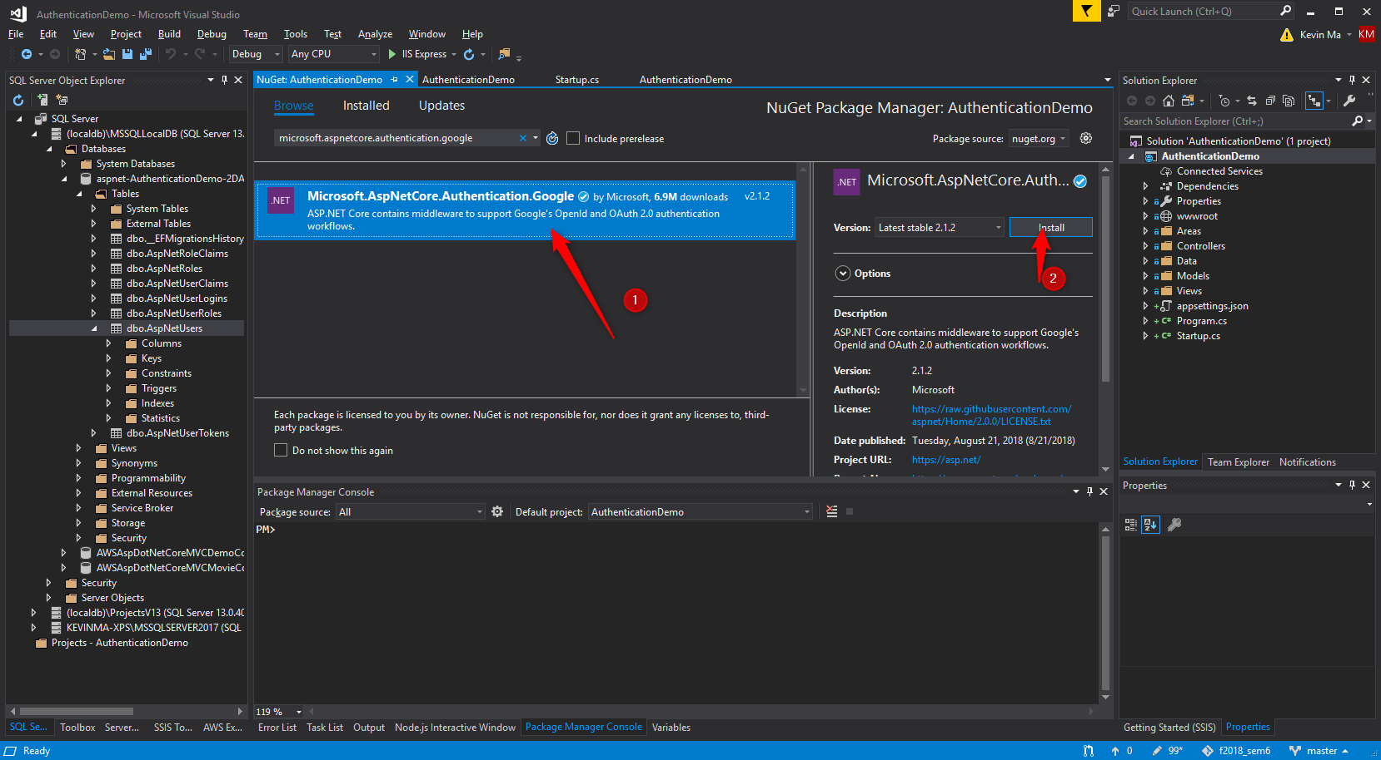
Configure Web App to use Google Auth

Slide 34
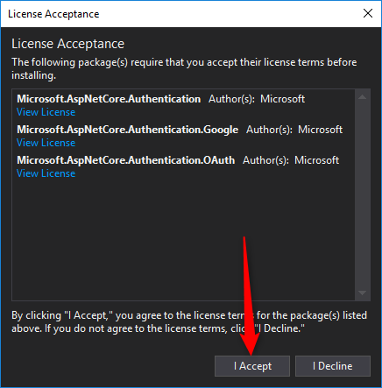
Configure Web App to use Google Auth

Slide 35
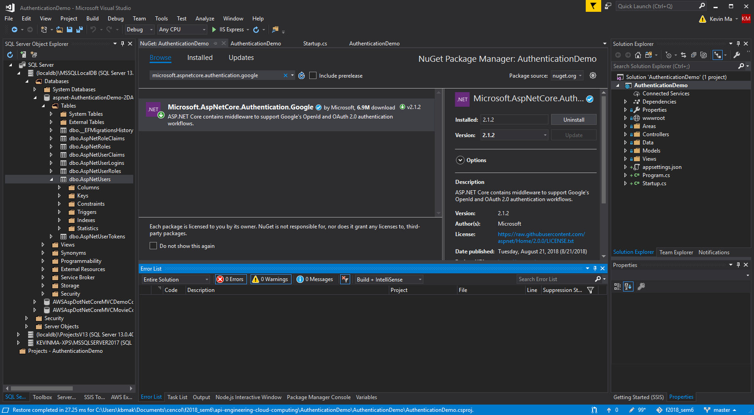
Configure Web App to use Google Auth

Slide 36
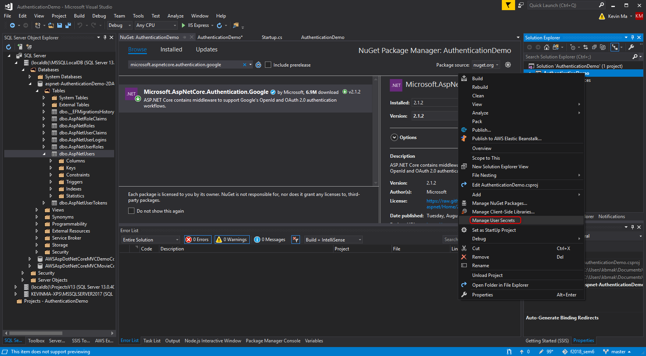
Configure Web App to use Google Auth

Slide 37
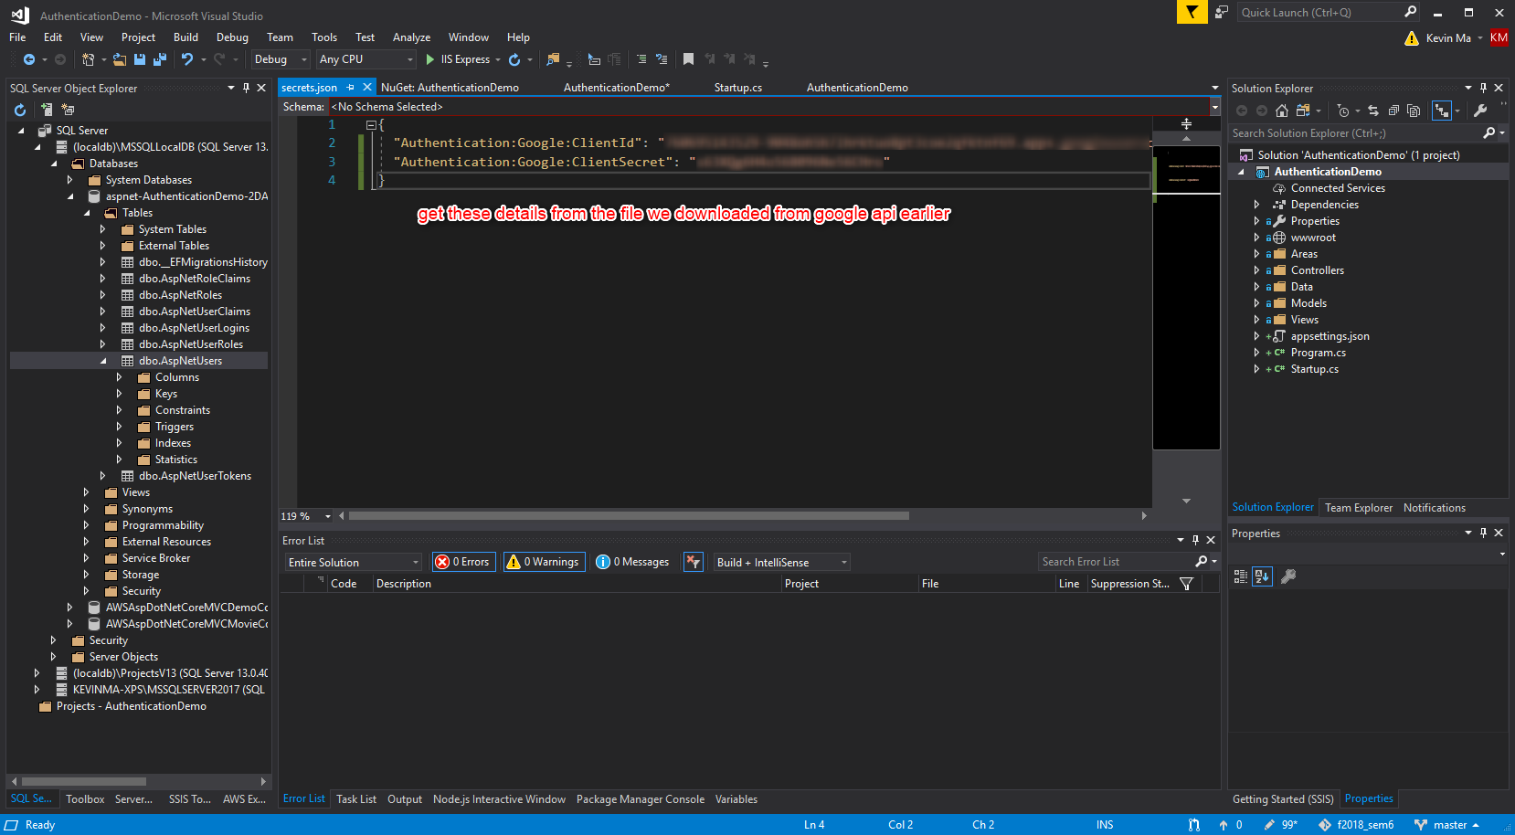
Configure Web App to use Google Auth
A secrets.json file will open. Add the following code to it:

Slide 38
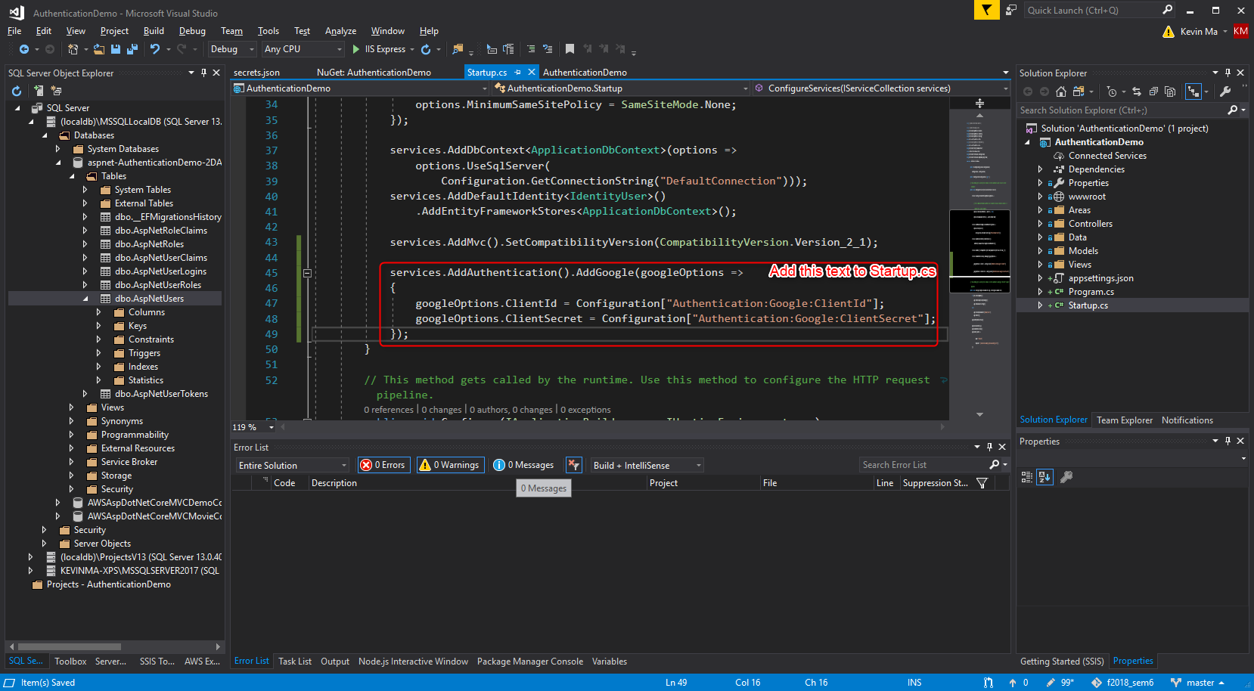
Configure Web App to use Google Auth

Slide 39
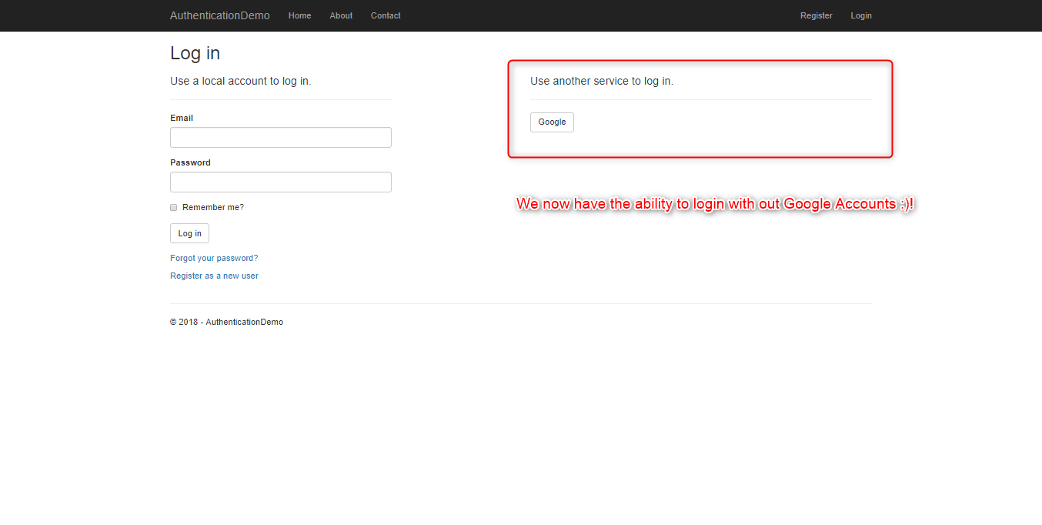
Configure Web App to use Google Auth

Slide 40
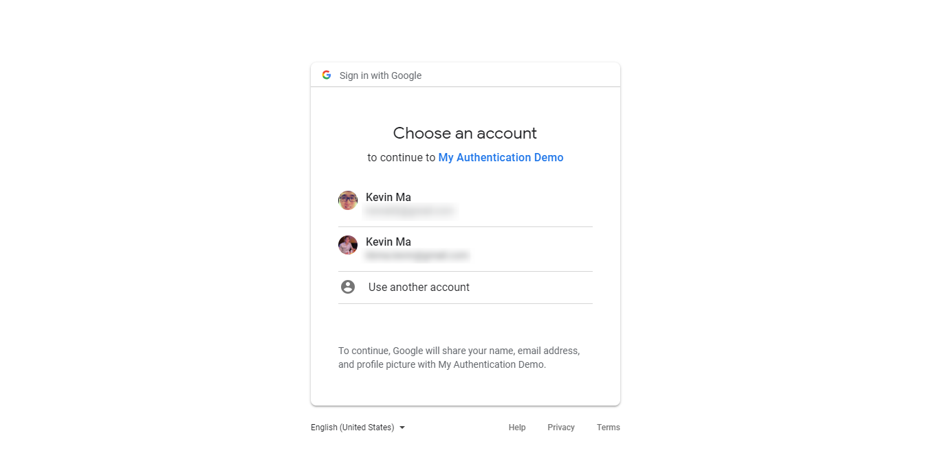
Configure Web App to use Google Auth

Slide 41
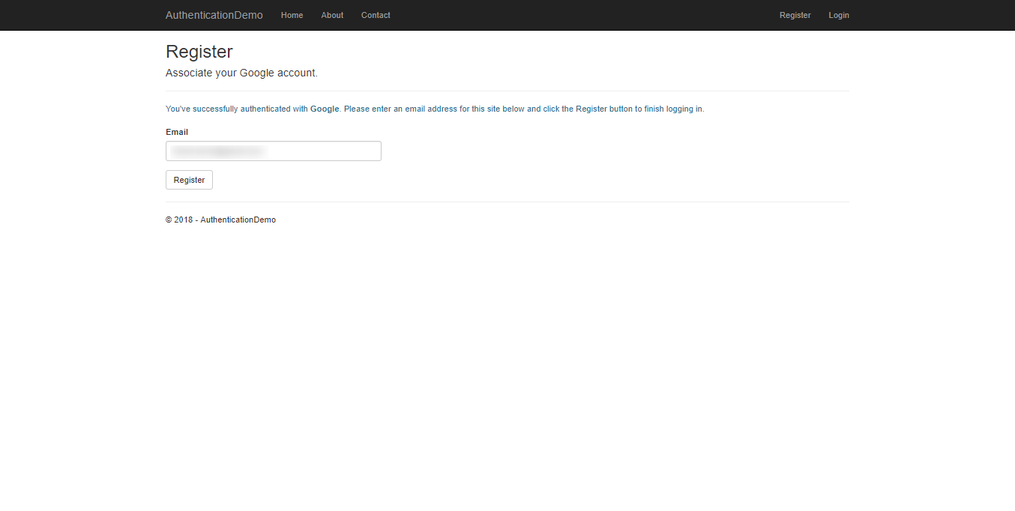
Configure Web App to use Google Auth

Slide 42
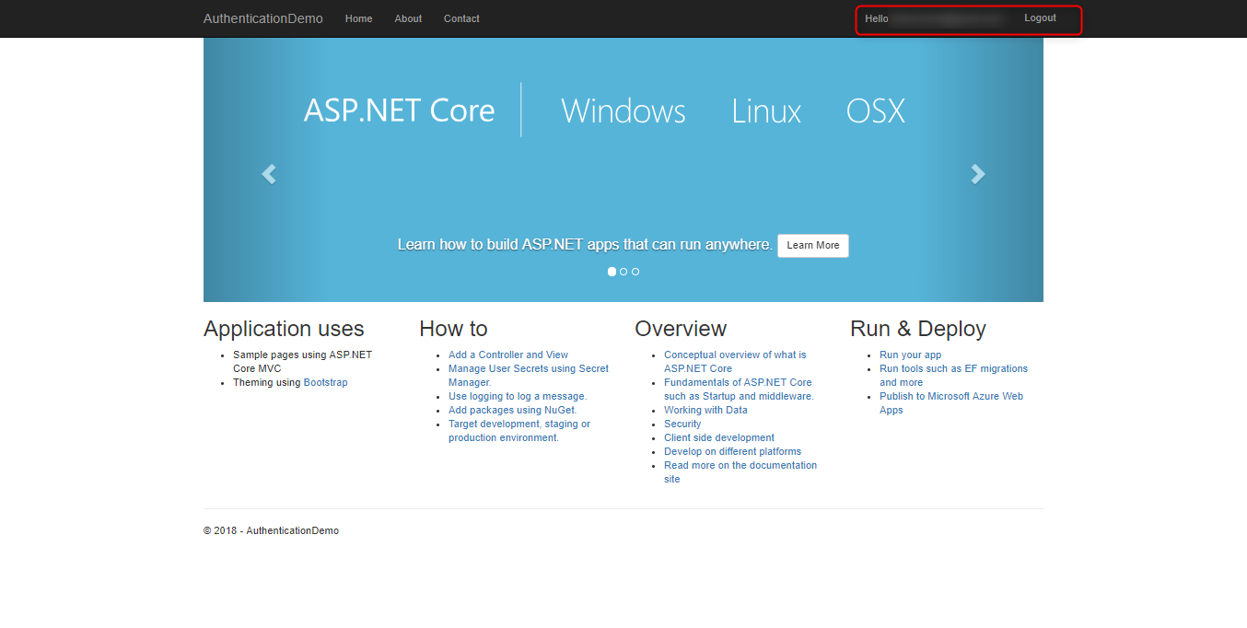
Configure Web App to use Google Auth

Slide 43
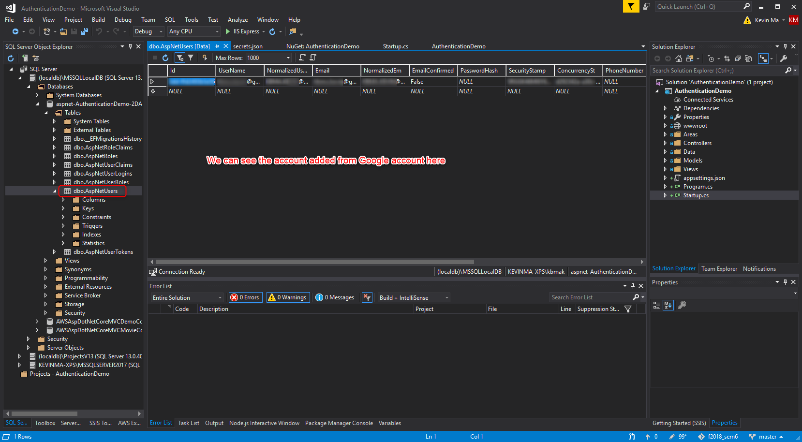
Configure Web App to use Google Auth

Slide 44
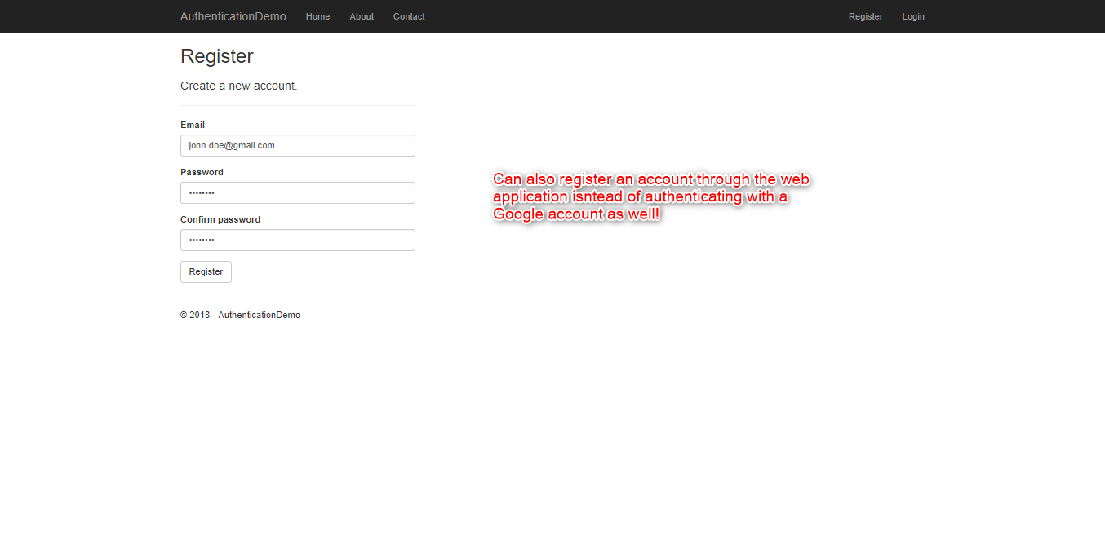
Simple Authentication with ASP.NET Core

Slide 45
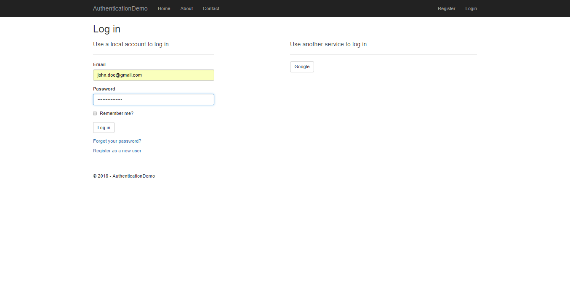
Simple Authentication with ASP.NET Core

Slide 46
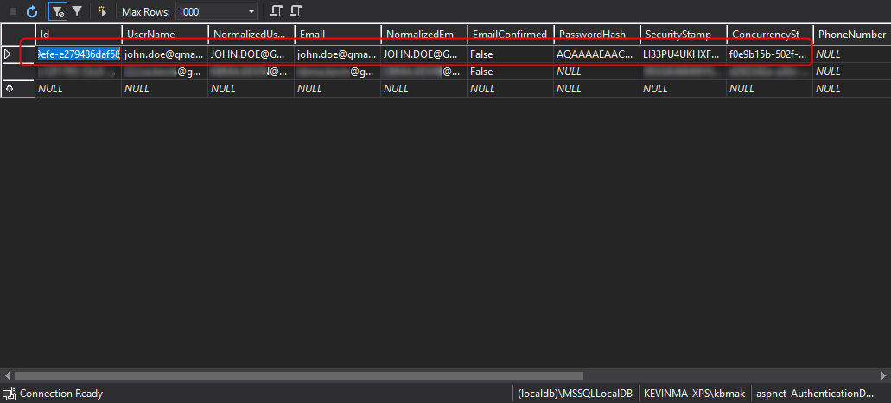
Simple Authentication with ASP.NET Core

