Slide 1
Explain the basic concepts and importance of data warehousing.
Differentiate transactional database and data warehousing.
Explain the importance of integration across the organization through Data.
Discuss Data Warehouse Design.

Slide 2
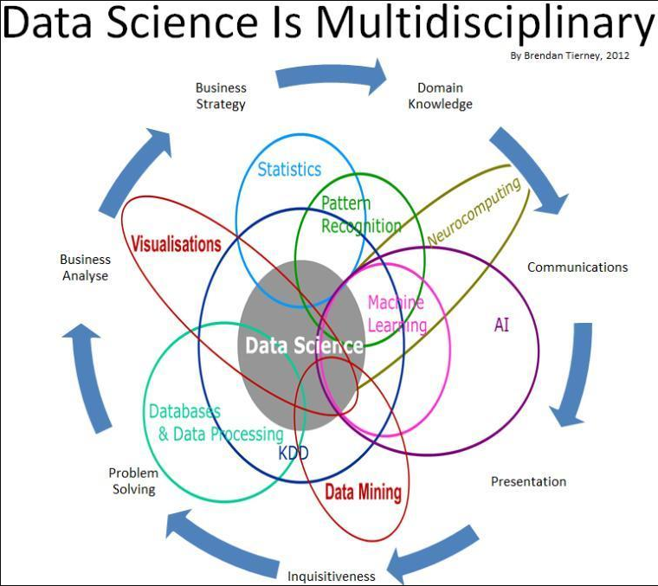
Where does it fit?

Slide 3
BI Tools Landscape
Self-Service BI
Involves free-form reporting and analysis
Enables you to integrate data from disparate sources and drill-down and understand the root cause for data anomalies.
You can perform your own reporting and analysis without relying on IT or others.

Slide 4
Corporate BI
Formatted reports that are typically based upon approved corporate data, and then shared more broadly with managers, teams, or departments.
IT oversees the distribution and monitoring of the reporting environment and building of the structured data layer upon which the reports are built.

Slide 5
Advanced Analytics
Tools and techniques used to forecast future outcomes and behaviors
Data mining uses mathematical analysis to derive patterns and trends that exist in data
Patterns cannot be discovered by traditional data exploration
relationships are too complex and there is too much data.

Slide 6
Database and Data Warehousing
History of data warehousing
Evolution in organization use of data warehouses
Data Warehouse Architecture
Benefits of data warehousing
Strategic uses of data warehousing
Disadvantages of data warehouses
Data mart
OLAP
Data warehousing integration
Business intelligence

Slide 7
The Difference…
DWH Constitute Entire Information Base For All Time..
Database Constitute Real Time Information…
DWH Supports DM And Business Intelligence.
Database Is Used To Running The Business
DWH Is How To Run The Business

Slide 8
A producer wants to know….
Which are our lowest/highest margin customers ?
Who are my customers and what products are they buying?
What is the most effective distribution channel?
What product prom- -otions have the biggest impact on revenue?
Which customers are most likely to go to the competition ?
What impact will new products/services
have on revenue and margins?

Slide 9
Hard/Infeasible Queries for OLTP
• Why not use the existing databases (OLTP) for business analysis?
• Business analysis queries
In the past five years, which product is the most profitable?
Which public holiday we have the largest sales?
Which week we have the largest sales?
Does the sales of dairy products increase over time?
Difficult to express these queries in SQL
3rd query: may extract the “week” value using a function
But the user has to learn many transformation functions …
4th query: use a “special” table to store IDs of all dairy products, in advance
There can be many different dairy products; there can be many other product types as well …

Slide 10
Unstructured , Inconsistent Data
I can’t find the data I need
data is scattered over the network
many versions, subtle differences
I can’t get the data I need
need an expert to get the data
I can’t understand the data I found
available data poorly documented
I can’t use the data I found
results are unexpected
data needs to be transformed from one form to other

Slide 11
What is a Data Warehouse?
A single, complete and consistent store of data obtained from a variety of different sources made available to end users in a what they can understand and use in a business context.

Slide 12
What is Data Warehousing?
Information
A process of transforming data into information and making it available to users in a timely enough manner to make a difference
Data

Slide 13
Data Warehousing -- a process
It is a relational or multidimensional database management system designed to support management decision making.
A data warehousing is derived from transaction data specifically structured for querying and reporting.
Technique for assembling and managing data from various sources for the purpose of answering business questions. Thus making decisions that were not previous possible

Slide 14
Data warehousing is …
Subject Oriented: Data that gives information about a particular subject instead of about a company's ongoing operations.
Integrated: Data that is gathered into the data warehouse from a variety of sources and merged into a coherent whole.
Time-variant: All data in the data warehouse is identified with a particular time period.
Non-volatile: Data is stable in a data warehouse. More data is added but data is never removed. This enables management to gain a consistent picture of the business.
Data warehousing is combining data from multiple and usually varied sources into one comprehensive and easily manipulated database.
Common accessing systems of data warehousing include queries, analysis and reporting.
Because data warehousing creates one database in the end, the number of sources can be anything you want it to be, provided that the system can handle the volume, of course.
The final result, however, is homogeneous data, which can be more easily manipulated.

Slide 15
Aggregate Example
Aggregate Example
Imagine 1 bio. sales rows, 1000 products, 100 locations
CREATE VIEW TotalSales (pid, locid, total) AS SELECT s.pid, s.locid, SUM(s.sales) FROM Sales s GROUP BY s.pid, s.locid
The materialized view has 100'000 rows
• Query rewritten to use view
SELECT p.category, SUM(s.sales) FROM Products p, Sales s WHERE p.pid=s.pid GROUP BY p.category
Rewritten to
SELECT p.category, SUM(t.total) FROM Products p, TotalSales t WHERE p.pid=t.pid GROUP BY p.category
Query becomes 10'000 times faster!

Slide 16
Pre-Aggregation Choices
Full pre-aggregation: (all combinations of levels)
Fast query response
Takes a lot of space/update time (200-500 times raw data)
• No pre-aggregation
Slow query response (for terabytes…)
• Practical pre-aggregation: chosen combinations
A good compromise between response time and space use
• Most (R)OLAP tools now support practical preaggregation
IBM DB2 UDB
Oracle 9iR2
MS Analysis Services
Hyperion Essbase (DB2 OLAP Services)

Slide 17
Choosing Aggregate
Using practical pre-aggregation, it must be decided what aggregates to store
This is a non-trivial (NP-complete) optimization problem
Many influencing factors
Space use
Update speed
Response time demands
Actual queries
Prioritization of queries
Index and/or aggregates Only choose an aggregate if it is considerably smaller than available, usable aggregates (factor 3-5-10)
Often supported (semi-)automatically by tool/DBMS  Oracle, DB2, MS SQL Server

Slide 18
Database explosion
10 | 20
30 | 40
10 | 20 | 30
30 | 40 | 70
40 | 60 | 100
5 extra values needed to hold all possible aggregations on a table that had only 4 values in it originally!

Slide 19
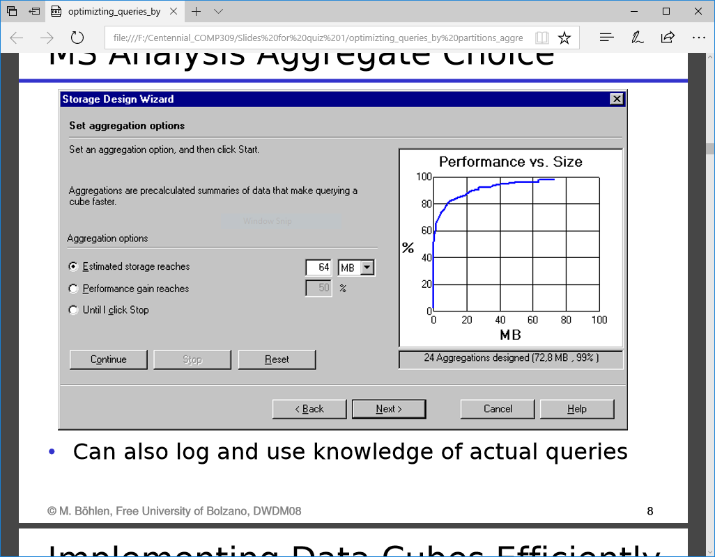
MS Analysis Aggregate Choice

Slide 20
History of data warehousing
The concept of data warehousing dates back to the late 1980s when IBM researchers Barry Devlin and Paul Murphy developed the "business data warehouse".
1960s - General Mills and Dartmouth College, in a joint research project, develop the terms dimensions and facts.
1970s - ACNielsen and IRI provide dimensional data marts for retail sales.
1983 – Tera data introduces a database management system specifically designed for decision support.
1988 - Barry Devlin and Paul Murphy publish the article An architecture for a business and information systems in IBM Systems Journal where they introduce the term "business data warehouse".

Slide 21
OLTP vs Data Warehouse
OLTP
Application Oriented
Used to run business
Detailed data
Current up to date
Isolated Data
Clerical User
Few Records accessed at a time (tens)
Read/Update Access
Volatile Creation/Deletion
No data redundancy
Database Size 100MB -100 GB
Transaction throughput is the performance metric
Thousands of users
Managed in entirety
Warehouse (DSS – Decision Support System)
Subject Oriented
Used to analyze business
Summarized and refined
Snapshot data
Integrated Data
Knowledge User (Manager)
Large volumes accessed at a time (millions)
Mostly Read (Batch Update)
Redundancy present
Database Size 100 GB - few terabytes
Query throughput is the performance metric
Hundreds of users
Managed by subsets

Slide 22
Data Analysis Problems
The same data found in many different systems
Example: customer data across different stores and departments
The same concept is defined differently
Heterogeneous sources
Relational DBMS, On-Line Transaction Processing (OLTP)
Unstructured data in files (e.g., MS Word)
Legacy systems

Slide 23
Data Analysis Problems ( Cont’d)
Data is suited for operational systems Accounting, billing, etc.
Do not support analysis across business functions
Data quality is bad
Missing data, imprecise data, different use of systems
Data are “volatile”
Data deleted in operational systems (6 months)
Data change over time – no historical information

Slide 24

To summarize ...
OLTP Systems are used to “run” a business
The Data Warehouse helps to “optimize” the business

Slide 25
Case Study of an Enterprise
Example of a chain (e.g., fashion stores or car dealers)
Each store maintains its own customer records and sales records.
Hard to answer questions like: “find the total sales of Product X from stores in Aalborg”
The same customer may be viewed as different customers for different stores; hard to detect duplicate customer information
Imprecise or missing data in the addresses of some customers
Purchase records maintained in the operational system for limited time (e.g., 6 months); then they are deleted or archived 
The same “product” may have different prices, or different discounts in different stores

Slide 26
Evolution in organizational use of data warehouses
Organizations generally start off with relatively simple use of data warehousing. Over time, more sophisticated use of data warehousing evolves. The following general stages of use of the data warehouse can be distinguished:
Operation Data Store
Data warehouses in this initial stage are developed by simply copying the data off an operational system to another server where the processing load of reporting against the copied data does not impact the operational system's performance.
Off line Data Warehouse
Data warehouses at this stage are updated from data in the operational systems on a regular basis and the data warehouse data is stored in a data structure designed to facilitate reporting.
Real Time Data Warehouse
Data warehouses at this stage are updated every time an operational system performs a transaction (e.g. an order or a delivery or a booking.)
Integrated Data Warehouse
Data warehouses at this stage are updated every time an operational system performs a transaction. The data warehouses then generate transactions that are passed back into the operational systems.

Slide 27
Data Warehouse Architecture
Client
Client
Query & Analysis
Metadata
Warehouse
Integration
Source
Source
Source

Slide 28
The data has been selected from various sources and then integrate and store the data in a single and particular format.
Data warehouses contain current detailed data, historical detailed data, lightly and highly summarized data, and metadata.
Current and historical data are voluminous because they are stored at the highest level of detail.
Lightly and highly summarized data are necessary to save processing time when users request them and are readily accessible.
Metadata are “data about data”. It is important for designing, constructing, retrieving, and controlling the warehouse data.
Technical metadata include where the data come from, how the data were changed, how the data are organized, how the data are stored, who owns the data, who is responsible for the data and how to contact them, who can access the data , and the date of last update.
Business metadata include what data are available, where the data are, what the data mean, how to access the data, predefined reports and queries, and how current the data are.

Slide 29
Business advantages
It provides business users with a “customer-centric” view of the company’s heterogeneous data by helping to integrate data from sales, service, manufacturing and distribution, and other customer-related business systems.
It provides added value to the company’s customers by allowing them to access better information when data warehousing is coupled with internet technology.
It consolidates data about individual customers and provides a repository of all customer contacts for segmentation modeling, customer retention planning, and cross sales analysis.
It removes barriers among functional areas by offering a way to reconcile views from multiple areas, thus providing a look at activities that cross functional lines.
It reports on trends across multidivisional, multinational operating units, including trends or relationships in areas such as merchandising, production planning etc.

Slide 30
Strategic uses of data warehousing
Industry | Functional areas of use | Strategic use
Airline | Operations; marketing | Crew assignment, aircraft development, mix of fares, analysis of route profitability, frequent flyer program promotions
Banking | Product development; Operations; marketing | Customer service, trend analysis, product and service promotions, reduction of IS expenses
Credit card | Product development; marketing | Customer service, new information service, fraud detection
Health care | Operations | Reduction of operational expenses
Investment and Insurance | Product development; Operations; marketing | Risk management, market movements analysis, customer tendencies analysis, portfolio management
Retail chain | Distribution; marketing | Trend analysis, buying pattern analysis, pricing policy, inventory control, sales promotions, optimal distribution channel
Telecommunications | Product development; Operations; marketing | New product and service promotions, reduction of IS budget, profitability analysis
Personal care | Distribution; marketing | Distribution decisions, product promotions, sales decisions, pricing policy
Public sector | Operations | Intelligence gathering

Slide 31
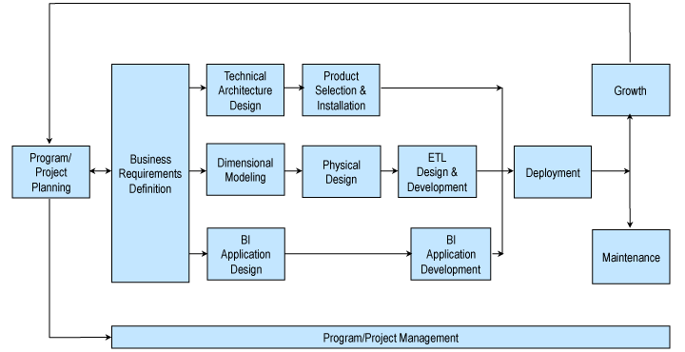
Life cycle of Data warehouse Design

Slide 32
Data Marts
A data mart is a scaled down version of a data warehouse that focuses on a particular subject area.
A data mart is a subset of an organizational data store, usually oriented to a specific purpose or major data subject, that may be distributed to support business needs.
Data marts are analytical data stores designed to focus on specific business functions for a specific community within an organization.
Usually designed to support the unique business requirements of a specified department or business process
Implemented as the first step in proving the usefulness of the technologies to solve business problems
Reasons for creating a data mart
Easy access to frequently needed data
Creates collective view by a group of users
Improves end-user response time
Ease of creation in less time
Lower cost than implementing a full Data warehouse
Potential users are more clearly defined than in a full Data warehouse

Slide 33
From the Data Warehouse to Data Marts
Information
Individually Structured
Less
History
Normalized
Detailed
Departmentally Structured
Data Warehouse
Organizationally Structured
More
Data

Slide 34

Characteristics of the Departmental Data Mart
Small
Flexible
Customized by Department
OLAP
Source is departmentally structured data warehouse
Data mart
Data warehouse

