Slide 1
COMP 306: API Engineering & Cloud Computing
Class Activity 02 – AWS DynamoDB Workshop
Created By: Kevin Ma (#300867968)
Fall 2018

Slide 2
Class Activity 02 – AWS DynamoDB Workshop
AWS DynamoDB

Slide 3
What is NoSQL?
A NoSQL database provides a way to store and retrieve data that is in a non-tabular format
NoSQL databases are used for managing large sets of data that are frequently updated in a distributed system
It eliminates the need for a rigid schema
Four types of NoSQL databases
Key-value pair databases
Document databases
Graph databases
Wide column stores

Slide 4
Key-Value Pair Databases
Uses a very simple data model that stores data in a pair of unique keys and associated value
Commonly used for storing time series data, click stream data, and application logs
Examples of key-value pair databases are: DynamoDB, Redis, et cetera

Slide 5
Document Databases
Stores data elements in a structure that represents a document-like format such as JSON, XML, or YMAL
Commonly used for content management and monitoring application
Examples of document databases: MongoDB, CouchDB, et cetera

Slide 6
Graph Databases
Use graph structures and stores related data in nodes
Emphasizes on the connection between the data elements to accelerate query performance
Mainly used for storing geographical data and recommendation engines
Examples of graph databases: IBM graph, Neo4J

Slide 7
Wide Column Databases
Stores data using column-oriented model
Stores data in a table-like structure and it can store large numbers of columns
Generally used for storing data related to internet searches and other similar large-scale web apps

Slide 8
Amazon DynamoDB
Amazon DynamoDB is a fast and flexible NoSQL database service for all applications that need consistent, single-digit millisecond latency at any scale. Its flexible data model and reliable performance make it a great fit for mobile, web, gaming, ad-tech, IoT, and many other applications.
It is not designed to support transactions

Slide 9
Components of Amazon DynamoDB
Tables
DynamoDB stores data in an entity called a table
A table consists of a set of data
Item
Like a record or row in an RDBMS table
A table consists of multiple items
Attributes
Similar to a field or column in RDBMS
An attribute is the basic data element of an item
An item in a table consists of multiple attributes
An attribute can have sub-attributes

Slide 10
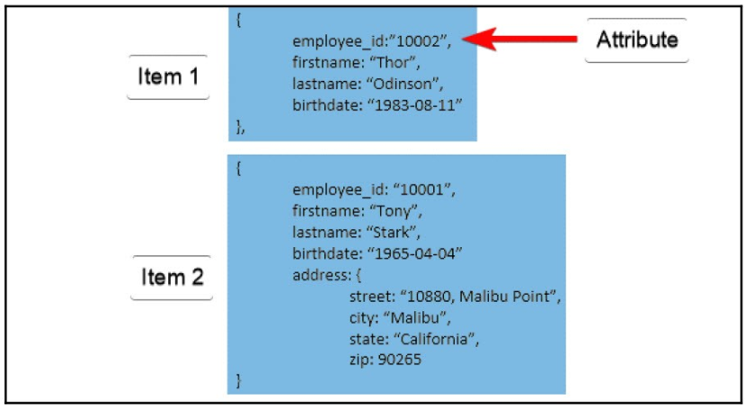
Example of Amazon DynamoDB

Slide 11
What is a Primary Key?
A primary key is a mechanism to uniquely identify each item in a table. Two items in the same table are not allowed to have same key value
Two types of primary keys
Partition key
Primary key composed of a single attribute
DynamoDB partitions the data in sections based on partition key value
Partition key value is used as an input to internal hash functions to determine in which partition the data is stored
Partition key and sort key
Composed of two attributes and called composite primary key

Slide 12
Data Types of Amazon DynamoDB
String
Number
Binary
Bool
Null
Set of string, number or binary
Map

Slide 13
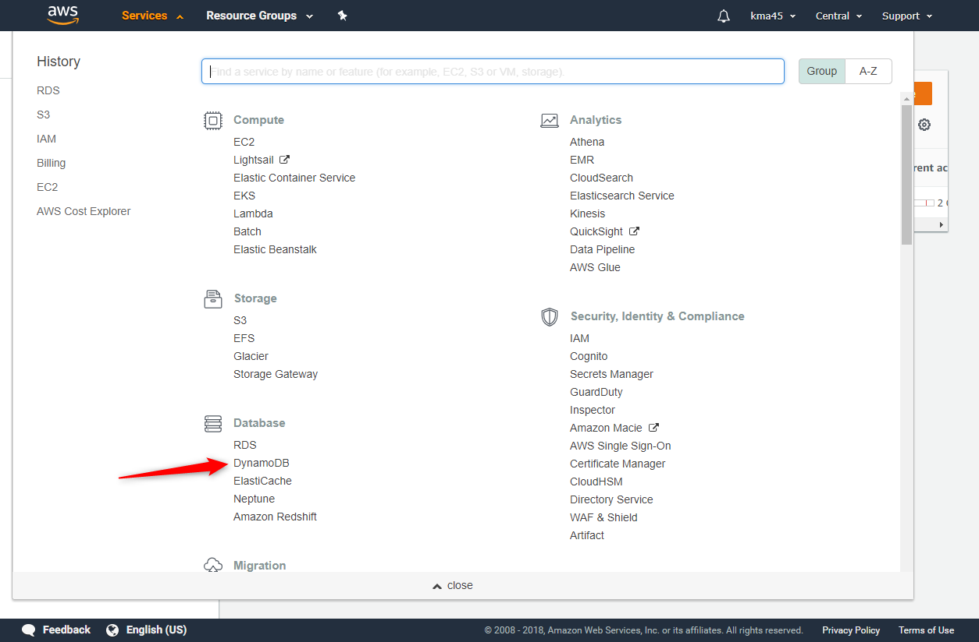
Create a DynamoDB Table

Slide 14
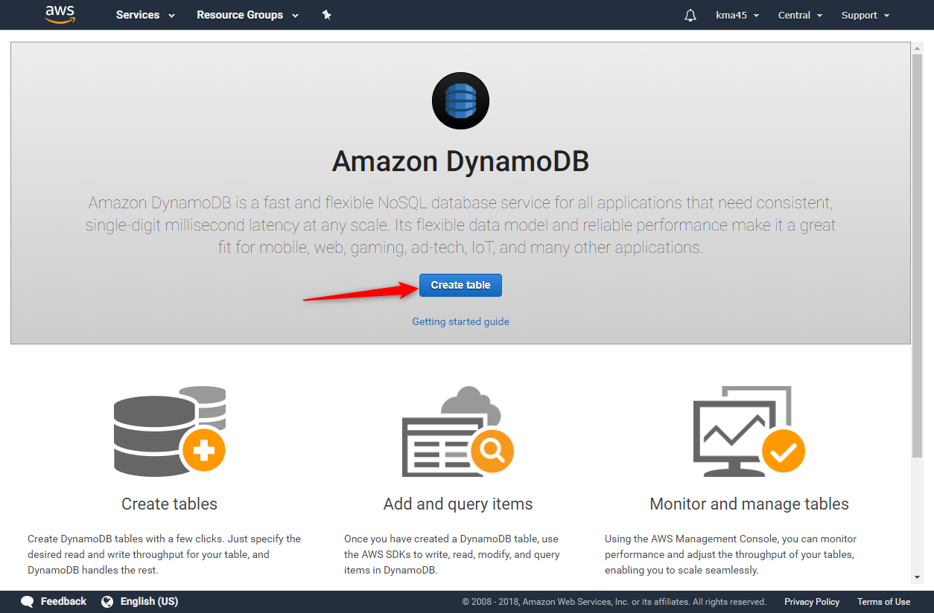
Create a DynamoDB Table (CONT’D)

Slide 15
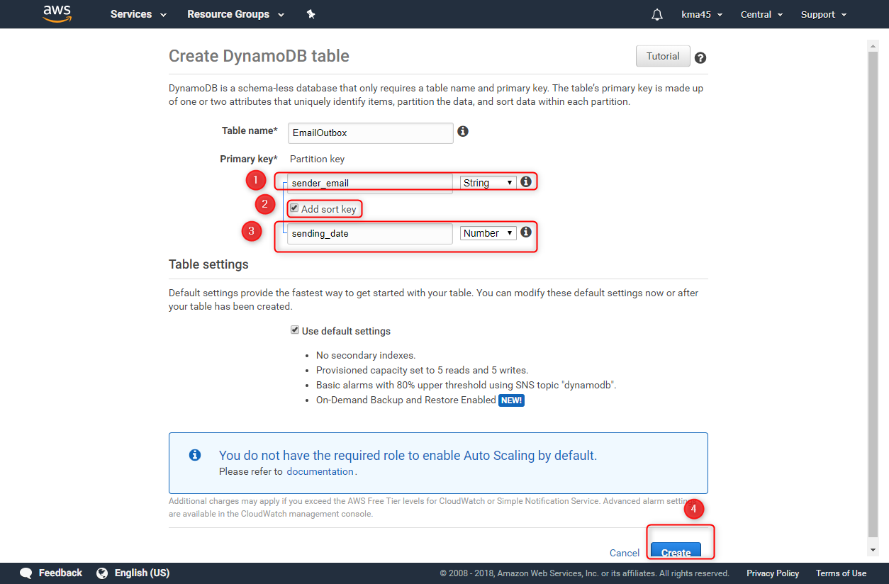
Create a DynamoDB Table (CONT’D)

Slide 16
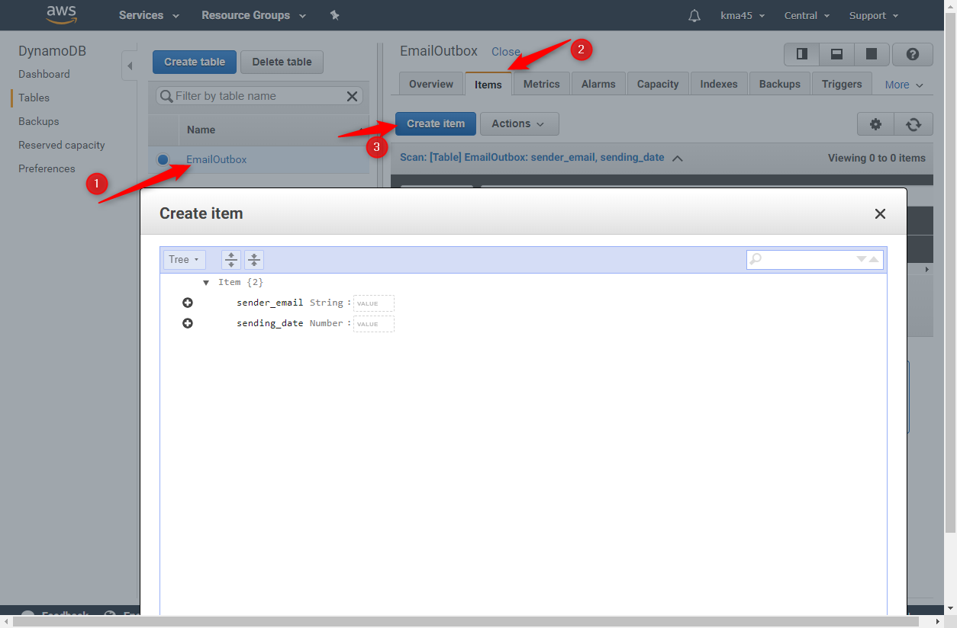
Create a DynamoDB Table (CONT’D)

Slide 17
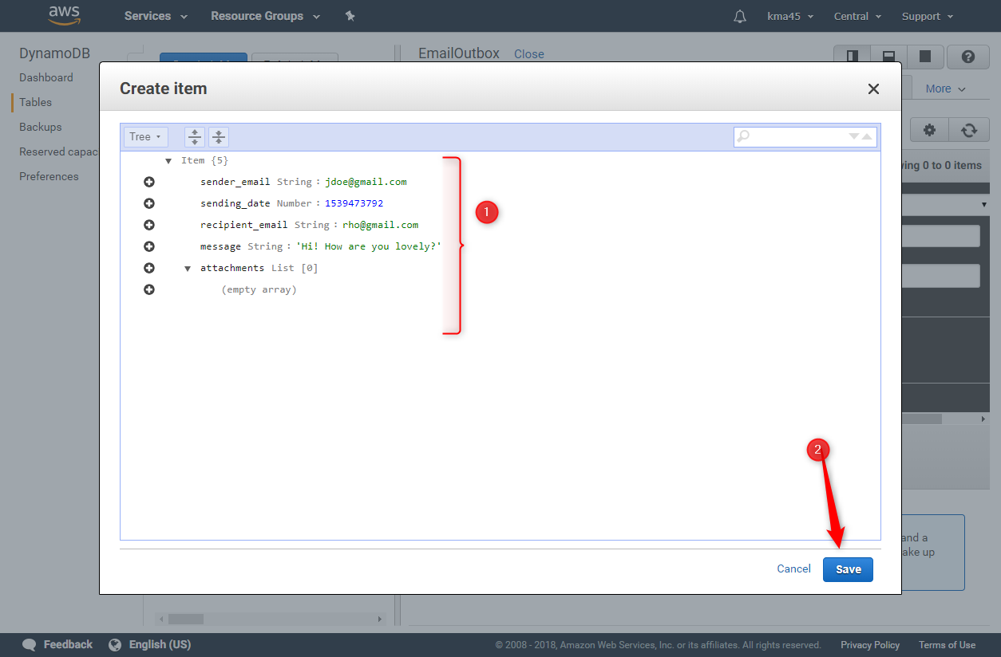
Create a DynamoDB Table (CONT’D)

Slide 18
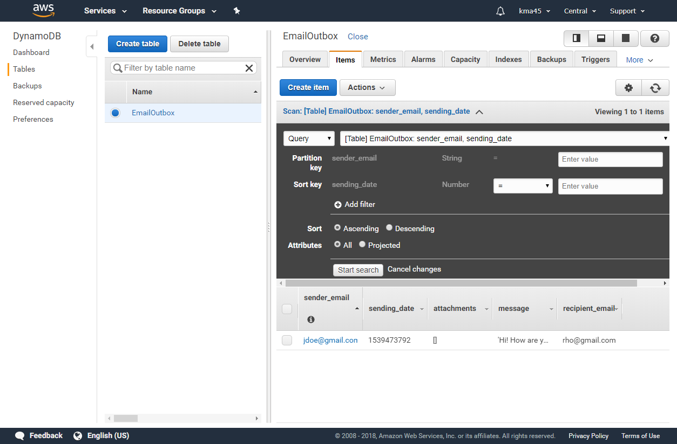
Create a DynamoDB Table (CONT’D)

