Slide 1
COMP 306: API Engineering & Cloud Computing
Class Activity 02 – AWS RDS Workshop
Created By: Kevin Ma (#300867968)
Fall 2018

Slide 2
Class Activity 02 – AWS RDS Workshop
AWS RDS

Slide 3
What is AWS RDS?
Amazon Relational Database Services (RDS) provides cost-efficient and scalable relational database capacity while automating time-consuming administration tasks such as hardware provisioning, database setup, patching and backups

Slide 4
What are DB Instances?
The basic building block of Amazon RDS is the DB instance.
A DB instance is an isolated database environment in the cloud. A DB instance can contain multiple user-created database, and you can access it by using the same tools and applications that you use with a stand-alone database instance.
Each DB instance runs a DB engine. Amazon RDS currently supports Amazon Aurora, MySQL, MariaDB, PostgreSQL, Oracle, and Microsoft SQL Server DB engine

Slide 5
What is Amazon Aurora?
Amazon Aurora is a MySQL- and PostgreSQL-compatible enterprise-class database, starting at <$1/day
Up to 5 times the throughput of MySQL and 3 times the throughput of PostgreSQL
Up to 64TiB of auto-scaling SSD storage
6-way replication across three Availability Zones
Up to 15 Read Replicas with sub-10ms replica lag
Automatic monitoring and failover in less than 30 seconds

Slide 6
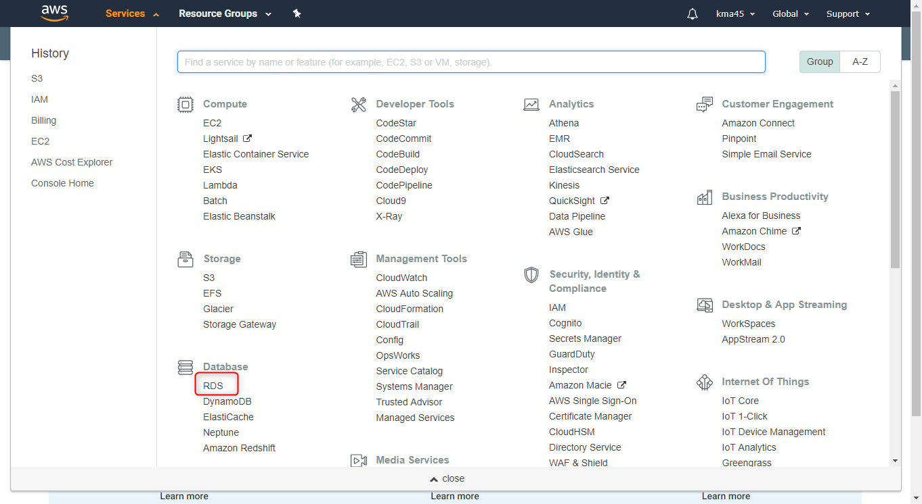
Create MySQL DB Instance

Slide 7
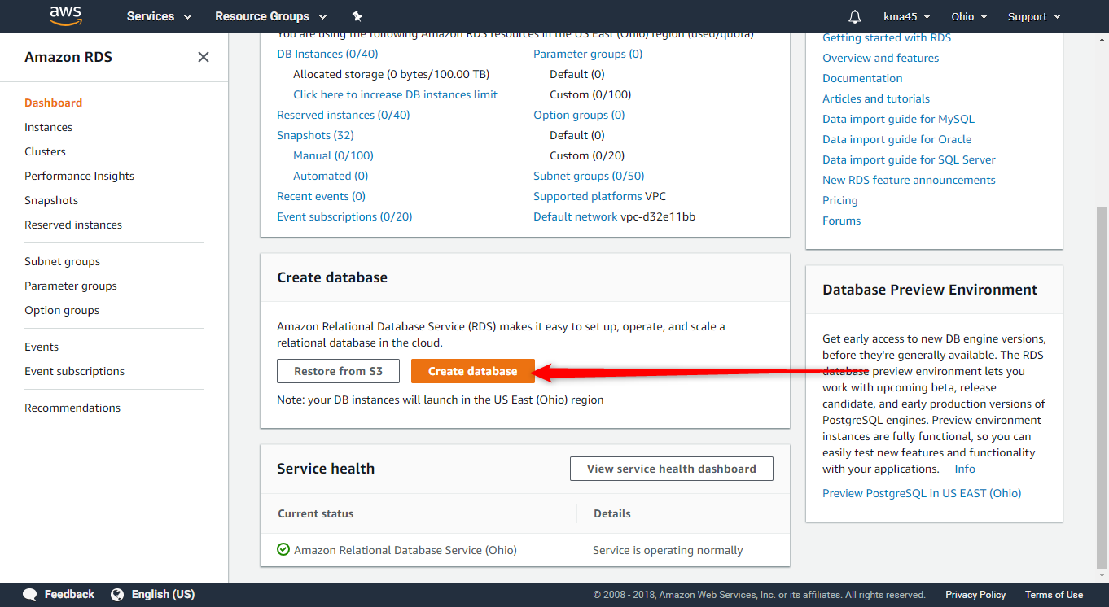
Create MySQL DB Instance (CONT’D)

Slide 8
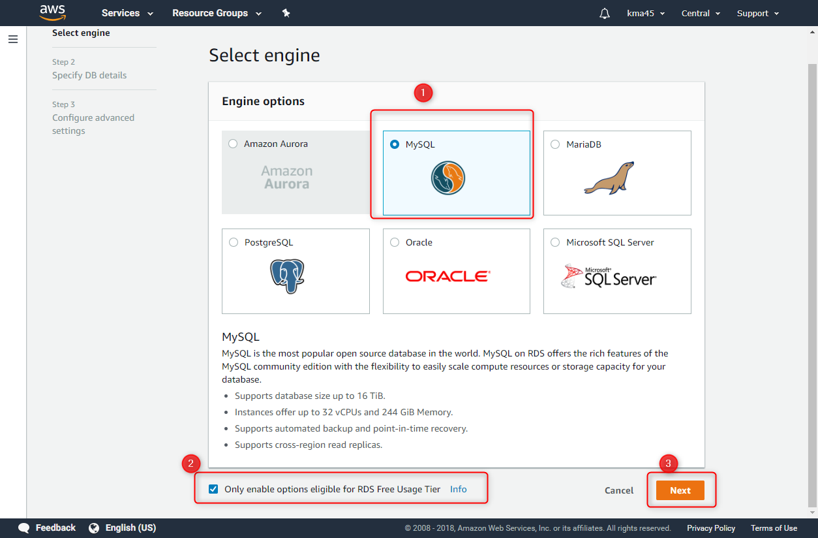
Create MySQL DB Instance (CONT’D)

Slide 9
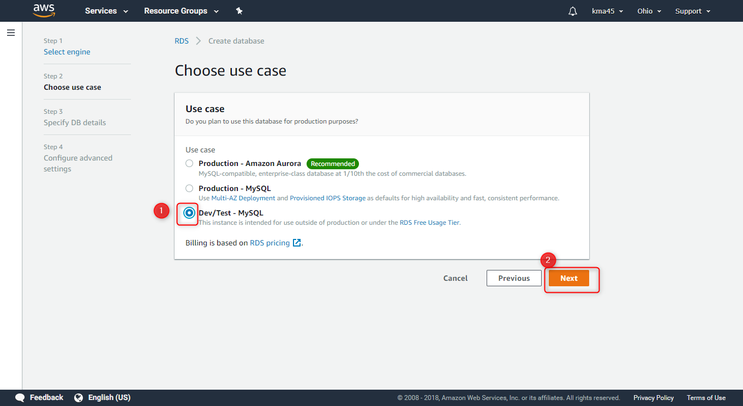
Create MySQL DB Instance (CONT’D)

Slide 10
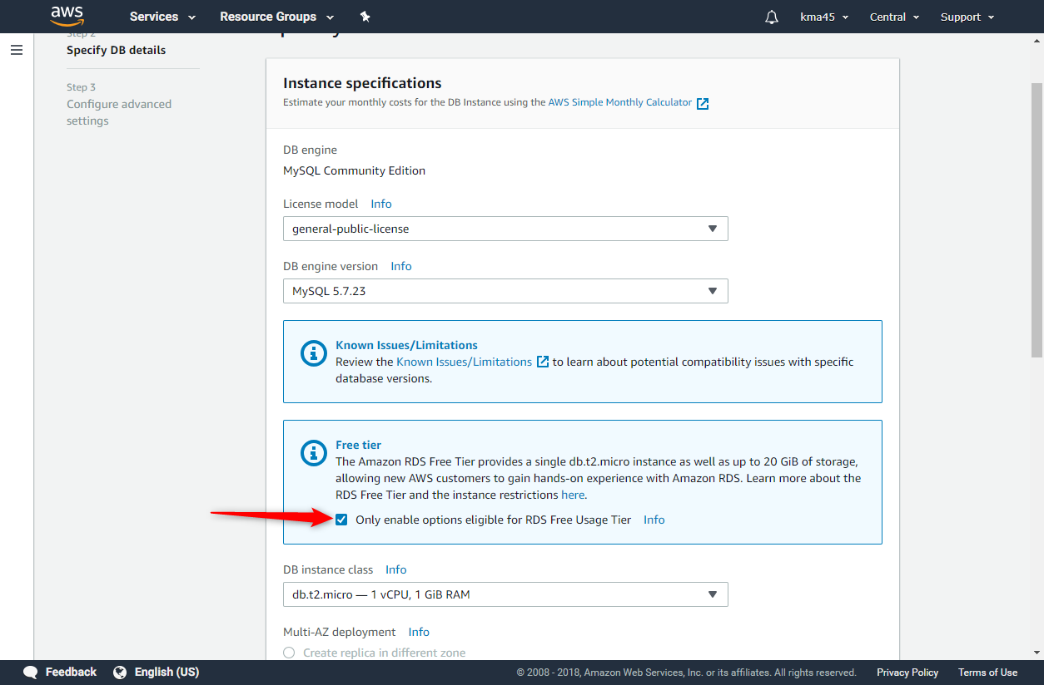
Create MySQL DB Instance (CONT’D)

Slide 11
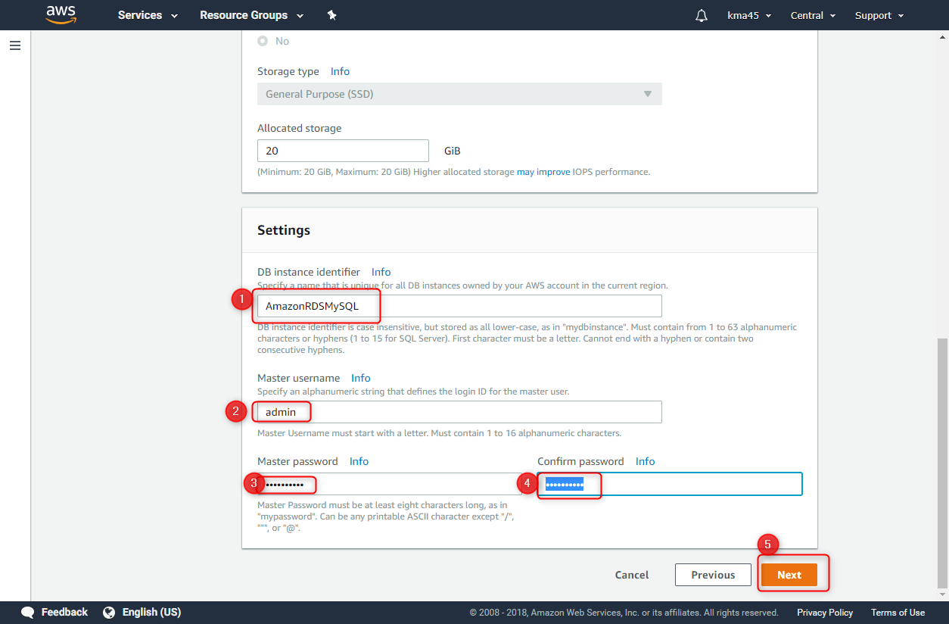
Create MySQL DB Instance (CONT’D)
Notes:
Credentials:
admin:mypassword

Slide 12
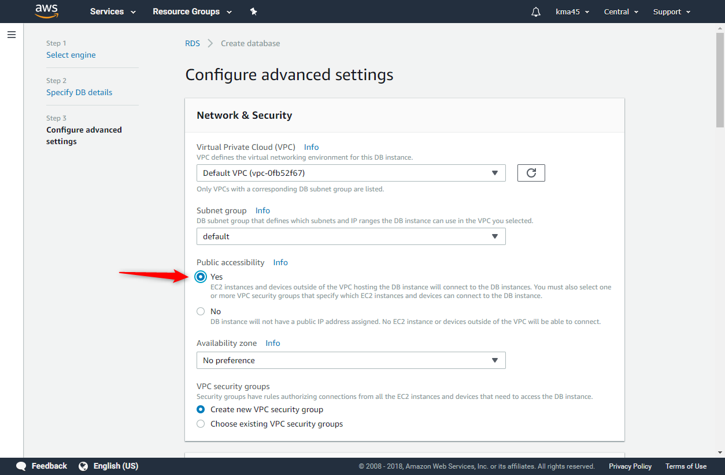
Create MySQL DB Instance (CONT’D)

Slide 13
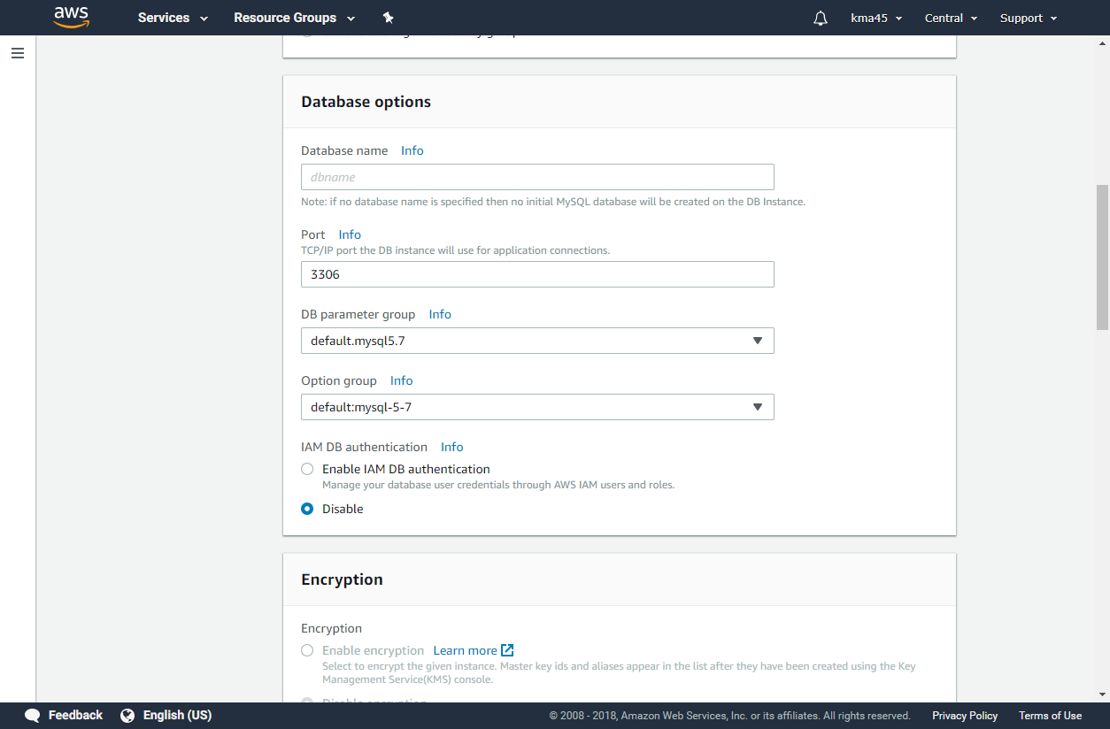
Create MySQL DB Instance (CONT’D)

Slide 14
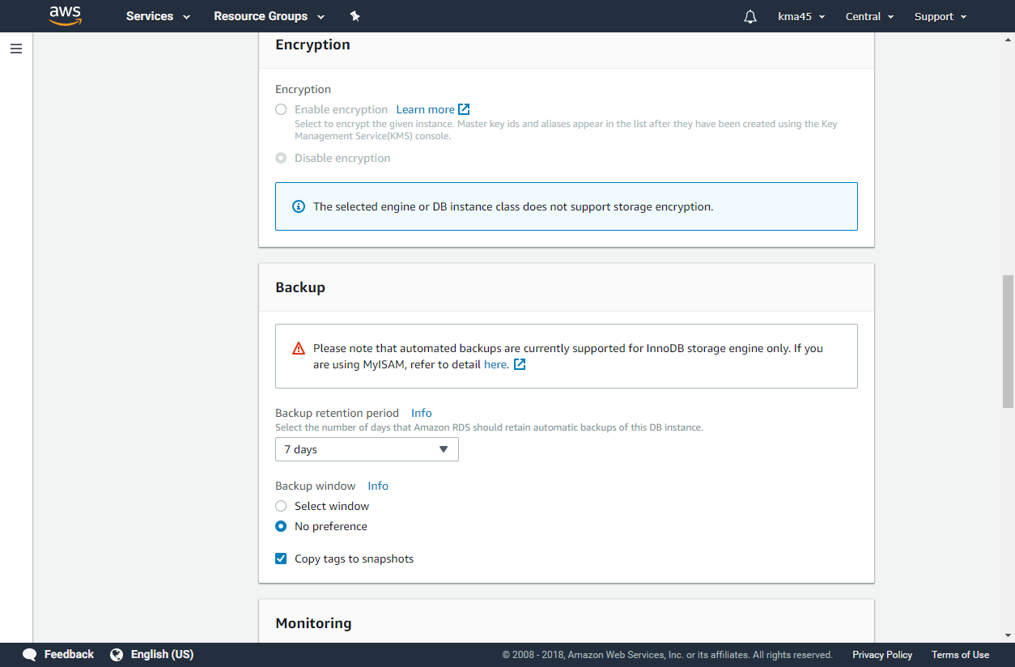
Create MySQL DB Instance (CONT’D)

Slide 15
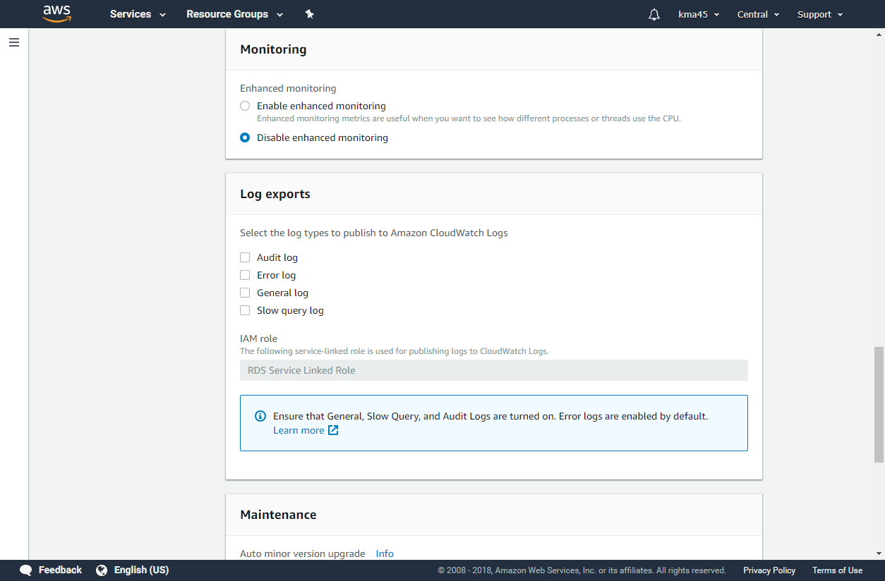
Create MySQL DB Instance (CONT’D)

Slide 16
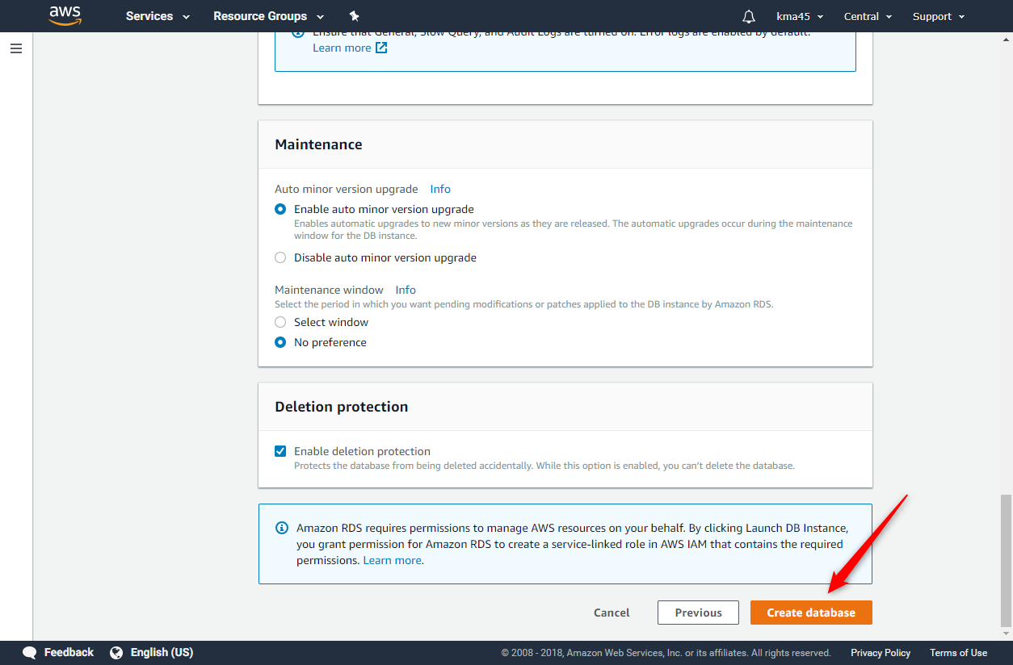
Create MySQL DB Instance (CONT’D)

Slide 17
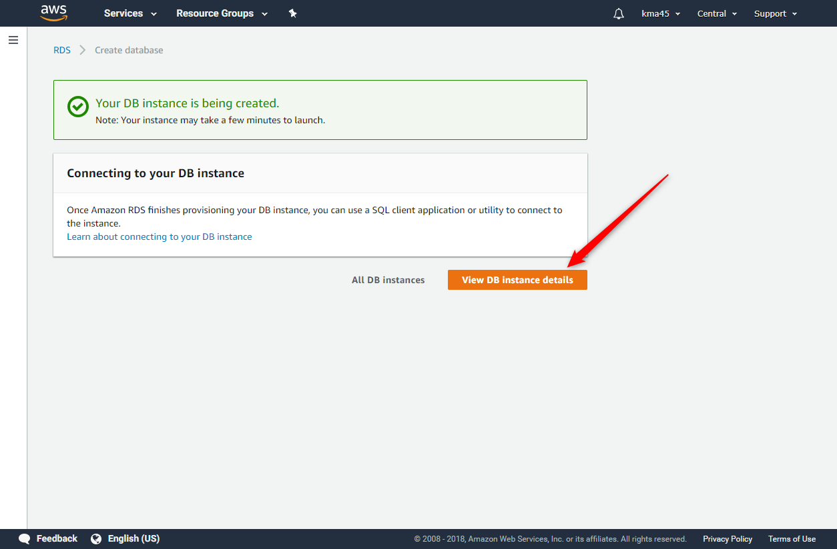
Create MySQL DB Instance (CONT’D)

Slide 18
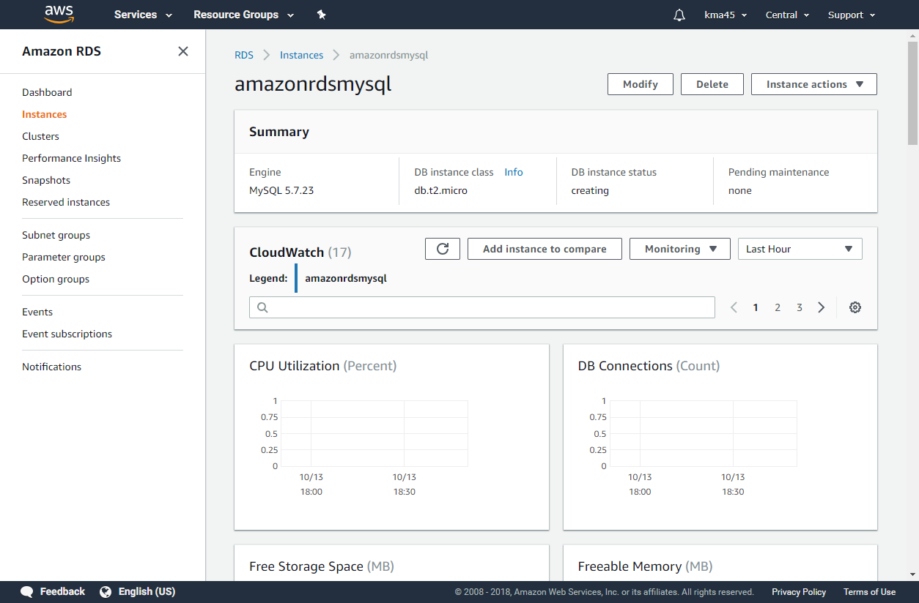
Create MySQL DB Instance (CONT’D)

Slide 19
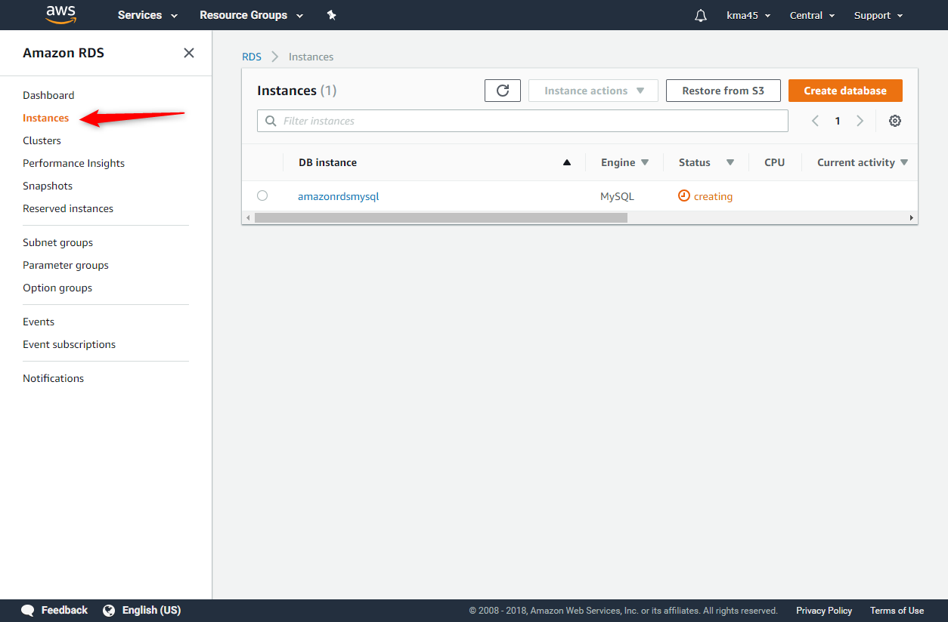
Create MySQL DB Instance (CONT’D)

Slide 20
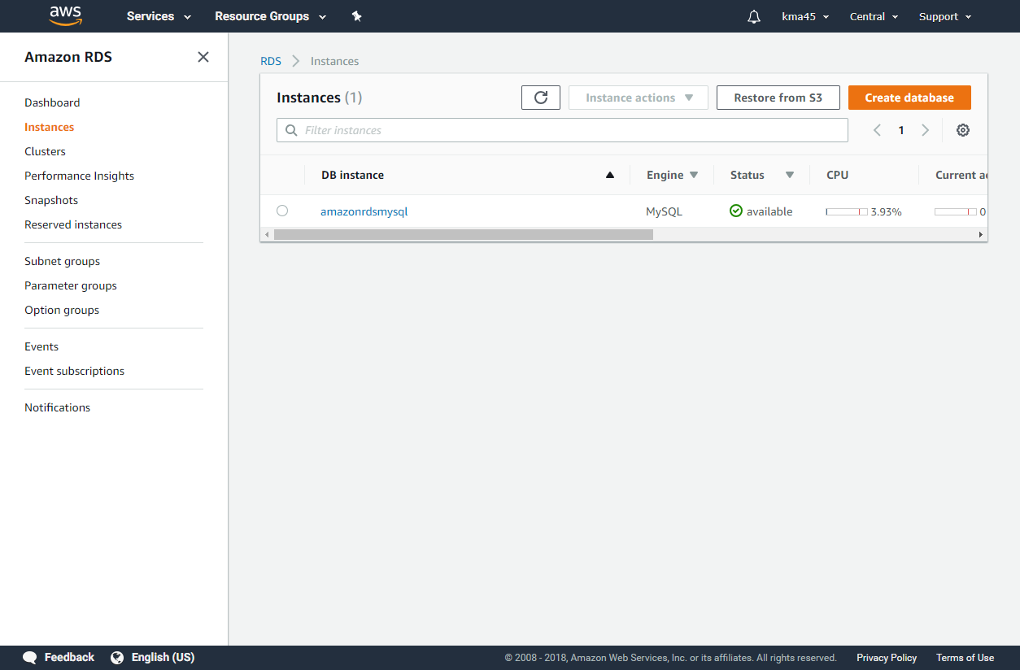
Create MySQL DB Instance (CONT’D)
Notes:
It may take a few minutes to create the database. Please be patient ☺!

Slide 21
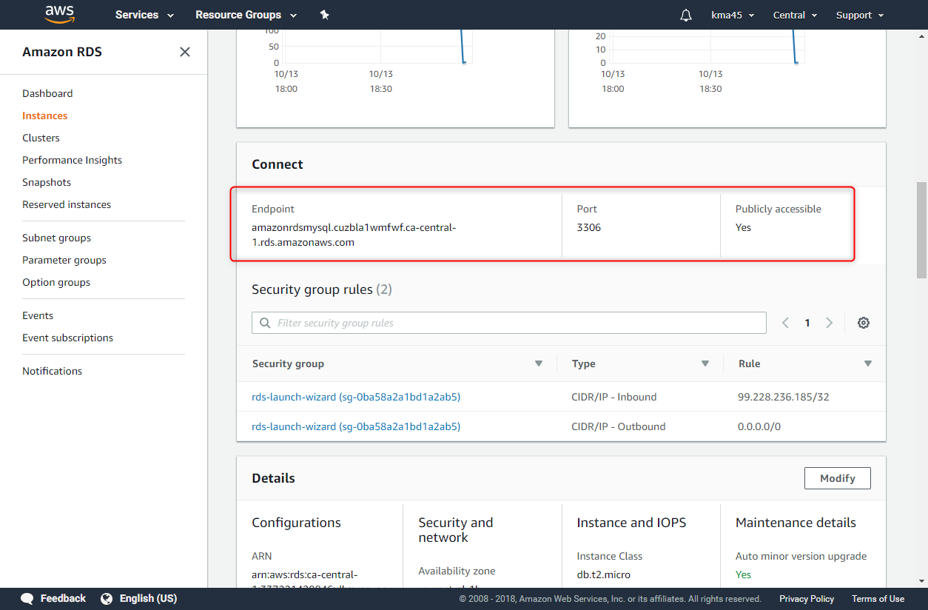
Create MySQL DB Instance (CONT’D)

Slide 22

Connect to MySQL DB Instance
Connect to DB Instance Running the MySQL Database Engine
The MySQL Command Line Tool
https://dev.mysql.com/doc/refman/5.6/en/mysql.html
MySQL Workbench
https://dev.mysql.com/downloads/workbench/
It is recommended to use MySQL Workbench

Slide 23
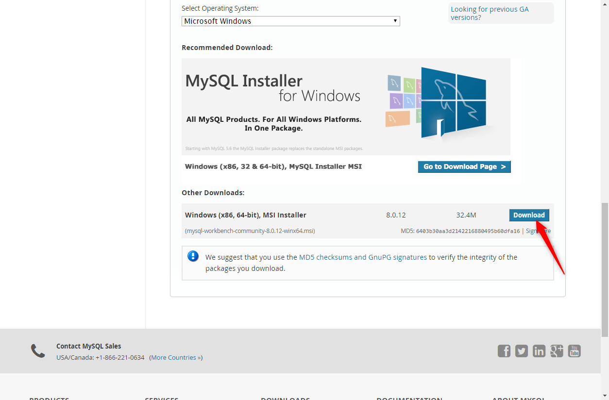
Connect to MySQL DB Instance (CONT’D)

Slide 24
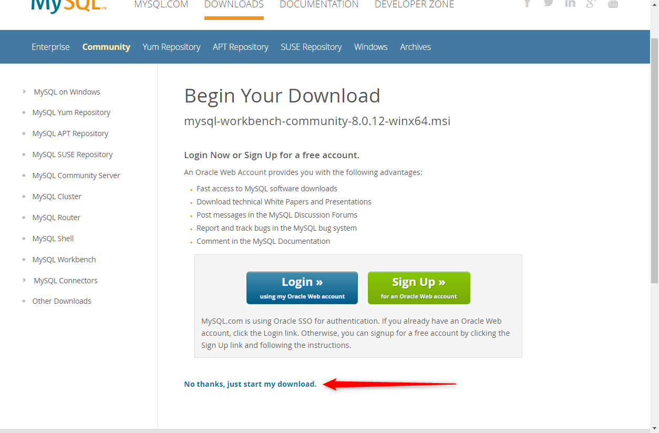
Connect to MySQL DB Instance (CONT’D)

Slide 25
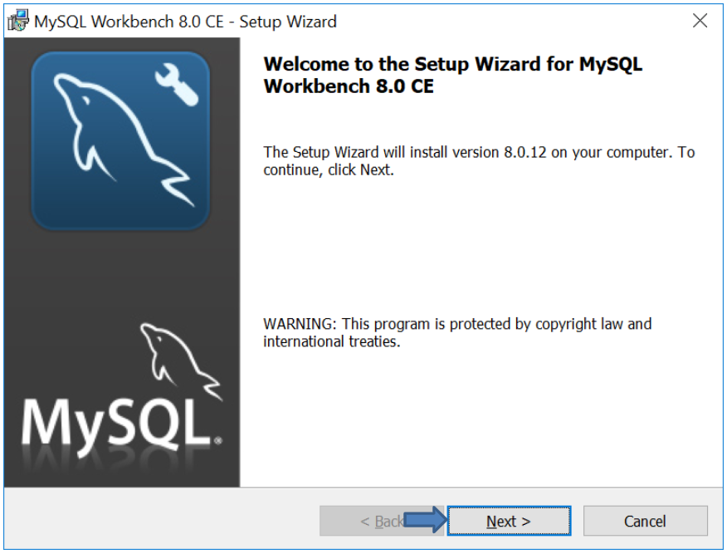
Connect to MySQL DB Instance (CONT’D)

Slide 26
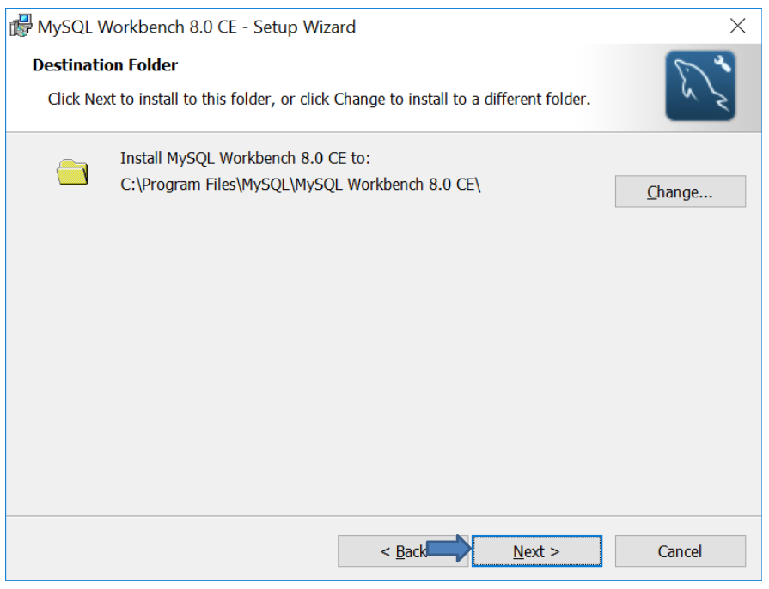
Connect to MySQL DB Instance (CONT’D)

Slide 27
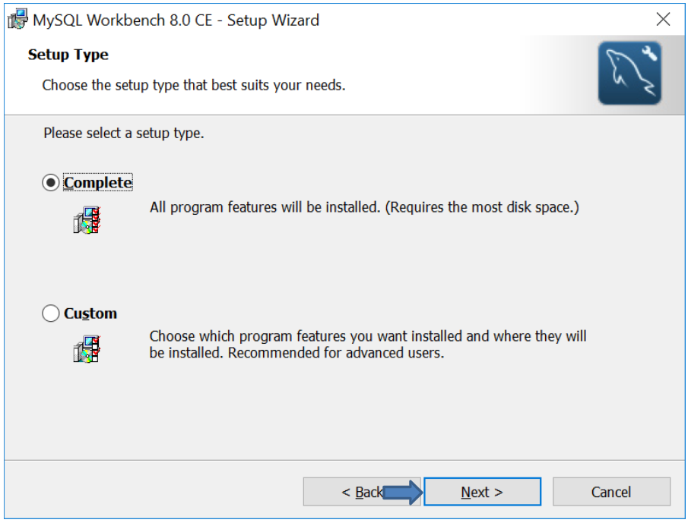
Connect to MySQL DB Instance (CONT’D)

Slide 28
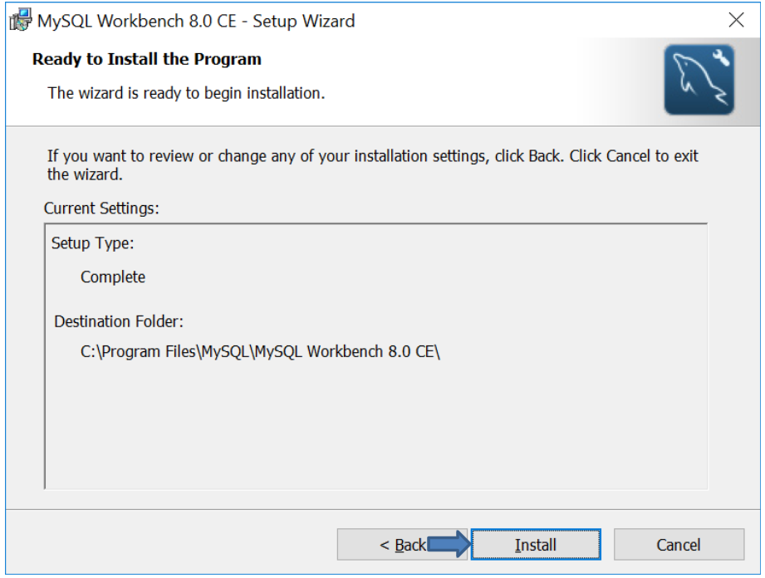
Connect to MySQL DB Instance (CONT’D)

Slide 29
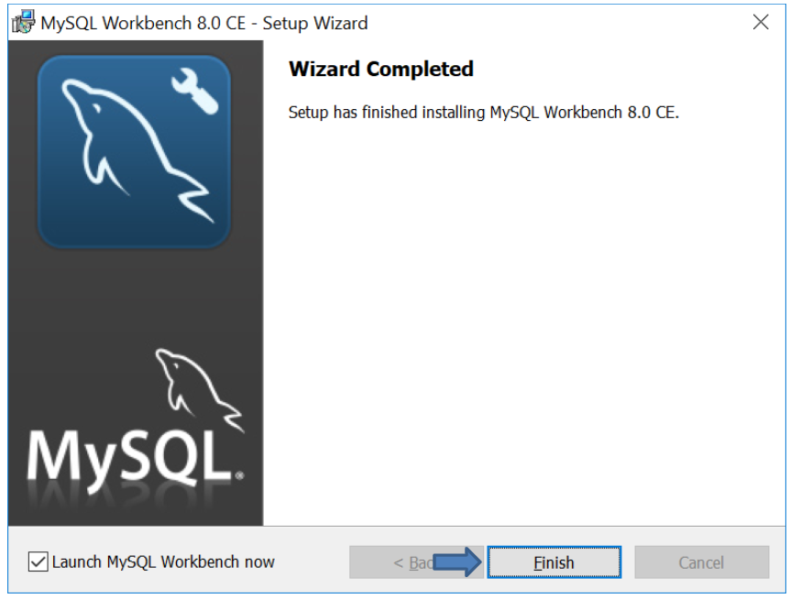
Connect to MySQL DB Instance (CONT’D)

Slide 30
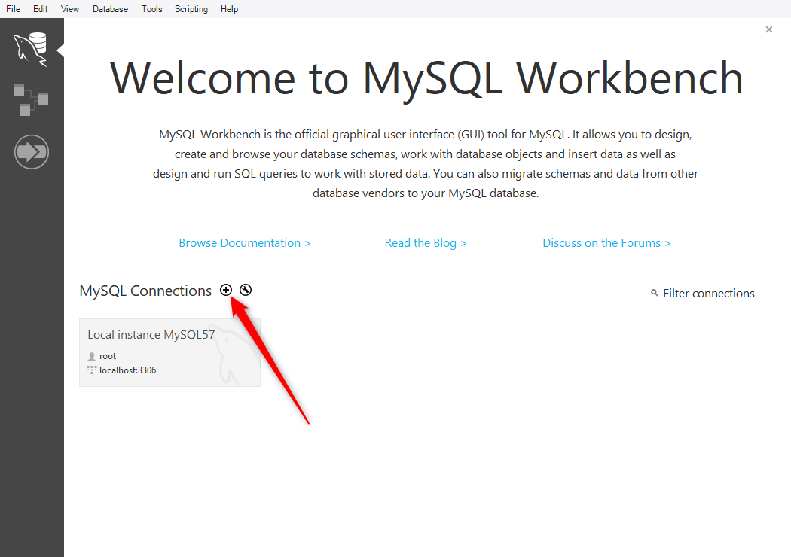
Connect to MySQL DB Instance (CONT’D)

Slide 31
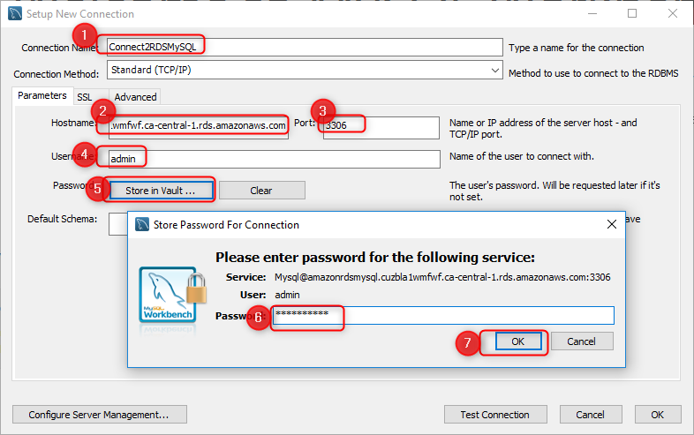
Connect to MySQL DB Instance (CONT’D)

Slide 32
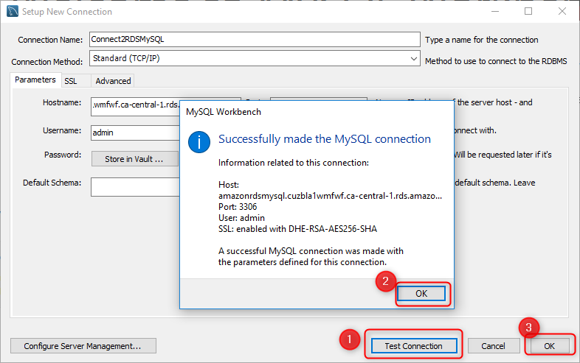
Connect to MySQL DB Instance (CONT’D)

Slide 33
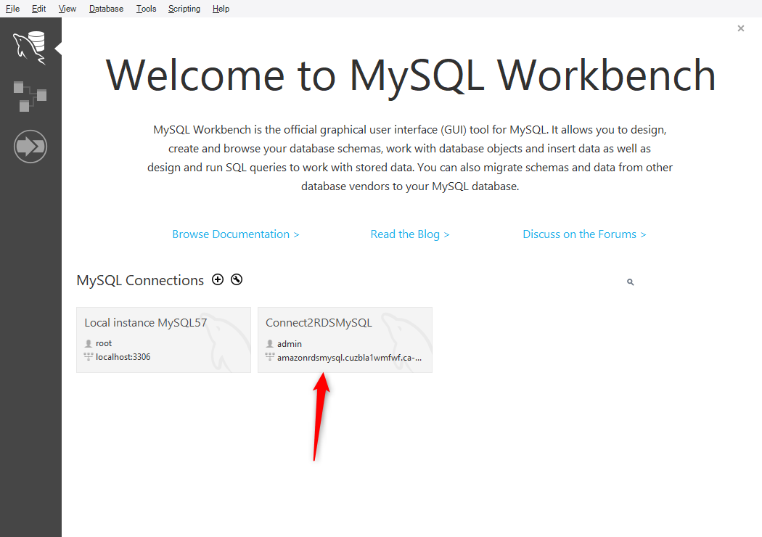
Connect to MySQL DB Instance (CONT’D)

Slide 34
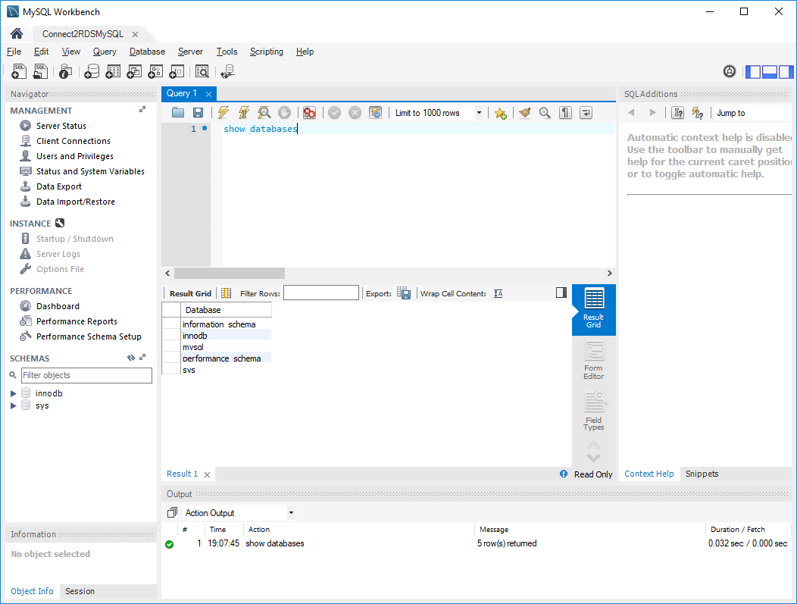
Connect to MySQL DB Instance (CONT’D)

Slide 35
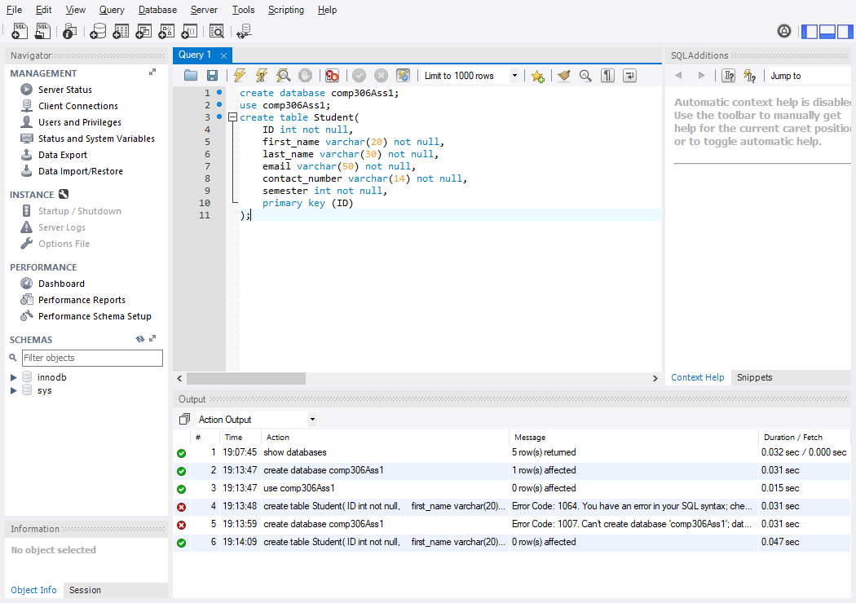
Creating a Table called Student

