Slide 1
COMP 306: API Engineering & Cloud Computing
Class Activity 02 – AWS Toolkit for Visual Studio, AWS IAM, and AWS S3
Created By: Kevin Ma (#300867968)
Fall 2018

Slide 2
Class Activity 02 – AWS Toolkit for Visual Studio, AWS IAM, and AWS S3
AWS Toolkit for Visual Studio

Slide 3

What is AWS Toolkit for Visual Studio?
The AWS Toolkit for Visual Studio is an extension for Microsoft Visual Studio running on Microsoft Windows that makes it easier for developers to develop, debug, and deploy .NET applications using Amazon Web Service
It can be downloaded by visiting the URL:
https://aws.amazon.com/visualstudio/

Slide 4
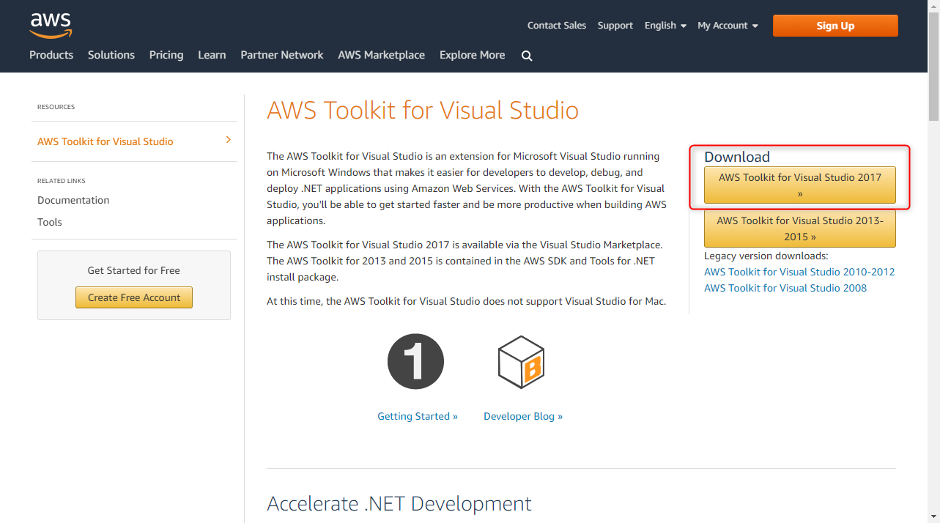
Setting Up AWS Toolkit for Visual Studio

Slide 5
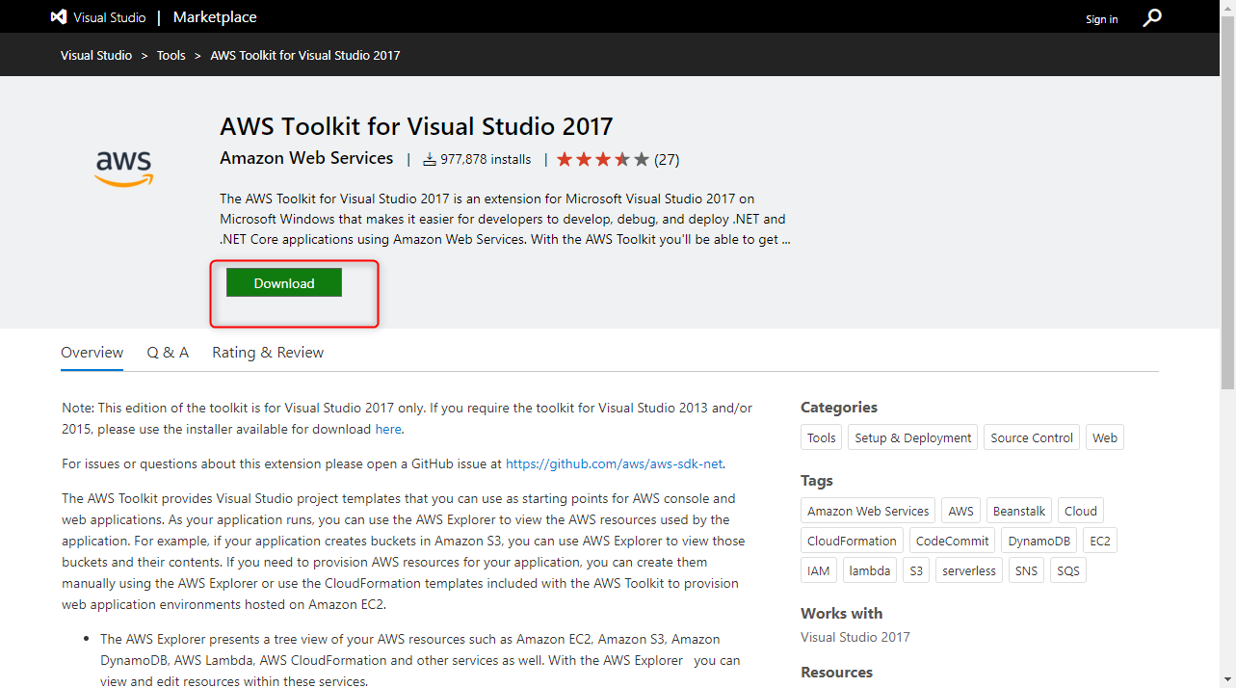
Setting Up AWS Toolkit for Visual Studio (CONT’D)

Slide 6
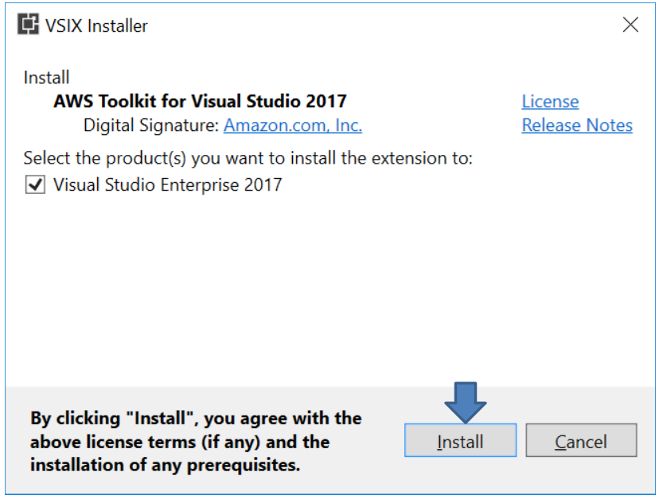
Setting Up AWS Toolkit for Visual Studio (CONT’D)

Slide 7
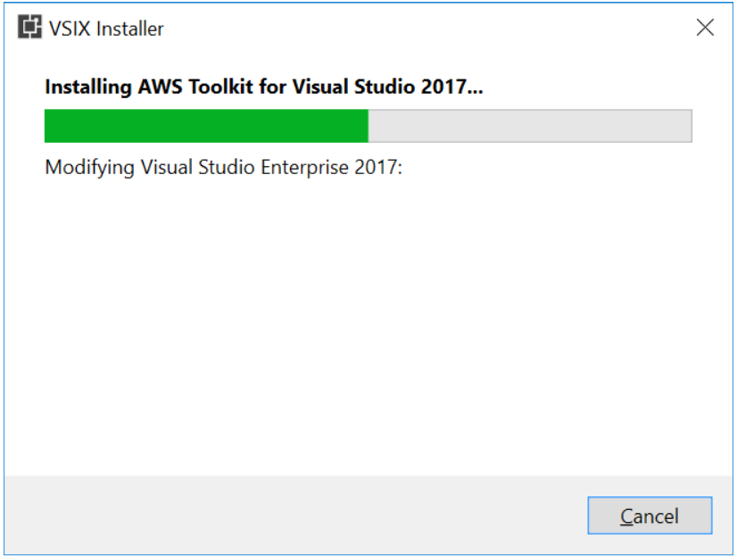
Setting Up AWS Toolkit for Visual Studio (CONT’D)

Slide 8
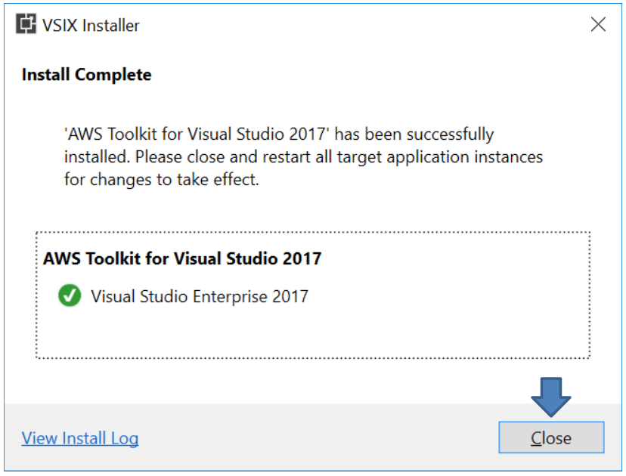
Setting Up AWS Toolkit for Visual Studio (CONT’D)

Slide 9
Class Activity 02 – AWS Toolkit for Visual Studio, AWS IAM, and AWS S3
AWS IAM

Slide 10


What is IAM?
AWS Identity and Access Management (IAM) is a web service for securely controlling access to AWS services. IAM is used to centrally manage users, security credentials such as access keys, and permissions that control the access level of users to resources and services

Slide 11
Concepts of IAM
User: A person or an application that requires access to various AWS resources to perform designated tasks
Access key: A 20-character alphanumeric key that acts as an user ID
Secret key: A 40-character alphanumeric key that acts as a password or secret key
Group: A collection of IAM users
Role: An IAM entity that constitute one or more IAM policies defining resource permissions
Policy: A document written in JSON format that formally states one or more permissions as per the IAM policy standards

Slide 12
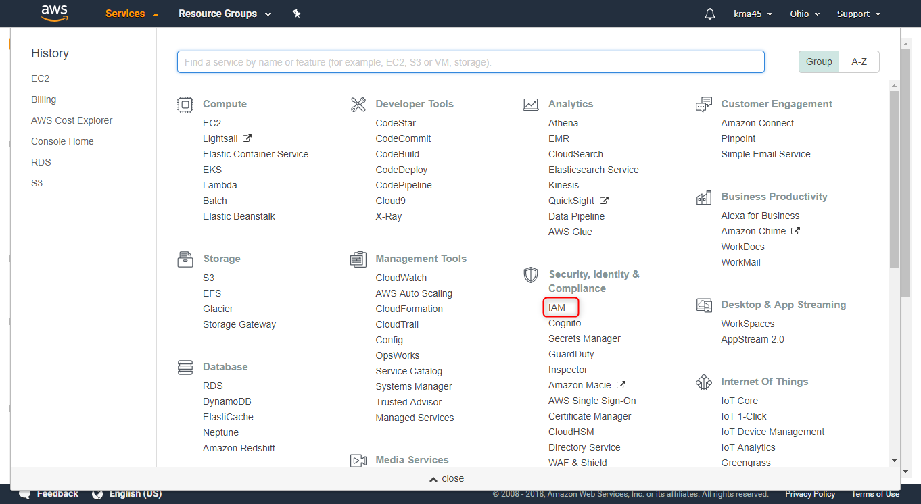
Identity Access Management (IAM)

Slide 13
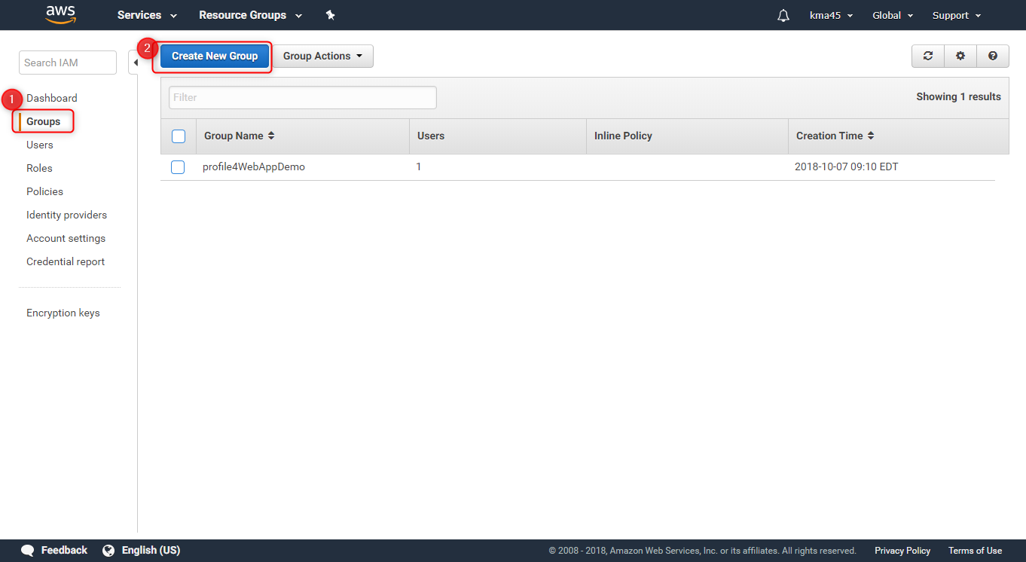
Create a user to allow an APP to Upload object(s) to S3

Slide 14
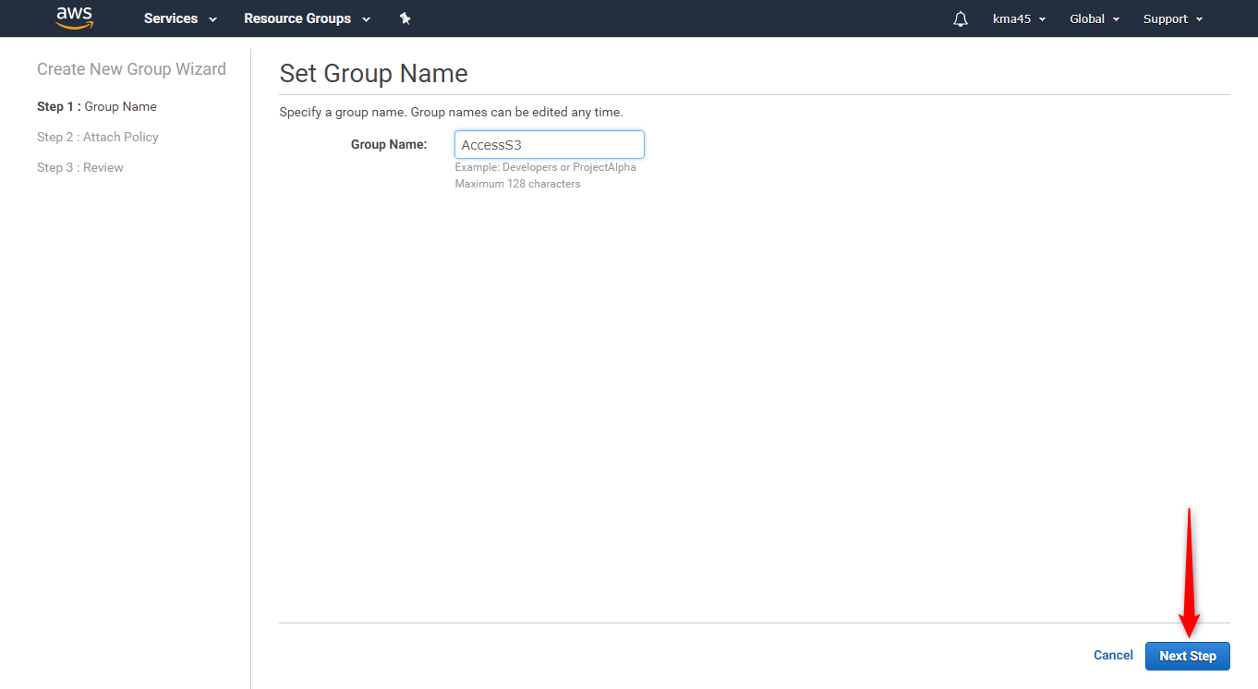
Create a user to allow an APP to Upload object(s) to S3

Slide 15
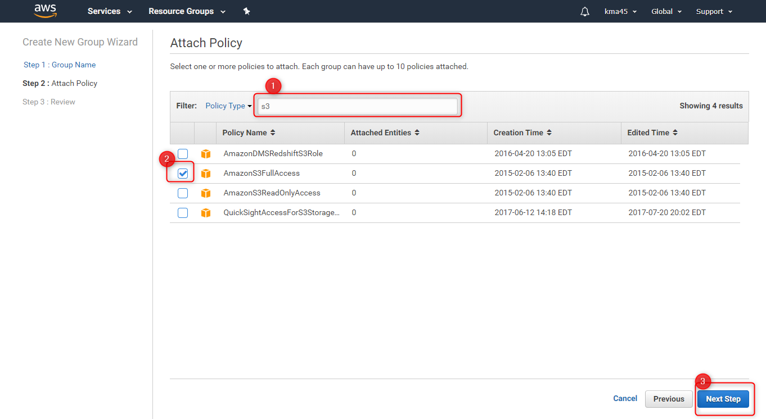
Create a user to allow an APP to Upload object(s) to S3

Slide 16
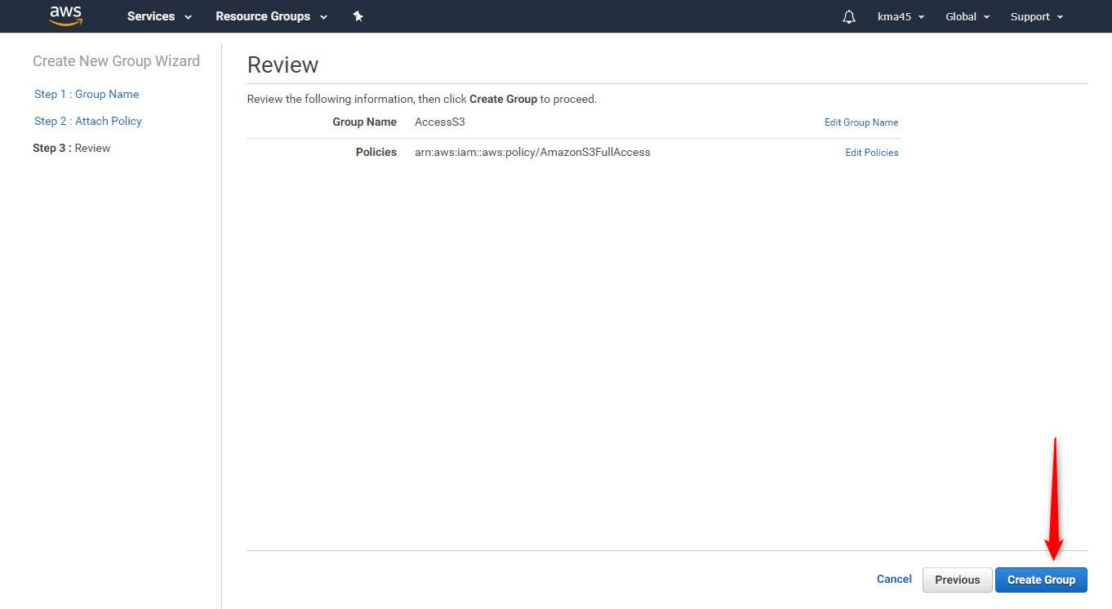
Create a user to allow an APP to Upload object(s) to S3

Slide 17
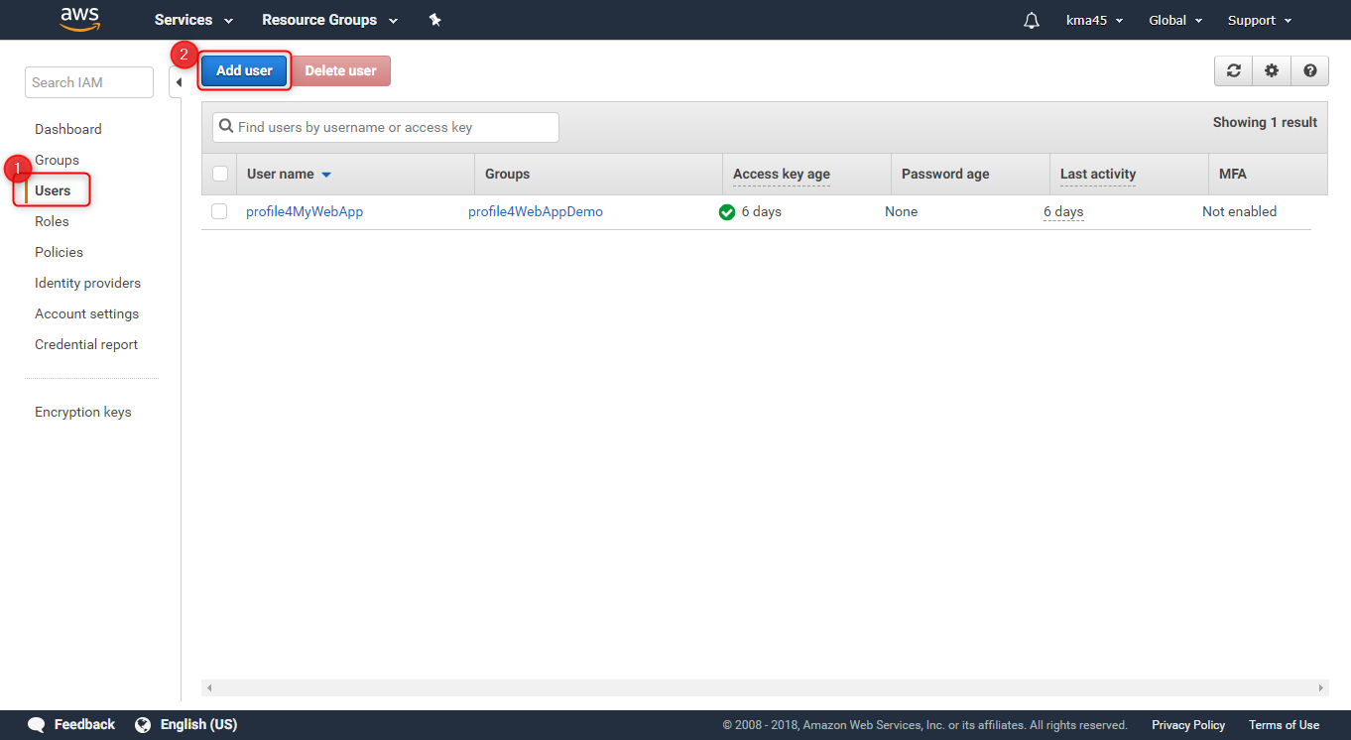
Create a user to allow an APP to Upload object(s) to S3

Slide 18
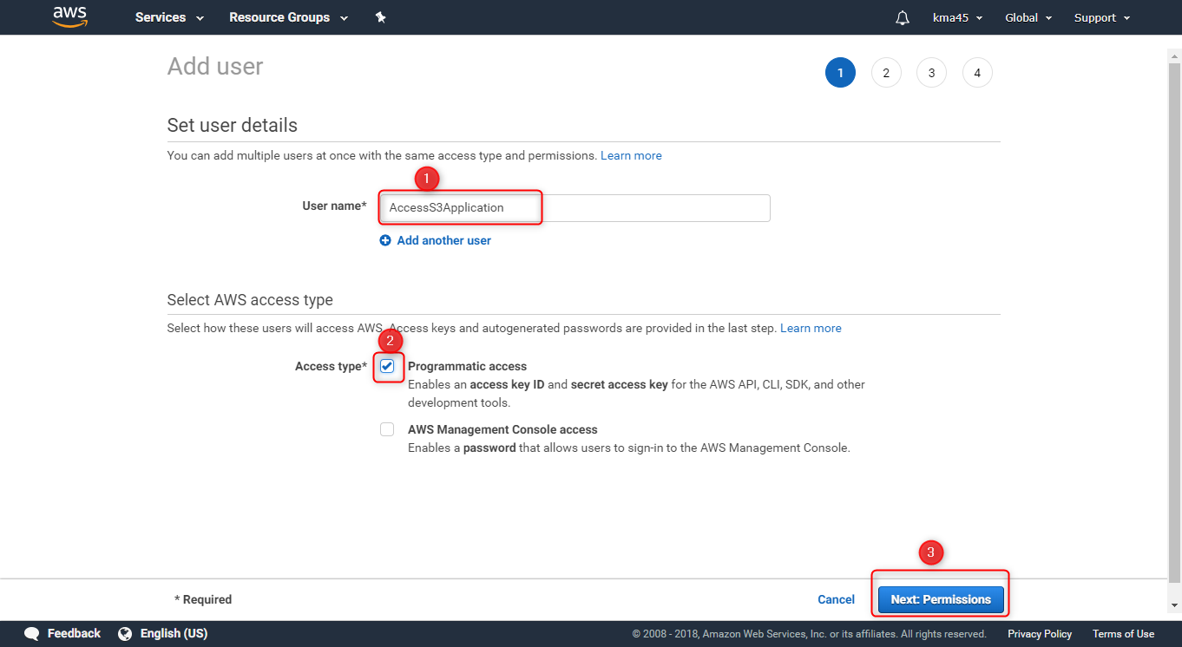
Create a user to allow an APP to Upload object(s) to S3

Slide 19
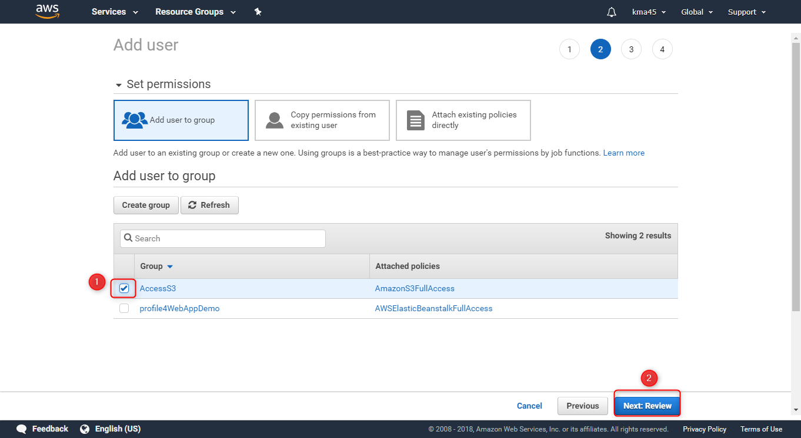
Create a user to allow an APP to Upload object(s) to S3

Slide 20
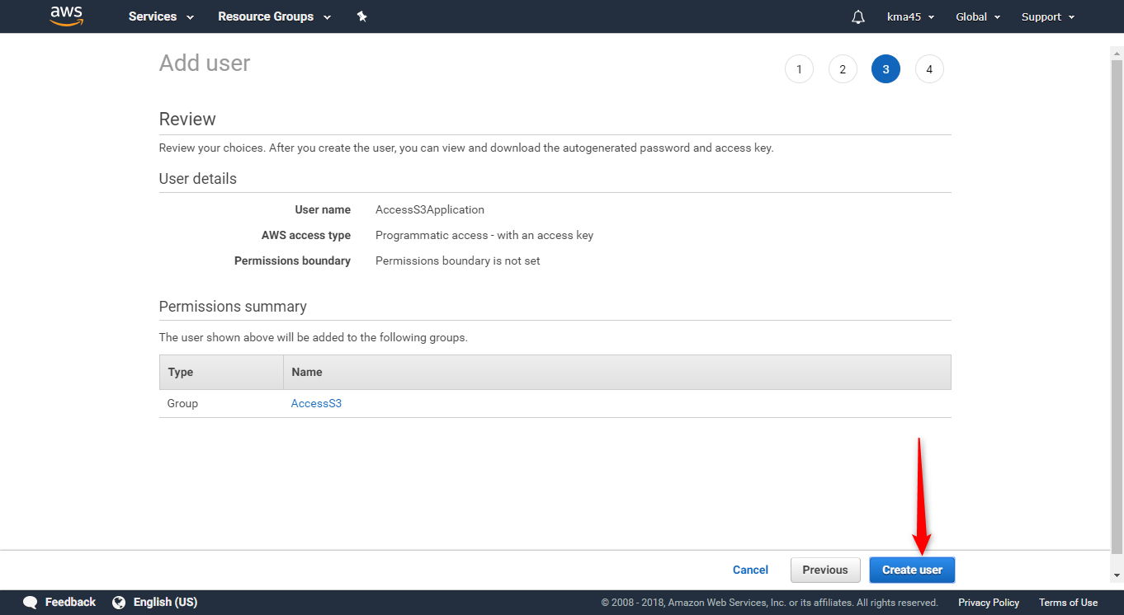
Create a user to allow an APP to Upload object(s) to S3

Slide 21
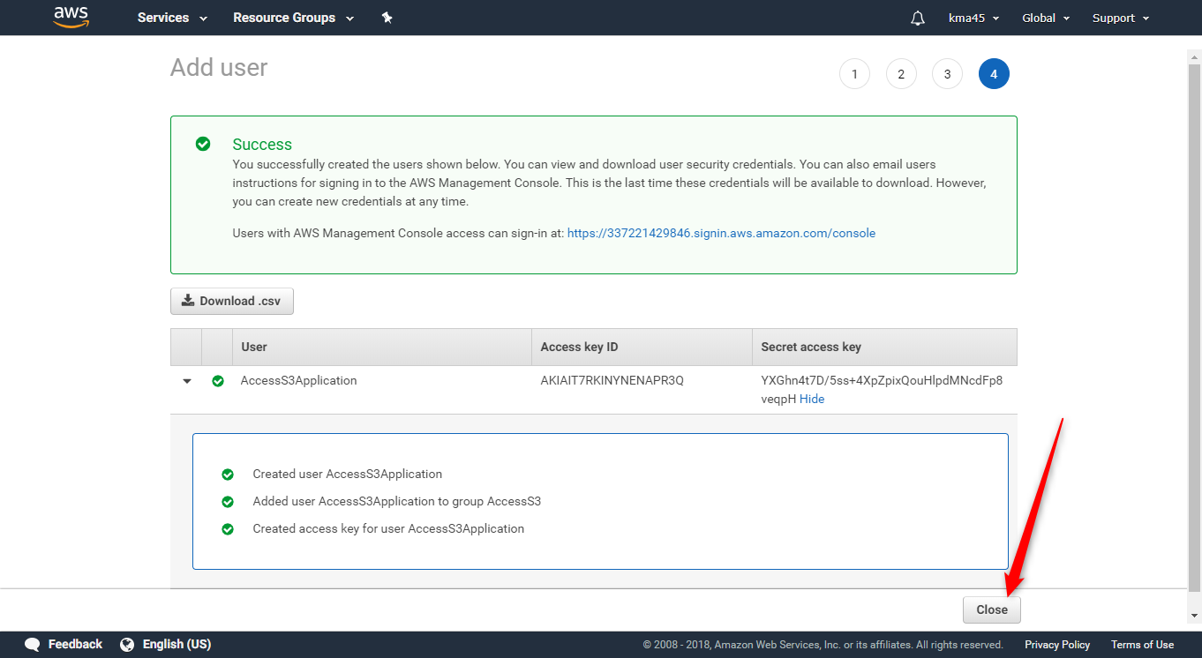
Create a user to allow an APP to Upload object(s) to S3

Slide 22
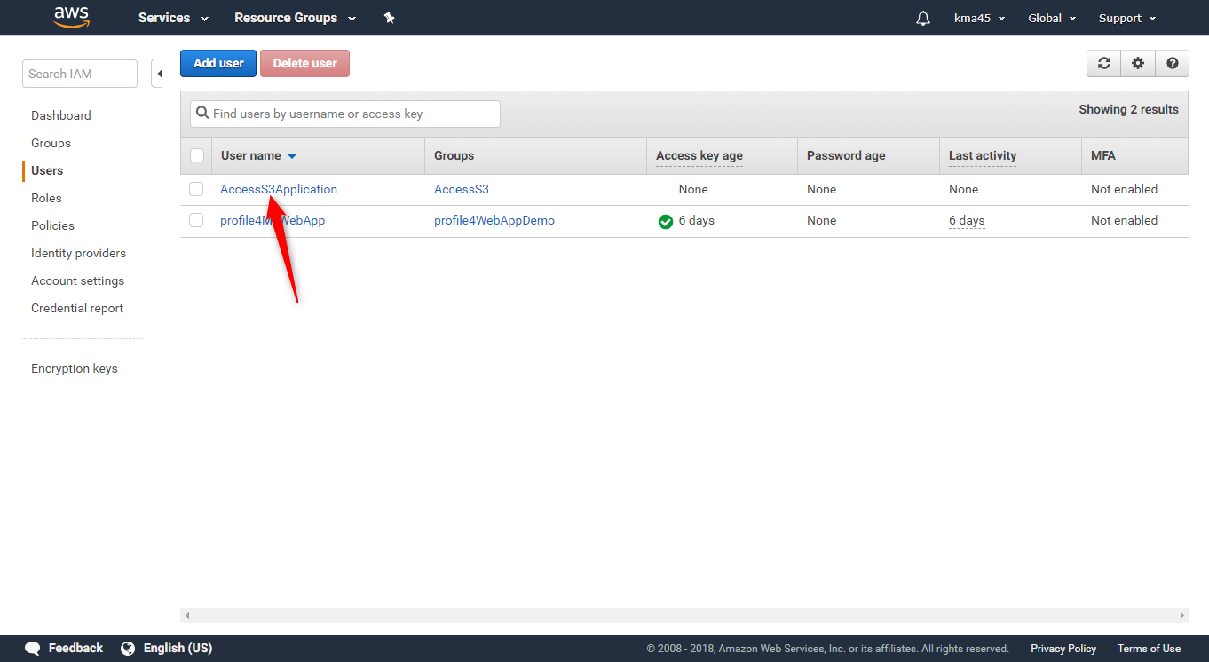
Retrieving Credentials for later use

Slide 23
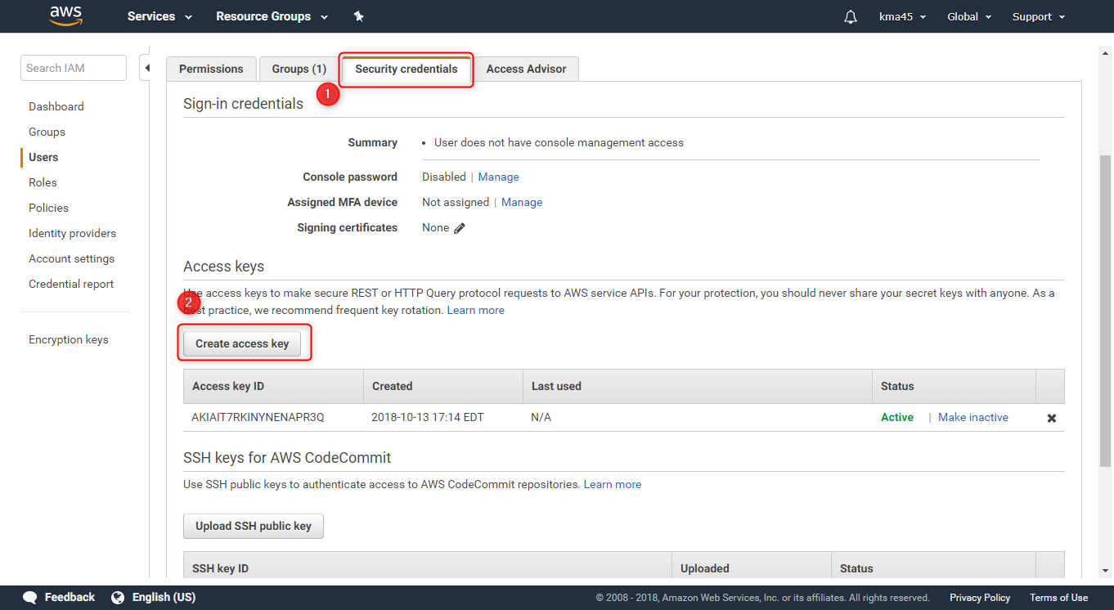
Retrieving Credentials for later use

Slide 24
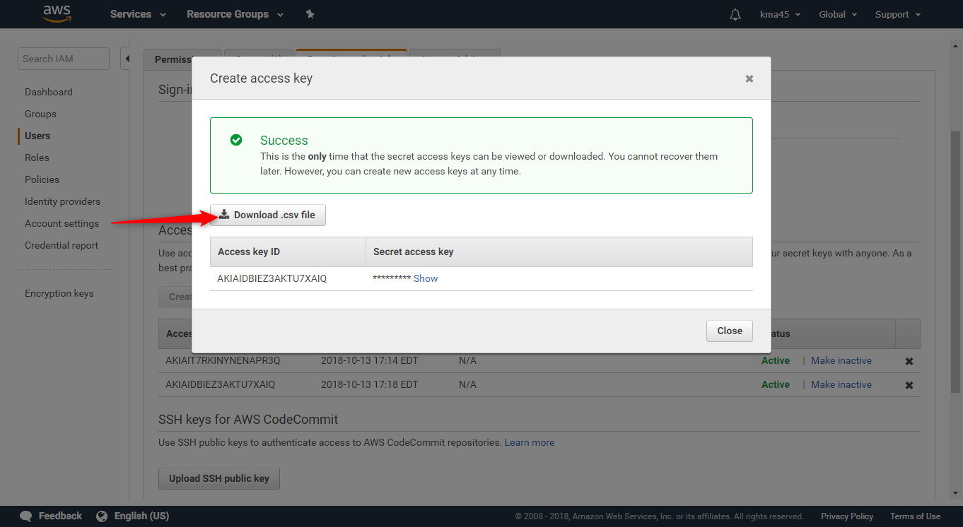
Retrieving Credentials for later use

Slide 25
Class Activity 02 – AWS Toolkit for Visual Studio, AWS IAM, and AWS S3
AWS S3

Slide 26
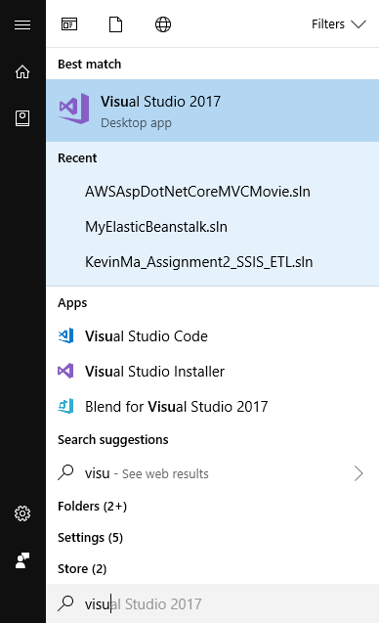
Accessing S3 Storage Programmatically

Slide 27
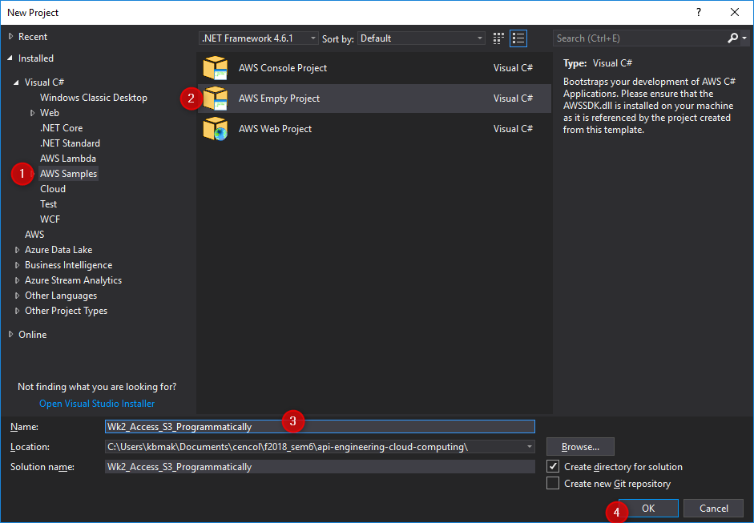
Accessing S3 Storage Programmatically

Slide 28
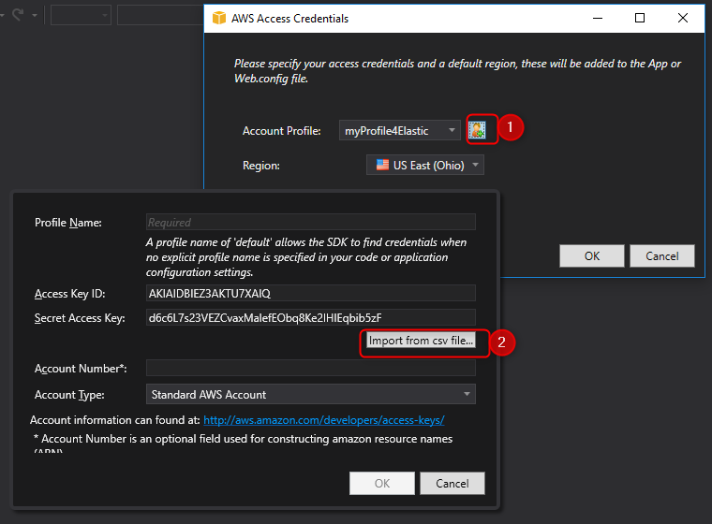
Accessing S3 Storage Programmatically

Slide 29
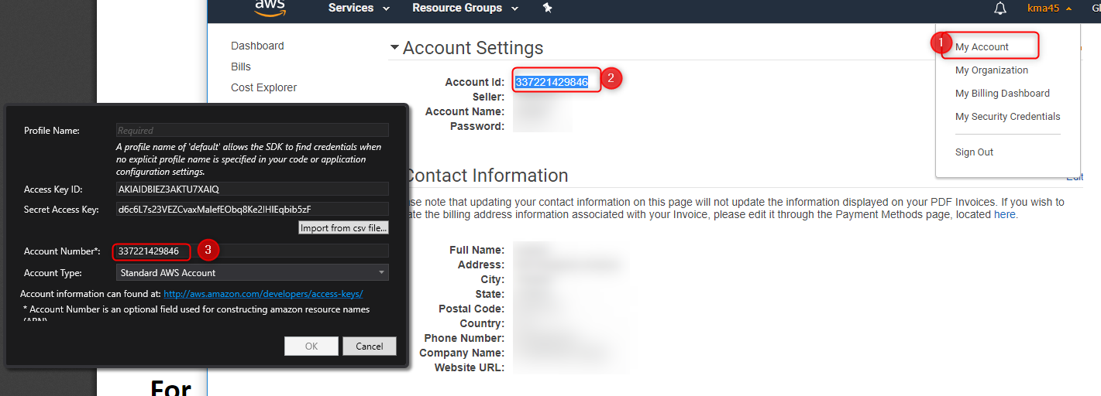
Accessing S3 Storage Programmatically

Slide 30
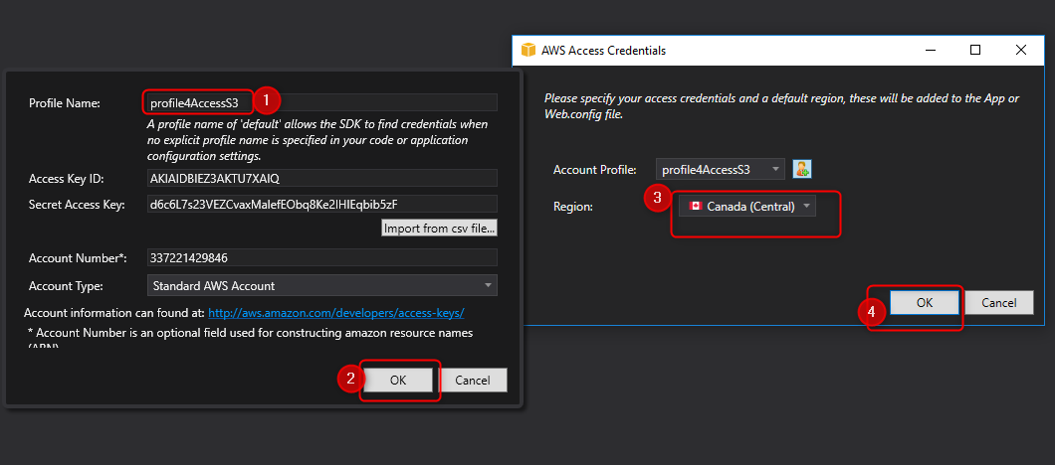
Accessing S3 Storage Programmatically

Slide 31
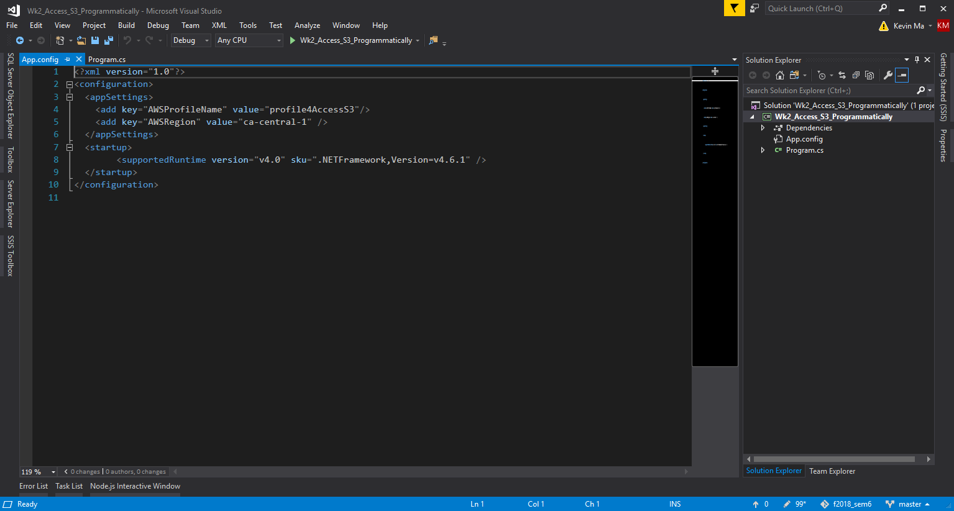
Accessing S3 Storage Programmatically

Slide 32
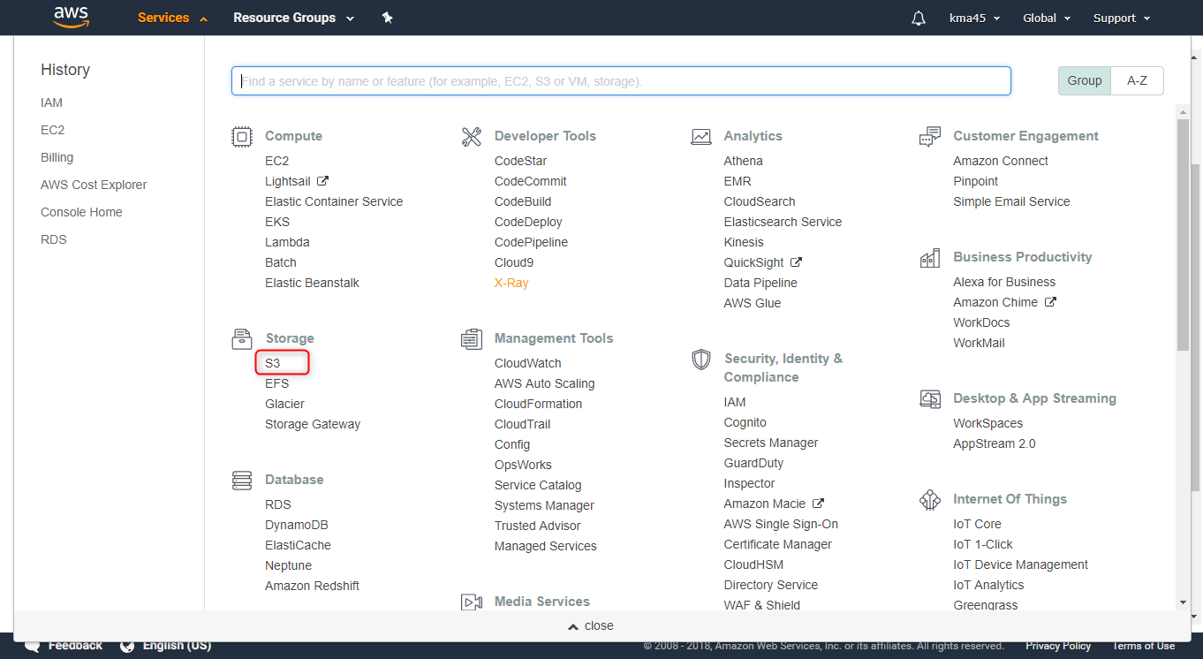
Accessing S3 Storage Programmatically

Slide 33
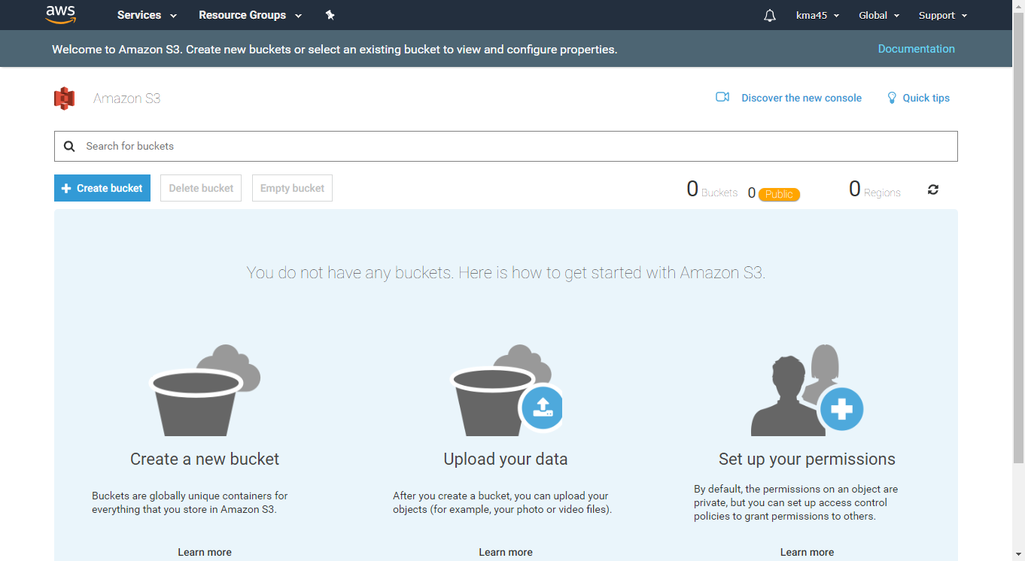
Accessing S3 Storage Programmatically

Slide 34
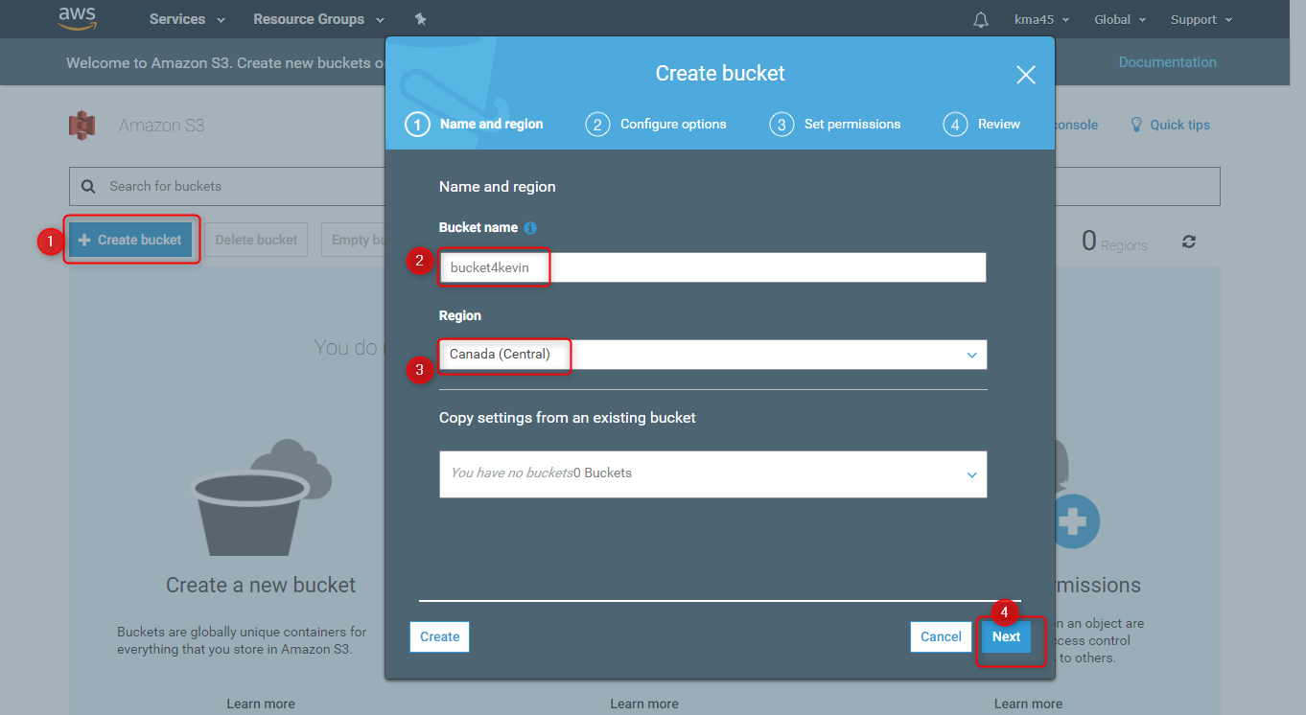
Accessing S3 Storage Programmatically

Slide 35
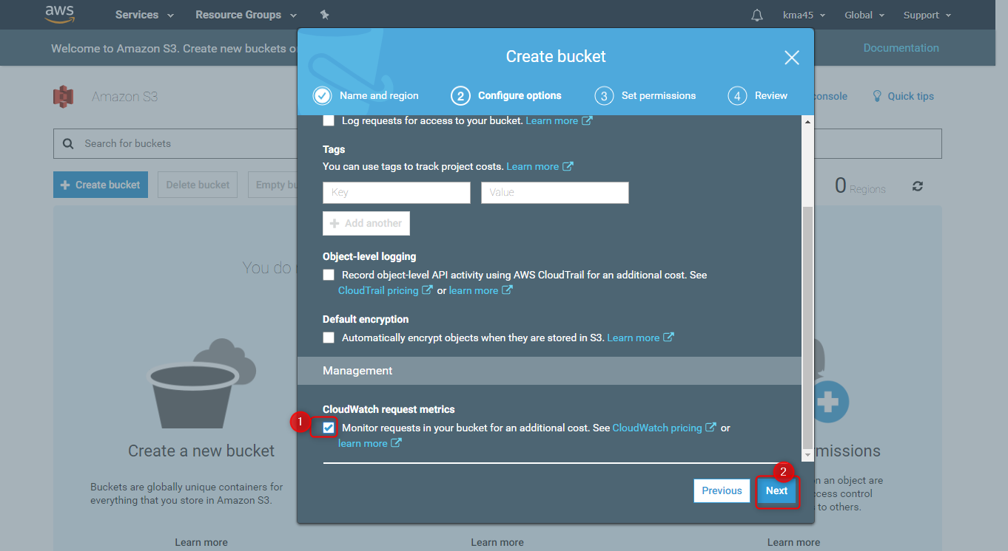
Accessing S3 Storage Programmatically

Slide 36
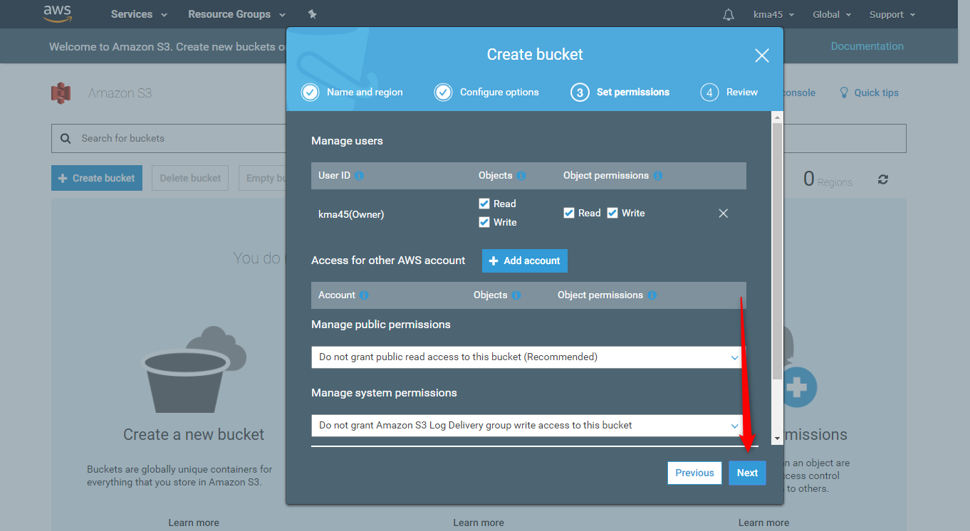
Accessing S3 Storage Programmatically

Slide 37
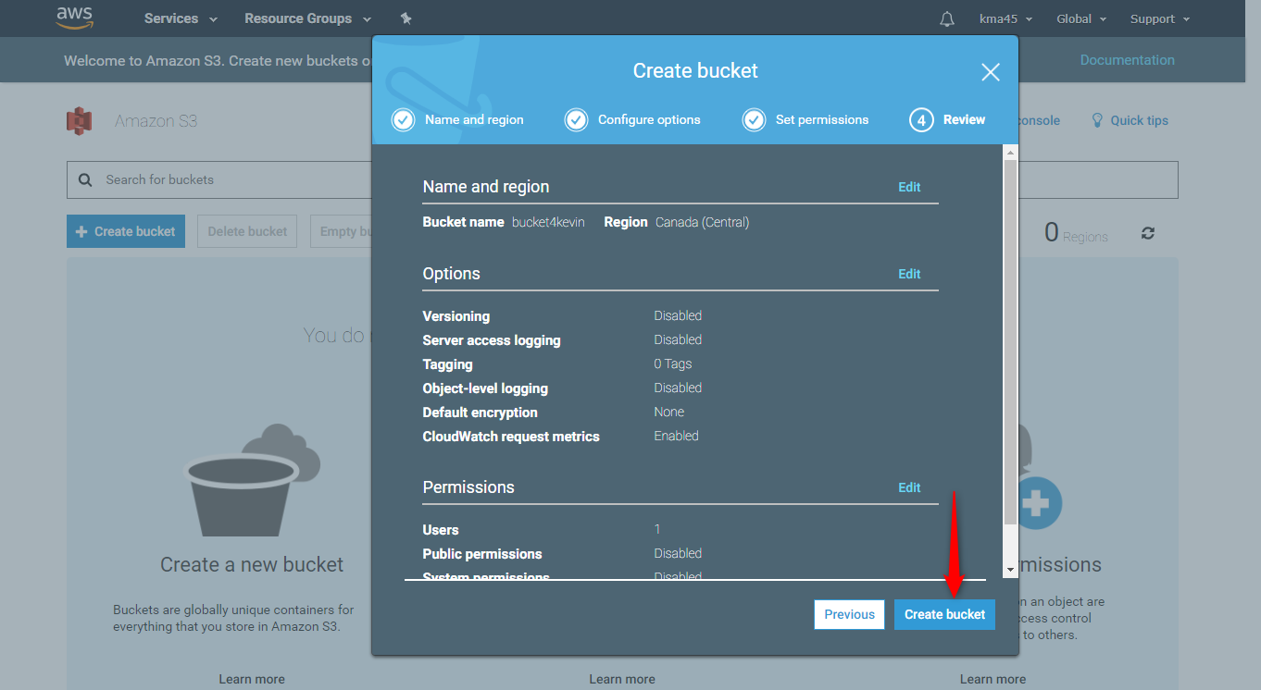
Accessing S3 Storage Programmatically

Slide 38
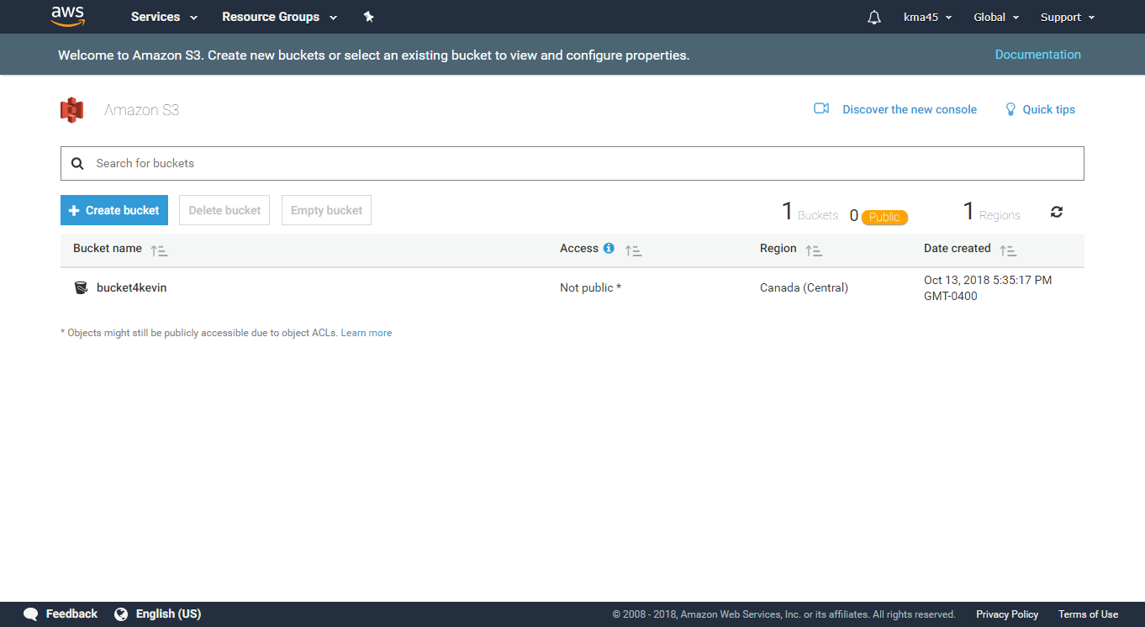
Accessing S3 Storage Programmatically

Slide 39
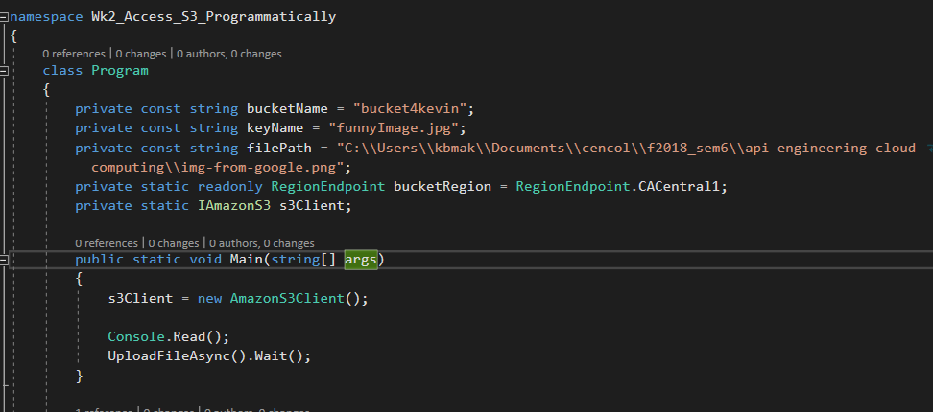
Accessing S3 Storage Programmatically

Slide 40
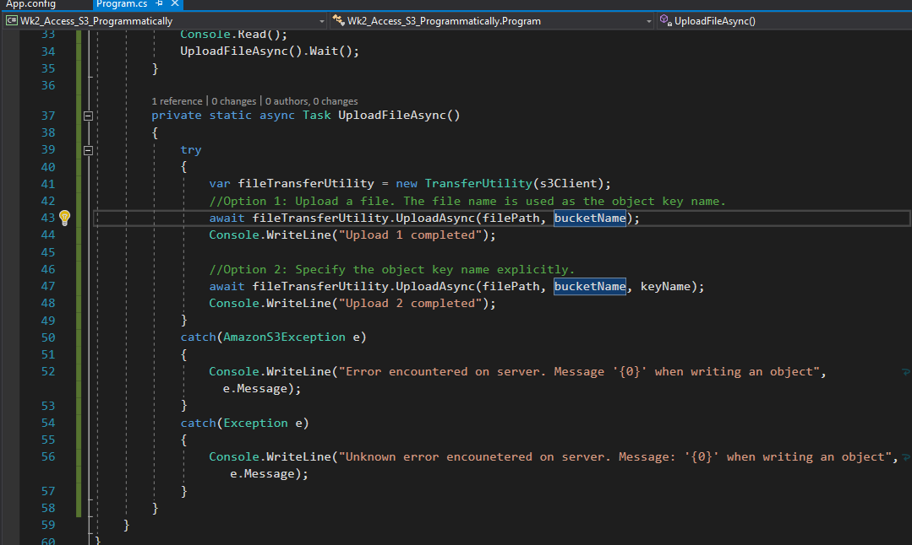
Accessing S3 Storage Programmatically

Slide 41
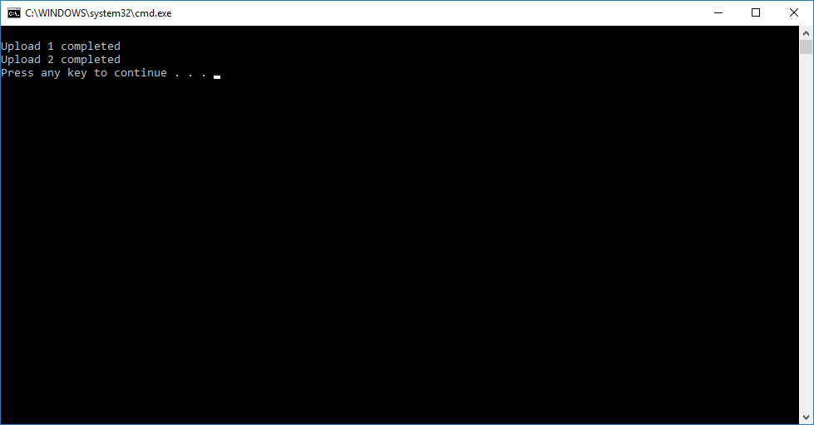
Accessing S3 Storage Programmatically
Notes:
Output from running the program

Slide 42
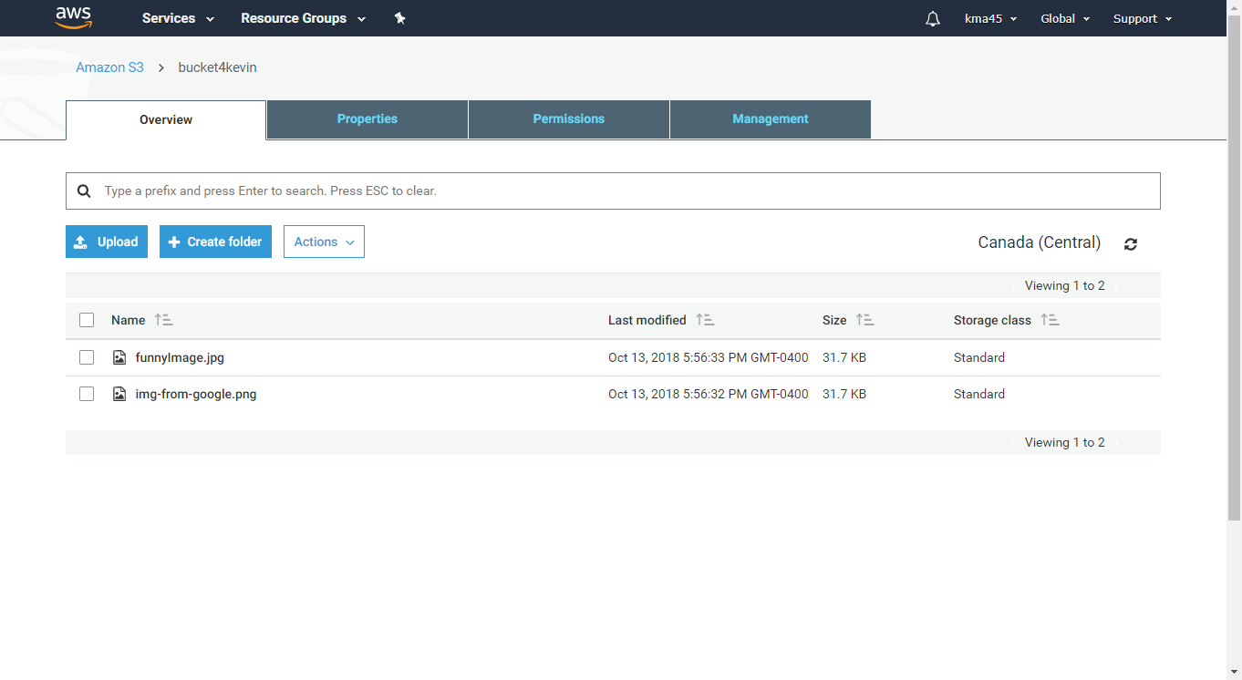
Accessing S3 Storage Programmatically
Notes:
Results online in AWS s3

