Slide 1
API Engineering
Yin Hua Li
Centennial College
Week#1 2018Fall
Topic: Overview of Cloud Computing

Slide 2
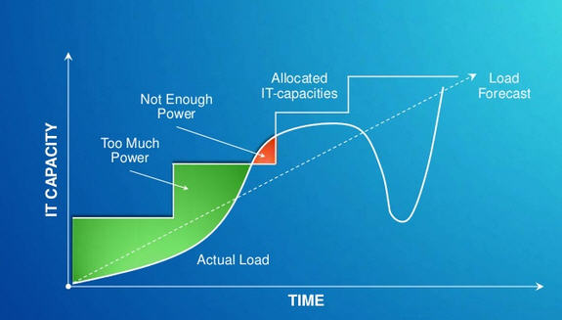
Problem
From http://www.slideshare.net/businessintelligenze/windows-azure-platform-overview

Slide 3
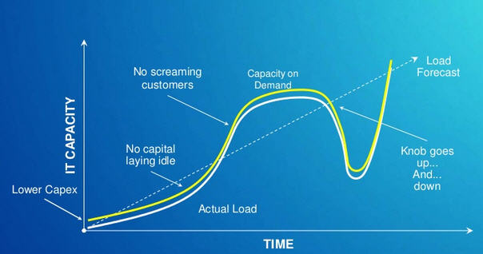
Ideal Solution
From http://www.slideshare.net/businessintelligenze/windows-azure-platform-overview

Slide 4
A Brief History of Cloud Computing
Back to 1961, John McCarthy was the first to publicly suggest that computer time-sharing technology might lead to a future in which computing power and even specific applications could be sold through the utility business model ( e.g., water or electricity). This idea of a computer or information utility was very popular in the late 1960s, but faded by the mid-1970s as it became clear that the hardware, software and telecommunications technologies of the time were simply not ready. However, since 2000, the idea has resurfaced in new forms.
Cloud computing implements the idea of utility computing, where computing is viewed as a public utility. Cloud computing can also be compared to cluster computing, which views a group of linked computers as a single virtual computer for high-performance computing (HPC), or grid computing, where the linked computers tend to be geographically distributed to solve a common problem. Time-sharing systems were offered in the 1960s IBM, General Electric, and other companies.
https://techspirited.com/differences-similarities-between-grid-cluster-computing

Slide 5
What is Cloud Computing
There are many different definitions for cloud computing
The one, industry widely accepted , was composed by National Institute of Standards and Technology (NIST)
Cloud computing is a model for enabling ubiquitous, convenient, on-demand network access to a shared pool of configurable computing resources (e.g., networks, servers, storage, applications, and services) that can be rapidly provisioned and released with minimal management effort or service provider interaction. This cloud model is composed of five essential characteristics, three service models, and four deployment models
Source: http://nvlpubs.nist.gov/nistpubs/Legacy/SP/nistspecialpublication800-145.pdf

Slide 6
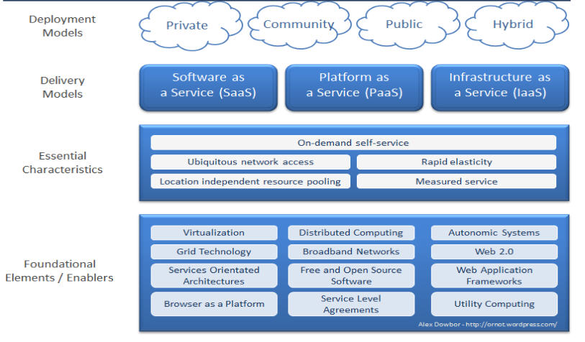
Cloud Computing

Slide 7
Cloud Computing Characteristics(1/2)
On-demand self-service
A user can provision computing capabilities, such as server time and storage, as needed without requiring human interaction
Ubiquitous network access
Capabilities are available over a network and typically accessed by the users’ mobile phones, tablets, laptops, and workstations
Location independent resource pooling
The provider’s computing resources are pooled to serve multiple users using a multi-tenant model, with different physical and virtual resources dynamically assigned and reassigned according to consumer demand. Examples of resources include storage, processing, memory, and network bandwidth.

Slide 8
Cloud Computing Characteristics(2/2)
Rapid elasticity
Capabilities can be elastically provisioned and released, in some cases automatically, to scale rapidly horizontally and/or vertically as needed. For the user, the capabilities available for provisioning often appear to be unlimited and can be appropriated in any quantity at any time
Measured service
Cloud systems automatically control and optimize resource use by leveraging a metering capability appropriate to the type of service (e.g., storage, processing, bandwidth, and active user accounts). Resource usage can be monitored, controlled, and reported, providing transparency for both the provider and user of the service. This cloud characteristic enables a cloud user to consume the service in a “pay as you grow” model or for internal IT departments to provide IT chargeback capabilities.

Slide 9
Service Model of Cloud Computing(1/4)
Infrastructure-as-a-service (IaaS)
abstracts the underlying infrastructure and data center capabilities so that consumers no longer have to rack and stack hardware, power and cool data centers, and procure hardware. Computer resources can be provisioned on demand as a utility, much like how we consume water and electricity today
IaaS provider list, AWS, Microsoft Azure, DigitalOcean, Google Compute Engine, RackSpace Managed Cloud,etc.

Slide 10
Service Model of Cloud Computing(2/4)
platform-as-a-service (PaaS)
Takes us one level higher in the stack and abstracts that operating system, database, application server, and programming language.
Consumers using PaaS can focus on building software on top of the platform and no longer need to worry about installing, managing, and patching LAMP stacks or Windows operating systems.
PaaS also takes care of scaling, failover, and many other technical design considerations so that developers can focus on business applications and less on the underlying IT "plumbing”

Slide 11
PaaS Provider List
Platform as a Service (PaaS) is a computing platform that provides users with the tools to develop, run, and manage web applications
Amazon EC2
Microsoft Azure Service
Salesforce App Cloud: Heroku Enterprise
Google App Engine
Etc.
https://www.g2crowd.com/categories/cloud-platform-as-a-service-paas

Slide 12
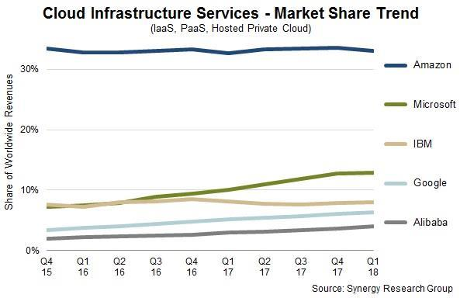
Top 5 Market Share of IaaS & PaaS

Slide 13
Service Model of Cloud Computing(3/4)
Software as a Service (SaaS)
SaaS is the ultimate level of abstraction. With SaaS, the entire application or service is delivered over the web through a browser and/or via an API. In this service model, the consumer only needs to focus on administering users to the system.
SaaS is very common for non-core competency type applications like customer relationship management (CRM), human resources applications, and financial and accounting applications.

Slide 14
SaaS Provider List
50 SaaS providers can be found here
Our college launched Microsoft Office 365 in 2015 fall

Slide 15
Service Model of Cloud Computing (4/4)
FaaS (Functions as a Service)
It sits between SaaS and PaaS
It provides a platform allowing customers to develop, run, and manage application functionalities without the complexity of building and maintaining the infrastructure

Slide 16
Four Deployment Models (1/4)
Public cloud
The cloud infrastructure is provisioned for open use by the general public. It may be owned, managed, and operated by a business, academic, or government organization, or some combination of them. It exists on the premises of the cloud provider.
Public cloud providers
Amazon Web Services (AWS) (https://aws.amazon.com/)
Microsoft Azure
Rackspace (http://www.rackspace.com/)
Google cloud platform (https://cloud.google.com/)

Slide 17
Four Deployment Models (2/4)
Private cloud (or corporate cloud)
The cloud infrastructure is provisioned for exclusive use by a single organization comprising multiple consumers (e.g., business units). It may be owned, managed, and operated by the organization, a third party, or some combination of them, and it may exist on or off premises.

Slide 18
Four Deployment Models (3/4)
Community cloud
The cloud infrastructure is provisioned for exclusive use by a specific community of consumers from organizations that have shared concerns (e.g., mission, security requirements, policy, and compliance considerations). It may be owned, managed, and operated by one or more of the organizations in the community, a third party, or some combination of them, and it may exist on or off premises.
E.g. GovCloud (http://aws.amazon.com/govcloud-us/)
Finance services cloud (https://cloud.oracle.com/financial-services-cloud)

Slide 19
Four Deployment Models (4/4)
Hybrid cloud
The cloud infrastructure is a composition of two or more distinct cloud infrastructures (private, community, or public) that remain unique entities, but are bound together by standardized or proprietary technology that enables data and application portability (e.g., cloud bursting for load balancing between clouds).

Slide 20
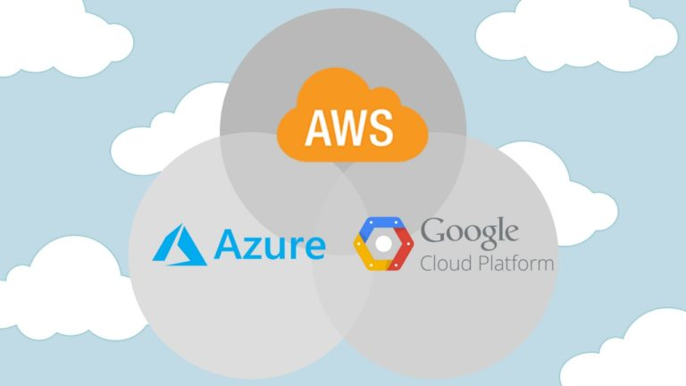
Big Three Public cloud providers(1/2)
From https://www.parkmycloud.com/blog/aws-vs-azure-vs-google-cloud-market-share/

Slide 21
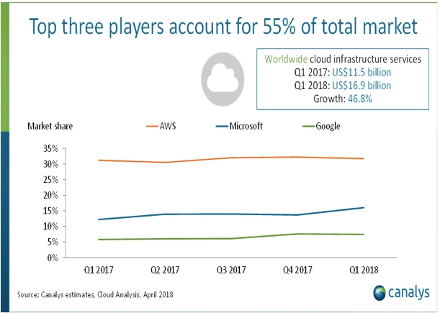
Big Three Public cloud providers(2/2)

Slide 22
Reference
https://www.parkmycloud.com/blog/aws-vs-azure-vs-google-cloud-market-share/
https://www.channele2e.com/channel-partners/csps/cloud-market-share-2018-aws-microsoft-google/

