Slide 1
API Engineering
Yin Hua Li
Centennial College
Week#1 2018 Fall
Topic: AWS Overview

Slide 2
What is Amazon Web Services (AWS)?
In 2006, AWS began offering IT infrastructure services to businesses as web services, now commonly known as cloud computing
Now, AWS provides a highly reliable, scalable, low-cost infrastructure platform in the cloud that powers hundreds of thousands of businesses in 190 countries around the world

Slide 3
AWS Global Infrastructure(1/2)
AWS cloud infrastructure is build around Regions and Availability Zones
An AWS Region is a physical location in the world where AWS provides multiple, physically separated and isolated Availability Zones
Availability Zones consist of one or more discrete data centers, each with redundant power, networking, and connectivity, housed in separate facilities
Each Availability Zone is isolated, but the Availability Zones in a Region are connected through low-latency links
AWS provides customers with the flexibility to place instances and store data within multiple geographic regions as well as across multiple Availability Zones within each ASW Region
An AWS Local Region is a single datacenter designed to complement an existing AWS Region, and it completely isolated from other AWS Regions

Slide 4
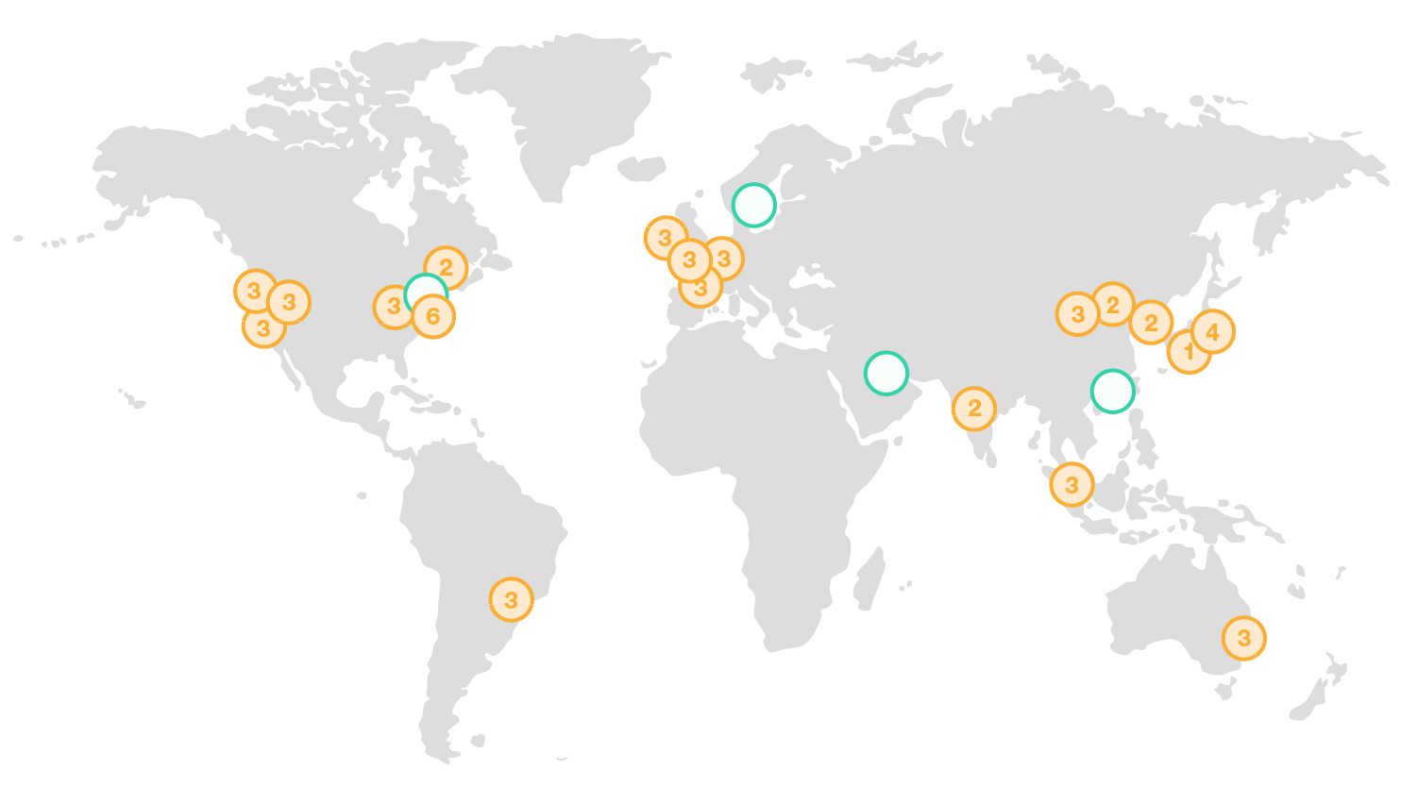
AWS Global Infrastructure
The AWS Cloud spans 55 Availability Zones within 18 geographic Regions and 1 Local Region around the world, with announced plans for 12 more Availability Zones and 4 more Regions in Bahrain, Hong Kong SAR, Sweden, and a second AWS GovCloud Region in the US.
From https://aws.amazon.com/about-aws/global-infrastructure/

Slide 5
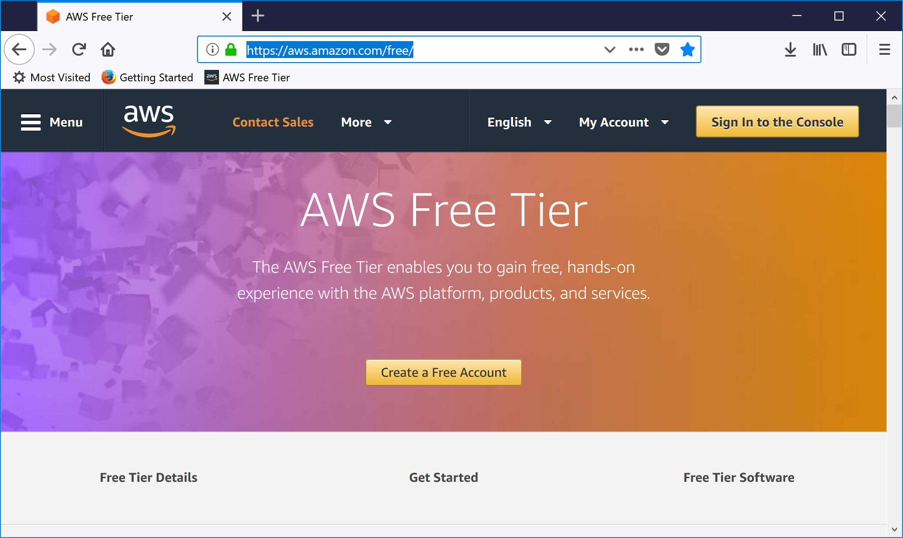
Subscription
Notes:
https://aws.amazon.com/free/

Slide 6
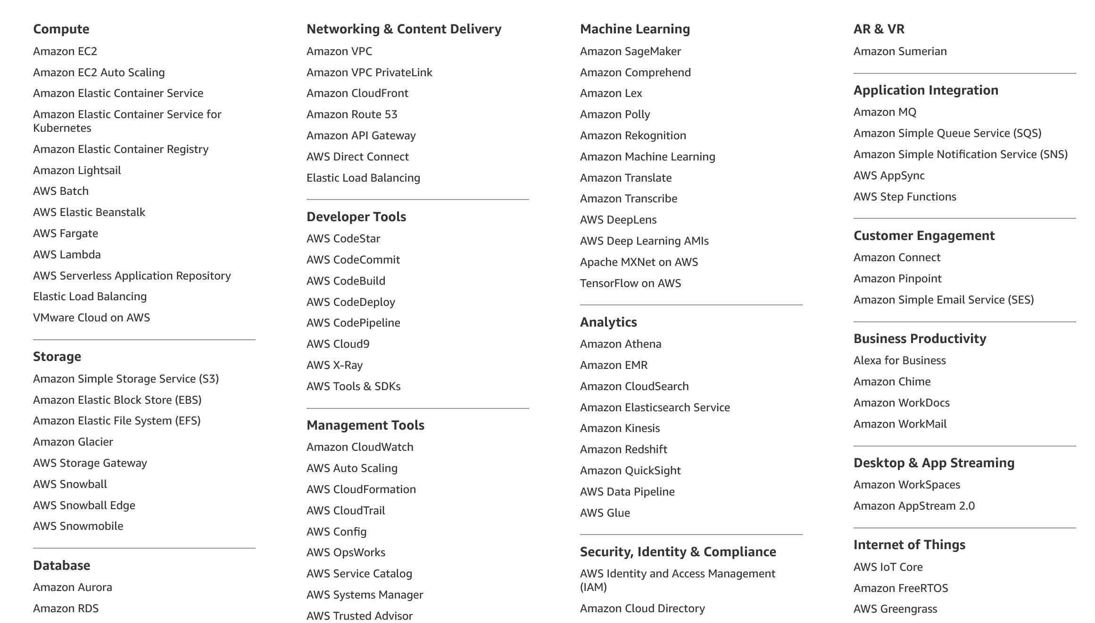
Services Offered by AWS

Slide 7
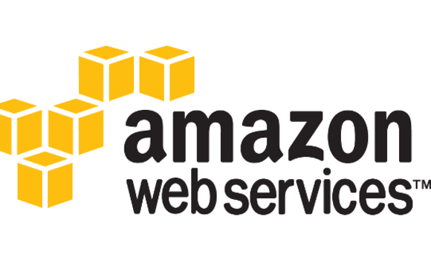
Interact with AWS
AWS Management Console – Web user interface
AWS Command Line Interface (CLI) (command-line interfaces)
Software Development Kits(SDKs): use AWS services in your apps with an API tailored to programming language or platform
AWS Management Console
AWS Command Line Interface
SDK

Slide 8
Reference
https://aws.amazon.com/education/faqs/

