Slide 1
API Engineering
Yin Hua Li
Centennial College
Week#1 2018 Fall
Topic: AWS EC2

Slide 2
AWS EC2
Virtual machine: a software computer, like a physical computer, runs an operating system and applications
AWS EC2 is a compute service that provides on-demand and scalable computing service in the cloud
AWS EC2 allows you to create and run virtual machines on AWS infrastructure
Choose a VM that fits your needs and gain the performance of AWS’s worldwide network

Slide 3
EC2 Features
Virtual computing environments in the cloud, known as instances.
Preconfigured templates for instances, known as AMIs, that package the bits needed for server(including OS and additional software)
Various configurations of CPU, memory, storage, and networking capacity of instances, known as instance types
Secure login information for instances using key pairs (AWS stores the public key, and the private key is provided to the who provisions the server instance)
Storage volumes for temporary data that’s deleted when the instance are stopped or terminated
Persistent storage volumes for the data using Amazon Elastic Block Store(Amazon EBS)
Multiple physical locations for the resources
A firewall that enables user to specify the protocols, ports, and source IP ranges
Static IPv4 address for dynamic could computing
Etc…

Slide 4
Amazon Machine Images(AMI) (1/2)
An AMI provides the information required to launch an instance, which is a virtual server in the cloud
A source AMI must be specified when you launch an instance
Multiple instances can be launched from a single AMI when multiple instances with the same configuration are needed.
Different AMIs can be used to launch instances with different configurations

Slide 5
Amazon Machine Images(AMI) (2/2)
An AMI includes the following:
A template for the root volume for the instance(e.g., an operating system, an application server, and applications)
Launch permissions that control which AWS accounts can use the AMI to launch instances
A block device mapping that specifies the volumes to attach to the instance when it’s launched

Slide 6
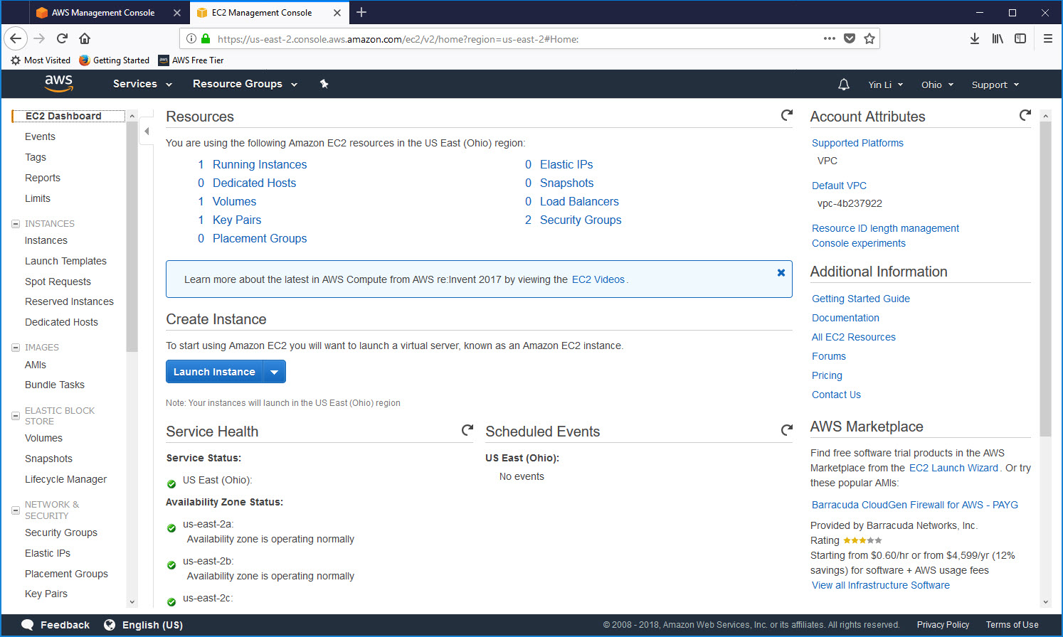
Create Amazon EC2 Key Pairs(1/2)
Amazon EC2 uses public-key cryptography to encrypt and decrypt login information. Public-key cryptography uses a public key to encrypt a piece of data, such as a password, then the recipient uses the private key to decrypt the data. The public key and private keys are known as a key pair

Slide 7
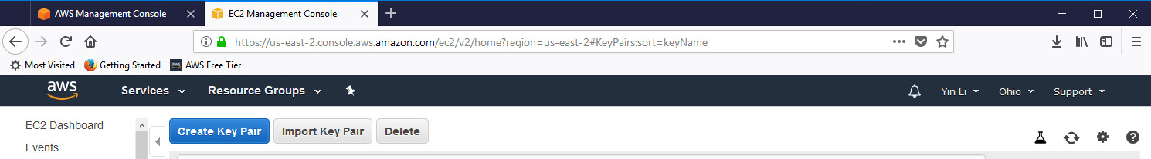
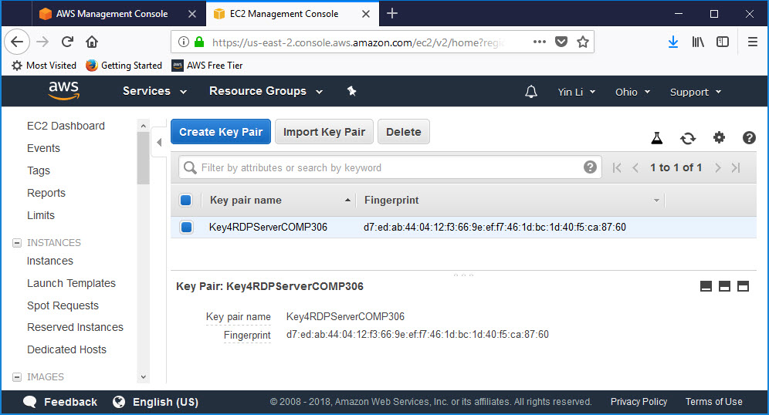
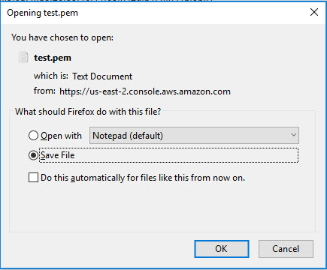
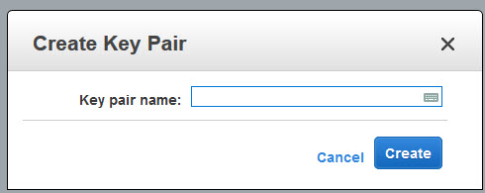
Create Amazon EC2 Key Pairs(2/2)

Slide 8
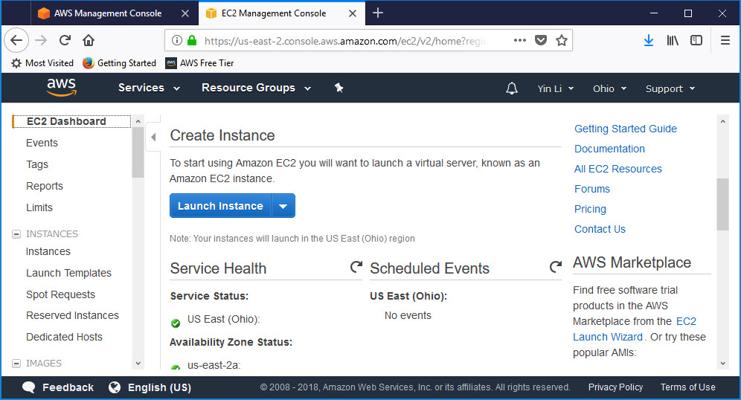
Launch EC2 Instance(1/9)

Slide 9
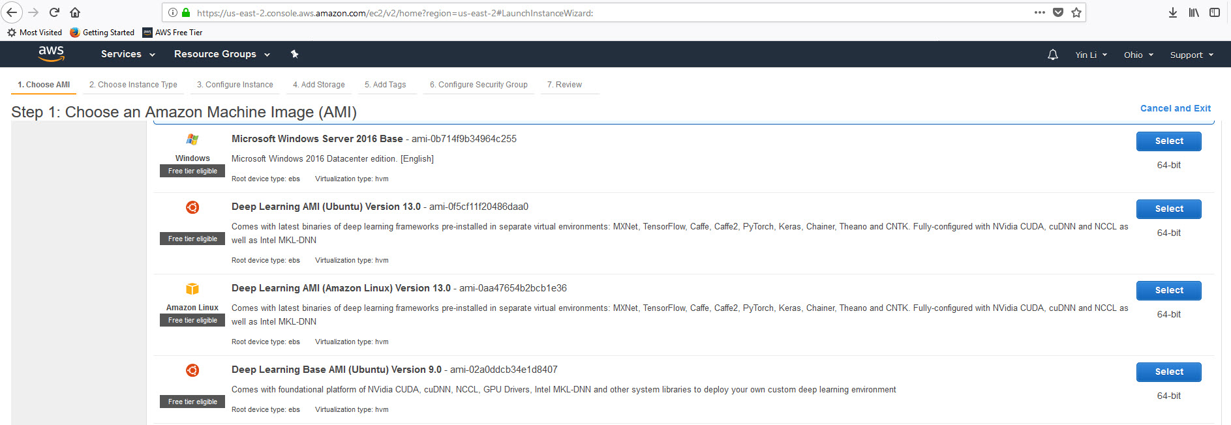
Launch EC2 Instance(2/9)
All services that offer a free tier have limits on what you can use without being charged. Many services have multiple types of limits. EC2 has limits on both the type of instance you can use and how many hours you can use in one month.

Slide 10
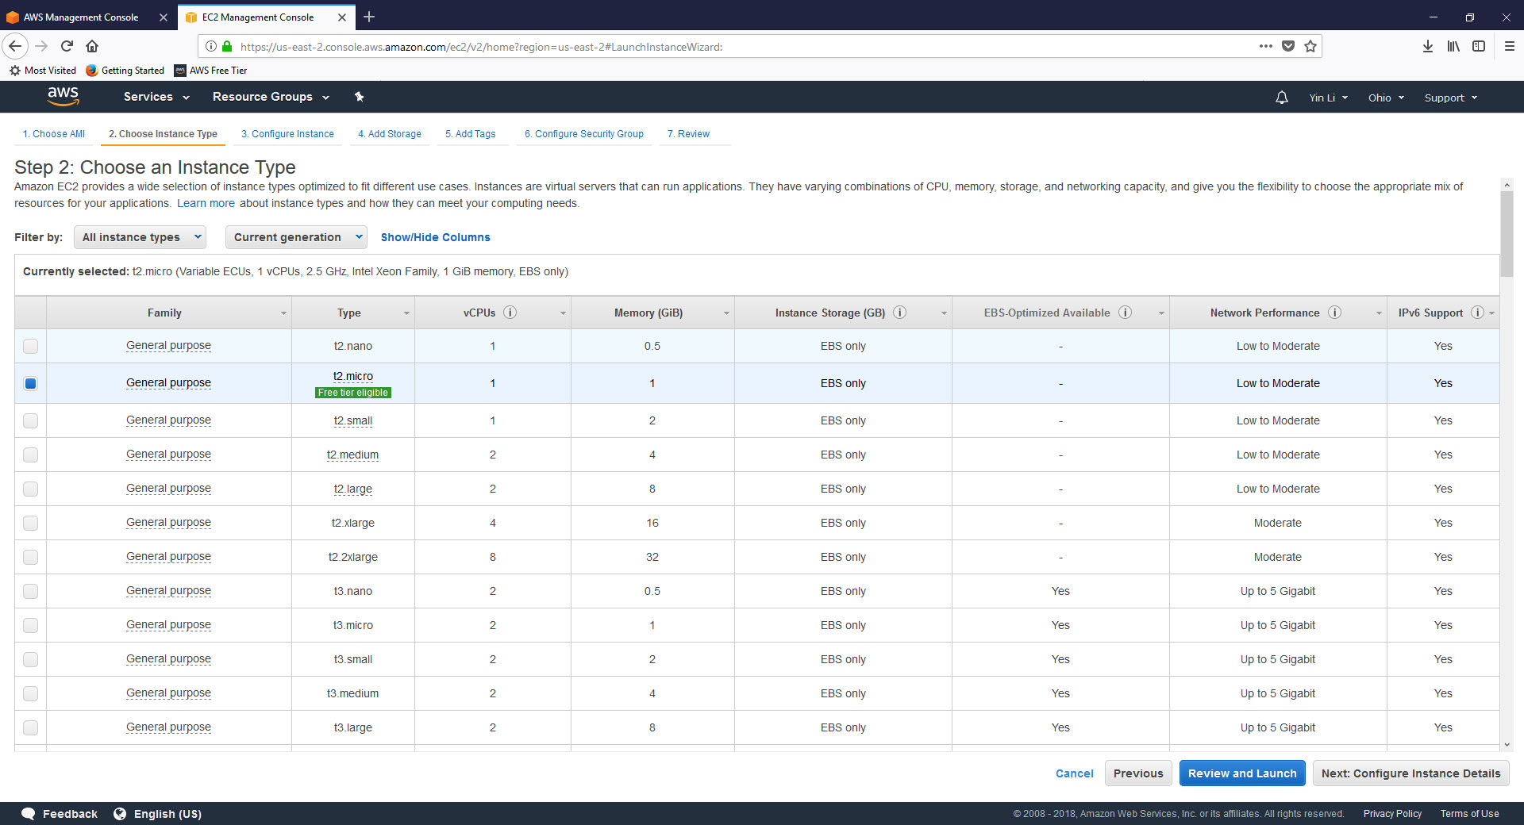
Launch EC2 Instance(3/9)

Slide 11
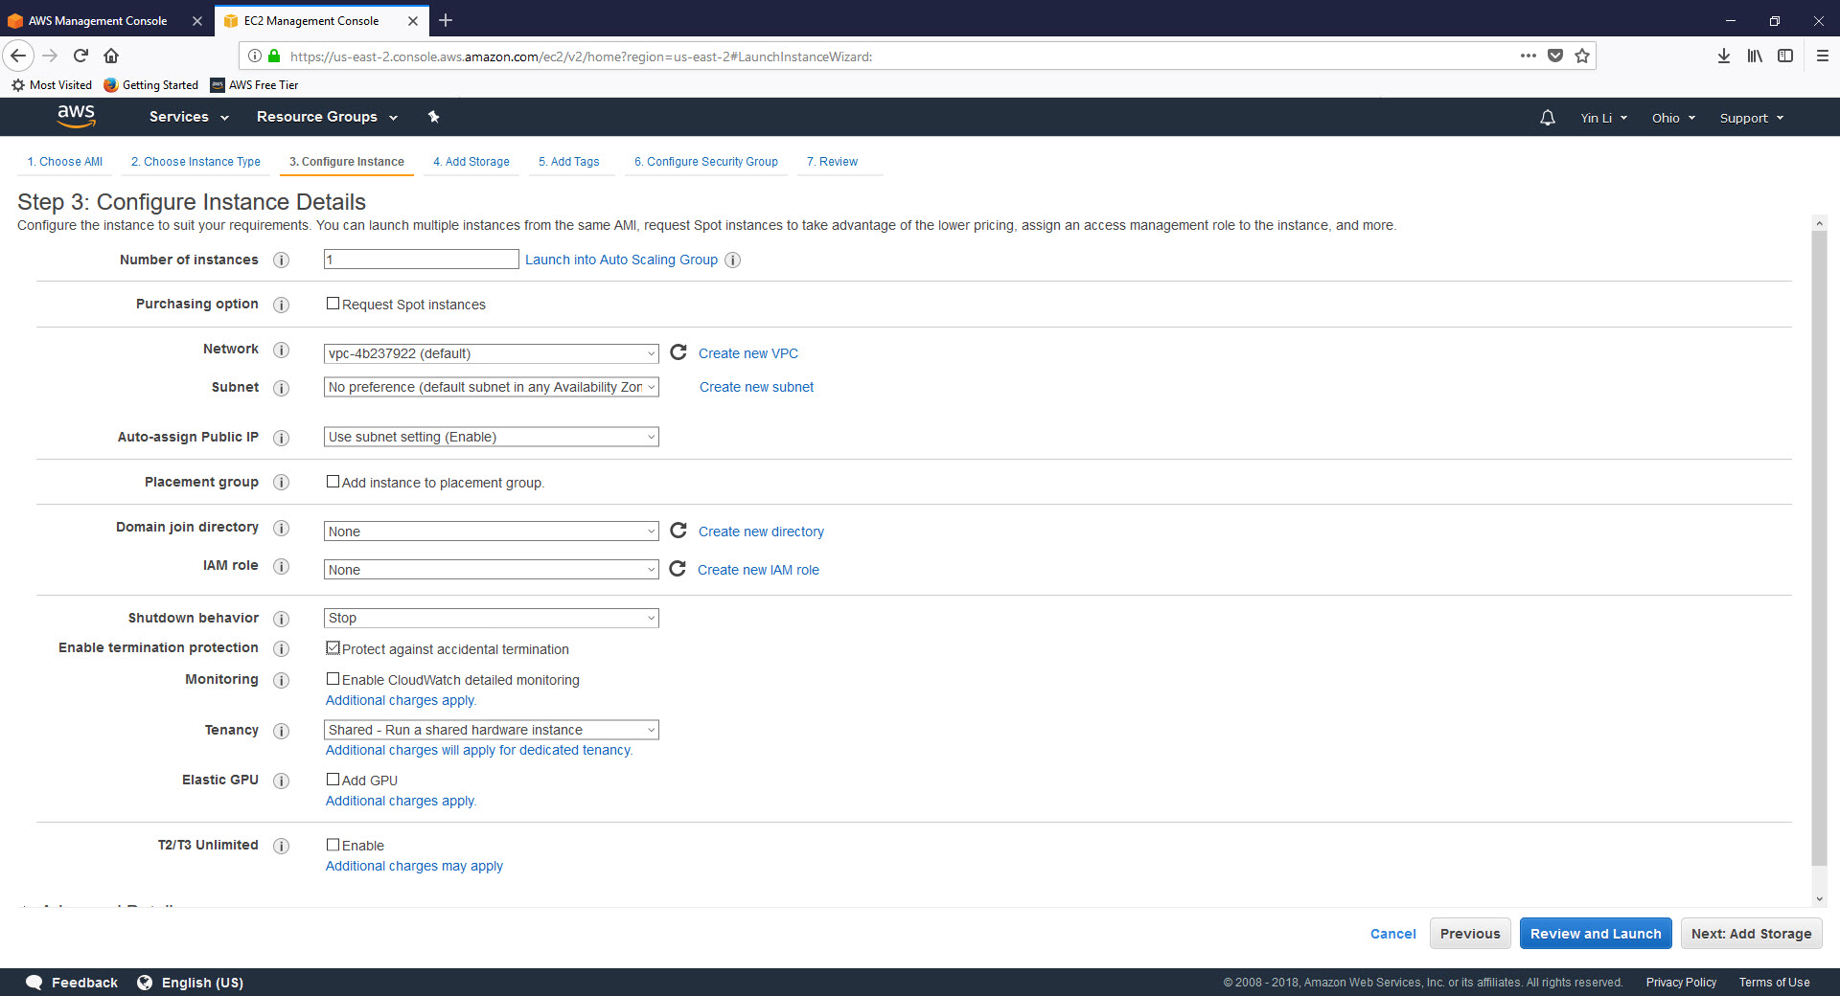
Launch EC2 Instance(4/9)

Slide 12
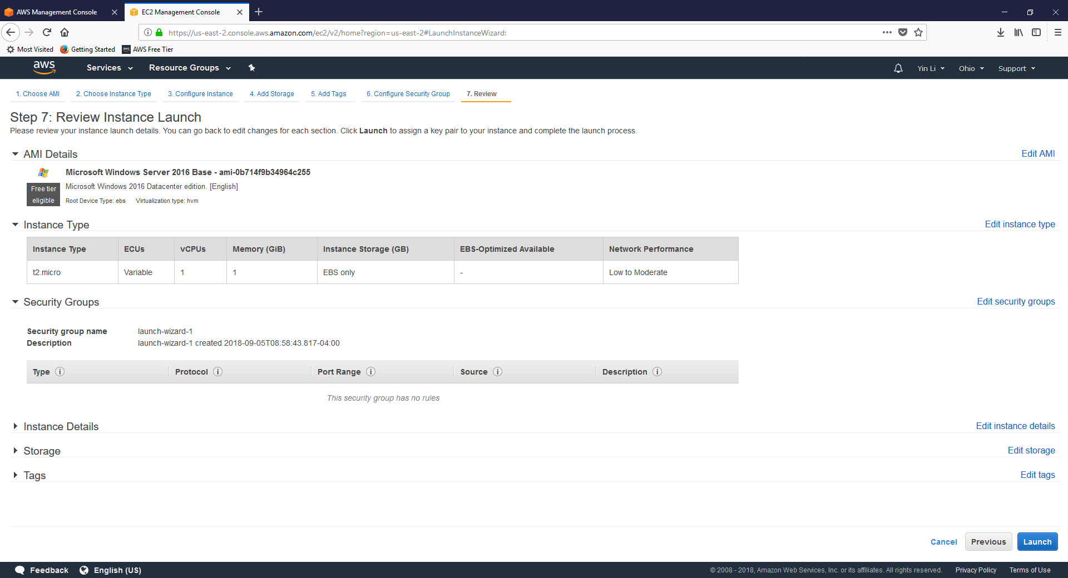
Launch EC2 Instance(5/9)

Slide 13
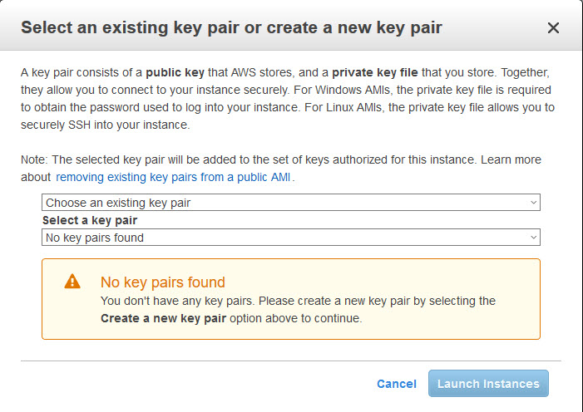
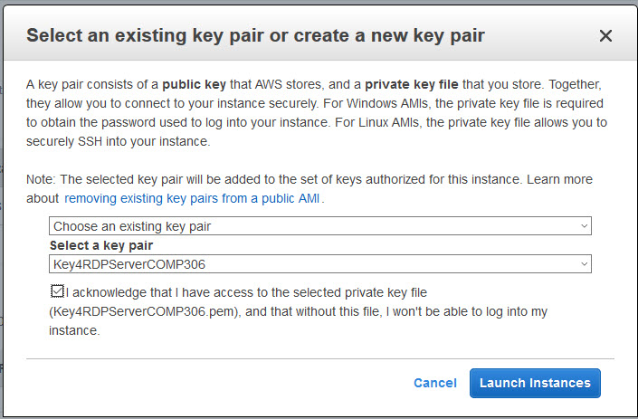
Launch EC2 Instance(6/9)

Slide 14
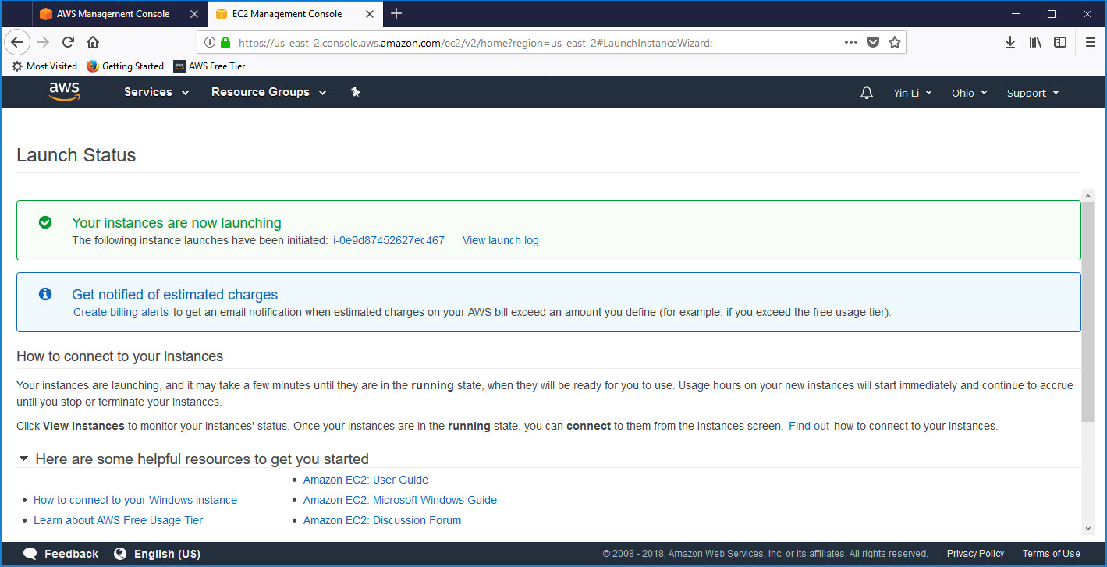
Launch EC2 Instance(7/9)

Slide 15
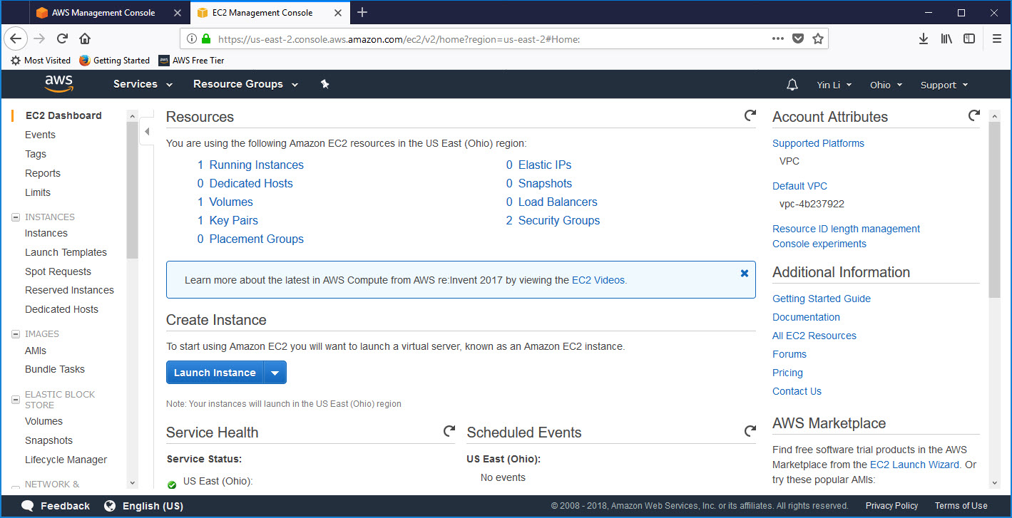
Launch EC2 Instance(8/9)

Slide 16
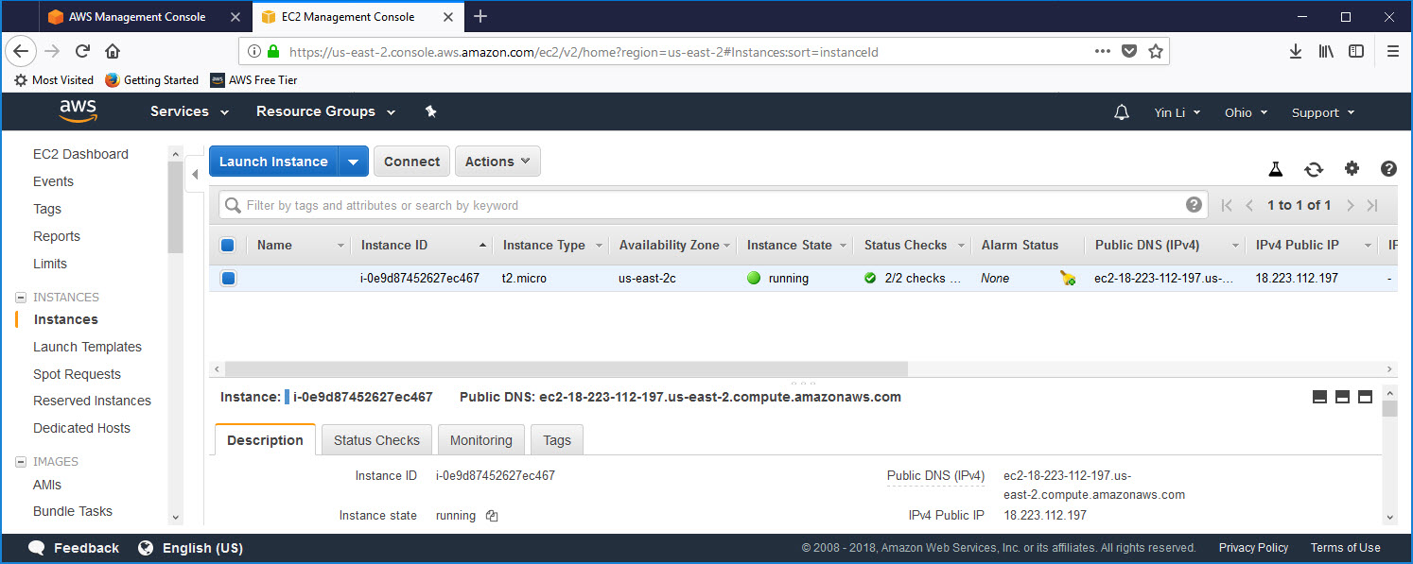
Launch EC2 Instance(9/9)

Slide 17
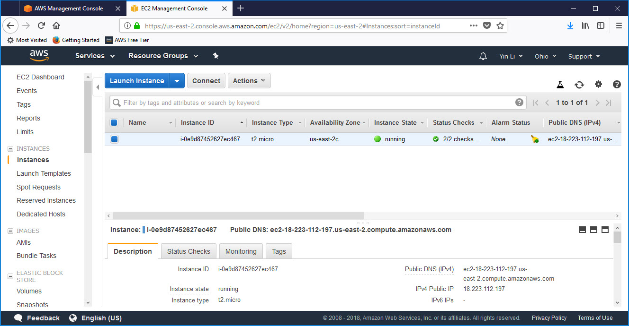
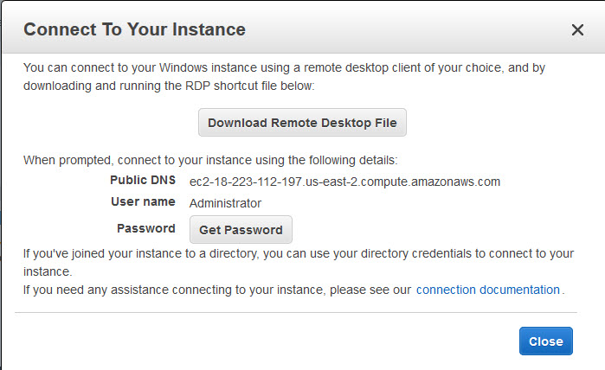
Connect to Launched Instance(1/3)

Slide 18
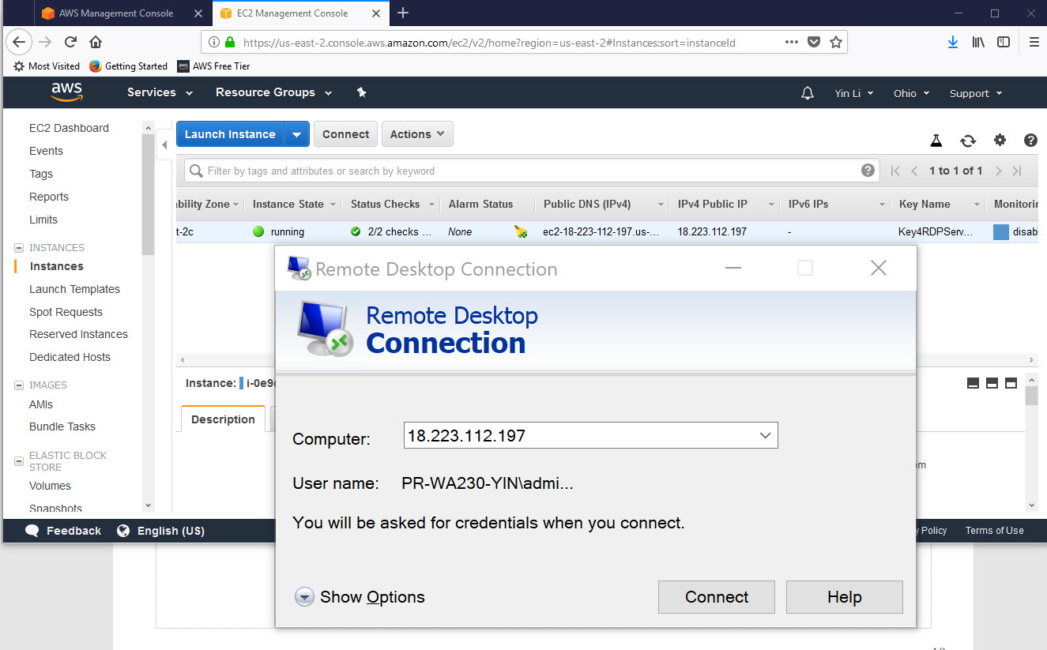
Connect to Launched Instance(2/3)

Slide 19
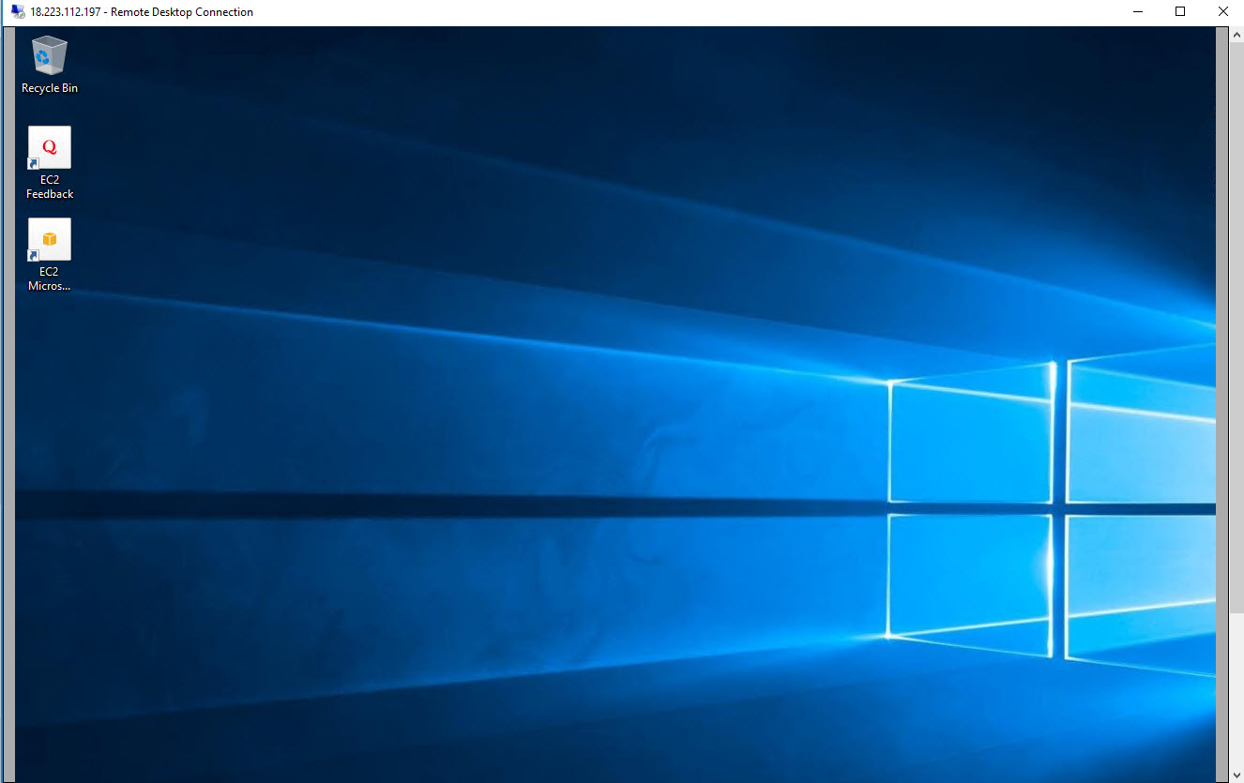
Connect to Launched Instance(3/3)

Slide 20
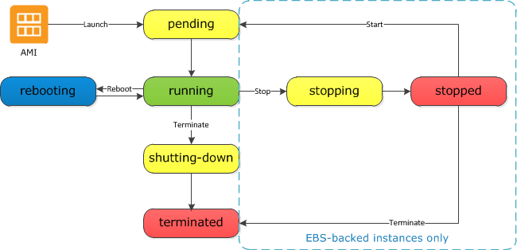
EC2 Instance Life Cycle
From https://docs.aws.amazon.com/AWSEC2/latest/UserGuide/ec2-instance-lifecycle.html

Slide 21
Reference
https://docs.aws.amazon.com/AWSEC2/latest/UserGuide/concepts.html
https://docs.aws.amazon.com/AWSEC2/latest/UserGuide/AMIs.html
https://en.wikipedia.org/wiki/Remote_Desktop_Protocol
https://aws.amazon.com/getting-started/tutorials/launch-windows-vm/
https://www.youtube.com/watch?v=r4YIdn2eTm4
https://www.youtube.com/watch?v=uJssXPyMf0s
https://www.youtube.com/watch?v=5FepK5pV39c\

