Slide 1
API Engineering
Yin Hua Li
Centennial College
Week#2 ,2018
Access AWS S3 Programmatically

Slide 2
Objective
Understand AWS Toolkit for Visual Studio
Be able to access AWS S3 programmatically

Slide 3
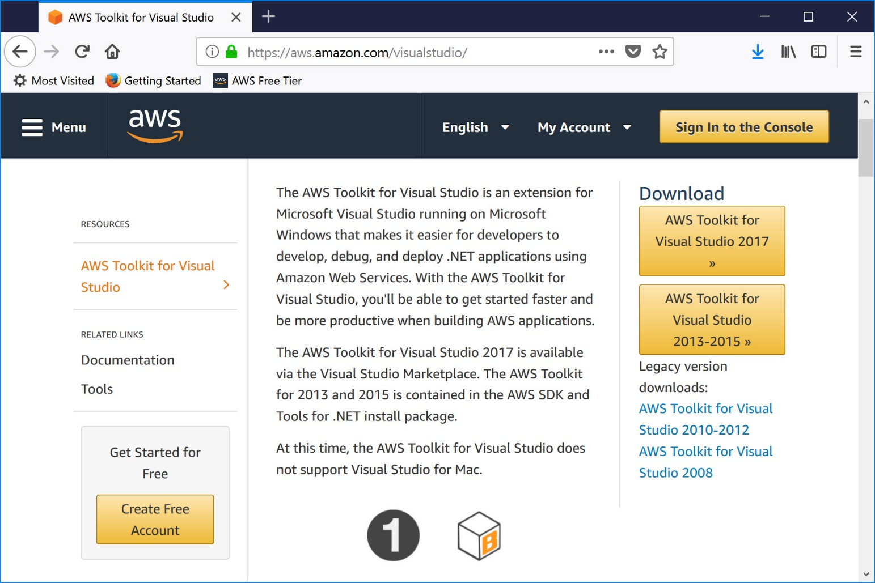
AWS Toolkit for Visual Studio (1/3)
The AWS Toolkit for Visual Studio is an extension for Microsoft Visual Studio running on Microsoft Windows that makes it easier for developers to develop, debug, and deploy .NET applications using Amazon Web Services

Slide 4
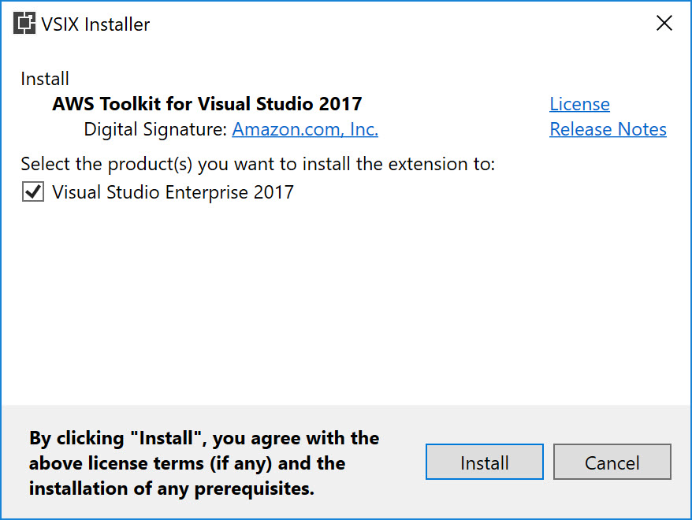
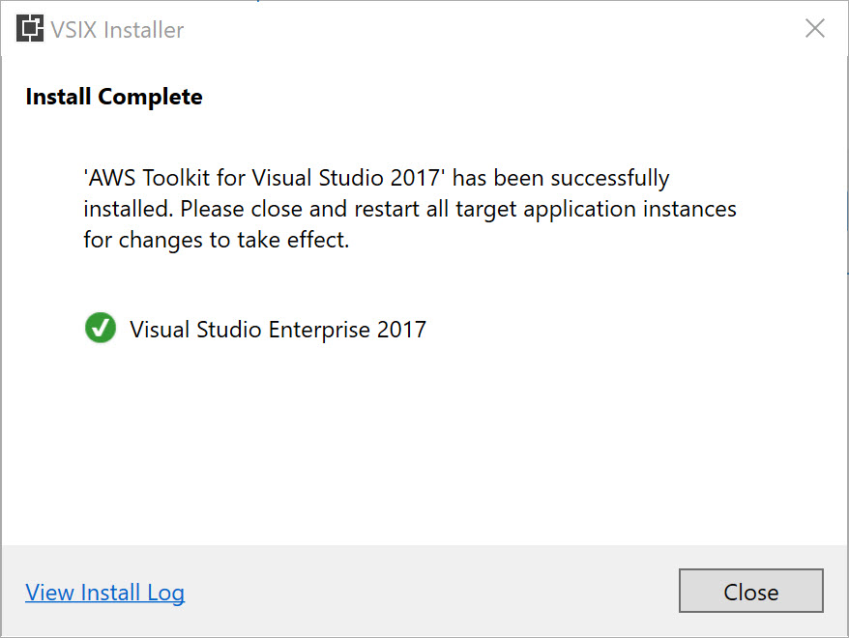
AWS Toolkit for Visual Studio (2/3)

Slide 5
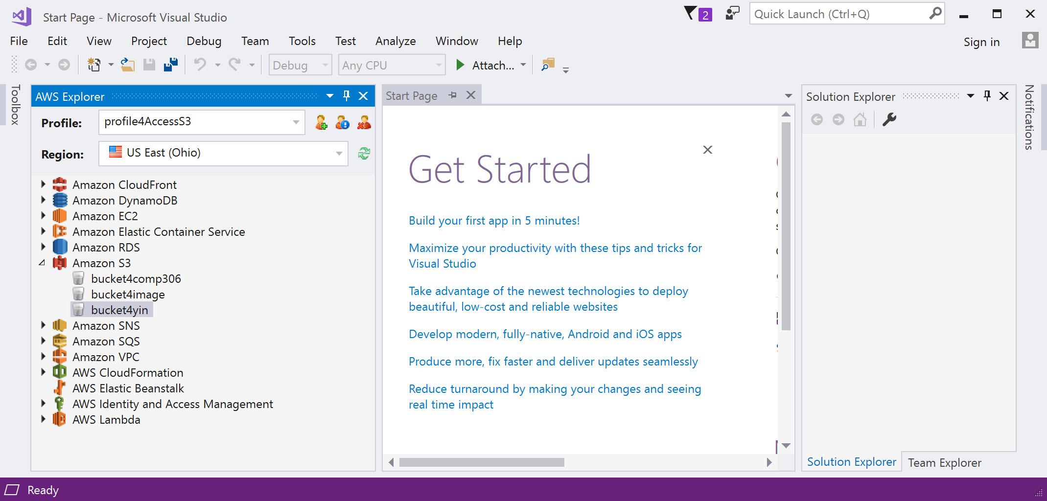
AWS Toolkit for Visual Studio (3/3)

Slide 6
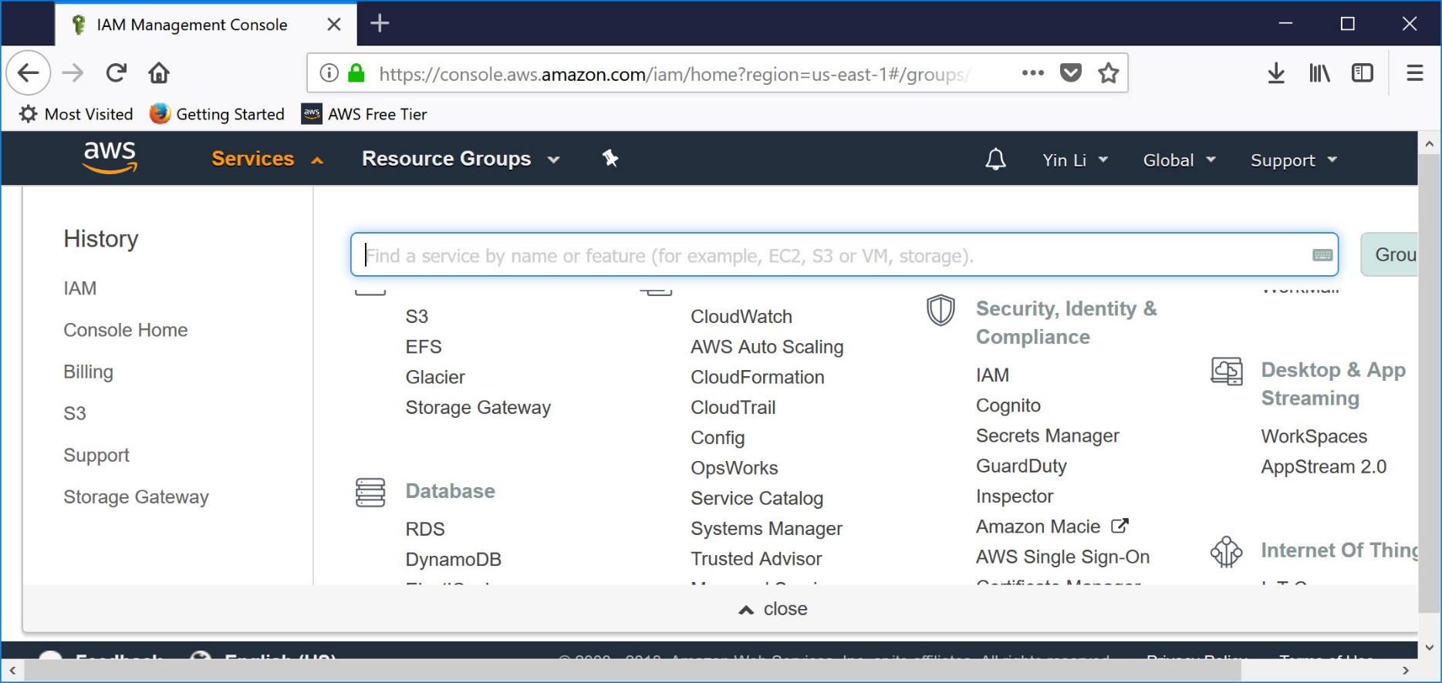
Identity Access Management(IAM)
AWS Identity and Access Management (IAM) is a web service for securely controlling access to AWS services. IAM is used to centrally manage users, security credentials such as access keys, and permissions that control which AWS resources users and applications can access

Slide 7
AWS Root User
Create an AWS account creates a root user
The email and password supplied at the time of creating the AWS account is the username and password for the root user, also called root account credentials.
The root account has complete, unrestricted access to all resources. Therefore, it is highly recommended not to use the root account for day-to-day activities

Slide 8
Concepts of IAM
User
A person or an application that requires access to various AWS resources to perform designated tasks
Access key
A 20-character alphanumeric key that acts as an user ID
Secret key
A 40-character alphanumeric key that acts as a password or secret key
Group
A collection of IAM users
Role
An IAM entity that constitute one or more IAM policies defining resource permissions
Policy
A document written in JSON format that formally states one or more permissions as per the IAM policy standards

Slide 9
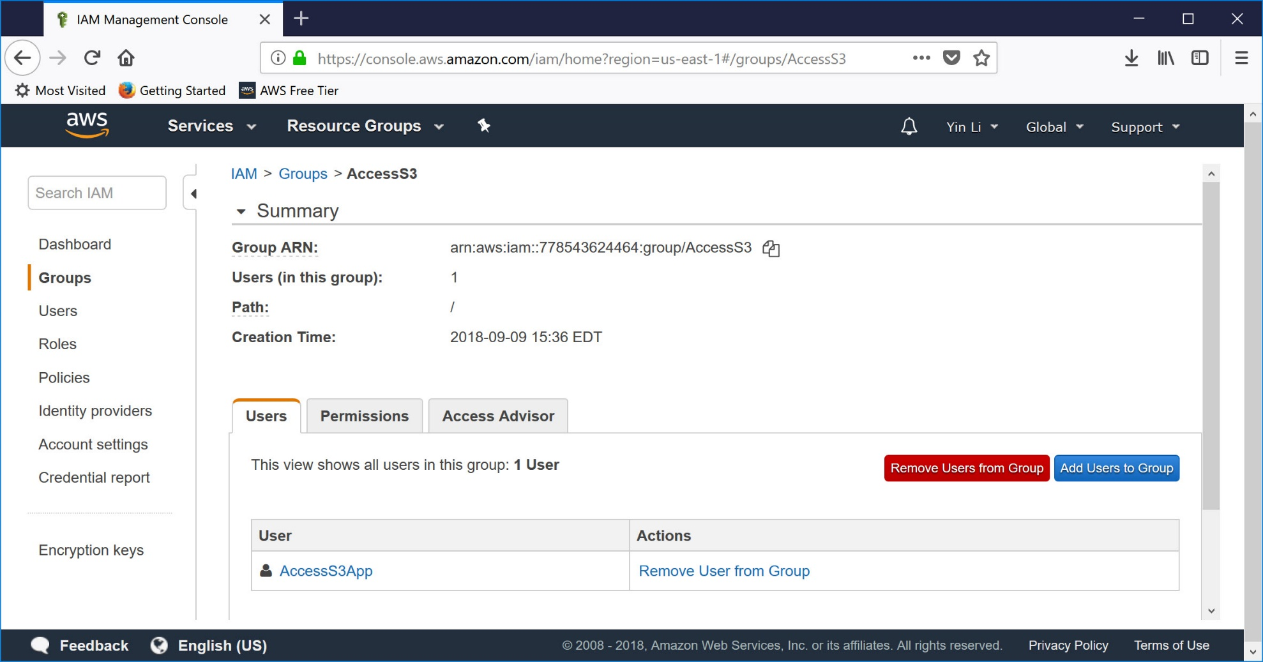
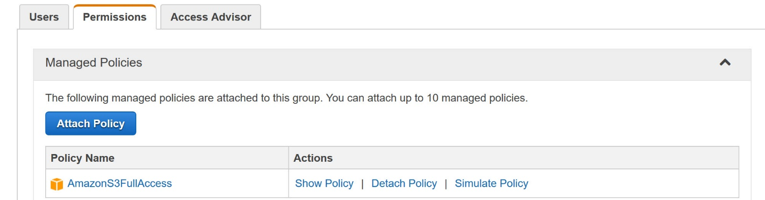
Create a user to allow an APP to Upload object(s) to S3

Slide 10
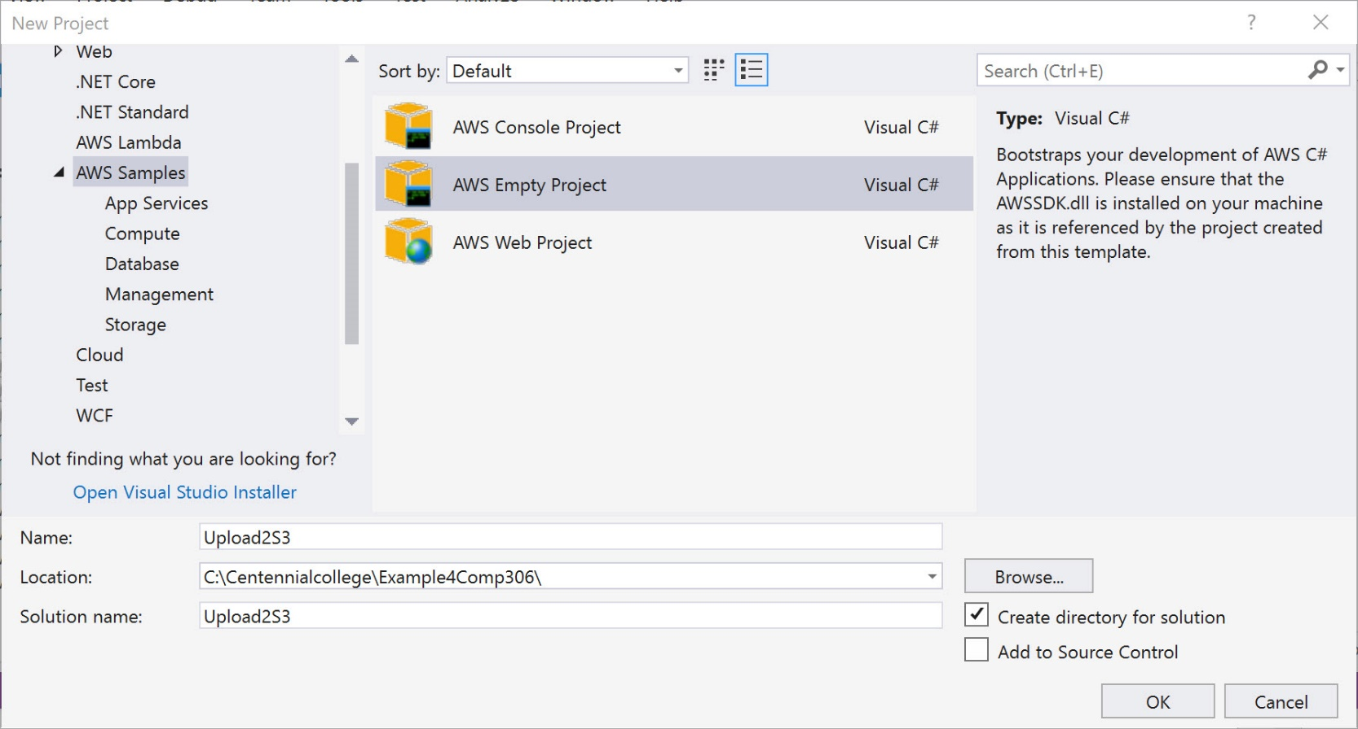
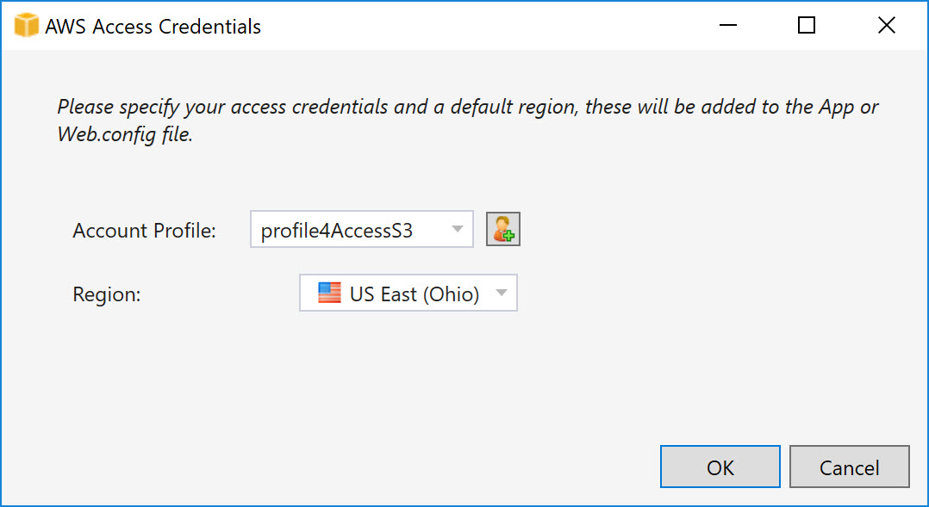
Access S3 Storage Programmatically(1/3)

Slide 11
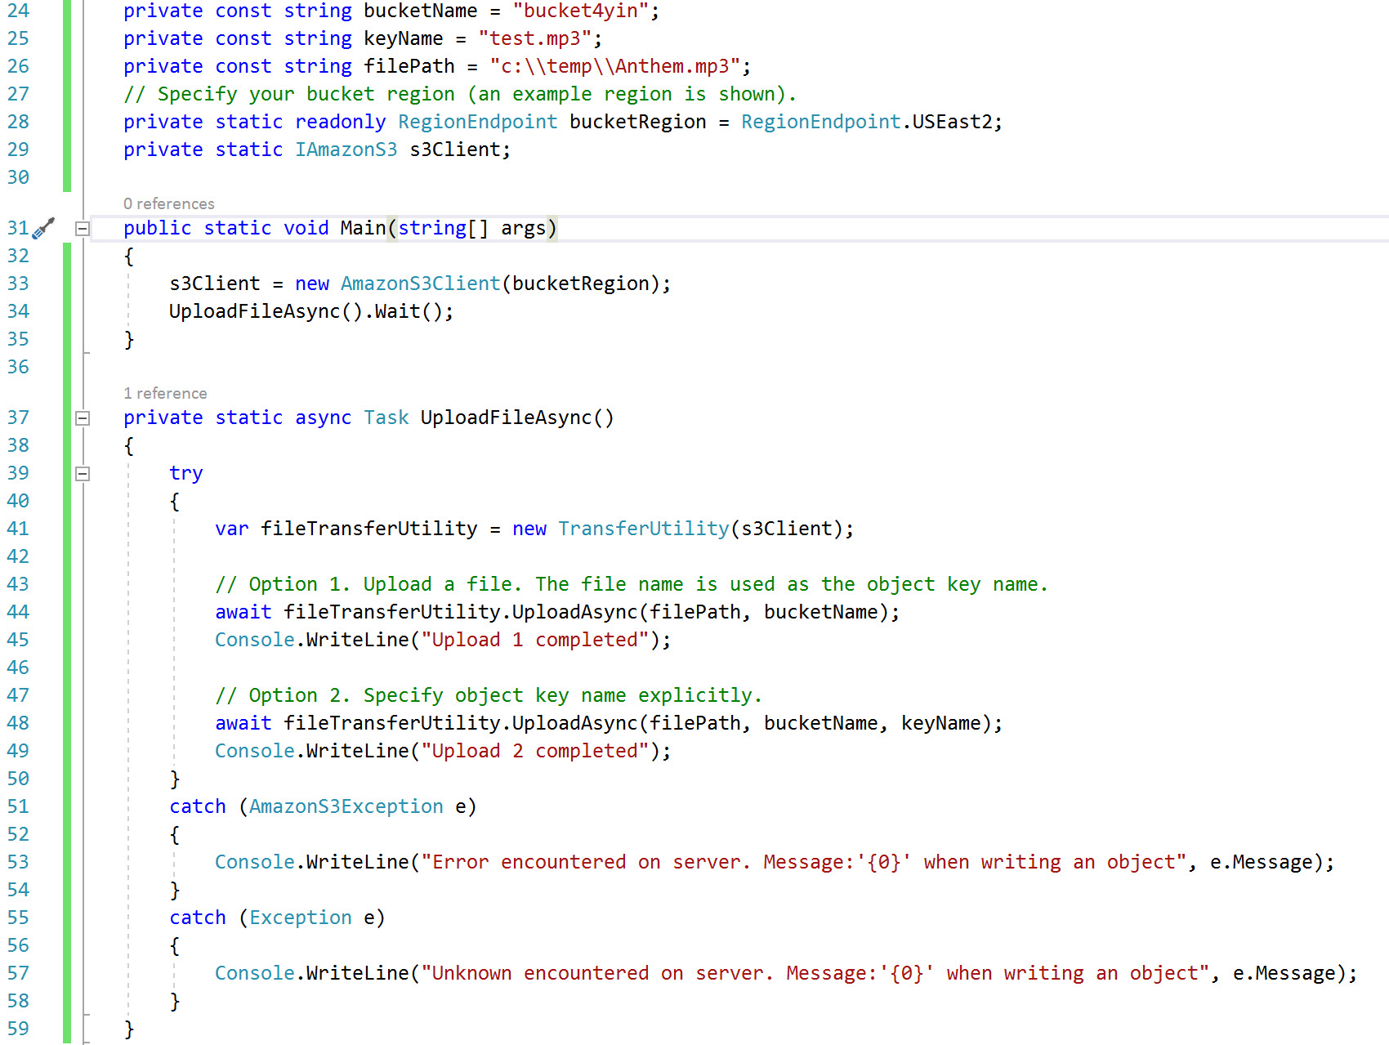
Access S3 Storage Programmatically(2/3)

Slide 12
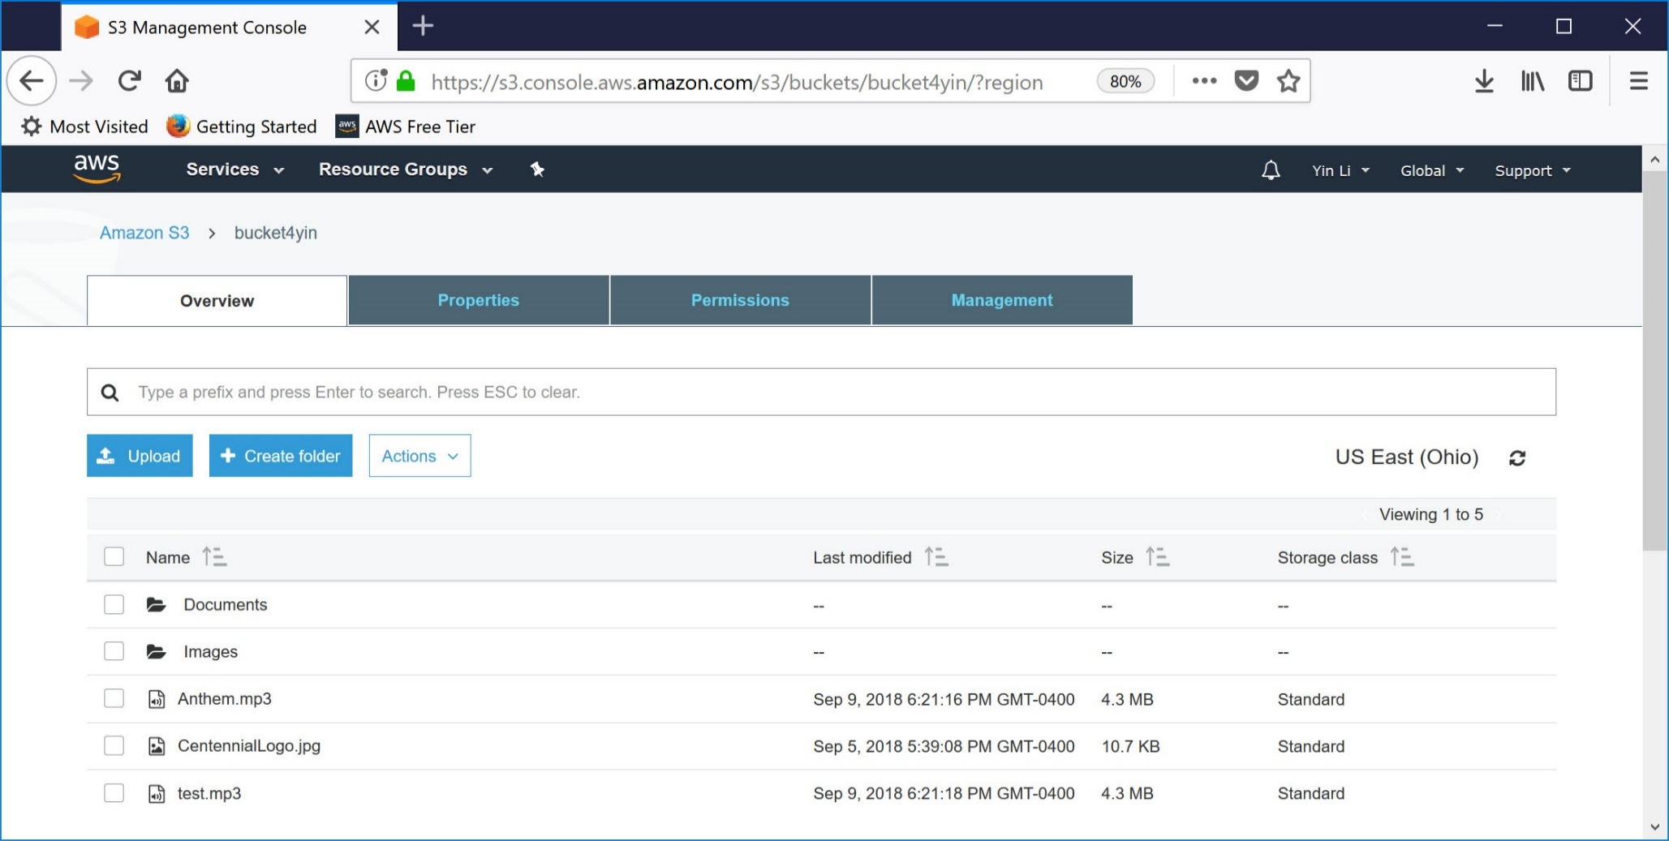
Access S3 Storage Programmatically(3/3)

Slide 13
Reference
https://docs.aws.amazon.com/IAM/latest/UserGuide/introduction.html
https://docs.aws.amazon.com/sdkfornet/v3/apidocs/items/Amazon/TRegionEndpoint.html

