Slide 1
API Engineering
Yin Hua Li
Centennial College
Week#2 ,2018
AWS RDS Service

Slide 2
Amazon Relation Database Service (RDS)
Amazon RDS provides cost-efficient and scalable relational database capacity while automating time-consuming administration tasks such as hardware provisioning, database setup, patching and backups.

Slide 3
DB Instances
The basic building block of Amazon RDS is the DB instance.
A DB instance is an isolated database environment in the cloud. A DB instance can contain multiple user-created database, and you can access it by using the same tools and applications that you use with a stand-alone database instance.
Each DB instance runs a DB engine. Amazon RDS currently supports Amazon Aurora, MySQL, MariaDB, PostgreSQL, Oracle, and Microsoft SQL Server DB engines

Slide 4
Amazon Aurora
Amazon Aurora is a MySQL- and PostgreSQL-compatible enterprise-class database, starting at <$1/day.
Up to 5 times the throughput of MySQL and 3 times the throughput of PostgreSQL
Up to 64TiB of auto-scaling SSD storage
6-way replication across three Availability Zones
Up to 15 Read Replicas with sub-10ms replica lag
Automatic monitoring and failover in less than 30 seconds

Slide 5
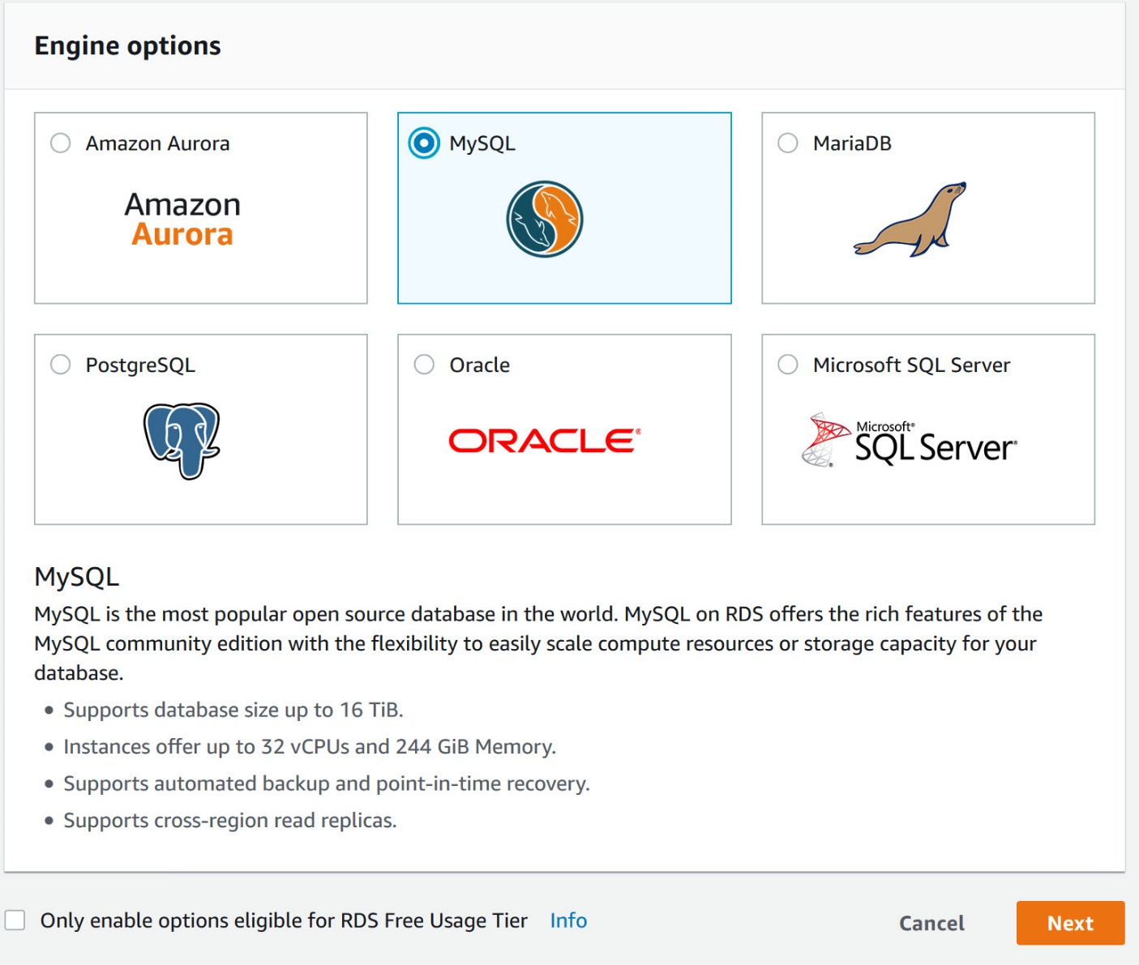
Create MySQL DB Instance(1/4)

Slide 6
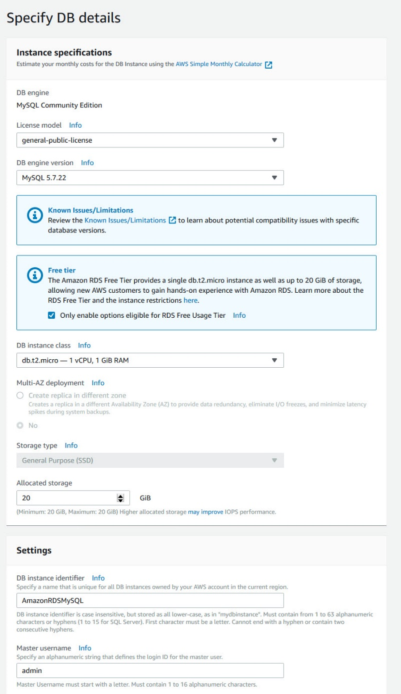
Create MySQL DB Instance(2/4)

Slide 7
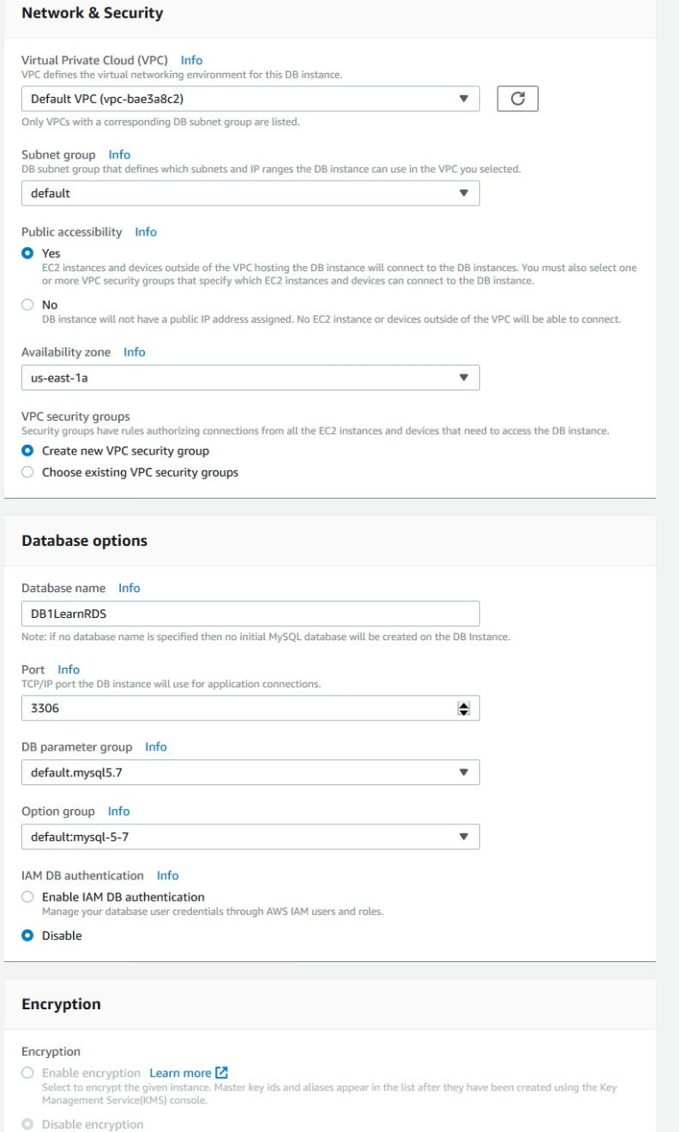
Create MySQL DB Instance(3/4)

Slide 8
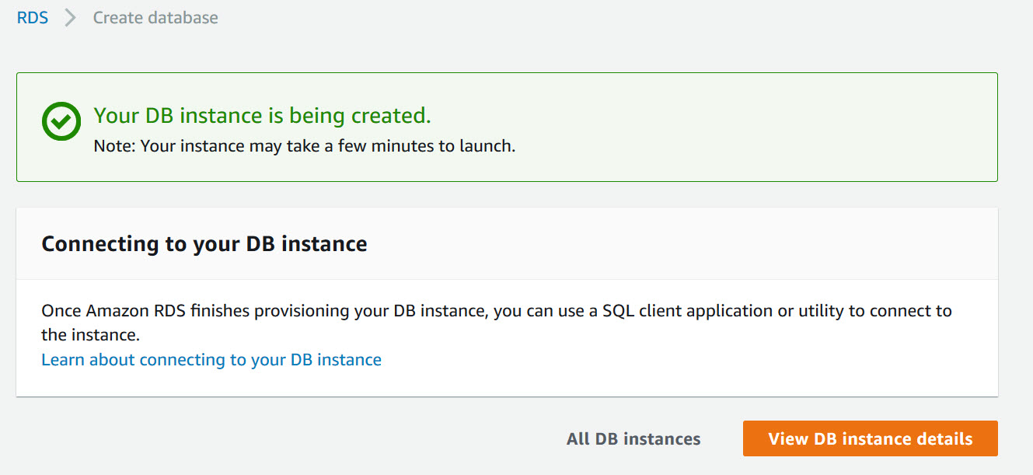
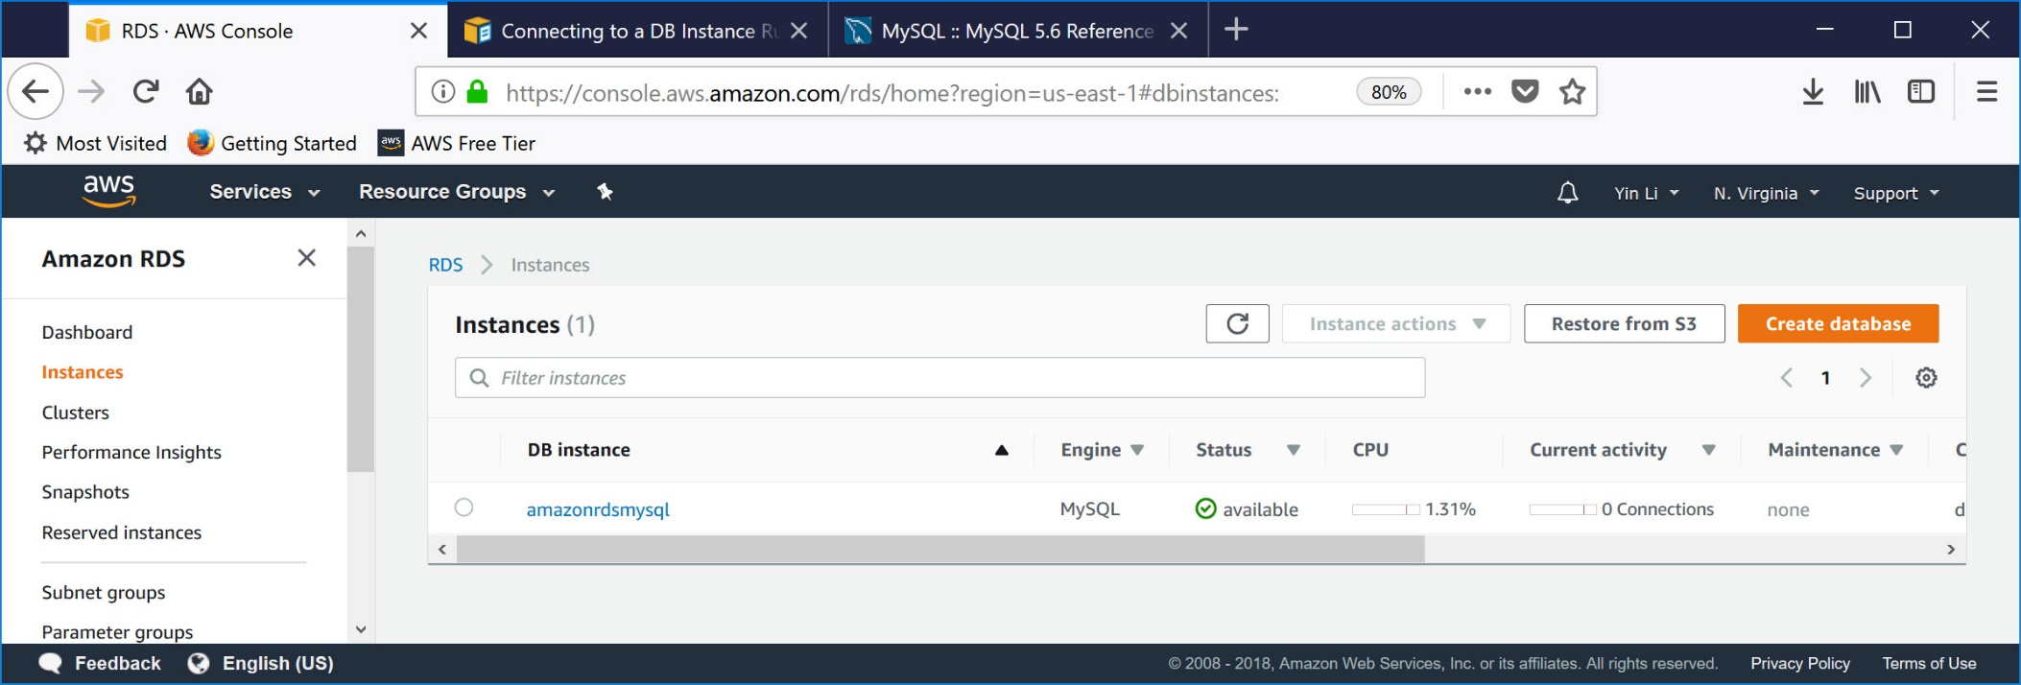
Create MySQL DB Instance(4/4)

Slide 9
Connect to MySQL DB Instance(1/6)
Connect to DB Instance Running the MySQL Database Engine
The MySQL Command Line Tool
MySQL Workbench
Download MySQL Workbench from here

Slide 10
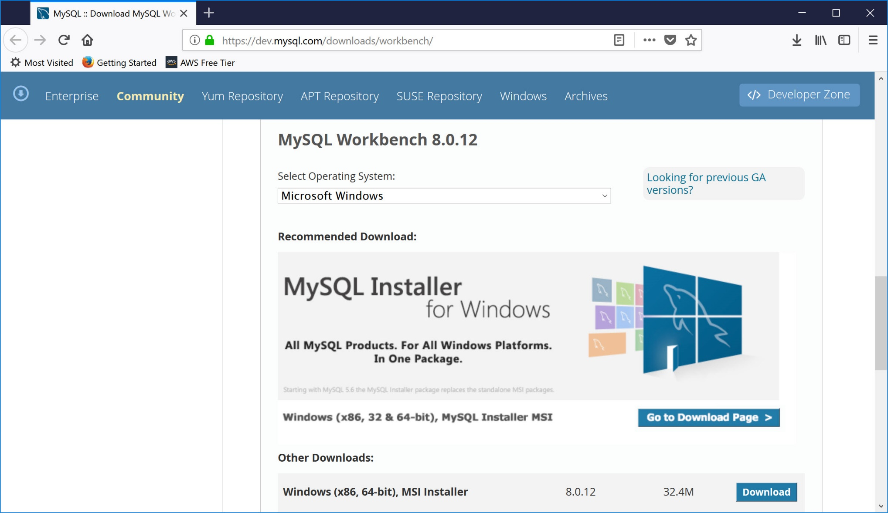
Connect to MySQL DB Instance(2/6)

Slide 11
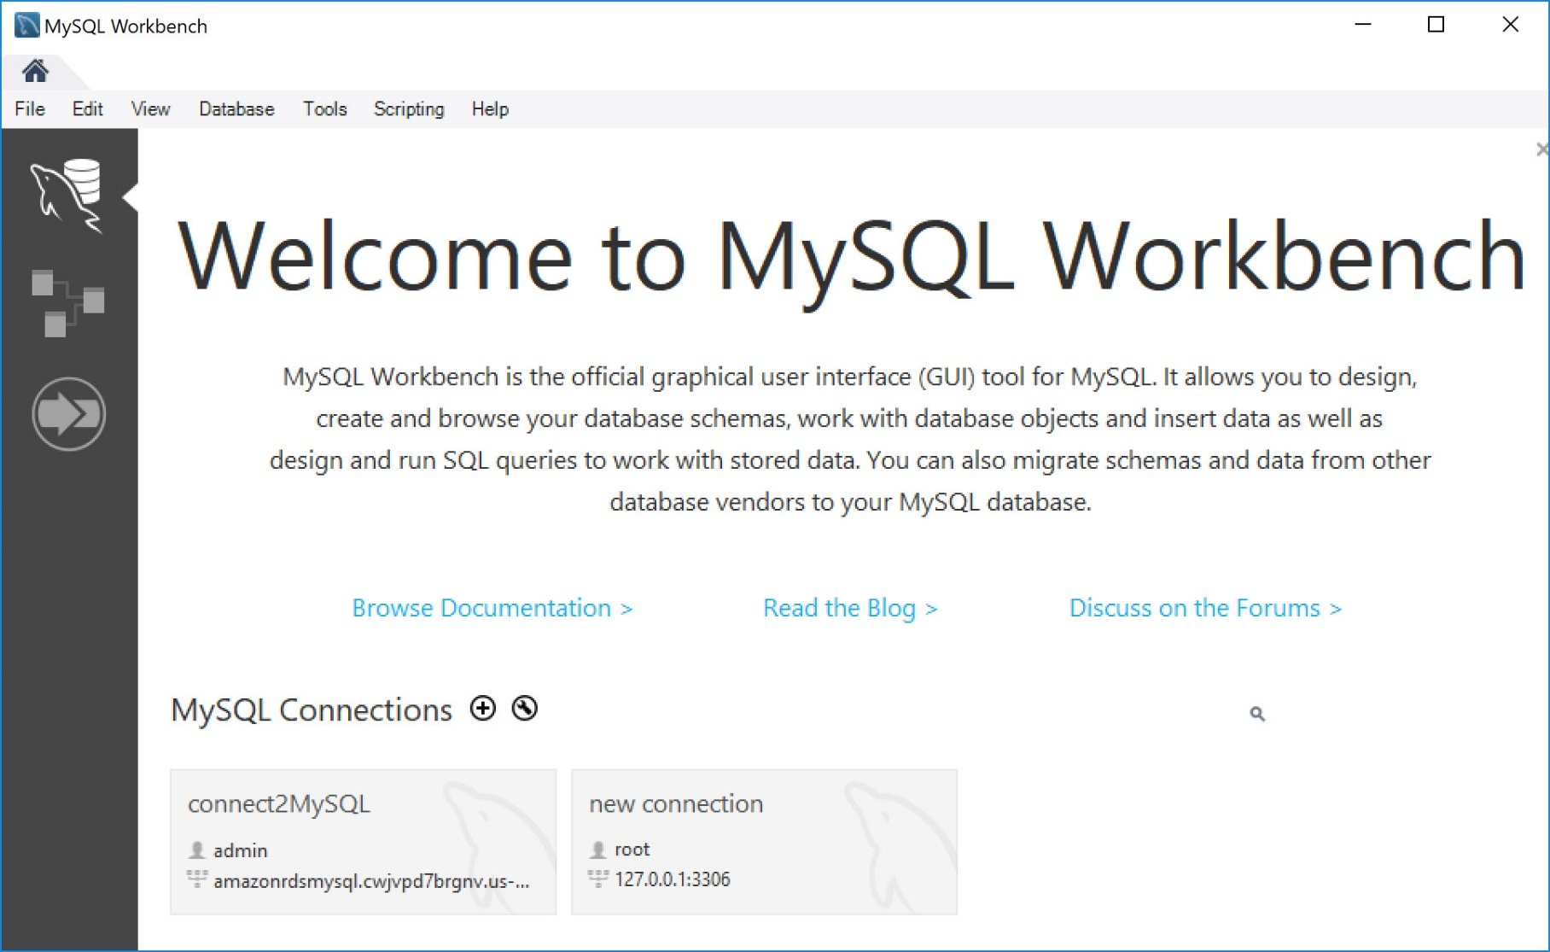
Connect to MySQL DB Instance(3/6)

Slide 12
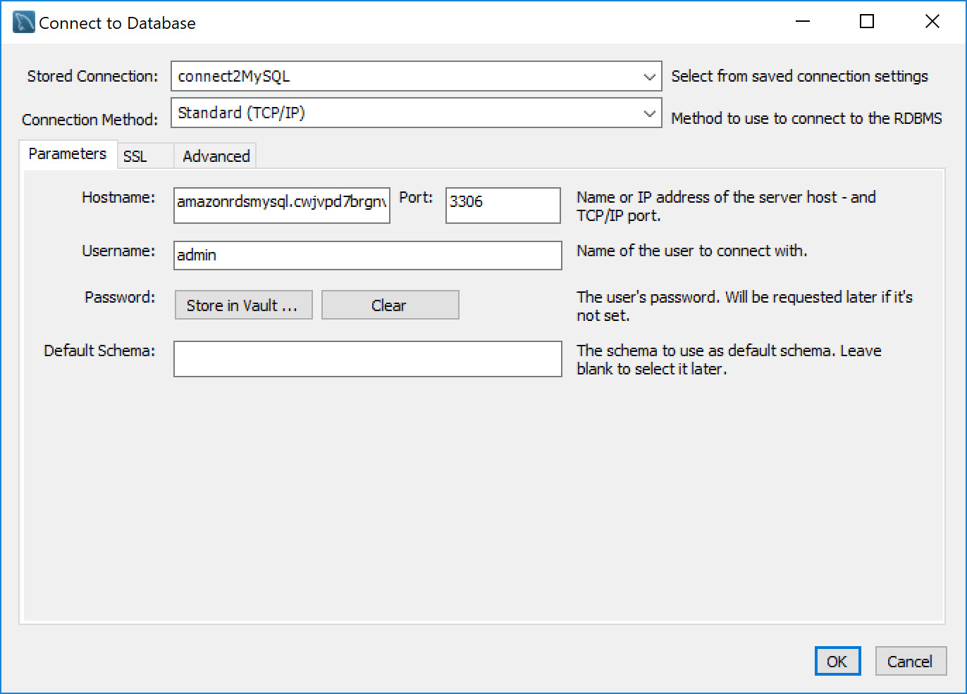
Connect to MySQL DB Instance(4/6)

Slide 13
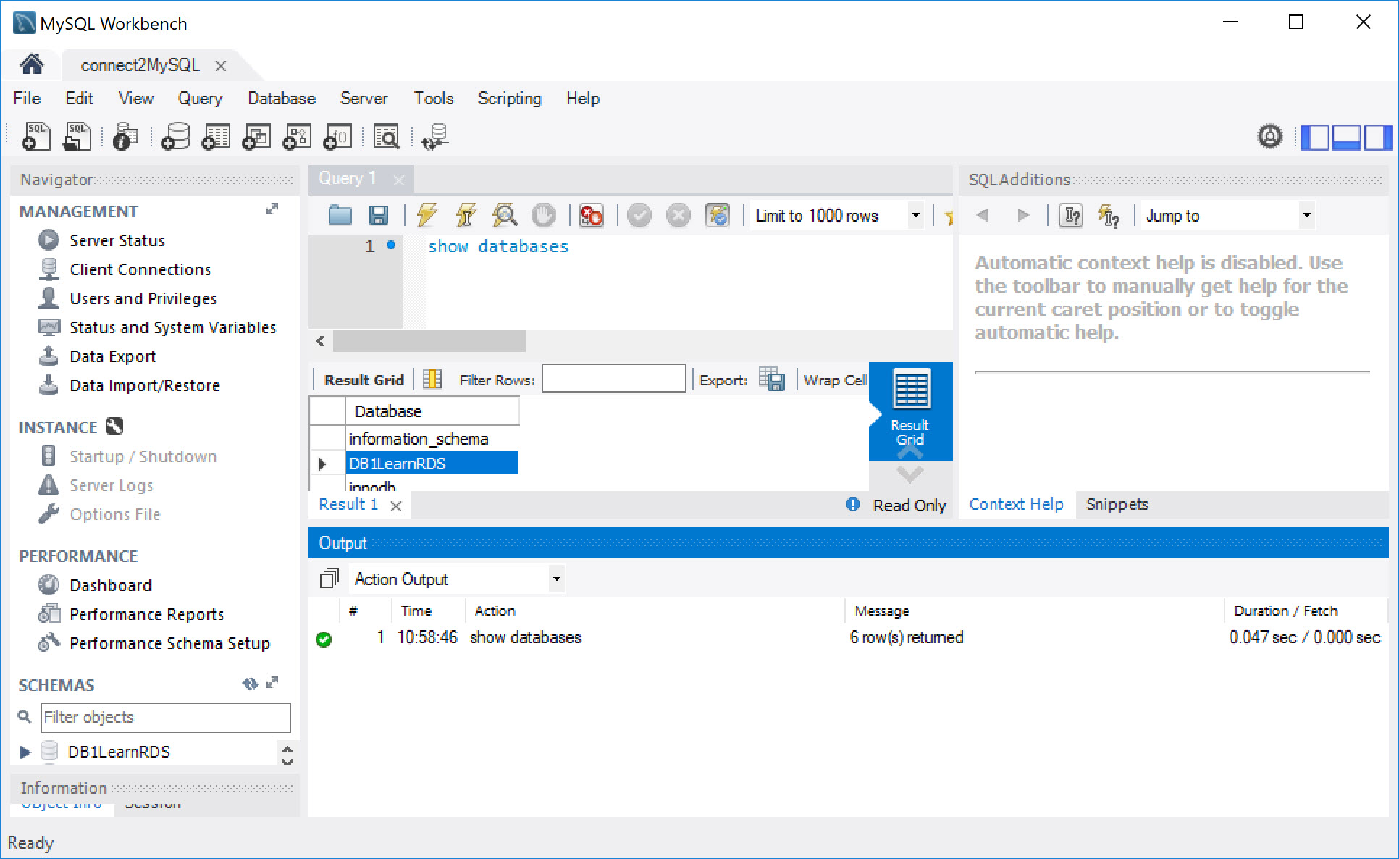
Connect to MySQL DB Instance(5/6)

Slide 14
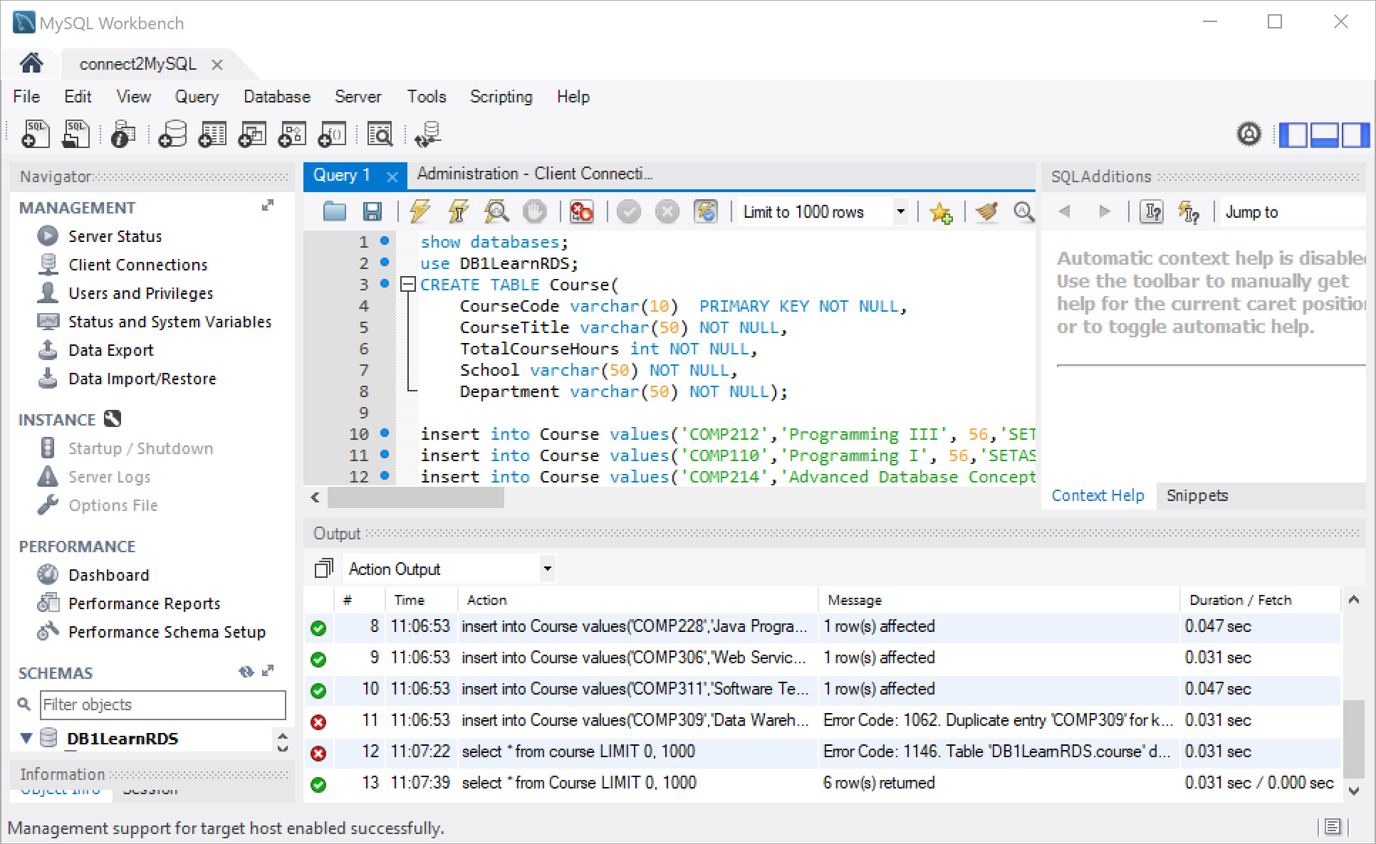
Connect to MySQL DB Instance(6/6)

Slide 15
Reference
https://downloads.mysql.com/archives/utilities/
https://aws.amazon.com/documentation/rds/
https://docs.aws.amazon.com/AmazonRDS/latest/UserGuide/USER_ConnectToInstance.html

