Slide 1
COMP 306: API Engineering & Cloud Computing
Class Activity 05 – AWS RDS Workshop
Created By: Kevin Ma (#300867968)
Fall 2018

Slide 2
Class Activity 05 – AWS RDS Workshop
Access AWS RDS Programmatically

Slide 3
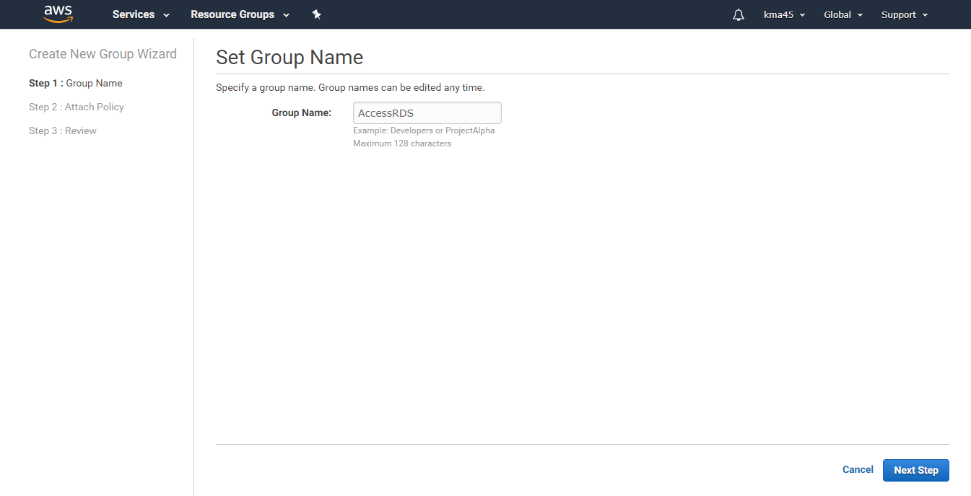
Create a User to Allow App to Access RDS

Slide 4
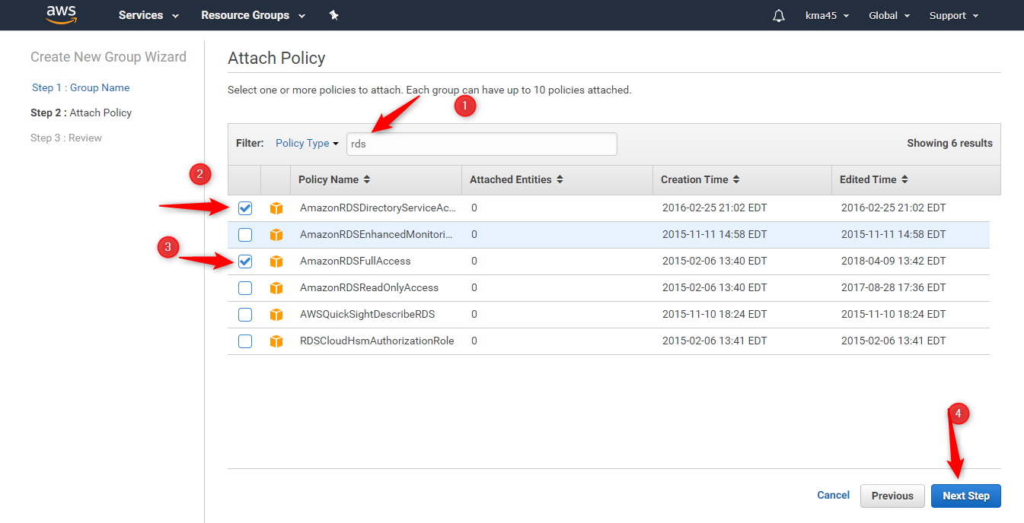
Create a User to Allow App to Access RDS

Slide 5
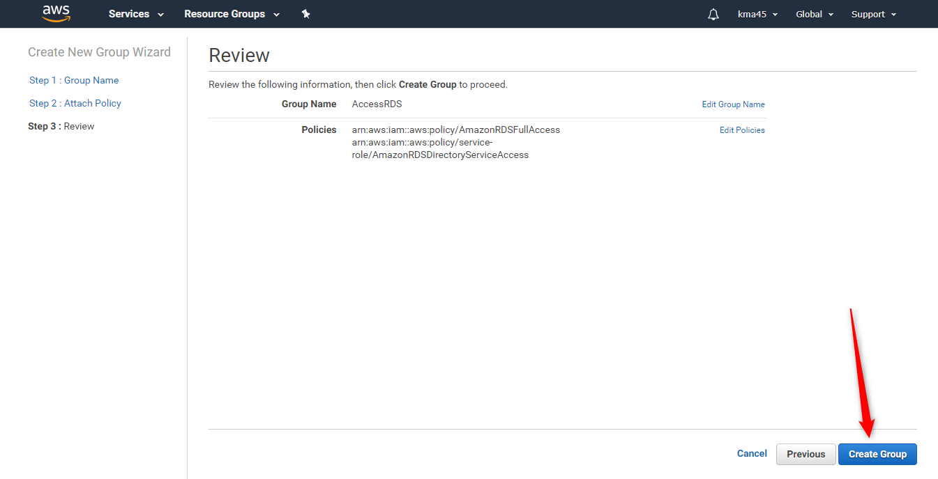
Create a User to Allow App to Access RDS

Slide 6
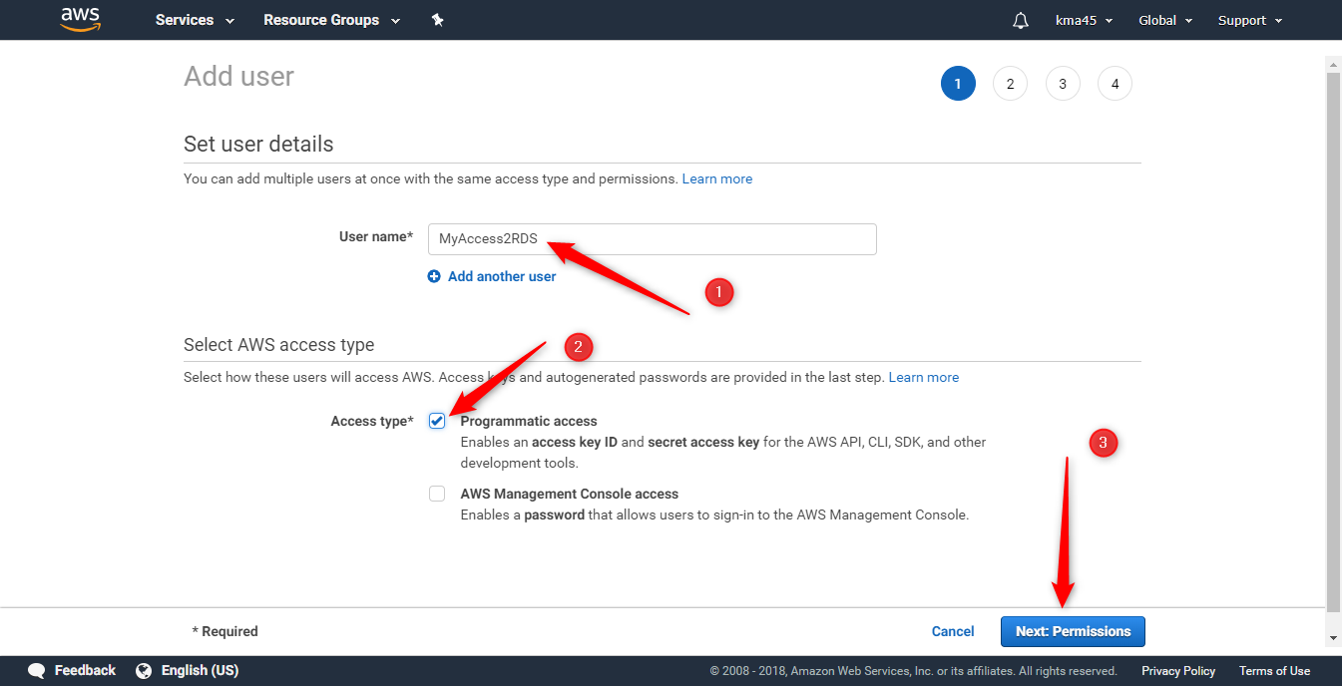
Create a User to Allow App to Access RDS

Slide 7
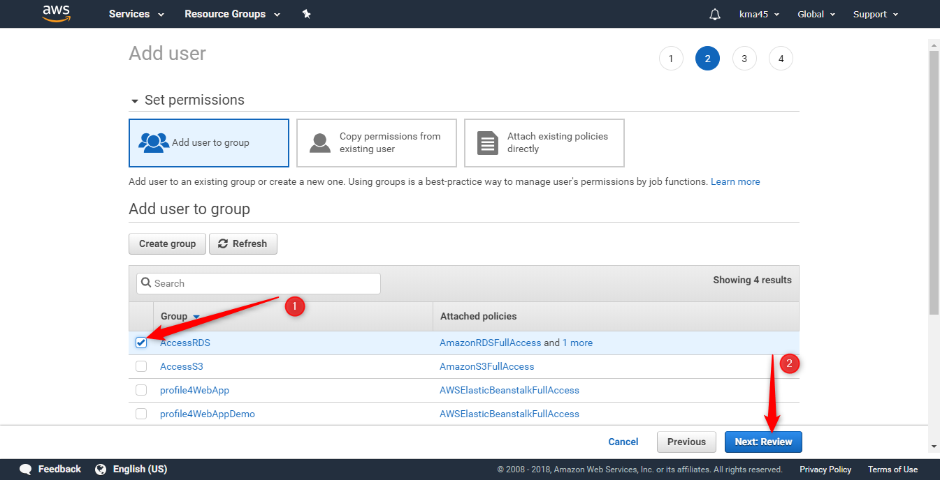
Create a User to Allow App to Access RDS

Slide 8
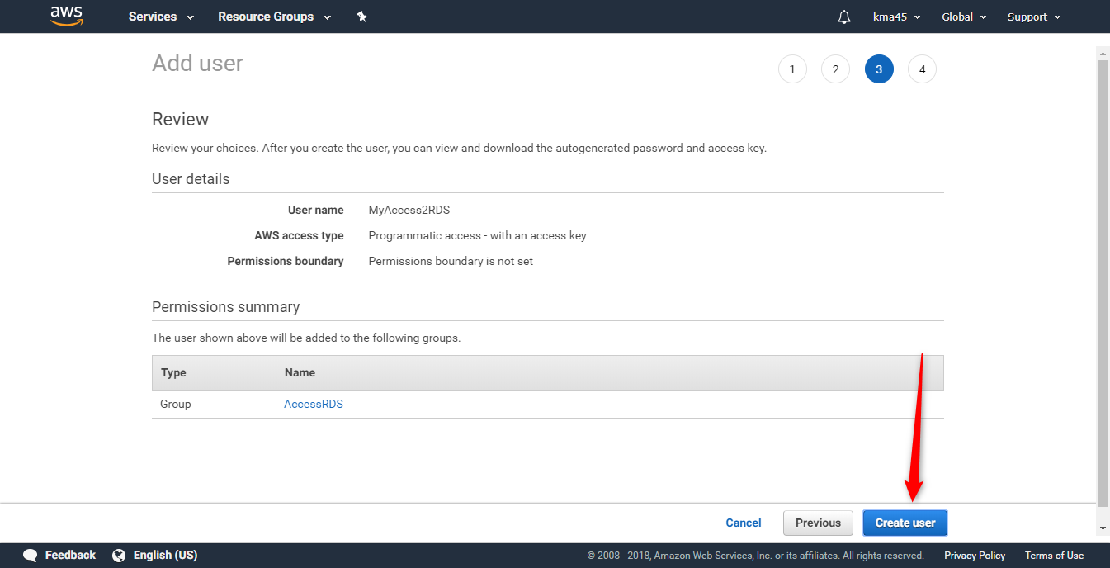
Create a User to Allow App to Access RDS

Slide 9
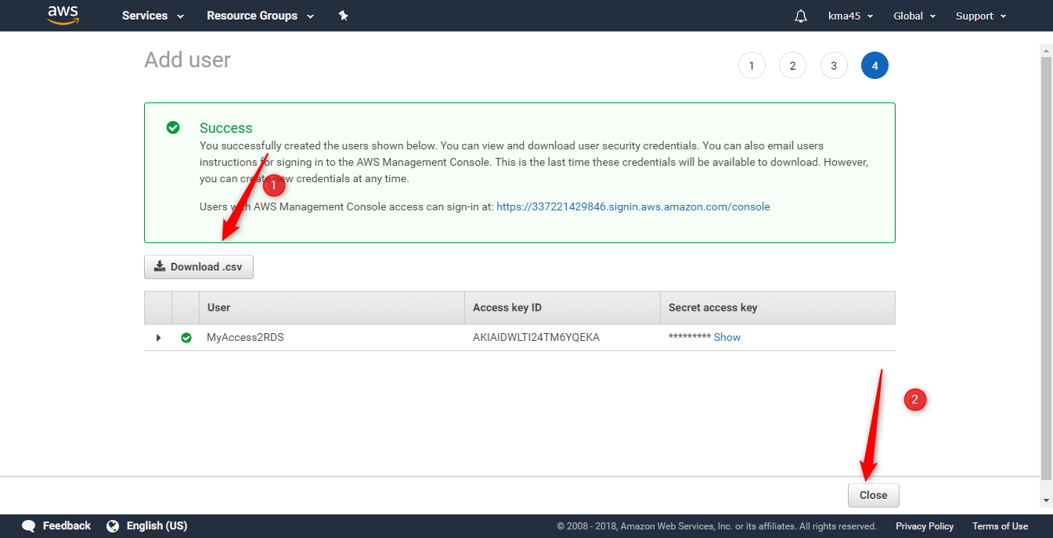
Create a User to Allow App to Access RDS

Slide 10
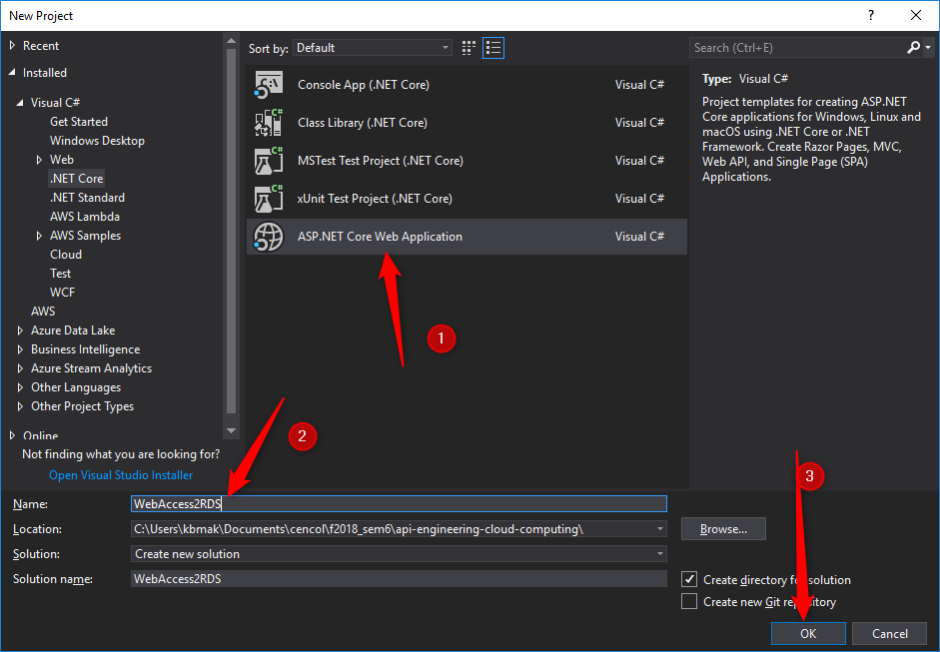
Access RDS Programmatically

Slide 11
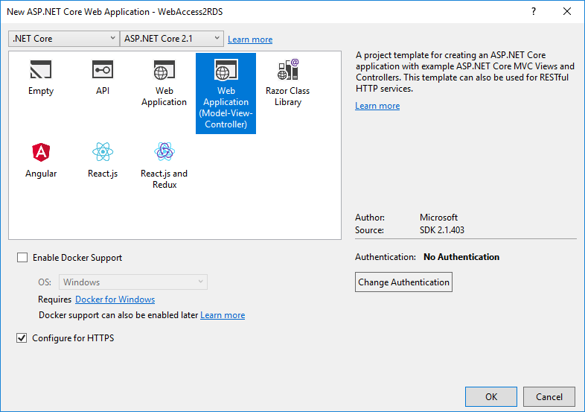
Access RDS Programmatically

Slide 12
Access RDS Programmatically
Install the needed packages
Micrsoft.EntityFrameWorkCore.Design
Micrsoft.EntityFrameWorkCore.Tools
Entity Framework Database Providers for .NET
SQL Server – Microsoft.EntityFrameworkCore.SqlServer
MySQL – Pomelo.EntityFrameworkCore.MySql
PostgreSQL – Npgsql.EntityFrameworkCore.PostgreSQL

Slide 13
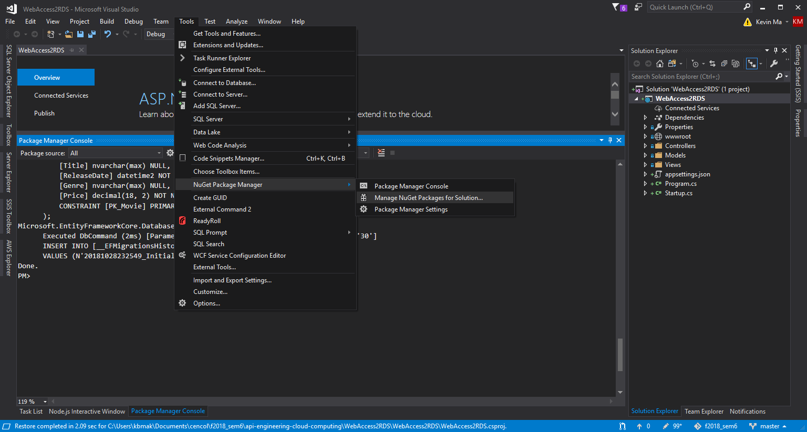
Access RDS Programmatically

Slide 14
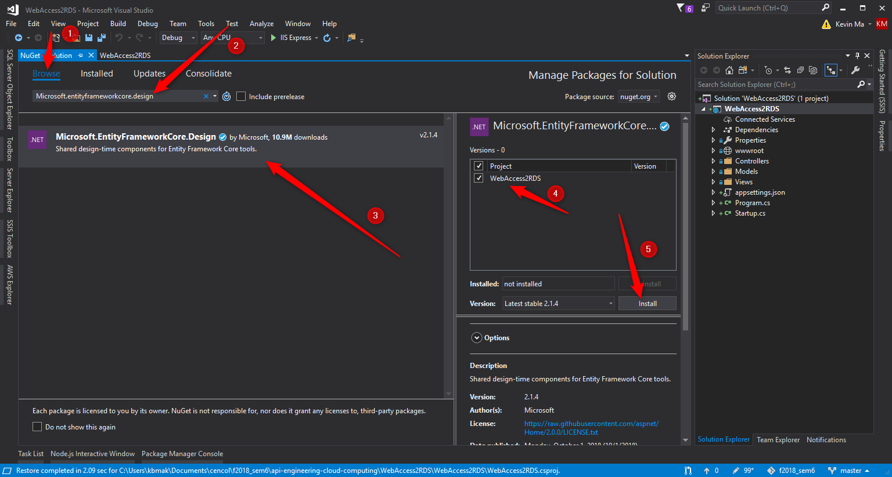
Access RDS Programmatically

Slide 15
Access RDS Programmatically

Slide 16
Install the needed packages
Repeat the previous steps for the remaining packages:
Micrsoft.EntityFrameWorkCore.Tools
Microsoft.EntityFrameworkCore.SqlServer.*
Pomelo.EntityFrameworkCore.MySql

Slide 17
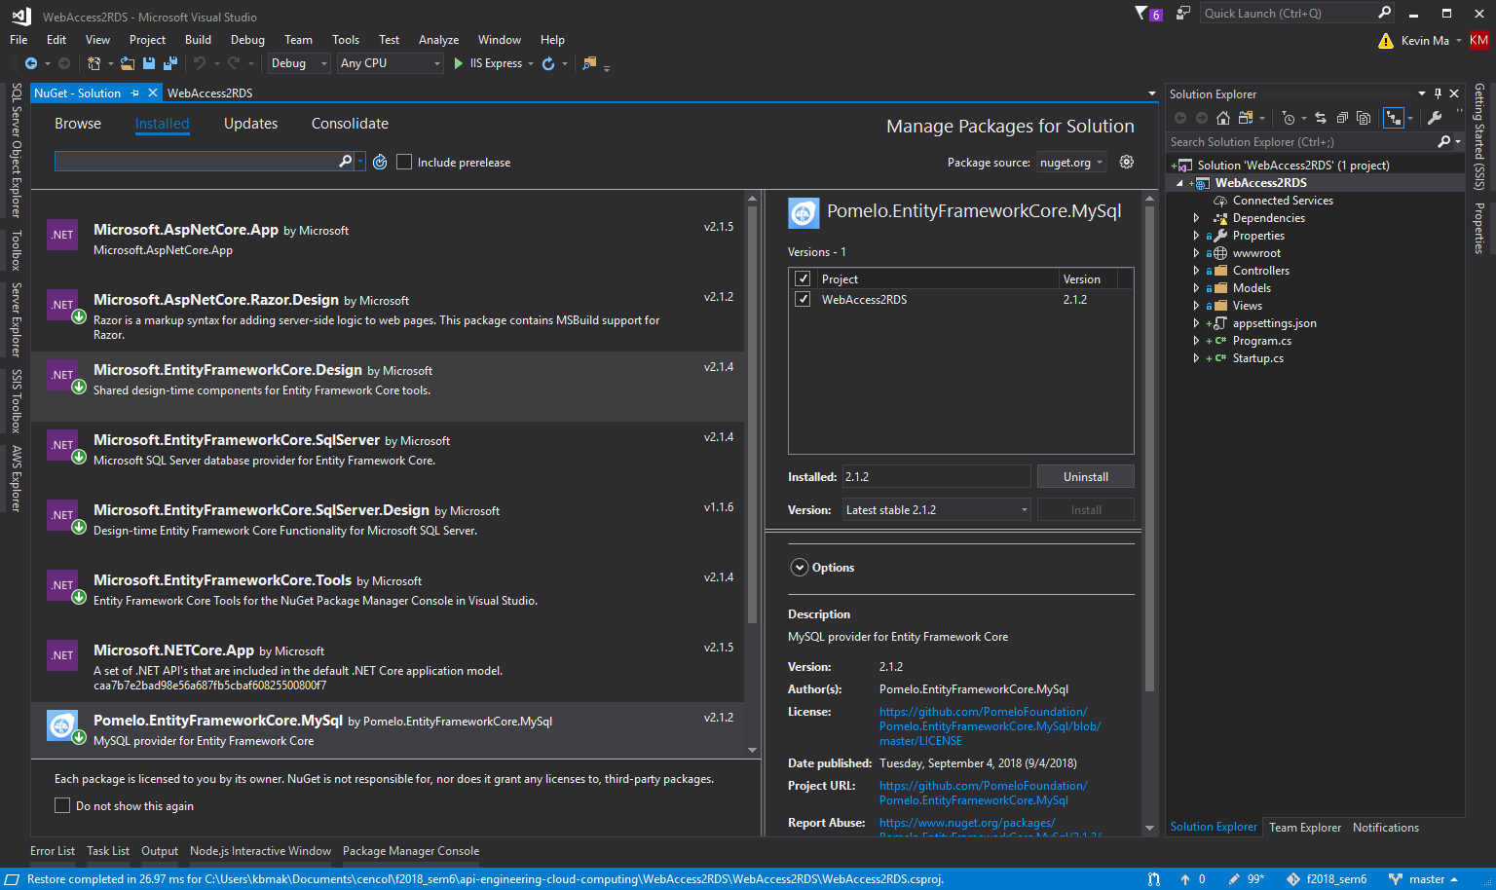
Install the needed packages

Slide 18
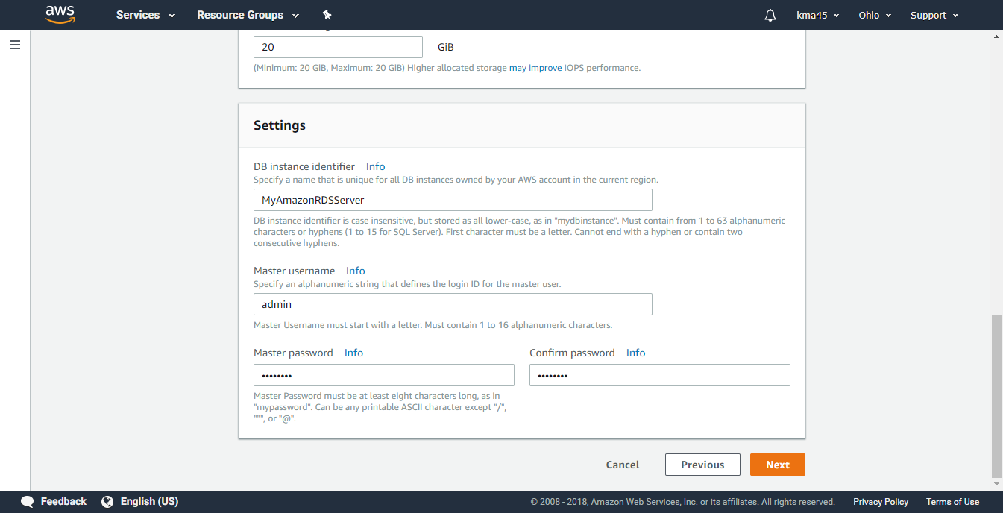
Create a RDS Instance

Slide 19
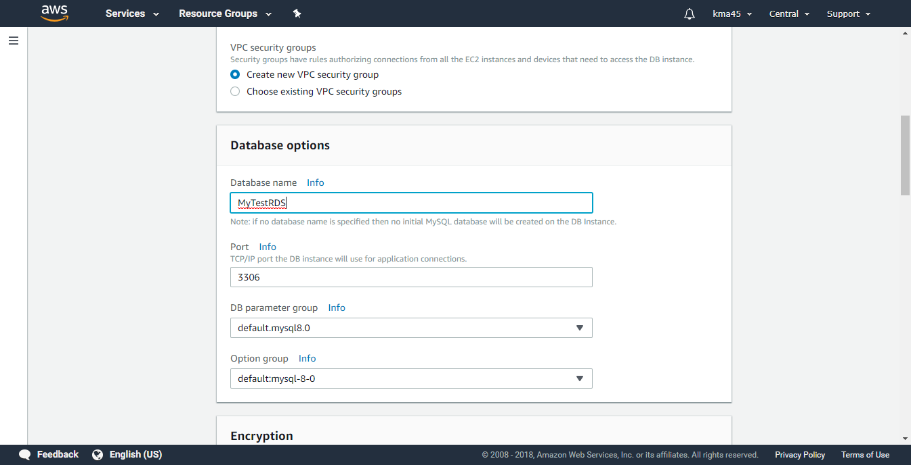
Create a RDS Instance

Slide 20
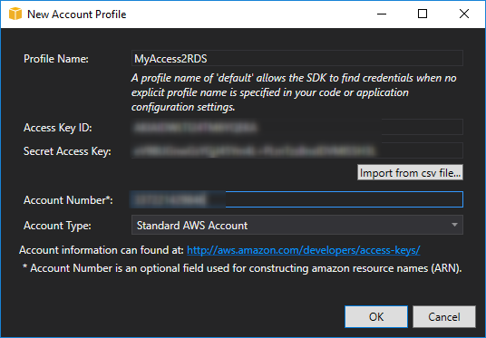
Create a RDS Instance

Slide 21
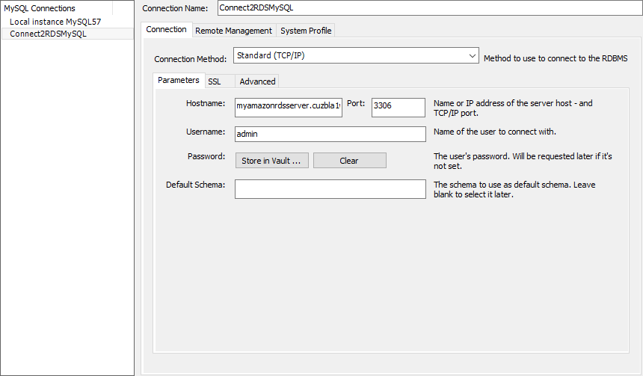
Connect to Amazon RDS using MySQL Workbench

Slide 22
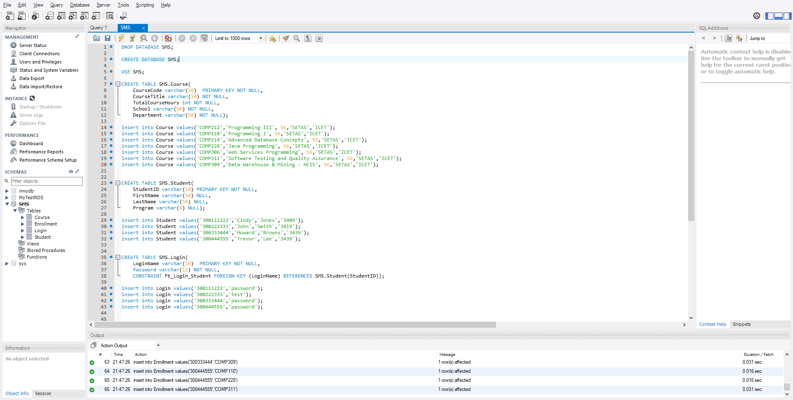
Create database using code provided (SMS.sql)

Slide 23
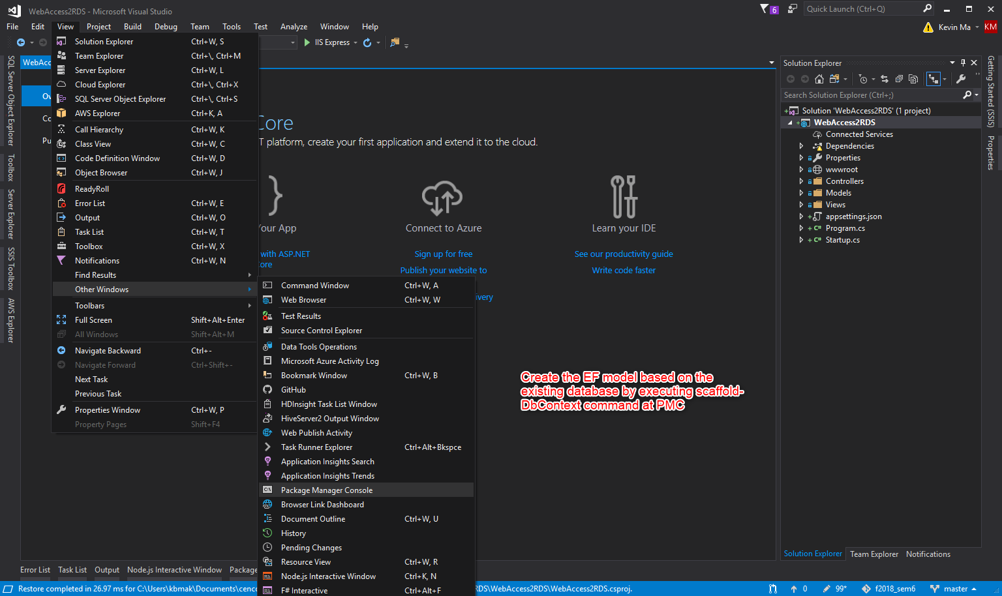
Access RDS Programmatically

Slide 24
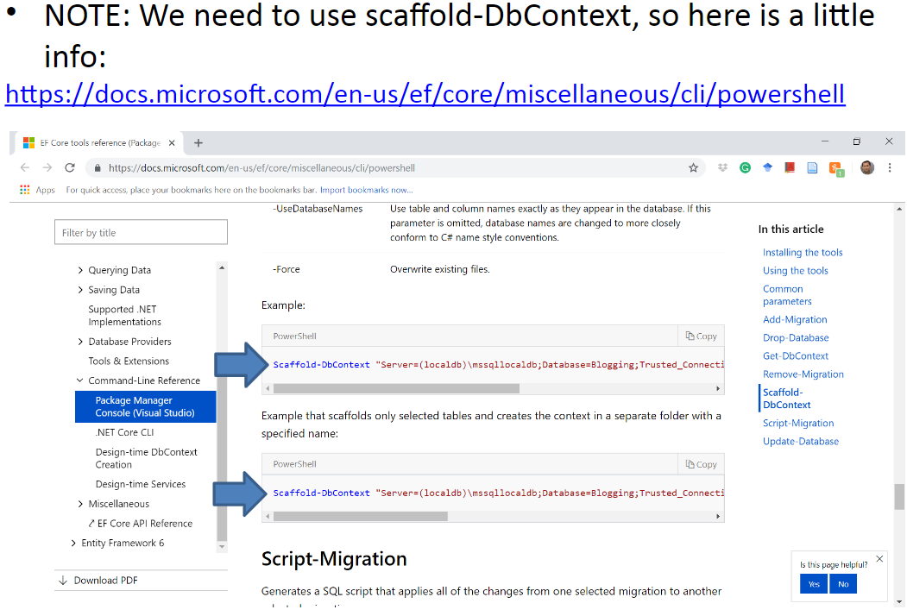
Access RDS Programmatically

Slide 25
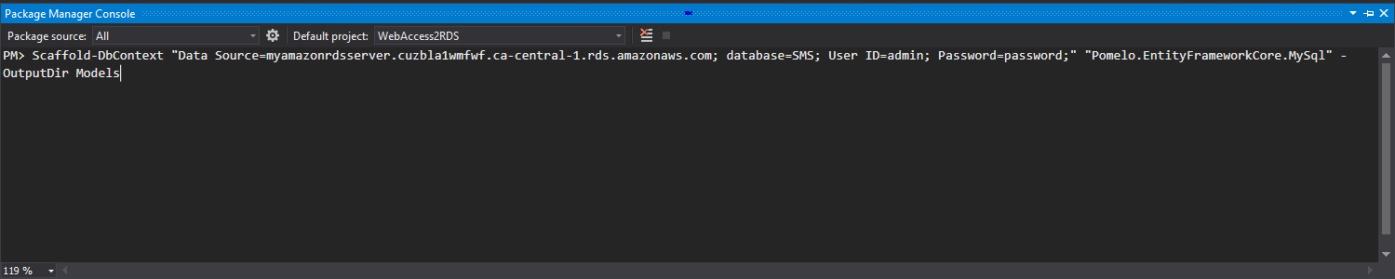
Access RDS Programmatically

Slide 26
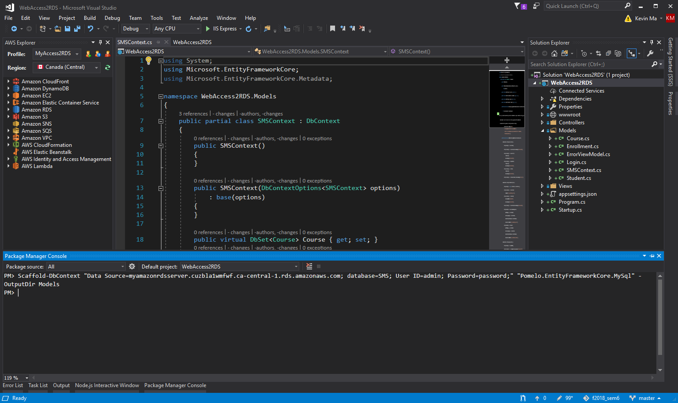
Access RDS Programmatically

Slide 27
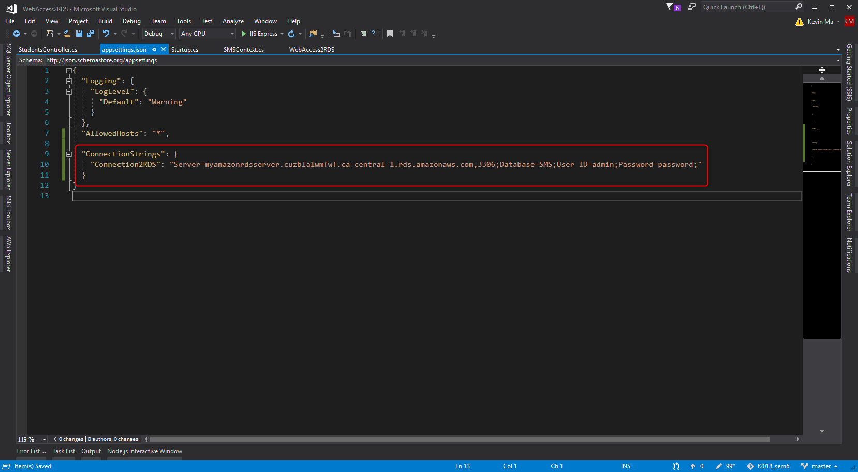
Access RDS Programmatically

Slide 28
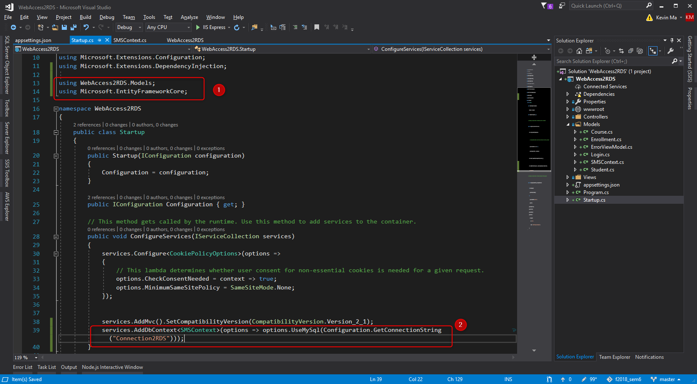
Access RDS Programmatically

Slide 29
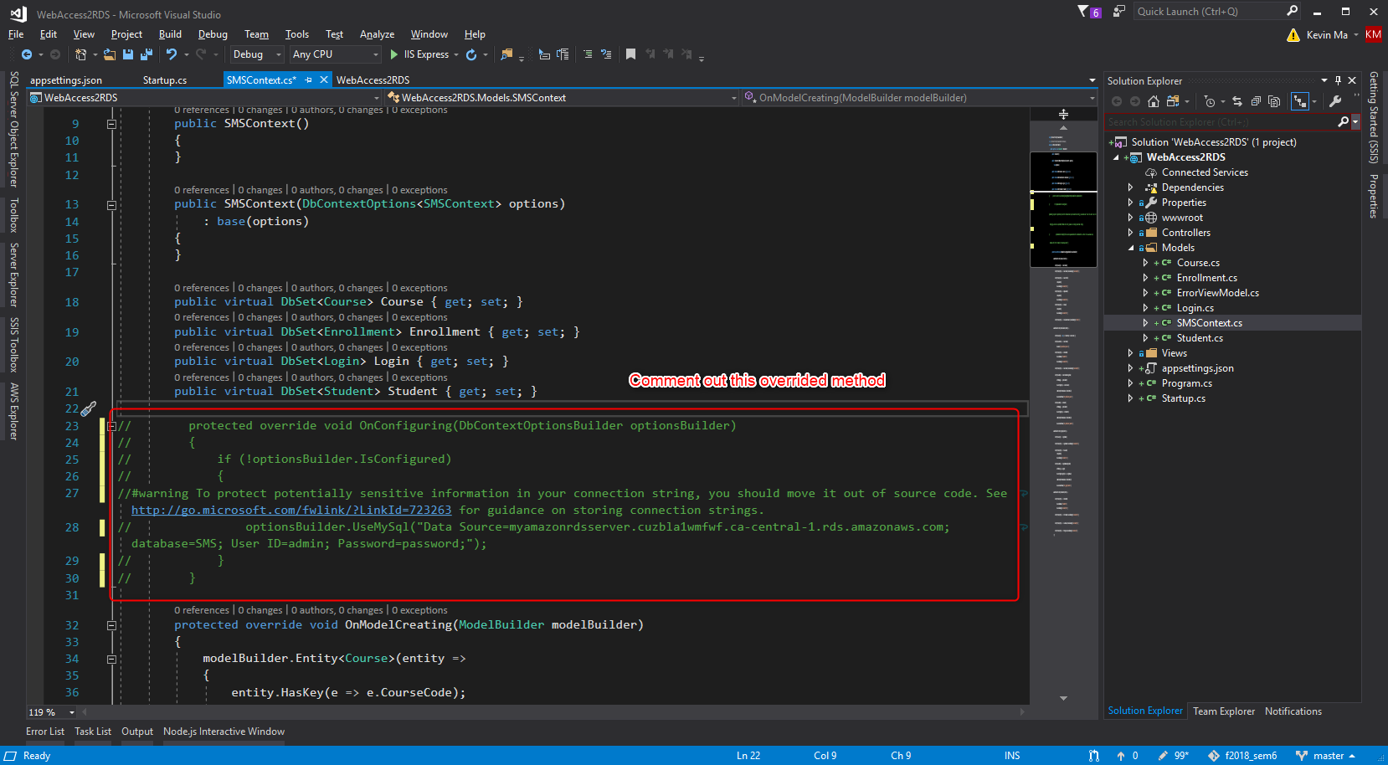
Access RDS Programmatically

Slide 30
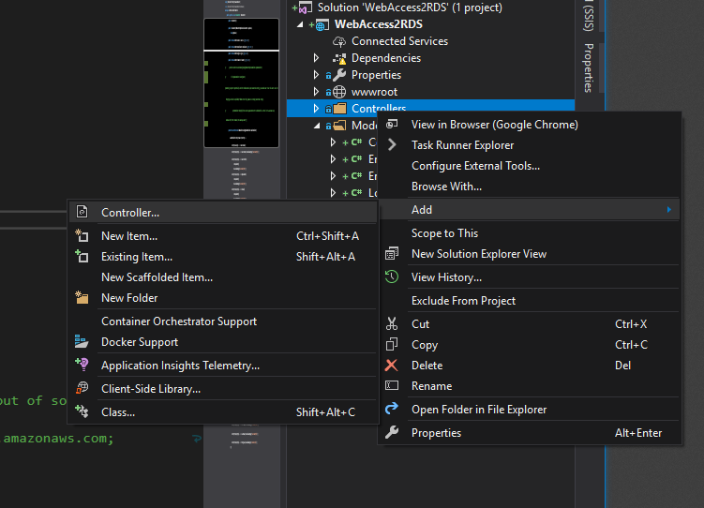
Access RDS Programmatically

Slide 31
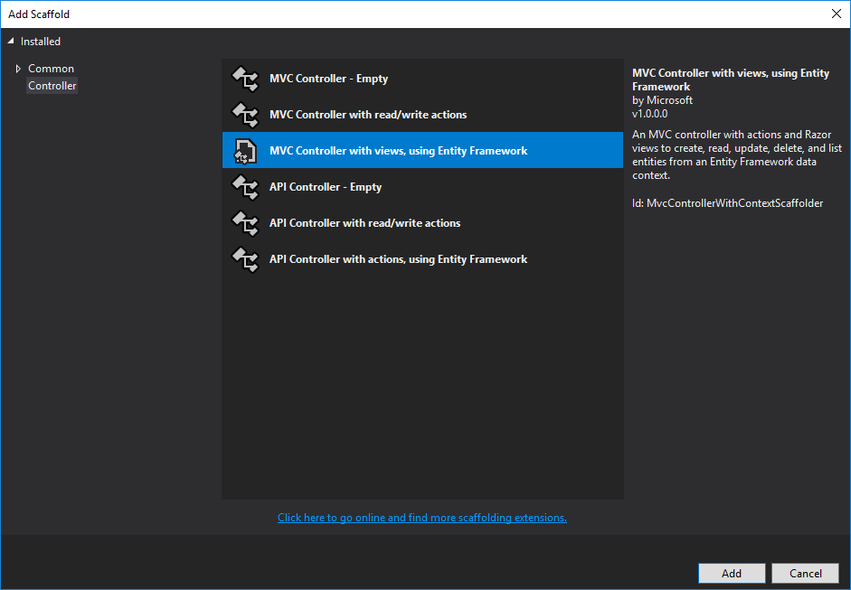
Access RDS Programmatically

Slide 32
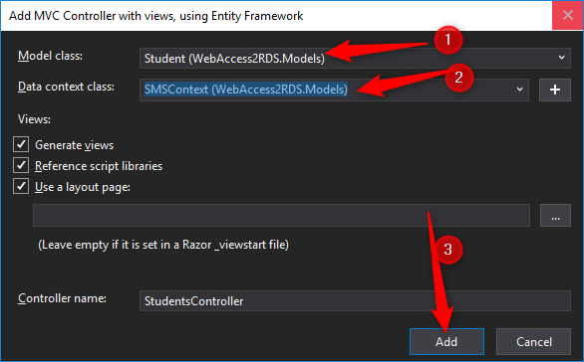
Access RDS Programmatically

Slide 33
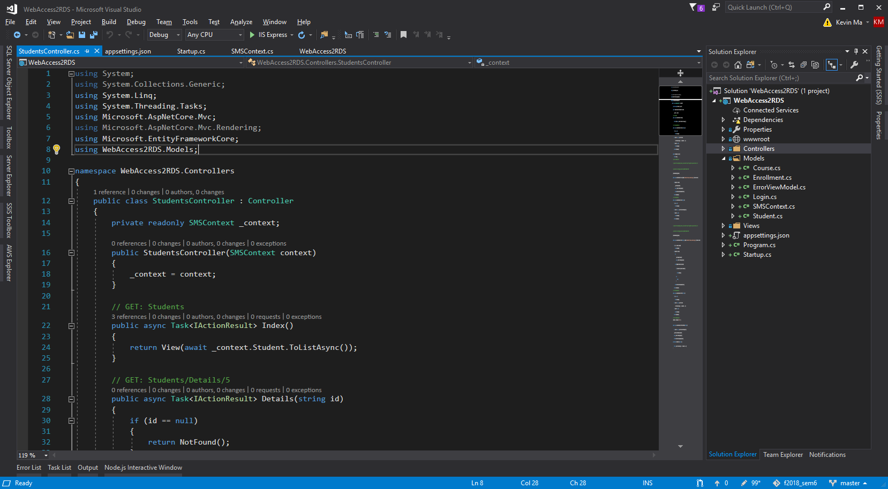
Access RDS Programmatically

Slide 34
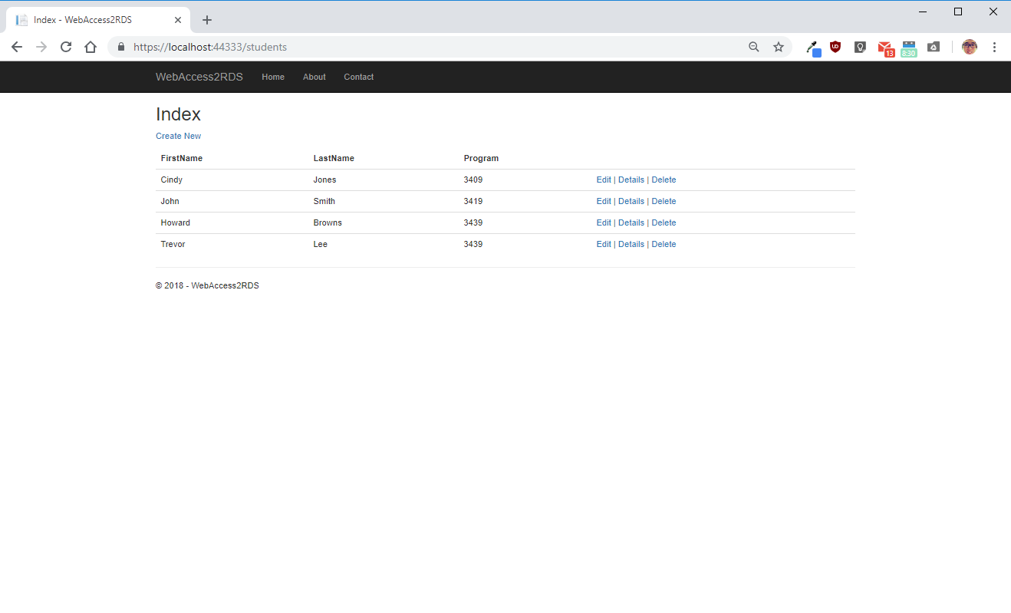
Access RDS Programmatically

