Slide 1
Security Strategies in Web Applications and Social Networking
Lesson 8
Securing Web Applications

Slide 2
Learning Objective
Describe the attributes and qualities of the software development life cycle (SDLC).

Slide 3
Key Concepts
Technologies and systems used to make a complete functional Web site
Secure software development life cycle (SDLC) approaches
Best practices in securing Web applications

Slide 4
Data Input Validation
Client side
Server side
Notes:
Previously, validation was only done at one side: server,
Now we have input coming from client side as well, so need to do validation on both ends
better to do client side as well because it saves a validation trip to server
Don’t need to go to server, determine it is invalid data.
Can just invalidate on client side, don’t make trip to server

Slide 5
Data Input Validation (Continued)
Do not rely solely on client-side validation
Ensure server-side validation
Use whitelisting and blacklisting
Assume all input is malicious
Sanitize your input
Notes:
Sanitize input can be for example, removing @ signs and special characters which are typically used to inject commands for example

Slide 6
Request for Comments (RFC) Syntax
Validating e-mail address syntax and usage
Validating URL input
Validating HTTP input
Request for Comments (RFC): A formal document from the IETF, which is the result of committee drafting and revisions to a technical document.
Many RFCs are intended to become Internet standards.
Review the RFC to verify syntax used when reviewing acceptable syntax for e-mail addresses, URL input, XML input, and so forth.

Slide 7
Common Web Elements
Hypertext Markup Language (HTML)
Common Gateway Interface (CGI) script
JavaScripting
SQL database back-end
Notes:
In computing, Common Gateway Interface (CGI) offers a standard protocol for web servers to execute programs that execute like console applications (also called command-line interface programs) running on a server that generates web pages dynamically. Such programs are known as CGI scripts or simply as CGIs.
SQL can have physical and logical attacks
Physical harming server storing the db
Logical being sql injection attacks

Slide 8
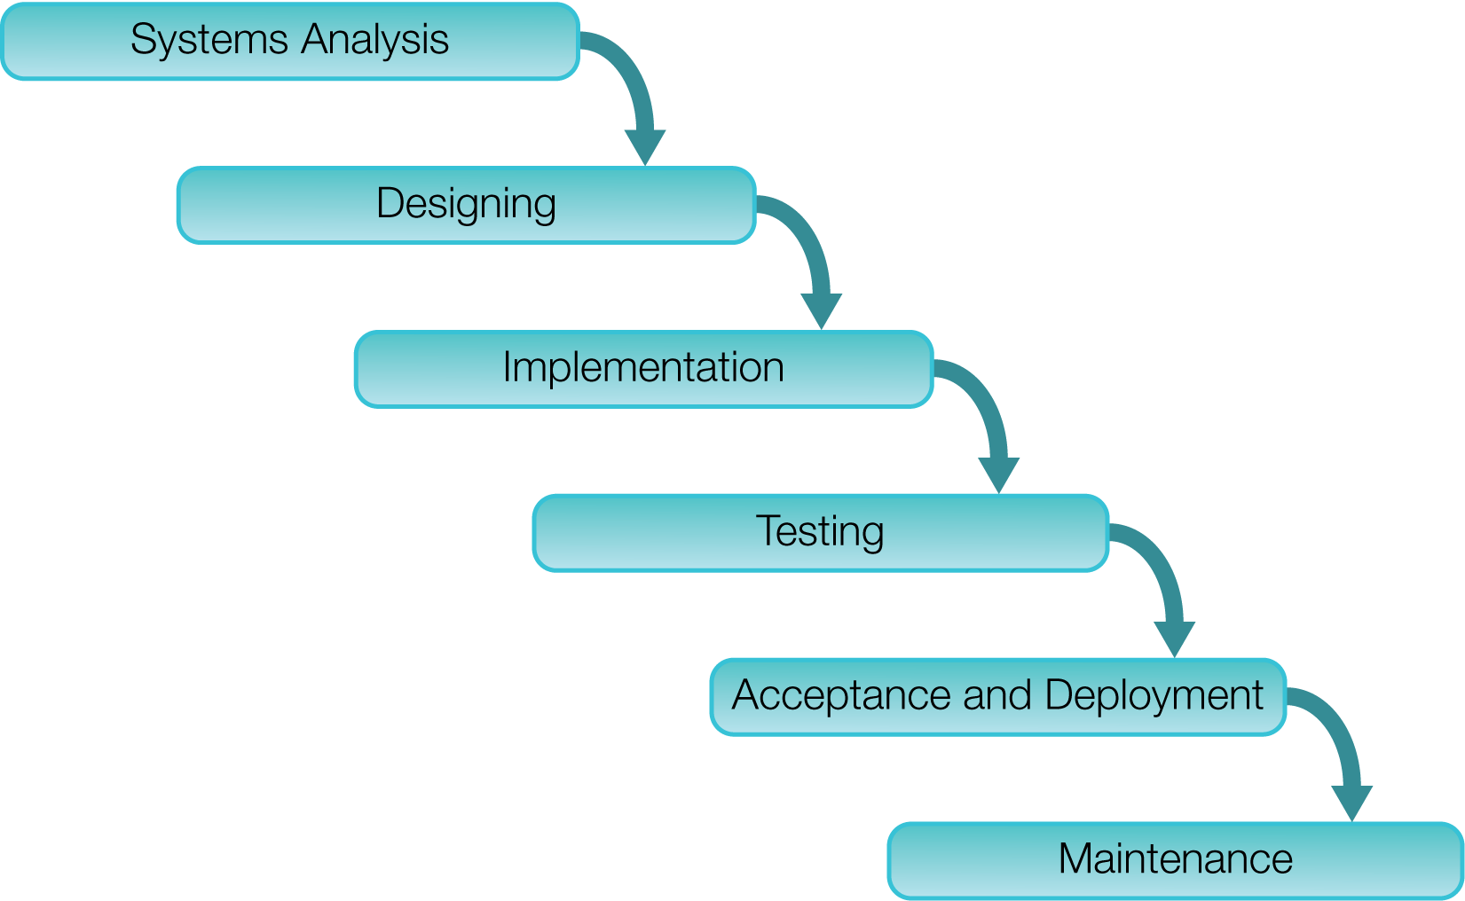
Traditional SDLC

Slide 9
Common SDLC Models
Waterfall
Iterative and Agile Scrum
Rapid Application Development
Rational Unified Process (RUP)
Spiral Model and V-Model

Slide 10
Web Site and Web Application Security
Perimeter Security
Host-based Security Mechanisms
End-User Validation
Authentication and Access Management
Input Validation
Vulnerability Management
Notes:
A.I.C – Security Triad
Availability
Integrity
Confidentiality
Triple A
Authentication
Authorization
Accounting

Slide 11
Secure Software Development Life Cycle
Secure coding practices
become part of organization policy
Software code base
is stored in a revision
tracking system
Security is introduced in the design
stage of the software development
lifecycle
Developers use secure
coding practices
Unit testing and code reviews
are performed
Process continues during the lifecycle
Quality assurance (QA) testers
test for security flaws using manual
and automated processes
Application launched in production
(another round of testing)
Notes:
Code review policies developed with consideration of laws surrounding environment and application
Policies are imposed upon developers entering the organization, whom must follow and carry out the policies

Slide 12
Securing SDLC
Governance
Systems Analysis
Strategy and Metrics
Policy and Compliance
Education and Guidance
Design
Construction
Threat Assessment
Security Requirements
Security Architecture
Implementation
Verification
Testing
Design Review
Code Review
Security Testing
Acceptance and Deployment
Deployments
Vulnerability Management
Hardening Environments
Operations
Maintenance
Notes:
You can secure SDLC by using Software Assurance Maturity Model (SAMM)

Slide 13
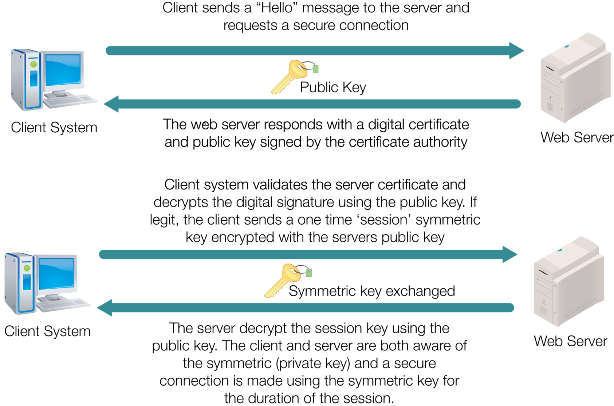
SSL for Secure Web Sites

Slide 14
Types of Access Control Methods
Discretionary Access Control (DAC)
Mandatory Access Control (MAC)
Rule-Based Access Control
Role-Based Access Control
Notes:
The last two are part of MAC,
So it is really just two types here:
DAC and MAC
DAC is ctrl in hands of owner of file/folder
Can choose to just give read, r/w, or rwx for example
MAC is ctrl in hands of administrator who grants the access permissions
Rule-based access ctrl for example may check a list of addresses
If u are accessing from a certain ip addr that is in the list, u will (or will not, depending on the rule) have access
Role-based
Ex. Ur account part of student group, teacher grp, etc.

Slide 15
Secure Web Application Development
Do not trust data input from users or external services
Validate data input on the server side using a variety of techniques
Use well tested and established authentication, authorization, and session management mechanisms
Notes:
This will be on the test

Slide 16
Secure Web Application Development (Continued)
Establish a user “time out” period
Do not allow concurrent sessions with the same user ID
Enforce strong password policies
Implement encryption for all confidential data
Provide generic error messages back to the user

Slide 17
Secure Web Application Development (Continued)
Know the programming language and avoid the use of known vulnerable functions
Know the database an application is using and utilize secure functions for the database layer
Never reveal any internal file paths or directories

Slide 18
Secure Web Application Development (Continued)
Do not allow uploaded files to have execute permissions
Perform peer code reviews

Slide 19
Best Practices for Maintaining Secure Software
Incorporate training and awareness programs for developers
Perform frequent application assessments
Determine the security requirements early
Implement secure development practices

Slide 20
Best Practices for Maintaining Secure Software (Continued)
Formalize vulnerability remediation processes
Define metrics and monitoring processes
Establish operational security guidelines

Slide 21
Summary
Tiers of a typical Web infrastructure
Secure SDLC
Practices for and impact of developing secure applications

