Slide 1
COMP 306: API Engineering & Cloud Computing
Class Activity 01 – AWS Ec2 Instance Basics Workshop
Created By: Kevin Ma (#300867968)
Fall 2018

Slide 2
What is AWS Ec2?
Amazon Elastic Compute Cloud (Amazon EC2) is a web service that provides on-demand and scalable computing service in the cloud
AWS EC2 allows you to create and run virtual machines on AWS infrastructure
Virtual machine: software computer, like a physical computer, runs an operating system and applications
Choose a VM that fits your need and gain the performance of AWS’s worldwide network

Slide 3
Class Activity 01 – AWS Ec2 Instance Basics Workshop
Creating Amazon Ec2 Key Pairs

Slide 4
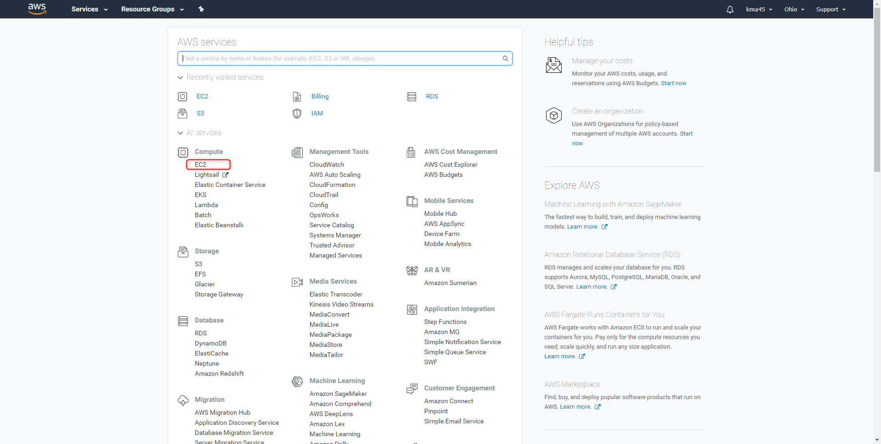
Creating Amazon Ec2 Key Pairs
Login to AWS
Select EC2 Service:
Notes:
Amazon EC2 uses public-key cryptography to encrypt and decrypt login information. Public-key cryptography uses a public key to encrypt a piece of data, such as a password, then the recipient uses the private key to decrypt the data. The public key and private keys are known as a key pair

Slide 5
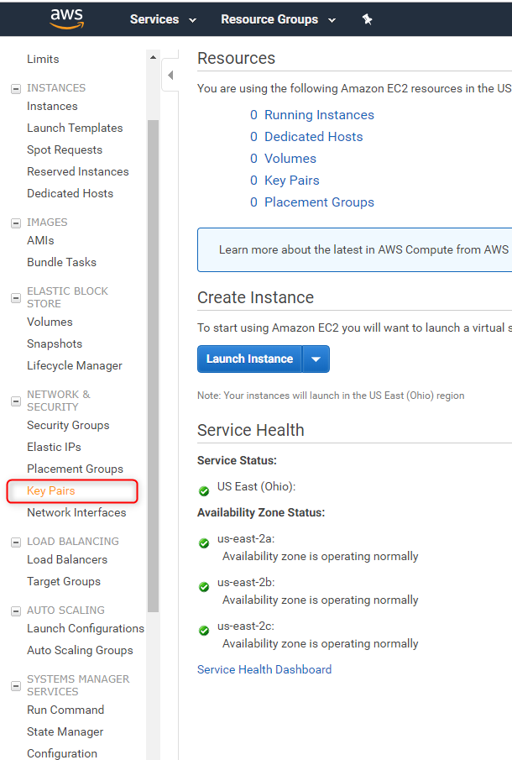
Creating Amazon Ec2 Key Pairs (Cont’d)
Click on “Key Pairs” under “NETWORK & SECURITY”

Slide 6
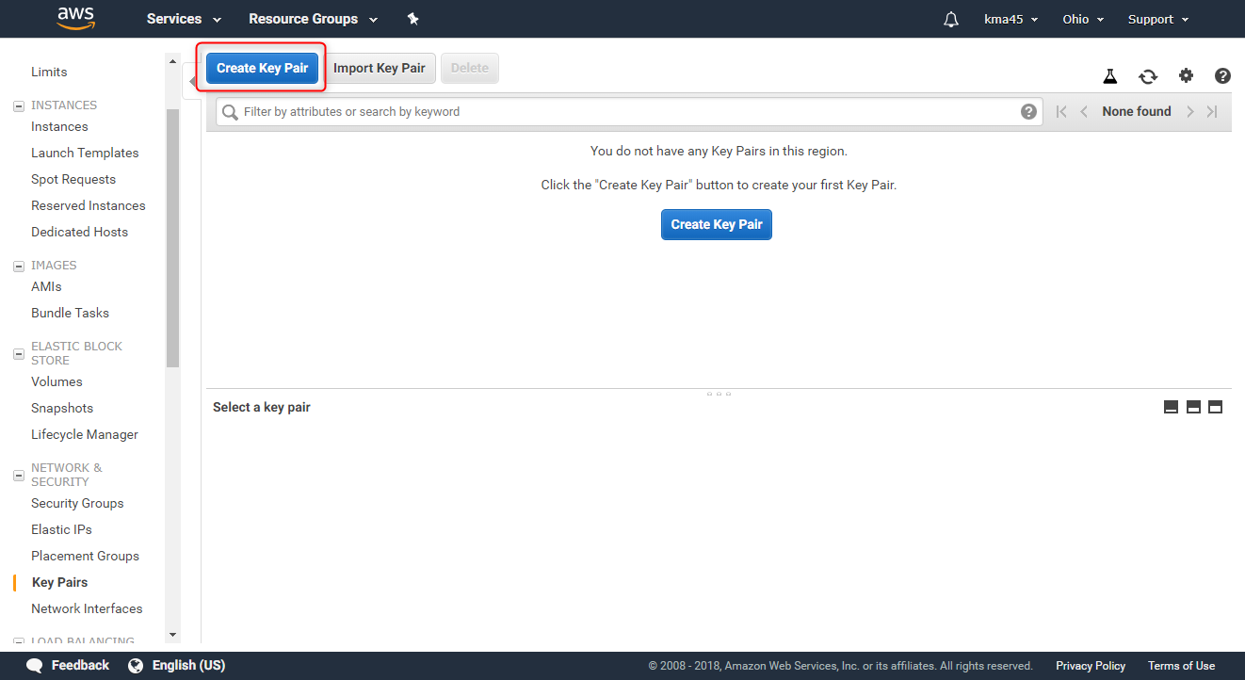
Creating Amazon Ec2 Key Pairs (Cont’d)

Slide 7
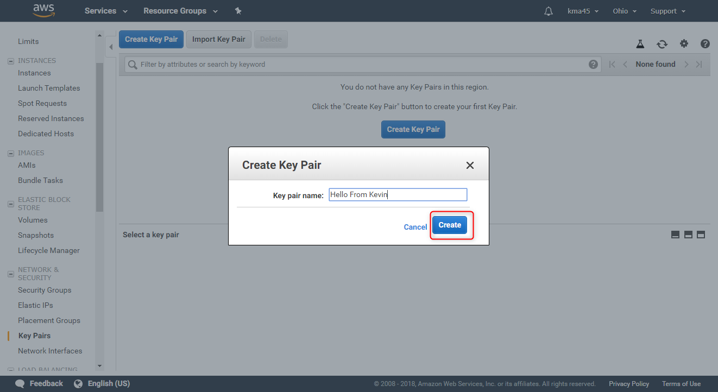
Creating Amazon Ec2 Key Pairs (Cont’d)

Slide 8
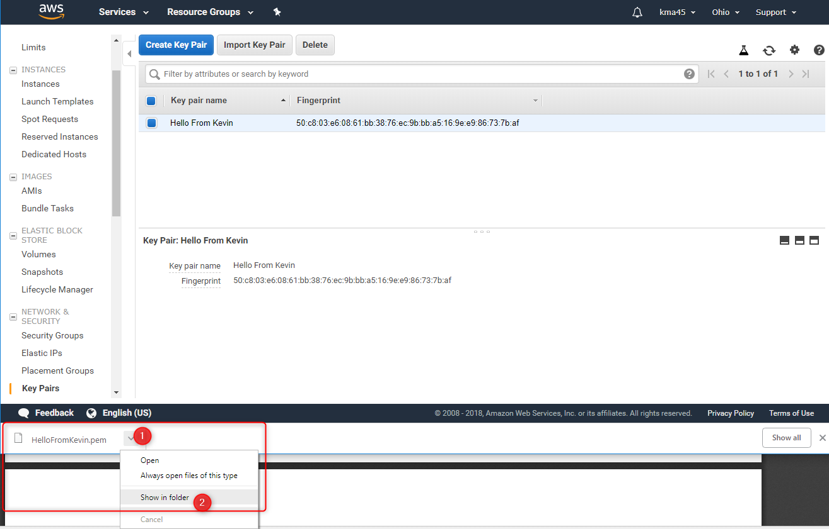
Creating Amazon Ec2 Key Pairs (Cont’d)
Open location of downloaded file
Move file to safe location for storage (we will need this later)

Slide 9
Class Activity 01 – AWS Ec2 Instance Basics Workshop
Launch EC2 Instance

Slide 10
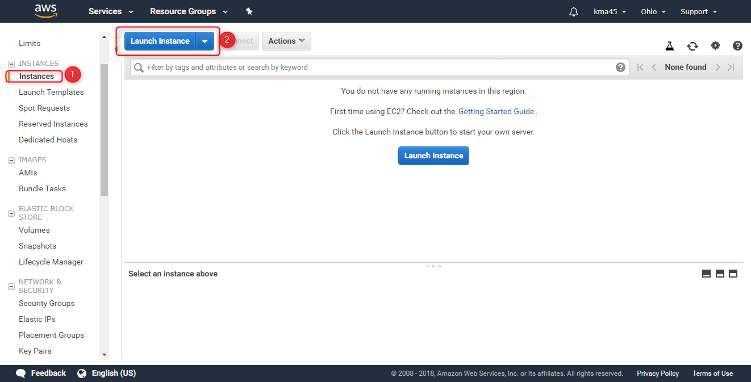
Launch EC2 Instance

Slide 11
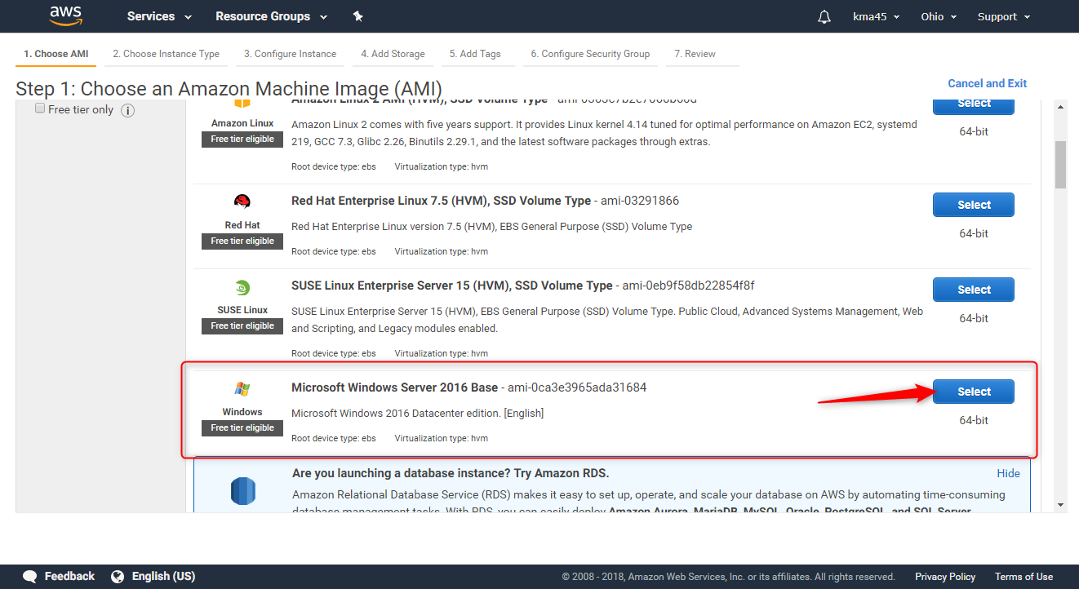
Launch EC2 Instance (Cont’d)
All services that offer a free tier have limits on what you can use without being charged. Many services have multiple types of limits.
EC2 has limits on both the type of instance you can use and how many hours you can use in one month

Slide 12
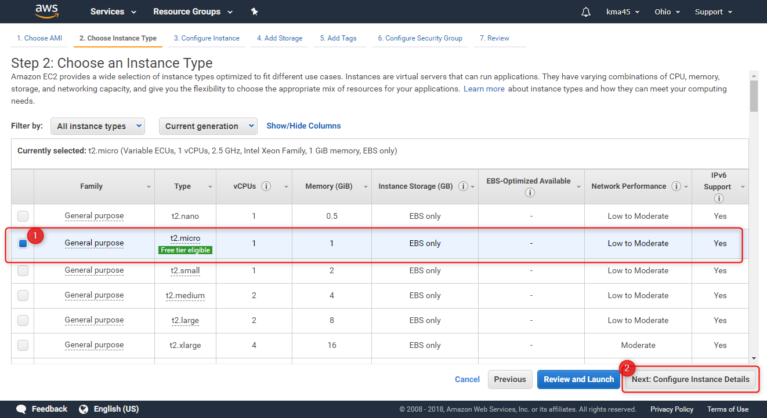
Launch EC2 Instance (Cont’d)

Slide 13
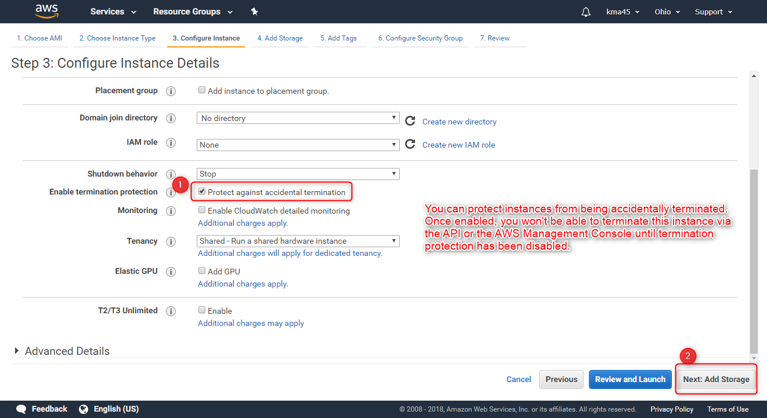
Launch EC2 Instance (Cont’d)

Slide 14
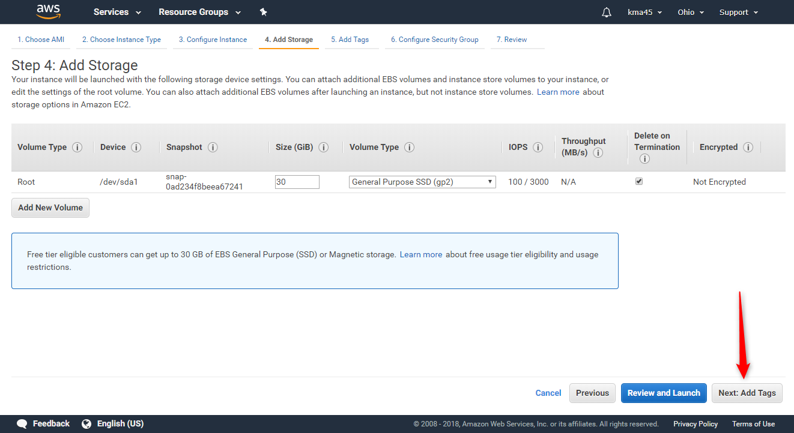
Launch EC2 Instance (Cont’d)

Slide 15
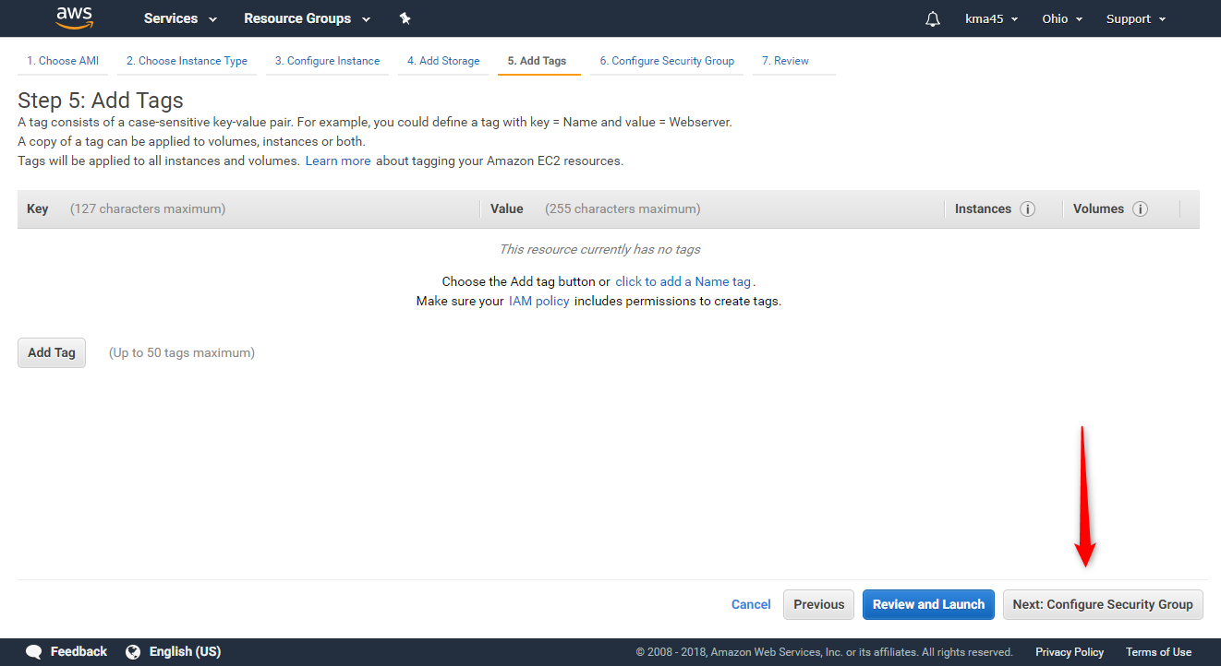
Launch EC2 Instance (Cont’d)

Slide 16
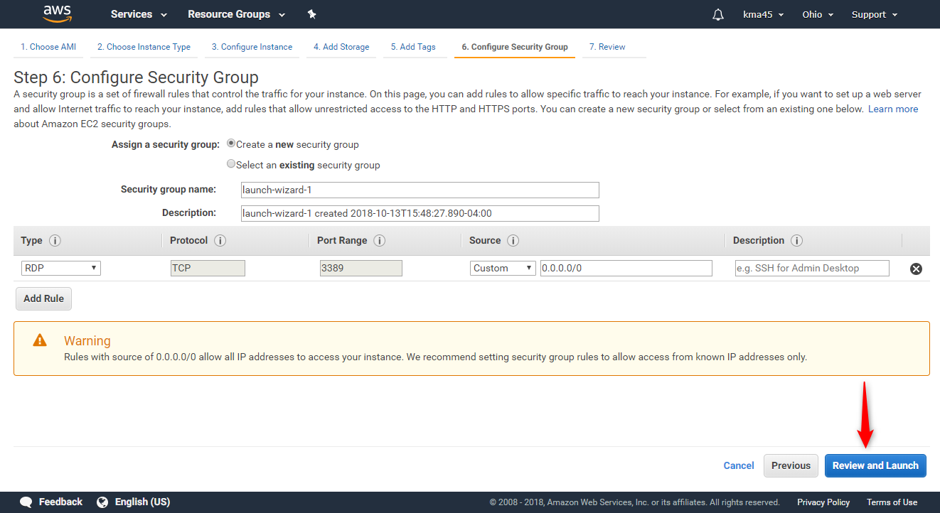
Launch EC2 Instance (Cont’d)

Slide 17
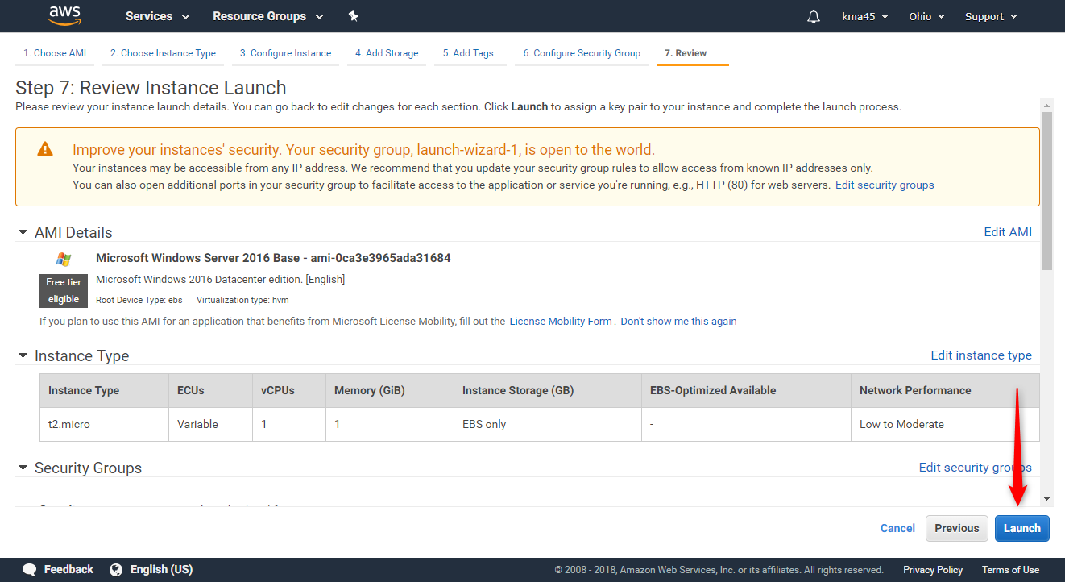
Launch EC2 Instance (Cont’d)

Slide 18
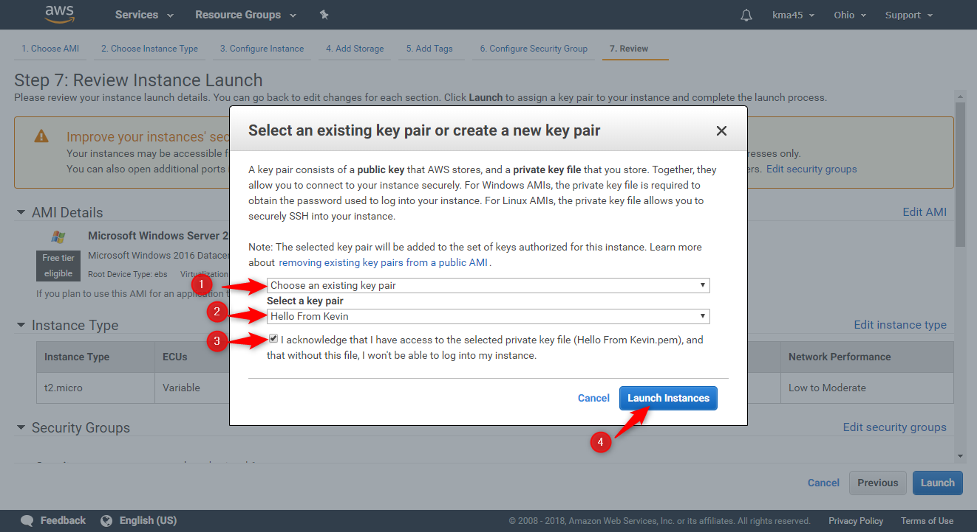
Launch EC2 Instance (Cont’d)

Slide 19
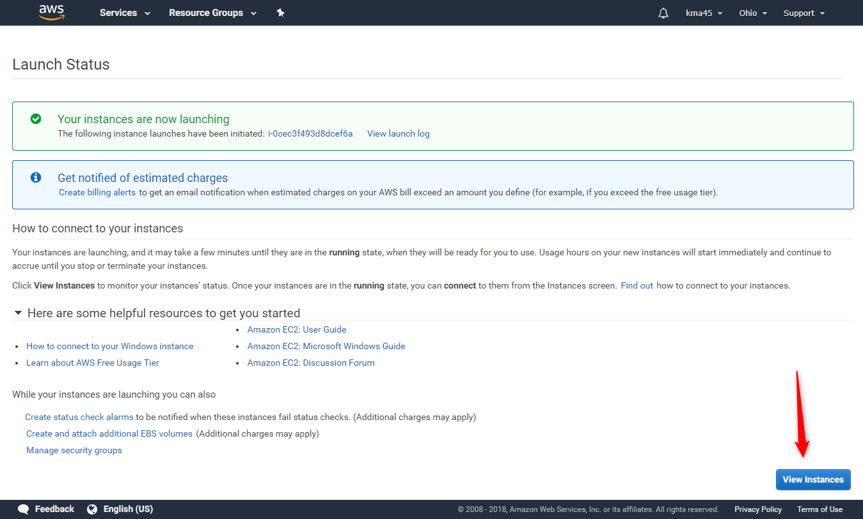
Launch EC2 Instance (Cont’d)

Slide 20
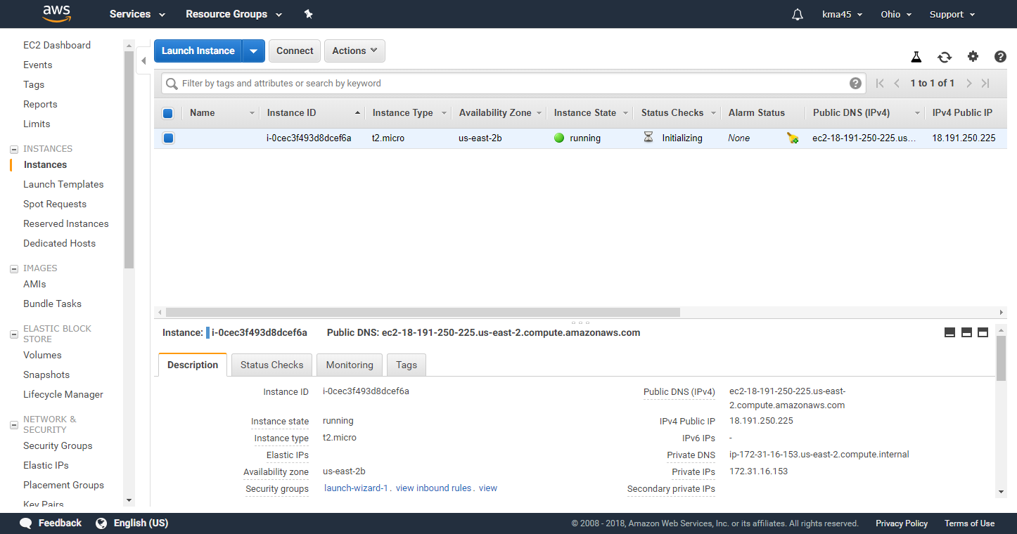
Launch EC2 Instance (Cont’d)

Slide 21
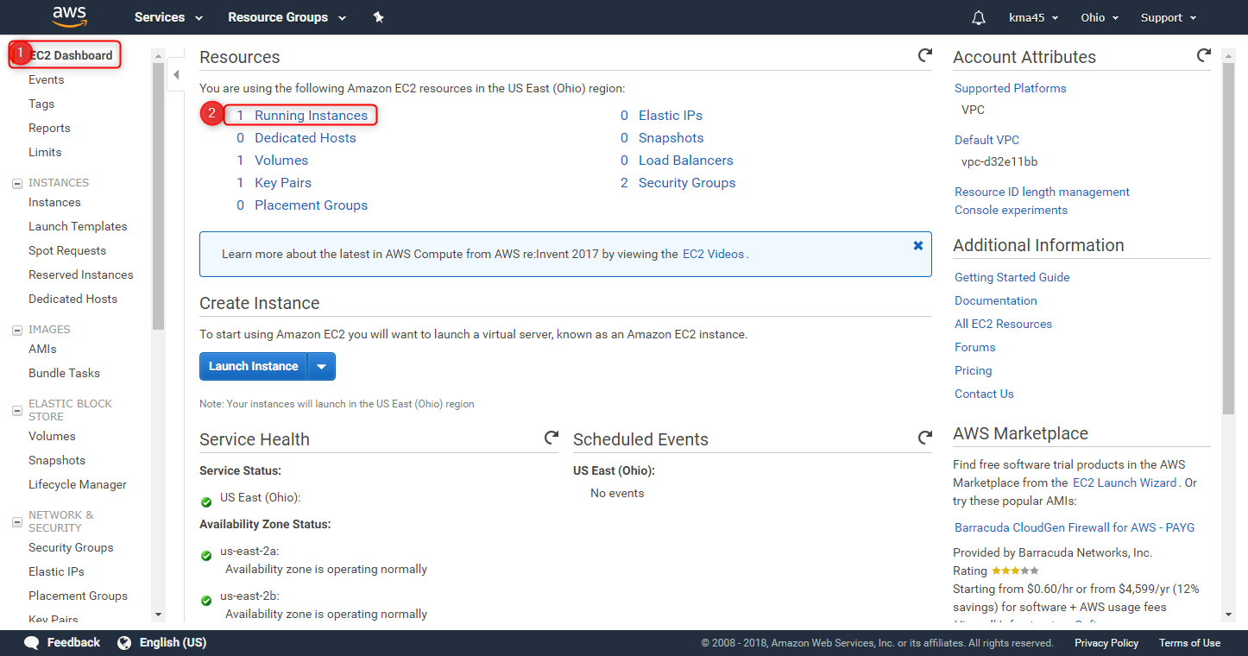
Launch EC2 Instance (Cont’d)

Slide 22
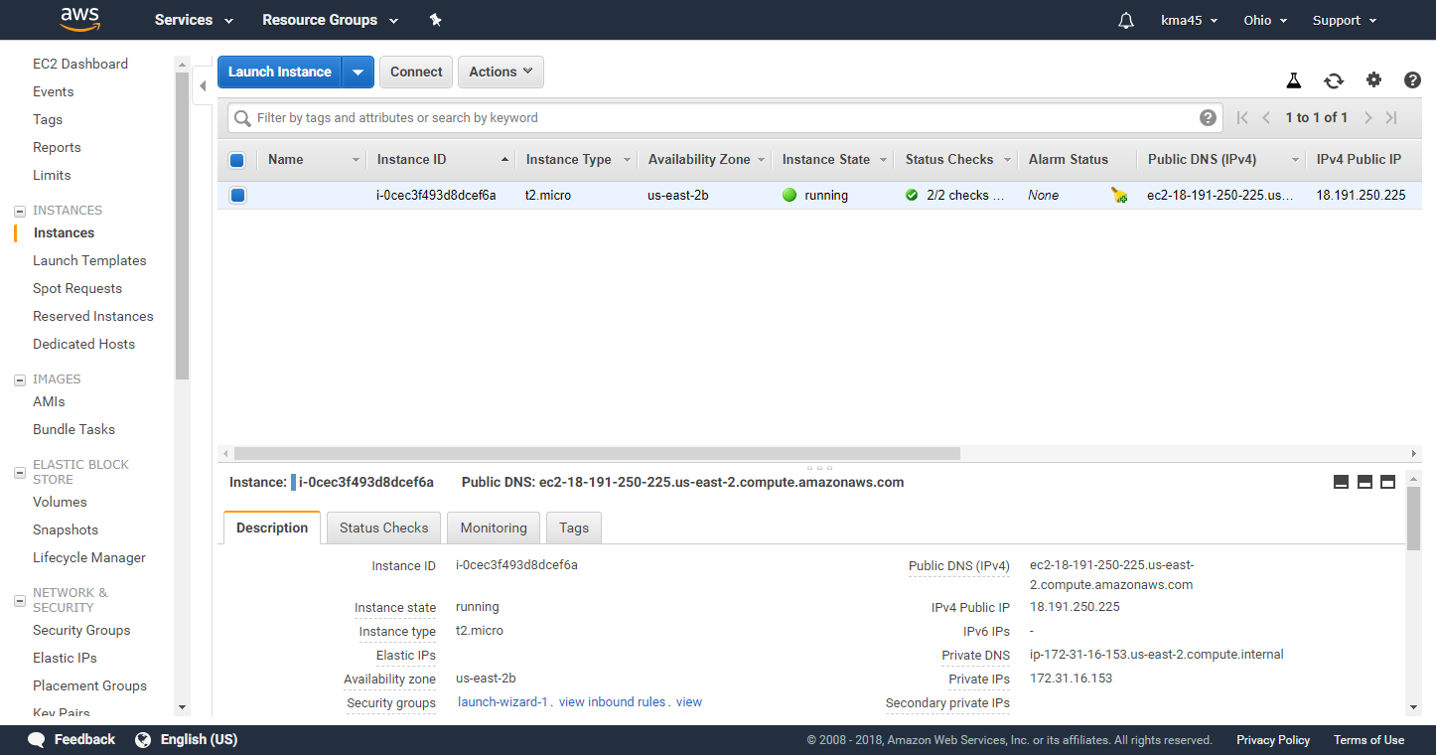
Launch EC2 Instance (Cont’d)

Slide 23
Class Activity 01 – AWS Ec2 Instance Basics Workshop
Connect to Launched Instance

Slide 24

Connect to Launched Instance

Slide 25
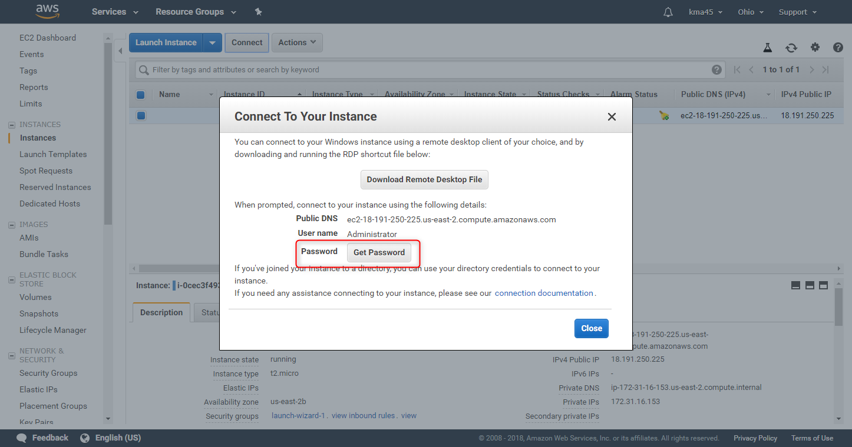
Connect to Launched Instance (Cont’d)

Slide 26
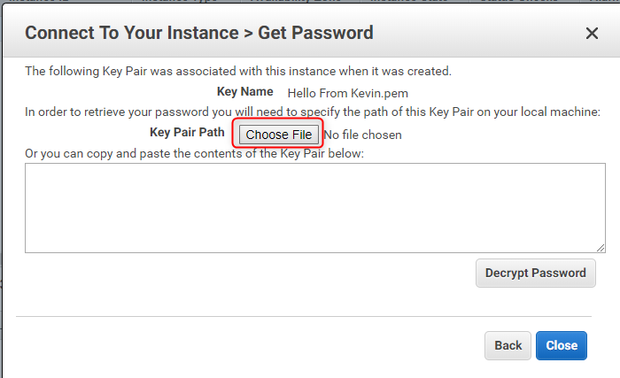
Connect to Launched Instance (Cont’d)

Slide 27
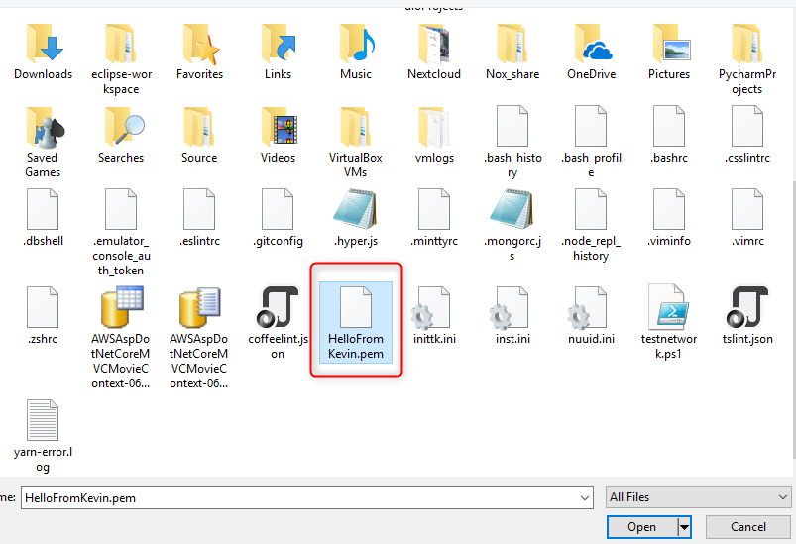
Connect to Launched Instance (Cont’d)

Slide 28
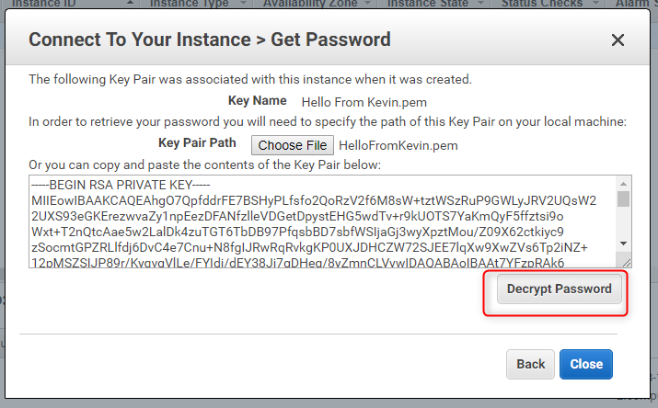
Connect to Launched Instance (Cont’d)

Slide 29
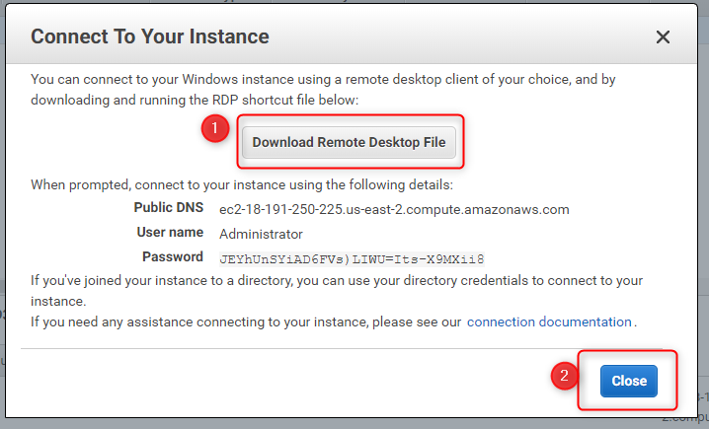
Connect to Launched Instance (Cont’d)

Slide 30
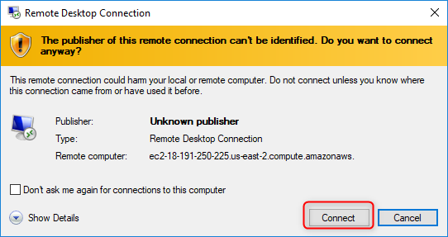
Connect to Launched Instance (Cont’d)

Slide 31
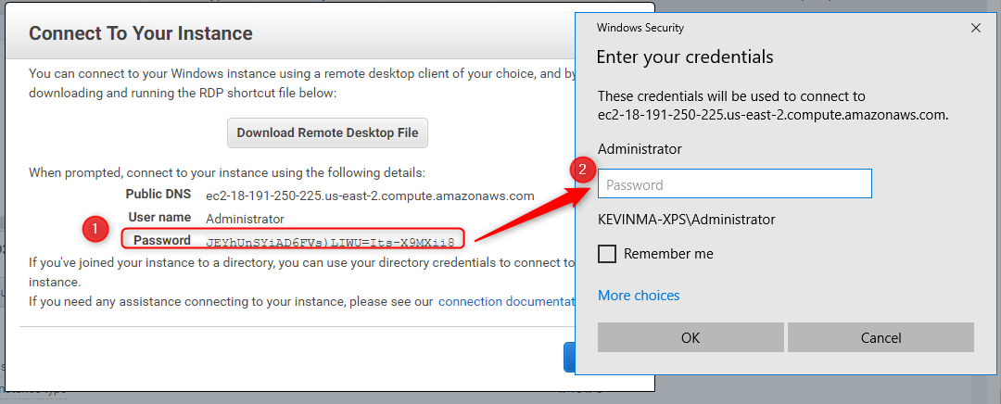
Connect to Launched Instance (Cont’d)

Slide 32
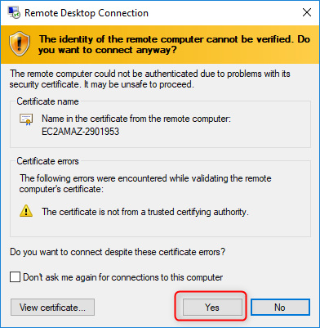
Connect to Launched Instance (Cont’d)

Slide 33

Connect to Launched Instance (Cont’d)

