Slide 1
COMP 306: API Engineering & Cloud Computing
Class Activity 03 – ASP.NET Core Workshop
Created By: Kevin Ma (#300867968)
Fall 2018

Slide 2
Class Activity 03 – ASP.NET Core Workshop
ASP.net Core

Slide 3

What is ASP.NET Core?
Complete rewrite of ASP.NET
Features modular programming
Lightweight for best use on the cloud
Available to non-Microsoft platform
ASP.NET Web Form is no longer part of ASP.NET Core
More information can be found at Microsoft Docs

Slide 4
Model-View-Controller (MVC)
Model
Implements data entities and data access
View
Represents the information shown to the user
Controller
Makes use of the model and sends data to the view

Slide 5
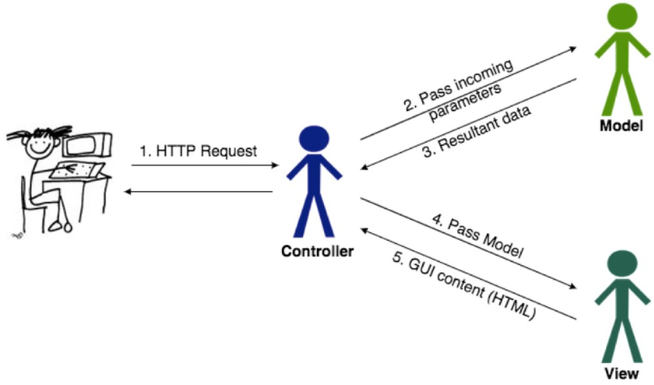
Model-View-Controller (MVC)

Slide 6
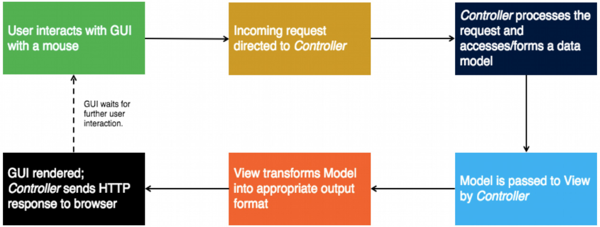
Model-View-Controller (MVC)

Slide 7
Class Activity 03 – ASP.NET Core Workshop
Hands-on Activity

Slide 8
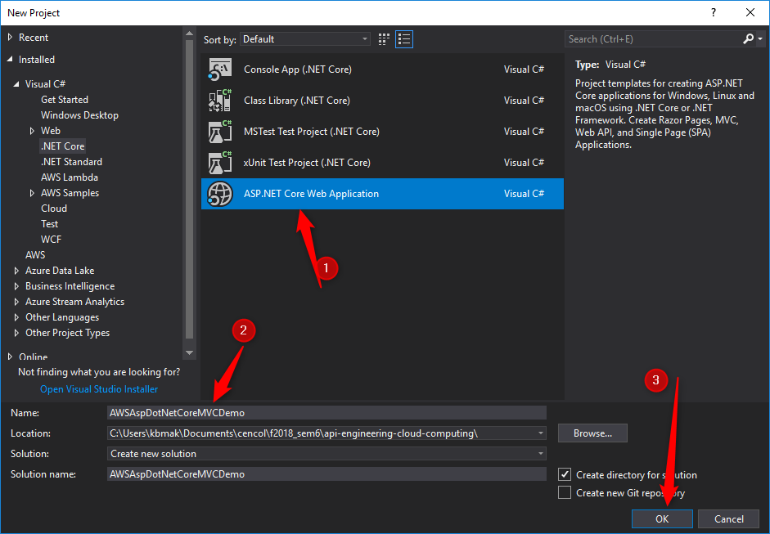
Develop Asp.NET Core Web Application

Slide 9
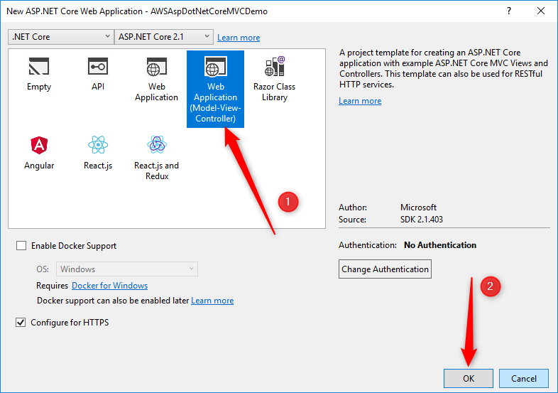
Develop Asp.NET Core Web Application

Slide 10
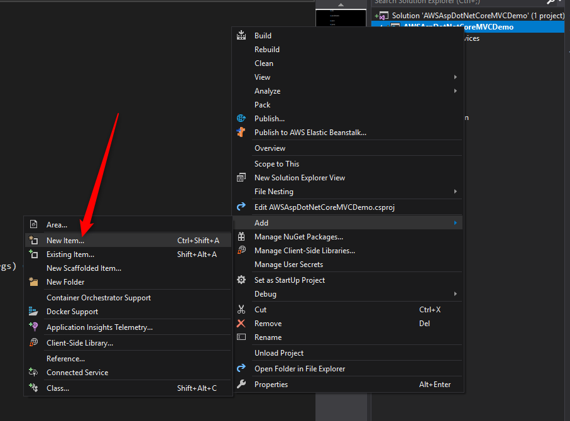
Develop Asp.NET Core Web Application

Slide 11
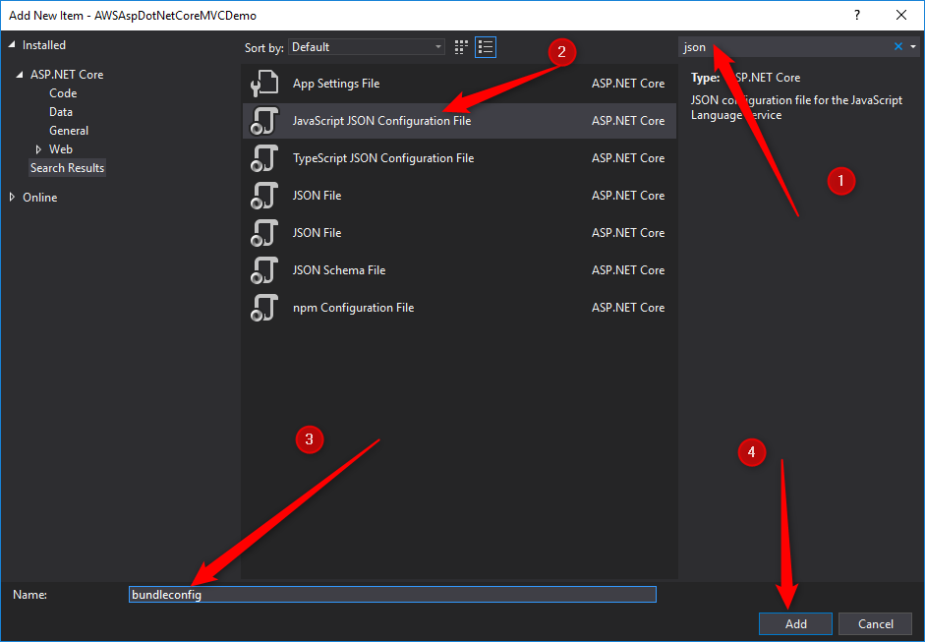
Develop Asp.NET Core Web Application

Slide 12
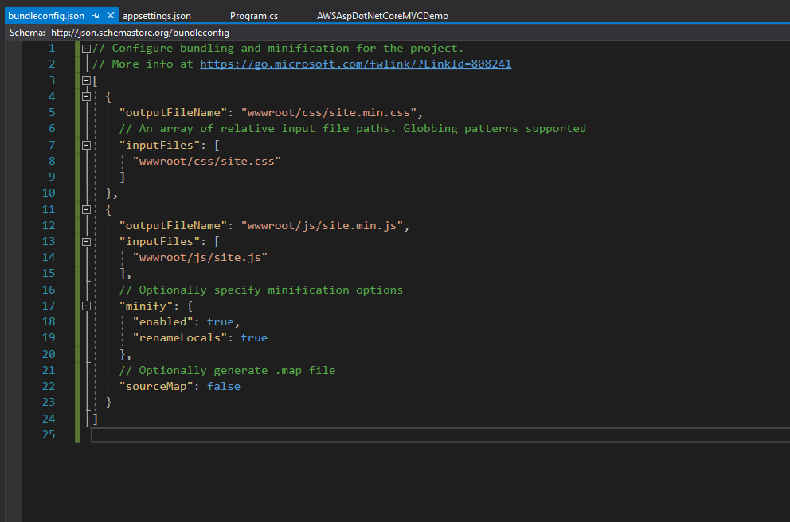
Develop Asp.NET Core Web Application

Slide 13
Taking a Closer Look at the Solution
Minifying is to remove comments and whitespace, while bundling is to combine multiple files into one. Bundleconfig.json file contains sections with outputFileName and inputFiles directives. The input files are minified and bundled to create one output file. E.g. all css files bundled into one css file
launchSettings.json file holds project specific settings associated with each profile (i.e. development, staging, production)
Appsettings.json contains config settings, and stores global values.
Similar to Web.config file

Slide 14
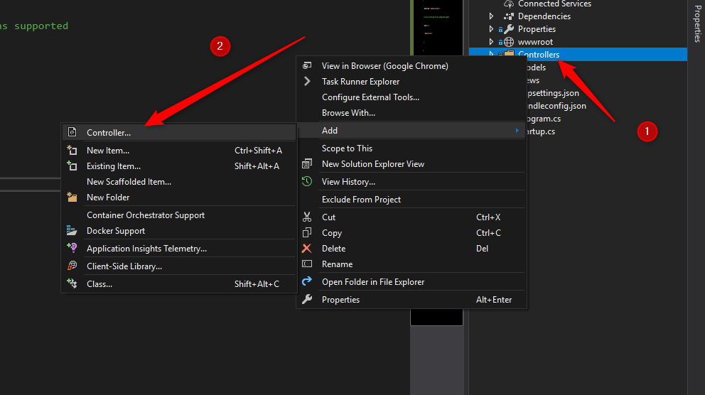
Develop Asp.NET Core Web Application

Slide 15
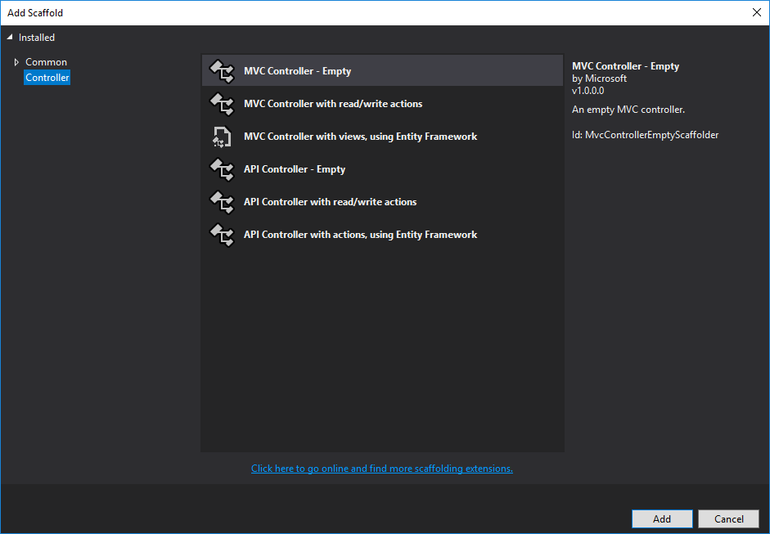
Develop Asp.NET Core Web Application

Slide 16
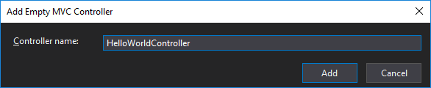
Develop Asp.NET Core Web Application

Slide 17
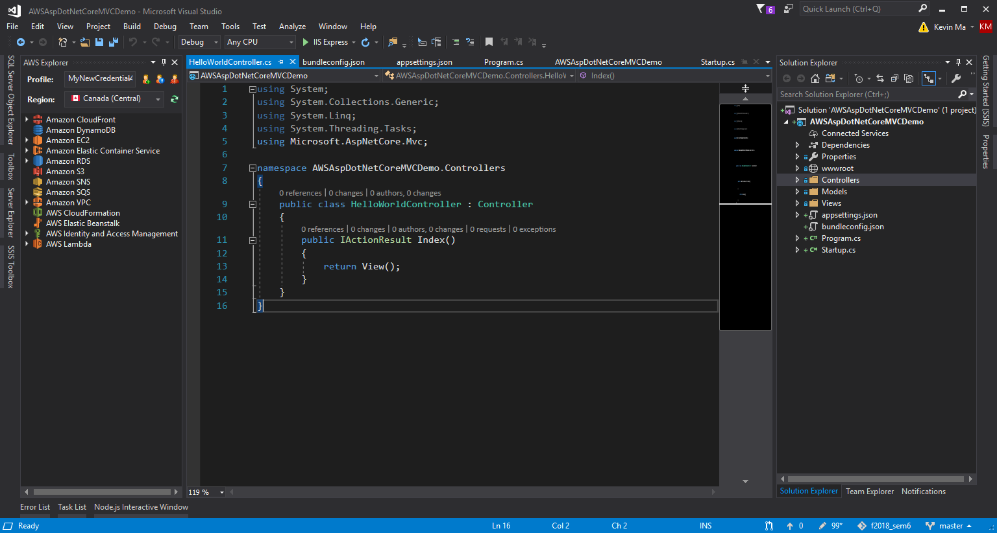
Develop Asp.NET Core Web Application

Slide 18
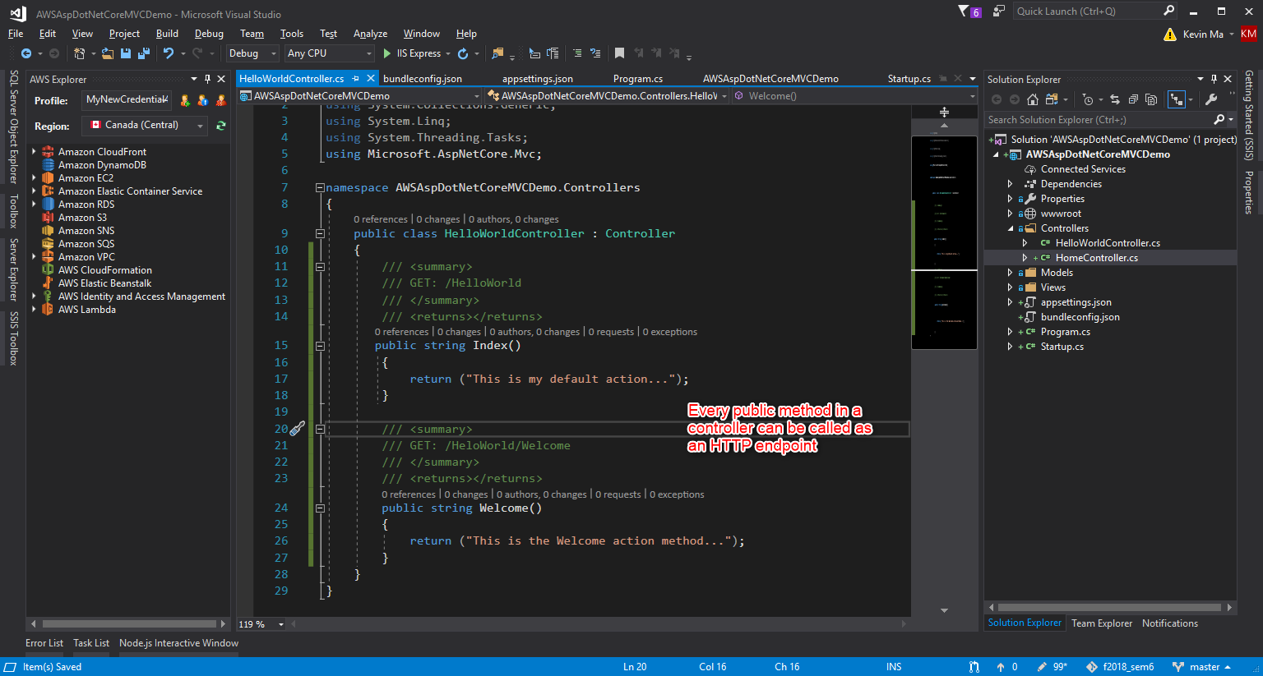
Develop Asp.NET Core Web Application

Slide 19
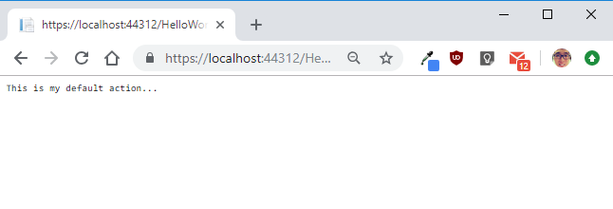
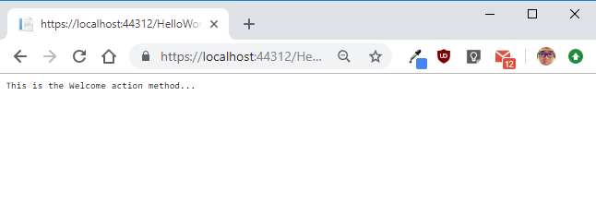
Modifying the Controller

Slide 20
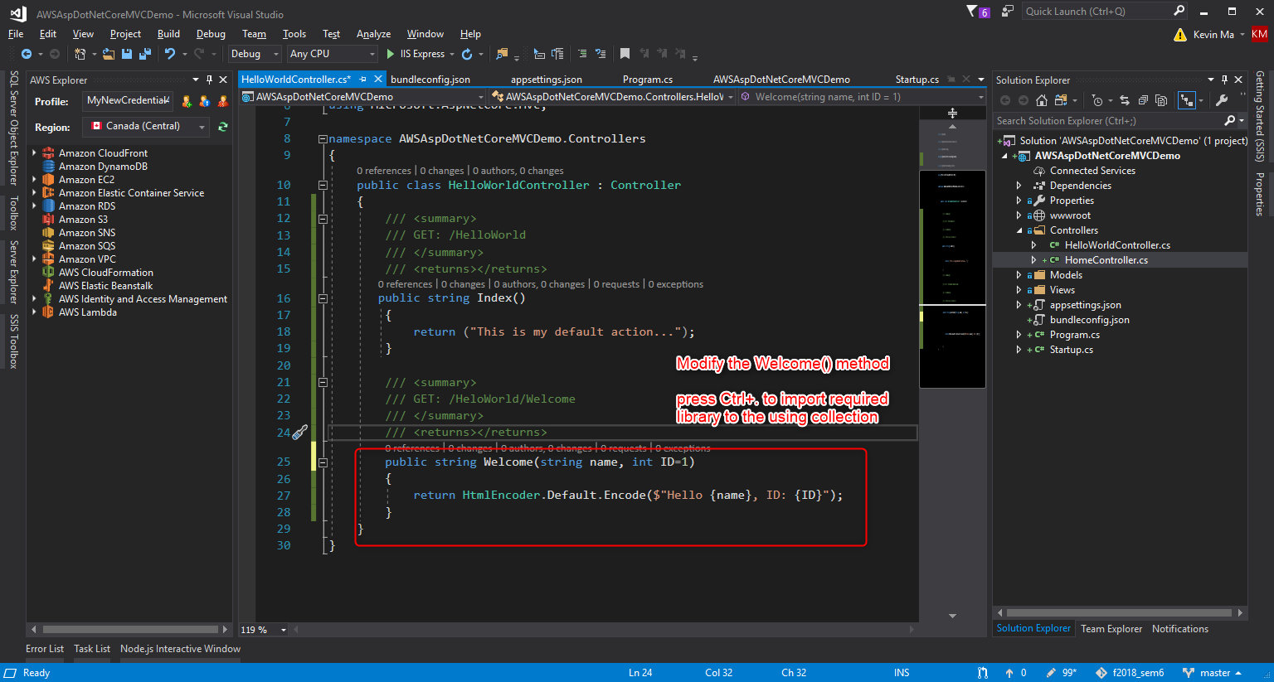
Modifying the Controller

Slide 21
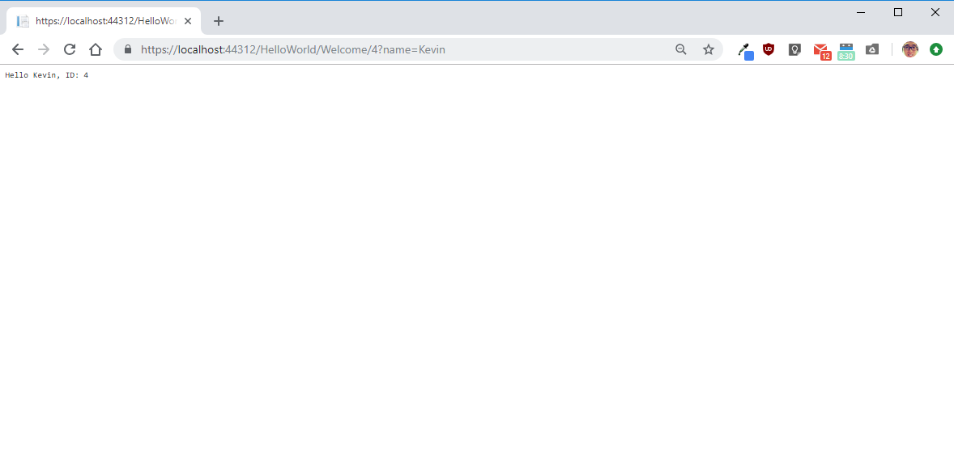
Modifying the Controller

Slide 22
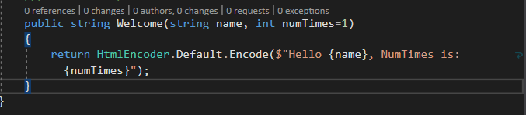
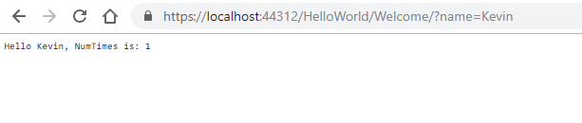
Modifying the Controller

Slide 23
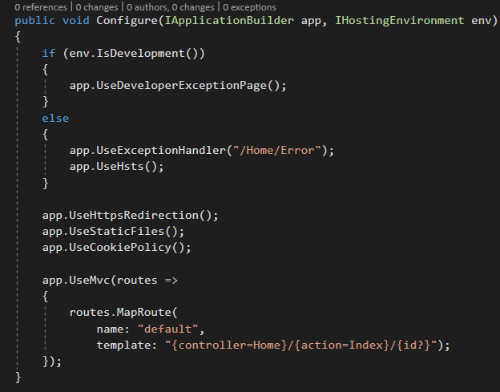
Define Routing
MVC invokes controller classes and the action methods within them depending on the incoming URL
/[Controller]/[ActionName]/[Parameters]
Specify the default route in Startup.cs

Slide 24
View
Razor is a markup syntax for embedding server-based code into webpages. The Razor syntax consists of Razor markup, C#, and HTML. Files containing Razor have a .cshtml file extension
in MVC pattern, the view handles the app’s data presentation and user interaction
A view is an HTML template with embedded Razor markup which is code that interacts with HTML markup to produce a webpage that is sent to the client
View files are grouped into folders named for each of the app’s controller and the folders are stored in a Views folder at the root of the app

Slide 25
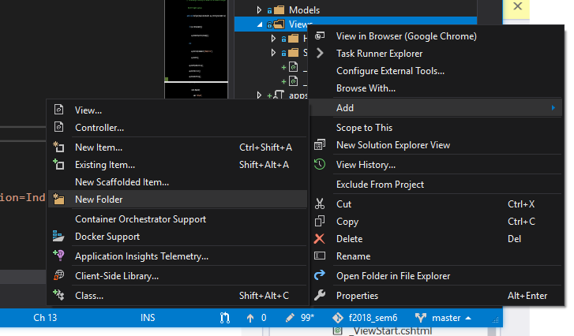
Add a Folder for Our View

Slide 26
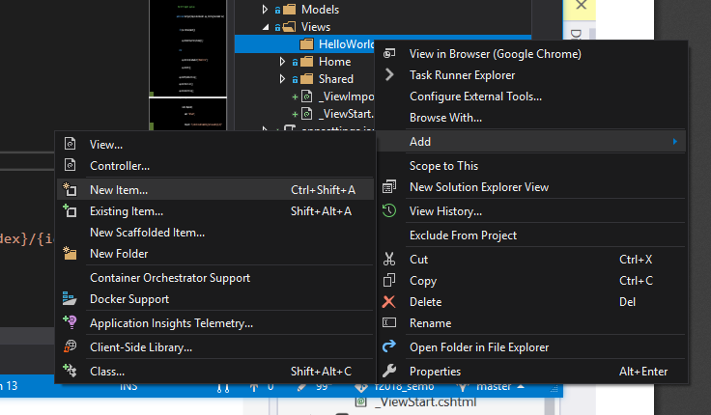
Add View

Slide 27
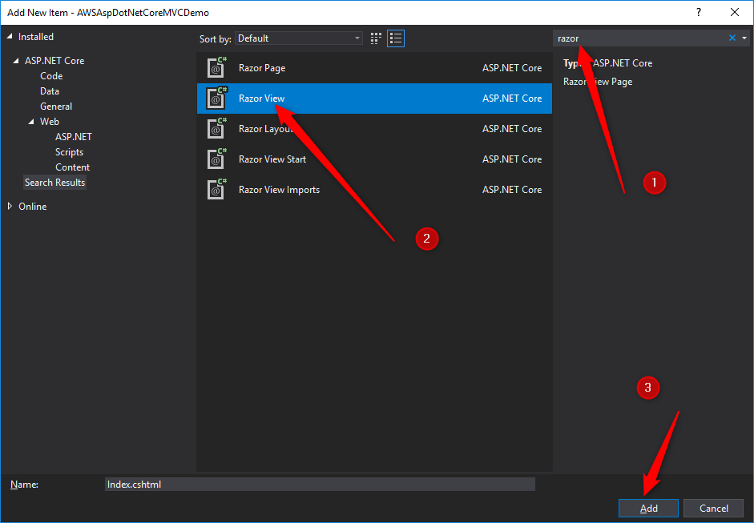
Add View

Slide 28
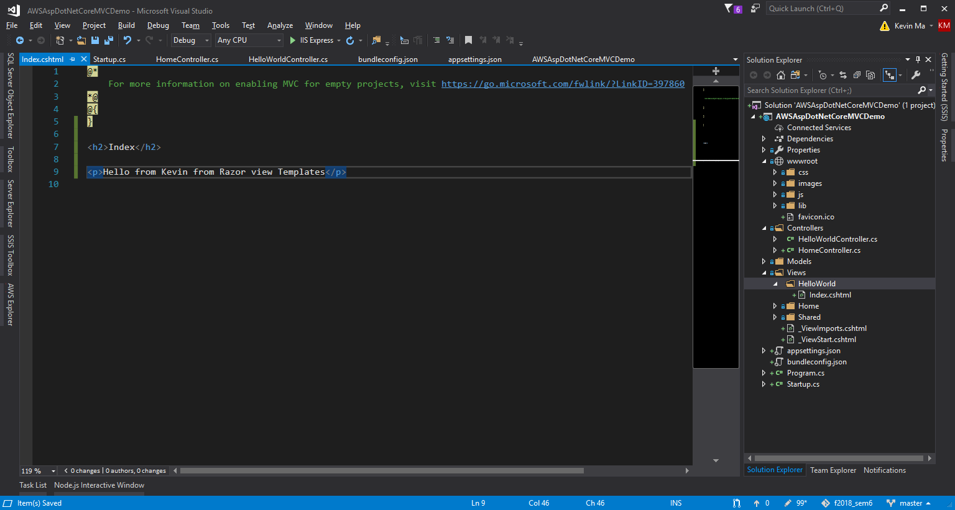
Add View

Slide 29
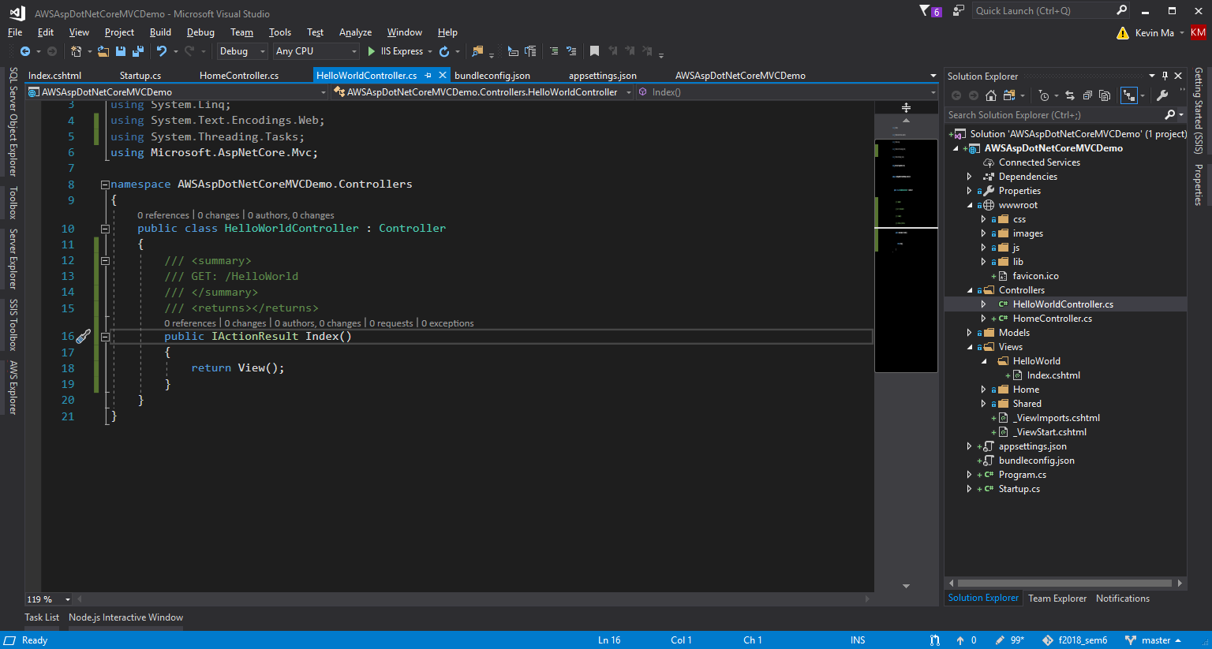
Add View

Slide 30
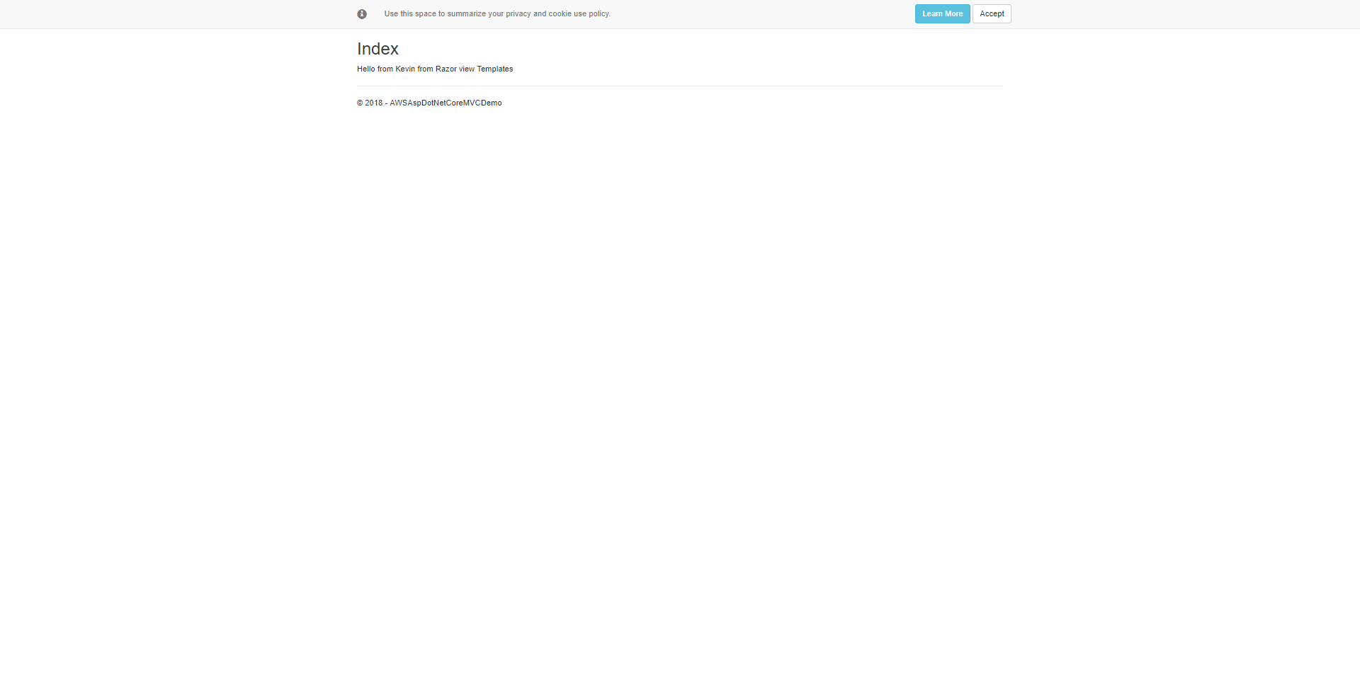
Add View

Slide 31
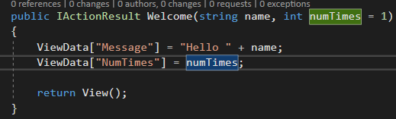
Pass Data from the Controller to the View
Controller handles the request, it retrieves data from a data source, generates response and sends response back to the client
Controllers are responsible for providing the data required in order for a view template to render a response, a view template should only work with the data that’s provided to it by the controller.

Slide 32
Pass Data from the Controller to the View
ViewData dictionary is a dynamic object, and developer can put whatever he/she wants in it. It has no defined properties until developer puts something inside of it. The MVC model binding system automatically maps the named parameters (name and numTimes) from the query string in the address bar to the parameters in that method

Slide 33
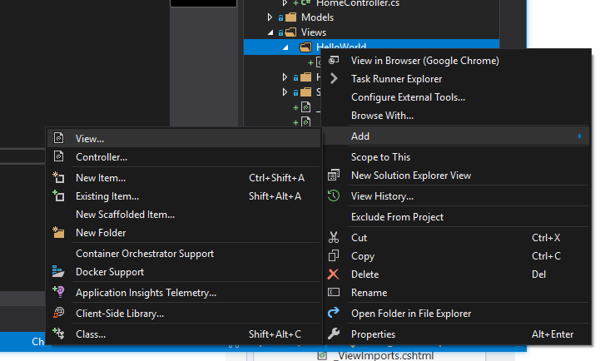
Add View

Slide 34
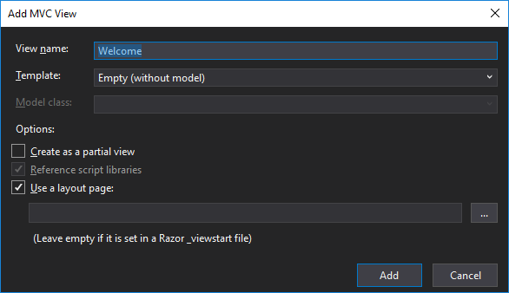
Add View

Slide 35
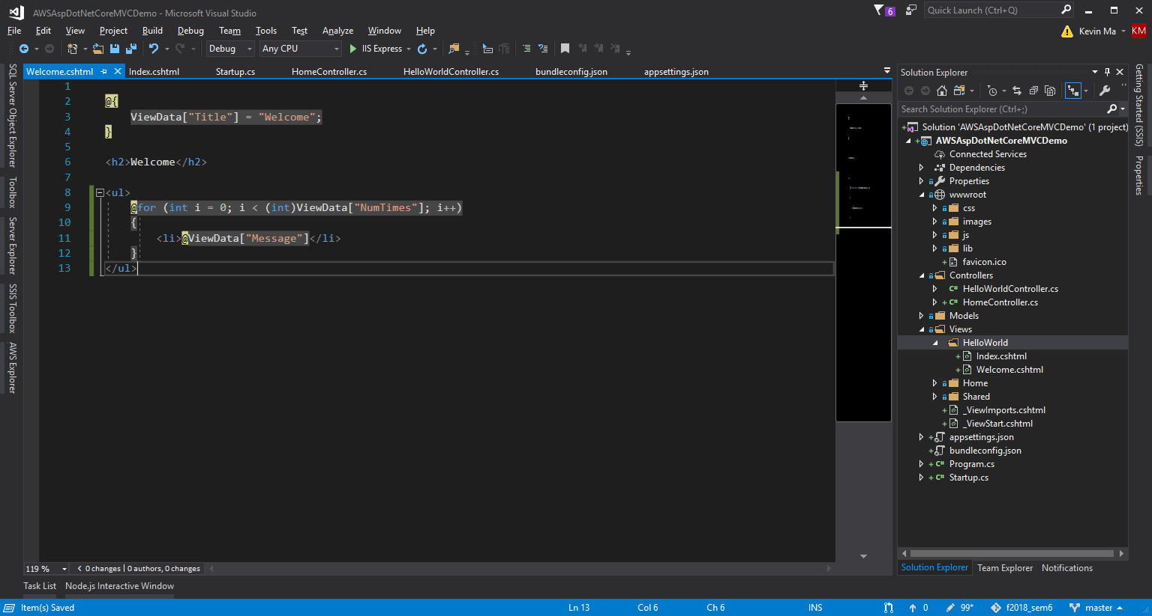
Add View

Slide 36
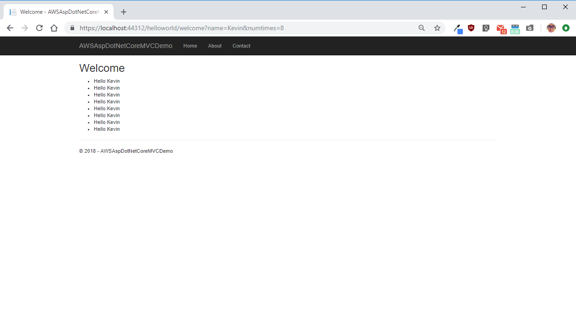
Add View

Slide 37
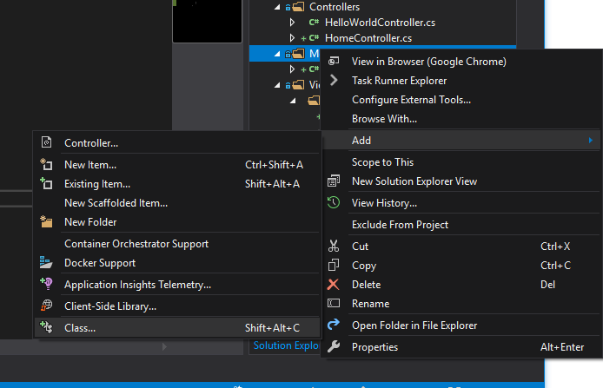
Add Data Model

Slide 38
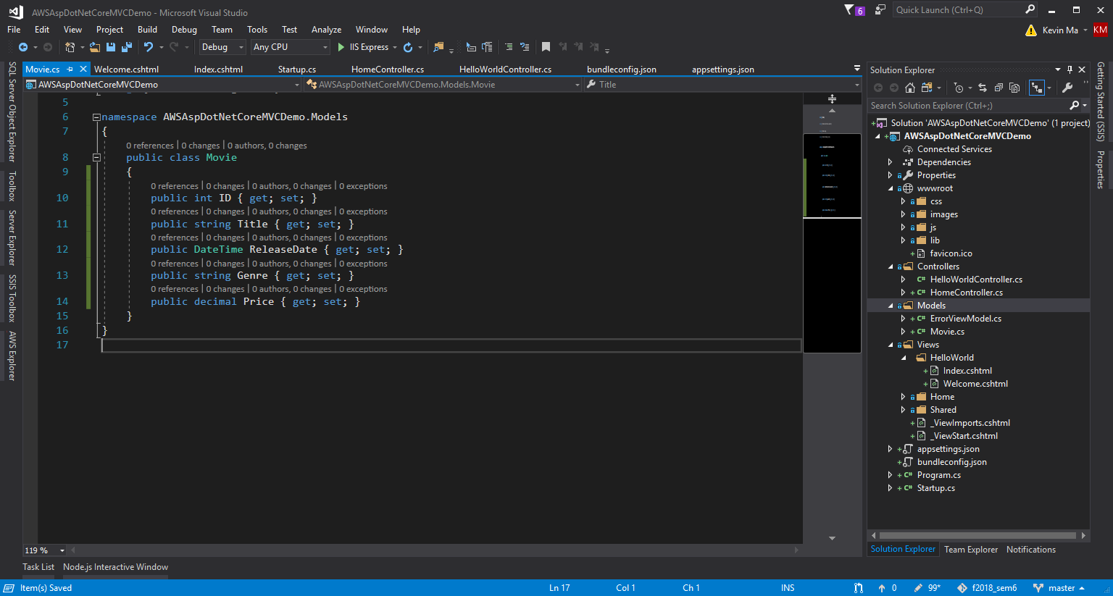
Add Data Model

Slide 39
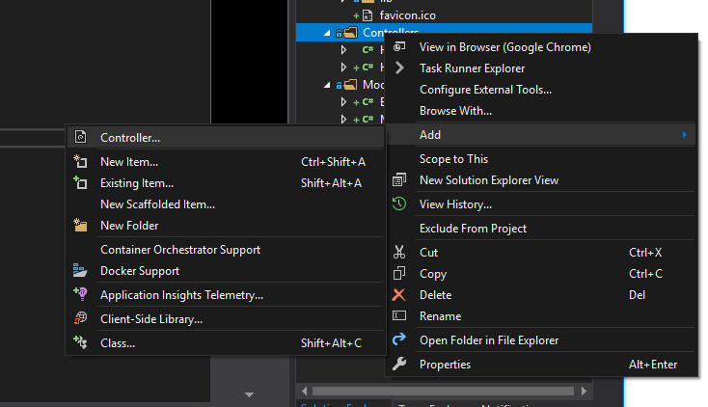
Add Controller

Slide 40
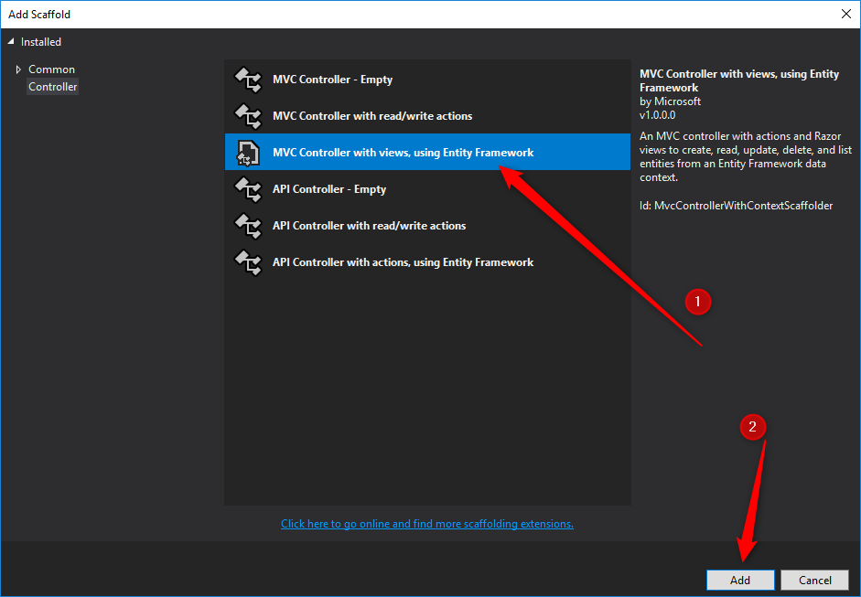
Add Controller

Slide 41
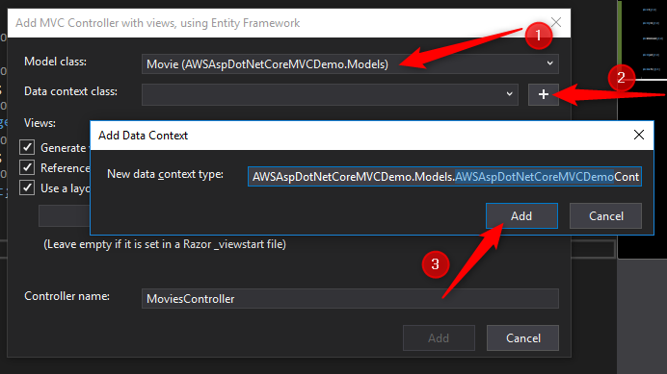
Add Controller

Slide 42
Add Controller
Visual Studio creates:
Entity Framework Core database context class (Data/MvcMovieContext.cs)
Movies controller (Controllers/MoviesController.cs)
Razor view files for Create, Delete, Details, Edit, and Index pages (Views/Movies/*.cshtml)
The automatic creation of the database context and CRUD action methods and views is known as scaffolding

Slide 43
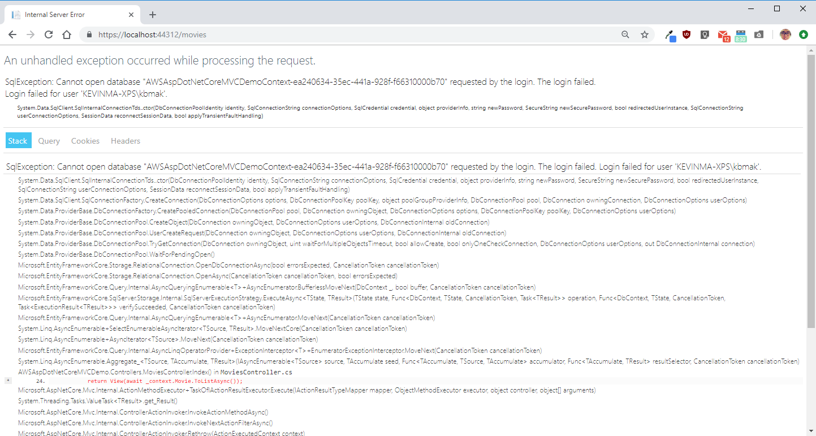
Add Controller

Slide 44
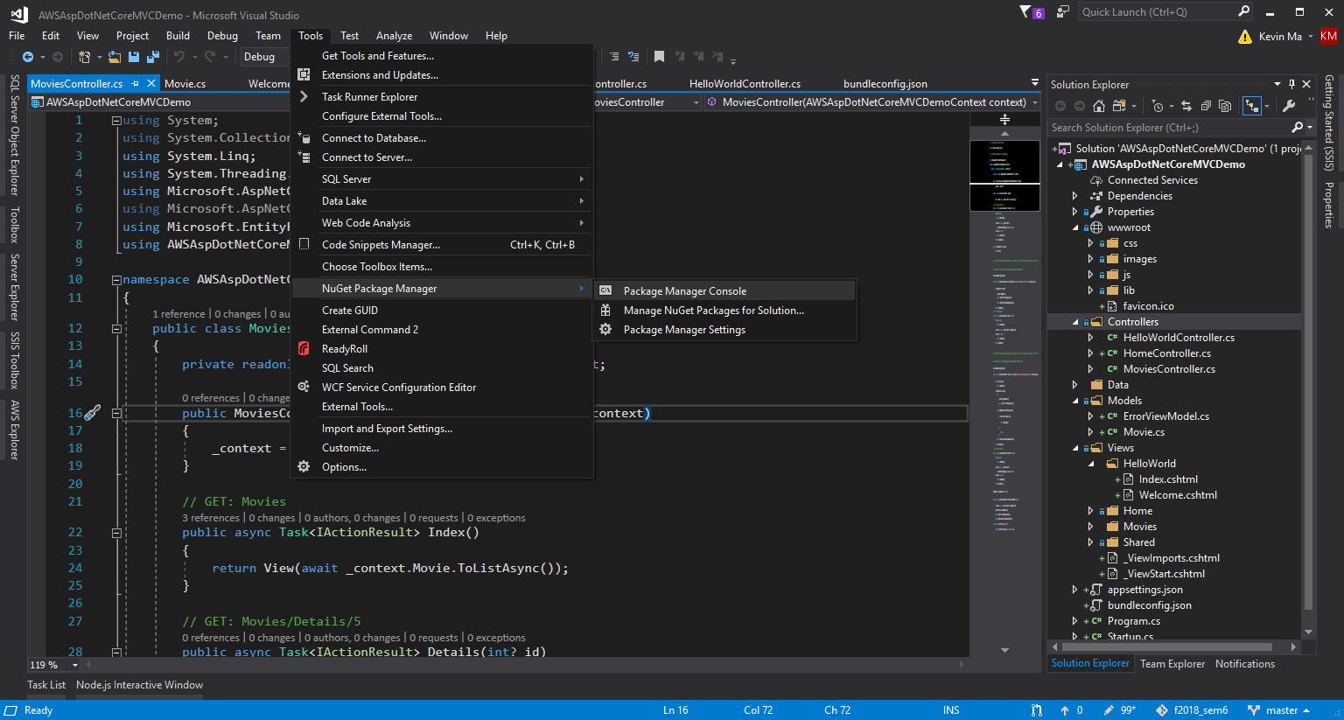
Add missing Entity Framework

Slide 45
Perform Initial Migration
In the Package Manager Console (PMC), enter the following commands:
Install-Package Microsoft.EntityFrameworkCore.tools
Add-Migration Initial
Update-Database

Slide 46
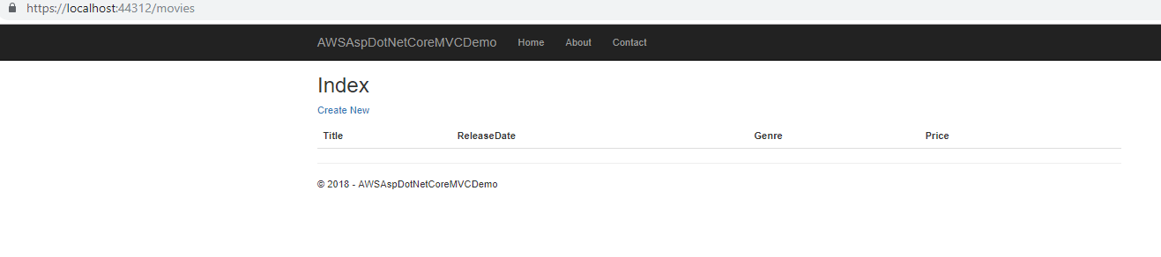
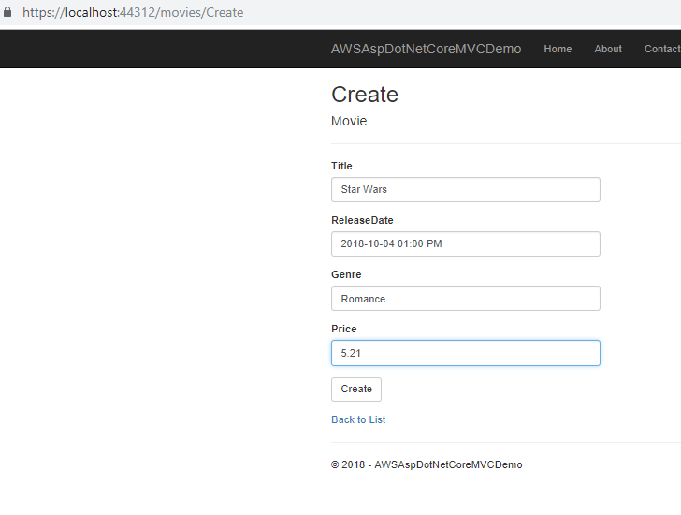
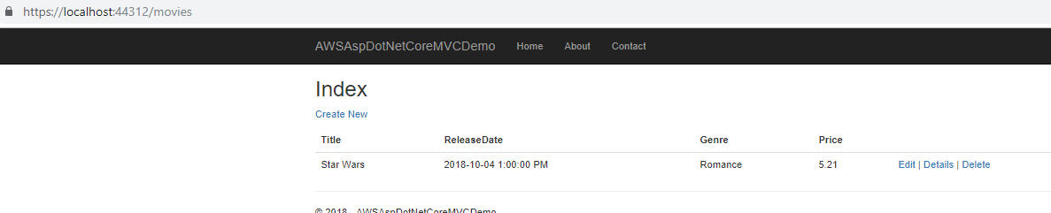
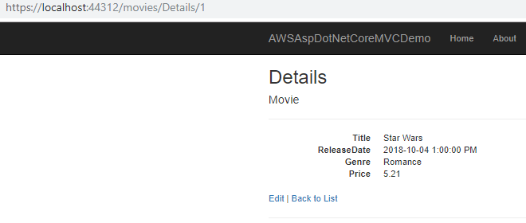
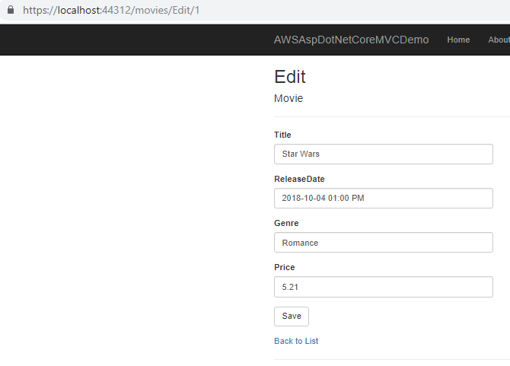
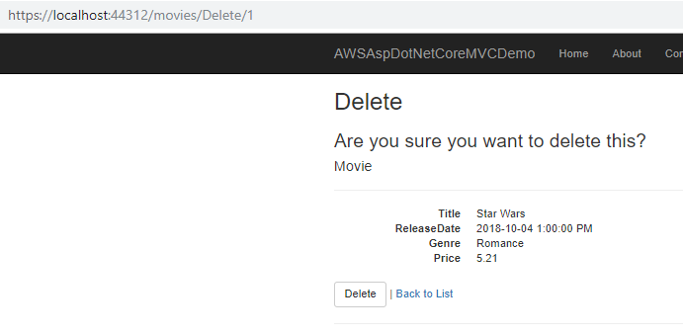
Test Application

