Slide 1
Security Strategies in Web Applications and Social Networking
Chapter 1
From Mainframe to Client/Server
to World Wide Web

Slide 2
Learning Objective
Identify the highlights in the evolution of data processing, from mainframes to the World Wide Web (WWW).
Understand the characteristics of Web 1.0, 2.0, 3.0
Understand the role of cloud computing
Identify the functions of service packs
Review comparison on secure/insecure protocols

Slide 3
Key Concepts
Fundamental shift in technology and platforms
Phases of the WWW: Web 1.0, Web 2.0, Web 3.0
Key areas of concern for e-commerce
Lack of security in common WWW protocols
Securing communications

Slide 4
Understanding Data, Data Processing and Information
Data
Information
Facts, figures, raw input
Collection of observations, stats, recordings
Conclusions drawn become useful info
Organized, interpreted within a framework

Slide 5
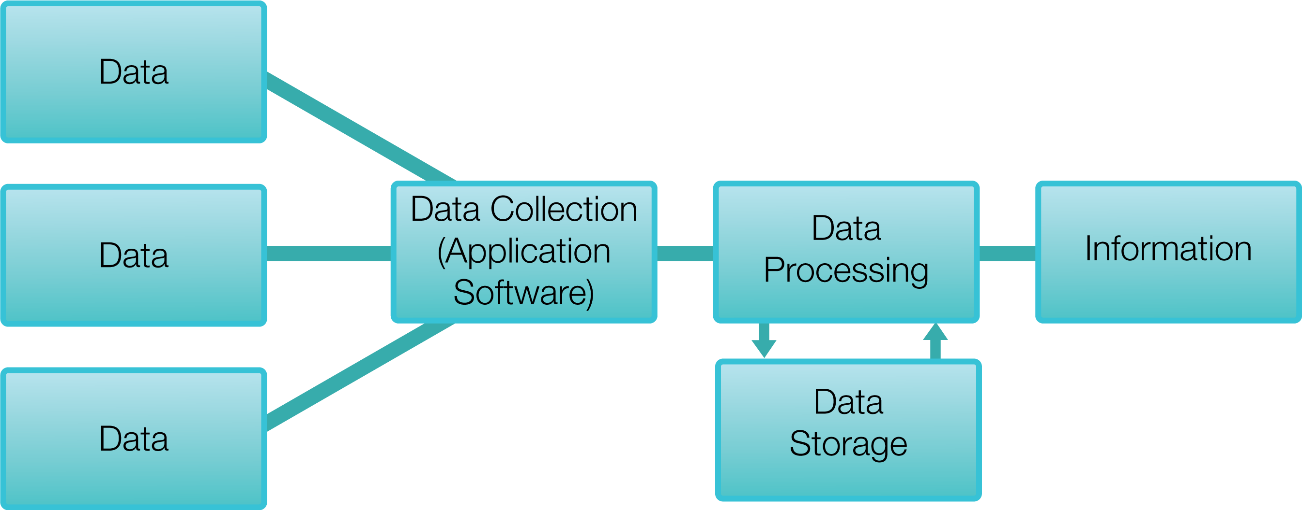
Processing Data

Slide 6
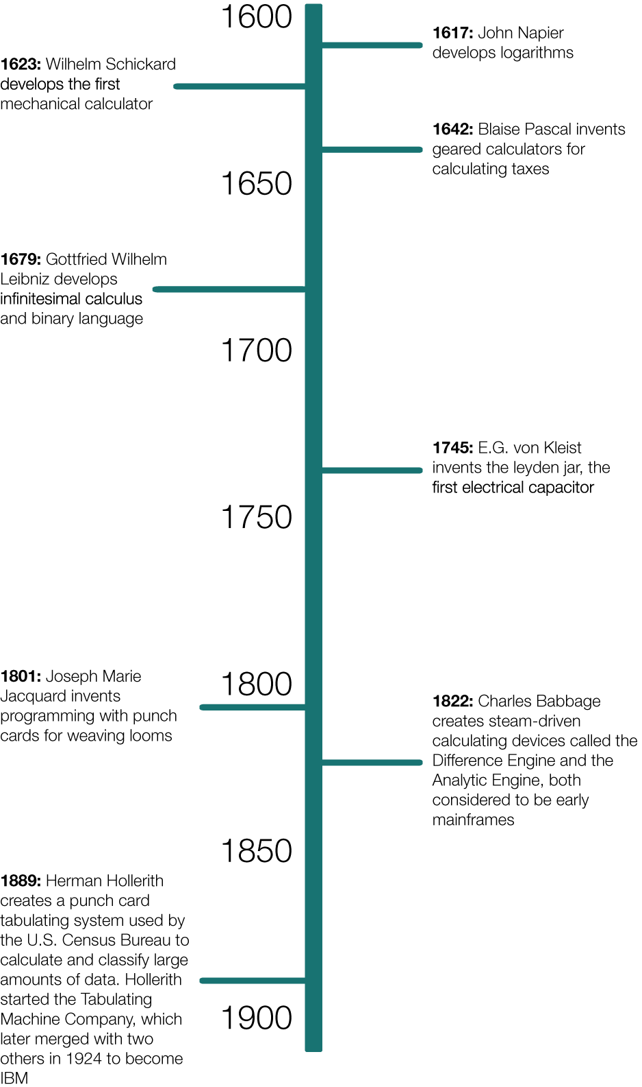
Data Processing Timeline

Slide 7
Evolution of Data Processing
Early 1900s to 1960s
  1924 Hollerith starts IBM
  1946 ENIAC British computer (vacuum tubes)
1950s through today
  1964 IBM/360 modern mainframe
  1977 Apple II with color graphics
  1981 IBM PC
  1990 Windows 3.0
  2002 one billion computers
Visual Timeline

Slide 8
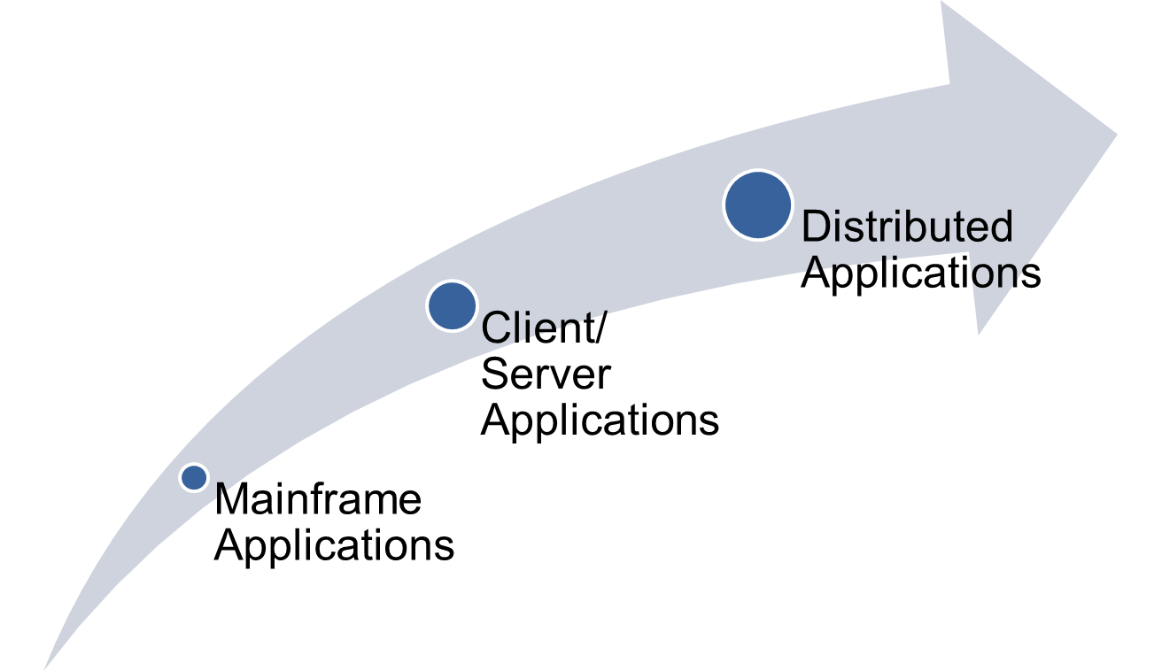
Evolution of Application Delivery
Notes:
Evolution of Application Delivery in detail:
Mainframe Application: A mainframe is a high-performance computer used for large-scale computing purposes that require greater availability and security than a smaller-scale machine can offer.
Example: Legacy inventory applications on a mainframe with dumb terminals throughout the warehouse.
Client Server Application: Client Server Application is when a client machine has it own processing but it request applications from a server. Example: Client programs on a user workstation request services from a server-basically a high-end computer. Server programs process client requests.
Distributed Application: Software that executes on two or more computers in a network.
Example: In a client-server environment, distributed applications have two parts: (1) the 'front end' runs on the client computer(s), and (2) the 'back end' that requires large amounts of data , and runs on a suitably equipped server computer.

Slide 9
Mainframe Computers
Processing power (more than network servers and workstations)
DB management (TB of info)
User-friendly interface (Web interface)
App continuity (robust, no down time)
App security (centralized management)
DB backups

Slide 10
Client/Server
Scalability (easy to add computers and peripherals)
Centralization (easier management of resources and user accounts)
Convenience (one uid/pwd for controlling access to all available network resources)
Efficiency (one location = easier backup)
Security (access easier to secure and monitor)
Protocols that use client/server:
  FTP
  SMTP
  Telnet
  POP3

Slide 11
Distributed Computing
Server handles centralized data, workstations perform the processing
Server clusters (farms)
Greater performance
Shared workload (balancing)
Disaster recovery

Slide 12
Transformation of Brick-and-Mortar to E-Commerce
Started mid-90’s
Key areas of concern for e-commerce:
  Integrity (message was not tampered with in transit)
  Nonrepudiation (neither party can deny the transaction has taken place)
  Authentication (verify user identity)
  Privacy (info stored confidentially)
New protocols (https, PKI)
E-commerce today:
  Catalog
  Shopping cart
  Transactions and payment processing
  Fulfillment system

Slide 13
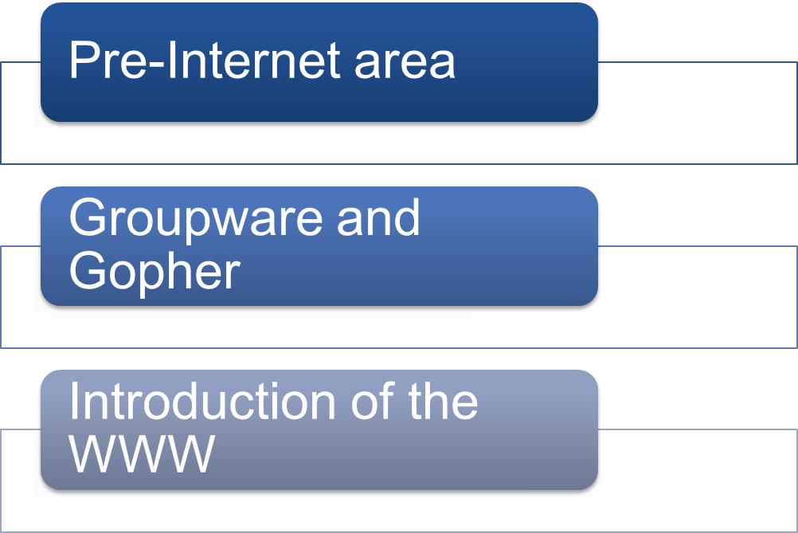
WWW Revolution

Slide 14
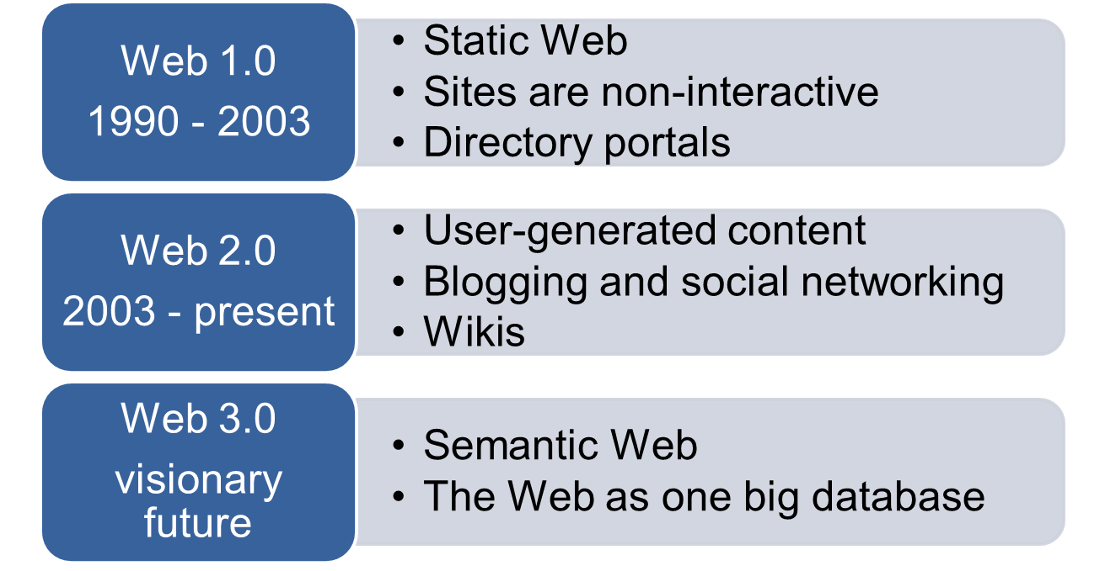
Phases of the WWW
Notes:
Web 1.0 (1991-2003)
Refers to the state of the WWW, and any Web site design style used before the advent of Web 2.0 phenomenon
Web 2.0
Is commonly associated with the Web applications that facilitate interactive, user-created information
Web 3.0
Content and services created by skilled individuals using Web 2.0 technologies

Slide 15
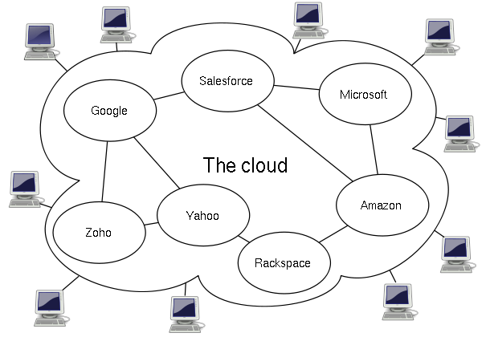
Virtualization and Cloud Computing
Virtualization:
  The creation of one or more virtual instances of servers running on one or more physical servers
Cloud Computing:
  Internet-based computing

Slide 16
Lack of Inherent Security Within Protocols and Coding
Internet Protocol Version 4 (IPv4) lacks sufficient security technologies
Security flaws in software
  Operating systems and other applications

Slide 17
Securing Communications
  Use secure versions of insecure protocols
      IPv4 secured through higher layers (encryption, SSL, HTTPS)
      IPv6 designed with security built in
Use IPSec (Internet Security Protocol)
Prevent different types of attacks:
  Eavesdropping (intercepts and modifies clear-text)
  Address spoofing (impersonate an IP address)
  Man-in-the-middle (use non-repudiation)
  DoS

Slide 18
Securing Communications (Continued)
Manage application and coding security
  Developers plan for security concerns present at the time applications are created.
Use service packs
  As new security threats arise, updates, patches, and service packs must be installed to protect the applications.

Slide 19
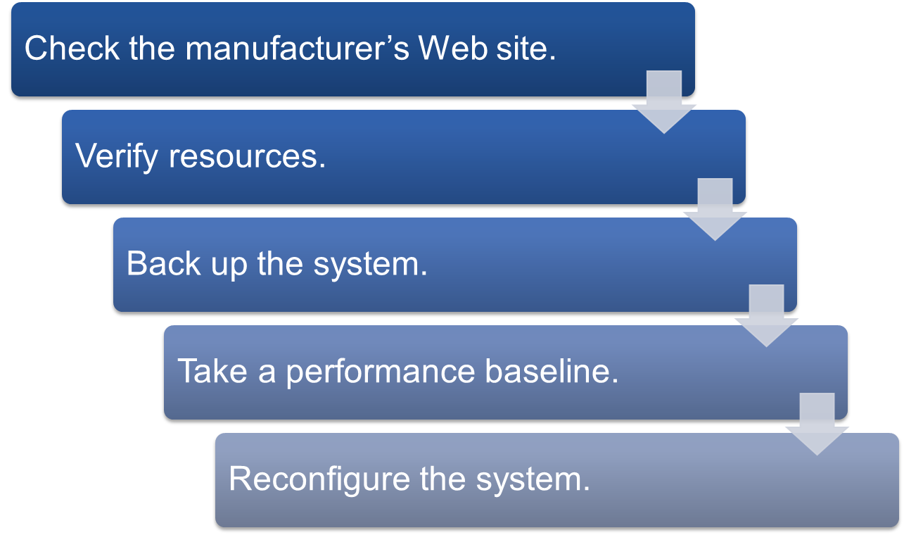
Installing Service Packs

Slide 20
Summary
Fundamental shift in technology and platforms
Phases of the WWW: Web 1.0, Web 2.0, Web 3.0
Key areas of concern for e-commerce
Lack of security in common WWW protocols
Securing communications

