Slide 1
API Engineering
Yin Hua Li
Centennial College
Week#6, 2018
Access AWS DynamoDB Programmatically

Slide 2
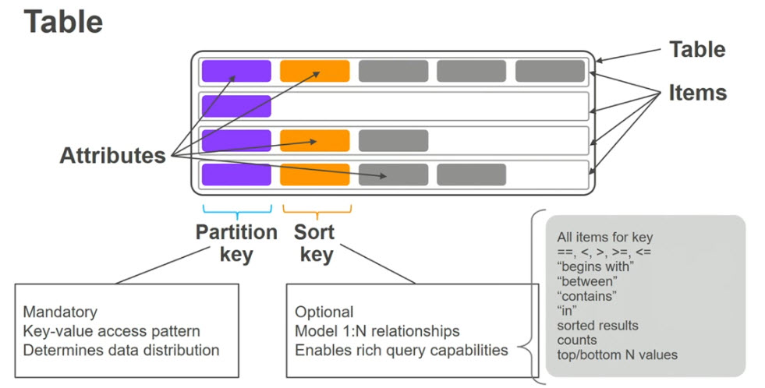
DynamoDB Overview

Slide 3
Access DynamoDB by Using .NET API
AWS SDK provides 3 programming models for communicating with DynamoDB
Object persistence model
Document Model
Low-Level model (Service client)

Slide 4
Object Persistence Model
The object persistence programming model is specifically designed for storing, loading and querying .NET objects in DynamoDB
The model is accessed through Amazon.DynamoDBv2.DataModel namespace

Slide 5
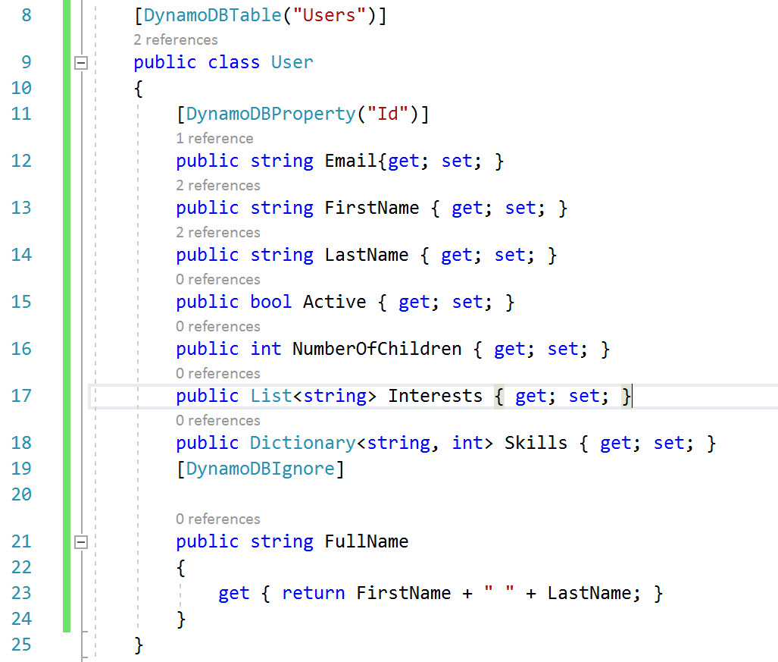
Data Model

Slide 6
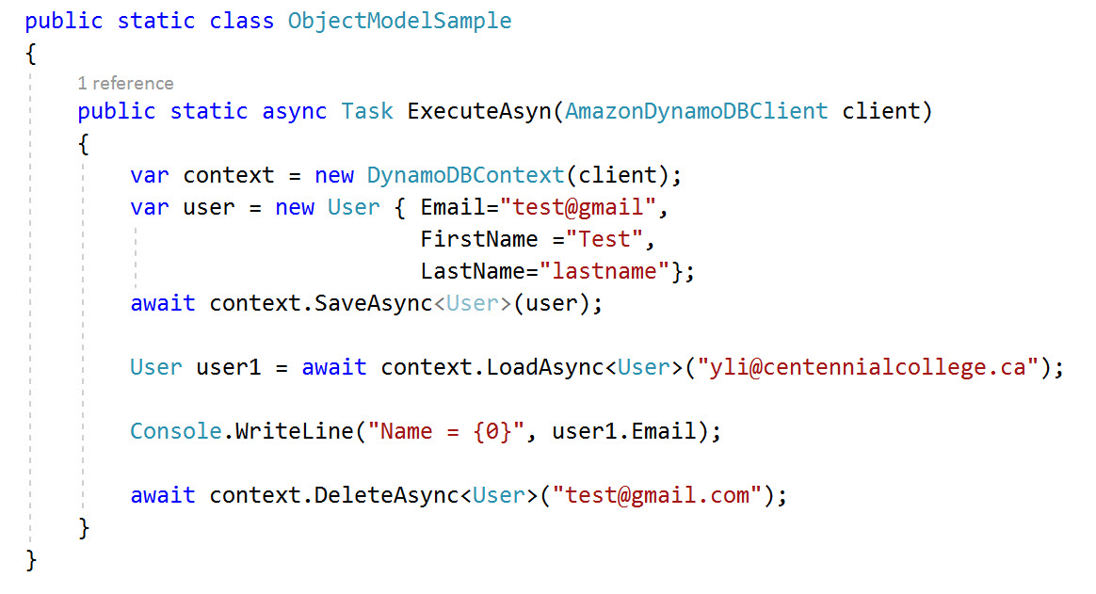
Store/Load/Delete Item from DynamoDB Table

Slide 7
Document Model
This model provides an easier way to work with data in DynamoDB
It is specifically intended for accessing tables and items in tables.
This model is accessed through Amazon.DynamoDBv2.DocumentModel namespace.

Slide 8
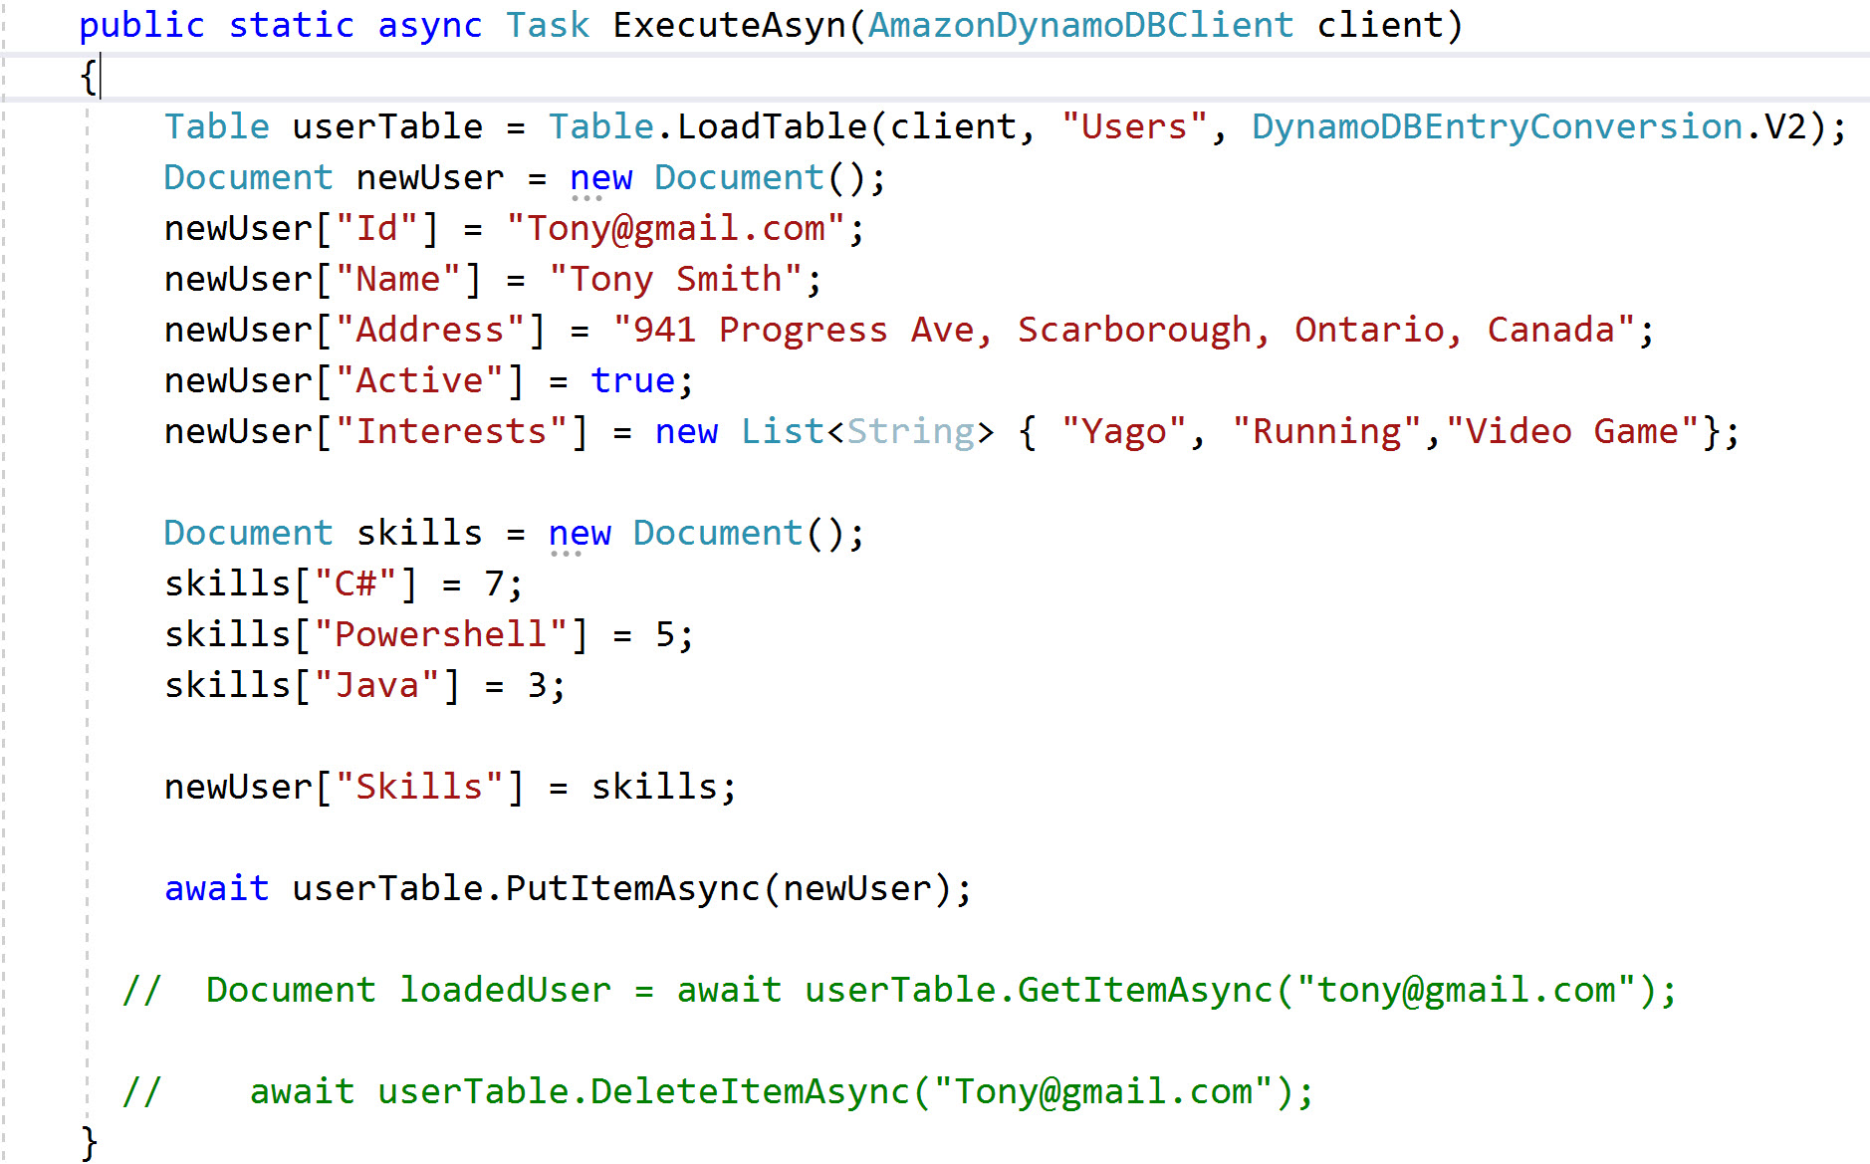
Document Model (Con’t)

Slide 9
Low-Level Model
This model wraps direct calls to DynamoDB service
Developer accesses low-level model through Amazon.DynamoDBv2 namespace
Requires developer to write most code (e.g., developer has to provide code to convert .NET data types to their equivalents in DynamoDB)
This model gives developer access to the most features

Slide 10
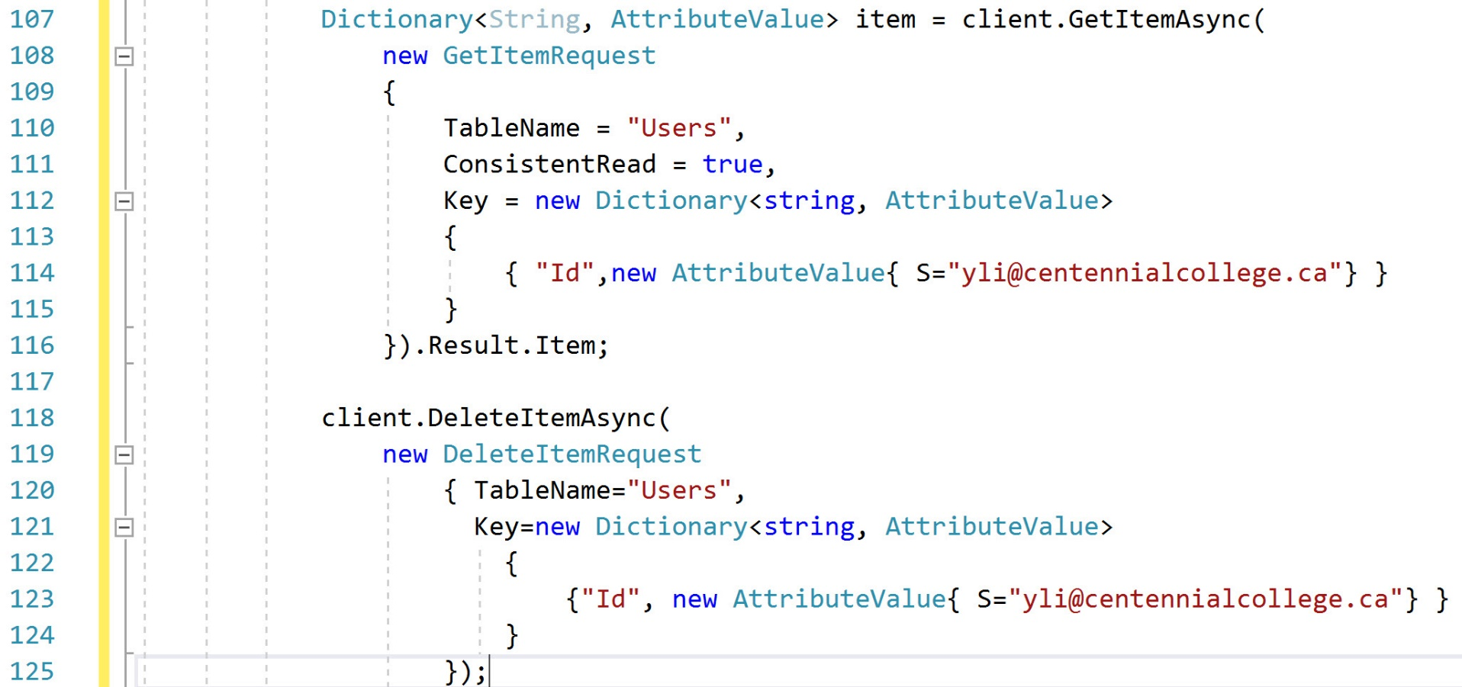
Read/Delete Item from DynamoDB Table class

Slide 11
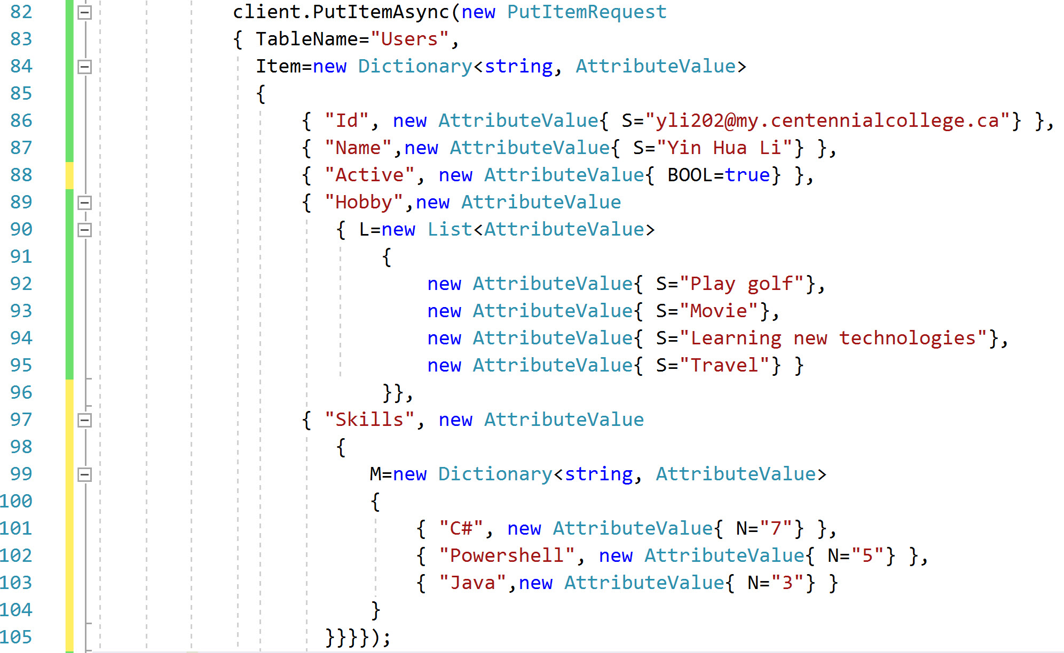
Insert Item to DynamoDB Table

Slide 12
Reference
https://docs.aws.amazon.com/amazondynamodb/latest/developerguide/LowLevelDotNetTableOperationsExample.html
https://docs.aws.amazon.com/sdk-for-net/v3/developer-guide/dynamodb-intro.html
https://www.youtube.com/watch?v=hNAWdXaW0Fs
https://www.youtube.com/watch?v=IfF1E2RJ6Do&t=33s
https://www.youtube.com/watch?v=jzeKPKpucS0

