Slide 1
OWASP Application Security Verification Standard (ASVS)
– Web Application Edition
Mike Boberski (Booz Allen Hamilton)
boberski_michael@bah.com
Jeff Williams (Aspect Security)
jeff.williams@aspectsecurity.com
Dave Wichers (Aspect Security)
dave.wichers@aspectsecurity.com
03/09

Slide 2

Agenda
  About ASVS
  Project Status
  Technical Details
  Getting Started
  Where to Go from Here
  Questions
The OWASP Foundation
http://www.owasp.org

Slide 3

Challenges…
There is a huge range in coverage and rigor available in the application security verification market!
Consumers have no way to tell the difference between:
  Someone running a grep tool, and
  Someone doing painstaking code review and manual testing!
There are differences in coverage and rigor between types of tools, between tools and manual techniques, and between types of manual techniques!

Slide 4

Philosophy of ASVS
It is intended as a standard for how to verify the security of web applications
It should be application-independent
It should be development life-cycle independent
It should define requirements that can be applied across web applications without special interpretation
Any such standard also needs to be commercially-viable and therefore not overly burdensome!

Slide 5

Design Goals of ASVS
The standard should define functional verification requirements that take a white-list (i.e., positive) approach
The standard should define increasing levels of application security verification
The difference in coverage and level of rigor between levels should be relatively linear
The standard should also be verification tool and technique independent!

Slide 6

What Questions Does ASVS Answer?
What security features should be built into the required set of security controls?
What are reasonable increases in coverage and level of rigor when verifying the security of a web application?
How can I compare verification efforts?
How much trust can be placed in a web application?
ASVS can answer these questions for applications ranging from minimum risk applications, to critical infrastructure applications.

Slide 7
Agenda
  About ASVS
  Project Status
  Technical Details
  Getting Started
  Where to Go from Here
  Questions
The OWASP Foundation
http://www.owasp.org

Slide 8
What is the status of the ASVS as an OWASP standard?
Web Application Edition of ASVS
  It is the first OWASP standard
  Current official release is Beta, released Dec 2008
  Being piloted by Booz Allen Hamilton
    Updates based on Booz Allen pilots under way
  ASVS assessments being offered by Aspect Security
Future Editions of ASVS
  Web Services Edition under development
  Translate to other languages
  Additional architectures being considered (perhaps client-server, Cloud computing for example)

Slide 9




Project Plan and Status
    2/25/2009 – Proposed updates based on pilots being considered
    12/5/2008 - OWASP ASVS exits the Summer of Code 2008! The Beta draft of the Web Application Edition is released! Mike Boberski, Jeff Williams, and Dave Wichers primary authors
    4/16/2008 - OWASP ASVS Summer of Code 2008 proposal submitted by Mike Boberski accepted!
    2/20/2008 – Jeff Williams conceives of ASVS idea and encourages Mike to submit proposal
Check out the ASVS project page for the latest news: http://www.owasp.org/index.php/ASVS#Announcements

Slide 10
Agenda
  About ASVS
  Project Status
  Technical Details
  Getting Started
  Where to Go from Here
  Questions
The OWASP Foundation
http://www.owasp.org

Slide 11
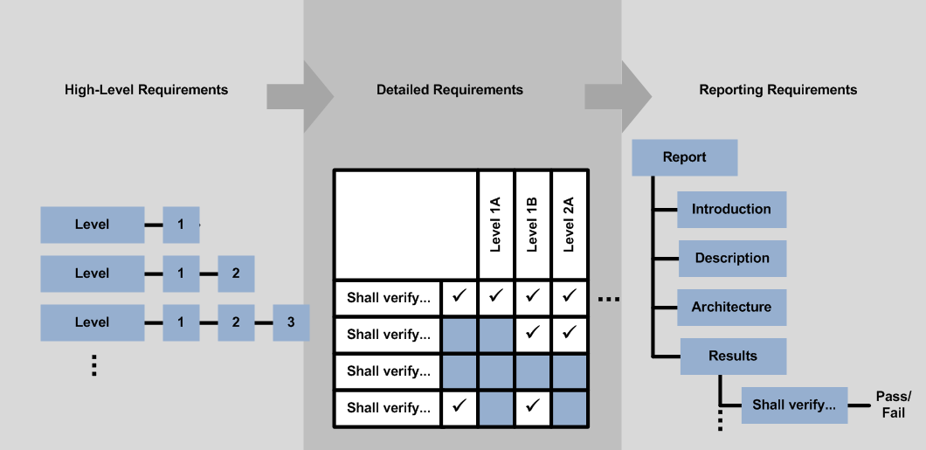
An Overview of ASVS
“Verification Levels” section
“Verification Requirements” section
“Verification Reporting Requirements” section

Slide 12
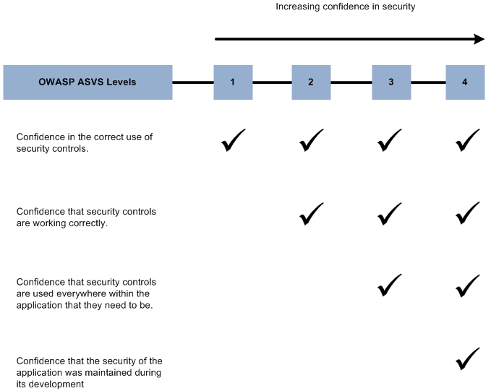
What are ASVS Verification Levels?

Slide 13








Application Security Verification Techniques
Find Vulnerabilities
Using the Running Application
Find Vulnerabilities
Using the Source Code
Manual Application
Penetration Testing
Manual Security
Code Review
Automated Application Vulnerability Scanning
Automated Static
Code Analysis
Notes:
You have a number of options when verifying the security of an application. The standard gives you the flexibility to use any and all of these options in your verification effort.

Slide 14
Level Definitions
Level 1 – Automated Verification
    Level 1A – Dynamic Scan (Partial Automated Verification)
    Level 1B – Source Code Scan (Partial Automated Verification)
Level 2 – Manual Verification
    Level 2A – Penetration Test (Partial Manual Verification)
    Level 2B – Code Review (Partial Manual Verification)
Level 3 – Design Verification
Level 4 – Internal Verification

Slide 15
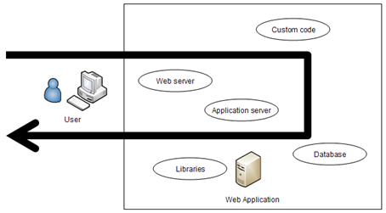
Level 1 in more detail
Automated verification of a web application treated as groups of components within single monolithic entity
Notes:
The point is, that at this level, your application can be considered one big blob of code. No breakdown of the application or architecture is required.

Slide 16
Level 1 Options
Level 1A
Dynamic Scan (Partial Automated Verification)
Level 1B
Source Code Scan (Partial Automated Verification)
Need BOTH to achieve a full level 1…
Notes:
Whichever tool or tools you use must provide coverage against all the requirements in the standard. Covering a requirement simply means that the tool provides some benefit in that area. Not that it necessarily finds ALL flaws in that area. For example, if the tool can find some XSS flaws, that it is considered to cover that area at Level 1, even though it can’t find all XSS flaws in a particular application.
If there is a level 1 (A or B) requirement that your selected tool suite doesn’t cover, then you can augment your verification process with manual verification to address that particular requirement.

Slide 17
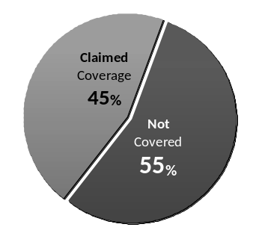
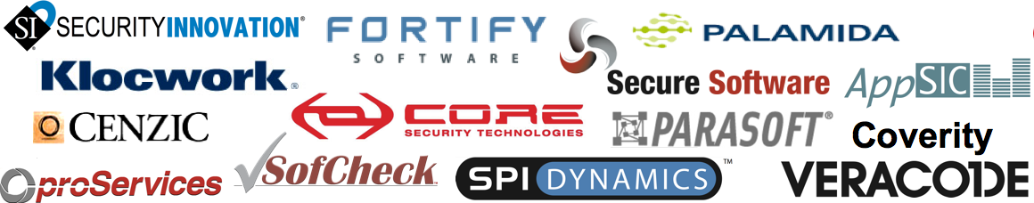

Tools – At Best 45%
    MITRE found that all application security tool vendors’ claims put together cover only 45% of the known vulnerability types (695)
    They found very little overlap between tools, so to get 45% you need them all (assuming their claims are true)
Notes:
Note: Clearly a level 1 review can’t do any more than what the tools can do, since it’s a tool based review. Given that tools don’t yet provide a huge amount of coverage of the application security problem space, level 1 reviews are understandable limited in their scope. But they are just the first level in the model. Higher levels provide better coverage and more rigor, as defined by the standard itself.

Slide 18
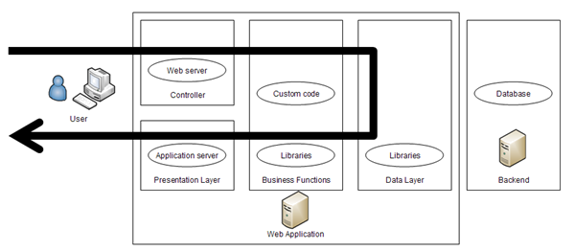
Level 2 in more detail
Manual verification of a web application organized into a high-level architecture.
Notes:
At level 2, the verifier needs to clearly articulate the architecture of your application at a high level, clearly identifying all custom components, and all commercial or open source components used in the application, and their purpose in the architecture.

Slide 19
Level 2 Options
Level 2A
Manual Penetration Test
Level 2B
Manual Code Review
Need BOTH to achieve a full level 2…
Notes:
Manual verification can also leverage the use of automated tools, but it doesn’t have to. Manual verification WILL involve the use of tools. It will be crazy not to. However, the level of ‘automation’ of such tools is up to the verifier. It could range from the simple use of an IDE, to automated commercial tools like what might be used at level 1, to custom code review tools that have custom rules built and maintained by the verifier that are not commercially available.

Slide 20
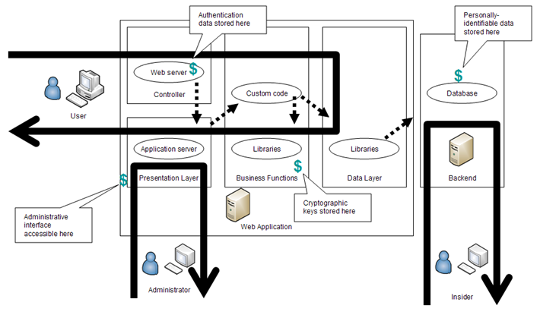
Level 3 in more detail
Design verification of a web application organized into a high-level architecture.
Notes:
Level 3, is Level 2 plus more coverage and more depth of analysis. It also include high level threat modeling and design verification, to verify that all the critical assets are protected by the proper set of security controls.

Slide 21
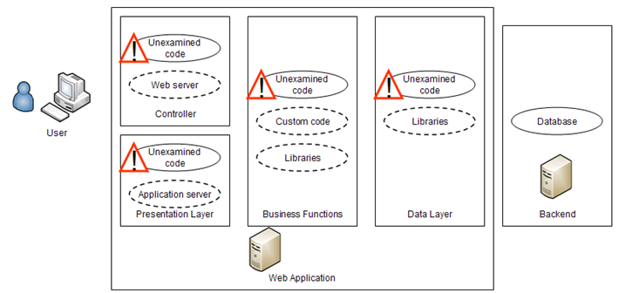
Level 4 in more detail
Internal verification of a web application by searching for malicious code (not malware) and examining how security controls work.

Slide 22
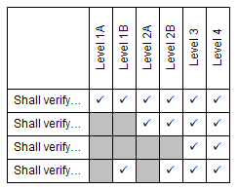
What are the ASVS Verification Requirements?
Security architecture verification requirements
Security control verification requirements
Security architecture information puts verification results into context and helps testers and reviewers to determine if the verification was accurate and complete.

Slide 23

A positive approach
Negative
  The tester shall search for XSS holes
Positive
  Verify that the application performs input validation and output encoding on all user input
Technology and threats change over time! ASVS takes a proactive a white-list approach.

Slide 24
Requirement Summary
Security Area | Level 1A | Level 1B | Level 2A | Level 2B | Level 3 | Level 4
V1 – Security Architecture Verification Requirements | 1 | 1 | 2 | 2 | 4 | 5
V2 – Authentication Verification Requirements | 3 | 2 | 9 | 13 | 13 | 14
V3 – Session Management Verification Requirements | 4 | 1 | 6 | 7 | 8 | 9
V4 – Access Control Verification Requirements | 5 | 1 | 12 | 13 | 14 | 15
V5 – Input Validation Verification Requirements | 3 | 1 | 5 | 7 | 8 | 9
V6 – Output Encoding/Escaping Verification Requirements | 0 | 1 | 2 | 8 | 9 | 10
V7 – Cryptography Verification Requirements | 0 | 0 | 2 | 8 | 9 | 10
V8 – Error Handling and Logging Verification Requirements | 1 | 1 | 2 | 8 | 8 | 9
V9 – Data Protection Verification Requirements | 1 | 1 | 2 | 3 | 4 | 4
V10 – Communication Security Verification Requirements | 1 | 0 | 3 | 6 | 8 | 8
V11 – HTTP Security Verification Requirements | 3 | 3 | 6 | 6 | 7 | 7
V12 – Security Configuration Verification Requirements | 0 | 0 | 0 | 2 | 3 | 4
V13 – Malicious Code Search Verification Requirements | 0 | 0 | 0 | 0 | 0 | 5
V14 – Internal Security Verification Requirements | 0 | 0 | 0 | 0 | 1 | 3
Totals | 22 | 12 | 51 | 83 | 96 | 112

Slide 25
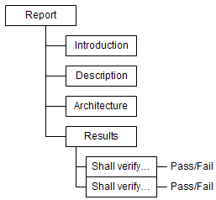
What are ASVS reporting requirements?
R1 – Report Introduction
R2 – Application Description
R3 – Application Architecture
R4 – Verification Results
Is the report sufficiently detailed to make verification repeatable? Is there enough information to determine if the verification was accurate and complete?

Slide 26
Agenda
  About ASVS
  Project Status
  Technical Details
  Getting Started
  Where to Go from Here
  Questions
The OWASP Foundation
http://www.owasp.org

Slide 27

How do I get started using ASVS?
Buyer and seller: agree how technical security requirements will be verified by specifying a level from 1 to 4,
Perform an initial review of the application to be verified,
  Minimum: Perform an ASVS Level 1 security architecture review!
Develop a verification plan and a project schedule,
Using ASVS requires planning and in that respect is just like any other testing exercise!

Slide 28

How do I get started using ASVS? (continued)
Perform a verification according to selected ASVS level requirements,
Present findings,
Develop and execute a remediation strategy,
Re-verify after fixes are made (repeat as necessary).
Ideally, develop a strategy to add verifications into the SDLC.
Tip: don’t scare people when you present your findings! Be specific. Propose a specific fix or a workaround, if able.

Slide 29
Agenda
  About ASVS
  Project Status
  Technical Details
  Getting Started
  Where to Go from Here
  Questions
The OWASP Foundation
http://www.owasp.org

Slide 30
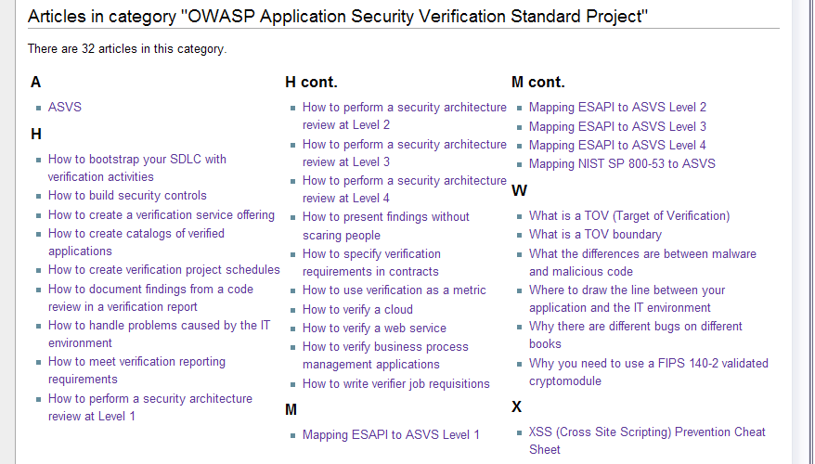
Where can I find help getting started using ASVS?
You can find information to help you get started using ASVS in two locations:
  Inside ASVS, section “Some Guidance on the Verification Process” in ASVS
  On the ASVS Project Page there are articles at the bottom of the page:

Slide 31

Where can I get a copy of ASVS, and talk to people using ASVS?
You can download a copy from the ASVS Project page:
  http://www.owasp.org/index.php/ASVS
You can send comments and suggestions for improvement using the project mailing list:
  See “Mailing List/Subscribe” link on project web page.
  Tell us how your organization is using the OWASP ASVS. Include your name, organization's name, and brief description of how you are using the ASVS
Tip: Subscribe to the OWASP ASVS mailing list!
Owasp-Application-Security-Verification-Standard@lists.owasp.org

Slide 32
Agenda
  About ASVS
  Project Status
  Technical Details
  Getting Started
  Where to Go from Here
  Questions
The OWASP Foundation
http://www.owasp.org

Slide 33


Questions?

