Slide 1
Security Strategies in Web Applications and Social Networking
Lesson 7
Introducing the Web Application Security Consortium (WASC)

Slide 2
Learning Objective and Key Concepts
Learning Objective
Analyze common Web site attacks, weaknesses, and security best practices.
Key Concepts
Sources of Web site attacks and weaknesses
Attack techniques using available tools and sources
Web site security best practices

Slide 3
Identify Attacks and Weaknesses
Web Application Security Consortium (WASC)
Lists 34 types of Web attacks and 15 classes of weaknesses
Maintains database of Web site hacking incidents

Slide 4
Threats Identified by WASC
Abuse of Functionality
Brute-Force Attack
Buffer Overflow
Content Spoofing
Credential/ Session Prediction
Cross-Site Scripting (XSS)
Cross-Site Forgery
Denial of Service (DoS)

Slide 5
Threats Identified by WASC (Cont.)
Fingerprinting
HTTP Response Splitting
HTTP Request Smuggling
HTTP Request Splitting
Integer Overflow
LDAP Injection
Mail Command Injection
Format String
HTTP Response Smuggling

Slide 6
Threats Identified by WASC (con’t)
Null Byte Injection
OS Commanding
Path Traversal
Predictable Resource Location
Remote File Inclusion (RFI)
Routing Detour
Session Fixation
SOAP Abuse Array
Server-side include (SSI) Injection

Slide 7
Threats Identified by WASC (con’t)
SQL Injection
XPath Injection
XML Attribute Blowup
XML External Entities
XML Injection
XQuery Injection
XML Entity Expansion
URL Redirector Abuse

Slide 8
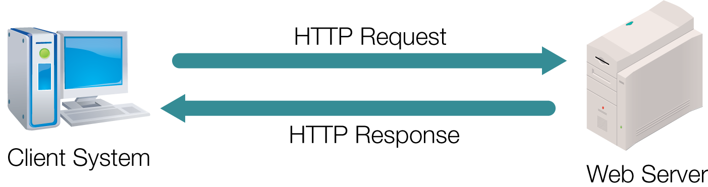
HTTP Communication Process

Slide 9
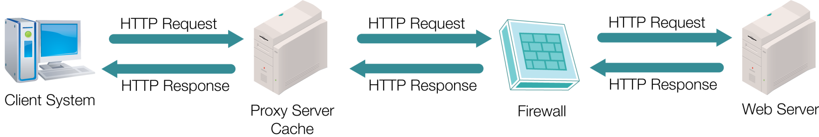
HTTP Communication Through Intermediary Points

Slide 10
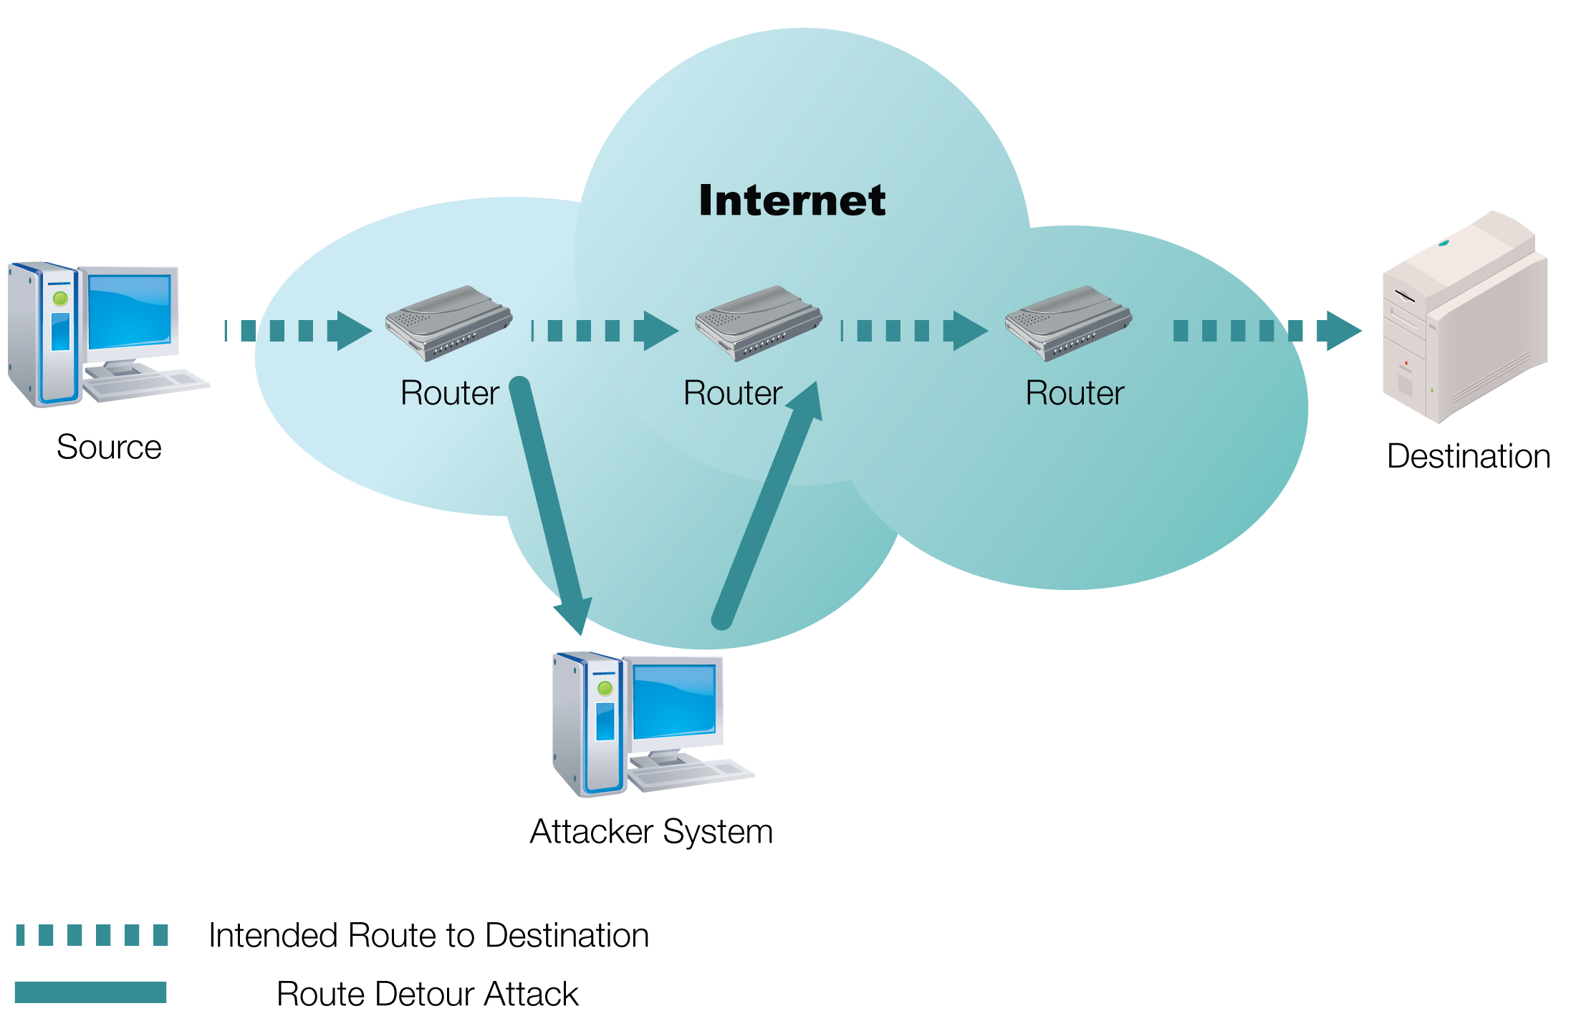
Routing Detour Attack

Slide 11
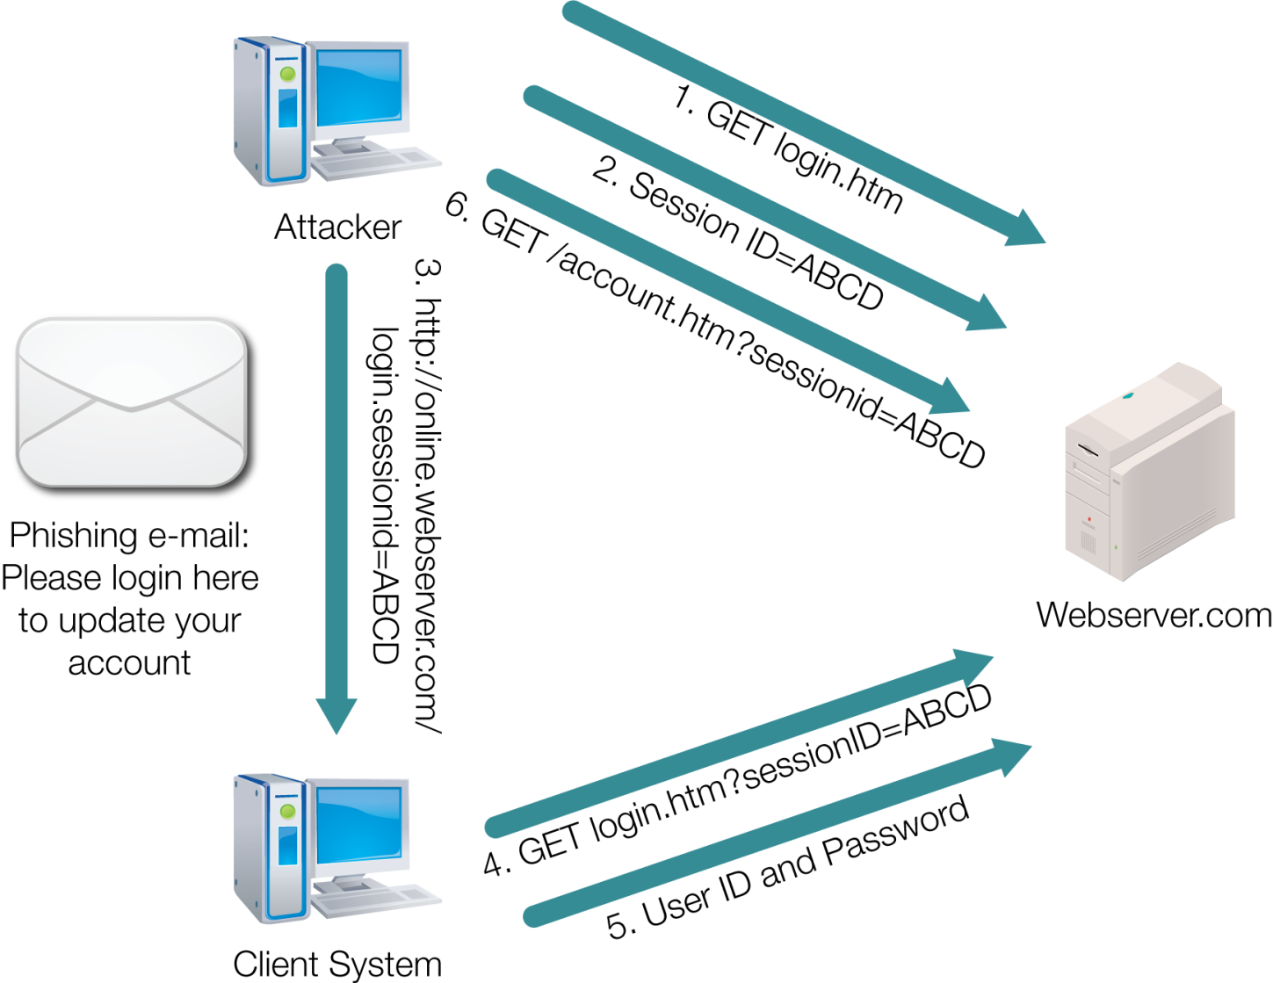
Session Fixation Attack

Slide 12
Fifteen Web Site Attacks
Application Misconfiguration
Directory Indexing
Improper File System Permissions
Improper Input Handling
Improper Output Handling
Information Leakage
Insecure Indexing
Insufficient Anti-Automation
Insufficient Authentication

Slide 13
Fifteen Web Site Attacks (Cont.)
Insufficient Authorization
Insufficient Password Recovery
Insufficient Process Validation
Insufficient Session Expiration
Insufficient Transport Layer Protection
Server Misconfiguration

Slide 14
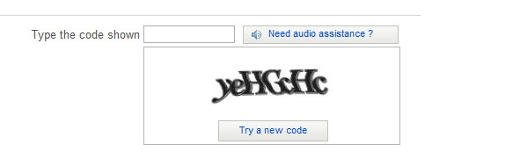
An Example of CAPTCHA

Slide 15
Best Practices
Mitigating Attack Risks
Implement a best practices approach.
Know your infrastructure.
Be proactive in gaining necessary support at all levels.
Mitigating Weaknesses
Practice due diligence for mitigating weaknesses.
Be security conscious as early as possible.
Be aware of vulnerabilities.
Be aware of WASC’s threats to Web Application security.
Validate user input.

Slide 16
Summary
Sources of the Web site attacks and weaknesses
Attack techniques using available tools and sources
Web site security best practices

Slide 17
Virtual Lab
Applying OWASP to a Web Security Assessment
Notes:
If your educational institution included the Jones & Bartlett labs as part of the course curriculum, use this script to introduce the lab:
“In this lesson, you took an in-depth look at security weaknesses of Web applications. You also learned about resources that provide information about Web application vulnerabilities, such as WASC.
In the lab for this lesson, you will explore the Open Web Application Security Project (OWASP) Web site and review its Web application test methodology. You will study the standards and guides published by this project and summarize your findings. Finally, you will draft a Web Application Test Plan based on the information you gained in your OWASP research.”

