Slide 1
COMP 306:
API Engineering & Cloud Computing
Class Activity 06 – AWS DynamoDB Workshop
Created By: Kevin Ma (#300867968)
Fall 2018

Slide 2
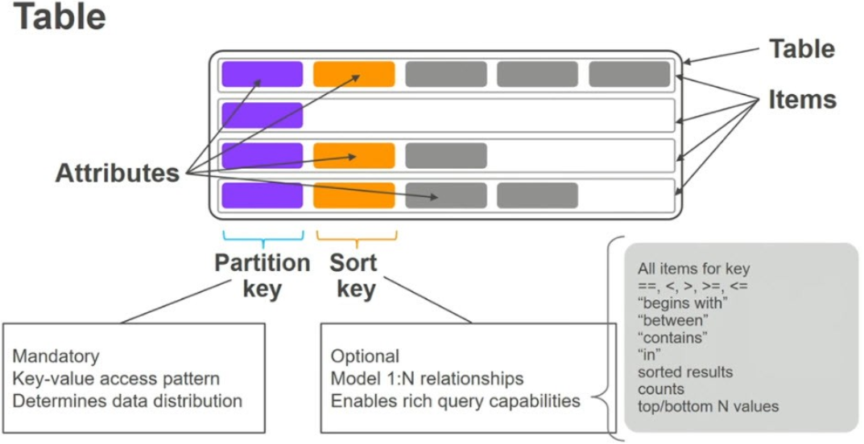
DynamoDB Overview

Slide 3
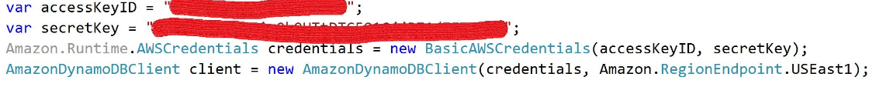
Access DynamoDB by using .NET API
AWS SDK provides 3 programming models for communicating with DynamoDB
  Object persistence model
  Document Model
  Low-Level Model (Service client)

Slide 4
Object Persistence Model
Programming model designed specifically for storing, loading and querying .NET objects in DyanmoDB
Model accessed through Amazon.DynamoDBv2.DataModel namespace

Slide 5
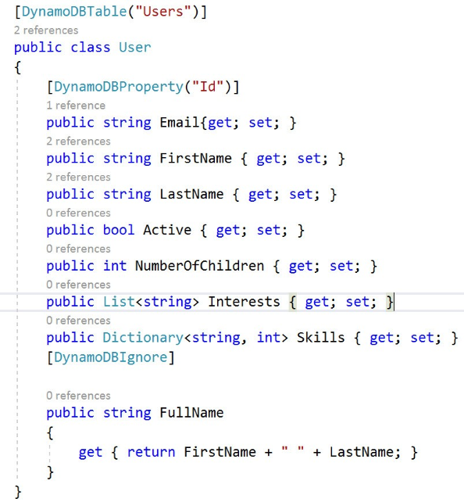
Object Persistence Model – Data Model

Slide 6
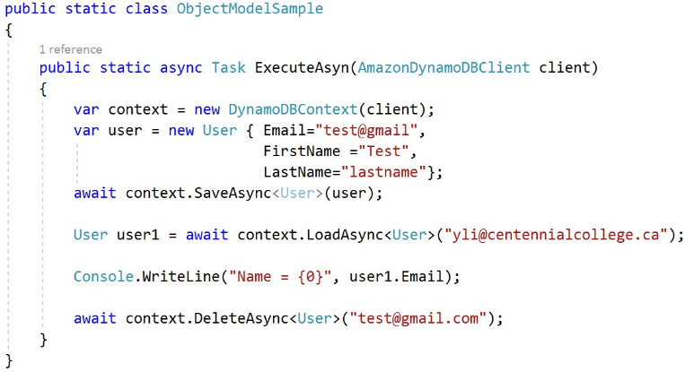
Object Persistence Model – CRUD

Slide 7
Document Model
Easier way to work with data in DynamoDB
Intended for accessing tables and items in tables
Model accessed through the Amazon.DynamoDBv2.DocumentModel namespace

Slide 8
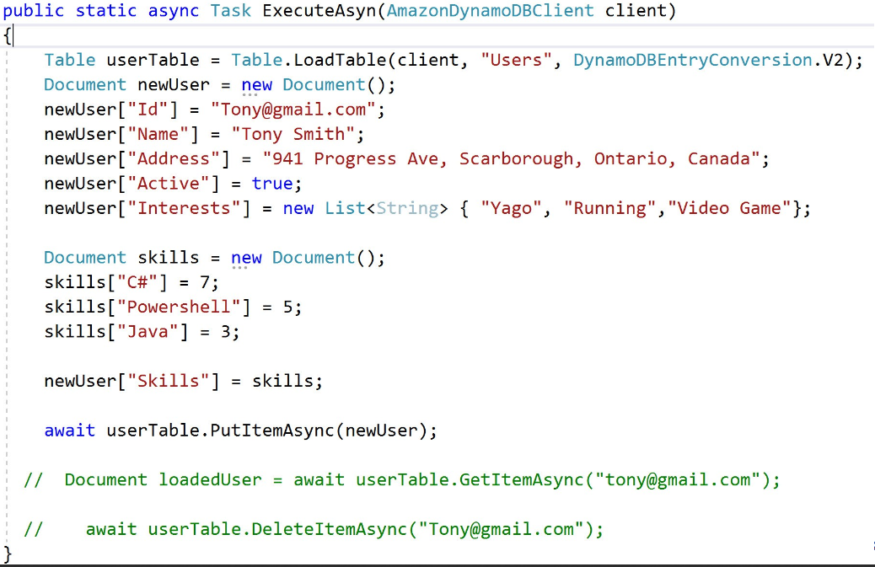
Document Model – CRUD

Slide 9
Low-Level Model (Service Client)
This model wraps direct calls to DynamoDB service
Access through Amazon.DynamoDBv2 namespace
Requires most code to be written between the 3 programming models
  Dev needs to write code to convert .NET data types into their equivalent DynamoDB types
However, this programming model gives devs access to the most features

Slide 10
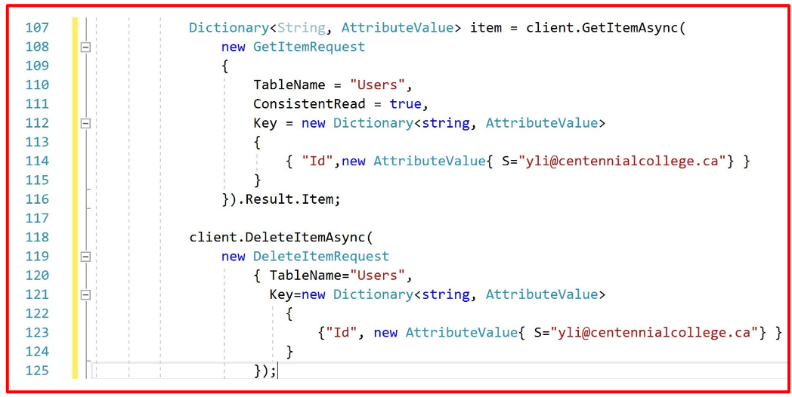
Low-Level Model (Service Client) – CRUD

Slide 11
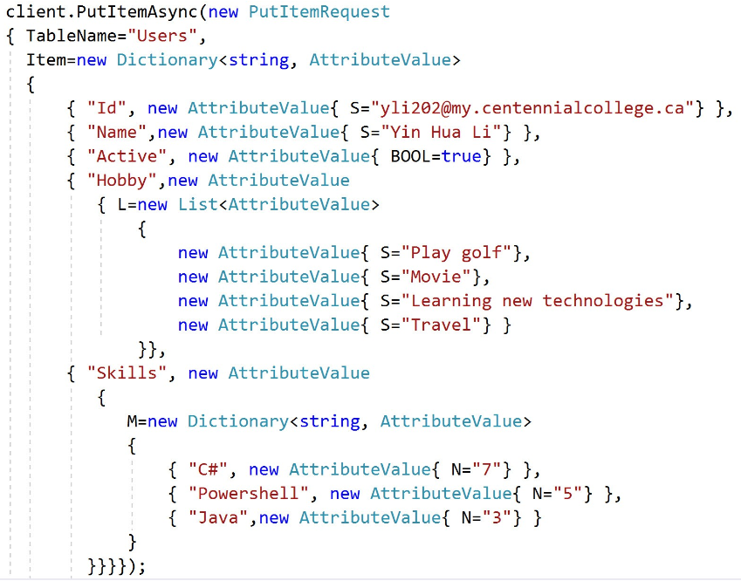
Low-Level Model (Service Client) – CRUD

