Slide 1
Outline
Discuss Microsoft reporting services architecture.
Create reports using Microsoft SSRS
Notes:
Review from last class (important concepts from ETL):
-most complex part of dwh
Cleansing “fuzzy” joins – where u kind of know the stuff around the data but it is not exact, e.g. joh or jon instead of john
Types of data sources e.g. cooperative vs non cooperative

Slide 2
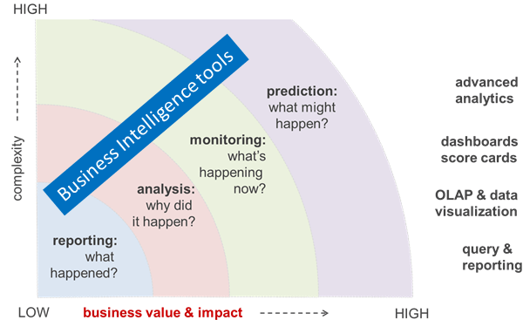
Business Value & Impact Reporting
Notes:
OLAP -> historical reports, looking at trends, subj oriented stuff, e.g. how we did last year, and the year before

Slide 3
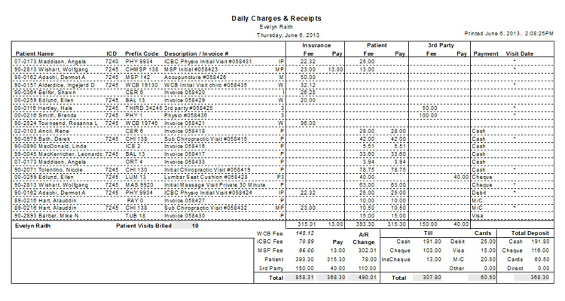
Sample Reports
Notes:
Hospital sample report
EoD report
Back end programming/processing

Slide 4
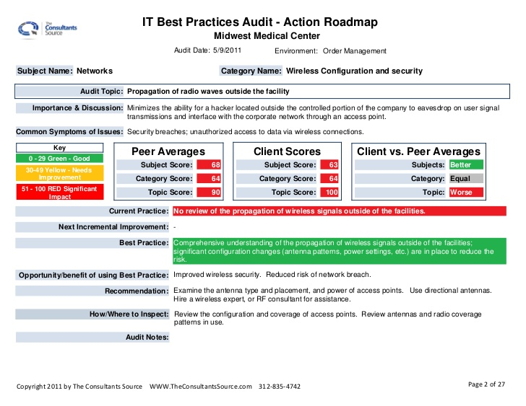
Samples cont’d
Notes:
Dashboard report
Provides alerts, shows health of system, shows jobs running/ran statuses

Slide 5
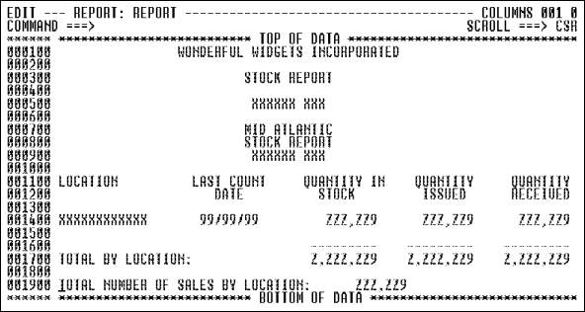
Sample cont’d
Notes:
need to layout report first, set up the view with placeholders

Slide 6
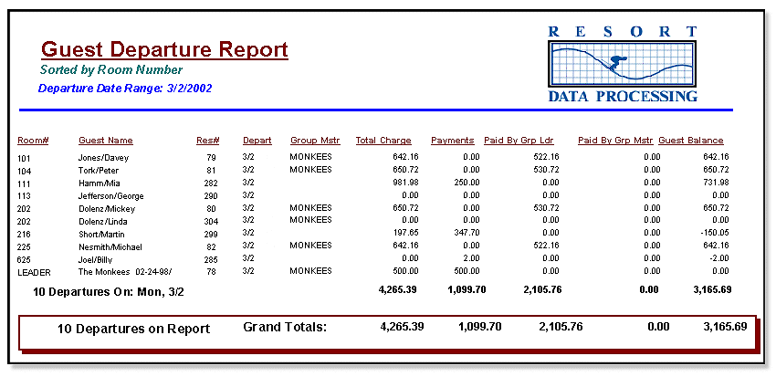
Report sample cont’d
Notes:
As a dev, u build packages and provide them to customers e.g. a resort/hotel
Ur packages need to be able to generate reports such as these

Slide 7
RPG
RPG is a high-lvl prog lang (HLL) for business apps
Is a IBM proprietary lang avail only on IBM OS/400-based sys
Dev by IBM in 1959 as the Report Program Generator – tool to replicate punched card processing on IBM 1401
Updated to PG II for the IBM System/3 in the late 1960s, since evolved into HLL equivalent for COBOL
Notes:
Missing more info from slide, look this up online
G.P.L
-C#
-C++
…
4GL
R.P.G
Crystal Reports, google this

Slide 8
RPG
Find sample file online, don’t need to know this on the test

Slide 9
RPG…
Cont’d from prev slide, examples of RPG code
Notes:
Book doesn’t detail how hard it is to generate reports, peter wanted to give examples using RPG

Slide 10


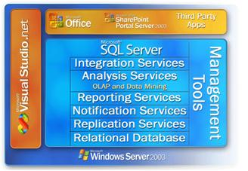


Microsoft Business Intelligence
Business Productivity Suite
Business Collaboration Platform
Information Platform
Notes:
MS BI Stack
Link demo capabilities to products

Slide 11












Reporting Services Architecture
SharePoint
Report Viewer
SSMS
Report Viewer
Web Part
Web Service Proxy
Data Sources
Web Services & URL Access
Security Services
Report Server
Report Engine
Output Formats
Data Processing
Security
Delivery Targets
(E-mail, SharePoint, Custom)
Rendering
Scheduling & Delivery
Custom
Visualization
Custom Report Item
RDCE
Report Definition Custom Extension
Customized RDL
SQL Server Catalog
Notes:
SSMS – Sql server management studio

Slide 12
Reporting Services How Report Execution Works
Client Application
Report Catalog
“Get & Run Report”
Report Server
RSDB
Report
Metadata
Compiled Definition
Session
Word/Excel/
HTML/PDF
Execution Snapshot
RSTempDB
Session
Report Data
Report Data

Slide 13
Highlights of Reporting Services – reporting life cycle
Authoring
Wide range of supported data sources
Open report authoring options
Flexible report designs
Management
Parameterized reports
Execution properties
Report scheduling and history
Role-based security
Delivery
Range of rendering options
Flexible and extensible delivery

Slide 14
Managing Reports
Publish reports to a centralized report server database
General report management tasks:
Define execution schedule–on demand or in advance
Set up security
Maintain report folders
Administer user features
Management roles
Content manager
System administrator
Notes:
e.g. of a security role provided by peter since he worked on this before
Sys administrator
Network
Services
Create users under each of these roles to grant them permissions to the reports
Security is a big problem as data is sensitive

Slide 15
Reporting Services Scenarios
Internal reporting
Departmental
Corporate
External reporting
Business to business
Embedded reporting
Portals
Applications

Slide 16
SSRS Components
Data Sources ...
Microsoft SQL Server
Microsoft SQL Server Analysis Services
Microsoft Access
OLE DB
ODBC
Oracle
XML
Notes:
OLE DB (Object Linking and Embedding, Database, sometimes written as OLEDB or OLE-DB), an API designed by Microsoft, allows accessing data from a variety of sources in a uniform manner.
Older way is ODBC
Technically speaking, ODBC (Open Database Connectivity) is designed to provide access primarily to SQL data in a multi-platform environment. OLE DB (Object Linking and Embedding Database) is designed to provide access to all types of data in an OLE Component Object Model (COM) environment.
Maybe ~80% of data is in XML –Peter bhola
Need a way of querying that data

Slide 17
Delivering Reports
Runtime rendering ( cannot decide format ahead of time)
Web – HTML, MHTML
Print – PDF, TIFF
Data – CSV, Excel, XML
Pull delivery – User issues report request
Report Manager
Custom
Push delivery – Report is automatically distributed to user
E-mail
File
Custom
Notes:
MHTML (short for MIME HTML) is a file extension for a Web page archive file format as saved by Internet Explorer. The archived Web page is an MHTML document.MHTML saves the Web page content and incorporates external resources, such as images, applets, Flash animations and so on, into HTML documents.
Custom made format may be something like the format used by Quickbooks (popular accounting/money management system used by banks)
Quickbooks used for income tax too, compatible with turbotax

Slide 18
The Reporting Lifecycle
AUTHORING
MANAGEMENT
DELIVERY
RDL
Any .NET managed data provider
Report Designer, Report Builder or custom
Central Report Server database
Managed report execution
Secured reports
Web-based Report Manager or custom
Runtime report rendering
Pull
Report Manager
Custom
Push
E-mails
Custom
Notes:
Authoring
Wide range of supported data sources
Open report authoring options
Flexible report designs
Management
Parameterized reports
Execution properties
Report scheduling and history
Role-based security
Delivery
Range of rendering options
Flexible and extensible delivery
Need to use VPN for delivery, shouldn’t simply use email

Slide 19
SSRS Components
Data Sets ...
Mapping of Report Fields to Data Source
Query Definition
Result Set Schema

Slide 20
SSRS Components
Reports ...
Tabular
Matrix / Crosstab / Pivot
Charts / Graphs
Report Definition Language (RDL)
Notes:
RDL can be modified outside SSRS, but not recommended!

Slide 21
SSRS Components
Output Formats ...
HTML
Excel
CSV
PDF
XML
Word
TIFF File
MHTML (Web Archive)
Custom
Notes:
HTML: Good for display
Excel: Good for subsequent changes and manipulations
CSV: Good for exporting data behind the scene in comma-delimited format (NOT the presentation of the report)
PDF: Good for printing
XML: Good for exporting data behind the scene to another system

Slide 22
SSRS Components
Delivery Targets ...
E-mail
File Share
Custom

Slide 23
SSRS Components
Delivery Targets ...
E-mail
File Share
Custom

Slide 24
SSRS Components
Meta Data Database ...
Reports and Data Sources
Users and Permissions
Scheduling and Distribution

Slide 25
SSRS Setups
Developer Machine
Report Server
User Machine

Slide 26
With Reporting Services, we can create following types of reports:
Parameterized reports - used for filtering reports data
Linked reports - provides an access to an existing report
Snapshot reports - query results that were retrieved at a specific time
Cached reports - saved copy of a processed report
Ad hoc reports - created from an existing Report Model
Drilldown reports - initially hide complexity and enable the user to toggle conditionally
Drillthrough reports - accessed through a hyperlink on a report item in the original report
Subreports - displays another report inside the body of a main report

Slide 27
Reporting Services
Executing Reports On-Demand
Executing Cached Instances
Executing Snapshot Reports
Subscriptions
Rendering Reports Using URL Access
Report Printing in Windows Applications

Slide 28







Executing Reports On-Demand
Every report request triggers the same execution process:
Retrieves up-to-date data and processes report
Creates intermediate report and temporarily stores result in the session cache in ReportServerTempDB
Renders using intermediate report
Report Request
Intermediate Report .
Rendered Report
Published Report

Slide 29
Executing Cached Instances
Initial request triggers execution process (subsequent requests only use step 4)
Retrieves most up-to-date data and processes report
Creates intermediate report and stores intermediate result in the cache in ReportServerTempDB
Flags intermediate report as a cached instance
Renders report from cached instance
First Report Request
Other Report Request
Published Report
Intermediate Report .
Rendered Report
Report Server
Cache

Slide 30
Executing Snapshot Reports
Data retrieval and processing occurs in advance of report browsing
Scheduled event occurs
Creates the intermediate report and stores result as a snapshot in the report server database
Requests are satisfied by retrieving and rendering the snapshot
Report Request
Snapshot Creation
Published Report
Intermediate Report .
Rendered Report
Report Server
Snapshot Cache

Slide 31


Using Report History
Report histories store snapshots for future reference
History requests are satisfied by retrieving a specific historical snapshot
Snapshot
Published Report
Rendered Report
History Request
Snapshot History

Slide 32
Subscriptions
Mechanisms to execute and deliver rendered reports
Two types of subscriptions:
Standard – end-user driven
Data-driven – administrator driven
Default delivery extensions:
E-mail (SMTP)
File share

Slide 33
Report Development / Authoring
Create RS Project
Visual Studio
SQL Server BI Development Studio
Create Report
Data Source
Query
Fields / Layout
Preview
View Code (in XML)
Deploy

Slide 34
Report Development / Authoring
Create RS Project
Open Visual Studio
File – New Project – Business Intelligence Projects
Report Server Project Wizard
Set the Name:

Slide 35


Single Server Deployment
User
Report Author
SMTP
IIS
Report Manager
Visual Studio .NET
Report Server
Report Designer
Client
Report Server Database
Server

Slide 36

Web Farm Deployment
User
IIS
Report Manager
MSRS
MSRS
Report Server
SMTP
Web Farm Virtual Report Server
Report Server Database
MSSQL
Notes:
Briefly review AD
This is where virtual servers, configured alongside security permissions for accounts
Lookup heatmaps, treemaps and other visualization techniques

